Slide 1
Peer to Peer Networks • Distributed Hash Tables
Chord, Kelips, Dynamo
Galen Marchetti, Cornell University

Slide 2
1960s – 1999: Research Origins
ARPANET
every node requests and serves content
No self-organization
USENET
Decentralized messaging system
Self-organized
World Wide Web
Originally imagined as fundamentally P2P
Each node providing and receiving content
Notes:
ARPANET – nuclear war rumor disputed by Internet Society

Slide 3
Sean Parker

Slide 4
1999-2001: Industry Popularity
Napster
Centralized index
P2P file transfer
FastTrack / Kazaa
“Supernodes” can act as proxy servers and routers
P2P file transfer
Gnutella
Fully distributed P2P network
Notes:
Mention Skype WAS a SUPERNODE SERVICE!!!
Skype claimed supernodes did not route calls between users, but only keep track of who is online (“membership”)
Now, these ‘supernodes’ are in the cloud, not users. More centralized, this occurred before / during MS acquisition

Slide 5
Robert Morris

Slide 6
Chord Protocol
Handles one operation:
Map keys to nodes
With system properties:
Completely decentralized
Dynamic membership
Hits performance goals:
High availability
Scalable in number of nodes

Slide 7
Decentralization Requirements
User has a key k, wants a node n_{k}
Given k, every node must:
locate n_{k} OR
Delegate the location of n_{k} to another node
System must eventually return n_{k}

Slide 8
Consistent Hashing System
Given k, every node can locate n_{k}
Hash every node’s IP address
map these values on a circle
Given a key k, hash k
k is assigned to closest node on circle, moving clockwise.

Slide 9
Consistent Hashing System

Slide 10
Consistent Hashing System
Pros:
Load Balanced
Dynamic membership
when N^{th} node joins network, only O(1/N) keys are moved to rebalance
Con:
Every node must know about every other node
O(N) memory, O(1) communication
Not scalable in number of nodes

Slide 11
Scaling Consistent Hashing
Approach 0:
Each node keeps track of only their successor
Resolution of hash function done through routing
O(1) memory
O(N) communication

Slide 12
Scaling Consistent Hashing
Approach 1:
Each node keeps track of O(log N) successors in a “finger table”
O(log N) memory
O(log N) communication

Slide 13
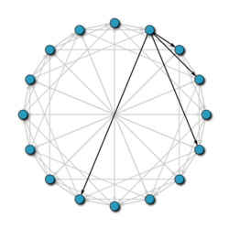
Finger Table Pointers

Slide 14
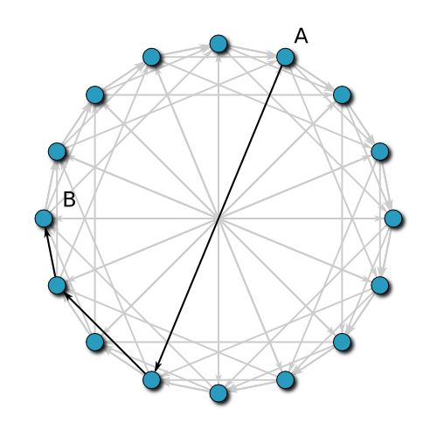
Routing with Finger Tables

Slide 15
Node Joins
Learn finger table from predecessor
O(log n)
Update other node’s tables
O(log² n)
Notify application for state transfer
O(1)

Slide 16
Concurrent Joins
Maintain correctness by ensuring successor is likely correct
“Stabilize” periodically
Verify successor
Update a random finger table entry

Slide 17
Handling Failures
Maintain list of “r” immediate successors
To higher level applications, this list may be a list of replicas

Slide 18
Chord Shortcomings
High churn rate really hurts the ability to find keys
Transient network partitions can permanently disrupt network
Chord does not converge – nodes are not eventually reachable
Researched with Alloy Modeling by Pamela Zave at AT&T

Slide 19
Two Circle Failure
Zave, Pamela. "Using lightweight modeling to understand chord."
ACM SIGCOMM Computer Communication Review 42.2 (2012): 49-57.

Slide 20
Cornell’s Response
Kelips: Building an Efficient and Stable P2P DHT Through Increased Memory and Background Overhead
Gossip!

Slide 21
Kelips
Take a a collection of “nodes”
110
230
202
30
Taken from Gossip-Based Networking Workshop: Leiden ‘06

Slide 22
Kelips
Affinity Groups:
peer membership thru consistent hash
Map nodes to affinity groups
0
1
2
N
−
1
110
230
202
N
members per affinity group
30
Taken from Gossip-Based Networking Workshop: Leiden ‘06

Slide 23
Kelips
110 knows about other members – 230, 30…
Affinity Groups:
peer membership thru consistent hash
Affinity group view
id | hbeat | rtt
30 | 234 | 90ms
230 | 322 | 30ms
0
1
2
N
−
1
110
230
202
N
members per affinity group
30
Affinity group pointers
Taken from Gossip-Based Networking Workshop: Leiden ‘06

Slide 24
Kelips
202 is a “contact” for 110 in group 2
Affinity Groups:
peer membership thru consistent hash
Affinity group view
id | hbeat | rtt
30 | 234 | 90ms
230 | 322 | 30ms
0
1
2
N
−
1
110
Contacts
N
230
202
members per
affinity group
group | contactNode
… | …
2 | 202
30
Contact pointers
Taken from Gossip-Based Networking Workshop: Leiden ‘06

Slide 25
Kelips
“cnn.com” maps to group 2. So 110 tells group 2 to “route” inquiries about cnn.com to it.
Affinity Groups:
peer membership thru consistent hash
Affinity group view
id | hbeat | rtt
30 | 234 | 90ms
230 | 322 | 30ms
0
1
2
N
−
1
110
Contacts
N
230
202
members per
affinity group
group | contactNode
… | …
2 | 202
30
Resource Tuples
Gossip protocol replicates data cheaply
resource | info
… | …
cnn.com | 110
Taken from Gossip-Based Networking Workshop: Leiden ‘06

Slide 26
How it works
Kelips is entirely gossip based!
Gossip about membership
Gossip to replicate and repair data
Gossip about “last heard from” time used to discard failed nodes
Gossip “channel” uses fixed bandwidth
… fixed rate, packets of limited size
Taken from Gossip-Based Networking Workshop: Leiden ‘06

Slide 27
Connection to self-stabilization
Self-stabilization theory
Describe a system and a desired property
Assume a failure in which code remains correct but node states are corrupted
Proof obligation: property reestablished within bounded time
Kelips is self-stabilizing. Chord isn’t.
Taken from Gossip-Based Networking Workshop: Leiden ‘06

Slide 28
Amazon Dynamo
Highly available distributed hash table
Uses Chord-like ring structure
Two operations:
get()
put()
Following “CAP Theorem” lore…
Sacrifice consistency
Gain availability
No “ACID” transactions

Slide 29
Performance Requirements
Service Level Agreement (SLA)
Cloud providers must maintain certain performance levels according to contracts
Clients describe an expected request rate distribution: SLA describes expected latency
Amazon expresses SLA’s at 99.9th percentile of latency

Slide 30
High Availability for Writes
Clients write to first node they find
Vector clocks timestamp writes
Different versions of key’s value live on different nodes
Conflicts are resolved during reads
Like git: “automerge conflict” is handled by end application

Slide 31
Incremental Scalability
Consistent Hashing a la Chord
Utilize “virtual nodes” along ring
Many virtual nodes per physical node
larger machines can hold more virtual nodes
Heterogeneous hardware is properly load balanced

Slide 32
Membership
Background gossip
propagates membership knowledge
Gives O(1) hops for routing
Heartbeats and timeouts
detects failures

Slide 33
Replication: Sloppy Quorum
Each node maintains a “preference list” of replicas for its own data
Replicas are made on first N healthy nodes from preference list
require R nodes to respond for get()
require W nodes to respond for put()

Slide 34
Replication: Sloppy Quorum
Quorum System: R + W > N, W > N/2
Dynamo: W < N, R < N
R, W, N are tunable
Blessing: highly flexible
Curse: developers must know how to work with Dynamo correctly

Slide 35
Replication: Hinted Handoff
If replica node is down
Use next node on preference list as replica
Include “hint” declaring the original replica
Periodically check if original comes back up : update replica

Slide 36
Permanent Failure Recovery
Anti-Entropy: Merkle Trees
Maintain a tree per virtual node
Every leaf is a hash of a block of data (value with an individual key)
Every node is the hash of its children
Quick check for consistency

Slide 37
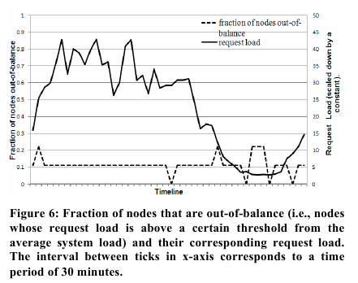

Slide 38
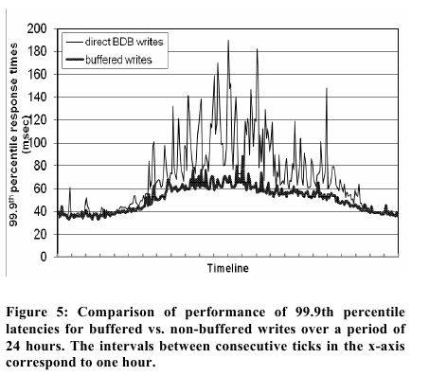

Slide 39
