Slide 1
Obsfuscation the hiding of intended meaning, making communication confusing, wilfully ambiguous, and harder to interpret.
Ken Birman
CS6410

Slide 2
Spafford’s Concern
Widely circulated memo by Gene Spafford:
Consolidation and virtualization are clearly winning on cost grounds, hence we can anticipate a future of extensive heavy virtualization
Xen-style sharing of resources implies that in this future the O/S will have privilaged components that can peek across protection boundaries and hence see the states of all hosted VMs without the VMs realizing it
Could leak information in ways that are undetectable
... but it gets worse

Slide 3
Spafford’s Concern
... and what if a virus breaks out?
In a standard networked environment, viral threats encounter some substantial amount of platform diversity
Not every platform is at the identical “patch” level
In a data center with virtualization, every node will be running identical versions of everything
At least this seems plausible, and this is how well-managed enterprises prefer things
The resulting “monoculture” will be fertile ground for a flash-virus outbreak

Slide 4
Could this risk be real?
Clearly, computing systems are playing socially critical roles in a vast diversity of contexts
Are computing platforms, networks and the power grid the three “most critical” infrastructures?
The case isn’t hard to make...
... although it is confusing to realize that the are mutually interdependent!
Massive outages really could cause very serious harm
On the other hand, is Spaf’s scenario really plausible, or is it just a kind of empty fretting?

Slide 5
... dire conclusions
Within a few years, consolidated computing systems will be the only viable choice for large settings
Government systems will inevitably migrate to these models under cost pressure, but also because there will be nothing else to buy: the market relentlessly reshapes itself under commercial pressure
And so everything – literally everything – will be vulnerable to viruses.
The world will end.

Slide 6
Chicken Little has a long history in CS...
Children’s tale should be a caution
Not every worry is plausible
Those who specialize in worrying think in larger terms, because there are too many things to worry about!
Real issues are dual:
How big is the (likelihood * damage) “estimate”?
And how likely is this, in absolute terms?
Below some threshold we seem to ignore even end-of-world scenarios. Basically, humanity believes bullets can be dodged...

Slide 7
... so how should we view monocultures?
Fred Schneider and Ken were asked to run a study of this by the government; we did so a few years ago.
How does one study a catastrophy prediction?
What does one then do with the findings?
We assembled a blue-ribbon team in DC to discuss the issues and make recommendations

Slide 8
Composing the team
We picked a group of people known for sober thinking and broad knowledge of the field
This include NSA “break in” specialists
Industry security leaders, like Microsoft’s top security person
Academic researchers specializing in how systems fail, how one breaks into systems, and how to harden them
Government leaders familier with trends and economic pressures/considerations

Slide 9
A day that split into three topics
Question one: Is there a definable problem here?
... that is, is there some sense in which consolidation is clearly worse than what we do now?
Question two: How likely and how large is it?
Question three: What should we recommend that they do about it?

Slide 10
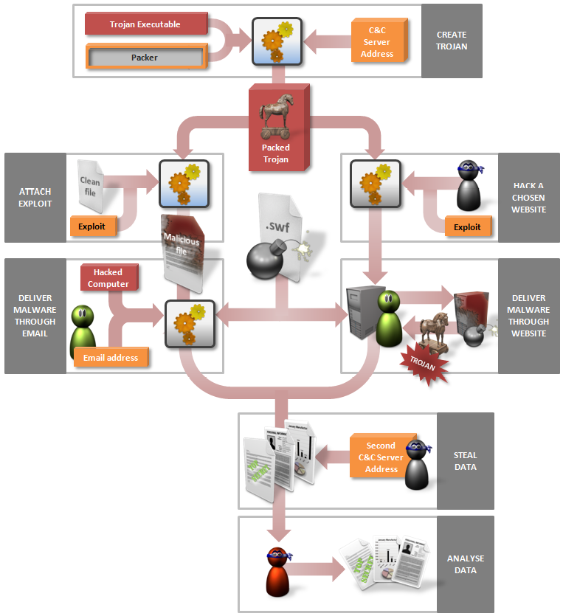
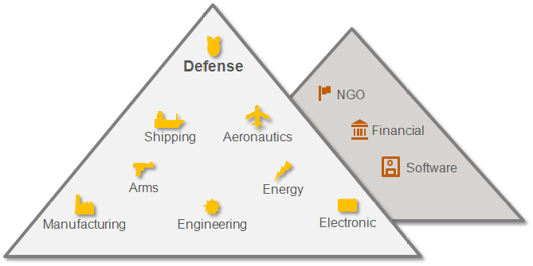
Breaking into systems...
... is, unfortunately, easy
Sophisticated “rootkit” products help the attacker
Example: Elderwood Gang has been very successful in attacking Adobe & Microsoft platforms
The virus was built using widely available components
Elderwood Targets

Slide 11
Elderwood... one of thousands
The numbers and diversity of viruses is huge, and rapidly increasing
NSA helped us understand why
Modern platforms of all kinds are “wide open”
O/S bugs and oversights
Even wider range of application exposures
Misconfiguration, open administrative passwords, etc
Modern software engineering simply can’t give us completely correct solutions. At best, systems are robust when used in the manner the testing team stress-tested.

Slide 12
Could we plug all the holes?
NSA perspective:
A town where everyone keeps their jewelry in bowls on the kitchen table...
... and leaves the doors unlocked
... and the windows too
... and where the walls are very thin, in any case
... not to mention that such locks as we have often have the keys left in them!

Slide 13
Expert statistics
Virus writers aim for low-hanging fruit, like everyone else
Why climb to the second floor and cut through the wall if you can just walk in the front door?
Hence most viruses use nearly trivial exploits
This leads to a “demographic” perspective on security: if we look at “probability of intrusion” times “category of intrusion”, what jumps out?

Slide 14
Configuration exploits!
By far the easiest way to break in is to just use a wide-open door into some component of the system, or application on the system
These are common today and often are as simple as poor configuration settings, factory passwords, other kinds of “features” the user was unaware of
For example, some routers can clone traffic
And many routers have factory-installed web accessible pages that allow you to access their control panel
Hence if the user has such a router you can clone all their network traffic without really “breaking in” at all!

Slide 15
Configuration exploits
Another very big class of configuration issues are associated with old and insecure modes of operation that have yet to be fully disabled
Many old systems had backdoors
Some just had terrible ad-hoc protection mechanisms
When we install and use this kind of legacy software we bring those exposures in the door
Even if we could easily “fix” a problem by disabling some feature, the simple action of doing that demands a kind of specialized knowledge of threats that few of us possess

Slide 16
Broad conclusion?
Computers are often loaded with “day zero” vulnerabilities:
The attack exploits some kind of a feature or problem that was present in your computer the day it arrived
Vendor either didn’t know about it or did know, but hasn’t actually fixed it
Your machine is thus vulnerable from the instant you start using it.
Sometimes also used to describe an attack that uses a previously unknown mode of compromise: the vulnerability becomes known even as the attack occurs

Slide 17
Good platform management
An antidote to many (not all) of these issues
Highly professional staff trained to configure systems properly can set them up in a much more robust manner
Best practice?
Experts examine every single program and support a small, fixed set of combinations of programs, configured in ways that are optimal
Every machine has the right set of patches
End-users can’t install their own mix of applications, must chose a configuration from a menu of safe choices

Slide 18
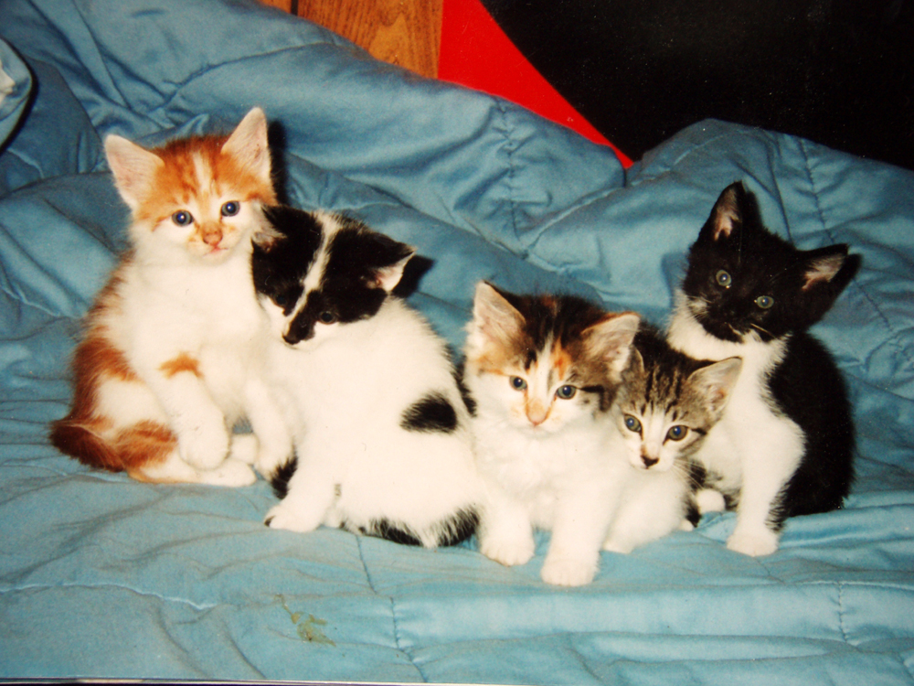
Synthetic diversity
Obsfuscation goes one step further
Start with one program but generate many versions
Use compiler techniques or other program transformation (or runtime transformation) tools to close attack channels by making platforms “systematically” diverse in an automated manner
Idea: if an attacker or virus tries to break in, it will confront surprises because even our very uniform, standard configurations will exist in many forms!

Slide 19
Historical perspective
Earliest uses focused on asking developer teams to create multiple implementations of key elements
Idea was to get them to somehow “vote” on the right action
Puzzle: Suppose A and B agree but C disagrees
Should we take some action to “fix” C? What if C is correct?
Nancy Levinson pointed out that specification is key: a confusing or wrong specification can lead to systematic mistakes even with a diverse team
Also found that “hard parts” of programs are often prone to systematic errors even with several implementations
Still, technique definitely has value

Slide 20
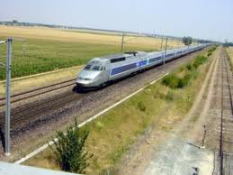
French TGV brake system
TGV is at grave risk if brakes fail to engage when there is danger on the track ahead
How to build a really safe solution?
One idea: flip the rule. Brakes engage unless we have a “proof” that the track ahead is clear
This proof comes from concrete evidence and is drawn from a diversity of reporting sources
But we also need to tolerate errors: weather and maintanence can certainly cause some failures

Slide 21
So are we done?
French engineers pushed further
Rather than trust software, they decided to prove the software correct using formal tools
Employed formal methods to specify the algorithm and to prove their solution correct.
Then coded in a high level language and used model-checking to verify all reachable states for their control logic
But what if the proof is correct but the compilation process or the processor hardware is faulty?

Slide 22
Next step
They generated multiple versions of the correct algorithm using a grab-bag of heuristics to transform the code “systematically”
Now the original single program exists as a set of k variant forms that vote among themselves
The brake hardware itself implements the voting in a mechanical way
Two votes out of three wins... space shuttle used the same idea to protect the cargo door latches

Slide 23
Other uses of this idea?
Ronitt Rubenfeld used it to overcome bugs in the implementation of complex numerical functions
She looked at continuous mathematical functions with complicated implementations
Rather than compute F(x), she would compute a series of values: F(x-2δ), F(x-δ), F(x), F(x+δ), F(x+2δ)
Then used the continuity of the underlying function to compensate for possible mistakes at “isolated” points
The technique works well and can overcome bugs known to have been present in released math libraries that entered widespread use

Slide 24
Applying diversity to programs
Various options present themselves
We can “permute” the program code in ways that preserve behavior but make the layout of the code hard to anticipate
We can pad heap-allocated objects with random “junk”
We could replace one variable with a set of replicas
We could vary the location of the heap itself
We could renumber the O/S system calls on a per-platform manner
Use different versions of the system-call library for each application we build...

Slide 25
Synthetic Diversity really works!
With aggressive use of these techniques our data center ends up with thousands of non-identical clones of the “identical” platform!
Each one differs in details but has same functionality
Virus is very likely to be confused if it tries to exploit array-bound overrun or similar bugs: Attack becomes a non-event, or causes a crash
Much evidence that these techniques genuinely eliminate much of that low-hanging fruit

Slide 26
What problems persist?
Functionality attacks will still be successful
Example: SQL code injection attack: on a web form that asks, e.g., for a name, provide “code”
Consider this query:
statement = "SELECT * FROM users WHERE name = '" + userName + "';“
Now set “userName” to ' or '1'='1
SELECT * FROM users WHERE name = ‘’ or 1=1
From a form or RPC argument

Slide 27
Synthetic diversity limitations
Can’t protect against “legitimate” APIs used in unintended ways, or that can be combined with undesired consequences
Can’t help if attacker has a way to discover a password or can manipulate network traffic or has a trick to “snapshot” your address space at runtime
Not too hard to find sensitive content even if it moves from place to place

Slide 28
What comes next?
Would it be feasible to compute on encrypted data?
(Without decrypting it first)
Many modern platforms include a hardware TPM: a form of trusted chip with secret keys baked in
Chip can do cryptographic ops: encrypt, decrypt, sign
But can’t be tricked into disclosing the key itself
Suppose we could somehow leverage this to compute on data while in encrypted form

Slide 29
What comes next?
Better O/S architecture with stronger built-in protection features
Modern O/S is far too permissive
Trusts things like the file system data structure, willing to “mount” a disk without checking it first
We install new applications and shell or browser extensions all the time!
Perhaps a stronger O/S security model could help
But on the other hand, would market accept it?

Slide 30
Hidden hand of the market
The ultimate decision tends to be market-driven
Trend in favor of cloud and virtualization/consolidation is a market (economics)-driven phenomenon
Money goes to the cheapest, most scalable story in town and eventually, the expensive “better” option fails
How have markets viewed diversity mechanisms?
By and large, they reject these solutions!
Even the ones that are “transparent” to users

Slide 31
Issue: Nothing is really transparent
Imagine a program with a serious heisenbug that is masked by some fluke of the runtime setup or compiled code layout
E.g. it sometimes reads past the end of of a string, but by accident, the next object is always zero and hence this terminates the string
Suppose that this passes Q/A and doesn’t crash
Now apply synthetic diversity tool...
... that “working” application starts to segment fault!

Slide 32
Large production users fear such issues
If Oracle starts to crash on my platform, I have few options to fix the issue
Debugging the Oracle source-code is not one of them
Paying for an urgent fix might break my budget
Disabling the synthetic diversity tool could be the best option available
Many platform owners have reasoned this way
After all, even with diversity, all we’ve done is to close the front door and perhaps removed the key from the lock

Slide 33
Conclusions
Modern systems are really wide open to attack
Consolidation onto the cloud or other virtualized platforms could benefit in many ways
Standard, professional administration could close configuration problems and ensure proper patch level
At least zero-day issues will mostly be removed
Diversity can take us further
Won’t solve the real issue, but can really help

