Slide 1
Multiprocessors CS 6410
Ashik Ratnani, Cornell University

Slide 2
Need for Faster Processors
End of Moore’s Law?
Unable to improve the processing speed of Uniprocessors.

Slide 3
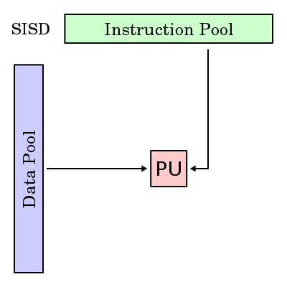
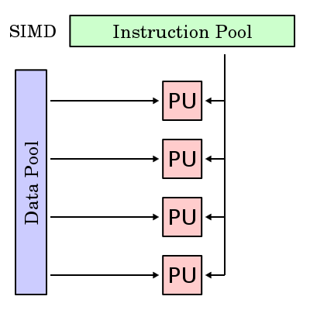
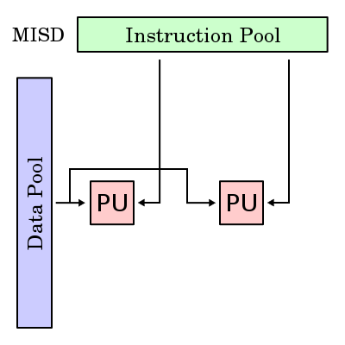
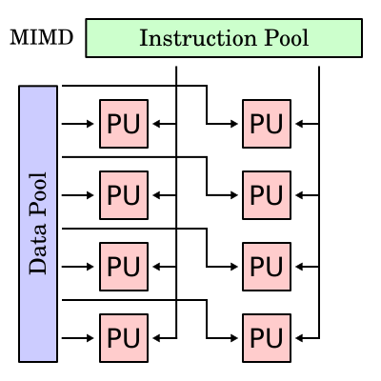
Flynn’s Classification of Multiple processor machines
*Image Source: Wikipedia
Notes:
Lets have a look at the Flynn’s Classification of Multiple processor Machines.
First, there are single instruction single data stream processors that we call Uni-Processors. These processors run a single instruction at a time on a single data.
Then there is the single instruction multiple data stream processor which are mostly used for graphics/audio or video manipulation. They are used either to work on data stored as vectors or arrays. Cray – 1 introduced the concept of vector processing.
Then there is multiple instruction, single data stream processor organization which was not commercially introduced but used only for some research studies.
Then at last we have the multiple instruction, multiple data stream processors. They either share their memory or have distributed memory. Clusters for example have distributed memories and work on multiple data with multiple instructions. On the other hand the multiprocessors share memory. The multiprocessors are either symmetric or have non-uniform access properties.

Slide 4
MIMD
Shared Memory Model (Multiprocessors)
Distributed Memory Model (Multi Computers)
Uniform Memory Access (UMA)
Non-Uniform Memory Access(NUMA)
Clusters
ccNUMA
ncNUMA
Notes:
Cache coherent NUMA (ccNUMA)
Nearly all CPU architectures use a small amount of very fast non-shared memory known as cache to exploit locality of reference in memory accesses. With NUMA, maintaining cache coherence across shared memory has a significant overhead.
Although simpler to design and build, non-cache-coherent NUMA systems become prohibitively complex to program in the standard von Neumann architecture programming model. As a result, all NUMA computers sold to the market use special-purpose hardware to maintain cache coherence^{[citation needed]}, and thus class as "cache-coherent NUMA", or ccNUMA.
Typically, this takes place by using inter-processor communication between cache controllers to keep a consistent memory image when more than one cache stores the same memory location. For this reason, ccNUMA may perform poorly when multiple processors attempt to access the same memory area in rapid succession. Operating-system support for NUMA attempts to reduce the frequency of this kind of access by allocating processors and memory in NUMA-friendly ways and by avoiding scheduling and locking algorithms that make NUMA-unfriendly accesses necessary. Alternatively, cache coherency protocols such as the MESIF protocol attempt to reduce the communication required to maintain cache coherency. Scalable Coherent Interface (SCI) is an IEEE standard defining a directory based cache coherency protocol to avoid scalability limitations found in earlier multiprocessor systems. SCI is used as basis for the Numascale NumaConnect technology.
Current^{[when?]} ccNUMA systems are multiprocessor systems based on the AMD Opteron, which can be implemented without external logic, and Intel Itanium, which requires the chipset to support NUMA. Examples of ccNUMA enabled chipsets are the SGI Shub (Super hub), the Intel E8870, the HP sx2000 (used in the Integrity and Superdome servers), and those found in recent NEC Itanium-based systems. Earlier ccNUMA systems such as those from Silicon Graphics were based on MIPS processors and the DEC Alpha 21364 (EV7) processor.
Intel announced NUMA^{[clarification needed]} introduction to its x86 and Itanium servers in late 2007 with Nehalem and Tukwila CPUs.^{[1]} Both CPU families will share a common chipset; the interconnection is called Intel Quick Path Interconnect (QPI).^{[2]}

Slide 5
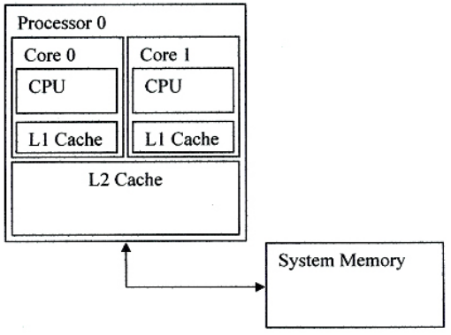
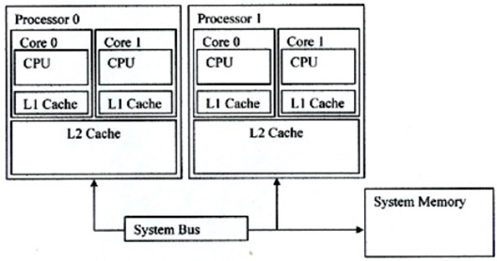
Multicore Multiprocessors
Multiple Cores /Chip & Single PU
Independent L1 cache and Shared L2 cache.
Single or Multiple Cores /Chip & Multiple PUs
Independent L1 cache and Independent L2 cache.
Image Source: Slides of Deniz Altinbuken

Slide 6
Challenges for System Software
Scalability
Flexibility
Reliability
Performance

Slide 7
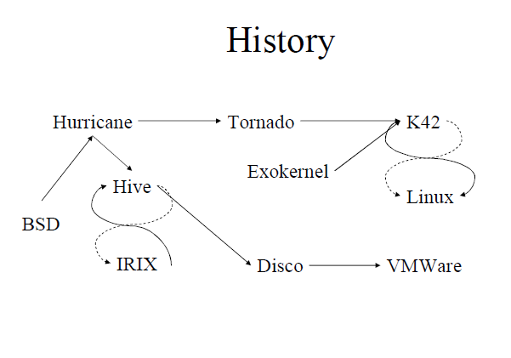

Slide 8
Approaches
Disco
Uses a Virtual Machine Monitor
Page Replication & Page Migration
Copy on write & Virtual subnet
Tornado
Designs an multiprocessor OS
Uses Object Oriented Design
Clustered Objects
A New locking strategy
Protected procedure call

Slide 9
DISCO: Running Commodity Operating system on Scalable Multiprocessor
Edouard Bugnion, VP, Cisco
Phd from Stanford, Co-Founder of VMware, key member of Sim OS, Co-Founder of “Nuova Systems”
Scott Devine, Principal Engineer, VMware
Phd from Stanford, Co-Founder of VMware, key member of Sim OS
Mendel Rosenblum, Associate Prof, Stanford
Phd from UC Berkley, Co-Founder of VMware, key member of Sim OS

Slide 10
Virtual Machine Monitors (VMM)
Definition: VMM is a hardware virtualization techniques that allow multiple operating systems, termed guests, to run concurrently on a host computer.
Classification
Type 1: run directly on the host's hardware
Type 2: run within a conventional operating system environment

Slide 11
Return of Virtual Machines Monitors
Cost of development is less
Less risk of introducing software bugs
Flexibility to support wide variety of workloads
NUMA memory management is hidden from guest OS.

Slide 12
Disco: Challenges
Overheads
Additional Execution
Virtualization I/O
Memory management for multiple VMs
Resource Management
Lack of information to make good policy decisions
Communication & Sharing
Interface to share memory between multiple VMs

Slide 13
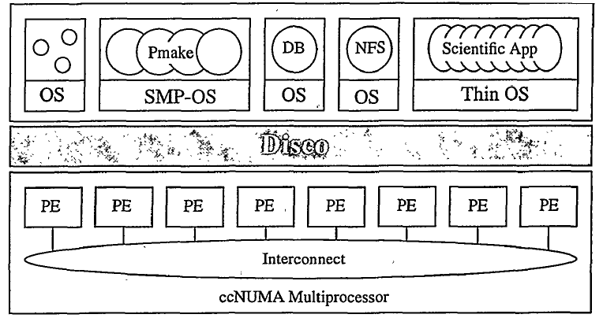
Disco: Interface
Processors – Virtual CPU
Memory
I/O Devices

Slide 14
Disco: Virtual CPUs
Direct Execution on the real CPU
Intercept Privileged Instructions
Different Modes:
Kernel Mode: Disco
Supervisor Mode: Virtual Machines
User Mode: Applications
Physical CPU
Disco
Normal Computation
DMA
Virtual CPU
Notes:
Virtual CPUs
Different Modes:
Kernel Mode: Disco
Supervisor Mode: Virtual Machines
User Mode: Applications
Direct Execution on the real CPU
Intercept Privileged Instructions such as TLB modification or DMA
Schedules VCPUs on Physical CPU by storing the state of the VCPU

Slide 15
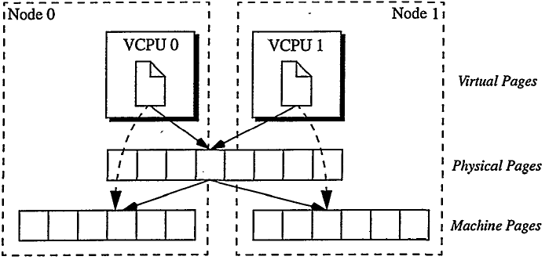
Disco: Memory Virtualization
Adds a level of address translation
Uses Software reloaded TLB and pmap
Flushes TLB on VCPU Switch
Uses second level Software TLB
Notes:
Memory Virtualization
Adds a level of address translation and maintains Virtual to Machine Address Mapping
Uses Software reloaded TLB and pmap
Flushes TLB on VCPU Switch
Simplifies VCPU Switch but increases workload
Uses second level Software TLB to lessen the effect of flushing TLB

Slide 16
Disco: Memory Management
Affinity Scheduling
Page Migration
Page Replication
memmap
Notes:
Memory Management
Allocates memory to virtual machines
Page Migration: pages that are heavily accessed by a single node are migrated to that node
Page Replication: pages which are read shared are replicated to the nodes.
Uses cache miss counting facility of FLASH and memmap for this approach

Slide 17
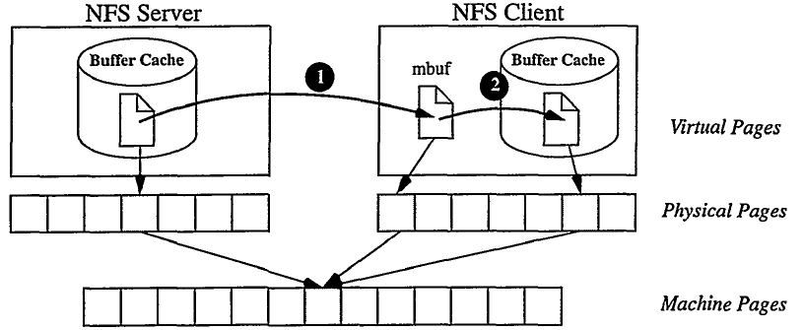
Disco: I/O Virtualization
Virtualizes access to I/O devices and intercepts all device access
Adds device drivers in to OS
Special support for Disk and Network access
Copy-on-write
Virtual Subnet
Allows memory sharing between VMs agnostic of each other
Notes:
I/O Virtualization
Virtualizes access to I/O devices and intercepts all device access
Adds device drivers for common I/O devices into the OS
DMA requests to disks and N/W interface are intercepted and handled by Disco’s device drivers
Copy-on-write disks allow memory sharing between VMs unaware of other VMs
Virtual N/W devices allow efficient communication among different VMs

Slide 18
Running Commodity OSes
Changes for MIPS Architecture
Required to relocate the unmapped segment
Device Drivers
Added device drivers for I/O devices.
Changes to the HAL
Inserted some monitor calls in the OS
Notes:
Changes for MIPS Architecture
Required to relocated the unmapped segment
Device Drivers
Added special drivers for I/O devices. For other devices the IRIX drivers are used.
Changes to the HAL
Inserted some monitor calls in the OS to get high level knowledge about resource management

Slide 19
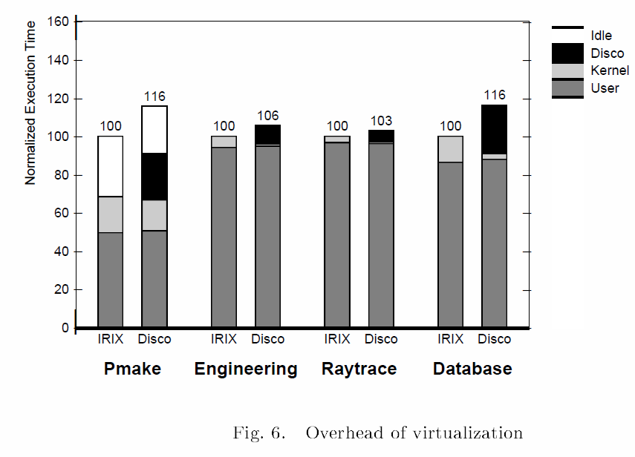
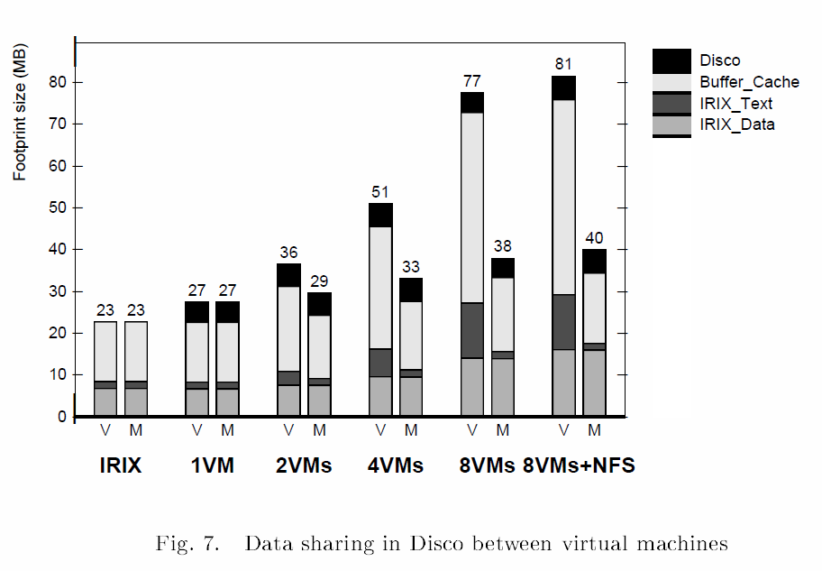
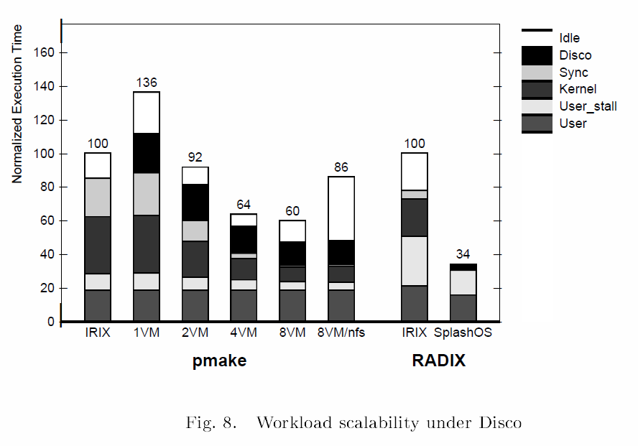
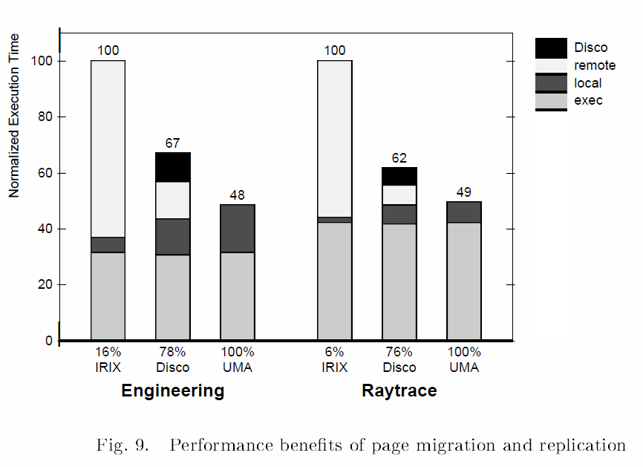
Experimental Results
Uses Sim OS Simulator for Evaluations

Slide 20
Disco: Takeaways
Develop system s/w with less effort
Low/Modest overhead
Simple solution for Scalable Hardware
Future Scope
Provide Resource management mechanisms comparable to Customized Operating Systems

Slide 21
Tornado Maximizing Locality and Concurrency in a SMMP OS
Ben Gamsa, Orran Krieger
Phd from University of Toronto
Jonathan Appavoo, Asistant Prof., Boston University
Phd from Uni of Toronto, worked as researcher in IBM
Michael Stumm, Prof, University of Toronto
Works with IBM research to develop K42 OS

Slide 22
Locality
Types of Locality
Temporal Locality
If at one point in time a particular memory location is referenced, then it is likely that the same location will be referenced again in the near future.
Spatial Locality
If a particular memory location is referenced at a particular time, then it is likely that nearby memory locations will be referenced in the near future.

Slide 23
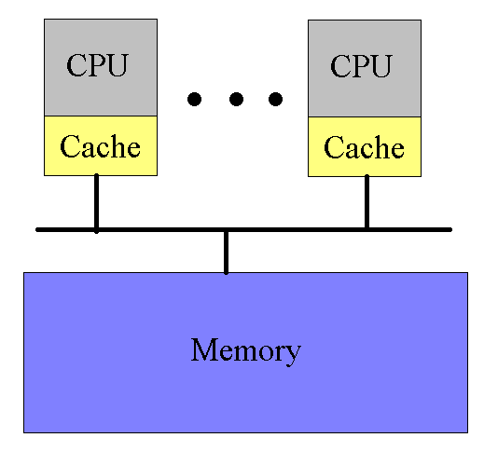
Example: Counter

Slide 24
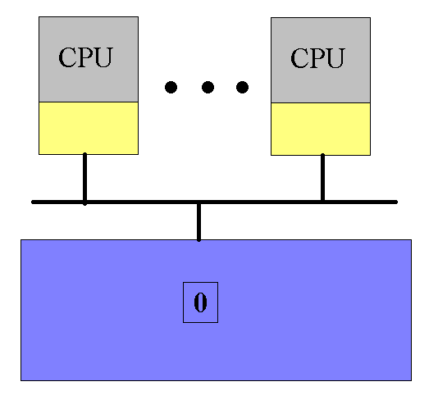
Example: Counter

Slide 25
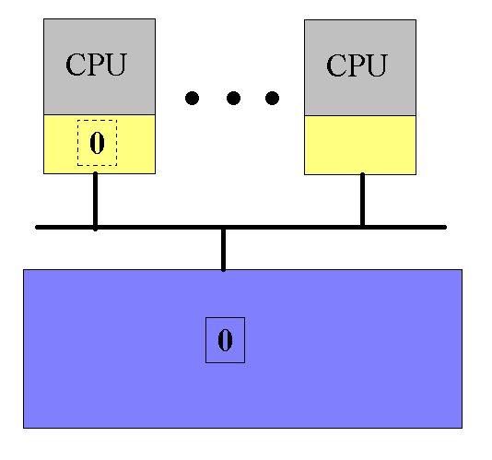
Example: Counter

Slide 26
Example: Counter

Slide 27
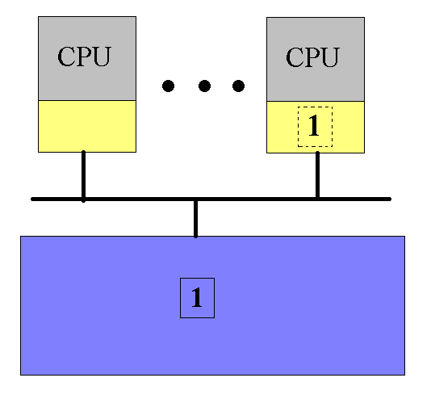
Example: Counter

Slide 28
Example: Counter

Slide 29
Example: Counter
Sharing the counter requires moving it back and forth between the CPU caches
Solution??
Split the counter into an array of integers
Each CPU gets its own counter

Slide 30
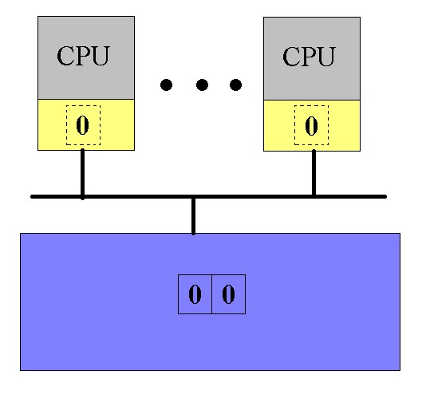
Example: Counter

Slide 31
Example: Counter

Slide 32
Example: Counter

Slide 33
Example: Counter
Using an array of counters seems to solve our problem…
But what happens if both array elements map to the same cache line?
False sharing
Solution:
Pad each array element
Different elements map to different cache lines

Slide 34
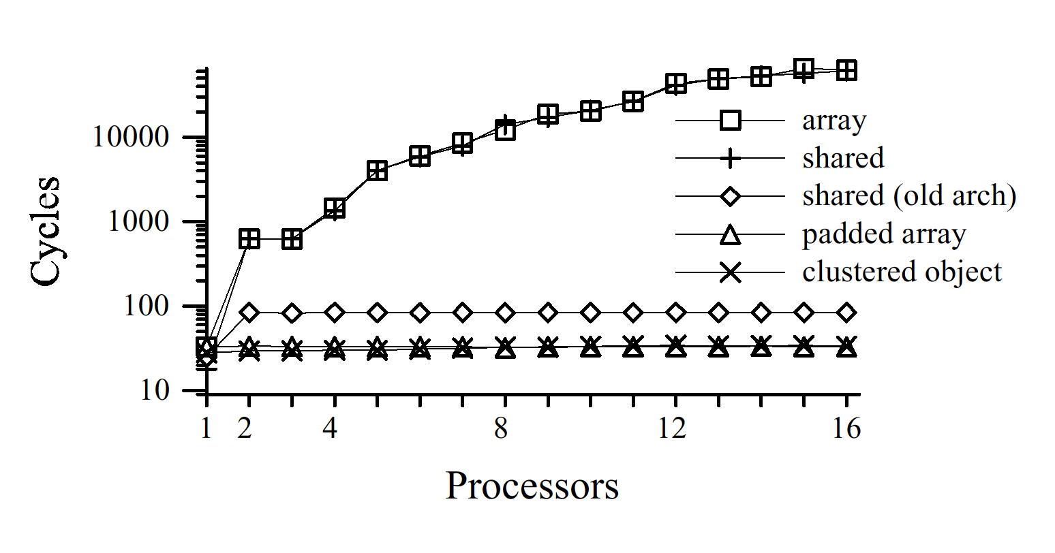
Example: Counter

Slide 35
Challenges
Minimize read/write and write sharing to minimize cache coherence
Minimize false sharing
Minimize distance between the accessing processor and target memory

Slide 36
Tornado’s Approach to Maximize Locality
Object Oriented Structure
Clustered Objects
Synchronization
Protected Procedure call
Notes:
Services all OS requests on the same processor with minimum access to common data or acquiring lock
Each virtual and physical resource in the system is represented by an independent object so that accesses on different processors to different objects remain independent.
Additional Innovations:
Clustered Objects
Protected Procedure Call
Semi Automatic garbage collection

Slide 37
Object Oriented Structure
Each OS resource is represented as a separate object
All locks and data structures are internal to the objects
This structure allows different resources to be managed
without accessing shared data structures
without acquiring shared locks

Slide 38
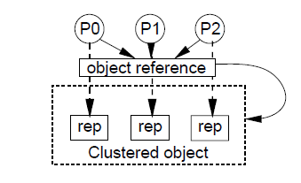
Clustered Objects
Appear as a single object.
Multiple “reps” to process object references.
Uses Replication, Distribution and partitioning
Benefits
Allows multiprocessor optimizations
Abstracts the object reference for programmers
Enables incremental optimization
Notes:
Appear as a single object
Multiple “reps” to process object requests.
Uses Replication, distribution and partitioning for widely shared objects
Benefits
Allows multiprocessor optimizations, like replication or partitioning of locks and data structures
Abstracts the object reference for programmers
Enables incremental optimization

Slide 39
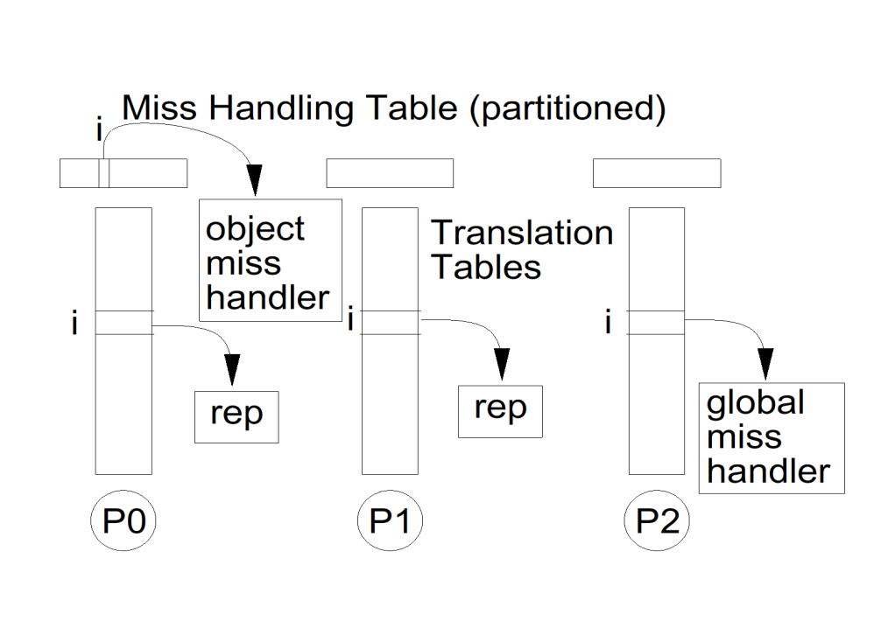
Clustered Objects: Implementation
Uses Translation tables
Per processor access to local object
Global partitioned table to find rep for given object
Default “miss” handler which is called by global miss handler

Slide 40
Synchronization
Separates Locking & Existence Guarantees
Locking:
Encapsulate lock with in the object
Uses Spin then block locks
Semi-Automatic Garbage collection
Ensures all persistent and temporary object reference removal
Maintains list of processor having object refs

Slide 41
Protected Procedure call
Brings locality and concurrency to IPC
A PPC is a call from a client object to a server object
Benefits
Client requests are always serviced on their local processor
Clients and servers share the CPU in a manner similar to handoff scheduling
The server has one thread of control for each client request

Slide 42
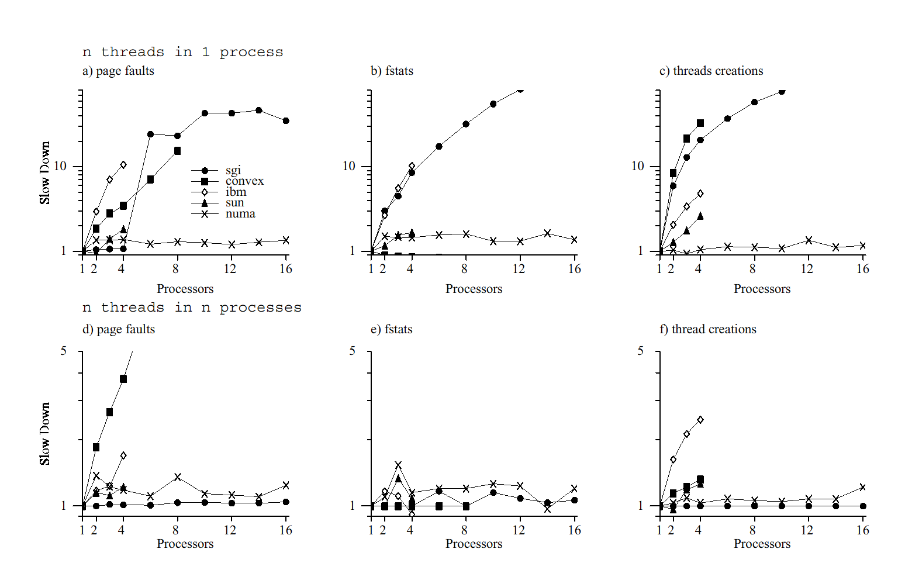
Experimental Results
Uses 16 processor NUMAchine prototype and SIM OS Simulator

Slide 43
Takeaways
Tornado’s increased locality and concurrency has produced a scalable OS design for multiprocessors
This locality was provided by several key system features
An object-oriented design
Clustered objects
A new locking strategy
Protected procedure calls

Slide 44
Perspective
Disco
Uses a Virtual Machine
Page Replication & Page Migration
Copy on write & Virtual subnet
Tornado
Designs an multiprocessor OS
Uses Object Oriented Design
Clustered Objects
A New locking strategy
Protected procedure call

Slide 45
Discussion

