Slide 1
Classic File Systems: FFS and LFS
Presented by Hakim Weatherspoon
(Based on slides from Ben Atkin and Ken Birman)
Notes:
Deniz,
Hari,
Jared
Petko
Taiyen
Bo
Yin
Srivant
Robert

Slide 2
A Fast File System for UNIX Marshall K. McKusick, William N. Joy, Samuel J Leffler, and Robert S Fabry
Bob Fabry
Professor at Berkeley. Started CSRG (Computer Science Research Group) developed the Berkeley SW Dist (BSD)
Bill Joy
Key developer of BSD, sent 1BSD in 1977
Co-Founded Sun in 1982
Marshall (Kirk) McKusick (Cornell Alum)
Key developer of the BSD FFS (magic number based on his birthday, soft updates, snapshot and fsck. USENIX
Sam Leffler
Key developer of BSD, author of Design and Implemention
Notes:
“UNIX is basically a simple operating system, but you have to be a genius to understand the simplicity.” – Dennis Ritchie

Slide 3
Background: Unix Fast File Sys
Original UNIX File System (UFS)
Simple, elegant, but slow
20 KB/sec/arm; ~2% of 1982 disk bandwidth
Problems
blocks too small
consecutive blocks of files not close together
(random placement for mature file system)
i-nodes far from data
(all i-nodes at the beginning of the disk, all data afterward)
i-nodes of directory not close together
no read-ahead

Slide 4
Inodes and directories
Inode doesn't contain a file name
Directories map files to inodes
Multiple directory entries can point to same Inode
Low-level file system doesn't distinguish files and directories
Separate system calls for directory operations

Slide 5
File system on disk
freespace map
inodes and blocks in use
...
...
super block disk layout
inodes inode size < block size
data blocks

Slide 6
File representation
file size
link count
access times
...
data blocks
indirect block
double indirect
triple indirect
data
data
data
data
data
data
...
data
data
...
data
...
data
data
...
...
...
data
...

Slide 7
The Unix Berkeley Fast File System
Berkeley Unix (4.2BSD)
4kB and 8kB blocks
(why not larger?)
Large blocks and small fragments
Reduces seek times by better placement of file blocks
i-nodes correspond to files
Disk divided into cylinders
contains superblock, i-nodes, bitmap of free blocks, summary info
Inodes and data blocks grouped together
Fragmentation can still affect performance

Slide 8
FFS implementation
Most operations do multiple disk writes
File write: update block, inode modify time
Create: write freespace map, write inode, write directory entry
Write-back cache improves performance
Benefits due to high write locality
Disk writes must be a whole block
Syncer process flushes writes every 30s

Slide 9
FFS Goals
keep dir in cylinder group, spread out different dir’s
Allocate runs of blocks within a cylinder group, every once in a while switch to a new cylinder group (jump at 1MB).
layout policy: global and local
global policy allocates files & directories to cylinder groups. Picks “optimal” next block for block allocation.
local allocation routines handle specific block requests. Select from a sequence of alternative if need to.

Slide 10
FFS locality
don’t let disk fill up in any one area
paradox: for locality, spread unrelated things far apart
note: FFS got 175KB/sec because free list contained sequential blocks
(it did generate locality), but an old UFS had randomly ordered blocks and only got 30 KB/sec

Slide 11
FFS Results
20-40% of disk bandwidth for large reads/writes
10-20x original UNIX speeds
Size: 3800 lines of code vs. 2700 in old system
10% of total disk space unusable

Slide 12
FFS Enhancements
long file names (14 -> 255)
advisory file locks (shared or exclusive)
process id of holder stored with lock => can reclaim the lock if process is no longer around
symbolic links (contrast to hard links)
atomic rename capability
(the only atomic read-modify-write operation,
before this there was none)
Disk Quotas
Overallocation
More likely to get sequential blocks; use later if not

Slide 13
FFS crash recovery
Asynchronous writes are lost in a crash
Fsync system call flushes dirty data
Incomplete metadata operations can cause disk corruption (order is important)
FFS metadata writes are synchronous
Large potential decrease in performance
Some OSes cut corners

Slide 14
After the crash
Fsck file system consistency check
Reconstructs freespace maps
Checks inode link counts, file sizes
Very time consuming
Has to scan all directories and inodes

Slide 15
Perspective
Features
parameterize FS implementation for the HW in use
measurement-driven design decisions
locality “wins”
Flaws
measuremenets derived from a single installation.
ignored technology trends
Lessons
Do not ignore underlying HW characteristics
Contrasting research approach
Improve status quo vs design something new

Slide 16
The Design and Impl of a Log-structured File System Mendel Rosenblum and John K. Ousterhout
Mendel Rosenblum
Designed LFS, PhD from Berkeley
Professor at Stanford, designed SimOS
Founder of VM Ware
John Ousterhout
Professor at Berkeley 1980-1994
Created Tcl scripting language and TK platform
Research group designed Sprite OS and LFS
Now professor at stanford after 14 years in industry
Notes:
“UNIX is basically a simple operating system, but you have to be a genius to understand the simplicity.” – Dennis Ritchie

Slide 17
The Log-Structured File System
Technology Trends
I/O becoming more and more of a bottleneck
CPU speed increases faster than disk speed
Big Memories: Caching improves read performance
Most disk traffic are writes
Little improvement in write performance
Synchronous writes to metadata
Metadata access dominates for small files
e.g. Five seeks and I/Os to create a file
file i-node (create), file data, directory entry, file i-node (finalize), directory i-node (modification time).

Slide 18
LFS in a nutshell
Boost write throughput by writing all changes to disk contiguously
Disk as an array of blocks, append at end
Write data, indirect blocks, inodes together
No need for a free block map
Writes are written in segments
~1MB of continuous disk blocks
Accumulated in cache and flushed at once
Data layout on disk
“temporal locality” (good for writing)
rather than “logical locality” (good for reading).
Why is this a better?
Because caching helps reads but not writes!

Slide 19
Log operation
Kernel buffer cache
inode blocks
data blocks
active segment
Disk
log
log head
log tail

Slide 20
LFS design
Increases write throughput from 5-10% of disk to 70%
Removes synchronous writes
Reduces long seeks
Improves over FFS
"Not more complicated"
Outperforms FFS except for one case

Slide 21
LFS challenges
Log retrieval on cache misses
Locating inodes
What happens when end of disk is reached?

Slide 22
Locating inodes
Positions of data blocks and inodes change on each write
Write out inode, indirect blocks too!
Maintain an inode map
Compact enough to fit in main memory
Written to disk periodically at checkpoints
Checkpoints (map of inode map) have special location on disk
Used during crash recovery

Slide 23
Cleaning the log: “Achilles Heel”
Log is infinite, but disk is finite
Reuse the old parts of the log
Clean old segments to recover space
Writes to disk create holes
Segments ranked by "liveness", age
Segment cleaner "runs in background"
Group slowly-changing blocks together
Copy to new segment or "thread" into old

Slide 24
Cleaning policies
Simulations to determine best policy
Greedy: clean based on low utilization
Cost-benefit: use age (time of last write)
Measure write cost
Time disk is busy for each byte written
Write cost 1.0 = no cleaning
benefit cost
(free space generated)*(age of segment) cost
=

Slide 25
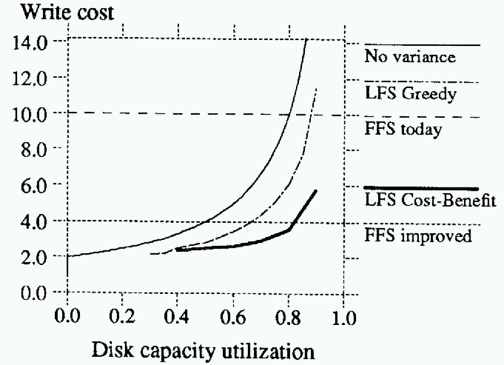
Greedy versus Cost-benefit

Slide 26
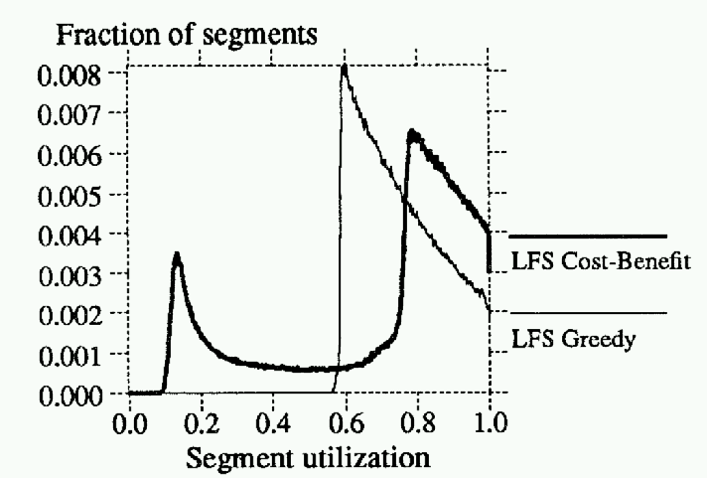
Cost-benefit segment utilisation

Slide 27
LFS crash recovery
Log and checkpointing
Limited crash vulnerability
At checkpoint flush active segment, inode map
No fsck required

Slide 28
LFS performance
Cleaning behaviour better than simulated predictions
Performance compared to SunOS FFS
Create-read-delete 10000 1k files
Write 100-MB file sequentially, read back sequentially and randomly

Slide 29
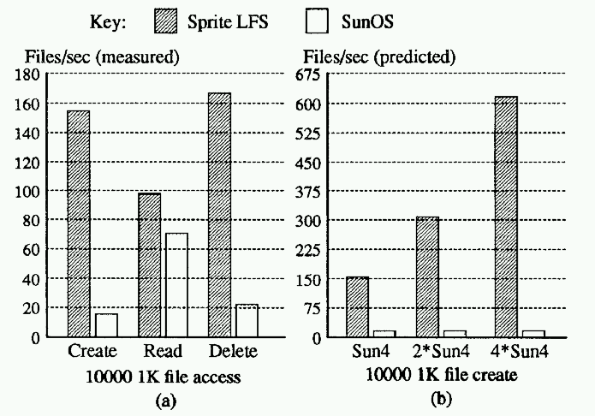
Small-file performance

Slide 30
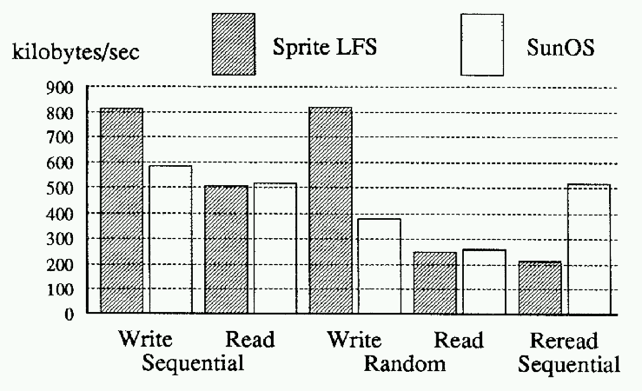
Large-file performance

Slide 31
Perspective
Features
CPU speed increasing faster than disk => I/O is bottleneck
Write FS to log and treat log as truth; use cache for speed
Problem
Find/create long runs of (contiguous) disk space to write log
Solution
clean live data from segments,
picking segments to clean based on a cost/benefit function
Flaws
Intra-file Fragmentation: LFS assumes entire files get written
If small files “get bigger”, how would LFS compare to UNIX?
Lesson
Assumptions about primary and secondary in a design
LFS made log the truth instead of just a recovery aid

Slide 32
Conclusions
Papers were separated by 8 years
Much controversy regarding LFS-FFS comparison
Both systems have been influential
IBM Journalling file system
Ext3 filesystem in Linux
Soft updates come enabled in FreeBSD

Slide 33
Next Time
Read and write review:
Lightweight Recoverable Virtual Memory, M. Satyanarayanan, Henry H. Mashburn, Puneet Kumar, David C. Steere, and James J. Kistler. Proceedings of the fourteenth ACM symposium on Operating systems principles, 1994, pages 146--160.
The evolution of Coda, M. Satyanarayanan. ACM Transactions on Computer Systems, Volume 20, Issue 2 (May 2002), pages 85--124

Slide 34
Next Time
Read and write review:
Project Proposal due this week, next Thursday
Possible projects presentations yesterday, slides online
Also, talk to faculty and email and talk to me
Check website for updated schedule

Slide 35
Overview of talk
Unix Fast File System
Log-Structured System
Soft Updates
Conclusions

Slide 36
Soft updates
Alternative mechanism for improving performance of writes
All metadata updates can be asynchronous
Improved crash recovery
Same on-disk structure as FFS

Slide 37
The metadata update problem
Disk state must be consistent enough to permit recovery after a crash
No dangling pointers
No object pointed to by multiple pointers
No live object with no pointers to it
FFS achieves this by synchronous writes
Relaxing sync. writes requires update sequencing or atomic writes

Slide 38
Design constraints
Do not block applications unless fsync
Minimise writes and memory usage
Retain 30-second flush delay
Do not over-constrain disk scheduler
It is already capable of some reordering

Slide 39
Dependency tracking
Asynchronous metadata updates need ordering information
For each write, pending writes which precede it
Block-based ordering is insufficient
Cycles must be broken with sync. writes
Some blocks stay dirty for a long time
False sharing due to high granularity

Slide 40
Circular dependency example
directory
inode block
a.txt | 89
b.pdf | 32
c.doc | 366
...
inode #32
inode #33
inode #34
inode #35

Slide 41
Circular dependency example
create file d.txt
a.txt | 89
b.pdf | 32
c.doc | 366
d.txt | 34
...
inode #32
inode #33
inode #34
inode #35
Inode must be initialised before directory entry is added

Slide 42
Circular dependency example
remove file b.pdf
a.txt | 89
c.doc | 366
d.txt | 34
...
inode #32
inode #33
inode #34
inode #35
Directory entry must be removed before inode is deallocated

Slide 43
Update implementation
Update list for each pointer in cache
FS operation adds update to each affected pointer
Update incorporates dependencies
Updates have "before", "after" values for pointers
Roll-back, roll-forward to break cycles

Slide 44
Circular dependency example
roll back remove
a.txt | 89
b.pdf | 32
c.doc | 366
d.txt | 34
...
inode #32
inode #33
inode #34
inode #35
Rollback allows dependency to be suppressed

Slide 45
Soft updates details
Blocks are locked during roll-back
Prevents processes from seeing stale cache
Existing updates never get new dependencies
No indefinite aging
Memory usage is acceptable
Updates block if usage becomes too high

Slide 46
Recovery with soft updates
"Benign" inconsistencies after crashes
Freespace maps may miss free entries
Link counts may be too high
Fsck is still required
Need not run immediately
Only has to check in-use inodes
Can run in the background

Slide 47
Soft updates performance
Recovery time on 76% full 4.5GB disk
150s for FFS fsck versus 0.35s ...
Microbenchmarks
Compared soft updates, async writes, FFS
Create, delete, read for 32MB of files
Soft updates versus update logging
Sdet benchmark of "user scripts"
Various degrees of concurrency

Slide 48
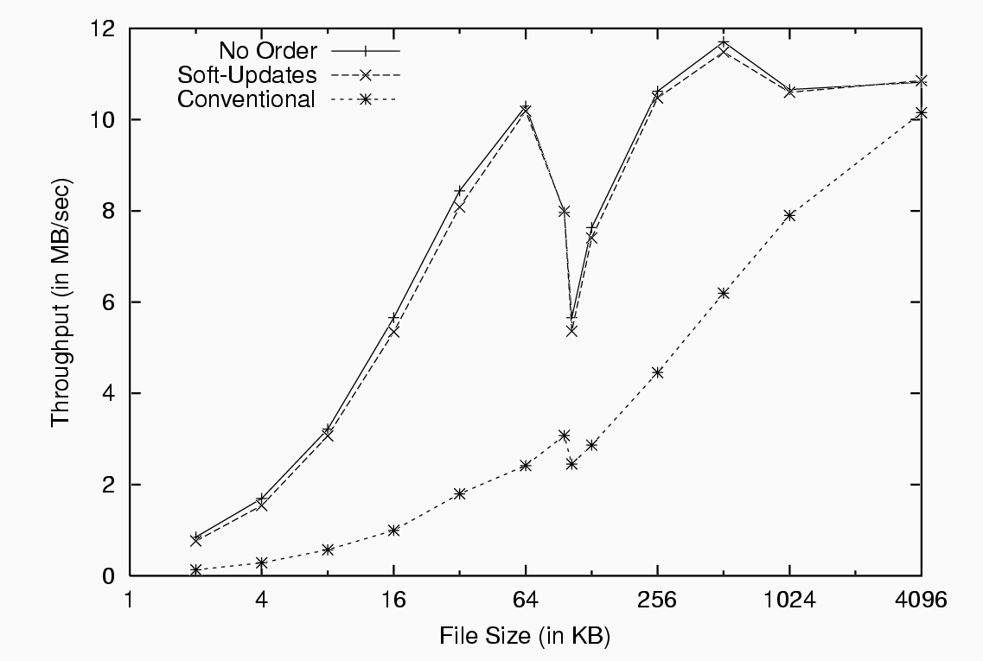
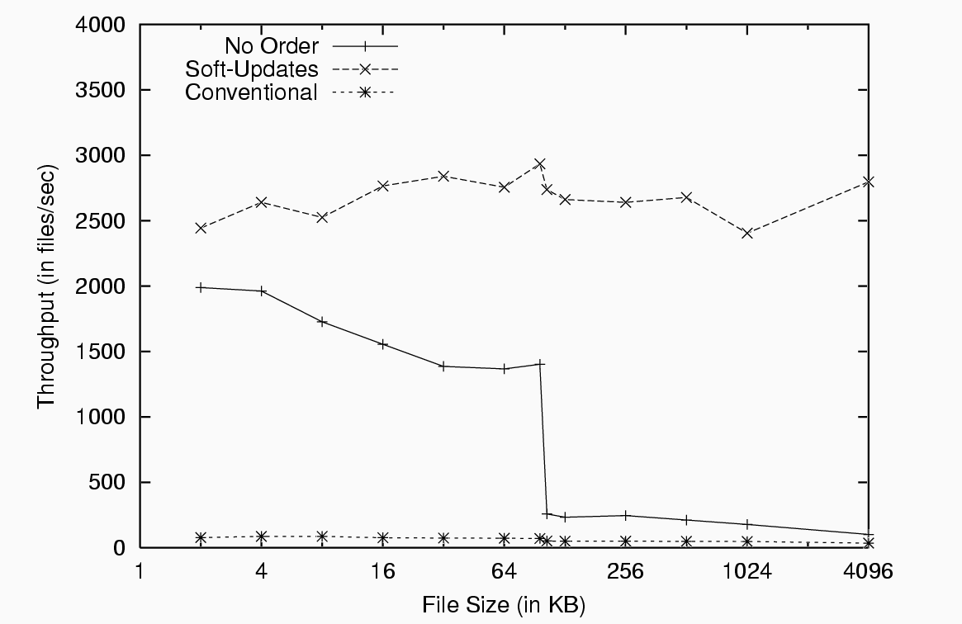
Create and delete performance
Create files
Delete files

Slide 49
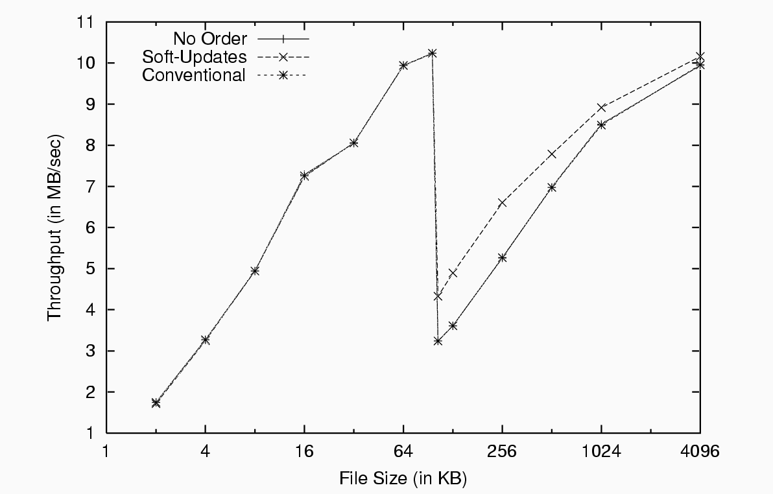
Read performance

Slide 50
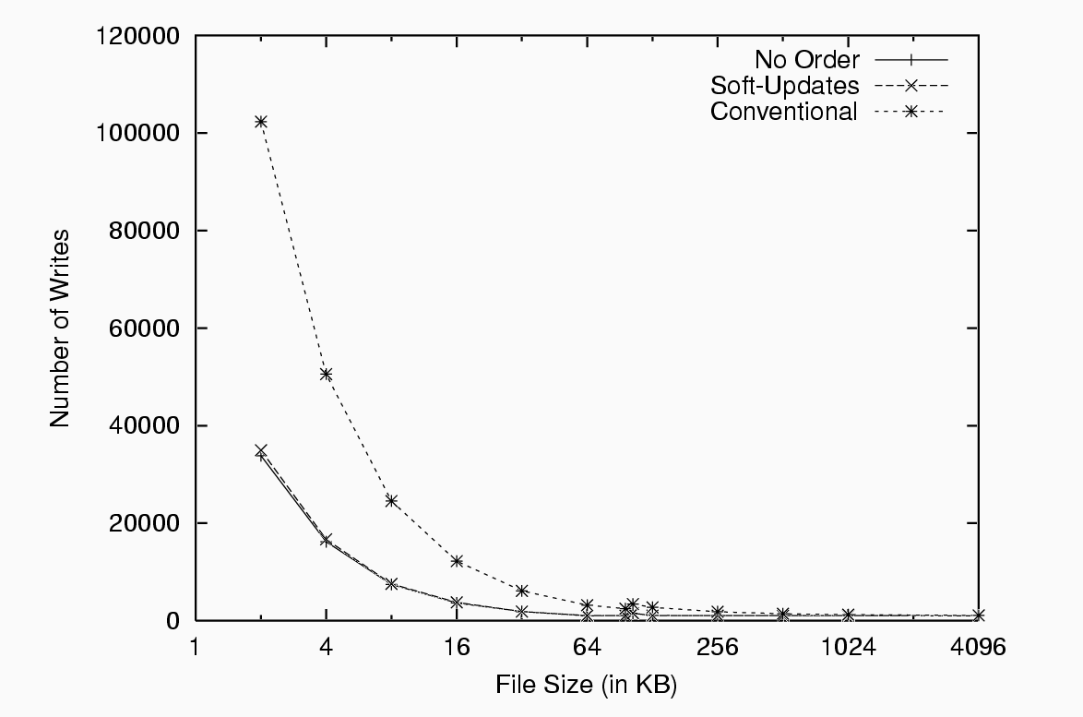
Overall create traffic

Slide 51
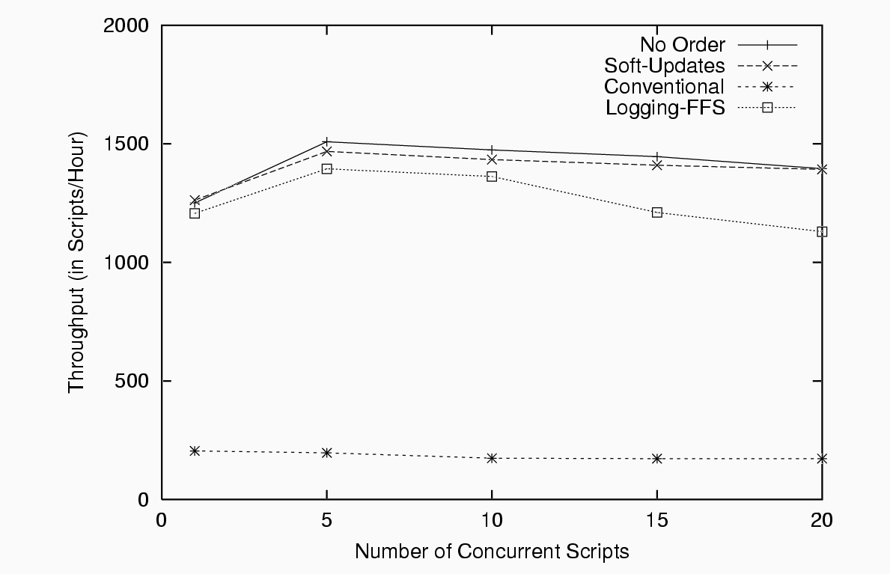
Soft updates versus logging

Slide 52
Conclusions
Papers were separated by 8 years
Much controversy regarding LFS-FFS comparison
Both systems have been influential
IBM Journalling file system
Ext3 filesystem in Linux
Soft updates come enabled in FreeBSD

Slide 53
Next Time
Read and write review:
SEDA: An Architecture for Well Conditioned, Scalable Internet Services, Matt Welsch, David Culler, and Eric Brewer. Proceedings of the Eighteenth ACM Symposium on Operating Systems Principles (Banff, Alberta, Canada, 2001), pages 230--243
On the duality of operating system structures, H. C. Lauer and R. M. Needham. ACM SIGOPS Operating Systems Review Volume 12, Issue 2 (April 1979), pages 3--19.

Slide 54
Next Time
Read and write review:
Project Proposal due this week, next Thursday
Possible projects presentations yesterday, slides online
Also, talk to faculty and email and talk to me
Check website for updated schedule

