Slide 1
Virtual Synchrony
Ki Suh Lee
Some slides are borrowed from Ken, Jared (cs6410 2009) and Justin (cs614 2005)

Slide 2
The Process Group Approach to Reliable Distributed Computing
Ken Birman
Professor, Cornell University
Isis
Quicksilver
Live Object

Slide 3
Understanding the Limitations of Causally and Totally Ordered Communication
David Cheriton
Stanford
PhD – Waterloo
Billionaire
Dale Skeen
PhD – UC Berkeley
Distributed pub/sub communication
3-phase commit protocol

Slide 4
Recap…
End-to-End Argument
Multicast
Partial/Total Ordering
Happens-before relation
Logical/Physical Clocks
Distributed snapshop
Consensus

Slide 5
Recap
Asynchronous vs. synchronous
Failure model
Crash-stop (fail-stop) Failures
Byzantine Failures

Slide 6
Distributed computing
1978 Lamport’s “Time, Clocks, and the Ordering of Events in a Distributed System”
1983 Schneider’s State machine replication
1985 FLP’s the impossibility of asynchronous fault-tolerant consensus
1981 transactional serializability (2PC)
1981 Non-blocking 3PC

Slide 7
Motivation
Distributed system with
Fault-tolerance
Reliability
Easy programmability

Slide 8
Virtual Synchrony
In the early 1980’s
Key idea: equate “group” with “data abstraction”
Each group implements some object
An application can belong to many groups

Slide 9
Virtual Synchrony
The user sees what looks like a synchronous execution
Simplifies the developer’s task
Process groups with state transfer, automated fault detection and membership reporting
Ordered reliable multicast, in several flavors
Extremely good performance

Slide 10
Historical Aside
Isis (Virtual synchrony)
Weaker properties – not quite “FLP consensus”
Much higher performance (orders of magnitude)
Simple Dynamic membership control
Paxos (state machine)
Closer to FLP definition of consensus
Slower (by orders of magnitude)
Sometimes can make progress in partitioning situations where virtual synchrony can’t
Complex dynamic membership control

Slide 11
Programming with groups
Many systems just have one group
E.g. replicated bank servers
Cluster mimics one highly reliable server
But we can also use groups at finer granularity
E.g. to replicate a shared data structure
Now one process might belong to many groups
A further reason that different processes might see different inputs and event orders

Slide 12
ISIS

Slide 13
Assumptions
Fail-stop model
Clocks are not synchronized
Unreliable network
Network partitions is rare
Failure detection subsystem
Consistent system-wide view

Slide 14
Difficulties
Conventional message passing technologies
TCP, UDP, RPC, …
Group addressing
Logical time and causal dependency
Message delivery ordering
State transfer (membership change)
Fault tolerance
…

Slide 15
No Reliable Multicast
Ideal
Reality
p
q
r
UDP, TCP, Multicast not good enough
What is the correct way to recover?

Slide 16
Membership Churn
Receives new membership
p
q
r
Never sent
Membership changes are not instant
How to handle failure cases?
Notes:
Send messages to an up-to-date membership?
No stale memberships
Solution: locks
Multicast →read-lock
Membership change →write-lock
Implemented in a distributed way

Slide 17
Message Ordering
1
2
p
q
r
Everybody wants it!
How can you know if you have it?
How can you get it?
Notes:
No causality
Causality
Receive messages concurrently?
Concurrent and totally ordered wrt. membership changes
Related Messages
Will they come in order?
The problem
Will programmers anticipate it?
Concurrent messages: 2 choices:
a) handle it or
b) delay messages so that they’re in order.
Real problem = this is overlooked!

Slide 18
State Transfers
p
q
r
New nodes must get current state
Does not happen instantly
How do you handle nodes failing/joining?
Notes:
Transfer state to new node
Membership churn → inconsistent
Solution is too complex

Slide 19
Failure Atomicity
Ideal
Reality
p
x
q
r
?
Nodes can fail mid-transmit
Some nodes receive message, others do not
Inconsistencies arise!

Slide 20
Process Groups
Distributed groups of cooperating programs
Pub/sub style of interaction
Requirements
Group communication
Group membership as input
Synchronization

Slide 21
Process Groups
Anonymous group
Group addressing
All or none delivery
Message Ordering
Explicit group
Members cooperate directly
Consistent views of group membership

Slide 22
Process groups
The group view gives a simple leader election rule
A group can easily solve consensus
A group can easily do consistent snapshot

Slide 23
Close Synchrony
Lock-step execution model
Implementing synchronous model in asynchronous environment
Order of events is preserved
A multicast is delivered to its full membership

Slide 24
Close Synchrony
p
q
r
s
t
u

Slide 25
Close Synchrony
Not practical
Impossible in the presence of failures
Expensive
We want close synchrony with high throughput.
=> Virtual Synchrony

Slide 26
Virtual Synchrony
Relax synchronization requirements where possible
Different orders among concurrent events won’t matter as long as they are delivered.

Slide 27
Asynchronous Execution
p
q
r
s
t
u

Slide 28
ABCAST
Atomic delivery ordering
Stronger Ordering, but costly
locking or token passing
Not all applications need this…

Slide 29
CBCAST
Two messages can be sent to concurrently only when their effects on the group are independent
If m1 causally precedes m2, then m1 should be delivered before m2.
Weaker then ABCAST
Fast!

Slide 30
When to use CBCAST?
Each thread corresponds to a different lock
2
5
p
1
r
s
3
t
1
4
2
When any conflicting multicasts are uniquely ordered along a single causal chain
…..This is Virtual Synchrony

Slide 31
Benefits
Assuming a closely synchronous execution model
Asynchronous, pipelined communication
Failure handling through a system membership list

Slide 32
Isis toolkit
A collection of higher-level mechanisms for process groups
Still used in
New York and Swiss Stock Exchange
French Air Traffic Control System
US Navy AEGIS

Slide 33
Problems
Message delivery is atomic, but not durable
Incidental ordering
Limited to ensure communication-level semantics
Not enough to ensure application-level consistency.
Violates end-to-end argument.
Notes:
.

Slide 34
Limitations
Can’t say “for sure”
Can’t say the “whole story”
Can’t say “together”
Can’t say “efficiently”

Slide 35
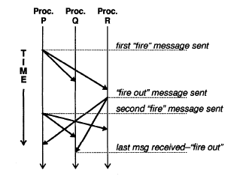
Can’t say “for sure”
Causal relationships at semantic level are not recognizable
External or ‘hidden’ communication channel.

Slide 36
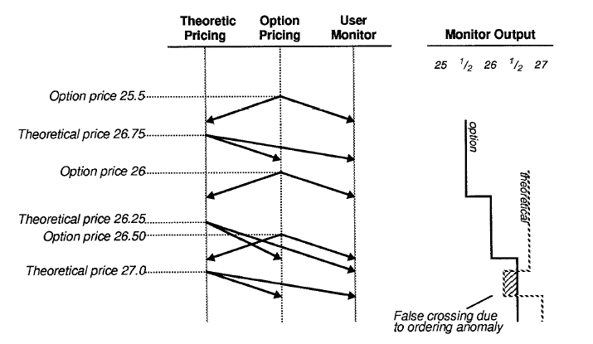
Can’t say “together”, “whole story”
Serializable ordering, semantic ordering are not ensured

Slide 37
Can’t say “efficiently”
No efficiency gain over state-level techniques
False Causality
Not scalable
Overhead of message reordering
Buffering requirements grow quadratically

Slide 38
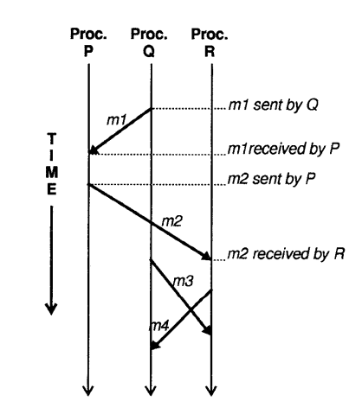
False Causality
What if m2 happened to follow m1, but was not causally related?

Slide 39
Discussion
Virtual Synchrony good!
But, not perfect

