Slide 1
Making peer-to-peer systems scalable
Presented by Elisavet Kozyri

Slide 2
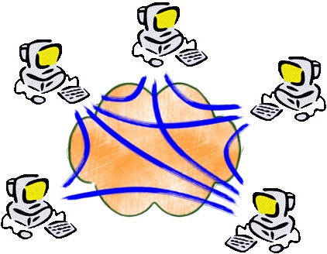
What is a peer-to-peer system?
A distributed application architecture that partitions tasks or work loads between peers
Main actions:
Find the owner of the file (indexing)
Get the file from the owner

Slide 3
Popular P2P Systems
 | indexing | get file
Napster (1999 – 2001)
Gnutella (2000 – now)

Slide 4
What was it missing?
Scalable indexing mechanism

Slide 5
Goals
Each node (peer) should be responsible for certain files
System remain robust during and after the arrival and departure of nodes

Slide 6
Observation
At the new system:
Given an identifier of data it should find the owner.
If a node joins or leaves it should rearrange the data.
Is it similar to hash table?
node ⬄ bucket
identifier ⬄ key
data ⬄ value
Distributed hash table

Slide 7
Distributed Hash Table
Abstraction:
Simple interface
Similar to hash table
Pairs (key, value) are spread across the nodes
Implementation:
Name space partitioning
Each node responsible for a fraction
Each node has ID from the same name space
Nodes communicate over an overlay network to route lookup requests
Feb | abcd
Apr | bcde
Jun | bcd
Jul | cde
Jan
May
Sep
Nov | ebcd

Slide 8
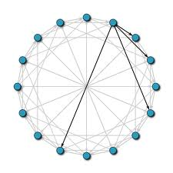
Chord: A DHT Implementation

Slide 9
Chord: Authors
Ion Stoica
Associate Professor of CS at Berkeley
Robert Morris
Professor in the EECS department at MIT
David Karger
Professor in the EECS department at MIT
M. Frans Kaashoek
Professor in the EECS department at MIT
Hari Balakrishnan
Professor in the EECS department at MIT

Slide 10
Chord: Goals
Load balance
Keys are spread evenly over the nodes
Decentralization
No node is more important than any other
Scalability
The cost of lookups grows as the log of the number of nodes
Availability
The node responsible for the key can always be found
Flexible naming
No constraints on the structure of the keys

Slide 11
Chord: Protocol
Hashing
Determines the name space and the way it is partitioned among nodes.
Routing
Determines the way lookup requests will be routed among nodes to reach their destination.
Joining
Determines the way the system adopts itself at the arrival of a node

Slide 12
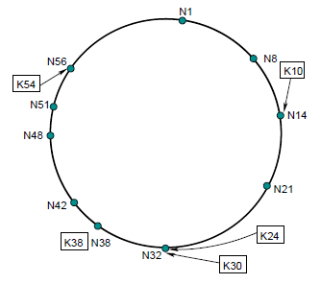
Chord: Hashing
Consistent hash function
Each node and key has an m-bit identifier
Identifiers ordered in an identifier circle
Key k belongs to the node which identifier is the first clockwise from k

Slide 13
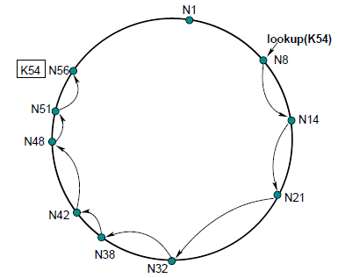
Chord: Inefficient Routing
Complexity: O(N)

Slide 14
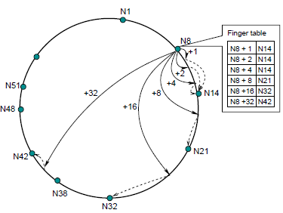
Chord: Efficient Routing
Complexity: O(logN)

Slide 15
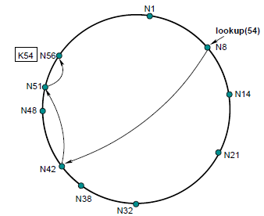
Chord: Routing
N8 + 1 | N14
N8 + 2 | N14
N8 + 4 | N14
N8 + 8 | N21
N8 +16 | N32
N8 +32 | N42
N42 + 1 | N48
N42 + 2 | N48
N42 + 4 | N48
N42 + 8 | N51
N42 +16 | N1
N42 +32 | N14

Slide 16
Chord: Node joins
Stabilization
Ensure node’s successor pointer is up to date
Ex: N26.join(N42) -> N26.stabilize -> N26.notify(N32) -> N21.stabilize -> N26.notify(N26)

Slide 17
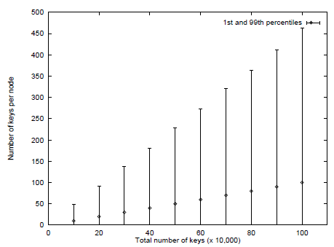
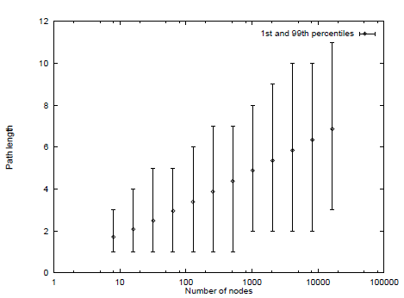
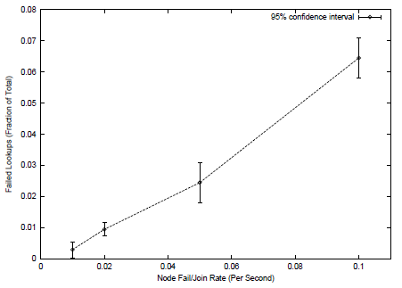
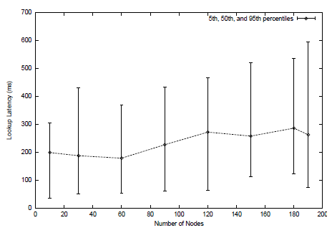
Chord: Evaluation
Load Balance
Path Length
Lookups During Stabilization
Experimental Results

Slide 18
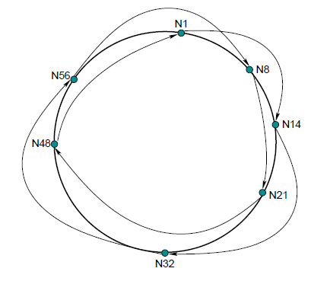
Chord: Discussion
Basic principle of routing algorithm: Longest Shooting
Network locality?
Stabilization: “we separate our correctness and performance goals”
Lookups eventually succeed
Is Chord globally consistent ?
Anonymity?
General comments

Slide 19
Other DHT Implementations
Pastry
CAN
Tapestry
PRR
Viceroy
Kademlia

Slide 20
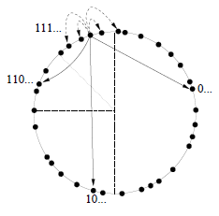
Pastry

Slide 21
Pastry: Hashing
Circular namespace
Each node is randomly assigned a 128-bit identifier (nodeID)
Each object is assigned an identifier at least 128 bits long (objID)
An object belongs to a node if nodeID is numerically closest to the 128 most significant bits of the objID
An object is stored on k nodes

Slide 22
Pastry: Hashing
00100
001
011
100
110
11010
01010
01101
10100
10011

Slide 23
Pastry: Routing
nodeID
Routing table
For each level l, the routing table contains the IP address of 2^{b-1} nodes that have the same nodeID prefix as the local node up to level l-1, but differ at level l.
From all possible nodes, the closest are selected.
Level 0 | Level 1 | Level 2 | Level 3
1 | 1 | 0 | 0 | 1 | 0 | 0 | 0 | 1 | 1 | 1 | 1
A message whose destID matches the local node’s nodeID up to level l is forwarded to a node whose nodeID matches the destID up to least l+1.

Slide 24
CAN
Content-Addressable Network

Slide 25
CAN: Hashing
d-torus
Each node owns a zone within the overall space
A key is mapped onto a point in the space
If the point P belongs to the zone of node n, then the corresponding (key, value) is stored at n.

Slide 26
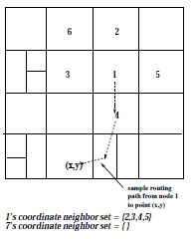
CAN: Routing
Routing table: IP address and virtual coordinate zone of each immediate neighbors
A node forwards the message to the neighbor with coordinates closest to destination

Slide 27
Comparison of DHT Geometries
“The Impact of DHT Routing Geometry of Resilience and Proximity”
K. Gummadi: Head of Networked Systems Research Group at Max Planck Institute for Software Systems
R. Gummadi: Assistant Professor, ECE, UMass Amherst
S. Gribble: Associate Professor, CSE, University of Washington
S. Ratnasamy: Researcher at Intel Research Berkeley
S. Shenker: Professor, EECS, UC Berkeley
I. Stoica: Associate Professor, CS, US Berkeley

Slide 28
Comparison of DHT Geometries
Resilience
The ability of the DHT implementation to route during and after arrivals/departures of nodes.
Proximity
The ability of the DHT implementation to adapt to the underlying Internet topology.
Flexibility
Neighbor Selection
Route Selection

Slide 29
Tree
000
001
010
011
100
101
110
111
PRR, Tapestry
Generous flexibility in choosing neighbors
No flexibility in route selection

Slide 30
Hypercube
110
111
100
101
010
011
000
001
CAN
Flexibility in route selection
No flexibility in choosing neighbors

Slide 31
Ring
Chord
Changes
i^{th} neighbor of a belongs to
[(a + 2^{i}),(a+ 2^{i+1})]
multiple paths
Flexibility in route selection
Flexibility in choosing neighbors
000
111
001
110
010
101
011
100

Slide 32
Hybrid
Pastry (ring + tree)
Flexibility in route selection
Flexibility in choosing neighbors

Slide 33
Static Resilience
Static resilience ⬄ Routing flexibility

Slide 34
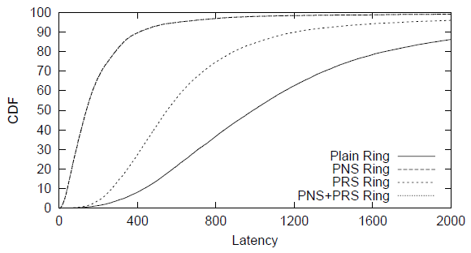
Proximity
Proximity Neighbor Selection (PNS)
Proximity Route Selection (PRS)
What is the best?

Slide 35
Discussion
Are ring geometries the best?
What is the importance of sequential neighbors?
How does neighbors flexibility influence resilience/proximity?
Chord, CAN, Pastry: Are they used today?
Which is the best?
General comments

Slide 36
References
Pastry: Scalable, distributed object location and routing for large-scale peer-to-peer systems, Antony Rowston, Peter Druschel
A Scalable Content-Addressable Network, Sylvia Ratnasamy, Paul Francis, Mark Handley, Richard karp, Scott Shenker
Chord: A Scalable Peer-to-peer Lookup Service for Internet Applications, Ion Stoica, Robert Morris, David Liben-Nowell, David Karger, M. Frans Kaashoek, Frank Dabek, Hari Balakrishnan
Geometry shapes from Krishna’s SIGCOMM talk

Slide 37
Thank you!

