Slide 1
Virtual Synchrony
Jared Cantwell

Slide 2
Review
Multicast
Causal and total ordering
Consistent Cuts
Synchronized clocks
Impossibility of consensus
Distributed file systems

Slide 3
Goal
Distributed programming is hard
What tools can make it easier?
What assumptions can make it easier?
Distributed programming is hard!
Let’s go shopping!!!
According to http://en.wikipedia.org/wiki/Barbie,
Barbie once said “Math is hard!” (misquoted).
Notes:
FLP Impossibility Result → it really is hard, even if we only try to tolerate a single failing node

Slide 4
The Process Group Approach to Reliable Distributed Computing
Ken Birman
Professor, Cornell University
ISIS
“toolkit mechanism for distributed programming”
Financial trading floors
Telecommunications switching
Notes:
Let me digress slightly and talk about the author.
This paper proposes a solution to the problem.
replicated data
synchronizing distributed computations
automating recovery
dynamically reconfiguring a system to accommodate changing workloads
financial trading floors to telecommunications switching systems.

Slide 5
Virtual Synchrony
Simplify distributed systems programming by assuming a synchronous environment
Features:
Process Groups
Reliable Multicast
Fault Tolerance
Performance
Notes:
Takeaway!!

Slide 6
Outline
Problem / Motivation
Solution (Virtual Synchrony)
Assumptions
Close Synchrony
Virtual Synchrony

Slide 7
Outline
Problem / Motivation
Solution (Virtual Synchrony)
Assumptions
Close Synchrony
Virtual Synchrony

Slide 8
Motivation
Distributed Programming is hard

Slide 9
Difficulties
No reliable multicast
Membership churn
Message ordering
State transfers
Failure atomicity
Notes:
Make sure to say each one slowly
Each in turn
Weak support, particularly with inconistencies and when channels break
Addressing → how to make sure you’re sending to the latest membership and a consistent membership?
Concurrent messages: 2 choices: a) handle it or b) delay messages so that they’re in order. Real problem = this is overlooked!
Same thing
State transfer: easy if membership doesn’t change. Very hard if it does. And there’s no support
Failure atomicity: “all or none”

Slide 10
No Reliable Multicast
Ideal
Reality
p
q
r
UDP, TCP, Multicast not good enough
What is the correct way to recover?
Notes:
Talk about the different protocols and their weaknesses
- UDP, TCP, Multicast
Multicast is useful for replication, but we want it to be reliable
Making it reliable results in acknowledgement explosion
Even if app implemented this, it’s not clear how to correct for failures
TCP is reliable point-to-point
Impossible to know if multicast reaches all receivers without additional logic
Reliable multicast is application’s responsibility

Slide 11
Membership Churn
Receives new membership
p
q
r
Never sent
Membership changes are not instant
How to handle failure cases?
Notes:
Send messages to an up-to-date membership?
No stale memberships
Solution: locks
Multicast →read-lock
Membership change →write-lock
Implemented in a distributed way

Slide 12
Message Ordering
1
2
p
q
r
Everybody wants it!
How can you know if you have it?
How can you get it?
Notes:
No causality
Causality
Receive messages concurrently?
Concurrent and totally ordered wrt. membership changes
Related Messages
Will they come in order?
The problem
Will programmers anticipate it?
Concurrent messages: 2 choices:
a) handle it or
b) delay messages so that they’re in order.
Real problem = this is overlooked!

Slide 13
State Transfers
p
q
r
New nodes must get current state
Does not happen instantly
How do you handle nodes failing/joining?
Notes:
Transfer state to new node
Membership churn → inconsistent
Solution is too complex

Slide 14
Failure Atomicity
Ideal
Reality
p
x
q
r
?
Nodes can fail mid-transmit
Some nodes receive message, others do not
Inconsistencies arise!
Notes:
What if sender fails mid-broadcast?
Inconsistent state would result
Simple solutions exist
solution: 3-phase commit

Slide 15
Motivation Review
Distributed programming is hard!
No reliable multicast
Membership churn
Message ordering
State transfers
Failure atomicity
Notes:
Breeze by this rather quickly

Slide 16
Outline
Problem / Motivation
Solution (Virtual Synchrony)
Assumptions
Close Synchrony
Virtual Synchrony

Slide 17
Assumptions
WAN of LANs
Unreliable network
Flow control at lowest layer
Clocks not synchronized
No partitions
CAP Theorem?
Notes:
LAN, local low latency, 1 – 100 nodes

Slide 18
Failure Model
Nodes crash
Network is lossy
Can’t distinguish difference
Notes:
Nodes are correct until they crash

Slide 19
Outline
Problem / Motivation
Solution (Virtual Synchrony)
Assumptions
Close Synchrony
Virtual Synchrony

Slide 20
Outline
Problem / Motivation
Solution (Virtual Synchrony)
Assumptions
Close Synchrony
Model
Significance
Issues
Virtual Synchrony

Slide 21
Model
Events (all or nothing)
Internal computation
Message transmission & delivery
Membership change
Notes:
System is a set of process executions (messages can be though of as multicasts)
Same two messages always arrive in same order
A multicast is delivered to full membership– send and delivery happen instantaneously

Slide 22
Model
Synchronous execution
p
q
r
s
t
u
Ken’s Slides - 2006

Slide 23
Significance
Multicast is always reliable
Membership is always consistent
Totally ordered message delivery
State-transfer happens instantaneously
Failure Atomicity
Multicast is a single event
Notes:
Solves all problems!!!
Multicast is always reliable
Membership is always consistent
Concurrent message delivery
Multicast are distinct events, therefore same order
Order of related messages
Never inconsistent?
State-transfer
Happens at a well defined instant in “model” time
Failure Atomicity
Multicast is a single event
Failure = group membership change → ordered wrt. multicast

Slide 24
Issues
Discrete event simulator
Is it practical?
Impossible with failures
Very expensive
System progresses in lock-step
Limited by speed of other members

Slide 25
Outline
Problem / Motivation
Solution (Virtual Synchrony)
Assumptions
Close Synchrony
Virtual Synchrony

Slide 26
Outline
Virtual Synchrony
Asynchronous Execution
Virtual Synchrony
ISIS
Parallels
Benefits
Discussion

Slide 27
Asynchronous Execution
Key to high throughput in distributed systems
Only wait for responses (or too fast sends)
Communication channel
Acts as a pipeline
Not limited by latency
Not possible with Close Synchrony!!

Slide 28
Asynchronous Execution
p
q
r
s
t
u
Ken’s Slides - 2006

Slide 29
Virtual Synchrony
Close Synchrony + Asynchronous
Indistinguishable to application
So….when can synchronous execution be relaxed?
Notes:
There exits a CS execution indistinguishable from Asynchronous one

Slide 30
ISIS
Communication Framework
Membership Service
VS primitives
ABCAST
CBCAST

Slide 31
ISIS
Problem
Crash and Lossy Network Indistinguishable
Solution:
Membership list
Nonresponsive or failed members are dropped
Only listed members can participate
Re-join protocol
Does Membership exist in all distributed systems?
Notes:
Does Membership exist in all distributed systems?
---- YES, it makes the problem go away.

Slide 32
ISIS
Atomic Broadcast (ABCAST)
No message can be delivered to any user until all previous ABCAST messages have been delivered
Costly to implement
…But not everyone needs such strong guarantees

Slide 33
ISIS
Causal Atomic Broadcast (CBCAST)
Sufficient for most programmers
Concurrent messages commute
Weaker than ABCAST
Notes:
Allows concurrent messages to be delivered in different orders
Tokens ??????

Slide 34
When to use CBCAST?
Each thread corresponds to a different lock
2
5
p
1
r
s
3
t
1
4
2
When any conflicting multicasts are uniquely ordered along a single causal chain
…..This is Virtual Synchrony
Ken’s Slides - 2006
Notes:
If two messages are NOT concurrent, then they must have a causal relationship
May need to add locks for CBCAST to work properly

Slide 35
Parallels
Logical time
Replication in database systems
Schneider’s state machine approach
Parallel processor architectures
Distributed database systems

Slide 36
Benefits
Assume a closely synchronous model
Group state and state transfer
Pipelined communication (async)
Single event model
Failure handling
Notes:
Communication and membership changes viewed through a single event model
Simplifies the developer’s task – very few cases to worry about, and all group members see the same thing at the same “time”
But the actual execution is rather concurrent and asynchronous
Maximizes performance
Reduces risk that lock-step execution will trigger correlated failures

Slide 37
Discussion
Partitions
False positives
Most have them, VS admits it
False negatives
Depend on a timeout

Slide 38
Summary
Programming in distributed systems is hard
Close Synchrony makes it easier
Costs too much
Take asynchronous when you can
Virtual Synchrony
Pipelined
Easy to reason over

Slide 39
Understanding the Limitations of Causally and Totally Ordered Communication
Authors
David Cheriton
Stanford
PhD – Waterloo
Billionaire
Dale Skeen
PhD – UC Berkeley
3-phase commit protocol

Slide 40
The flaws of CATOCS
Unrecognized causality
No semantic ordering
No Efficiency Gain (over State-level Techniques)
No Scalability
Notes:
Only going to cover 2! Admit it!
Could be external communication that would imply causality, but the communication layer doesn’t know about it
Groups a messages may need to be grouped together, so treating them serial will have to happen at the application level, but this eliminates the need CATOCS….supposedly
More general statement of #2. ????
Still need timestamps
CATOCS is prone to false causality
Potential vs. Actual causality
Doesn’t scale!

Slide 41
Unrecognized Causality
p
q
r
s
External communication is unknown

Slide 42
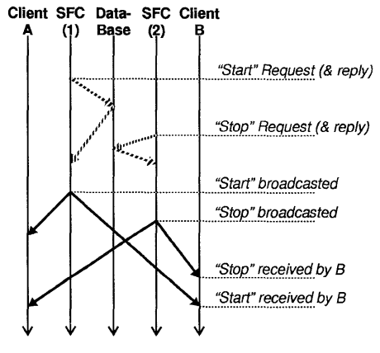
Unrecognized Causality
Database is external entity
Causal relation exists, but CATOCS misses it

Slide 43
No Semantic Ordering
Serialization
Messages can’t be “group together”
Implementing eliminates CATOCS need
Causal Memory
Solution: state-level logical clock

Slide 44
No Efficiency Gain
Still need state-level techniques
False causality
Reduces Performance
Increased Memory
Message overhead

Slide 45
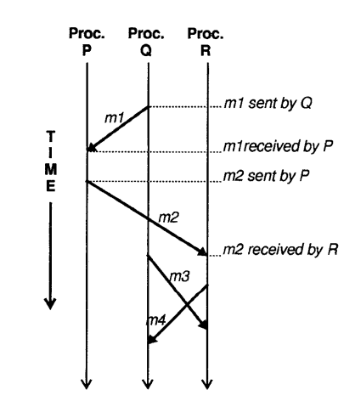
No Efficiency Gain
What if m2 happened to follow m1, but was not causally related?
CATOCS would make False Causality

Slide 46
No Scalability
≈ quadratic growth of expected message buffering
Rebuttal:
Worst case
Impractical use case

Slide 47
Summary
CATOCS software is overkill
Communication system doesn’t know everything
Everything is better at the application level

Slide 48
Conclusions
Distributed Programming is hard
Close Synchrony
Too costly
Virtual Synchrony
Limitations
VS not perfect for all situations
Notes:
It’s a model and a way of thinking about distributed programming

