Slide 1
Classic Systems: Unix and THE
Presented by Hakim Weatherspoon
Notes:
Deniz,
Hari,
Jared
Petko
Taiyen
Bo
Yin
Srivant
Robert

Slide 2
The UNIX Time-Sharing System Dennis Ritchie and Ken Thompson
Background of authors at Bell Labs
Both won Turing Awards in 1983
Dennis Ritchie
Key developer of The C Programming Lanuage, Unix, and Multics
Ken Thompson
Key developer of the B programming lanuage, Unix, Multics, and Plan 9
Also QED, ed, UTF-8
Notes:
“UNIX is basically a simple operating system, but you have to be a genius to understand the simplicity.” – Dennis Ritchie

Slide 3
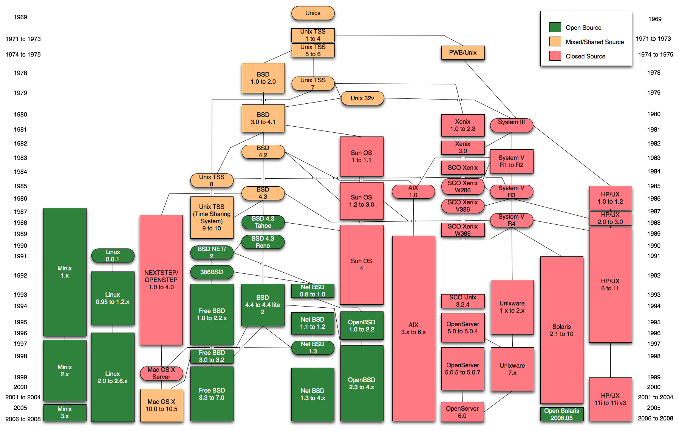
The UNIX Time-Sharing System Dennis Ritchie and Ken Thompson

Slide 4
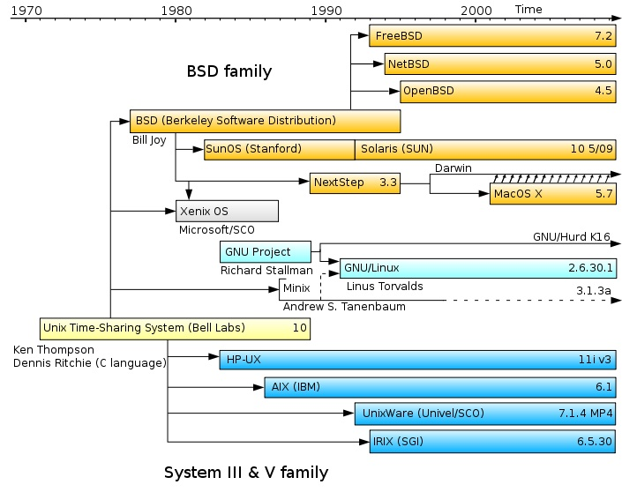
The UNIX Time-Sharing System Dennis Ritchie and Ken Thompson

Slide 5
The UNIX Time-Sharing System Dennis Ritchie and Ken Thompson
Classic system and paper
described almost entirely in 10 pages
Key idea
elegant combination of a few concepts that fit together well

Slide 6
System features
Time-sharing system
Hierarchical file system
Device-independent I/O
Shell-based, tty user interface
Filter-based, record-less processing paradigm

Slide 7
Version 3 Unix
1969: Version 1 ran PDP-7
1971: Version 3 Ran on PDP-11’s
Costing as little as $40k!
< 50 KB
2 man-years to write
Written in C

Slide 8
File System
Ordinary files (uninterpreted)
Directories (protected ordinary files)
Special files (I/O)

Slide 9
Directories
root directory
path names
rooted tree
current working directory
back link to parent
multiple links to ordinary files

Slide 10
Special Files
Uniform I/O model
Each device associated with at least one file
But read or write of file results in activation of device
Advantage: Uniform naming and protection model
File and device I/O are as similar as possible
File and device names have the same syntax and meaning, can pass as arguments to programs
Same protection mechanism as regular files

Slide 11
Removable File System
Tree-structured
Mount’ed on an ordinary file
Mount replaces a leaf of the hierarchy tree (the ordinary file) by a whole new subtree (the hierarchy stored on the removable volume)
After mount, virtually no distinction between files on permanent media or removable media

Slide 12
Protection
User-world, RWX bits
set-user-id bit
super user is just special user id

Slide 13
Uniform I/O Model
open, close, read, write, seek
Uniform calls eliminates differences between devices
other system calls
close, status, chmod, mkdir, ln
bytes, no records

Slide 14
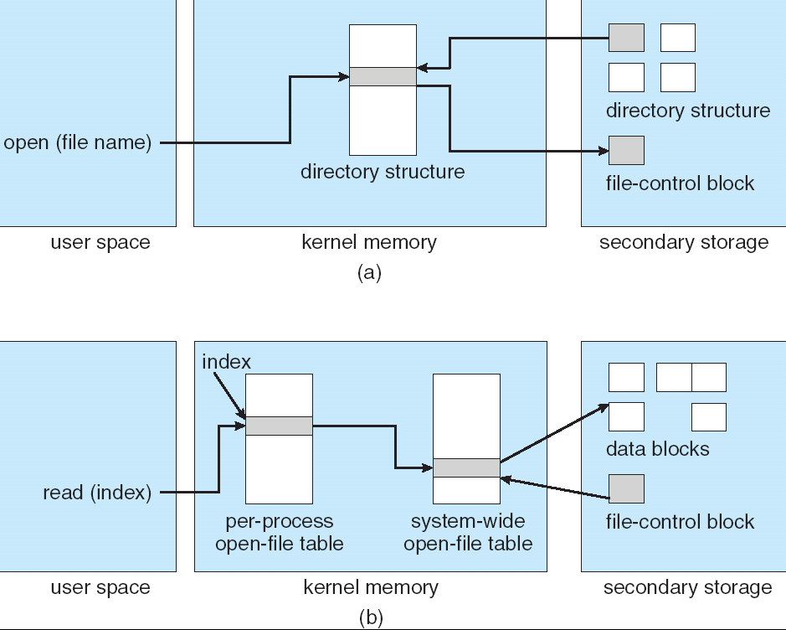
File System Implementation
table of i-nodes
path name scanning
mount table
buffered data
write-behind

Slide 15
I-node Table
short, unique name that points at file info.
allows simple & efficient fsck
cannot handle accounting issues
Inode
File name
Inode#

Slide 16
Processes and images
text, data & stack segments
process swapping
pid = fork()
pipes
exec(file, arg1, ..., argn)
pid = wait()
exit(status)

Slide 17
The Shell
cmd arg1 ... argn
stdio & I/O redirection
filters & pipes
multi-tasking from a single shell
shell is just a program
Trivial to implement in shell
Redirection, background processes, cmd files, etc

Slide 18
Traps
Hardware interrupts
Software signals
Trap to system routine

Slide 19
Perspective
Not designed to meet predefined objective
Goal: create a comfortable environment to explore machine and operating system
Other goals
Programmer convenience
Elegance of design
Self-maintaining

Slide 20
“THE”-Multiprogramming System Edsger W. Dijkstra
Received Turing Award in 1972
Contributions
Shortest Path Algorithm, Reverse Polish Notation, Bankers algorithm, semaphore’s, self-stabilization
Known for disliking ‘goto’ statements and using computers!

Slide 21
“THE”-Multiprogramming System Edsger W. Dijkstra
Never named “THE” system; instead, abbreviation for "Technische Hogeschool Eindhoven”
Batch system (no human intervention) that supported multitasking (processes share CPU)
THE was not multiuser
Introduced
software-based memory segmentation
Cooperating sequential processes
semaphores

Slide 22
Design
Layered structure
Later Multics has layered structure, ring segmentation
Layer 0 – the scheduler
Allocated CPU to processes, accounted for blocked proc’s
Layer 1 – the pager
Layer 2 – communication between OS and console
Layer 3 – managed I/O
Layer 4 – user programs
Layer 5 – the user

Slide 23
Perspective
Layered approach
Design small, well defined layers
Higher layers dependent on lower ones
Helps prove correctness
Helps with debugging
Sequential process and Semaphores

Slide 24
Next Time
Read and write review:
Do Lab 1 due yesterday
Project Proposal due this Thursday
Email and talk to me before Thursday
Check website for updated schedule

