Slide 1
Projective Geometry Redux
& Image Based Rendering
By Abe Davis

Slide 2
Announcements
Project 4 is released
  Due Friday, April 17 by 11:59pm.
  The project will be done in groups of two, with groups defaulting to the Project 3 groups (though groups can be changed on CMSX)
New Grading Policy
  Check email for more information

Slide 3
Today’s Lecture
Homogeneous Coordinates and Geometry in n-dimensions
  New slides, following my own derivations, intended to help with confusion I’ve noticed in the first part of the course
  Mostly re-derives stuff you know, but hopefully with stronger motivation, rigor, and intuition
Image Based Rendering and Light Fields
  Not in previous versions of the course, but an active area of work in computer vision with many applications (e.g., AR/VR, film special effects, etc.)

Slide 4
Part 1:
Building a Geometry of Points & Views
By Abe Davis
Or “Let’s derive homogeneous coordinates from scratch!”

Slide 5
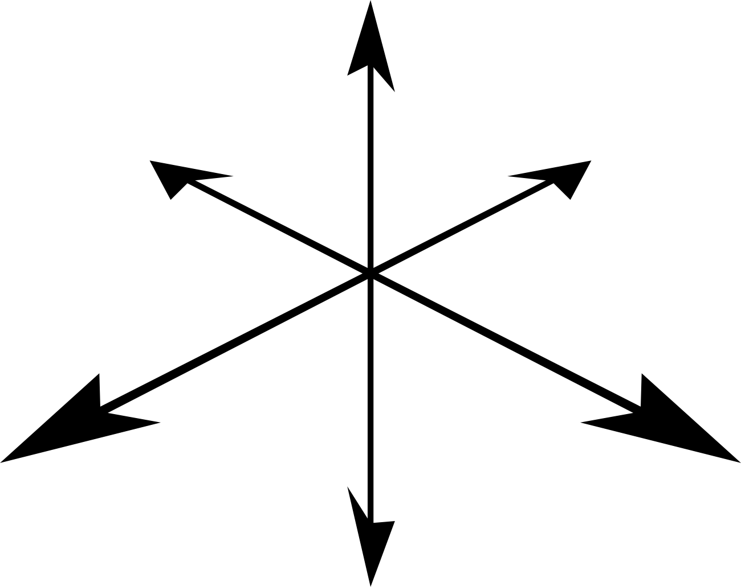
Motivation
We may observe geometry in different ways
  e.g., different views or cameras
How do we separate our description of geometry from our choice of reference frame?
Notes:
We may observe geometry in different ways and from different perspectives
This is especially true in computer vision where every image offers a different view of the world
…So a reasonable question to ask is:
how can we separate our description of geometry from any particular choice of reference frame?
Because the TRADITIONAL way we represent geometry, with points represented by simple coordinates vectors, depends heavily on our choice of coordinate system
The easiest way to see this is by noting that
a POINT is actually indistinguishable from
a VECTOR connecting the origin to that point.
Which CLEARLY depends on WHERE we decide to place the origin

Slide 6
Motivation
We may observe geometry in different ways
  e.g., different views or cameras
How do we separate our description of geometry from our choice of reference frame?
Multiplying a point by a constant
Notes:
And this dependence affects the MEANING of different operations,
For example, if we multiply a point by a constant,
*we end up with DIFFERENT points depending on where we place the origin

Slide 7
Motivation
We may observe geometry in different ways
  e.g., different views or cameras
How do we separate our description of geometry from our choice of reference frame?
Adding two points
Notes:
And the same is true if we ADD two points.
*We get different results depending on where our origin is, EVEN RELATIVE TO THOSE POINTS
[meaning]

Slide 8
Motivation
We may observe geometry in different ways
  e.g., different views or cameras
How do we separate our description of geometry from our choice of reference frame?
Problem:
Standard representation treats points like vectors from the origin
Points and vectors are NOT the same thing!
Notes:
From these examples we can see that at least PART of the problem is that our standard representation doesn’t distinguish between points and vectors
Which is an issue, because points and vectors ARE NOT THE SAME THING

Slide 9
Relating Points and Vectors
A point is a unique location
A vector is the difference between two locations
We can add vectors to points and to other vectors
We can scale vectors
Notes:
To make this concrete, let’s consider what points and vectors actually ARE, independent of any coordinate system
*So a point is just a location, and for now we will reason about it without specifying any frame of reference or even a number of dimensions
*and a VECTOR is something that describes the RELATIONSHIP between TWO LOCATIONS
Which means that if we take the difference of two points we should get a vector
And for now, we'll only consider operations that we can depict pictorally.
More rigorously, we'll consider operations that produce the same result no matter where you place the origin.
In this case, there is a lot we can do with vectors that that we can't with points
For example, *we can ADD a vector to a point or another vector
*and we can SCALE a vector safely as well

Slide 10
Homogeneous Values
A point is a unique location
A vector is the difference between two locations
We can add vectors to points and to other vectors
We can scale vectors
Homogeneous Points and Vectors:
Set an extra value to 1 for points
And to 0
for vectors
For now, let’s only consider
homogeneous values that are 0 or 1
Notes:
So how do we build a common representation for points and vectors that captures their different behavior?
*Well, first we need to make sure that points and vectors are actually distinguishable
so we'll simply add a binary value to indicate whether something is a point,
*So if it’s a point, we’ll set that value to 1
*and if it’s a vector we’ll set it to 0
*And for now, let's just consider those two options: point or vector; 0 or 1

Slide 11

Homogeneous Values
A point is a unique location
A vector is the difference between two locations
We can add vectors to points and to other vectors
We can scale vectors
Homogeneous Points and Vectors:
point – point = vector
point + vector = point
Set an extra value to 1 for points
And to 0
for vectors
vector + vector = vector
For now, let’s only consider
homogeneous values that are 0 or 1
vector constant = vector
Notes:
so lets see how this homogeneous value stacks up with what we know about points and vectors
*So a point is a unique location; well, if we could distinguish between two points before then adding our homogeneous value shouldn’t change that, so our first bullet point checks out…
*And, if we subtract a point from another point then we get a homogeneous value of 0, which means we get a vector,
*so our second behavior checks out
*if we add a vector to a point we get a homogeneous value of 1, which gives us another point, so that checks out
*and if we add a vector to another vector we get homogeneous value of 0, which is another vector,
*so we can check off this third criteria as well
And finally, *if we multiply a vector by a constant then it doesn’t change the homogeneous value so we get another vector
*which gives us the fourth criteria as well
So this looks great so far, but there’s a problem…

Slide 12
Homogeneous Values
A point is a unique location
A vector is the difference between two locations
We can add vectors to points and to other vectors
We can scale vectors
Homogeneous Points and Vectors:
point – point = vector
point + vector = point
Set an extra value to 1 for points
And to 0
for vectors
vector + vector = vector
For now, let’s only consider
homogeneous values that are 0 or 1
vector constant = vector
Notes:
Because if vectors can be multiplied by constants and added to other vectors or points
And we’re using he same representation for points and vectors
Then this operation should at least be VALID for points as well

Slide 13
Homogeneous Values
What should it mean to multiply a point by a constant?
What should it mean to add points?
Recall: The Problem With Regular Coordinates
Multiplying a point by a constant
With regular coordinates
Adding two points
With regular coordinates
Notes:
So what should it mean for us to multiply a point by a constant?
And what should it mean to add two points?
*Because remember: we saw that, with standard coordinates, both of these operations depend on our choice of reference frame
Because a point was treated like a vector from the origin…
Now, homogeneous values give us a way to DISTINGUIGH between points and vectors, but we still need to decide what these operations should mean for points

Slide 14
Homogeneous Values
What should it mean to multiply a point by a constant?
What should it mean to add points?
What does it mean to have a homogeneous value that is not 0 or 1?
Notes:
Well, if we continue to treat this homogeneous value as just another number,
then at least ARITHMATICALLY, we KNOW what these problematic operations look like
*And what you’ll NOTICE is that BOTH of them result in UNEXPECTED homogeneous values
that is, values that may not be 0 or 1

Slide 15
Homogeneous Values
What should it mean to multiply a point by a constant?
What should it mean to add points?
When , this becomes , a vector
When this becomes , a point
When can these operations be combined to get valid points or vectors?
Notes:
But we can COMBINE these operations to get valid points and vectors
*If we look at the formula for linear combinations of points
*then if we set the homogeneous value to zero, we expect a vector, and sure enough we will always get a scaled version of the vector between Pa and Pb
*and if we set the homogeneous value to 1 then we get this equation, which is precisely the equation for a weighted average of our two points

Slide 16
Homogeneous Values
What should it mean to multiply a point by a constant?
What should it mean to add points?
When , this becomes , a vector
When this becomes , a point
When can these operations be combined to get valid points or vectors?
Notes:
So GEOMETRICALLY
*If these are our two points
*then every point on the line passing through them corresponds to a different choice of alpha
*with zero and 1 corresponding to our original points
*alpha less than one giving us these points
*and alpha greater than one giving us these points
And what’s GREAT is that THIS IS ALL TRUE NO MATTER WHERE WE PLACE OUR COORDINATE SYSTEM
So now the question is: how can we generalize this behavior to non-binary homogeneous values
And how does that change our algebra more broadly

Slide 17
Homogeneous Values Coordinates
Homogeneous values keep track of how much our choice of origin has influenced our coordinates
We can correct for the influence on a point by dividing all coordinates by the homogeneous value
Origin

Slide 18
Barycentric Coordinates, Homogenization, & Center of Mass
If we homogenize the weighted sum of k points, we get get their center of mass
Weighted sum of points
(weights given by alphas)
Equation for center of mass
(masses given by m’s)

Slide 19
Homogeneous Coordinates & Projection
How to project an n-dimensional vector onto an image plane?
Notes:
So we’ve seen how homogeneous coordinates can help separate our description of geometry from our choice of coordinate frame
Now lets take a look at how they help us represent different views of that geometry
And, in particular, how we can model projection of points and vectors onto arbitrary image planes in n-dimensional space

Slide 20
Homogeneous Coordinates & Projection
How to project an n-dimensional vector onto an image plane?
What is the projection of onto the image plane?
Image Plane
Where is the unit vector perpendicular to the image plane
In homogeneous coordinates
Notes:
So let’s start with some point p, which we’ll represent in homogeneous coordinates as the n-dimensional vector v, and a homogeneous coordinate of 1
*
*

Slide 21
Homogeneous Coordinates & Projection
How to project an n-dimensional vector onto an image plane?
How do we express this as a matrix?
Image Plane
Where is the unit vector perpendicular to the image plane
In homogeneous coordinates
Projection onto image plane defined by .

Slide 22
Similar triangles used to compute (Extra Slide)
Image Plane
Notes:
1=\frac{\mathbf{u}^\intercal\mathbf{v}}{\mathbf{u}^\intercal\mathbf{v}}

Slide 23
Homogeneous Coordinates & Translation
3D translation is not linear in regular 3D coordinates
In regular coordinates, no matrix can take the origin away from the origin…

Slide 24
Homogeneous Coordinates & Translation
Translation is not linear in regular coordinates

Slide 25
Homogeneous Coordinates & Translation
Translation is not linear in regular coordinates

Slide 26
Homogeneous Coordinates & Translation
Translation is not linear in regular coordinates
Translation & Rotation: Vectors vs Points
Points rotate and translate
Vectors rotate but do not translate
  Consider the surface normal of an object
  If we translate the object, the surface normal direction does not change
Rp
Rv
v
p
Tv
Tp

Slide 27
Homogeneous Coordinates & Translation
Translating vectors (e.g., surface normals)

Slide 28
Homogeneous Coordinates: Putting It All Together
Change of Basis/Rotation
Translation
Location
Image Plane for Projection
Whether Point or Vector
0 if projection is done, 1 otherwise

Slide 29
Part 2:
Image-Based Rendering
By Abe Davis

Slide 30
Light Fields & Image-Based Rendering
With Stick Figures!
Notes:
But lets start with light fields 101, and since a lot of people find light fields confusing I’m going to attempt to explain them
*with stick figures

Slide 31

Traditional Photography
Scene
Photographer
User
Notes:
Now In traditional photography you have
*a scene
*a photographer, and then
*somewhere else in time and space
*You have the person who is actually going to use or look at the photo

Slide 32

Traditional Photography
Scene
Photographer
User
Notes:
And normally,
*the photographer decides what image to take
Because HE is the one in control of the camera
*so we’ll give him a beret and mustache

Slide 33
Image-Based Rendering
Scene
Photographer
User
Notes:
But let’s say you are trying to capture content for VR. This makes things more complicated
*Because NOW, our user expects an interactive viewing experience that puts HIM in control of the camera,
*so he wants the beret and mustache
(Or she---this can totally be a gender-neutral mustache)
But, anyway, this presents a technical challenge:
Because now we need to figure out a way to let our user, who is not physically present in the scene, control the camera

Slide 34
What would be the simplest, most naïve, brute force approach to give the viewer control of the camera?
Notes:
So can anyone think of the most simple, naïve, brute force way to solve this problem?

Slide 35

APTURE
IMAGES
HyperboleAndAHalf

Slide 36

“Light Field” Photography
Scene
Photographer
User
Notes:
[explain concept]

Slide 37
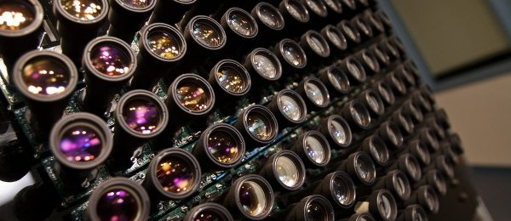
Notes:
And, in fact, this is not so far from what people actually do

Slide 39
“Light Field” Photography
Scene
Photographer
User
Notes:
Can anyone see a problem with this strategy?

Slide 40
We can’t capture all the images

Slide 41
Light Field Photography
Captured Views
Synthesized Views
Scene
Notes:
So in practice we capture as much as we can,
and then we
*interpolate between captured images to synthesize everything else
So, on some level, the only way to make this strategy cheaper WITHOUT SACRIFICING QUALITY is to find better ways to interpolate

Slide 42
Light Field Photography
Captured Views
Synthesized Views
Scene
Notes:
Because if do a better job of interpolating we don’t need to capture as many images
So at the end of the day, efficient light field capture is largely about good interpolation

Slide 43
Sampling and Reconstruction
How do we synthesize this image?
Images
Camera parameters
(e.g. position, orientation, focus, depth of field…)

Slide 44
Sampling and Reconstruction
How do we sample?
What space do we use to represent our data?
How do we Interpolate in that space?
How do we extract images from that space?

Slide 45

Sampling and Reconstruction
How do we sample?
What space do we use to represent our data?
How do we Interpolate in that space?
How do we extract images from that space?
Notes:
[QUICK]

Slide 46
Sampling and Reconstruction
How do we sample?
What space do we use to represent our data?
How do we Interpolate in that space?
How do we extract images from that space?

Slide 47
Sampling and Reconstructing Rays
Notes:
[what is intuition ]

Slide 48
Sampling and Reconstructing Rays

Slide 49
Sampling and Reconstructing Rays
Sample ≈ Pixel ≈ 1 Ray of Light

Slide 50
Captured
Images
Ray Space
New Images
Interpolation happens here

Slide 51
How should we parameterize light?
Light ray = f(?)

Slide 52
Light
Radiance:
  R(position, angle)
  How many dimensions?

Slide 53
Light
Radiance:
  R(position, angle)
  Position = (x,y,z)
  Angle = (theta, phi)
  5 dimensions

Slide 54
What is a good parameterization for light?
The Light Field
Notes:
But, there’s a trick! And it turns out that with pretty minor assumptions that hold most of the time we can get things down to 4 dimensions.

Slide 55
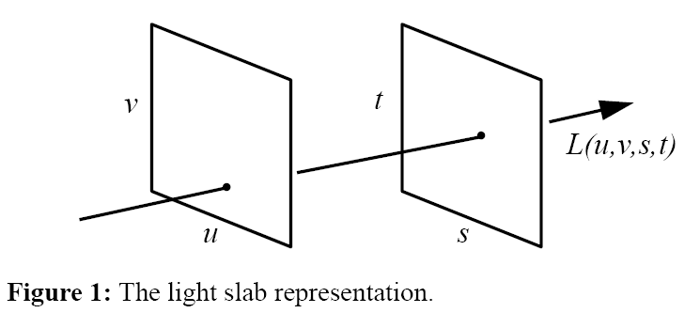
What is a good parameterization for light?
The Light Field
  Unobstructed light
  Each ray defined by intersection with 2 planes
Notes:
Specifically, if we assume that light is unobstructed in the space we care about
Then we can describe every ray of light by its intersection with two parallel planes.
And each intersection gives us two coordinates

Slide 56
What is a good parameterization for light?
The Light Field
  Unobstructed light
  Each ray defined by intersection with 2 planes
4D!
Notes:
so we end up with 4 dimensions
And we call this a two plane parameterization.
So some of you might have a question here. Is there a corner case we’re missing with this parameterization?
Can anyone think of why we don’t have to worry about that corner case?
For an arbitrary choice of orientation, the chance that we will be parallel to a ray is virtually nil

Slide 57
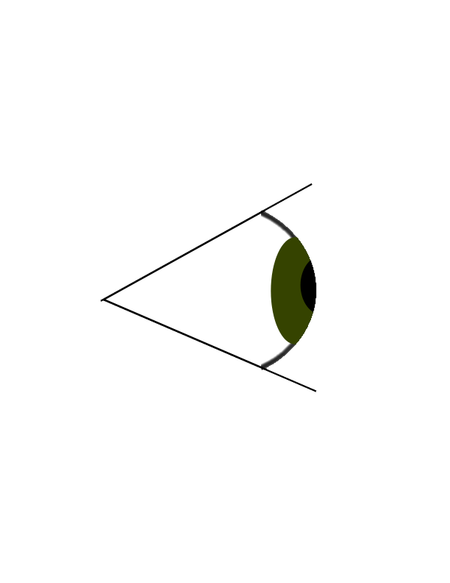
The Light Field
b
a
Notes:
So this parameterization is great because we’ve squeezed the number of dimensions down to 4,
Which is a lot more manageable than 6,
But it’s also going to be a little weird to think about at first, so to make things easier we’re going to use what’s called a ray space diagram
and the best way to understand a ray space diagram is to think about a
*birds-eye view of the setup you see here

Slide 58
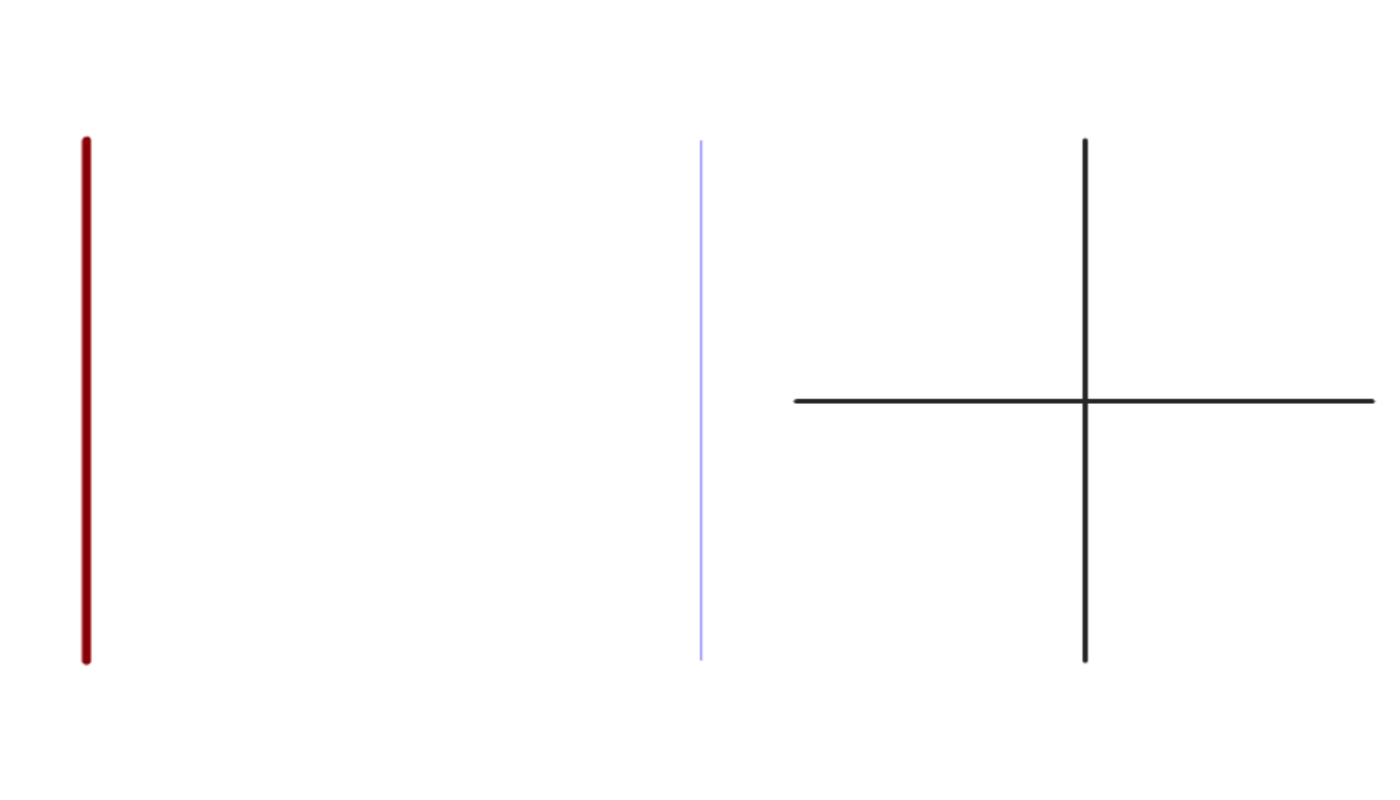
Ray Space
u
s
s
u
Viewpoint
Plane
Image
Plane
Notes:
So rays of light are given by their intersection with
*a viewpoint plane
*and an image plane

Slide 59
Ray Space
u
s
s
Each ray (pixel) is a single point
u
Notes:
So a ray of light on the left
*corresponds to a point on the right

Slide 60
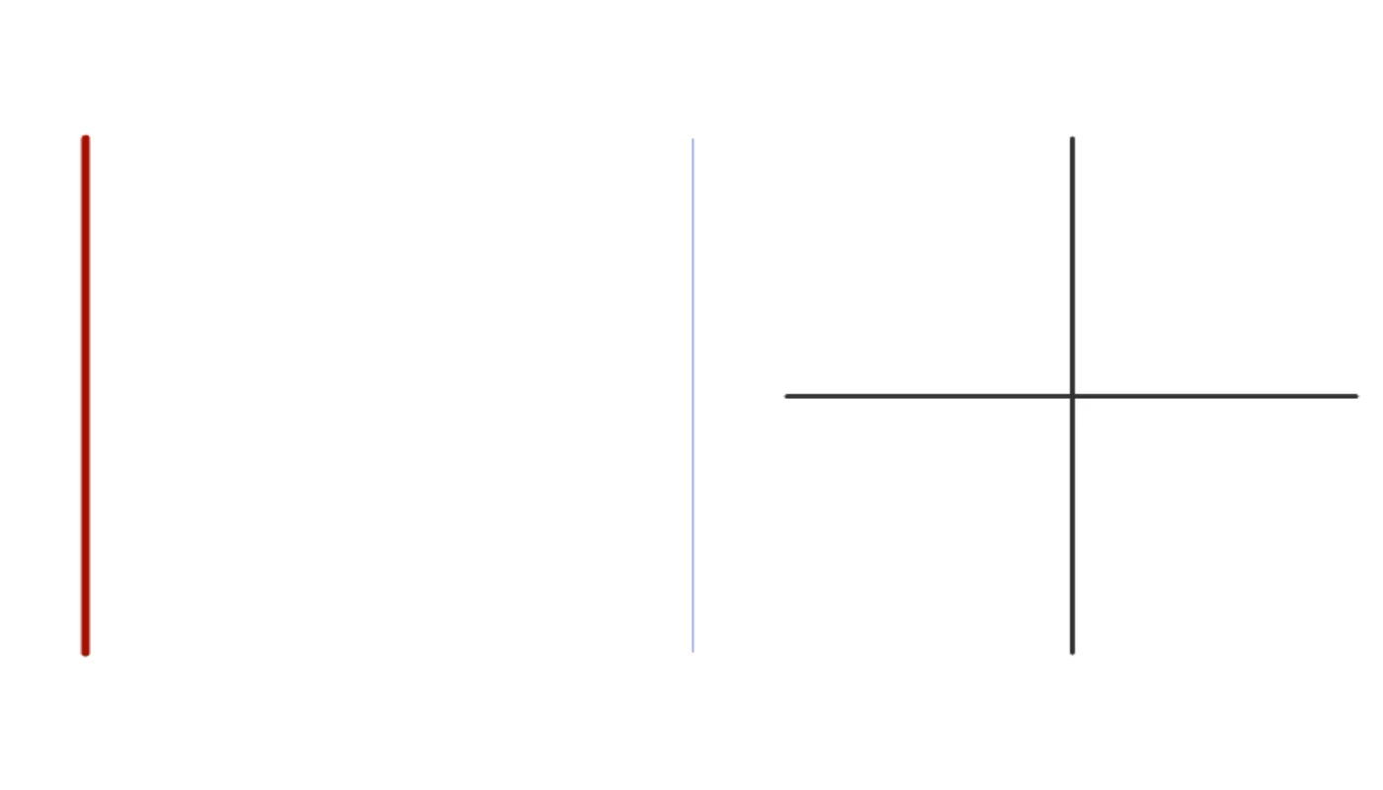
Ray Space
u
s
s
P
u
Notes:
And the argument for sparsity assumes lambertian reflectance, which means that if we have a point in our scene
*all of the rays reflected off of that point will be the same color, and they will form a constant line in rayspace

Slide 61
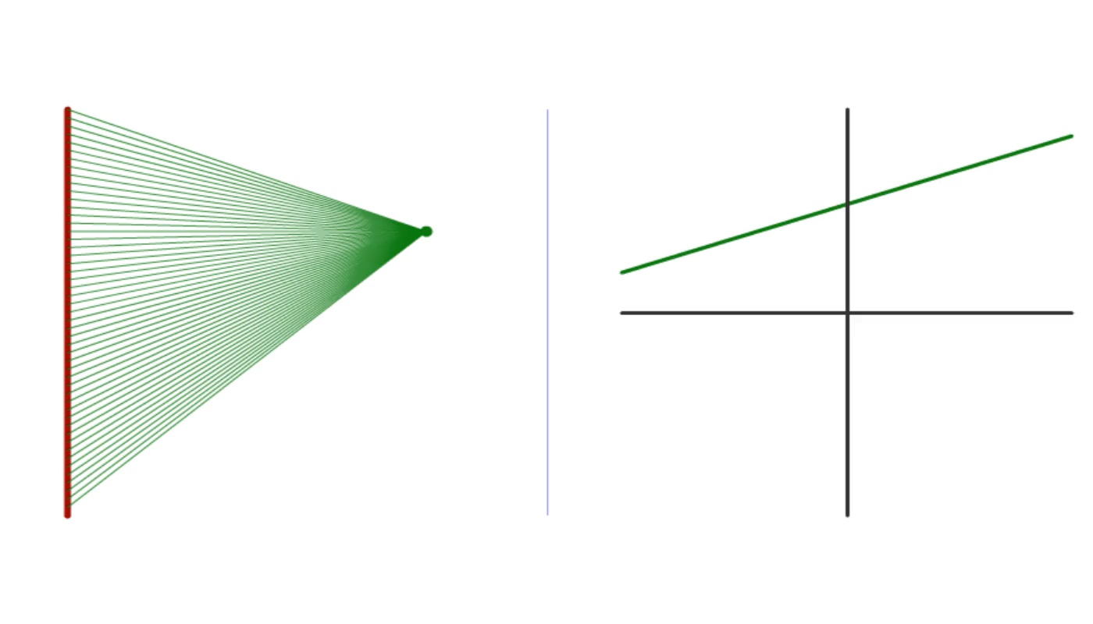
Ray Space
u
s
s
u
Notes:
And if we put our point at a different depth
*this changes the slope of our line in ray space

Slide 62
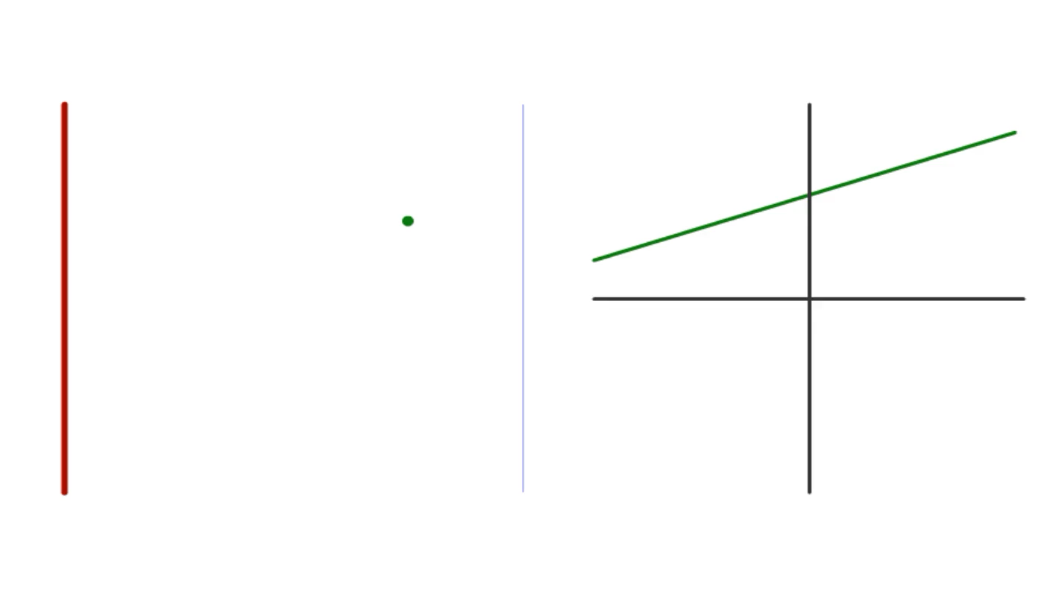
Ray Space
u
s
s
u
Notes:
But sets of points at the same depth have the same slope

Slide 63
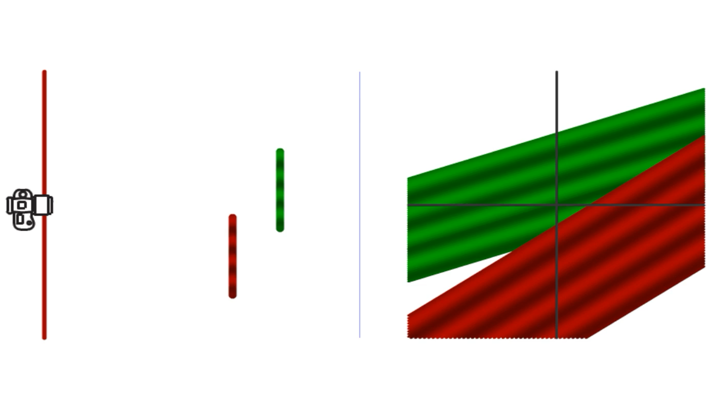
Ray Space
u
s
s
u
Notes:
But sets of points at the same depth have the same slope

Slide 64
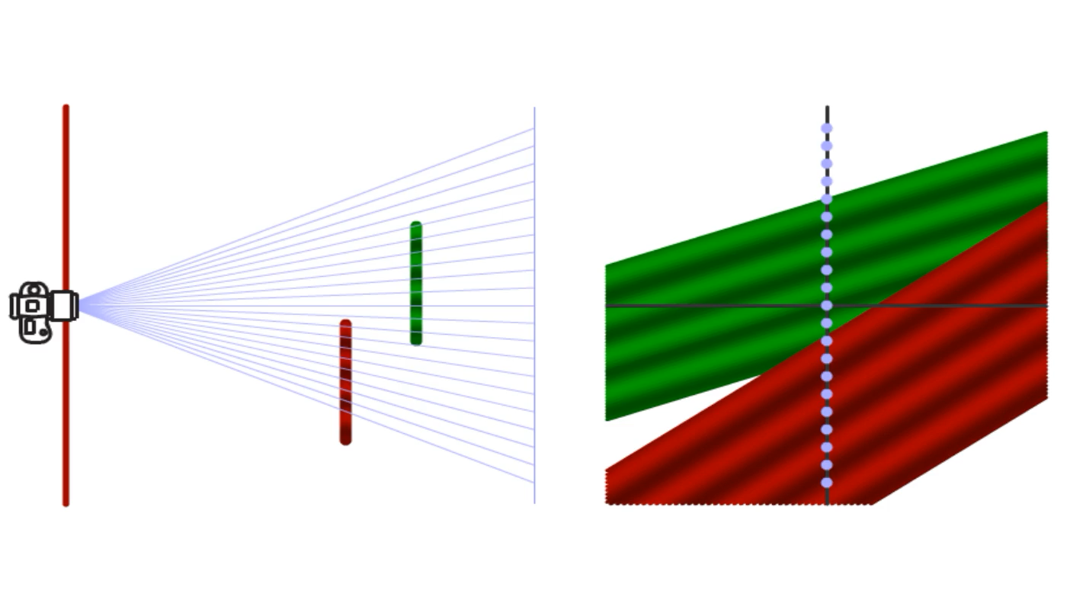
Ray Space
u
s
s
u
Notes:
But sets of points at the same depth have the same slope

Slide 65
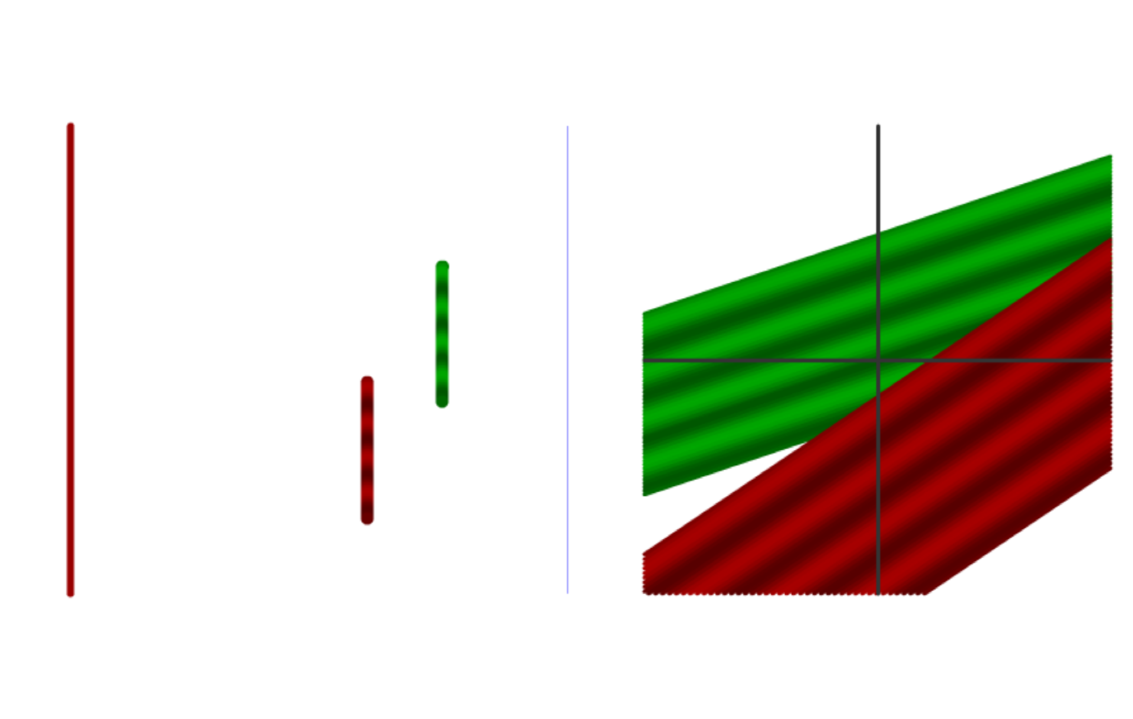
Ray Space
u
s
s
u
Notes:
[So lets say we have two captured views]
[And we want to interpolate between them to get this third view]

Slide 66
Ray Space
u
s
s
u
P

Slide 67
Ray Space
u
s
s
u
Notes:
[If we know all of the depths in the scene we can…]

Slide 68
Ray Space
u
s
s
u
Notes:
[this is effectively the same as projecting each of our captured images onto white surface geometry that matches our scene
and viewing that lit up surface geometry from a new angle]

Slide 69
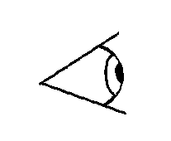
Projection Mapping
Captured Image
Requested
Image
Notes:
So again let’s look at the geometric picture here

Slide 70
Projection Mapping
Captured Image
Requested Image
3D Geometry
Notes:
We’ve captured some picture of our scene
*And we ha

Slide 71
Projection Mapping
Captured Image
Requested Image
3D Geometry

Slide 72
Projection Mapping
Captured Image
Isotropy
Requested Image
3D Geometry
Notes:
If you assume that surfaces are relatively diffuse

Slide 73
Projection Mapping
Captured Image
Requested Image
3D Geometry
Notes:
Then you can just render this textured model from a new view

Slide 74
Projection Mapping
Captured Image
Requested Image
3D Geometry
Notes:
And you get your new image.

Slide 75
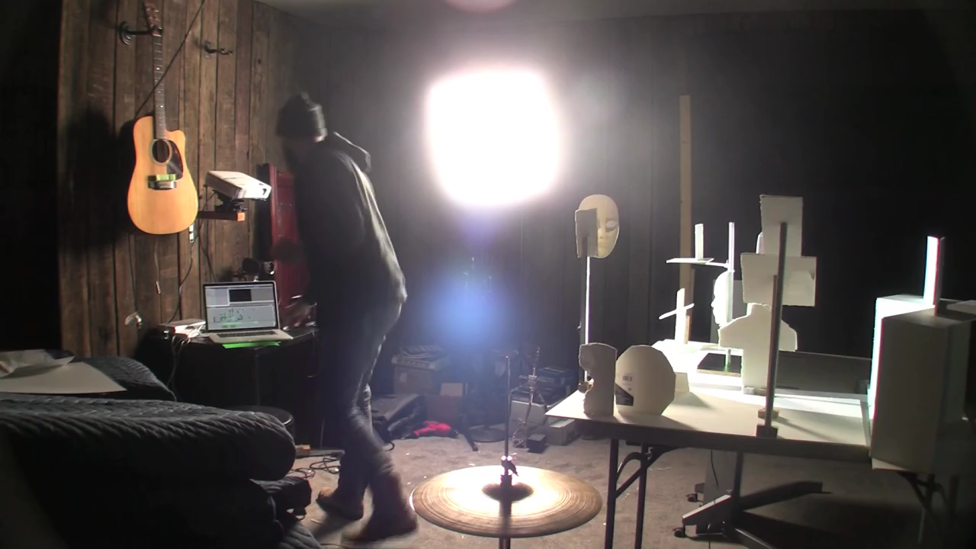

Slide 76
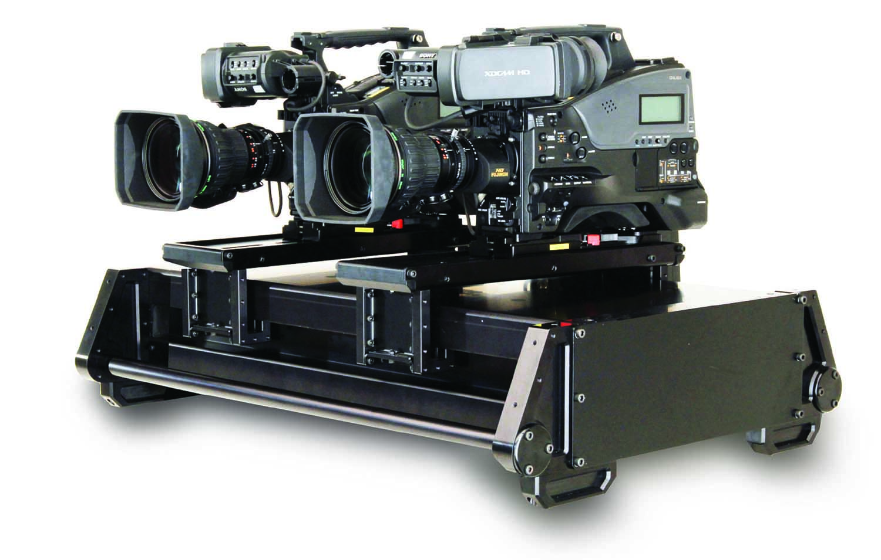
Ray Space
s
u
Stereo
Notes:
And to be clear, this means that if your scene is nice and simple and diffuse, you can often capture it with a simple stereo pair of cameras
Which is super efficient

Slide 77
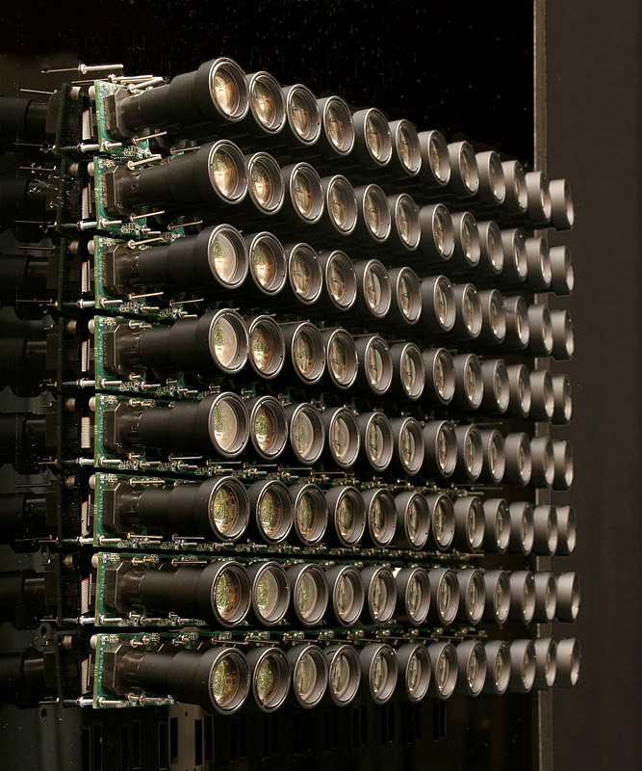
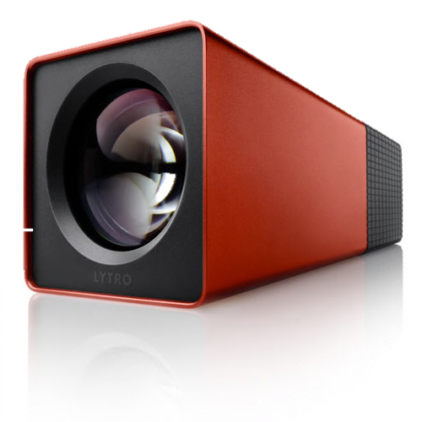
Ray Space
s
Camera Array
u
Lytro
Notes:
Which is effectively the strategy of camera arrays and the lytro camera

Slide 78
Capture Strategies
s
Camera Array
u
Stereo
Rely more on sampling
Lytro
Rely more on geometry
Notes:
So most approaches to light field capture can be placed on a
*spectrum of how much they rely on sampling vs geometry
Where devices like lytro sit at one costly but robust extreme
And a simple stereo pair of cameras sits at the other cheap but brittle extreme
And it’s been hard to break out of this spectrum, because in order to do that you need some kind of prior
That captures a lot of the redundancy in light fields without making restrictive assumptions like diffuse reflection

Slide 79

What happens when we don’t know geometry?

Slide 80
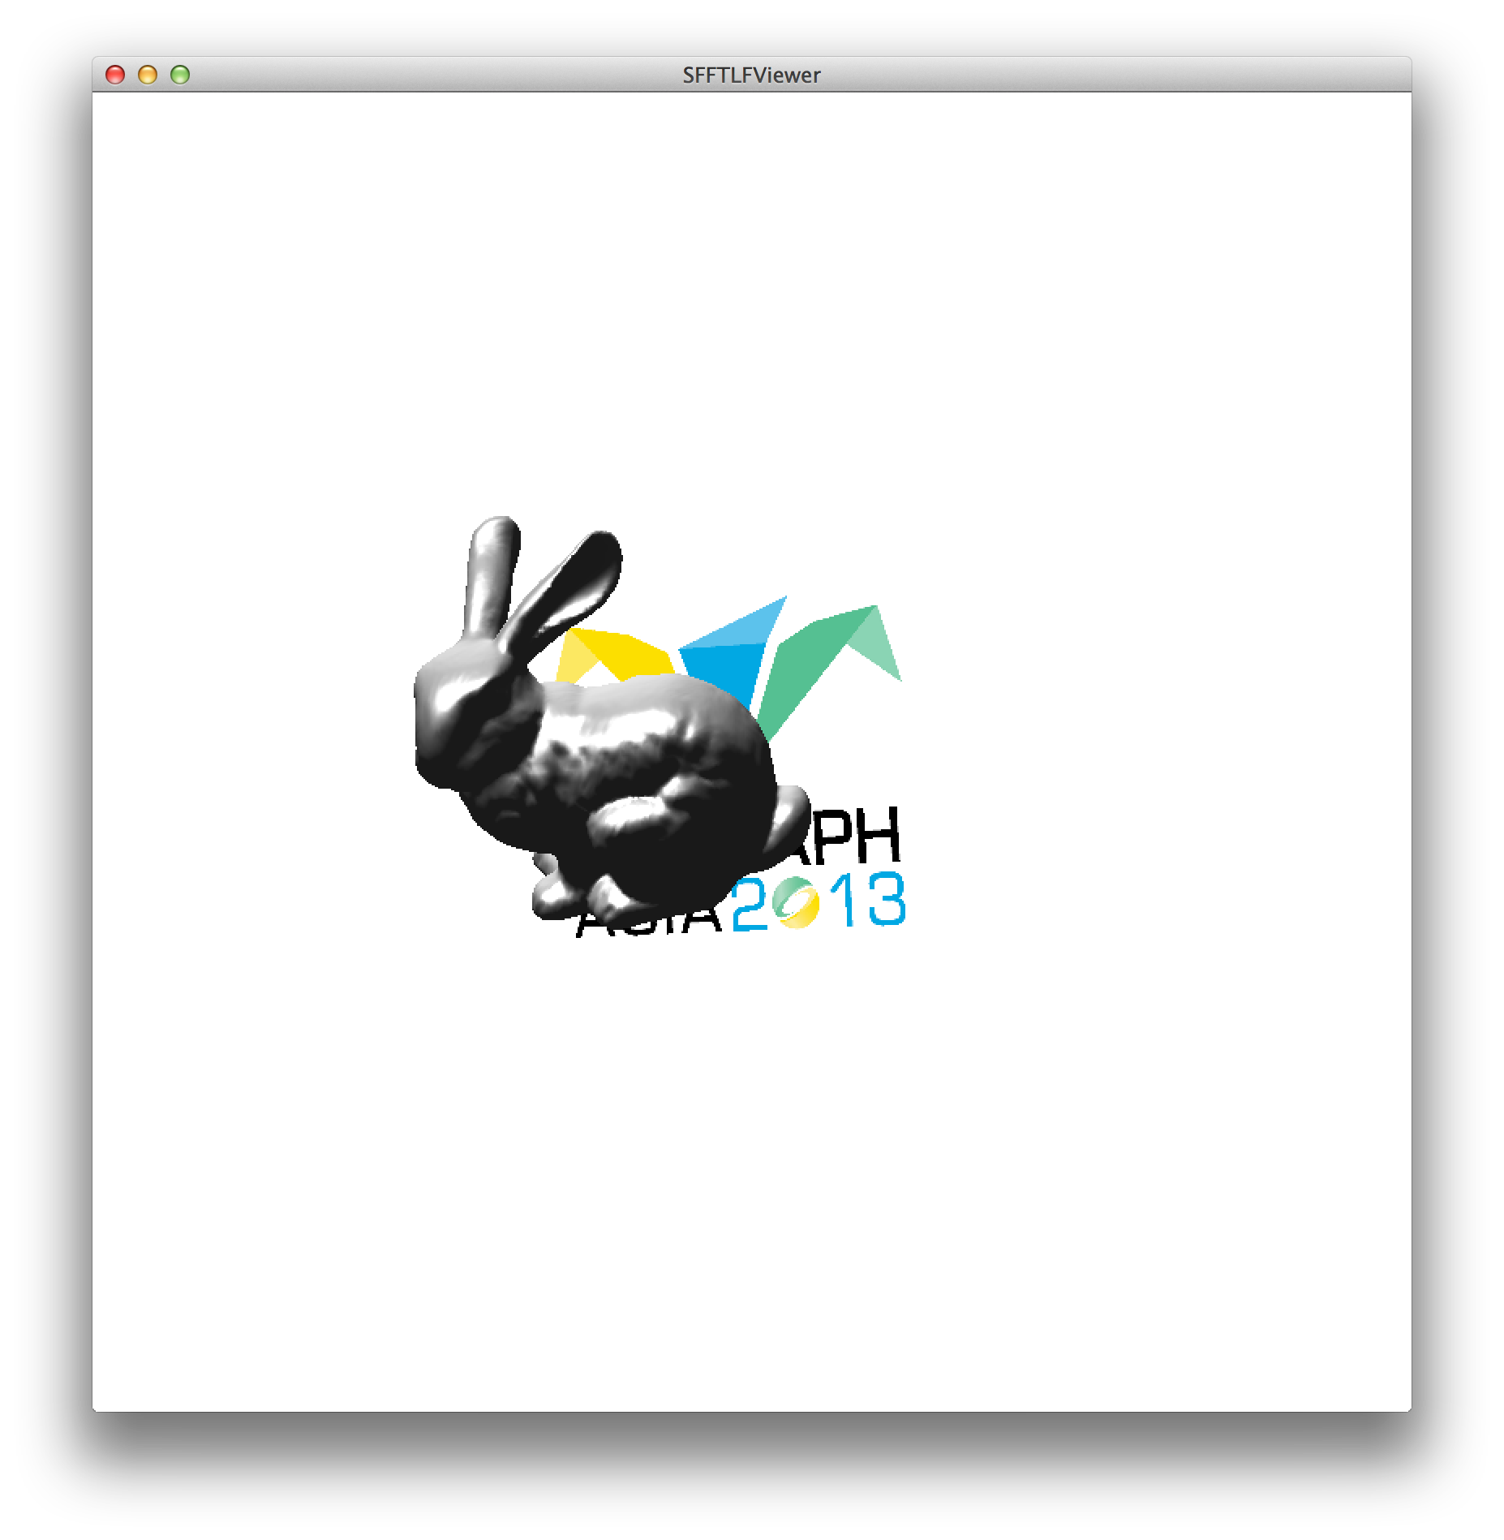


What happens when we don’t know geometry?
Notes:
(Take these three images, align them in 2D
If I focus on bunny, they align on bunny)

Slide 81


What happens when we don’t know geometry?

Slide 82

What happens when we don’t know geometry?

Slide 83
What happens when we don’t know geometry?

Slide 84
What happens when we don’t know geometry?

Slide 86
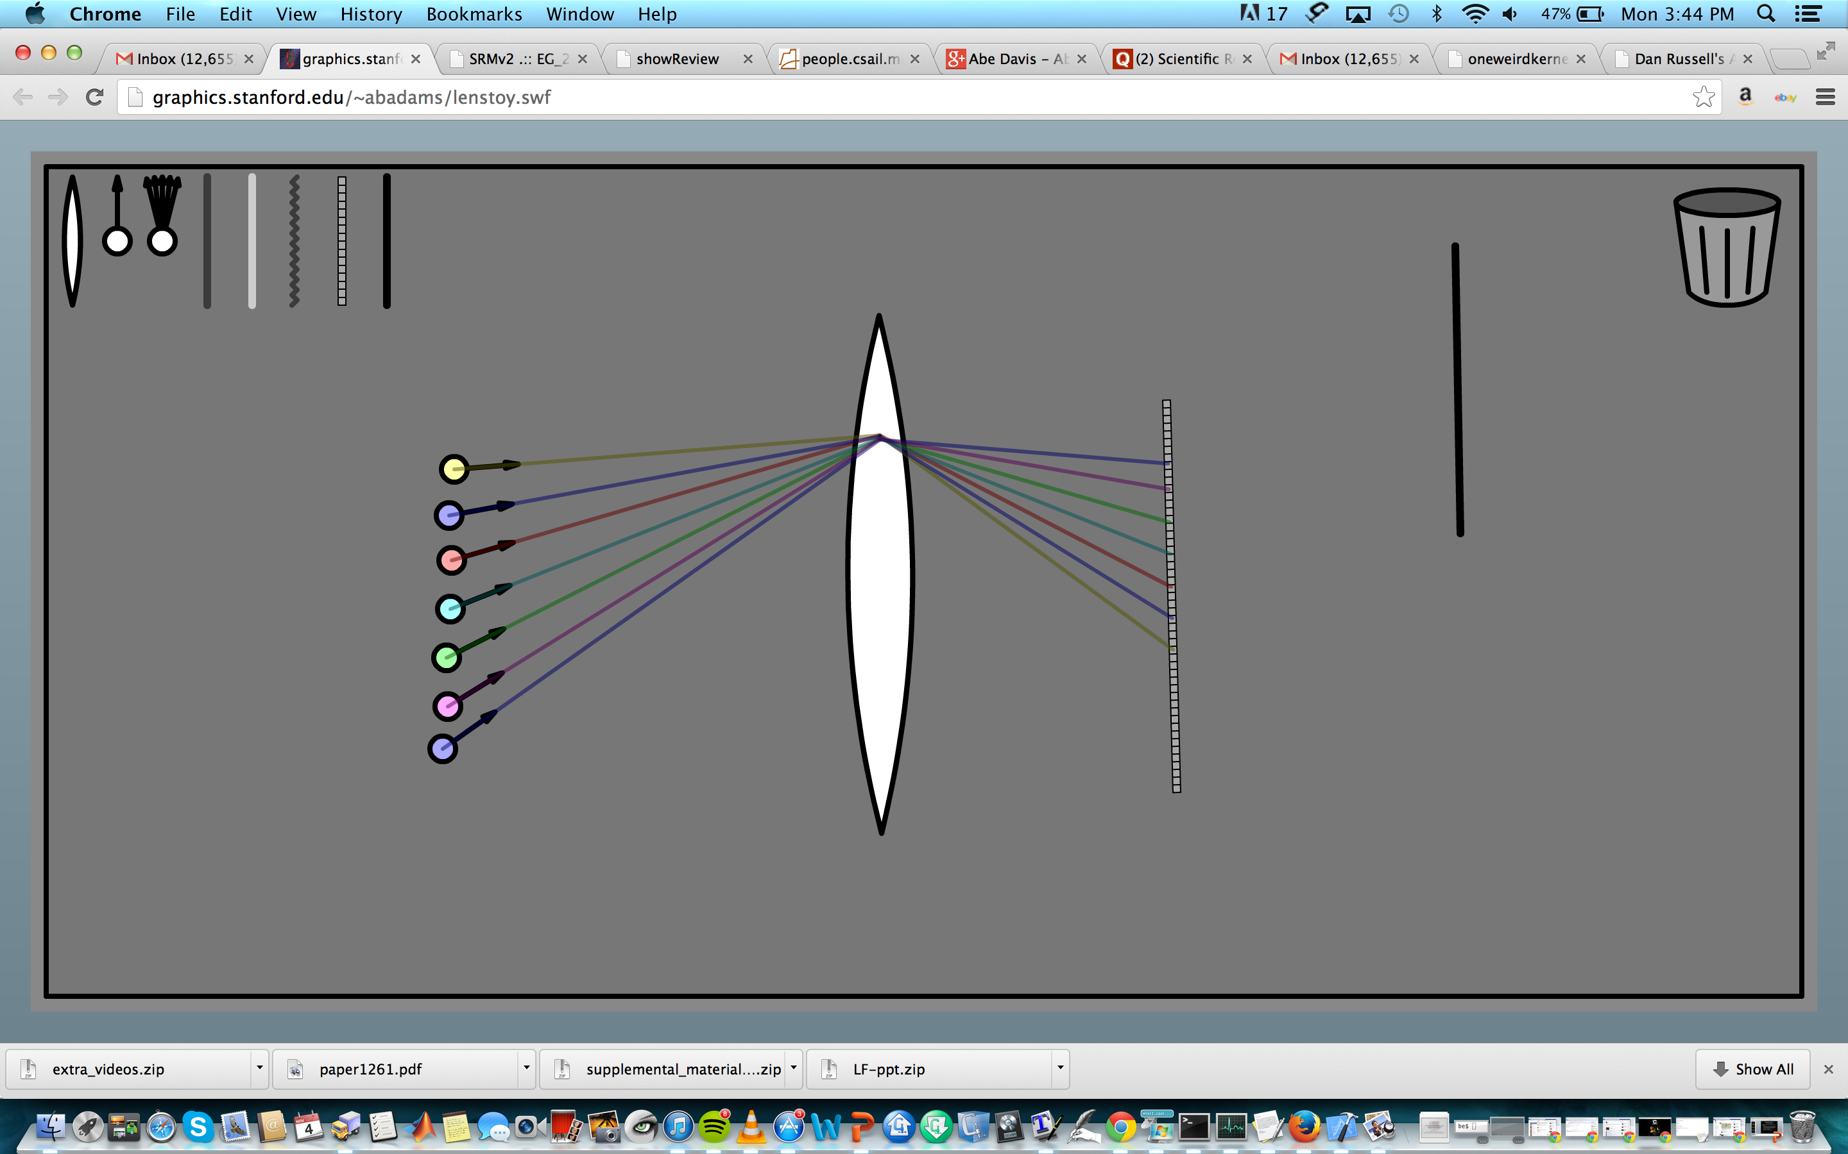

Slide 87
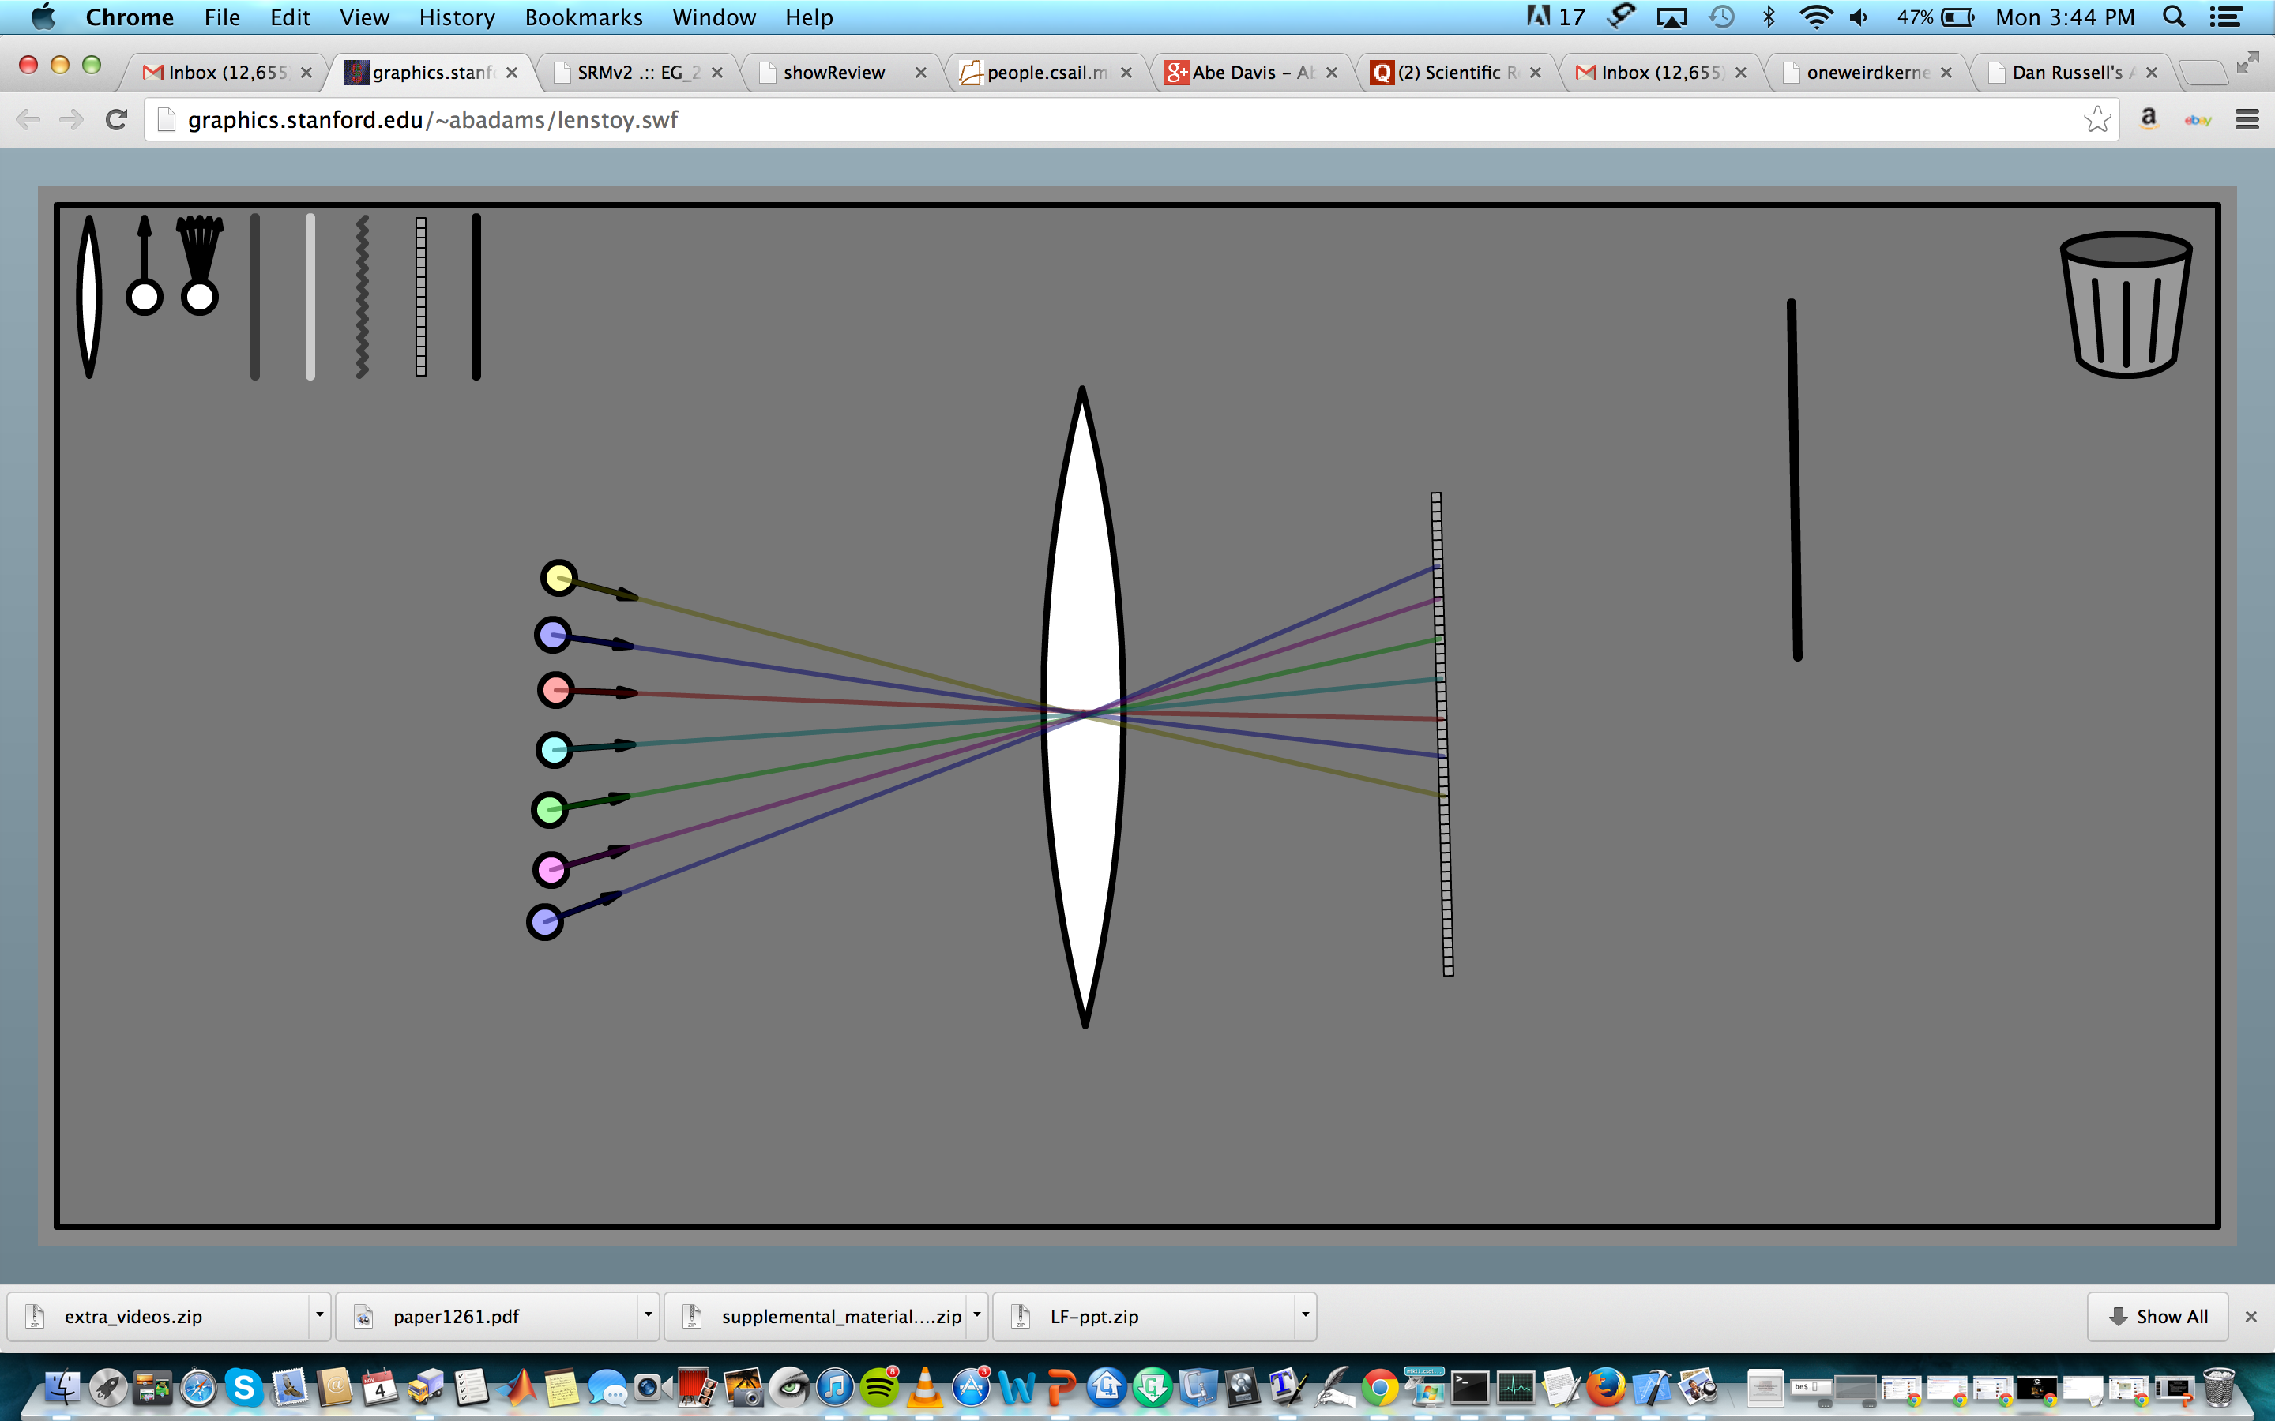

Slide 88
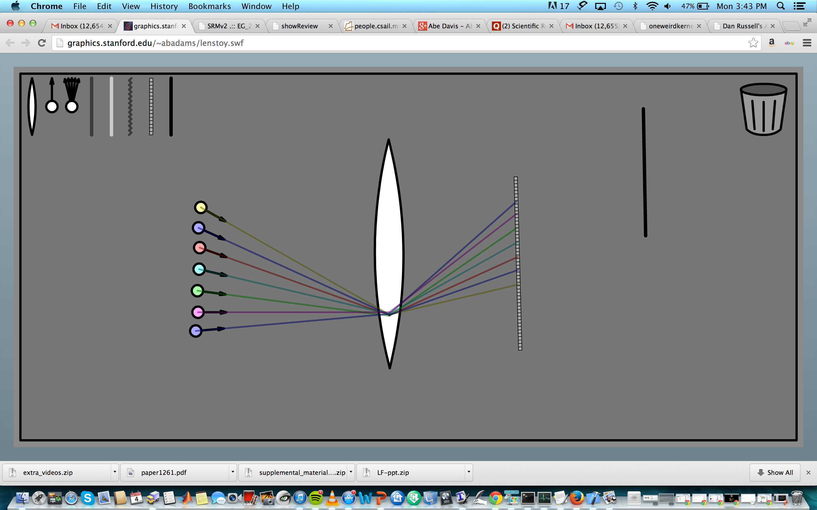

Slide 94
Notes:
Because we’re projecting them all onto the same sensor, it’s like adding them together

Slide 96
Notes:
And if we’re in focus (go back over)

Slide 97
Notes:
But if we’re out of focus…

Slide 100
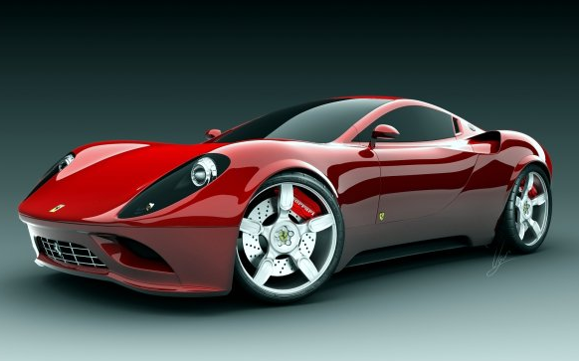
Ray Space
u
s
s
u
Notes:
But most of the world isn’t nice and simple and diffuse.
Most things are at least a little glossy, or transparent, or something
For instance,
*take this gratuitously shiny sports car.
If we look at it’s light field we’re going to see something like this

Slide 101
Ray Space
u
s
s
u
Notes:
And even if these specular highlights don’t throw off our depth from stereo algorithm (which they often will)
*our connect the dots strategy isn’t really going to work anymore

Slide 102
Ray Space
u
s
s
u
Notes:
So for the most part, there’s been one successful strategy for capturing these kinds of scenes
And that is
*very
*dense
*sampling

Slide 103
Ray Space
s
Camera Array
u
Lytro
Notes:
Which is effectively the strategy of camera arrays and the lytro camera

Slide 104
Capture Strategies
s
Camera Array
u
Stereo
Rely more on sampling
Lytro
Rely more on geometry
Notes:
So most approaches to light field capture can be placed on a
*spectrum of how much they rely on sampling vs geometry
Where devices like lytro sit at one costly but robust extreme
And a simple stereo pair of cameras sits at the other cheap but brittle extreme
And it’s been hard to break out of this spectrum, because in order to do that you need some kind of prior
That captures a lot of the redundancy in light fields without making restrictive assumptions like diffuse reflection

Slide 105
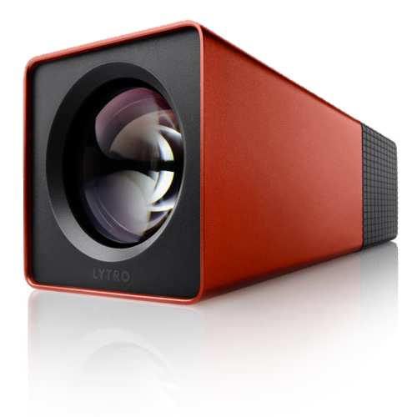
Specialized Devices
Scene
Camera Array
Lytro
Notes:
And certainly, for the dense sampling approach, it makes sense to use specialized devices
/////
So at the end of the day, efficient light field capture is all about interpolating between images
But before we can do that we need a suitible space to interpolate in

