Slide 1
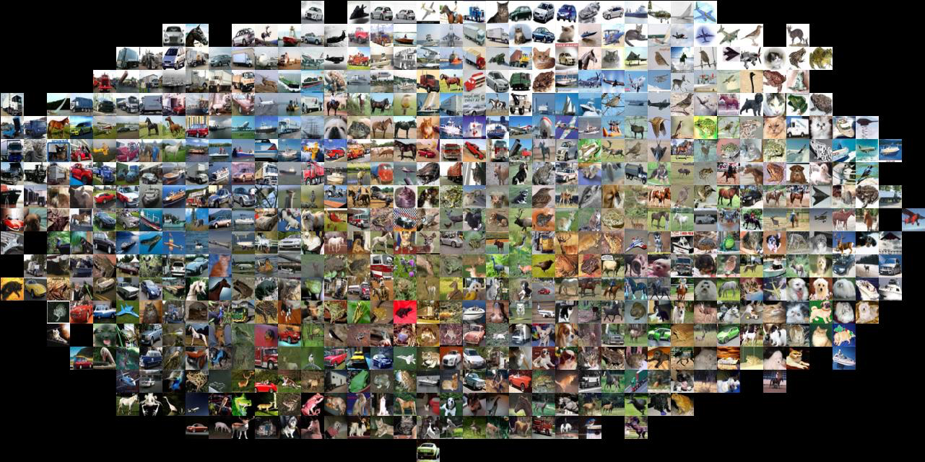
Image Classification
CS5670: Computer Vision
Noah Snavely
Slides from Fei-Fei Li, Justin Johnson, Serena Yeung
http://vision.stanford.edu/teaching/cs231n/

Slide 2
Announcements
Project 4 due today
Project 5 to be released soon
Quiz 4 this Wednesday (4/24) (1st 10 minutes)
Will cover material since last quiz (photometric stereo, multi-view stereo, structure from motion, image classification (today’s lecture))
Guest lecture next Monday, 4/29, Jin Sun
Generative Adversarial Networks (GANs)
Wednesday’s lecture: Convolutional Neural Networks

Slide 3
Today
Image classification pipeline
Training, validation, testing
Nearest neighbor classification
Linear classification
Building up to CNNs for learning
Next four lectures on deep learning

Slide 4
References
Stanford CS231N
http://cs231n.stanford.edu/

Slide 5
Where to from here?
Scene Understanding
Big data – lots of images
Crowd sourcing – lots of people
Deep Learning – lots of compute

Slide 6
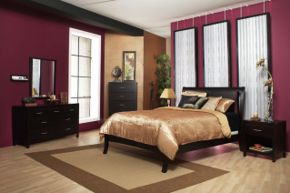
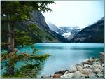
Image categorization
Training
Training Images
Training Labels
Image Features
Classifier Training
Trained Classifier

Slide 7
What matters in recognition?
Machine learning methods (e.g., linear classification, deep learning)
Representation (e.g., SIFT, HoG, deep learned features)
Data (e.g., PASCAL, ImageNet, COCO)

Slide 8
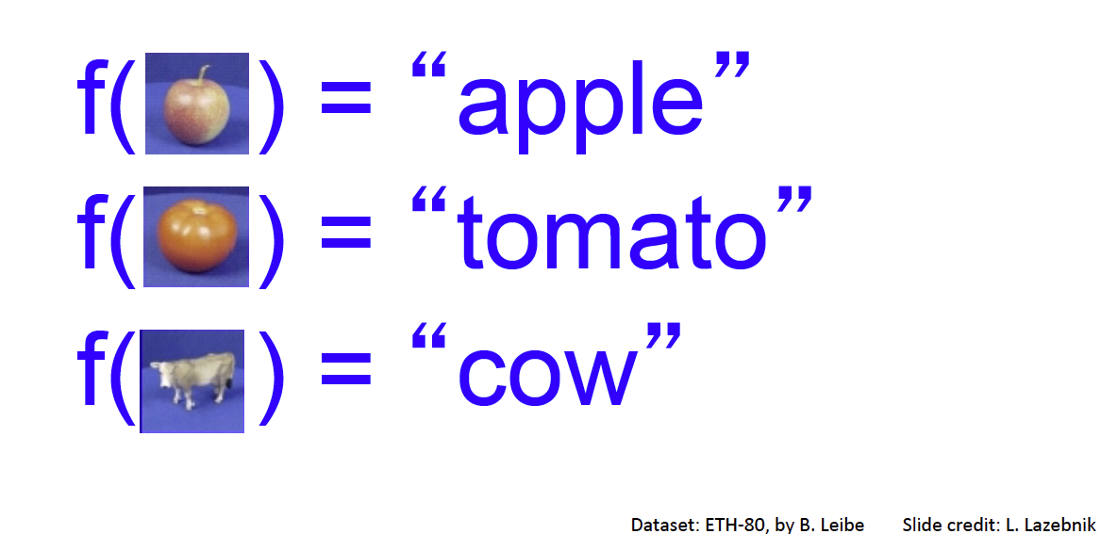
Image Classification: A core task in Computer Vision
Assume given set of discrete labels, e.g. {cat, dog, cow, apple, tomato, truck, … }

Slide 9
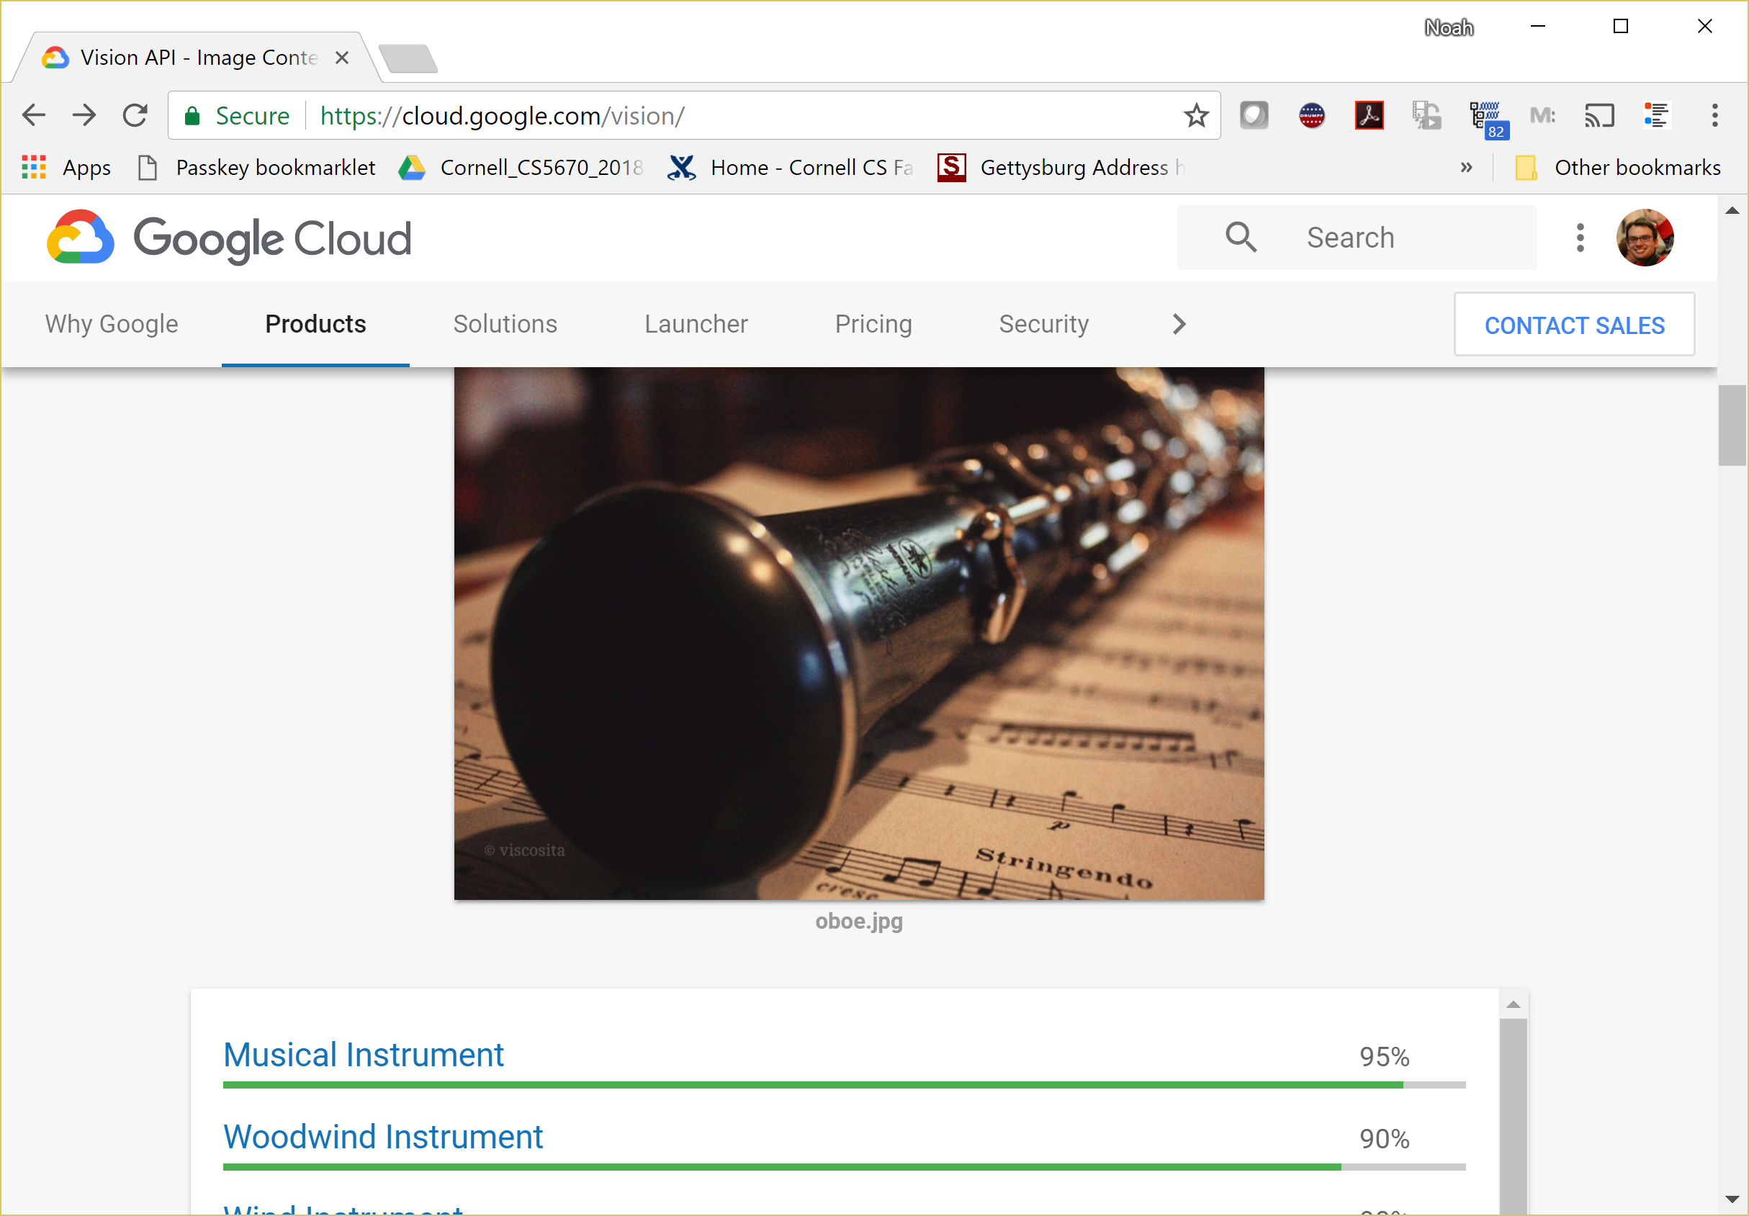
Image classification demo
https://cloud.google.com/vision/
See also:
https://aws.amazon.com/rekognition/
https://www.clarifai.com/
https://azure.microsoft.com/en-us/services/cognitive-services/computer-vision/
…

Slide 10
Slide credit: Fei-Fei Li & Justin Johnson & Serena Yeung

Slide 13
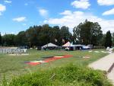
Image Categorization
Training
Training Images
Training Labels
Image Features
Classifier Training
Trained Classifier
Testing
Image Features
Trained Classifier
Prediction
Outdoor
Test Image

Slide 14
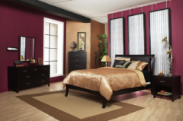
Crowdsourcing
Unlabeled Images
Show images,
Collect and filter labels
Training Labels
Training Images
Image Features
Classifier Training
Trained Classifier
Training

Slide 16
Deep Learning (or convnets, CNNs)
Since 2012, huge impact, best results
Can soak up all the data for better prediction

Slide 17
Image Classification
Slides from Andrej Karpathy and Fei-Fei Li
http://vision.stanford.edu/teaching/cs231n/

Slide 18
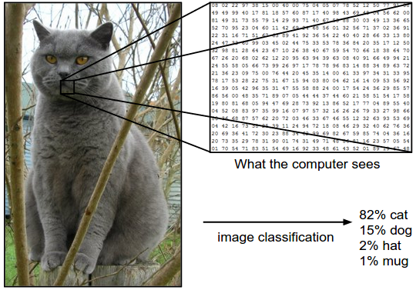
Image Classification: Problem

Slide 20
Slide credit: Fei-Fei Li & Justin Johnson & Serena Yeung

Slide 21
Data-driven approach
Collect a database of images with labels
Use ML to train an image classifier
Evaluate the classifier on test images
Slides from Andrej Karpathy and Fei-Fei Li
http://vision.stanford.edu/teaching/cs231n/

Slide 22
Data-driven approach
Collect a database of images with labels
Use ML to train an image classifier
Evaluate the classifier on test images
Slides from Andrej Karpathy and Fei-Fei Li
http://vision.stanford.edu/teaching/cs231n/

Slide 23
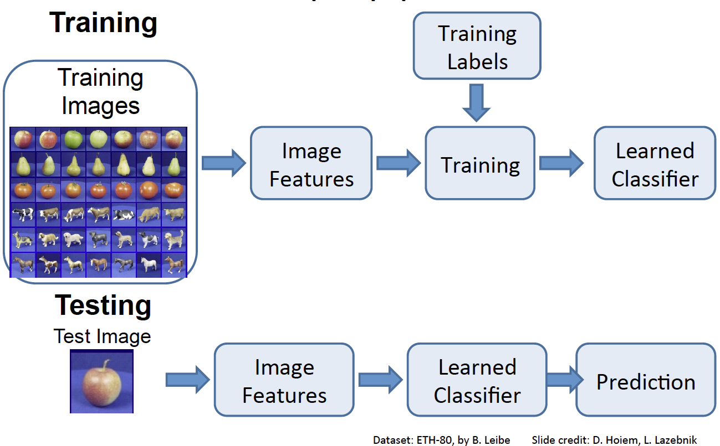

Slide 25
Classifiers
Nearest Neighbor
kNN (“k-Nearest Neighbors”)
Linear Classifier
Neural Network
Deep Neural Network
…

Slide 26
First: Nearest Neighbor (NN) Classifier
Train
Remember all training images and their labels
Predict
Find the closest (most similar) training image
Predict its label as the true label

Slide 28
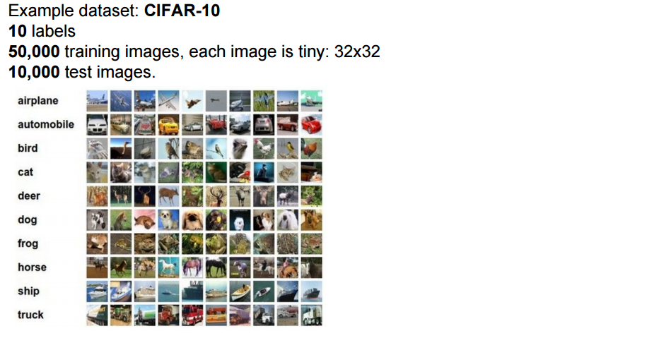
CIFAR-10 and NN results

Slide 29
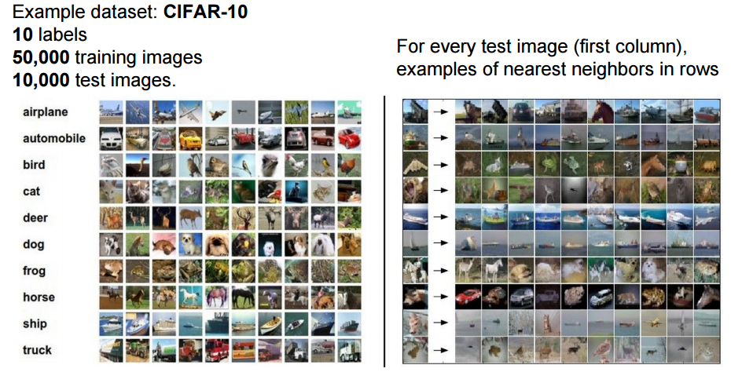
CIFAR-10 and NN results
Slides from Andrej Karpathy and Fei-Fei Li
http://vision.stanford.edu/teaching/cs231n/

Slide 30
k-nearest neighbor
Find the k closest points from training data
Take majority vote from K closest points

Slide 33
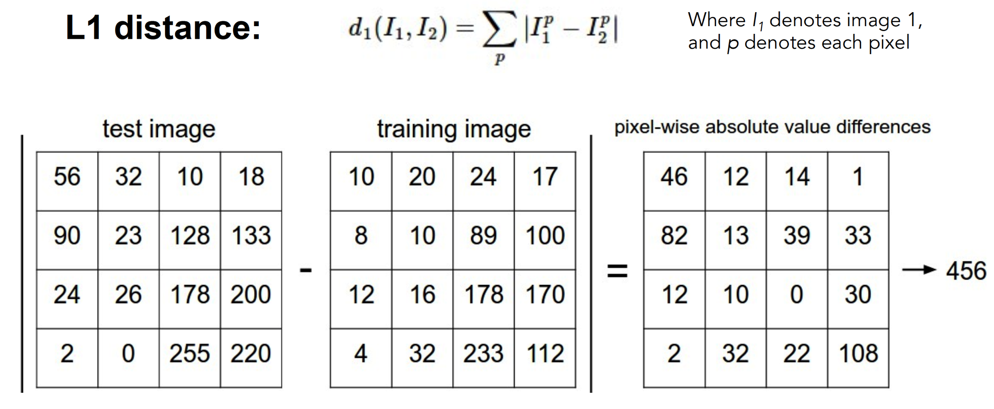
How to find the most similar training image? What is the distance metric?
Slides from Andrej Karpathy and Fei-Fei Li
http://vision.stanford.edu/teaching/cs231n/

Slide 34
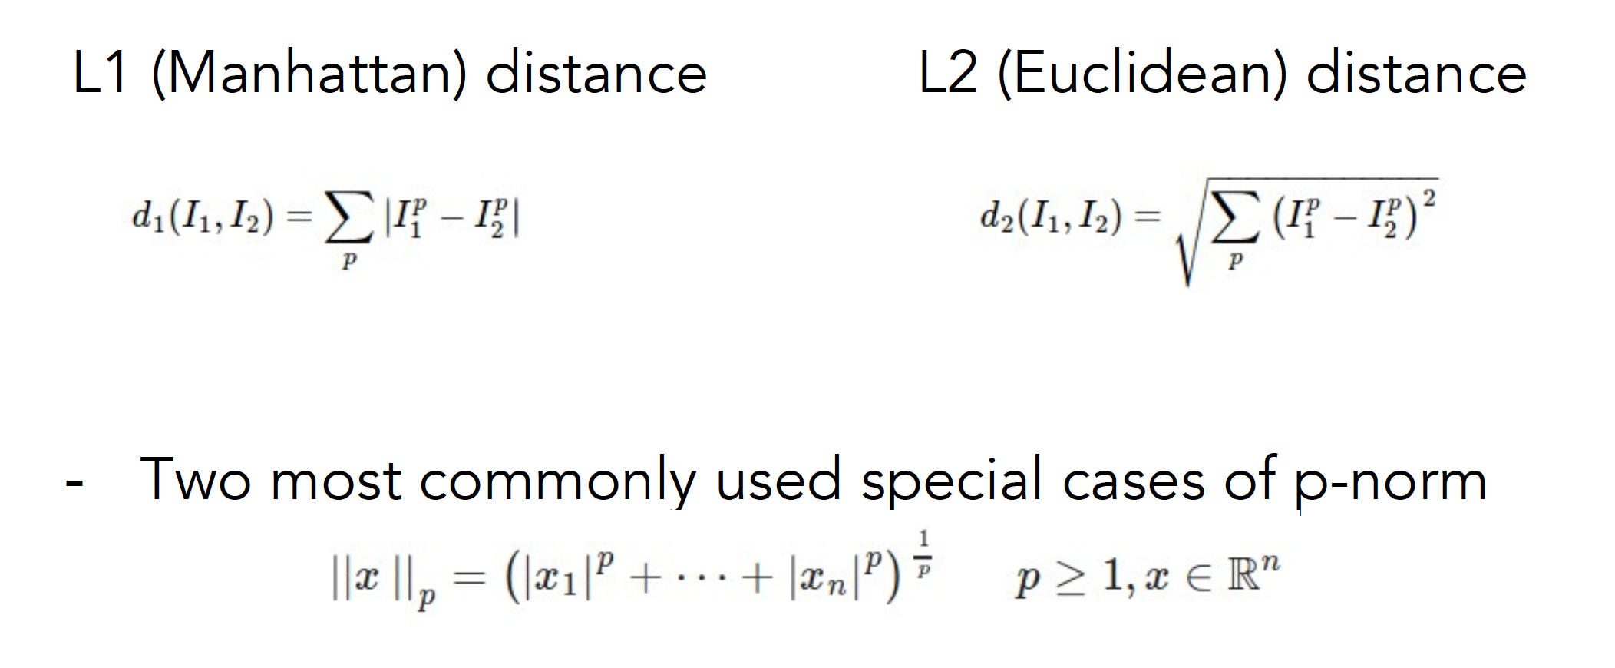
Choice of distance metric
Hyperparameter
Slides from Andrej Karpathy and Fei-Fei Li
http://vision.stanford.edu/teaching/cs231n/

Slide 36
Demo: http://vision.stanford.edu/teaching/cs231n-demos/knn/

Slide 37
Visualization: L2 distance
Notes:
Background plays an unrealistically large role

Slide 38
Hyperparameters

Slide 39
Hyperparameters
What is the best distance to use?
What is the best value of k to use?
These are hyperparameters: choices about the algorithm that we set rather than learn
How do we set them?
One option: try them all and see what works best

Slide 46
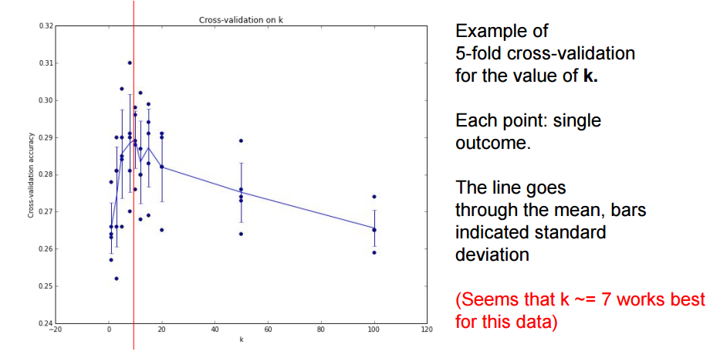

Slide 47
Recap: How to pick hyperparameters?
Methodology
Train and test
Train, validate, test
Train for original model
Validate to find hyperparameters
Test to understand generalizability

Slide 48
kNN -- Complexity and Storage
N training images, M test images
Training: O(1)
Testing: O(MN)
Hmm…
Normally need the opposite
Slow training (ok), fast testing (necessary)

Slide 50
k-Nearest Neighbors: Summary
In image classification we start with a training set of images and labels, and must predict labels on the test set
The K-Nearest Neighbors classifier predicts labels based on nearest training examples
Distance metric and K are hyperparameters
Choose hyperparameters using the validation set; only run on the test set once at the very end!

Slide 51
Linear classifiers

Slide 52
Instead
Image classification using linear classifiers
Need
Score function: raw data to class scores
Loss function: agreement between predicted scores and ground truth labels

Slide 53
Score function
Slides from Andrej Karpathy and Fei-Fei Li
http://vision.stanford.edu/teaching/cs231n/

Slide 54
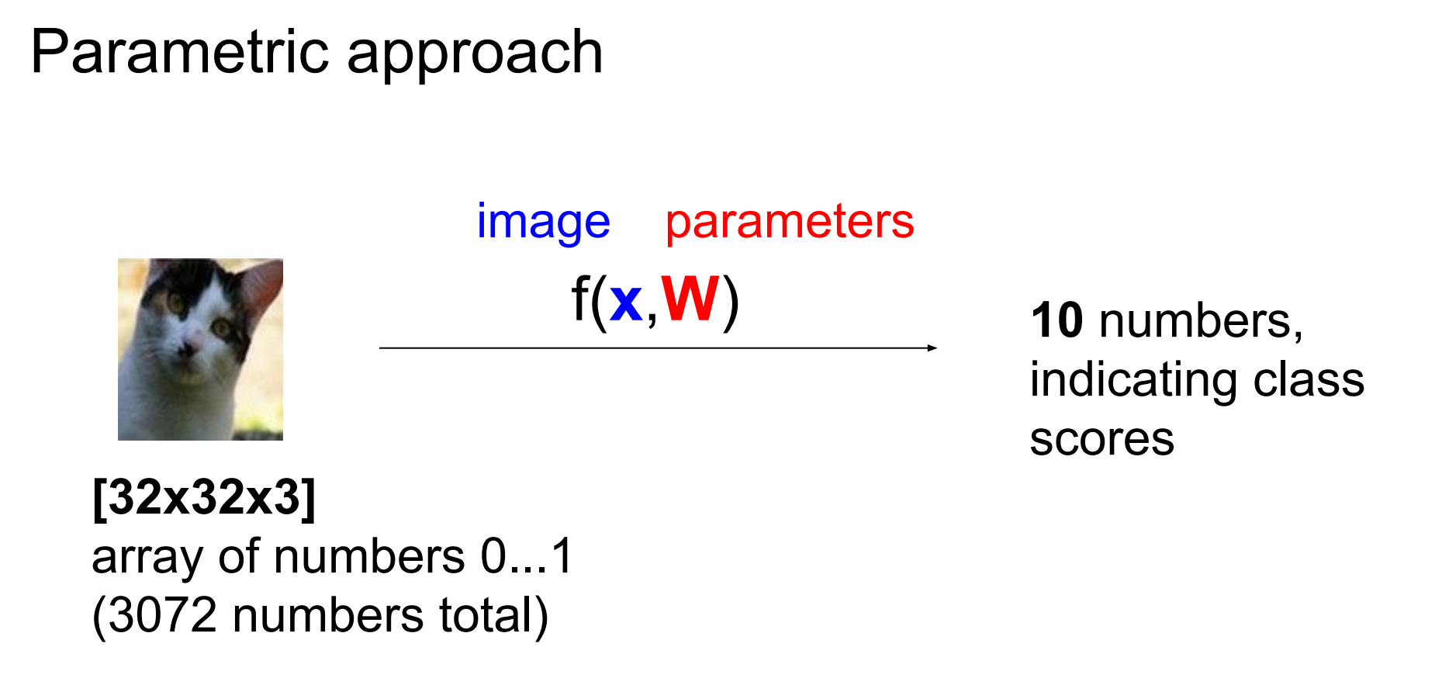
Score function: f

Slide 55
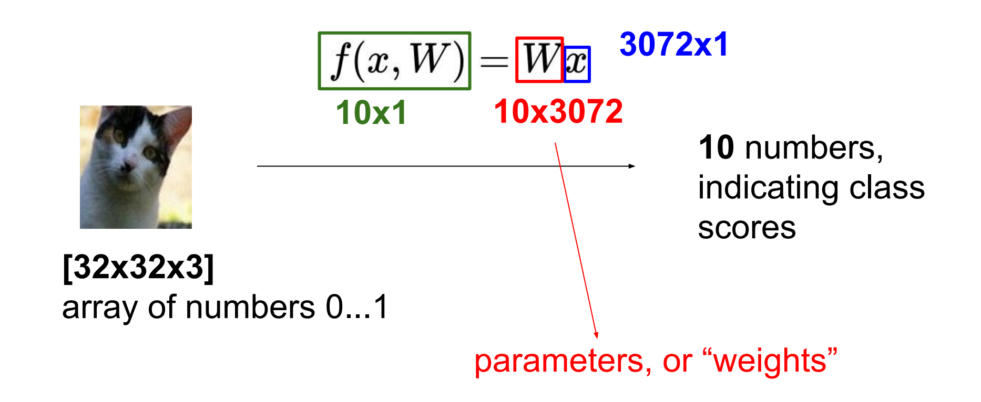
Parametric approach: Linear classifier

Slide 56
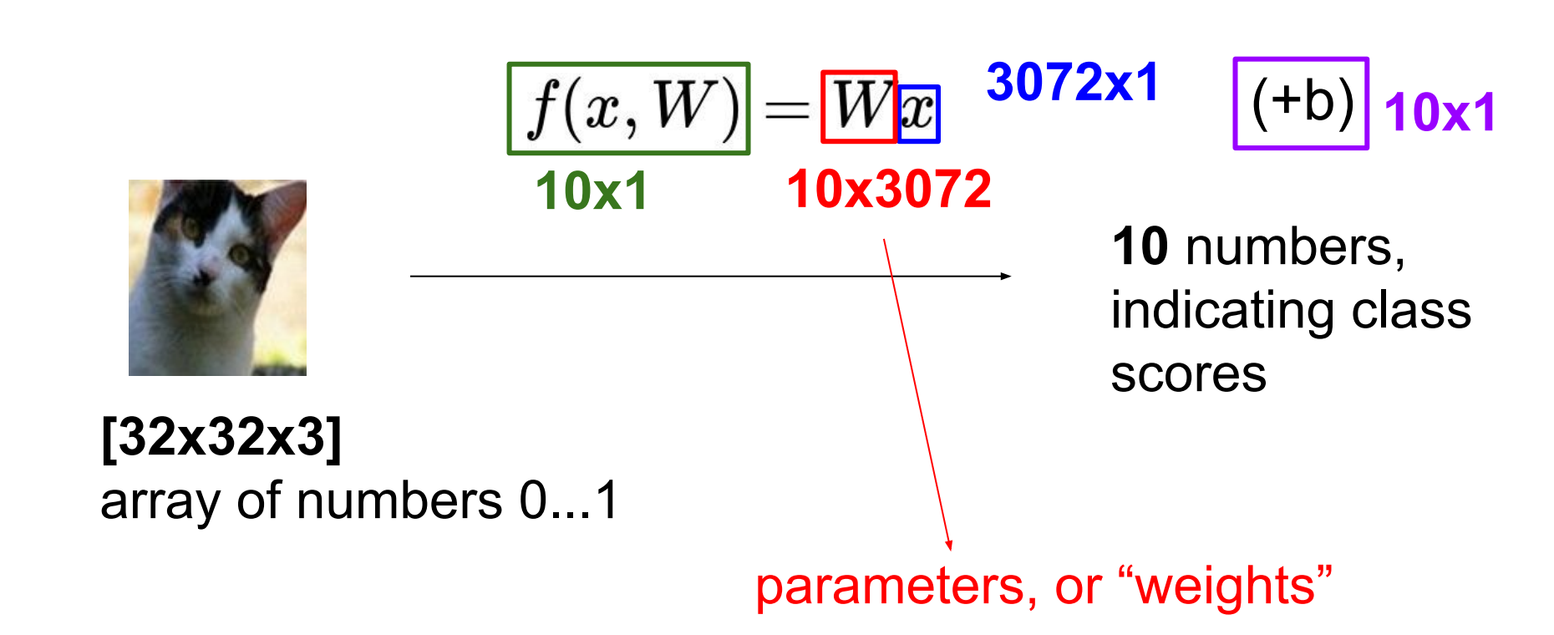
Parametric approach: Linear classifier

Slide 57
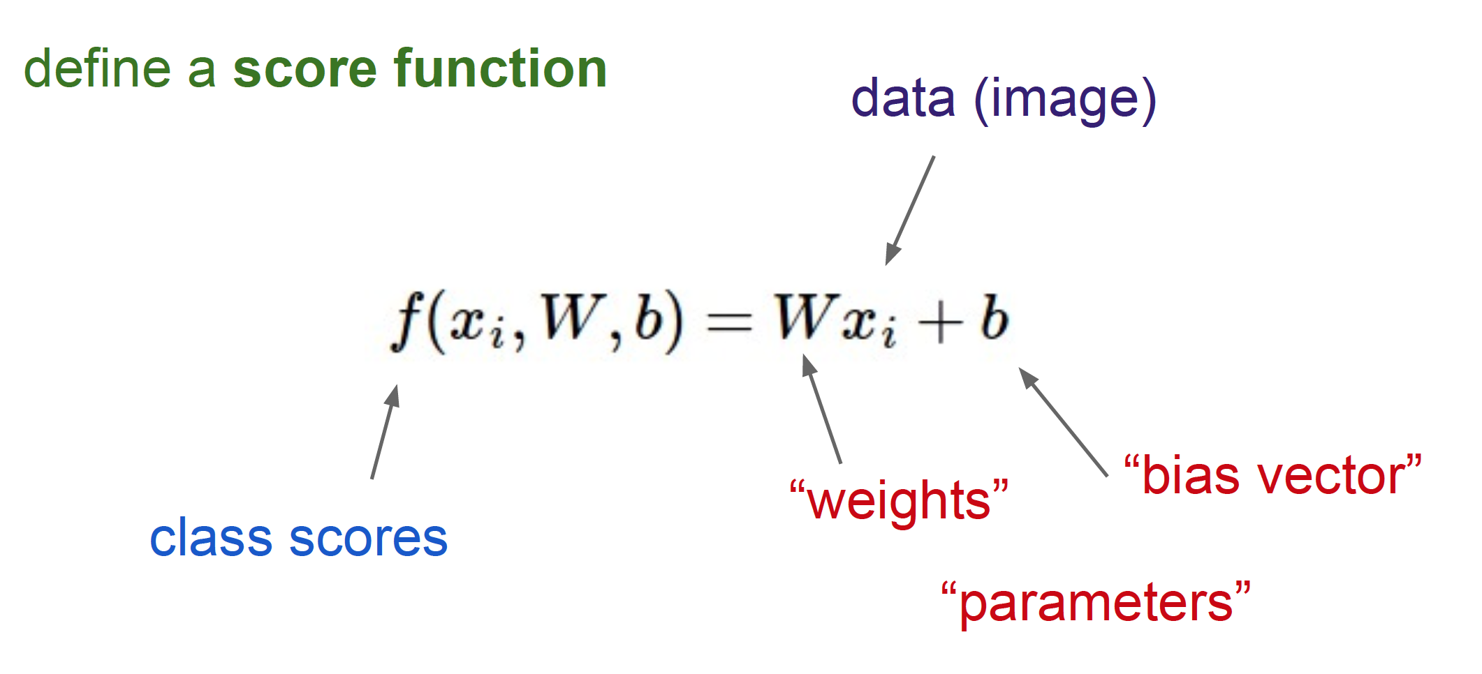
Linear Classifier

Slide 58
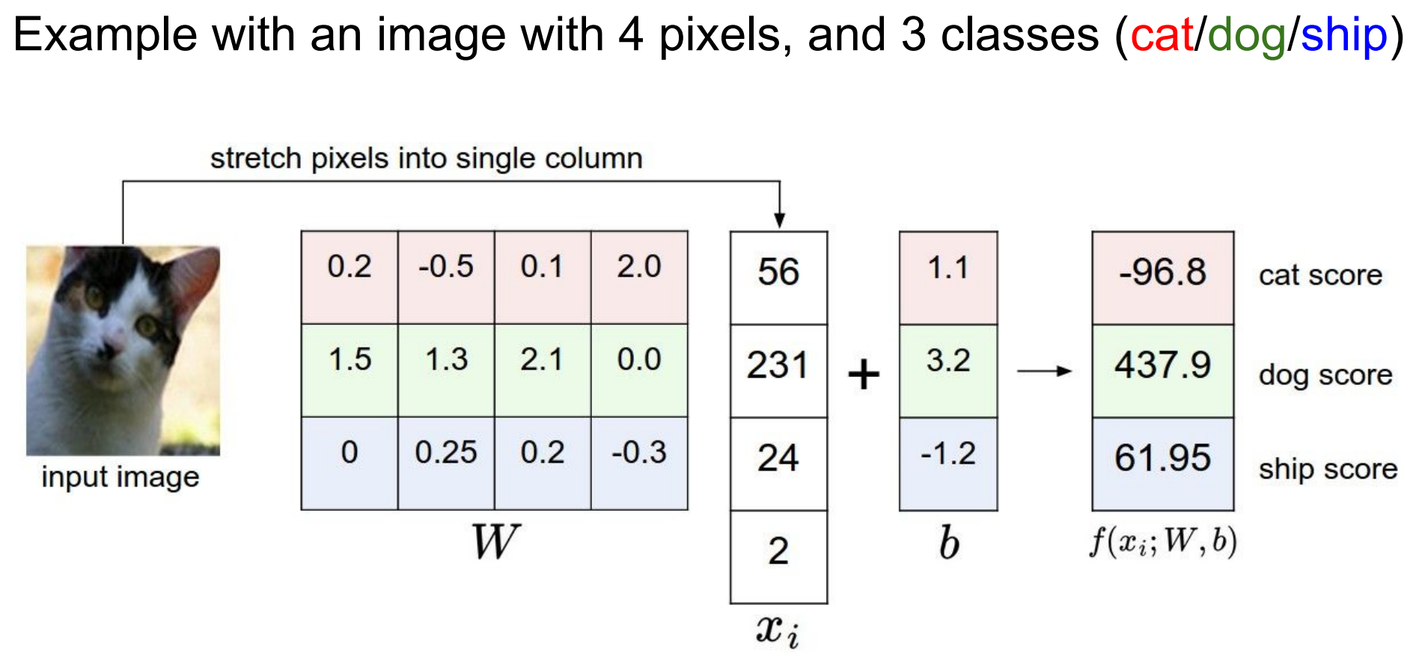

Slide 59
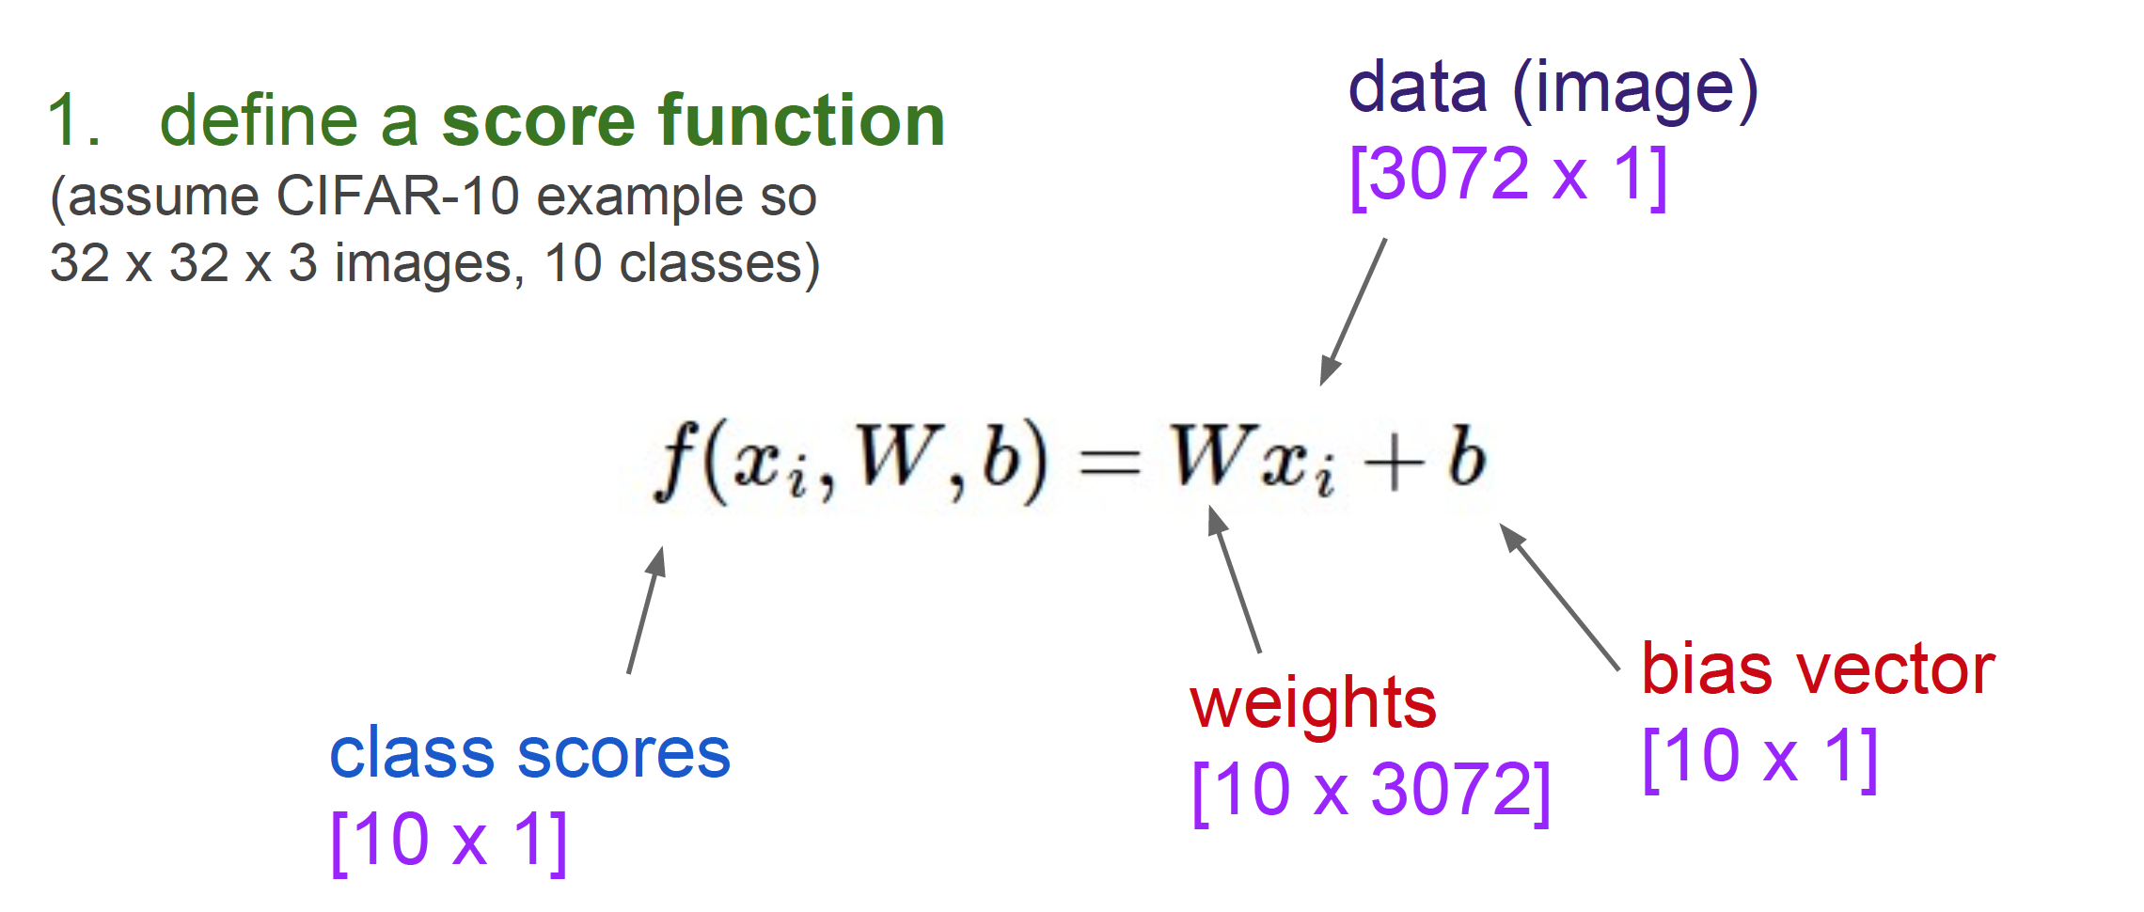
Linear Classifier

Slide 60
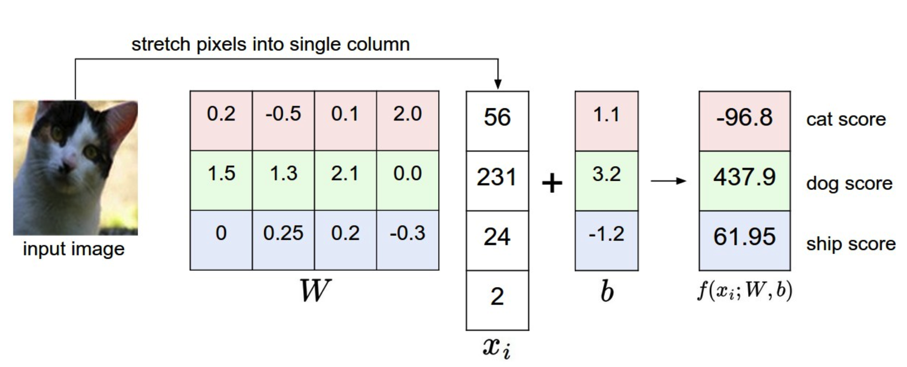
Computing scores
Notes:
This is a bad cat score

Slide 61
Interpretation: Template matching
Notes:
Each row of W is a template for that class

Slide 62
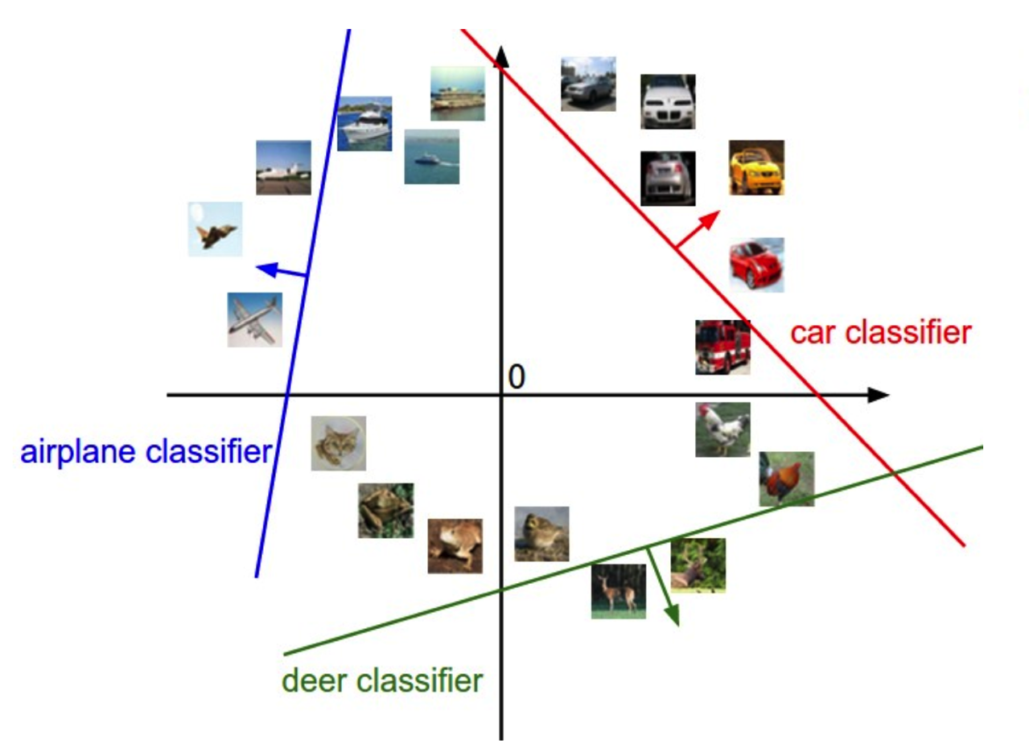
Geometric Interpretation

Slide 63
Linear classifiers
Find linear function (hyperplane) to separate positive and negative examples
Which hyperplane is best? We will come back to this later

Slide 64
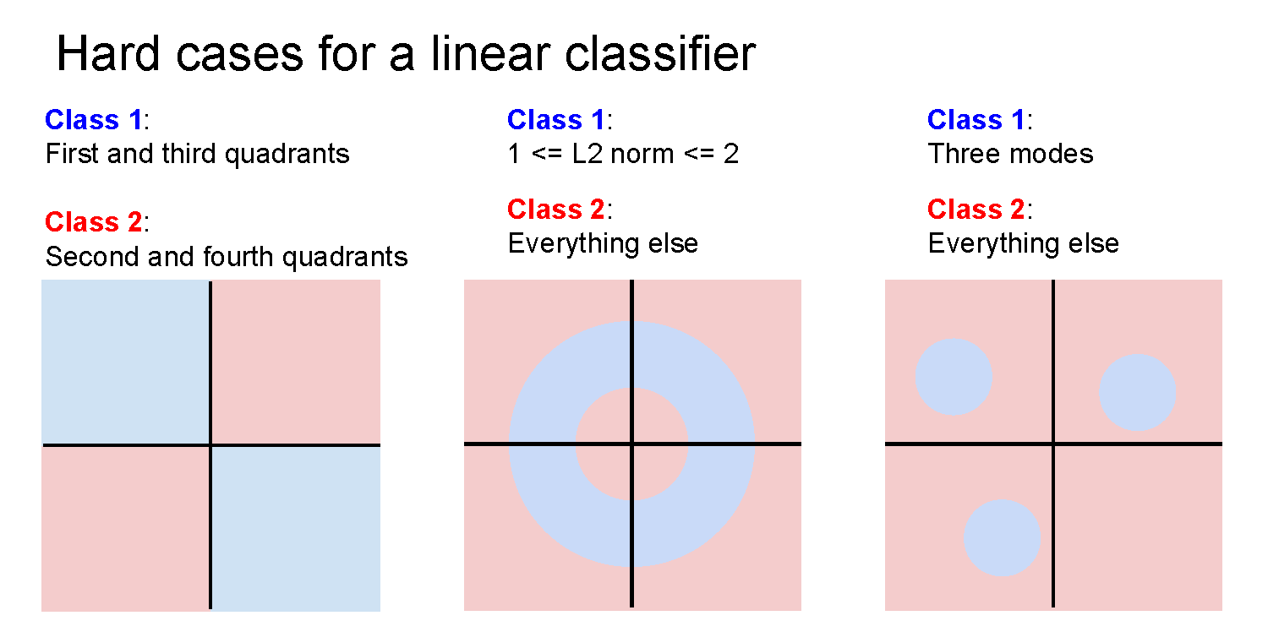

Slide 68
Recap
Learning methods
k-Nearest Neighbors
Linear classification
Classifier outputs a score function giving a score to each class
Today: how do we define how good a classifier is based on the training data? (Spoiler: define a loss function)

Slide 69
Linear classification
Output scores

Slide 71
Loss function, cost/objective function
Given ground truth labels (y_{i}), scores f(x_{i}, W)
how unhappy are we with the scores?
Loss function or objective/cost function measures unhappiness
During training, want to find the parameters W that minimizes the loss function

Slide 72
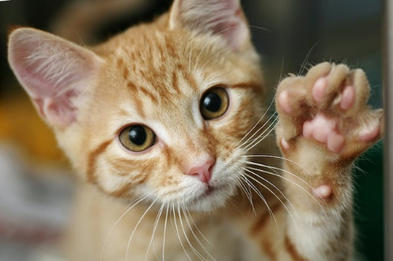
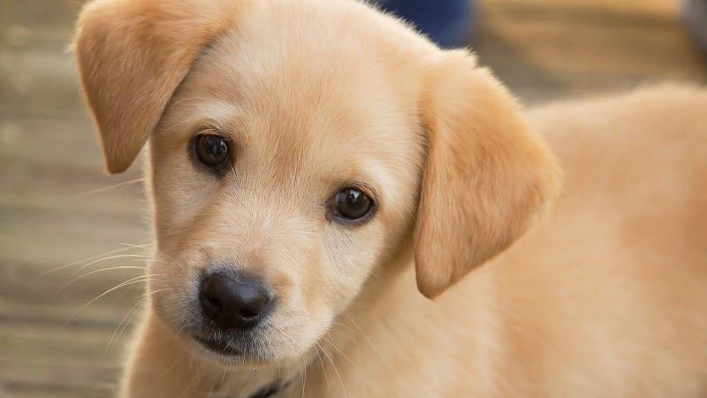
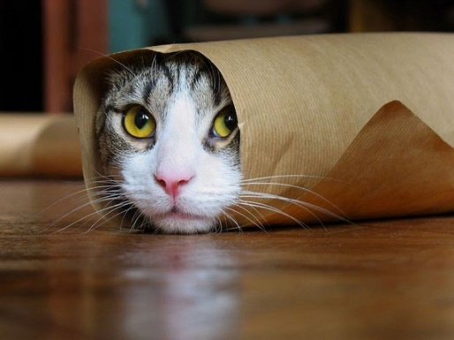
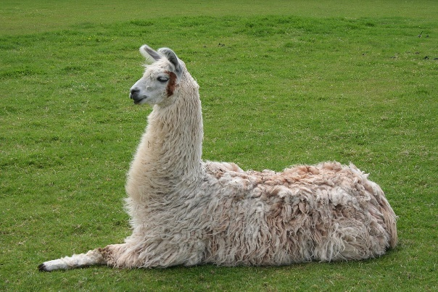
Simpler example: binary classification
Two classes (e.g., “cat” and “not cat”)
AKA “positive” and “negative” classes
cat
not cat

Slide 73
Linear classifiers
Find linear function (hyperplane) to separate positive and negative examples
Which hyperplane is best?
We need a loss function to decide

Slide 74
What is a good loss function?
One possibility
Number of misclassified examples
Problems: discrete, can’t break ties
We want the loss to lead to good generalization
We want the loss to work for more than 2 classes
Loss: 2
Loss: 0
Loss: 0

Slide 75
Softmax classifier
(score function)
Example with three classes:
Interpretation: squashes values into probabilities ranging from 0 to 1
Notes:
The binary logistic model is used to predict a binary response based on one or more predictor variables (features).
Notation: f_j is the jth element of the vector of class scores f.

Slide 76
Cross-entropy loss
(score function)

Slide 77
Losses
Cross-entropy loss is just one possible loss function
One nice property is that it reinterprets scores as probabilities, which have a natural meaning
SVM (max-margin) loss functions also used to be popular
But currently, cross-entropy is the most common classification loss

Slide 78
Aside: Loss function interpretation
Probability
Maximum Likelihood Estimation (MLE)
Regularization is Maximum a posteriori (MAP) estimation
Cross-entropy H
p is true distribution (1 for the correct class), q is estimated
Softmax classifier minimizes cross-entropy
Minimizes the KL divergence (Kullback-Leibler) between the distribution: distance between p and q

Slide 79
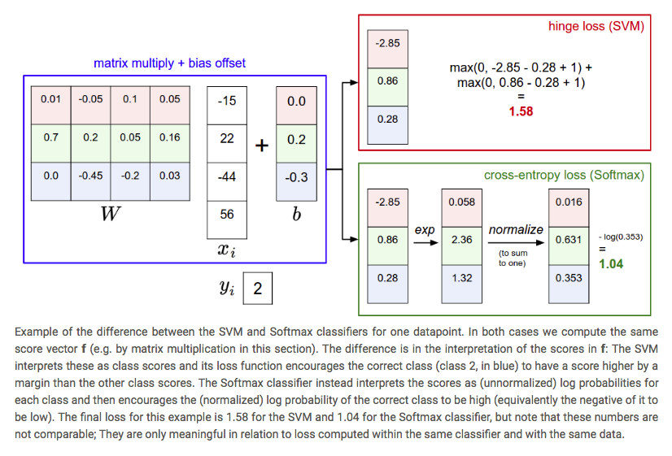
SVM vs. Softmax

Slide 80
Summary
Have score function and loss function
Currently, score function is based on linear classifier
Next, will generalize to convolutional neural networks
Find W and b to minimize loss
Notes:
In other words, the Softmax classifier is never fully happy with the scores it produces: the correct class could always have a higher probability and the incorrect classes always a lower probability and the loss would always get better. However, the SVM is happy once the margins are satisfied and it does not micromanage the exact scores beyond this constraint. This can intuitively be thought of as a feature: For example, a car classifier which is likely spending most of its "effort" on the difficult problem of separating cars from trucks should not be influenced by the frog examples, which it already assigns very low scores to, and which likely cluster around a completely different side of the data cloud.

