Slide 1
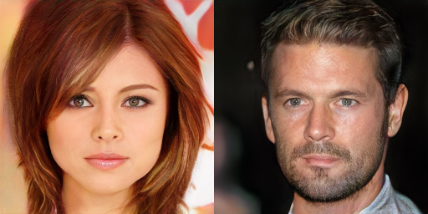
Synthesizing images with generative adversarial networks (GANs)
CS5670: Computer Vision
Noah Snavely
Automatically generated celebrities via GANs
Slides from Philipp Isola

Slide 2
Readings
NIPS 2016 Tutorial on GANs
https://arxiv.org/abs/1701.00160

Slide 3
Other resources
Deep visualization toolbox
https://www.youtube.com/watch?v=AgkfIQ4IGaM
A Beginner's Guide To Understanding Convolutional Neural Networks
https://adeshpande3.github.io/adeshpande3.github.io/A-Beginner's-Guide-To-Understanding-Convolutional-Neural-Networks/

Slide 4
Announcements
Project 5 due Monday, 5/14 at 11:59pm
Reminder: Course evals (5 bonus points)
https://apps.engineering.cornell.edu/CourseEval
Final exam in class on Wednesday
Please arrange yourselves with at least one space between you and the closest person in the same row when you arrive

Slide 5
Today
Generative adversarial networks
Course review

Slide 6
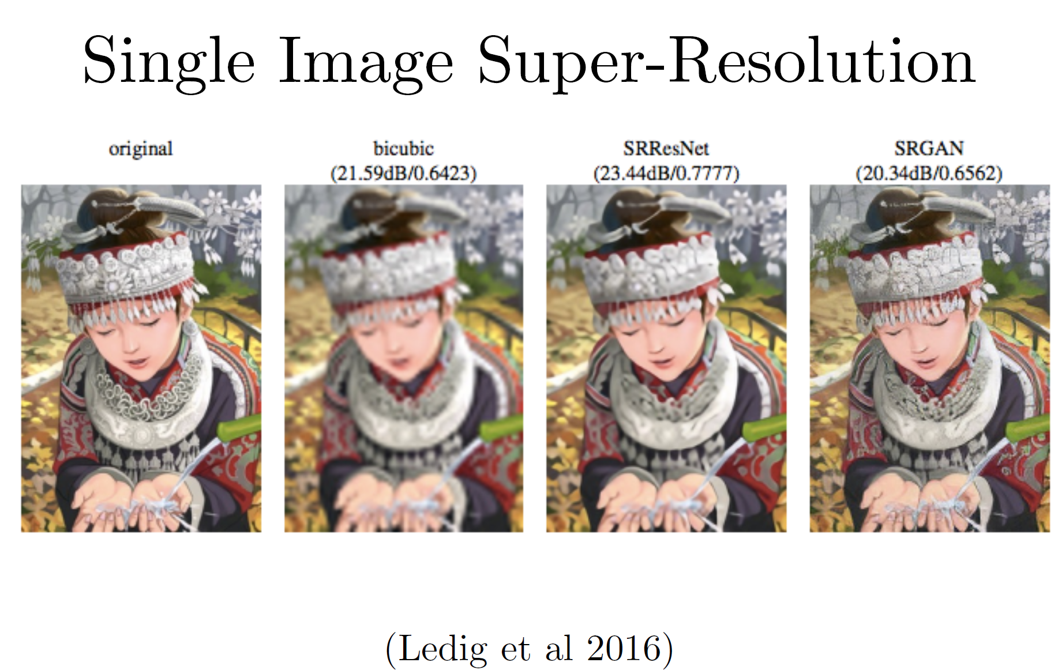
Motivation: Synthesizing images

Slide 7
Motivation: Synthesizing images

Slide 8
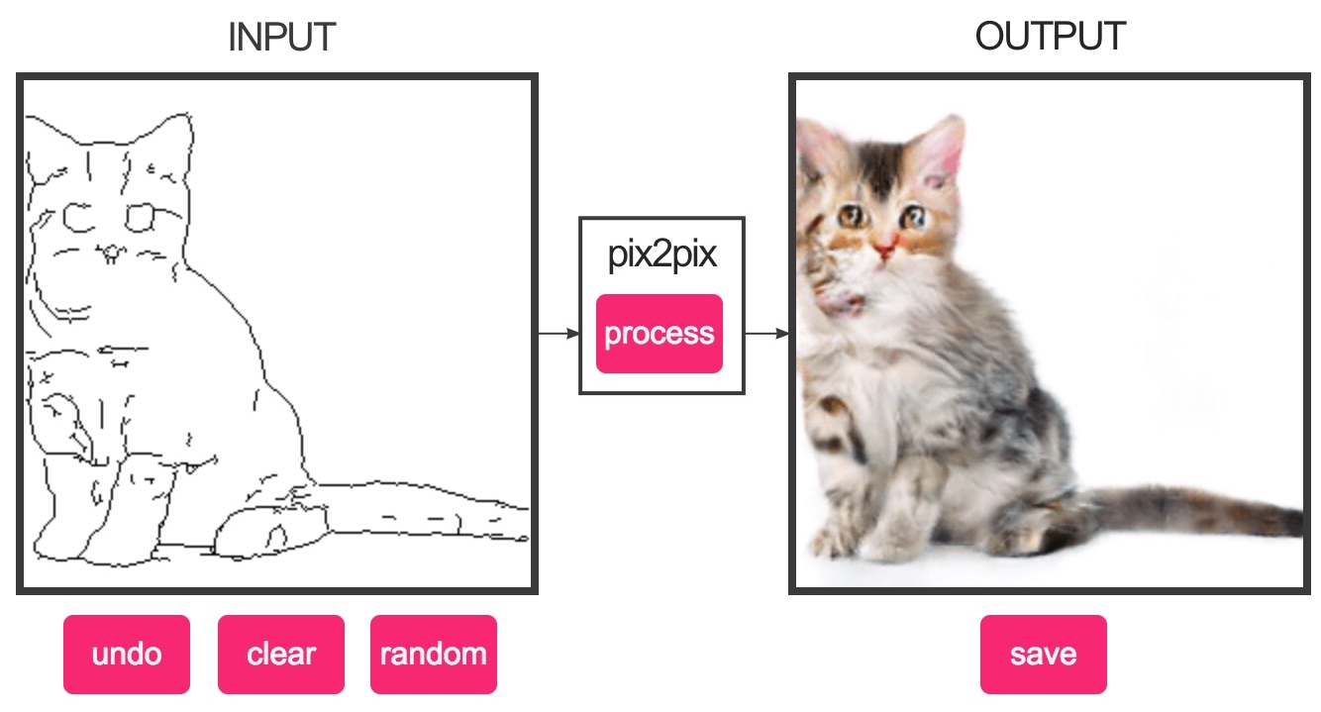
Demo
https://affinelayer.com/pixsrv/

Slide 9
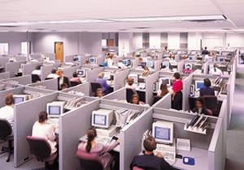
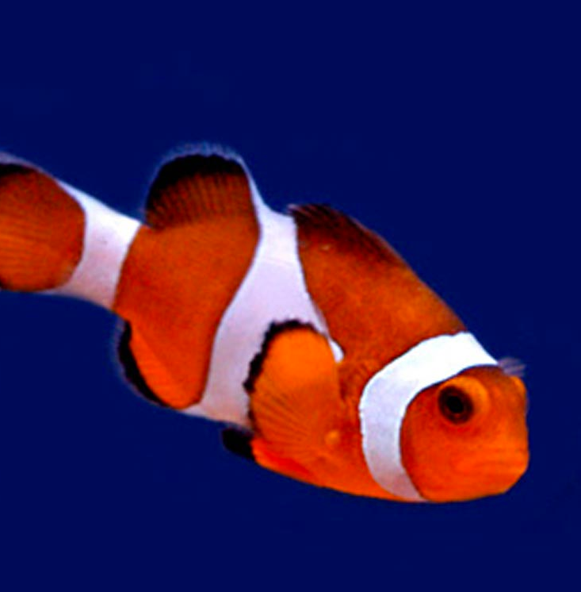
Image classification
Learner
“Fish”
image X
label Y

Slide 10
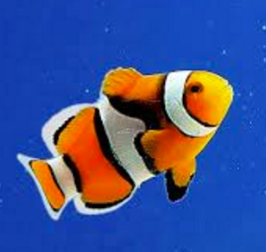
Image classification
Learner
“Fish”
image X
label Y

Slide 11
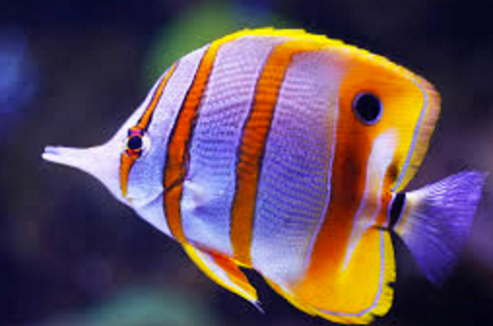
Image classification
Learner
“Fish”
image X
label Y

Slide 12
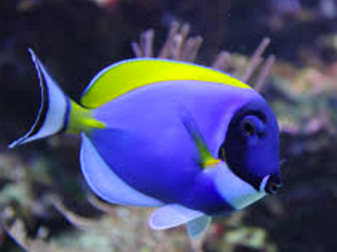
Image classification
Learner
“Fish”
…
image X
label Y

Slide 13
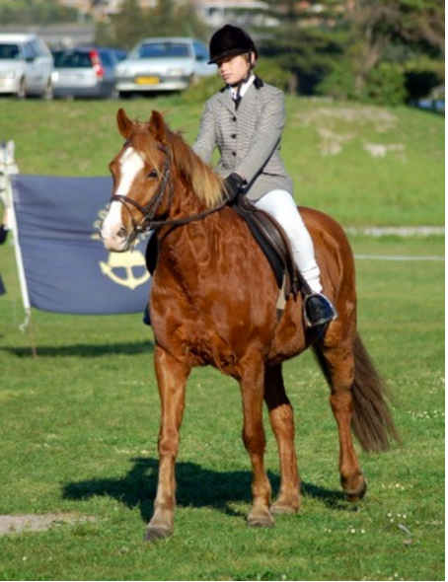
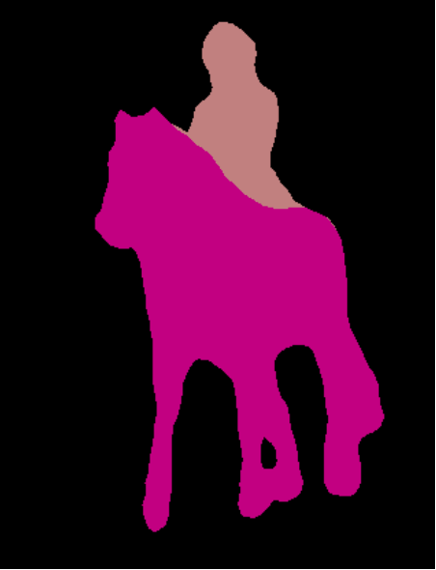
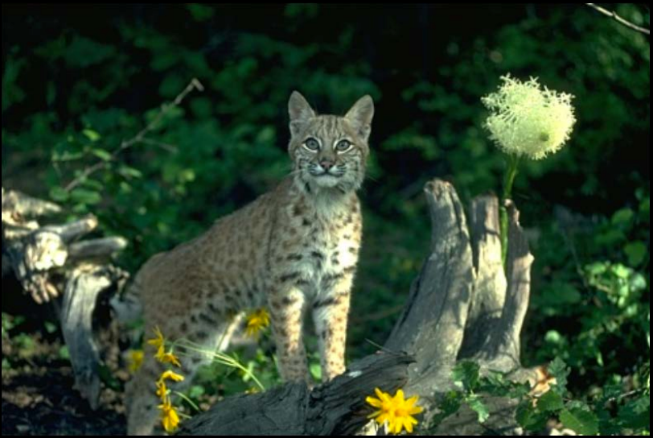
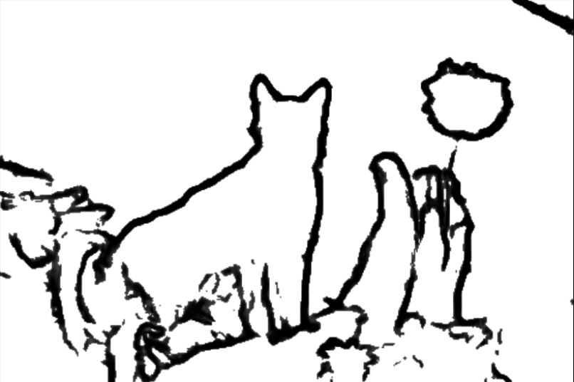
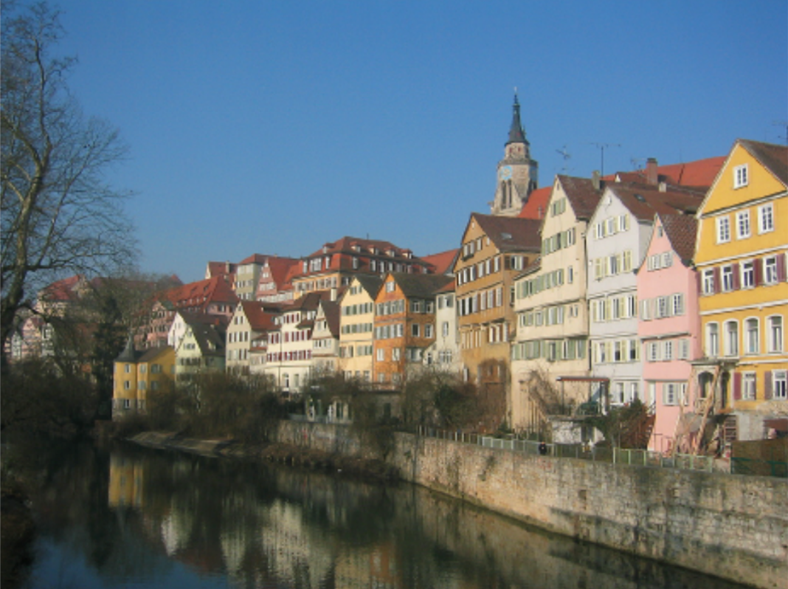
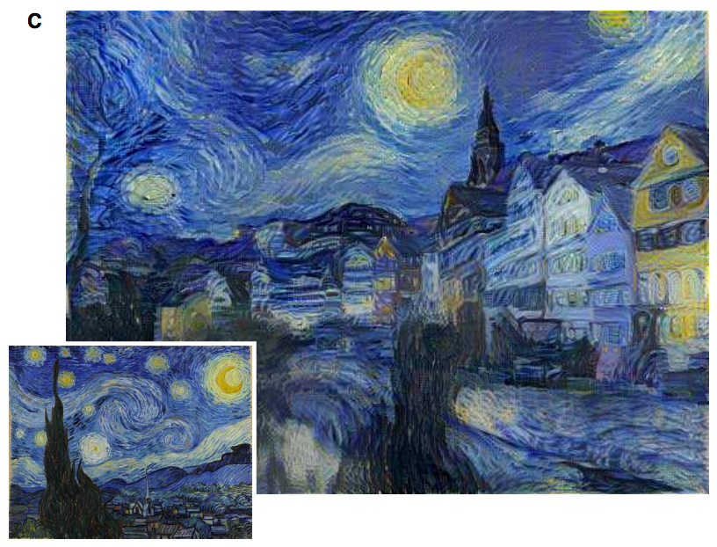
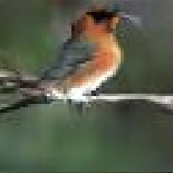
Image prediction (“structured prediction”)
Object labeling
Edge Detection
[Xie et al. 2015, …]
[Long et al. 2015, …]
Text-to-photo
Style transfer
“this small bird has a pink breast and crown…”
[Reed et al. 2014, …]
[Gatys et al. 2016, …]

Slide 14
Challenges
Output is high-dimensional, structured object
Uncertainty in mapping; many plausible outputs
Lack of supervised training data
“this small bird has a pink breast and crown…”

Slide 15
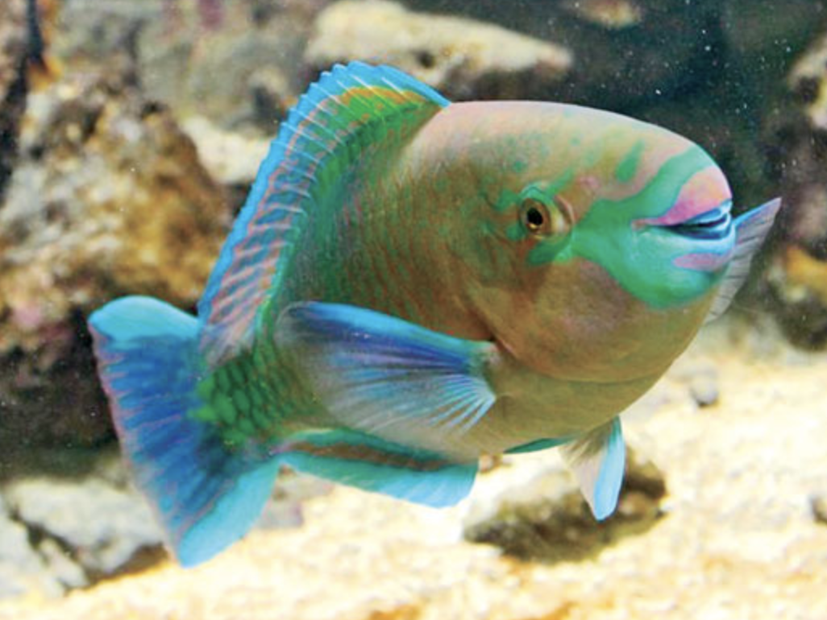
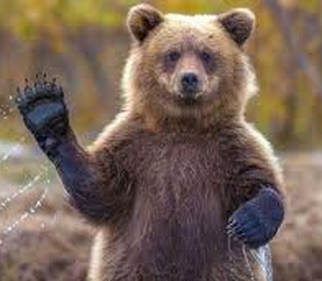
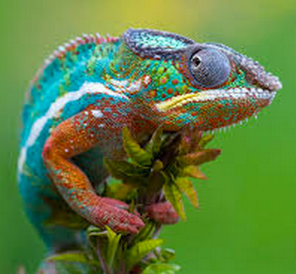
Training data
“Fish”
“Fish”
“Grizzly”
“Chameleon”
…
Objective function
(loss)
Convolutional Neural Network
Notes:
So formally, we are working in the Lab color space. The grayscale information is contained in the L, or lightness channel of the image, and is the input to our system.
The output is the ab, or color channels.
We’re looking to learn the mapping from L to ab using a CNN.
We can then take the predicted ab channels, concatenate them with the input, and hopefully get a plausible colorization of the input image. This is the graphics benefit of this problem.

Slide 16
“Fish”
“What should I do”
“How should I do it?”
Notes:
So formally, we are working in the Lab color space. The grayscale information is contained in the L, or lightness channel of the image, and is the input to our system.
The output is the ab, or color channels.
We’re looking to learn the mapping from L to ab using a CNN.
We can then take the predicted ab channels, concatenate them with the input, and hopefully get a plausible colorization of the input image. This is the graphics benefit of this problem.

Slide 18
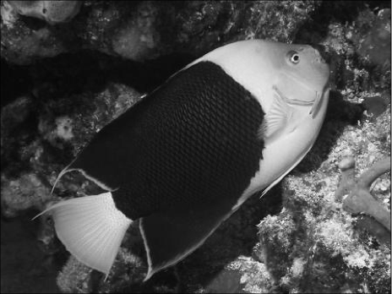
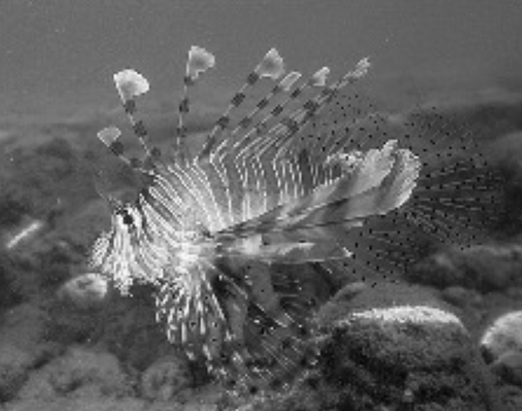
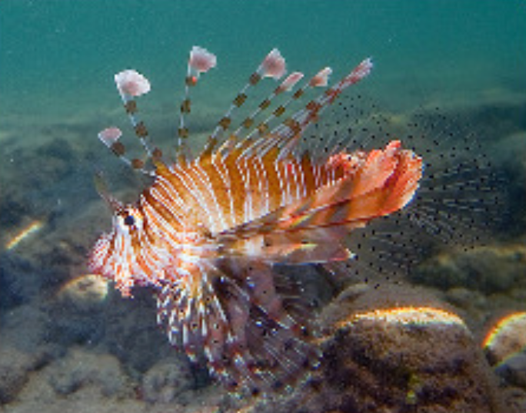
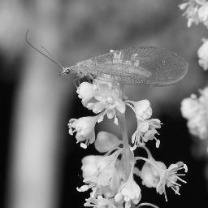
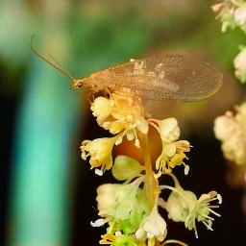
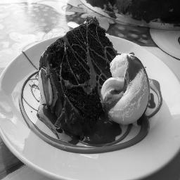
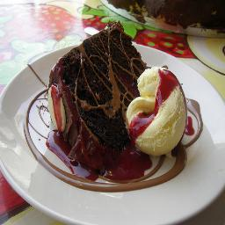
Training data
Grayscale image: L channel
Color information: ab channels
…
Objective function
(loss)
Neural Network
Notes:
So formally, we are working in the Lab color space. The grayscale information is contained in the L, or lightness channel of the image, and is the input to our system.
The output is the ab, or color channels.
We’re looking to learn the mapping from L to ab using a CNN.
We can then take the predicted ab channels, concatenate them with the input, and hopefully get a plausible colorization of the input image. This is the graphics benefit of this problem.

Slide 19
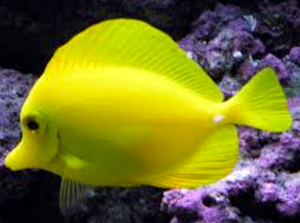
…
“rockfish”

Slide 20
…
“yellow”

Slide 21
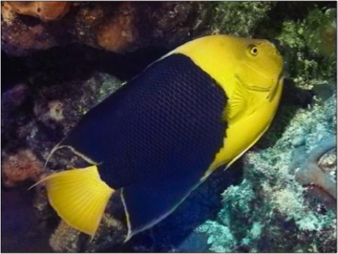
…

Slide 22
Loss Function

Slide 23
Image classification with a neural net
“clown fish”
Input image

Slide 24
Can we generate images using a neural net?
“clown fish”
Synthesized image

Slide 25
In structured prediction, you shouldn’t treat every output as independent!

Slide 26
In one-to-many prediction, you need to predict a set of possibilities

Slide 27
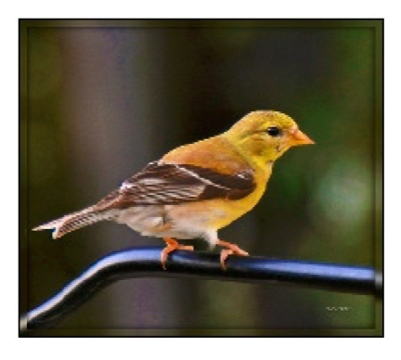
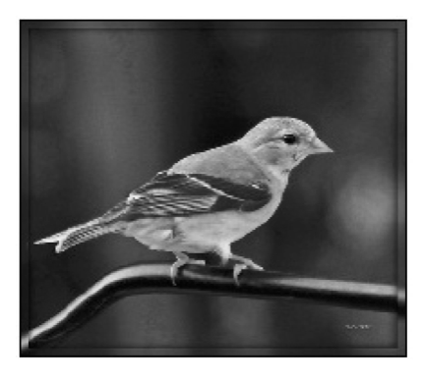
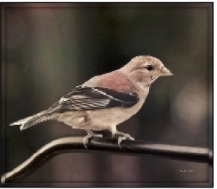
Designing loss functions
Input
Output
Ground truth
Notes:
Sounds reasonable, right?
“Minimize Euclidean distance between each predicted pixel color and its ground truth value.”

Slide 28
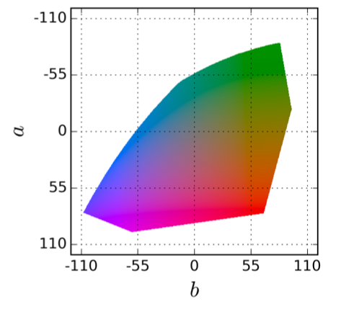
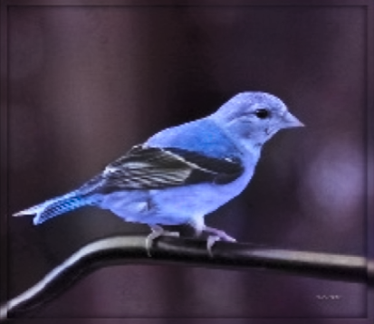
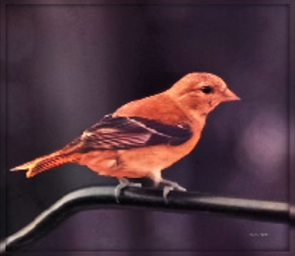
Notes:
Suppose there is an equal chance that the actual color is red or blue. Then the solution that minimizes the L2 norm is to output average of red and blue, which gives a grayish result.

Slide 29
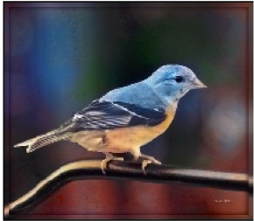
Designing loss functions
Input
Zhang et al. 2016
Ground truth
Color distribution cross-entropy loss with colorfulness enhancing term.
[Zhang, Isola, Efros, ECCV 2016]
Notes:
Required lots of engineering. Choose a color space, discretization scheme, soft-encoding, class-rebalancing with regularization, annealed-mean, etc.
Can we just automatically learn all this?

Slide 30
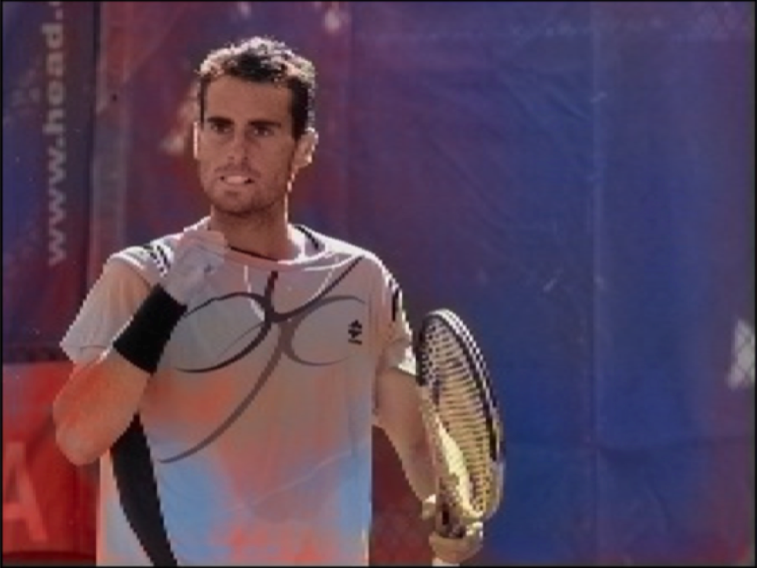
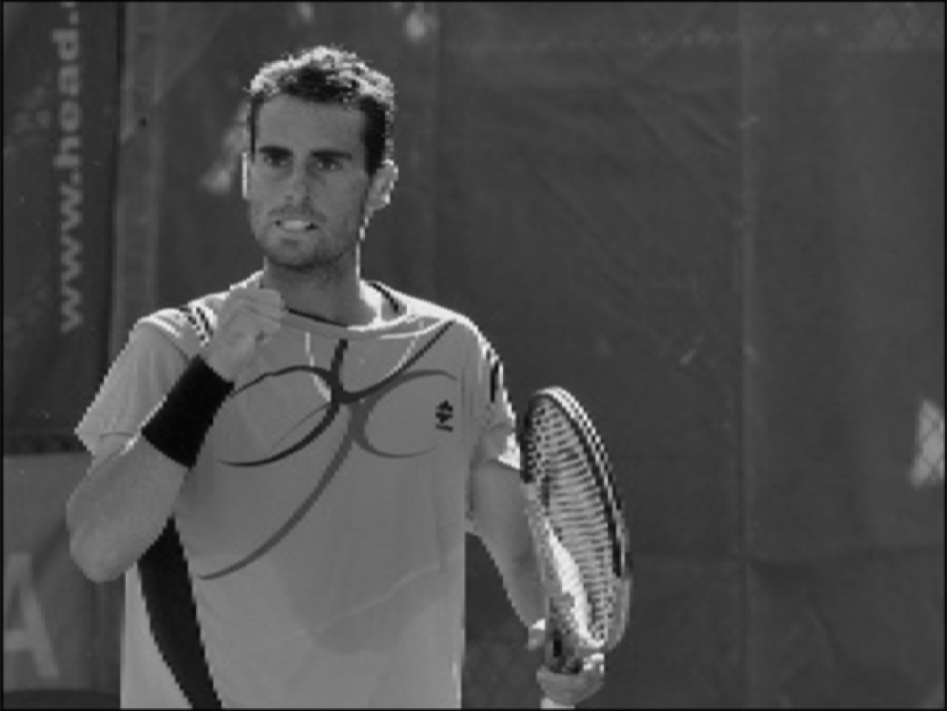
Notes:
But, it still messes up!

Slide 31
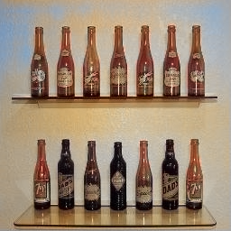
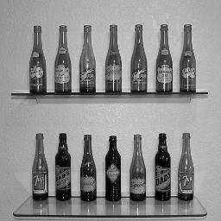

Slide 32
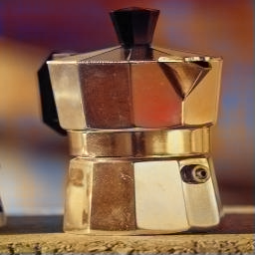
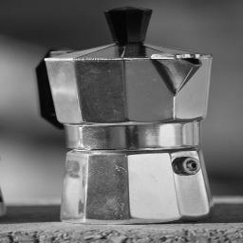

Slide 33
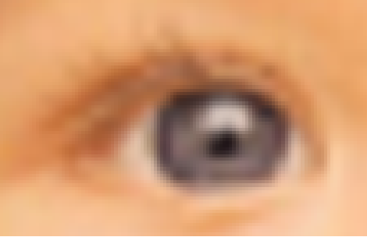
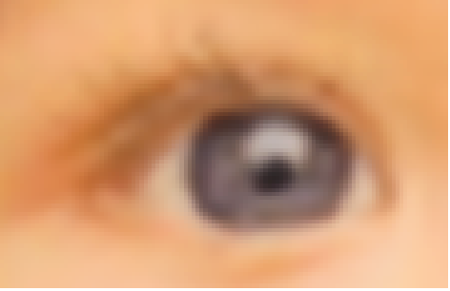
Designing loss functions
Input
Output
“Minimize Euclidean distance between each predicted pixel color and its ground truth value.”
[Johnson, Alahi, Li, ECCV 2016]

Slide 34
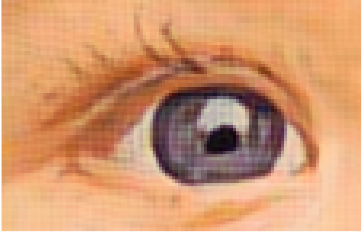
Designing loss functions
Input
Johnson et al. 2016
Match the covariance statistics of deep feature activations.
[Johnson, Alahi, Li, ECCV 2016]
Notes:
But all these problems are pretty much the same: map pixels to pixels.

Slide 35
Structured Losses
Each pixel treated as
independent
Looks at joint configuration
of pixels

Slide 36
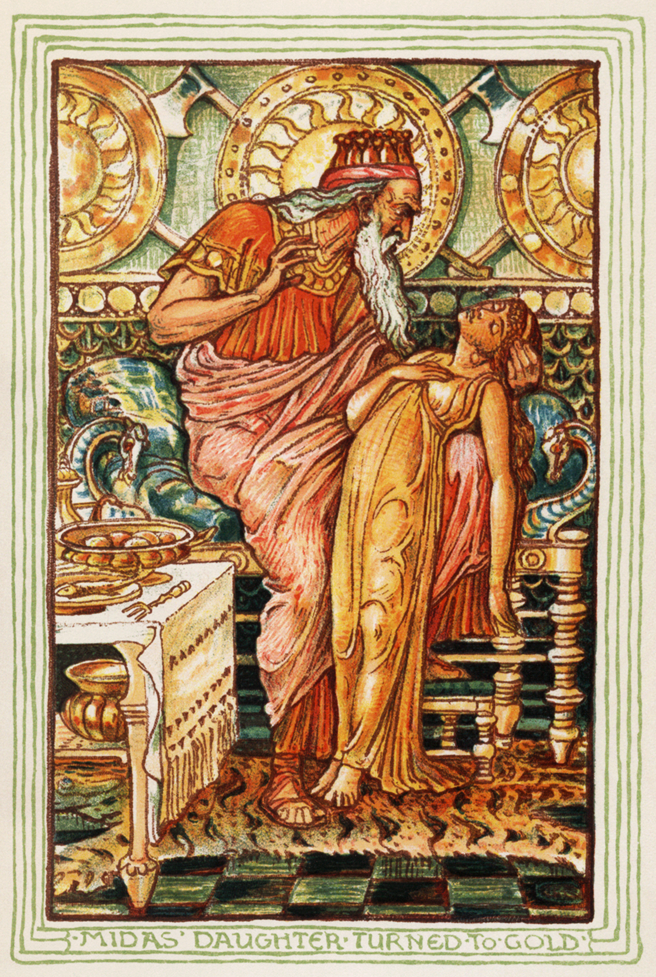
Designing loss functions
Be careful what you wish for!
Notes:
We have to be care not to make Midas’ mistake. If you recall your greek mythology, Midas was a king back in the day, and he was granted a wish, and he wished that everything he touched turned to gold. And then he ended up starving to death because all the food he touched immediately turned to gold. So be careful what you wish for.

Slide 37
Designing loss functions
Image colorization
L2 regression
[Zhang, Isola, Efros, ECCV 2016]
Super-resolution
L2 regression
[Johnson, Alahi, Li, ECCV 2016]
Notes:
So we can carefully engineer our loss functions

Slide 38
Designing loss functions
Image colorization
Cross entropy objective, with colorfulness term
[Zhang, Isola, Efros, ECCV 2016]
Super-resolution
Deep feature covariance matching objective
[Johnson, Alahi, Li, ECCV 2016]
Notes:
So we can carefully engineer our loss functions

Slide 39
Universal loss?
…
…
Notes:
All of these are just predicting pixels from pixels, so shouldn’t there be some universal loss?

Slide 40
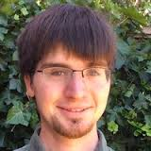
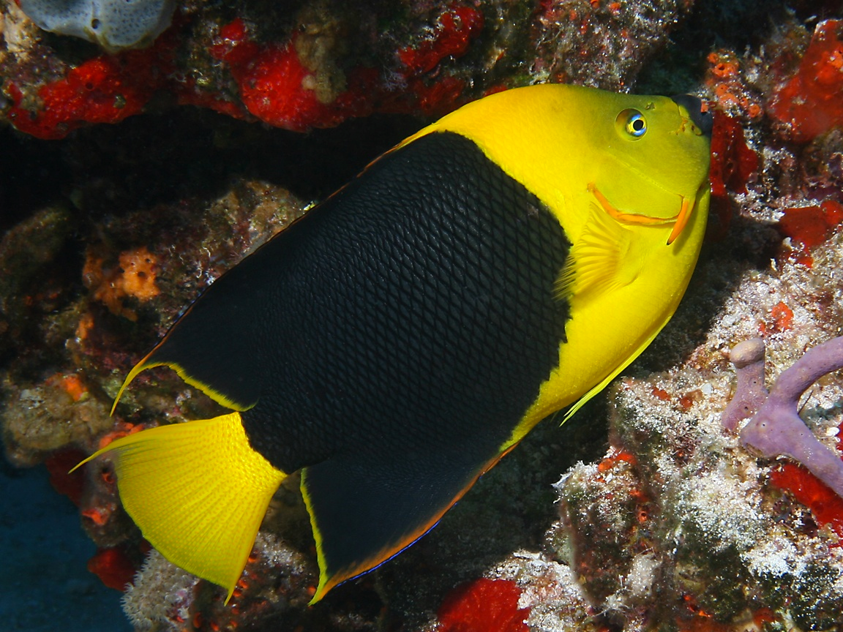
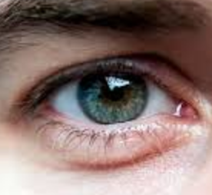
Generated images
“Generative Adversarial Network”
(GANs)
…
…
Generated vs Real
(classifier)
Real photos
[Goodfellow, Pouget-Abadie, Mirza, Xu, Warde-Farley, Ozair, Courville, Bengio 2014]
…
Notes:
motivate with either turk “real vs fake” or graphics
add full citation

Slide 41
Conditional GANs
[Goodfellow et al., 2014]
[Isola et al., 2017]

Slide 42
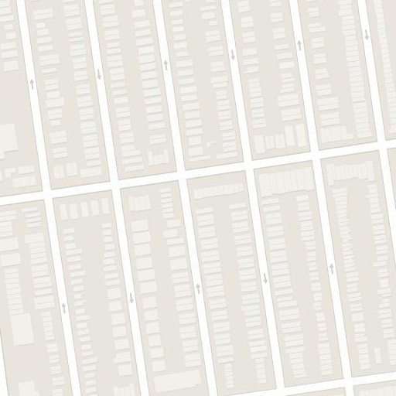
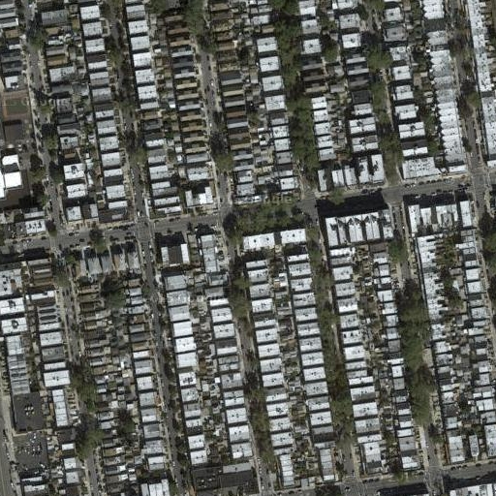
Image-to-Image Translation
“What should I do?”
“How should I do it?”

Slide 43
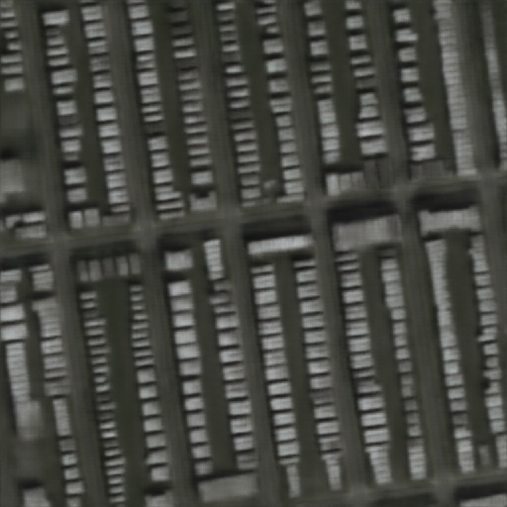
Image-to-Image Translation
“Minimize the distance between each predicted pixel color and its ground truth value.”

Slide 44
Generator
[Goodfellow et al., 2014]

Slide 45
real or fake?
Generator
Discriminator
G tries to synthesize fake images that fool D
D tries to identify the fakes
[Goodfellow et al., 2014]

Slide 46
fake (0.9)
real (0.1)
[Goodfellow et al., 2014]

Slide 47
real or fake?
G tries to synthesize fake images that fool D:
[Goodfellow et al., 2014]

Slide 48
real or fake?
G tries to synthesize fake images that fool the best D:
[Goodfellow et al., 2014]

Slide 49
Loss Function
G’s perspective: D is a loss function.
Rather than being hand-designed, it is learned.
[Goodfellow et al., 2014]
[Isola et al., 2017]

Slide 50
real or fake?
[Goodfellow et al., 2014]
Notes:
But what if, given this input, out generator outputs this image? Is it real or is it fake?

Slide 51
real!
(“Aquarius”)
[Goodfellow et al., 2014]

Slide 52
real or fake pair ?
[Goodfellow et al., 2014]
[Isola et al., 2017]

Slide 53
real or fake pair ?
[Goodfellow et al., 2014]
[Isola et al., 2017]

Slide 54
fake pair
[Goodfellow et al., 2014]
[Isola et al., 2017]

Slide 55
real pair
[Goodfellow et al., 2014]
[Isola et al., 2017]

Slide 56
real or fake pair ?
[Goodfellow et al., 2014]
[Isola et al., 2017]

Slide 57
BW → Color
Input
Output
Input
Output
Input
Output
Data from [Russakovsky et al. 2015]

Slide 58
Input
Output
Groundtruth
Data from
[maps.google.com]
Notes:
Again, pixels to pixels!
These are 512x512 but you can run it at any resolution, since it’s fully convolutional.

Slide 59
Input
Output
Groundtruth
Data from [maps.google.com]
Notes:
Note 512x512

Slide 60
Labels → Facades
Input
Output
Data from [Tylecek, 2013]

Slide 61
Labels → Facades
Input
Output
Input
Output
Data from [Tylecek, 2013]

Slide 62
Day → Night
Input
Output
Input
Output
Input
Output
Data from [Laffont et al., 2014]

Slide 63
Edges → Images
Input
Output
Input
Output
Input
Output
Edges from [Xie & Tu, 2015]

Slide 64
Sketches → Images
Input
Output
Input
Output
Input
Output
Trained on Edges → Images
Data from [Eitz, Hays, Alexa, 2012]

Slide 65
#edges2cats [Chris Hesse]

Slide 66
Ivy Tasi @ivymyt
Vitaly Vidmirov @vvid

Slide 67
Hallucinations
Input
Output
Input
Output
Input
Output
Input
Output
Notes:
GAN: when it doesn’t know what to do, when there is no information in the input about how the output should look, it makes stuff up, like these psychedelic colors
L1: when it doesn’t know what to do, it just outputs the most typical response, flat gray mush

Slide 68
Challenges —> Solutions
Output is high-dimensional, structured object
Uncertainty in mapping; many plausible outputs
Lack of supervised training data
—> Use a deep net, D, to analyze output!
“this small bird has a pink breast and crown…”
—> D only cares about “plausibility”, doesn’t hedge

Slide 69
Challenges —> Solutions
Output is high-dimensional, structured object
Uncertainty in mapping; many plausible outputs
Lack of supervised training data
—> Use a deep net, D, to analyze output!
“this small bird has a pink breast and crown…”
—> D only cares about “plausibility”, doesn’t hedge

Slide 70
https://junyanz.github.io/CycleGAN/

Slide 72
Progressive GANs
30 minutes of fake celebrities
https://www.youtube.com/watch?v=f8xSD4HO_8k

Slide 73
Questions?

