Slide 1
Training convolutional neural networks
CS5670: Computer Vision
Noah Snavely
Slides from Fei-Fei Li, Justin Johnson, Serena Yeung
http://vision.stanford.edu/teaching/cs231n/

Slide 2
Readings
Stochastic Gradient Descent & Backpropagation
http://cs231n.github.io/optimization-1/
http://cs231n.github.io/optimization-2/
Best practices for training CNNs
http://cs231n.github.io/neural-networks-2/
http://cs231n.github.io/neural-networks-3/

Slide 3
Announcements
Final exam in class, May 9
Will provide study materials Wednesday
Final is open book / open note (please use your judgement – see Piazza for more info)
No laptops / iPads / phones. Calculator is OK.
Project 5 (CNNs) to be released by Wednesday
Likely due Monday, 5/14

Slide 4
Last time
Backpropagation algorithm
Training networks via gradient descent

Slide 5
Today
Best practices for training CNNs

Slide 21
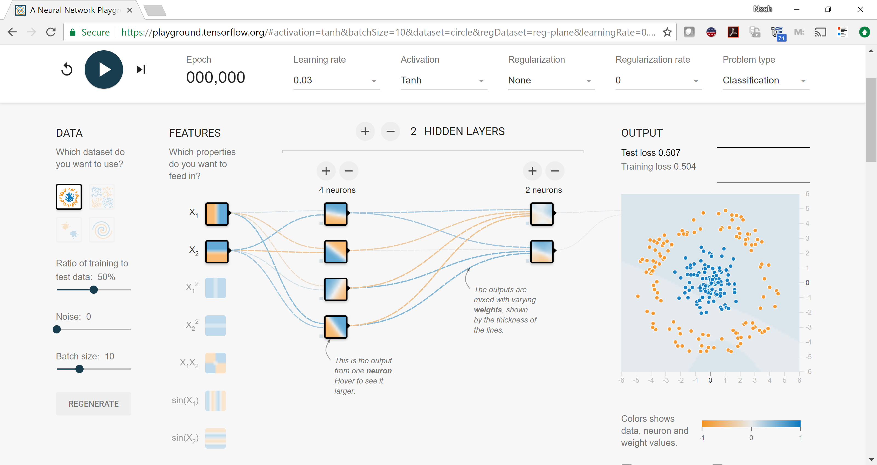
Demo time
https://playground.tensorflow.org/

Slide 22
(if you use ReLU activations, folks tend to initialize bias to small positive number)

Slide 26
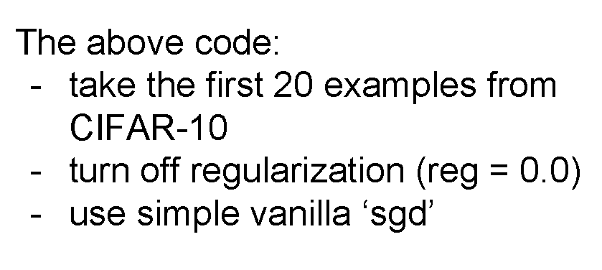

Slide 29
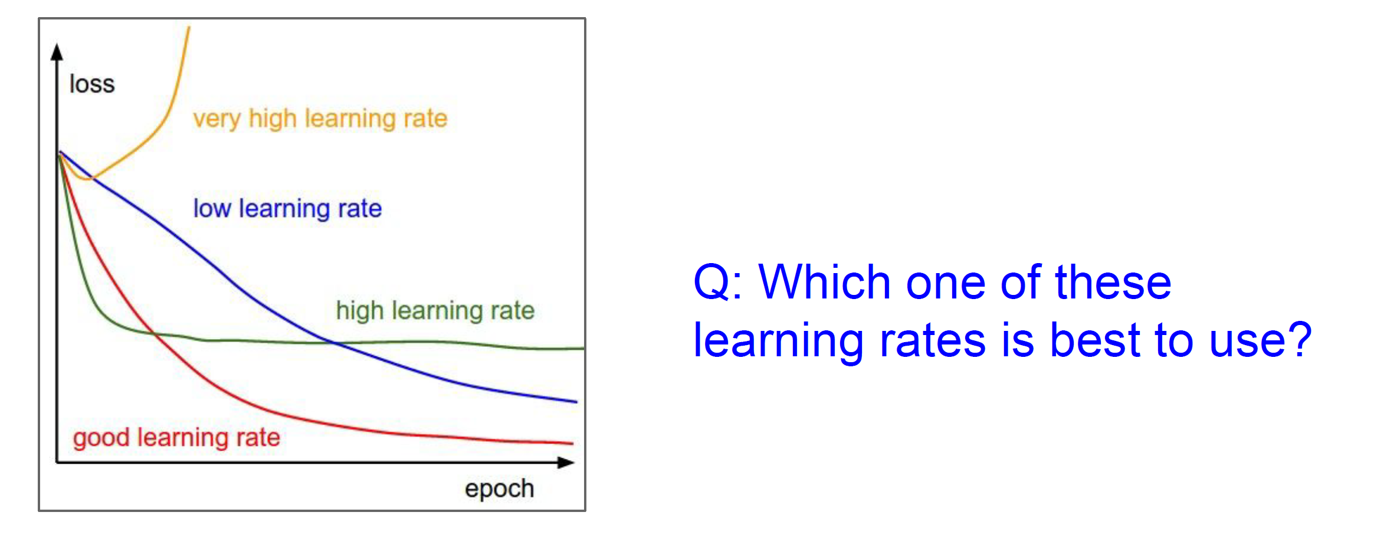
Babysitting learning

Slide 46
Questions?

Slide 59
Questions?

Slide 72
Questions?

