Slide 1
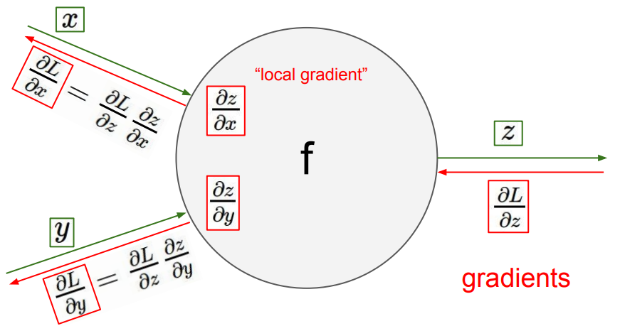
Backpropagation
CS5670: Computer Vision
Noah Snavely
Slides from Fei-Fei Li, Justin Johnson, Serena Yeung
http://vision.stanford.edu/teaching/cs231n/

Slide 2
Readings
Stochastic Gradient Descent & Backpropagation
http://cs231n.github.io/optimization-1/
http://cs231n.github.io/optimization-2/

Slide 3
Announcements
Project 4 (Stereo) due tomorrow, April 26, 2018, by 11:59pm
Quiz 3 in class, Monday, 4/30, first 10 minutes of class
Final exam in class, May 9
Will provide some study materials

Slide 4
Today
How to train CNNs
Backpropagation algorithm
Best practices for training deep CNNs
Data augmentation

Slide 5
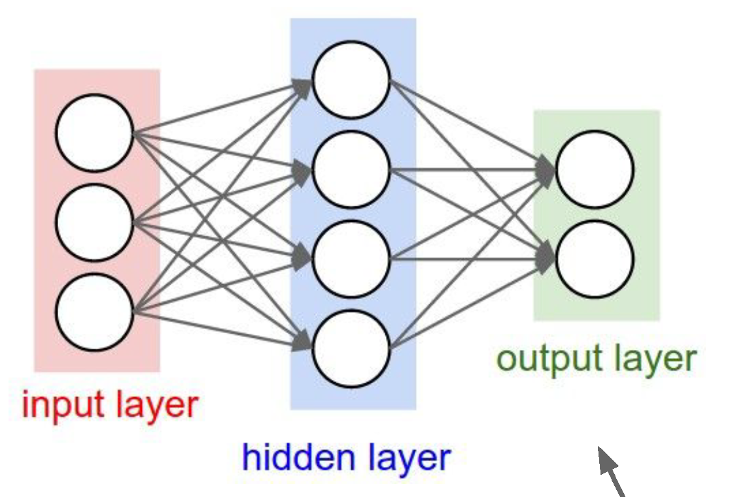
Last time: neural networks
Computation graph for a 2-layer neural network
Neuron or unit

Slide 6
Last time: convolutional neural networks

Slide 7
Last time: convolutional layers

Slide 8
Last time: convolutional neural networks

Slide 23
https://cs.stanford.edu/people/karpathy/convnetjs/demo/cifar10.html

Slide 24
Summary of CNNs

Slide 25
Questions?

Slide 26
Bigger picture
A convolutional neural network can be thought of as a function from images to class scores
With millions of adjustable weights…
… leading to a very non-linear mapping from images to features / class scores.
We will set these weights based on classification accuracy on training data…
… and hopefully our network will generalize to new images at test time

Slide 27
Back to optimization
Now we know what the structure of our function from images -> class scores is
How do we learn the weights?
Answer: Stochastic gradient descent
Requires that we compute the derivative of the training loss with respect to all weights

Slide 28
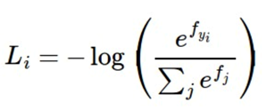
Where we are
Function f maps images to class scores
Loss function maps class scores to “badness”
f is a deep CNN
Cross-entropy loss
Data loss + regularization
(gradient of L w.r.t. W, computed analytically)

Slide 29
Computation graphs
Forward pass: compute loss using current weights
Backwards pass: compute gradients of loss w.r.t. weights, then update the weights
(backpropagation algorithm)

Slide 44
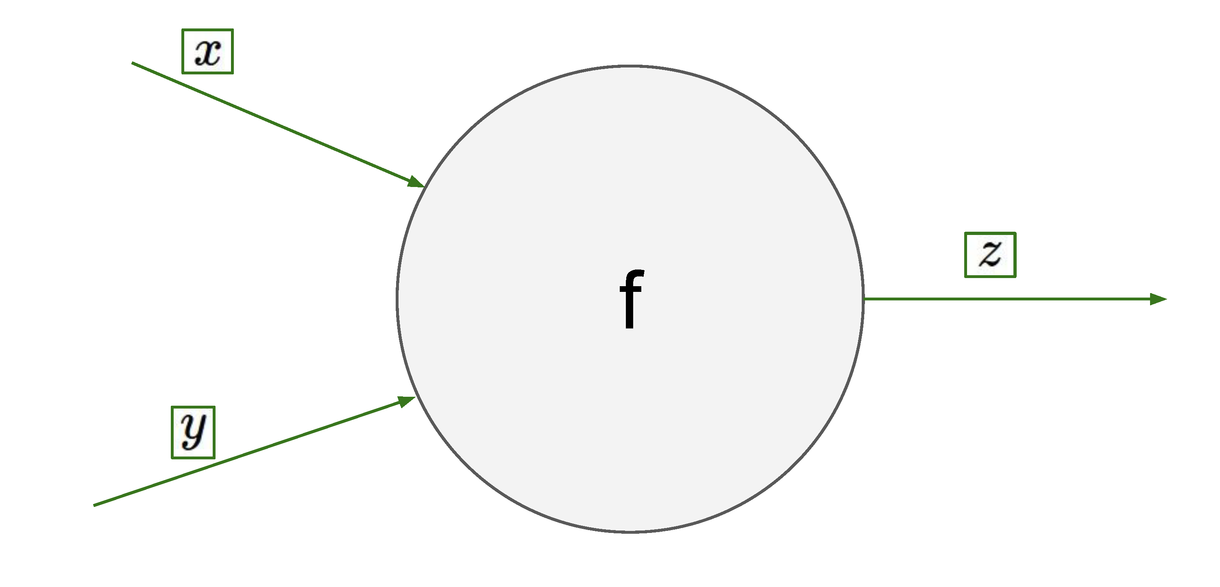

Slide 76
Questions?

