Slide 1
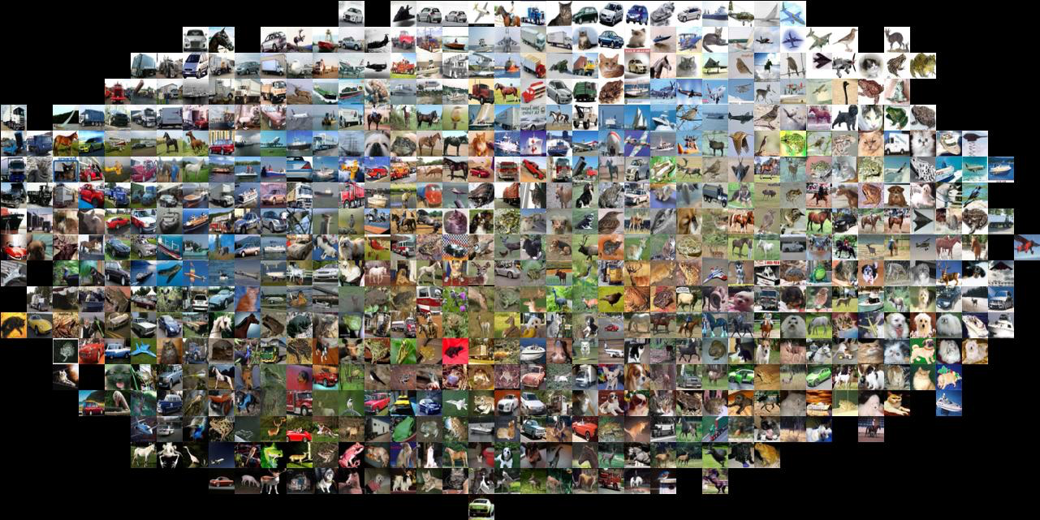
Image Classification
CS5670: Computer Vision
Noah Snavely
Slides from Fei-Fei Li, Justin Johnson, Serena Yeung
http://vision.stanford.edu/teaching/cs231n/

Slide 2
Announcements
Project 4 to be released shortly
Vote for Project 3 artifacts!
Deadline: midnight tonight

Slide 3
Today
Image classification pipeline
Training, validation, testing
Nearest neighbor classification
Linear classification
Score function and loss function
Building up to CNNs for learning
Next 2-4 lectures on deep learning

Slide 4
Where to from here?
Scene Understanding
Big data – lots of images
Crowd sourcing – lots of people
Deep Learning – lots of compute

Slide 5
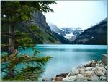
Image categorization
Training
Training Images
Training Labels
Image Features
Classifier Training
Trained Classifier

Slide 6
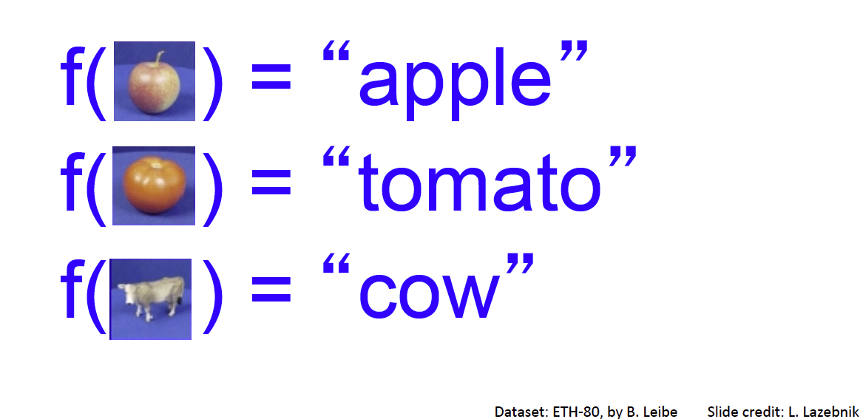
Image Classification: A core task in Computer Vision
Assume given set of discrete labels, e.g. {cat, dog, cow, apple, tomato, truck, … }

Slide 7
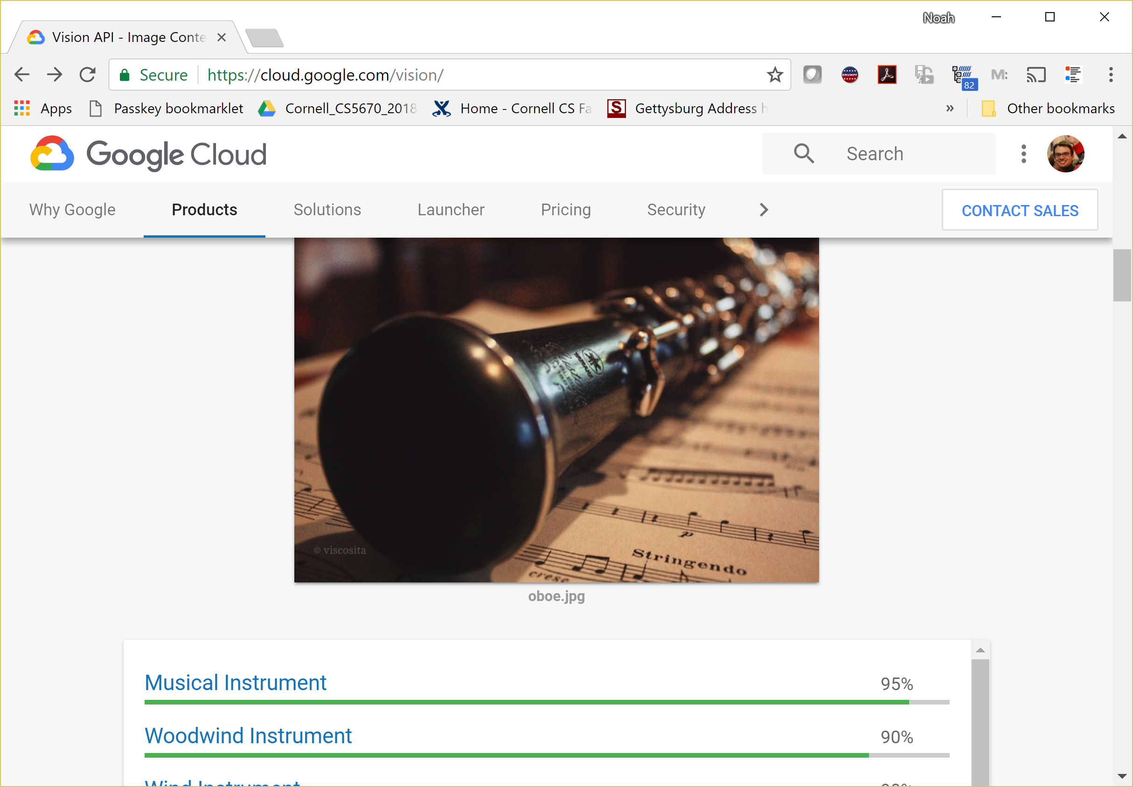
Image classification demo
https://cloud.google.com/vision/
See also:
https://aws.amazon.com/rekognition/
https://www.clarifai.com/
https://azure.microsoft.com/en-us/services/cognitive-services/computer-vision/
…

Slide 8
Slide credit: Fei-Fei Li & Justin Johnson & Serena Yeung

Slide 11
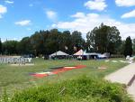
Image Categorization
Training
Training Images
Training Labels
Image Features
Classifier Training
Trained Classifier
Testing
Image Features
Trained Classifier
Prediction
Outdoor
Test Image

Slide 12
Crowdsourcing
Unlabeled Images
Show images,
Collect and filter labels
Training Labels
Training Images
Image Features
Classifier Training
Trained Classifier
Training

Slide 14
Deep Learning (or convnets, CNNs)
Since 2012, huge impact, best results
Can soak up all the data for better prediction

Slide 15
Image Classification
Slides from Andrej Karpathy and Fei-Fei Li
http://vision.stanford.edu/teaching/cs231n/

Slide 16
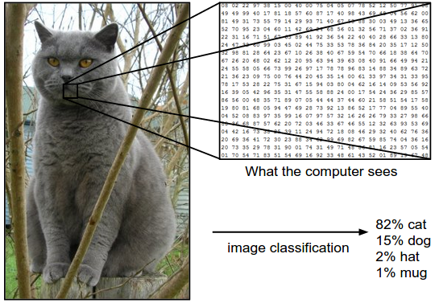
Image Classification: Problem

Slide 18
Slide credit: Fei-Fei Li & Justin Johnson & Serena Yeung

Slide 19
Data-driven approach
Collect a database of images with labels
Use ML to train an image classifier
Evaluate the classifier on test images
Slides from Andrej Karpathy and Fei-Fei Li
http://vision.stanford.edu/teaching/cs231n/

Slide 20
Data-driven approach
Collect a database of images with labels
Use ML to train an image classifier
Evaluate the classifier on test images
Slides from Andrej Karpathy and Fei-Fei Li
http://vision.stanford.edu/teaching/cs231n/

Slide 21
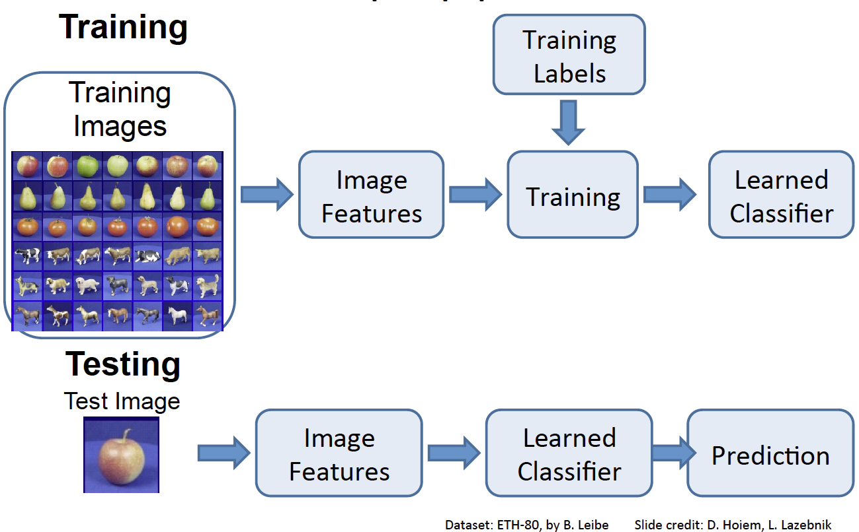

Slide 23
Classifiers
Nearest Neighbor
kNN (“k-Nearest Neighbors”)
Linear Classifier
SVM (Support Vector Machine)
…

Slide 24
First: Nearest Neighbor (NN) Classifier
Train
Remember all training images and their labels
Predict
Find the closest (most similar) training image
Predict its label as the true label

Slide 26
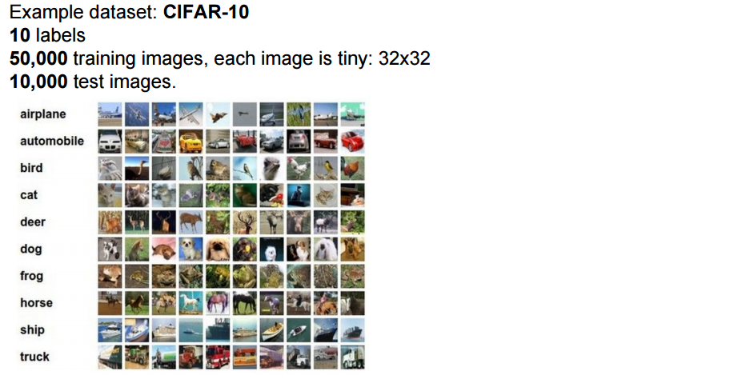
CIFAR-10 and NN results

Slide 27
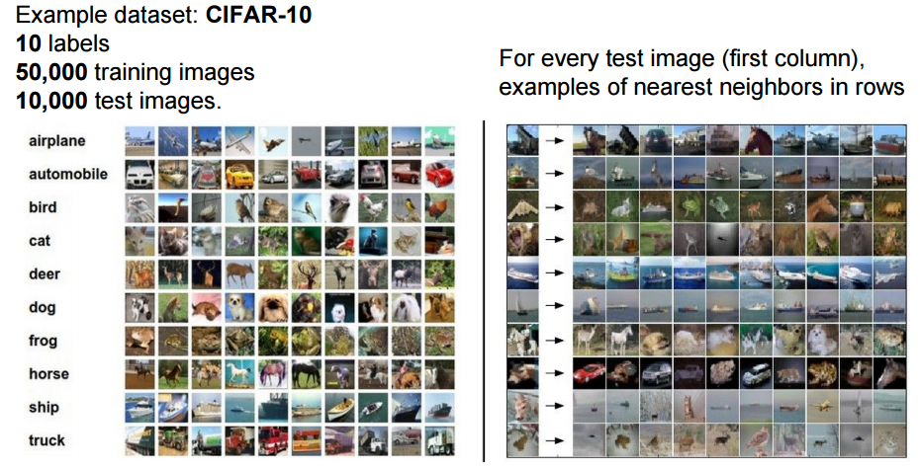
CIFAR-10 and NN results
Slides from Andrej Karpathy and Fei-Fei Li
http://vision.stanford.edu/teaching/cs231n/

Slide 28
k-nearest neighbor
Find the k closest points from training data
Take majority vote from K closest points

Slide 31
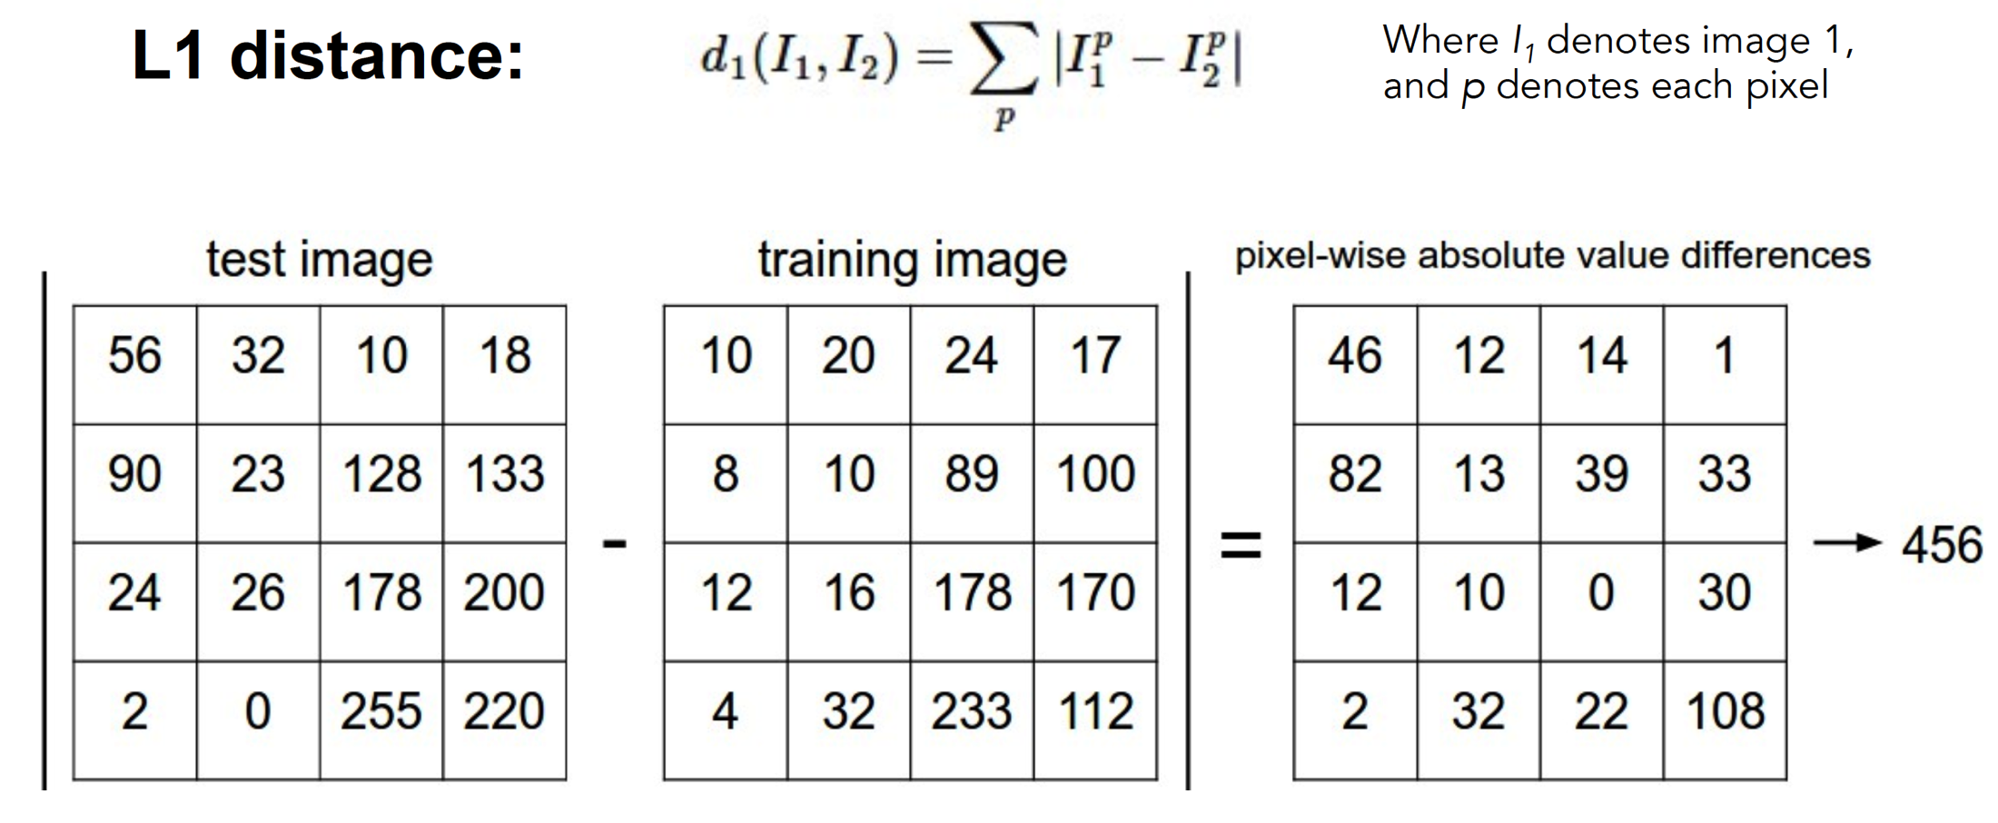
How to find the most similar training image? What is the distance metric?
Slides from Andrej Karpathy and Fei-Fei Li
http://vision.stanford.edu/teaching/cs231n/

Slide 32
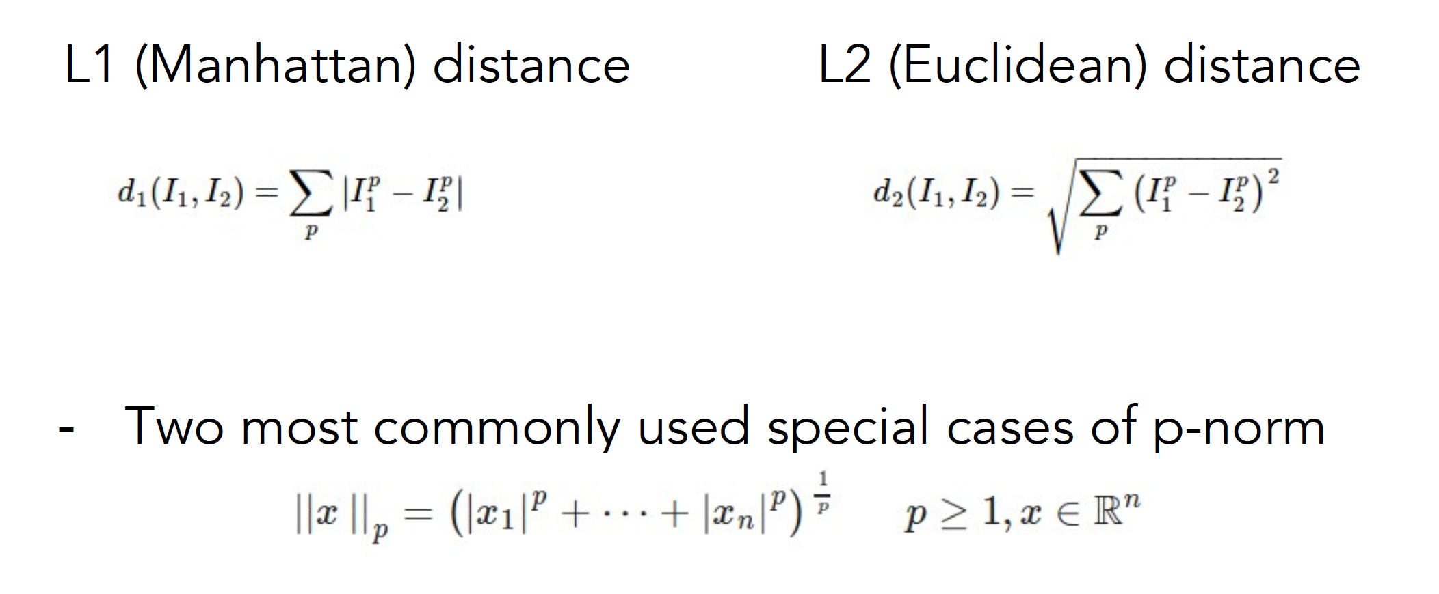
Choice of distance metric
Hyperparameter
Slides from Andrej Karpathy and Fei-Fei Li
http://vision.stanford.edu/teaching/cs231n/

Slide 34
Demo: http://vision.stanford.edu/teaching/cs231n-demos/knn/

Slide 35
Visualization: L2 distance
Notes:
Background plays an unrealistically large role

Slide 36
Hyperparameters

Slide 37
Hyperparameters
What is the best distance to use?
What is the best value of k to use?
These are hyperparameters: choices about the algorithm that we set rather than learn
How do we set them?
One option: try them all and see what works best

Slide 44
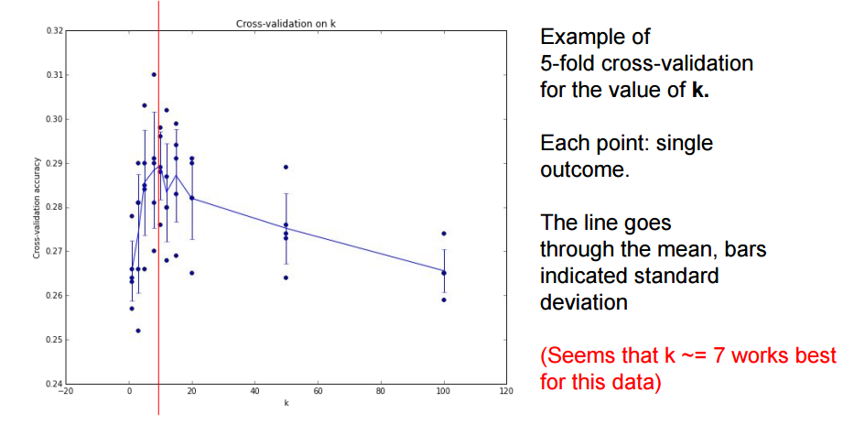

Slide 45
Recap: How to pick hyperparameters?
Methodology
Train and test
Train, validate, test
Train for original model
Validate to find hyperparameters
Test to understand generalizability

Slide 46
kNN -- Complexity and Storage
N training images, M test images
Training: O(1)
Testing: O(MN)
Hmm…
Normally need the opposite
Slow training (ok), fast testing (necessary)

Slide 48
k-Nearest Neighbors: Summary
In image classification we start with a training set of images and labels, and must predict labels on the test set
The K-Nearest Neighbors classifier predicts labels based on nearest training examples
Distance metric and K are hyperparameters
Choose hyperparameters using the validation set; only run on the test set once at the very end!

Slide 49
Linear classifiers

Slide 50
Instead
Image classification using linear classifiers
Need
Score function: raw data to class scores
Loss function: agreement between predicted scores and ground truth labels

Slide 51
Score function
Slides from Andrej Karpathy and Fei-Fei Li
http://vision.stanford.edu/teaching/cs231n/

Slide 52
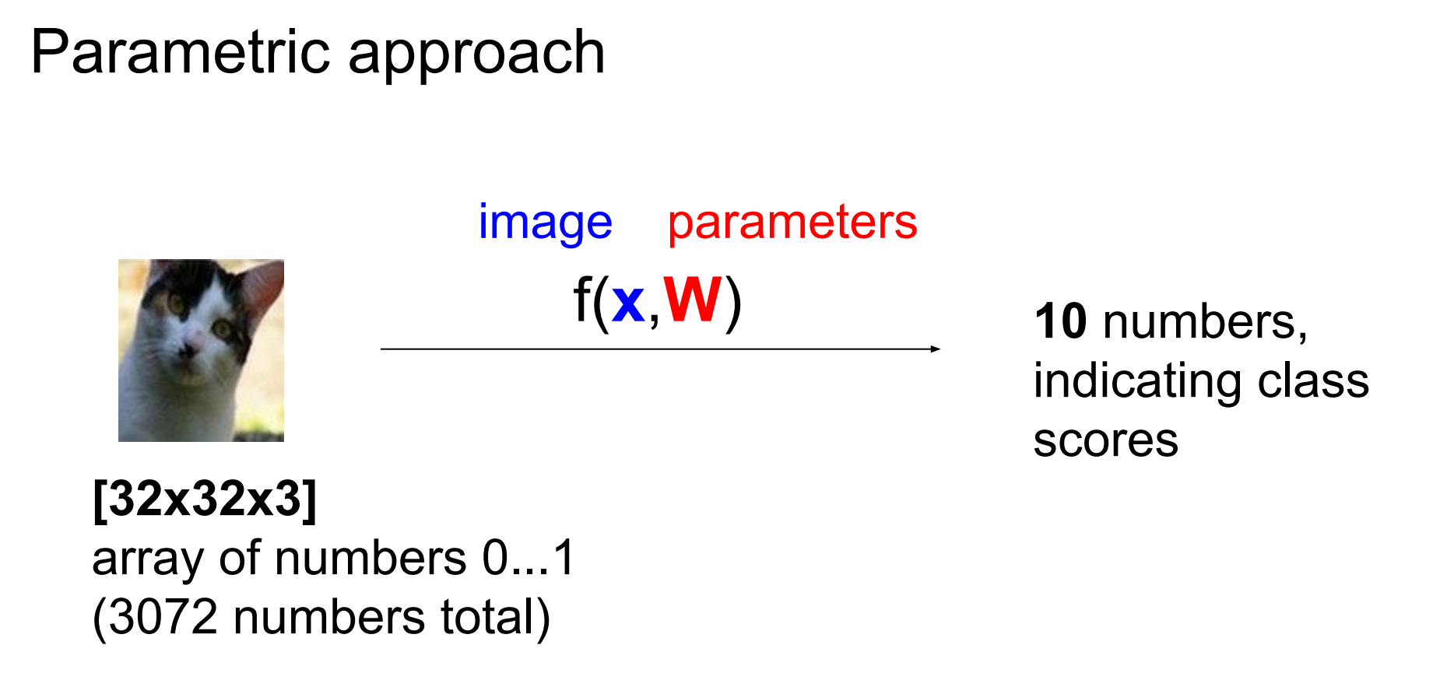
Score function: f

Slide 53
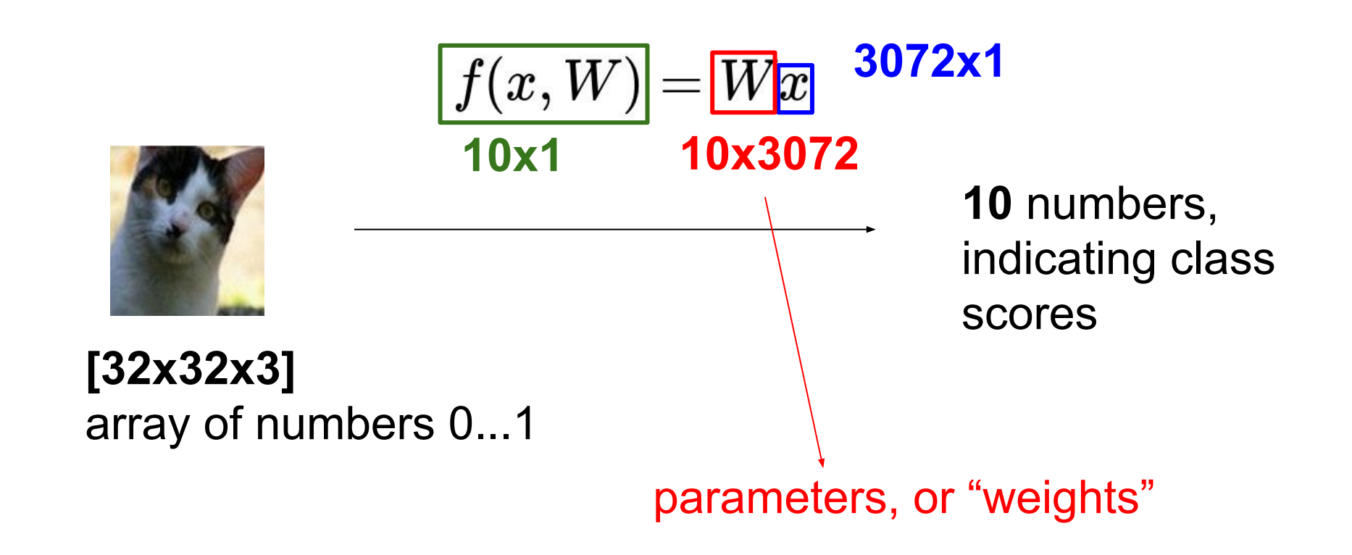
Parametric approach: Linear classifier

Slide 54
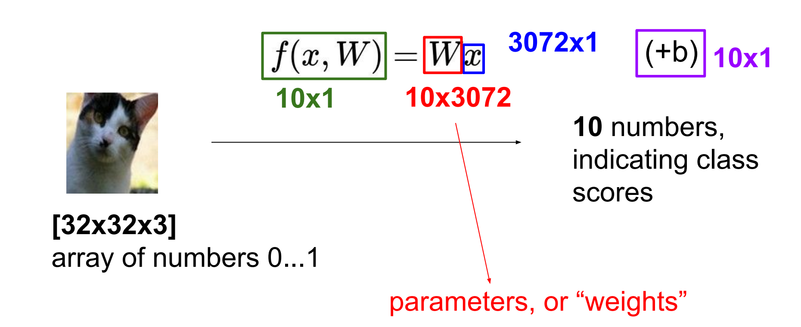
Parametric approach: Linear classifier

Slide 55
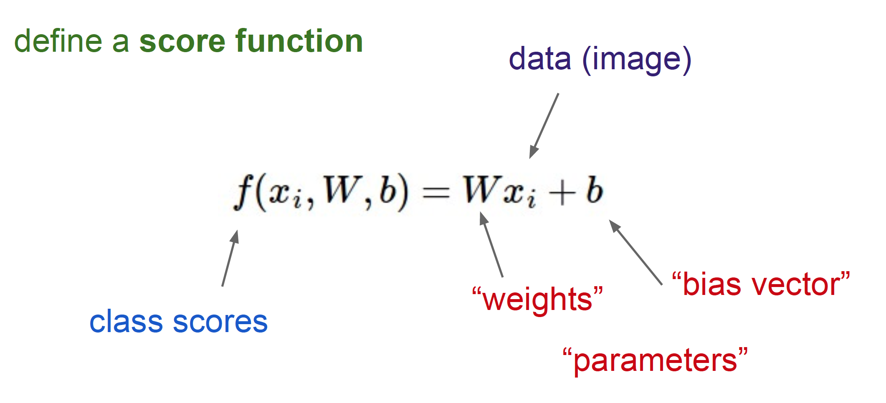
Linear Classifier

Slide 56
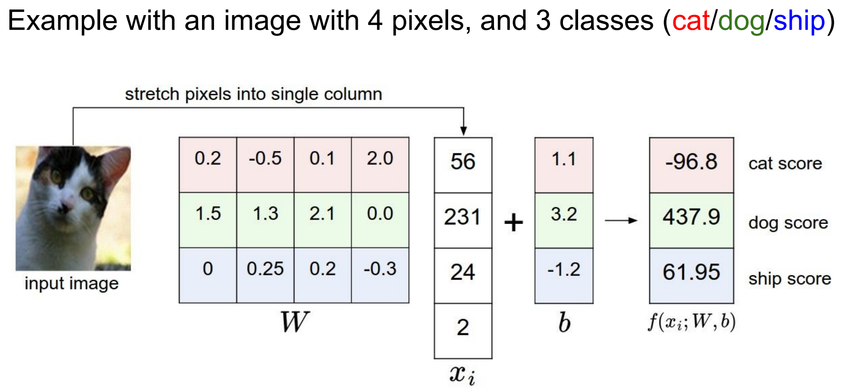

Slide 57
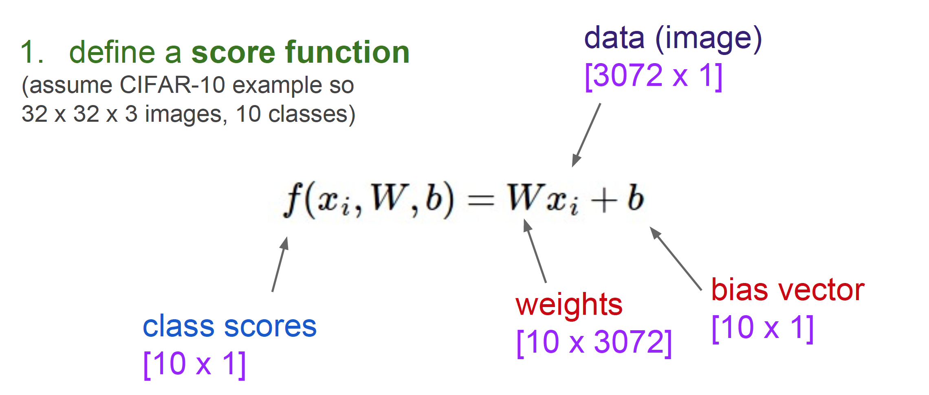
Linear Classifier

Slide 58
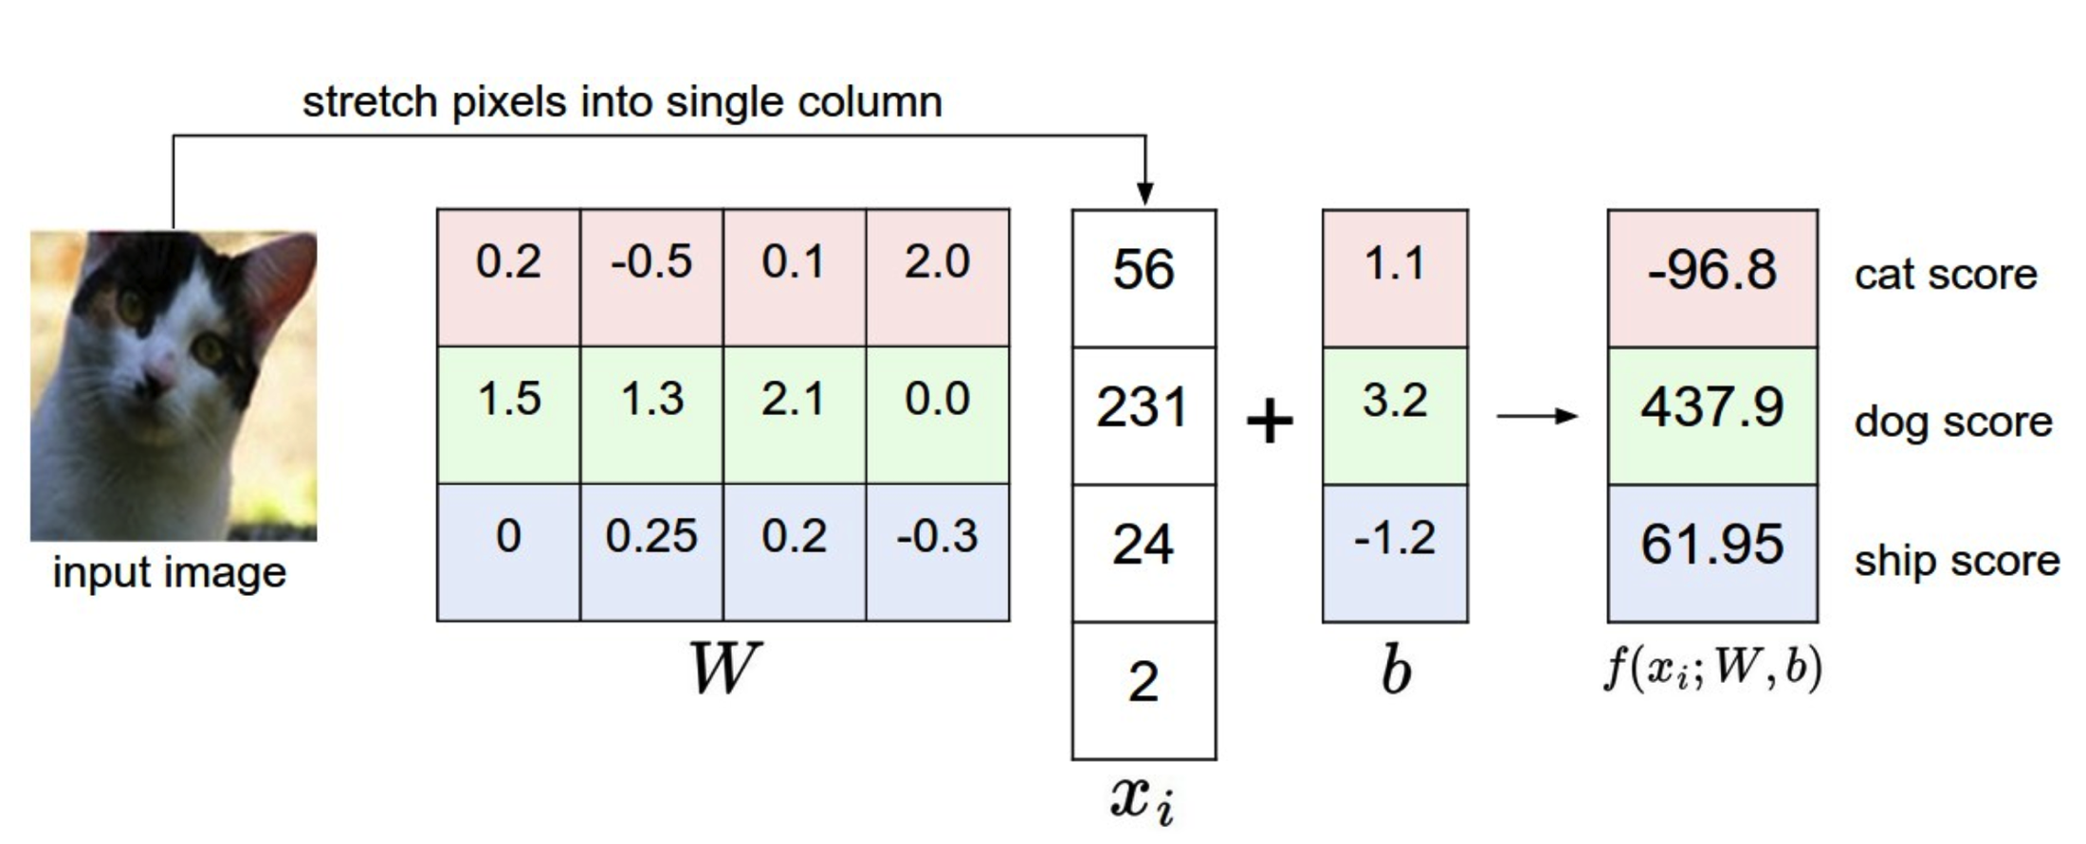
Computing scores
Notes:
This is a bad cat score

Slide 59
Interpretation: Template matching
Notes:
Each row of W is a template for that class

Slide 60
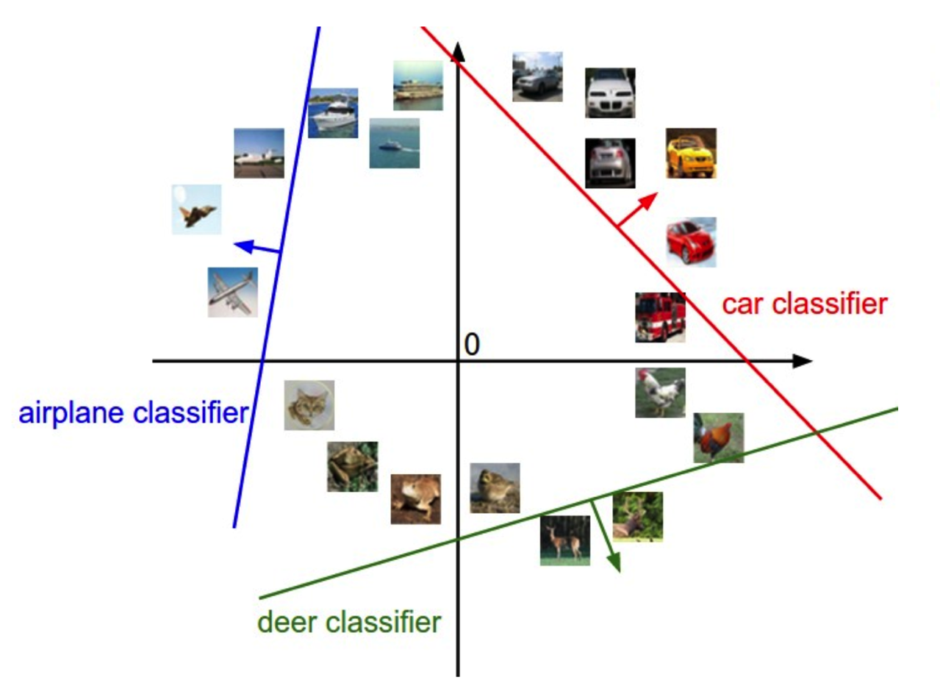
Geometric Interpretation

Slide 61
Linear classifiers
Find linear function (hyperplane) to separate positive and negative examples
Which hyperplane is best? We will come back to this later

Slide 62
