Slide 1
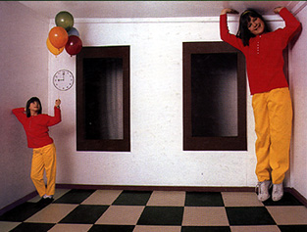
Single-View Modeling
CS5670: Computer Vision
Noah Snavely

Slide 2
Single-View Modeling
Ames Room
Readings
  Mundy, J.L. and Zisserman, A., Geometric Invariance in Computer Vision, Appendix: Projective Geometry for Machine Vision, MIT Press, Cambridge, MA, 1992,
  (read 23.1 - 23.5, 23.10)
    available online: http://www.cs.cmu.edu/~ph/869/papers/zisser-mundy.pdf

Slide 3
Announcements
Project 2 is due this Thursday, March 8
  Report due Friday, March 9
Take-home midterm
  To be distributed in class on Wednesday
  Due at the beginning of class next Monday, March 12

Slide 4
Roadmap ahead
The next few lectures will finish up geometry
  Next up is recognition / learning
We already know about camera geometry & panoramas
Coming up
  Single-view modeling (today)
  Two-view geometry
  Multi-view geometry

Slide 5
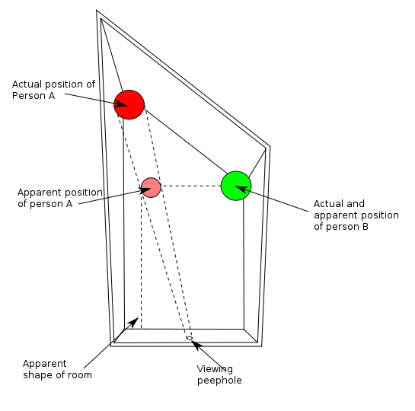
Ames Room

Slide 6
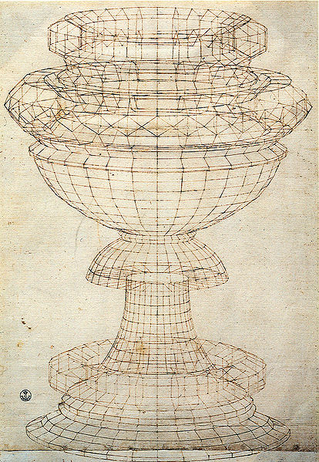
Projective geometry—what’s it good for?
Uses of projective geometry
  Drawing
  Measurements
  Mathematics for projection
  Undistorting images
  Camera pose estimation
  Object recognition
Paolo Uccello

Slide 7
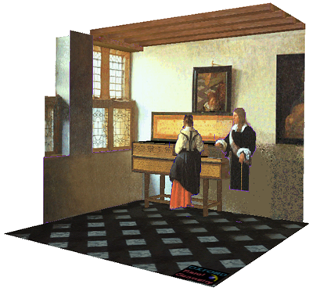
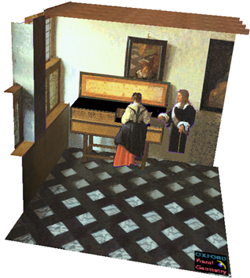

Applications of projective geometry
Vermeer’s Music Lesson
Reconstructions by Criminisi et al.

Slide 8

Making measurements in images

Slide 9

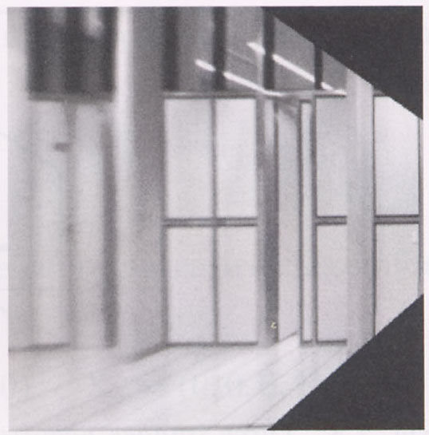

Measurements on planes
4
3
2
1
1
2
3
4
Approach: unwarp then measure
Notes:
homography!

Slide 10
Homogeneous coordinates and lines
(X,Y,W) same as (SX,SY,SW)
Line in projective plane
  ax + by + c = 0
  aX + bY + cW = 0
  u^{T}p = p^{T}u =0
    u = [a,b,c] ^{T} and p = [X,Y,W] ^{T}
    (x,y) Euclidean = (X/W,Y/W)
    W = 0? Ideal points, points at infinity (X,Y,0)

Slide 11
Point and line duality
  A line l is a homogeneous 3-vector
  It is ⊥ to every point (ray) p on the line: l.p=0
p₁
p₂
l₁
p
l
l₂
  What is the line l spanned by rays p₁ and p₂ ?
    l is ⊥ to p₁ and p₂ ⇒ l = p₁ × p₂
    l can be interpreted as a plane normal
  What is the intersection of two lines l₁ and l₂ ?
    p is ⊥ to l₁ and l₂ ⇒ p = l₁ × l₂
  Points and lines are dual in projective space

Slide 12
Ideal points and lines
(a,b,0)
-y
(sx,sy,0)
-y
-z
x
image plane
-z
image plane
x
Ideal point (“point at infinity”)
  p ≅ (x, y, 0) – parallel to image plane
  It has infinite image coordinates
Ideal line
  l ≅ (a, b, 0) – parallel to image plane
  Corresponds to a line in the image (finite coordinates)
    goes through image origin (principle point)

Slide 13
3D projective geometry
These concepts generalize naturally to 3D
  Homogeneous coordinates
    Projective 3D points have four coords: P = (X,Y,Z,W)
  Duality
    A plane N is also represented by a 4-vector
    Points and planes are dual in 3D: N P=0
    Three points define a plane, three planes define a point

Slide 14
3D to 2D: perspective projection
Projection:
Notes:
Preserved: lines, incidence
Not preserved: lengths, angles, parallelism

Slide 15
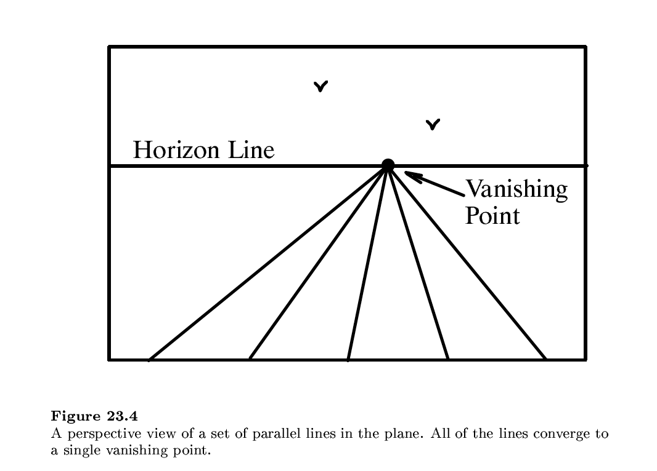

Slide 16
Vanishing points (1D)
image plane
vanishing point
camera
center
ground plane
Vanishing point
  projection of a point at infinity
  can often (but not always) project to a finite point in the image
camera
center
image plane
ground plane

Slide 17
Vanishing points (2D)
image plane
vanishing point
camera
center
line on ground plane

Slide 18
Vanishing points
image plane
vanishing point V
camera
center
C
line on ground plane
line on ground plane
Properties
  Any two parallel lines (in 3D) have the same vanishing point v
  The ray from C through v is parallel to the lines
  An image may have more than one vanishing point
    in fact, every image point is a potential vanishing point
Notes:
How to determine which lines in the scene vanish at a given pixel?

Slide 19

One-point perspective

Slide 20
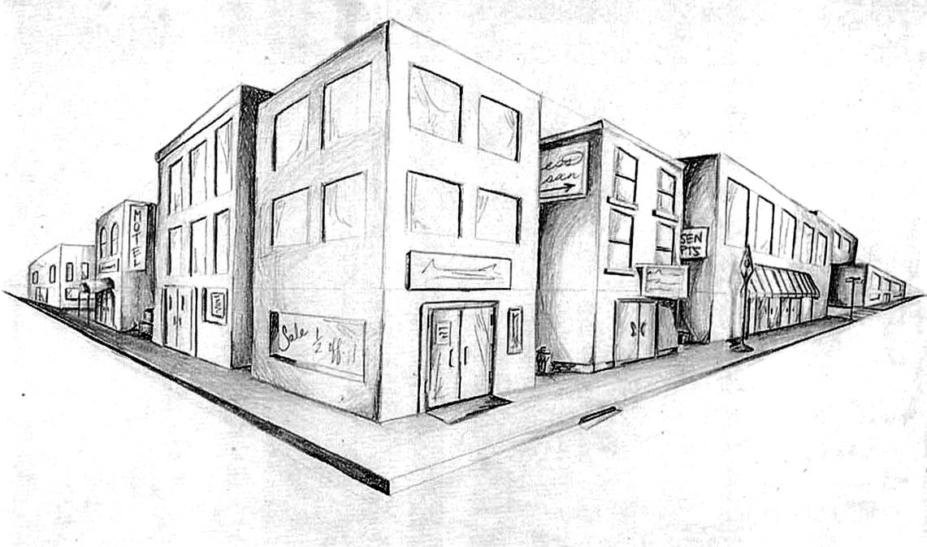
Two-point perspective
v_{y}
v_{x}

Slide 21
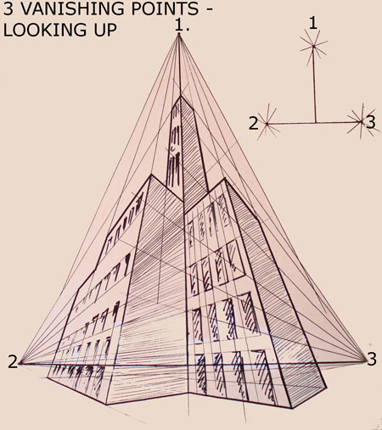
Three-point perspective

Slide 22
Questions?

Slide 23
Vanishing lines
v₁
v₂
Multiple Vanishing Points
  Any set of parallel lines on the plane define a vanishing point
  The union of all of these vanishing points is the horizon line
    also called vanishing line
  Note that different planes (can) define different vanishing lines

Slide 24
Vanishing lines
Multiple Vanishing Points
  Any set of parallel lines on the plane define a vanishing point
  The union of all of these vanishing points is the horizon line
    also called vanishing line
  Note that different planes (can) define different vanishing lines

Slide 25
Computing vanishing points
V
P₀
D

Slide 26
Computing vanishing points
V
P₀
D
Properties
  P∞ is a point at infinity, v is its projection
  Depends only on line direction
  Parallel lines P₀ + tD, P₁ + tD intersect at P∞

Slide 27
Computing vanishing lines
v₁
l
v₂
C
l
ground plane
Properties
  l is intersection of horizontal plane through C with image plane
  Compute l from two sets of parallel lines on ground plane
  All points at same height as C project to l
    points higher than C project above l
  Provides way of comparing height of objects in the scene

Slide 28

Notes:
Is this parachuter higher or lower than the person taking this picture?
Lower—he is below the horizon

Slide 29
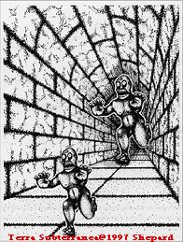
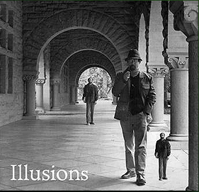
Fun with vanishing points

Slide 30
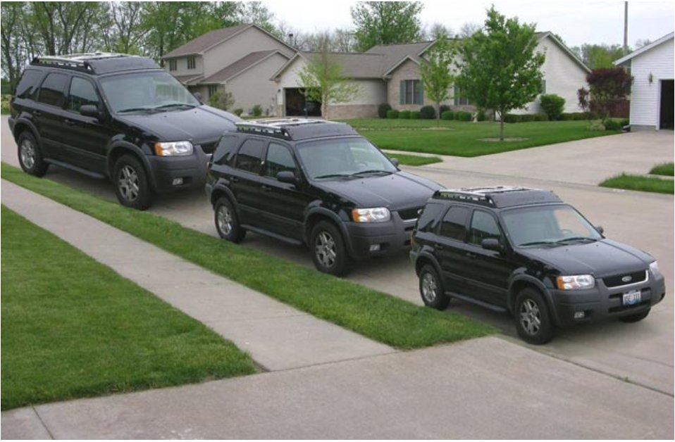
Lots of fun with vanishing points

Slide 31
Perspective cues

Slide 32
Perspective cues

Slide 33
Perspective cues

Slide 34
Comparing heights
Vanishing
Point

Slide 35
Measuring height
5.4
5
How high is the camera?
Camera height
4
3.3
3
2.8
2
1

Slide 36
Computing vanishing points (from lines)
v
q₂
q₁
p₂
p₁
Intersect p₁q₁ with p₂q₂
Least squares version
  Better to use more than two lines and compute the “closest” point of intersection
  See notes by Bob Collins for one good way of doing this:
    http://www-2.cs.cmu.edu/~ph/869/www/notes/vanishing.txt

Slide 37


Measuring height without a ruler
H
R

Slide 38
Measuring height without a ruler
C
Z
ground plane
Compute Z from image measurements
  Need more than vanishing points to do this

Slide 39
The cross ratio
A Projective Invariant
  Something that does not change under projective transformations (including perspective projection)
The cross-ratio of 4 collinear points
P₄
P₃
P₂
P₁
Can permute the point ordering
  4! = 24 different orders (but only 6 distinct values)
This is the fundamental invariant of projective geometry

Slide 40
Measuring height
∞
scene cross ratio
T (top of object)
t
r
R (reference point)
C
H
b
R
image cross ratio
v_{Z}
B (bottom of object)
ground plane
scene points represented as
image points as

Slide 41

Measuring height
v_{z}
r
vanishing line (horizon)
t₀
t
v_{x}
v
v_{y}
H
R
H
b₀
b
image cross ratio

Slide 42
Measuring height
v_{z}
r
t₀
vanishing line (horizon)
v_{x}
v
v_{y}
m₀
t₁
b₀
b₁
b
What if the point on the ground plane b₀ is not known?
  Here the person is standing on the box, height of box is known
  Use one side of the box to help find b₀ as shown above

Slide 43

3D Modeling from a photograph
St. Jerome in his Study, H. Steenwick

Slide 44
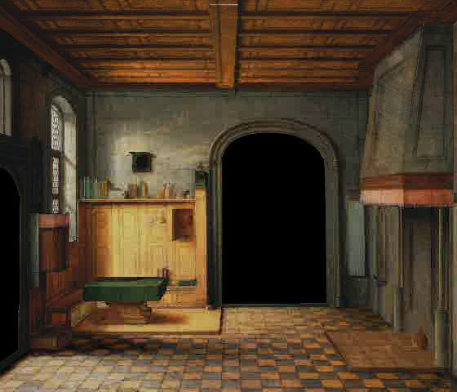
3D Modeling from a photograph

Slide 45
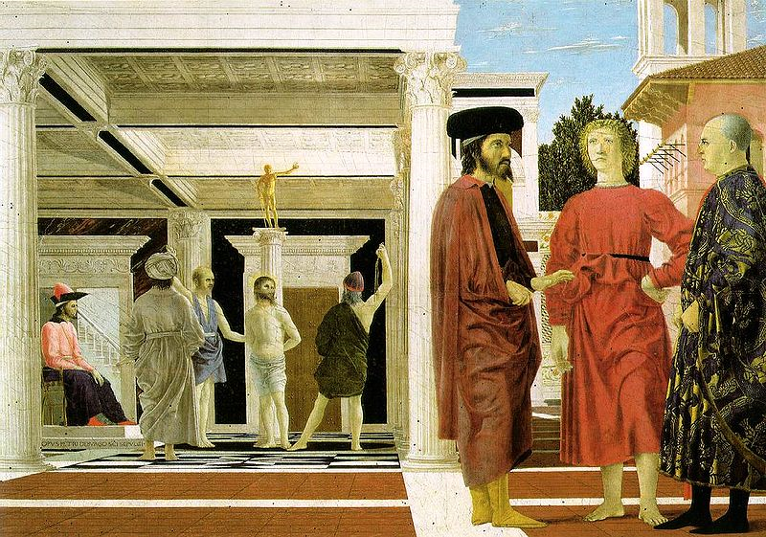
3D Modeling from a photograph
Flagellation, Piero della Francesca

Slide 46
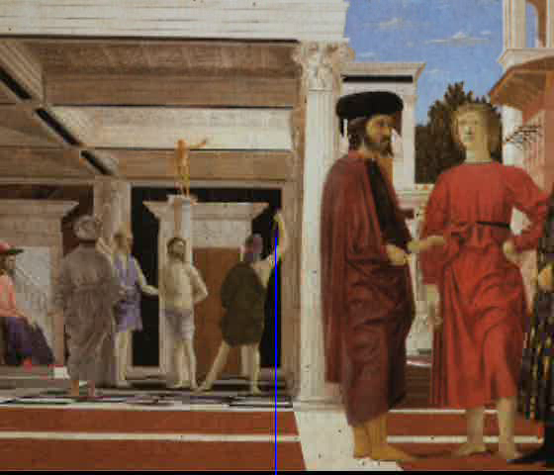
3D Modeling from a photograph
video by Antonio Criminisi

Slide 47

3D Modeling from a photograph

Slide 48
Camera calibration
Goal: estimate the camera parameters
  Version 1: solve for projection matrix
  Version 2: solve for camera parameters separately
    intrinsics (focal length, principle point, pixel size)
    extrinsics (rotation angles, translation)
    radial distortion

Slide 49
Vanishing points and projection matrix
= v_{x} (X vanishing point)
similarly,
π
=
v
,
π
=
v
2
Y
3
Z
Not So Fast! We only know v’s up to a scale factor
  Can fully specify by providing 3 reference points

Slide 50

Calibration using a reference object
Place a known object in the scene
  identify correspondence between image and scene
  compute mapping from scene to image
Issues
  must know geometry very accurately
  must know 3D->2D correspondence

Slide 51
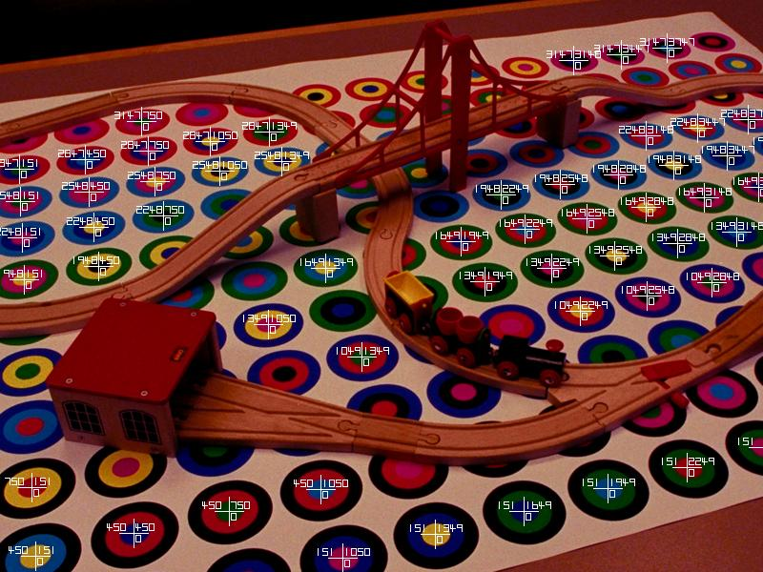
Chromaglyphs
Courtesy of Bruce Culbertson, HP Labs
http://www.hpl.hp.com/personal/Bruce_Culbertson/ibr98/chromagl.htm

Slide 52
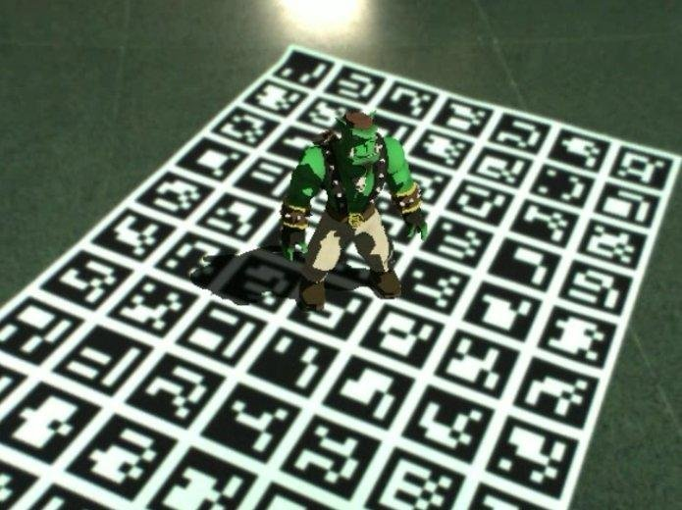
AR codes
ArUco

Slide 53
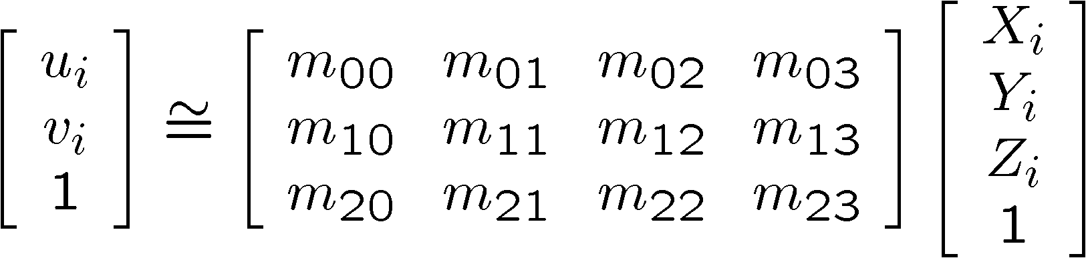
Estimating the projection matrix
Place a known object in the scene
  identify correspondence between image and scene
  compute mapping from scene to image

Slide 54
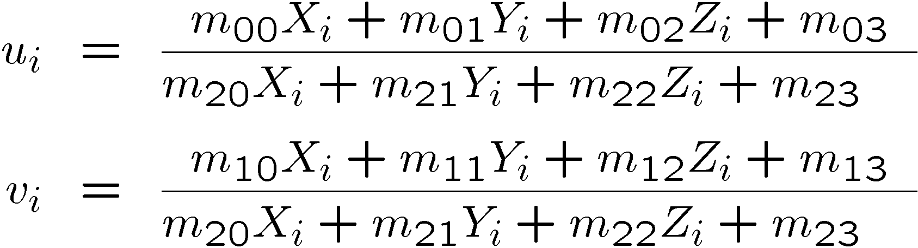
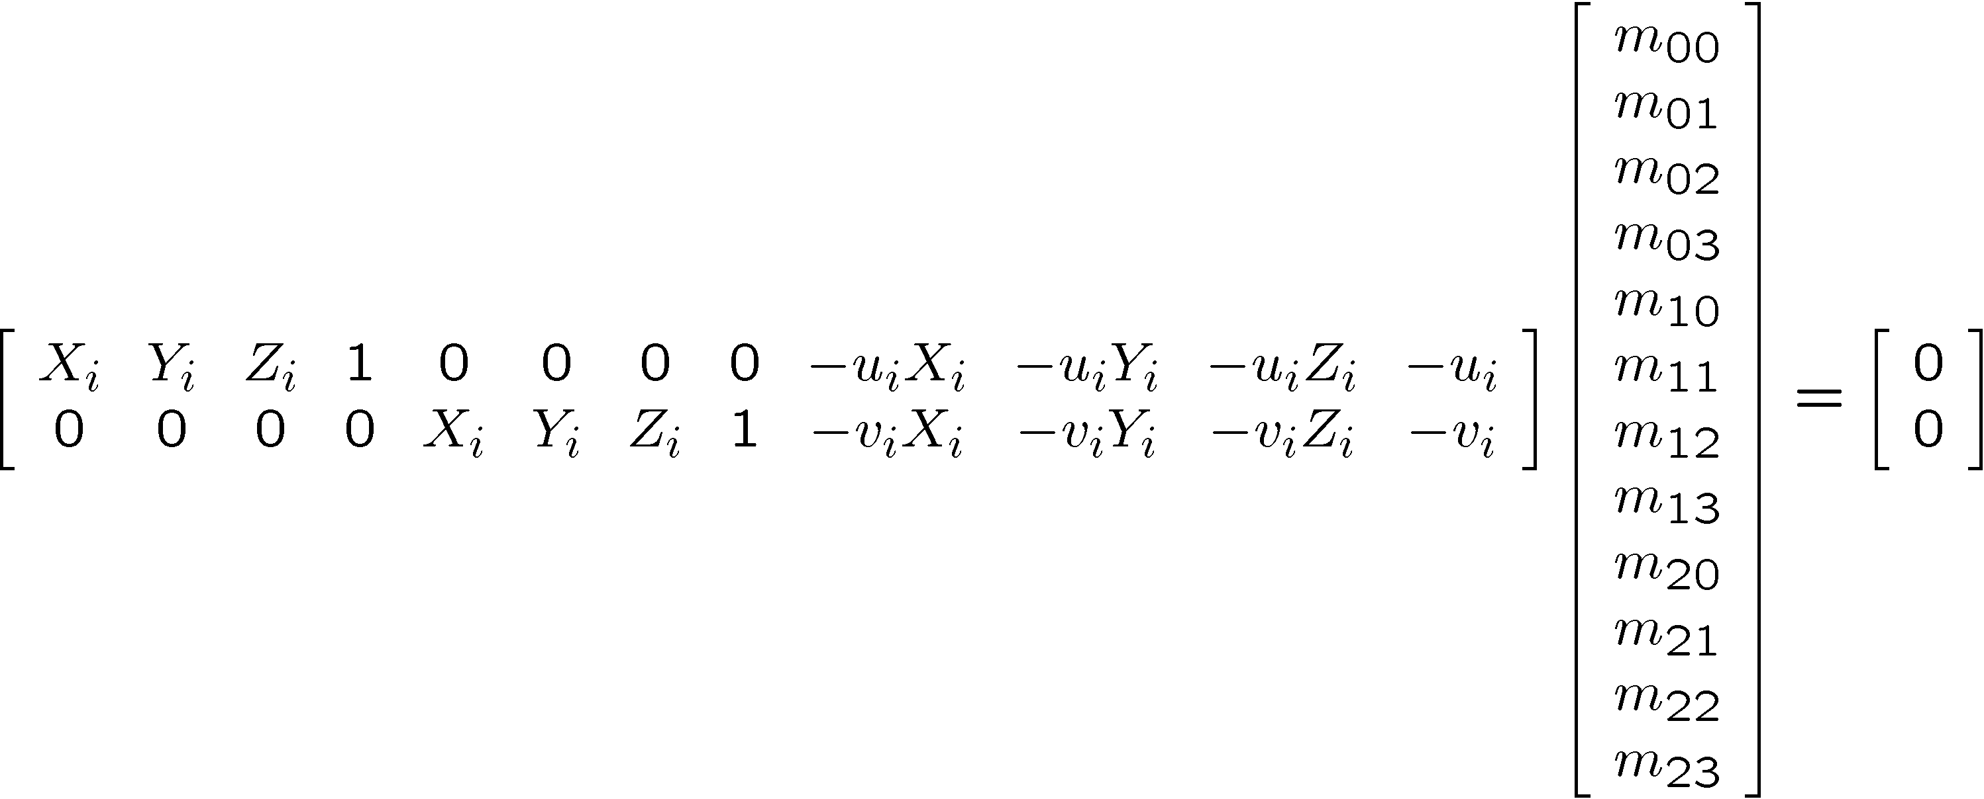
Direct linear calibration

Slide 55
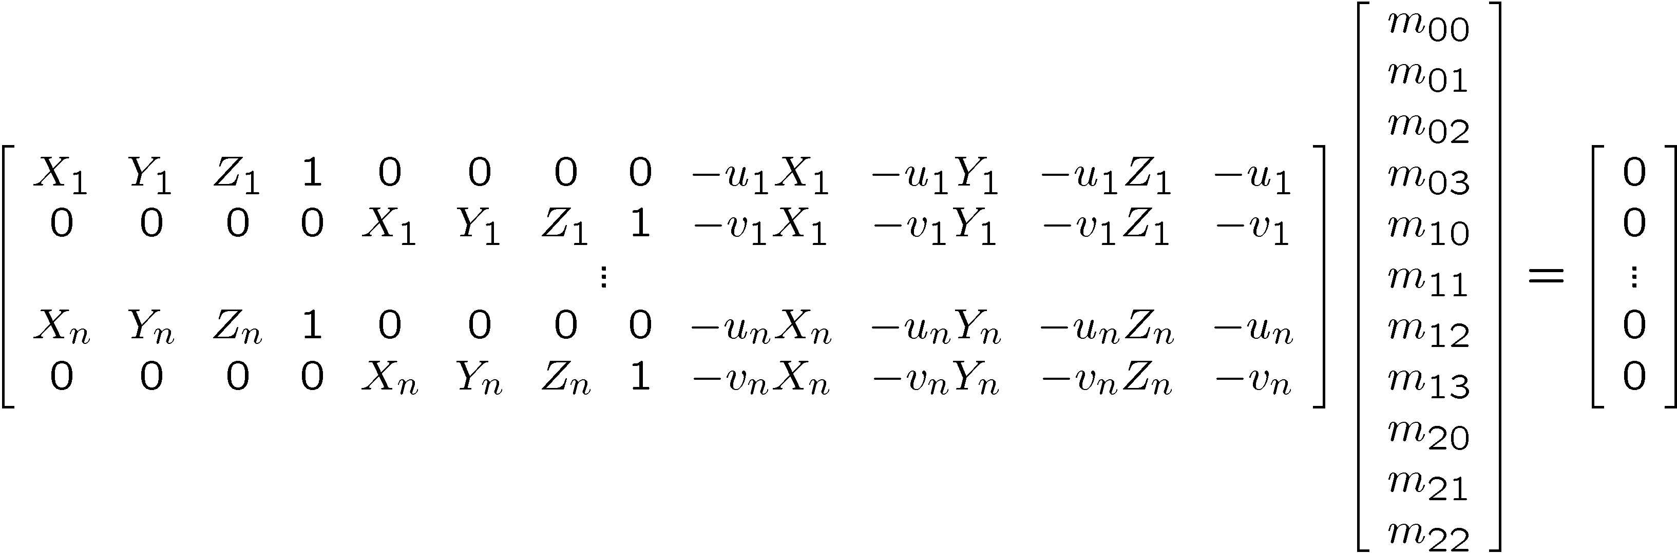
Direct linear calibration
Can solve for m_{ij} by linear least squares
  use eigenvector trick that we used for homographies

Slide 56
Direct linear calibration
Advantage:
  Very simple to formulate and solve
Disadvantages:
  Doesn’t tell you the camera parameters
  Doesn’t model radial distortion
  Hard to impose constraints (e.g., known f)
  Doesn’t minimize the right error function
For these reasons, nonlinear methods are preferred
  Define error function E between projected 3D points and image positions
    E is nonlinear function of intrinsics, extrinsics, radial distortion
  Minimize E using nonlinear optimization techniques

Slide 57
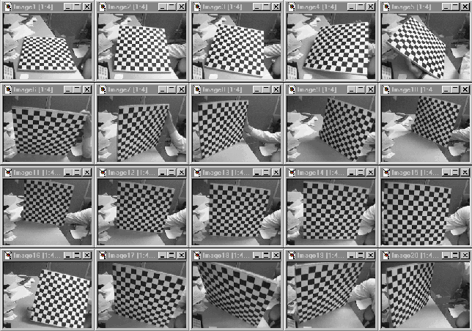
Alternative: multi-plane calibration
Images courtesy Jean-Yves Bouguet, Intel Corp.
Advantage
  Only requires a plane
  Don’t have to know positions/orientations
  Good code available online! (including in OpenCV)
    Matlab version by Jean-Yves Bouget: http://www.vision.caltech.edu/bouguetj/calib_doc/index.html
    Zhengyou Zhang’s web site: http://research.microsoft.com/~zhang/Calib/

Slide 58
Some Related Techniques
Image-Based Modeling and Photo Editing
  Mok et al., SIGGRAPH 2001
  http://graphics.csail.mit.edu/ibedit/
Single View Modeling of Free-Form Scenes
  Zhang et al., CVPR 2001
  http://grail.cs.washington.edu/projects/svm/
Tour Into The Picture
  Anjyo et al., SIGGRAPH 1997
  http://koigakubo.hitachi.co.jp/little/DL_TipE.html

