Slide 1
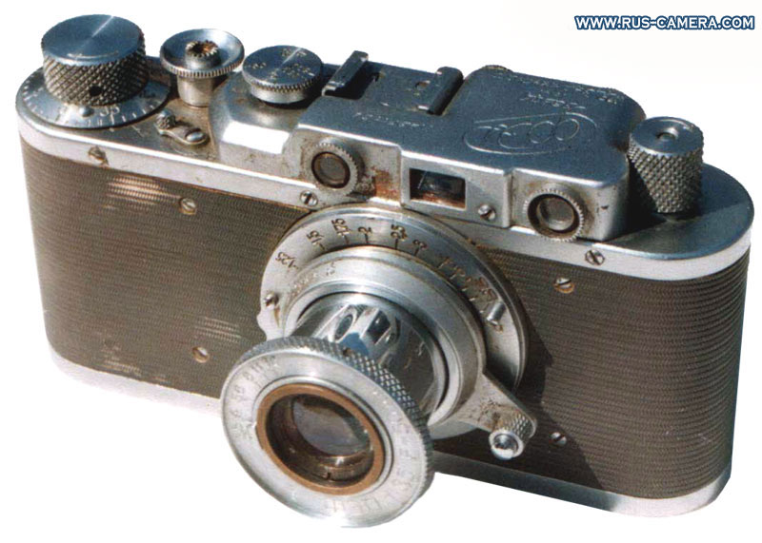
Lecture 10: Cameras
CS5670: Computer Vision
Noah Snavely
Source: S. Lazebnik

Slide 2
Announcements
Project 2 is out, due next Thursday, March 8
  Report due Friday, March 9
  Project to be done in pairs
    Please form groups on CMS!
Take-home midterm
  To be distributed in class next Thursday, March 8
  Due at the beginning of class the following Tuesday (March 13)
Planning on in-class final, last lecture of class

Slide 3

Can we use homographies to create a 360 panorama?
In order to figure this out, we need to learn what a camera is

Slide 4
Image formation
Let’s design a camera
  Idea 1: put a piece of film in front of an object
  Do we get a reasonable image?

Slide 5
Pinhole camera
Add a barrier to block off most of the rays
  This reduces blurring
  The opening known as the aperture
  How does this transform the image?
Notes:
It gets inverted

Slide 6
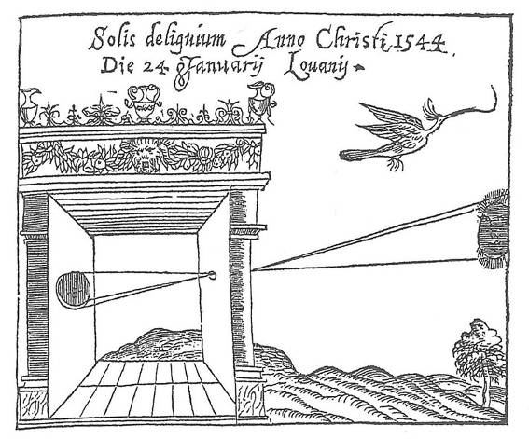
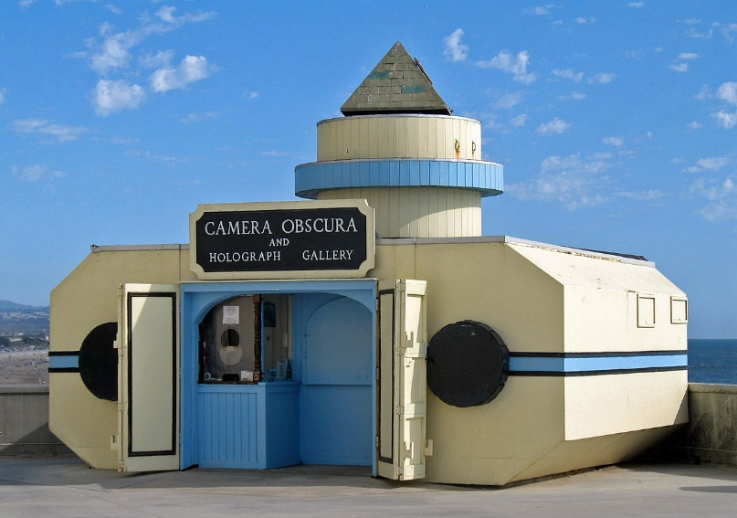
Camera Obscura
Basic principle known to Mozi (470-390 BC), Aristotle (384-322 BC)
Drawing aid for artists: described by Leonardo da Vinci (1452-1519)
Gemma Frisius, 1558
Source: A. Efros

Slide 7
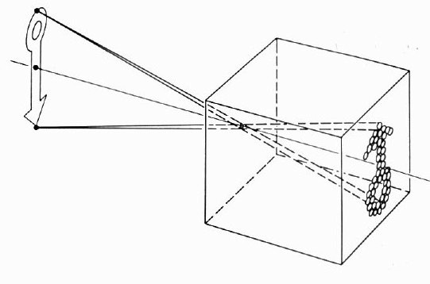
Camera Obscura

Slide 8
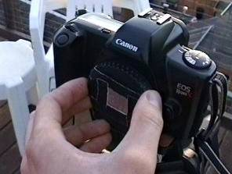
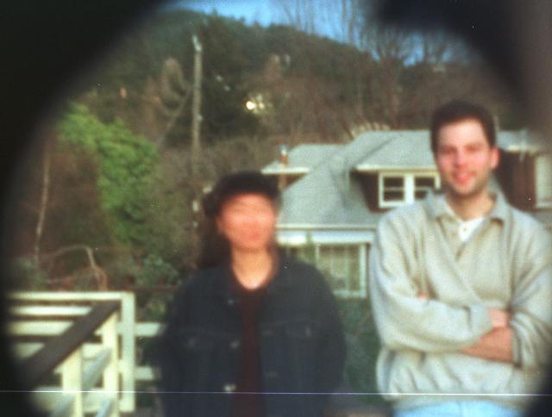
Home-made pinhole camera
Why so
blurry?
Slide by A. Efros
http://www.debevec.org/Pinhole/

Slide 9
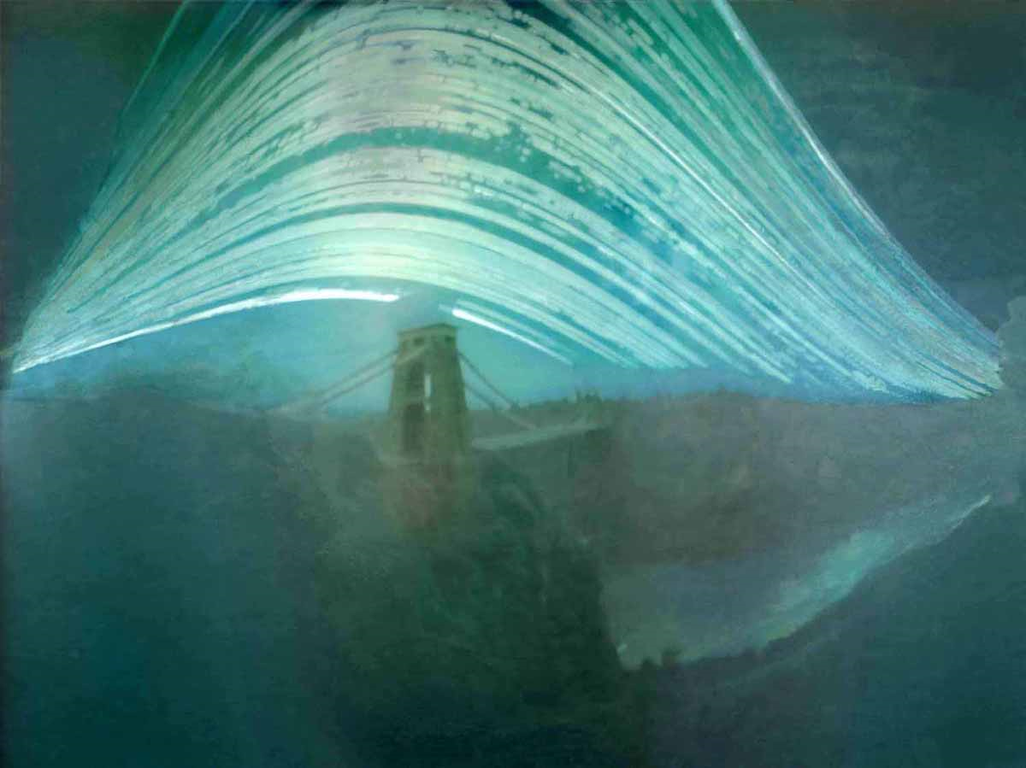
Pinhole photography
Justin Quinnell, The Clifton Suspension Bridge. December 17th 2007 - June 21st 2008
6-month exposure

Slide 10
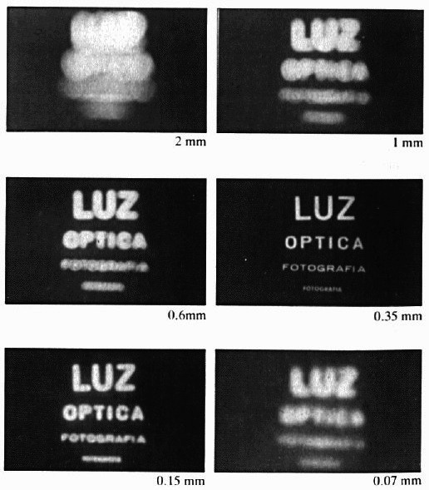
Shrinking the aperture
Why not make the aperture as small as possible?
  Less light gets through
  Diffraction effects...

Slide 11
Shrinking the aperture

Slide 12
Adding a lens
“circle of
confusion”
A lens focuses light onto the film
  There is a specific distance at which objects are “in focus”
    other points project to a “circle of confusion” in the image
  Changing the shape of the lens changes this distance

Slide 13


Slide 14
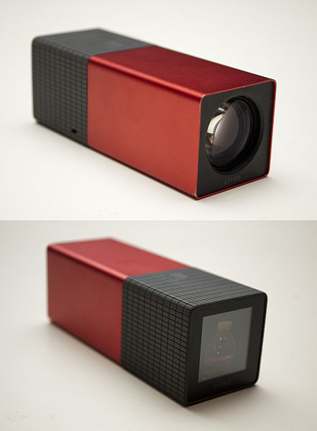
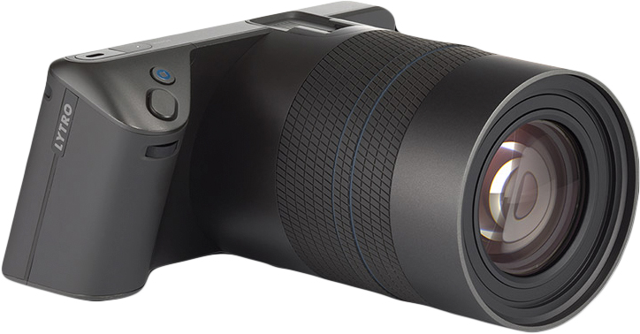
Lytro Lightfield Camera
Captures “all the rays”

Slide 15

Lenses
F
focal point
A lens focuses parallel rays onto a single focal point
  focal point at a distance f beyond the plane of the lens (the focal length)
    f is a function of the shape and index of refraction of the lens
  Aperture restricts the range of rays
    aperture may be on either side of the lens
  Lenses are typically spherical (easier to produce)

Slide 16
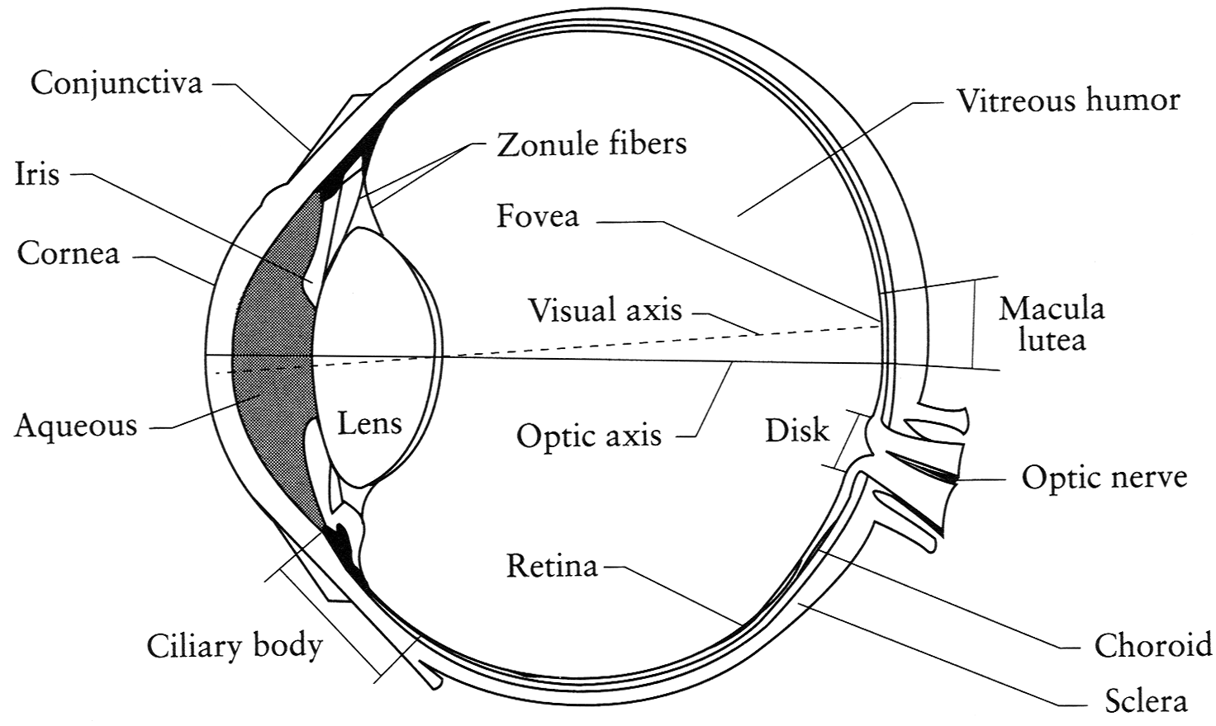
The eye
The human eye is a camera
  Iris - colored annulus with radial muscles
  Pupil - the hole (aperture) whose size is controlled by the iris
  What’s the “film”?
    photoreceptor cells (rods and cones) in the retina
Notes:
Note that the retina is curved

Slide 17
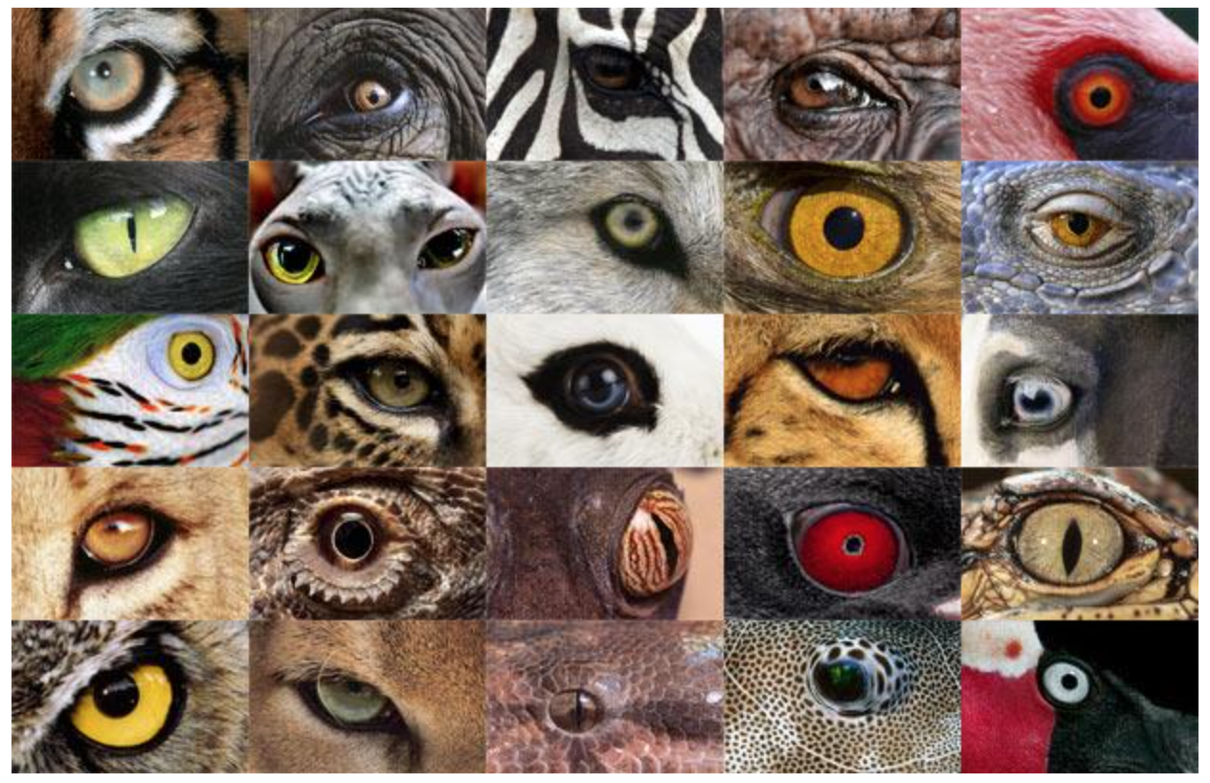
http://www.telegraph.co.uk/news/earth/earthpicturegalleries/7598120/Animal-eyes-quiz-Can-you-work-out-which-creatures-these-are-from-their-eyes.html?image=25

Slide 18
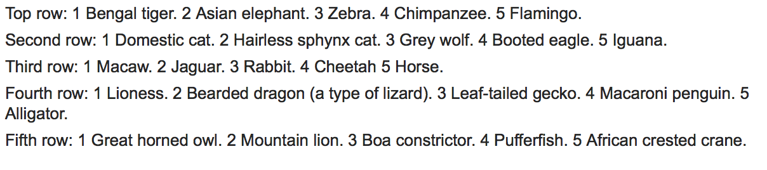
http://www.telegraph.co.uk/news/earth/earthpicturegalleries/7598120/Animal-eyes-quiz-Can-you-work-out-which-creatures-these-are-from-their-eyes.html?image=25

Slide 19

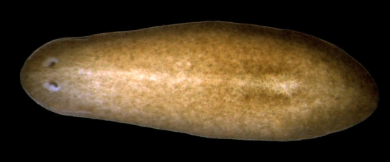
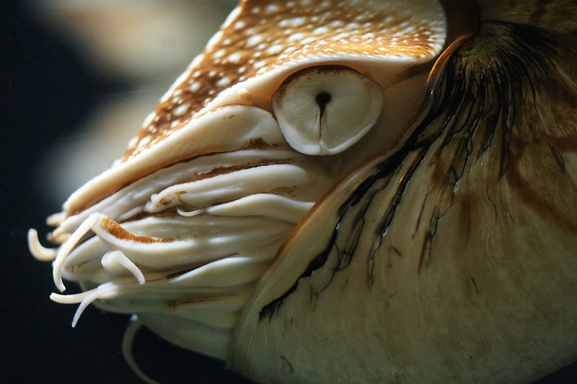
Eyes in nature: eyespots to pinhole camera
http://upload.wikimedia.org/wikipedia/commons/6/6d/Mantis_shrimp.jpg

Slide 20
Eyes in nature: eyespots to pinhole camera

Slide 21
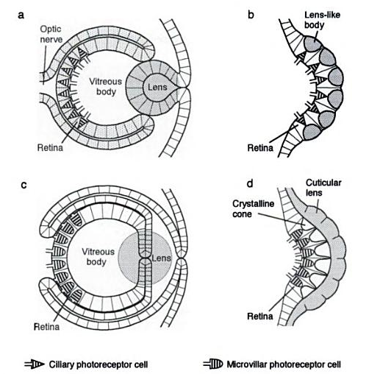
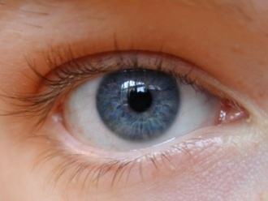

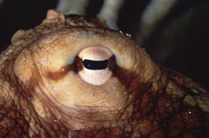
Eyes in nature
(polychaete fan worm)
Source: Animal Eyes, Land & Nilsson

Slide 22
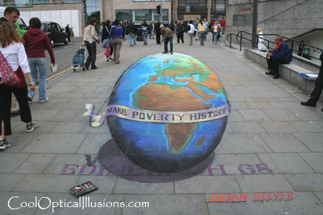
Projection

Slide 23
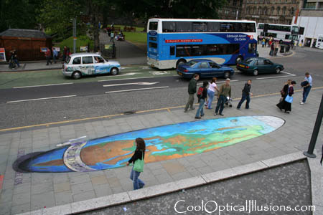
Projection

Slide 24

Müller-Lyer Illusion
http://www.michaelbach.de/ot/sze_muelue/index.html

Slide 25
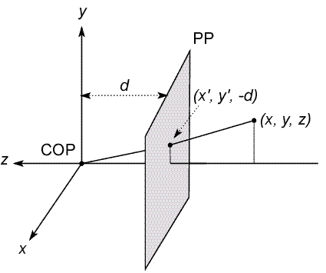
Modeling projection
The coordinate system
  We will use the pinhole model as an approximation
  Put the optical center (Center Of Projection) at the origin
  Put the image plane (Projection Plane) in front of the COP
    Why?
  The camera looks down the negative z axis
    we like this if we want right-handed-coordinates
Notes:
This way the image is right-side-up

Slide 26
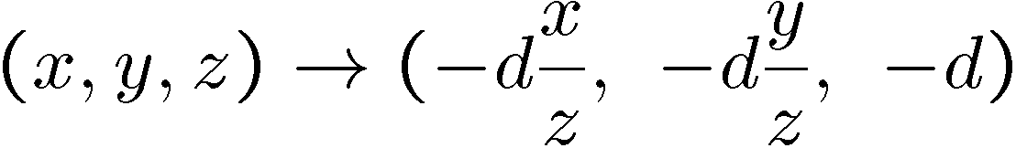
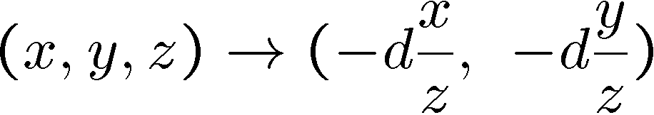
Modeling projection
Projection equations
  Compute intersection with PP of ray from (x,y,z) to COP
  Derived using similar triangles (on board)
  We get the projection by throwing out the last coordinate:

Slide 27




Modeling projection
Is this a linear transformation?
  no—division by z is nonlinear
Homogeneous coordinates to the rescue—again!
homogeneous image
coordinates
homogeneous scene
coordinates
Converting from homogeneous coordinates

Slide 28
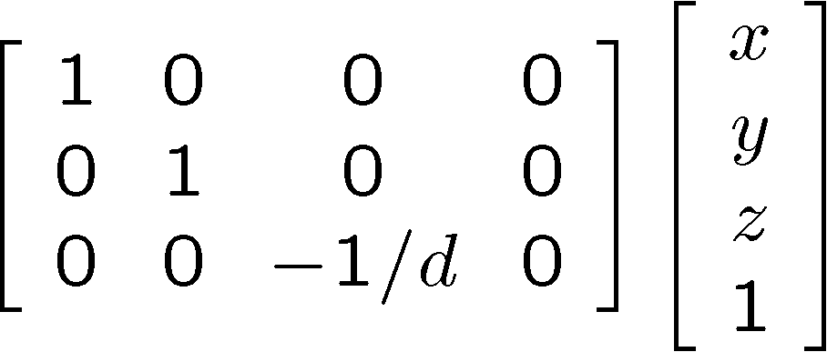
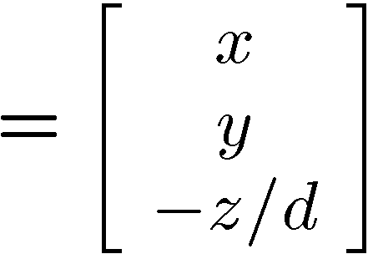
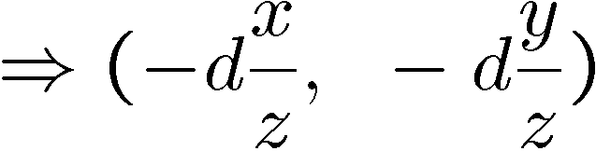
Perspective Projection
Projection is a matrix multiply using homogeneous coordinates:
divide by third coordinate
This is known as perspective projection
  The matrix is the projection matrix
(Can also represent as a 4x4 matrix – OpenGL does something like this)

Slide 29
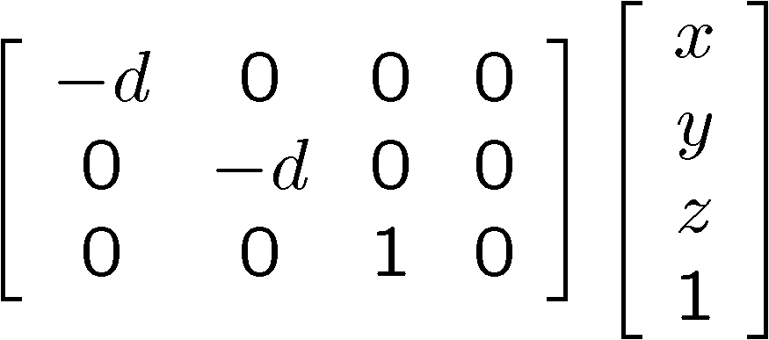
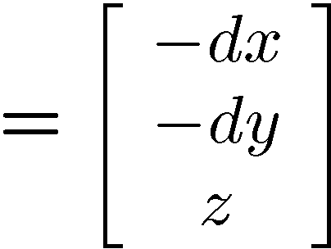
Perspective Projection
How does scaling the projection matrix change the transformation?

Slide 30
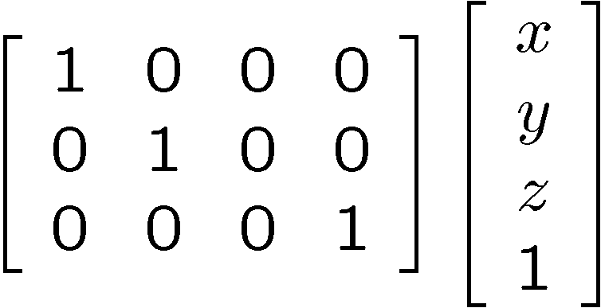
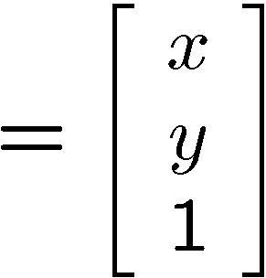

Orthographic projection
Special case of perspective projection
  Distance from the COP to the PP is infinite
  Good approximation for telephoto optics
  Also called “parallel projection”: (x, y, z) → (x, y)
  What’s the projection matrix?
Image
World

Slide 31
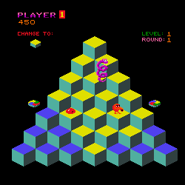
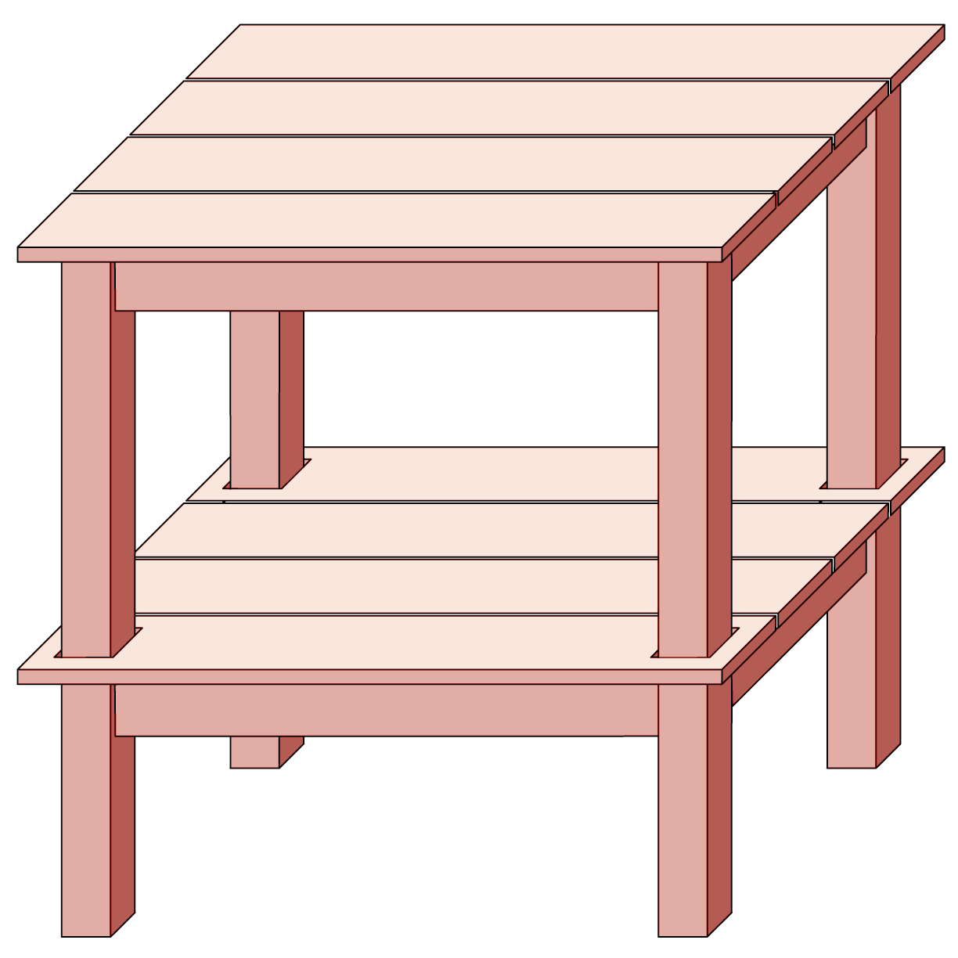
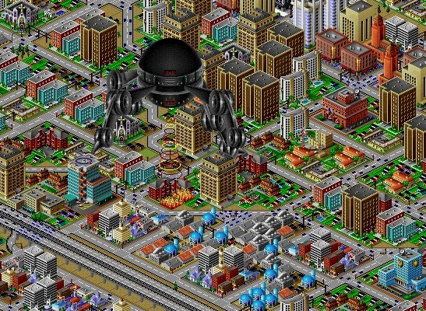
Orthographic projection

Slide 32
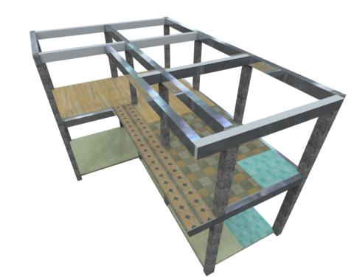
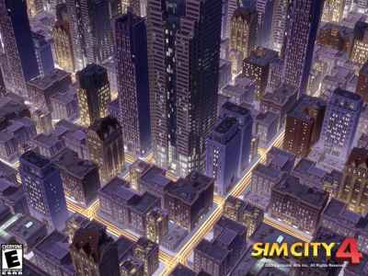
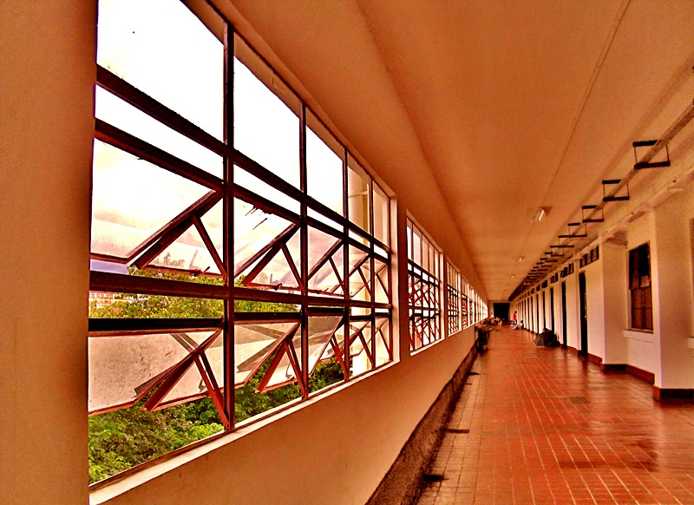
Perspective projection

Slide 33
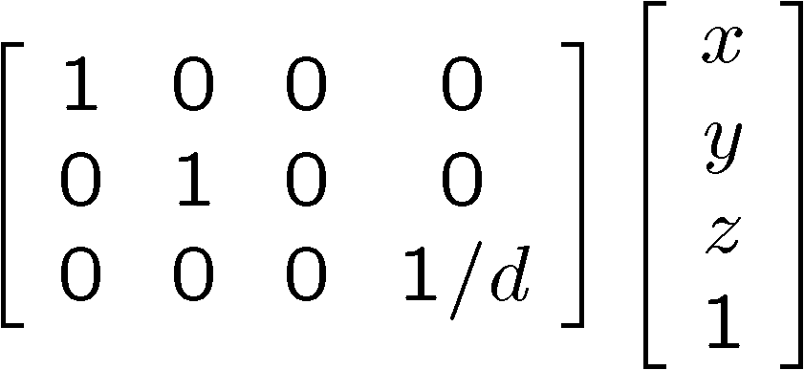
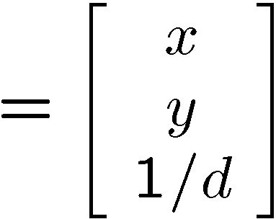

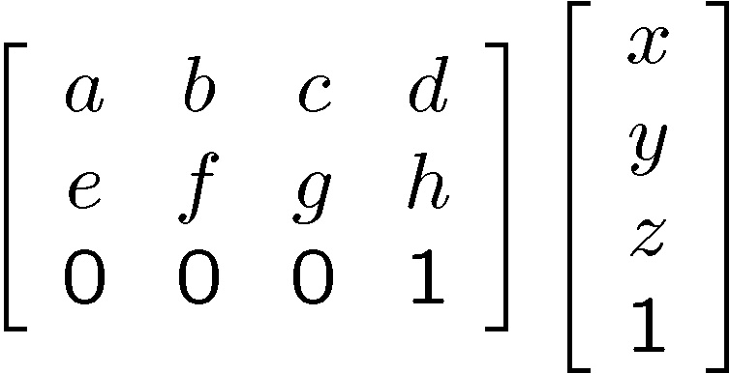
Variants of orthographic projection
Scaled orthographic
  Also called “weak perspective”
Affine projection
  Also called “paraperspective”

Slide 34
Dimensionality Reduction Machine (3D to 2D)
3D world
2D image
What have we lost?
  Angles
  Distances (lengths)
Slide by A. Efros
Figures © Stephen E. Palmer, 2002

Slide 35
Projection properties
Many-to-one: any points along same ray map to same point in image
Points → points
Lines → lines (collinearity is preserved)
  But line through focal point projects to a point
Planes → planes (or half-planes)
  But plane through focal point projects to line

Slide 36
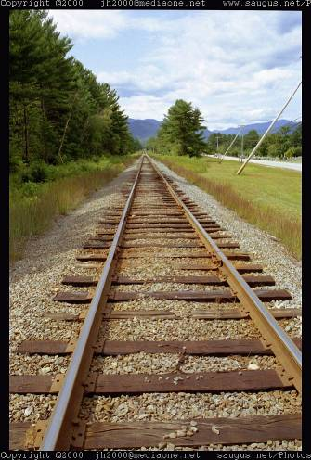
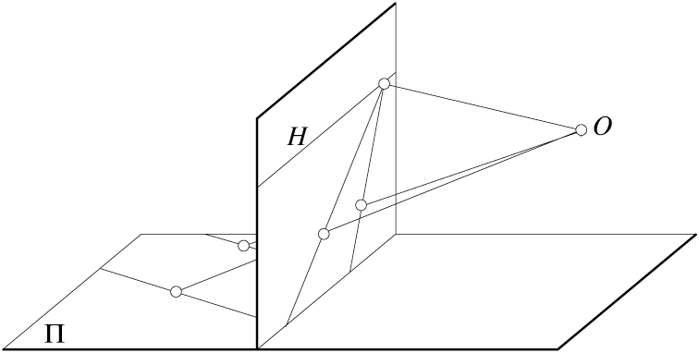
Projection properties
Parallel lines converge at a vanishing point
  Each direction in space has its own vanishing point
  But parallels parallel to the image plane remain parallel

Slide 37
Questions?

Slide 38

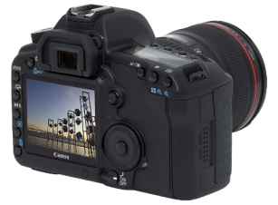
Camera parameters
How can we model the geometry of a camera?
v
y
(x, y, z)
COP
u
Camera
w
o
x
Two important coordinate systems:
1. World coordinate system
2. Camera coordinate system
z
“The World”
How do we project a given point (x, y, z) in world coordinates?

Slide 39
Camera parameters
To project a point (x,y,z) in world coordinates into a camera
First transform (x,y,z) into camera coordinates
Need to know
  Camera position (in world coordinates)
  Camera orientation (in world coordinates)
Then project into the image plane to get a pixel coordinate
  Need to know camera intrinsics

Slide 40





Camera parameters
A camera is described by several parameters
  Translation T of the optical center from the origin of world coords
  Rotation R of the image plane
  focal length f, principle point (x’_{c}, y’_{c}), pixel size (s_{x}, s_{y})
  blue parameters are called “extrinsics,” red are “intrinsics”
Projection equation
  The projection matrix models the cumulative effect of all parameters
  Useful to decompose into a series of operations
identity matrix
intrinsics
projection
rotation
translation
  The definitions of these parameters are not completely standardized
    especially intrinsics—varies from one book to another

Slide 41










Projection matrix
=
0
(in homogeneous image coordinates)

Slide 42
Extrinsics
How do we get the camera to “canonical form”?
  (Center of projection at the origin, x-axis points right, y-axis points up, z-axis points backwards)
Step 1: Translate by -c
0

Slide 43
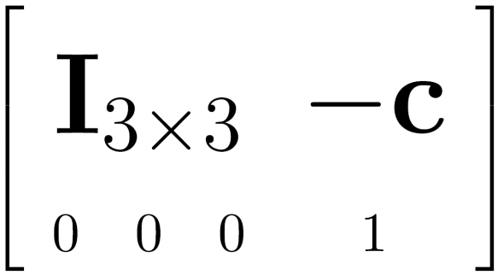

Extrinsics
How do we get the camera to “canonical form”?
  (Center of projection at the origin, x-axis points right, y-axis points up, z-axis points backwards)
Step 1: Translate by -c
How do we represent translation as a matrix multiplication?
0

Slide 44
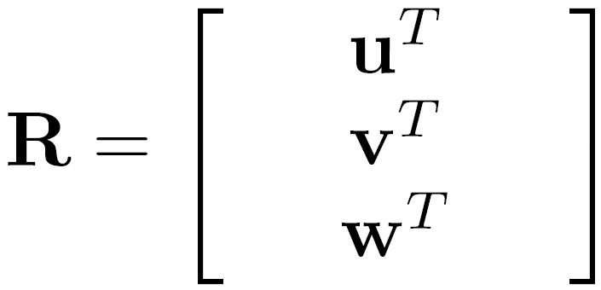
Extrinsics
How do we get the camera to “canonical form”?
  (Center of projection at the origin, x-axis points right, y-axis points up, z-axis points backwards)
Step 1: Translate by -c
Step 2: Rotate by R
0
3x3 rotation matrix

Slide 45
Extrinsics
How do we get the camera to “canonical form”?
  (Center of projection at the origin, x-axis points right, y-axis points up, z-axis points backwards)
Step 1: Translate by -c
Step 2: Rotate by R
0
(with extra row/column of [0 0 0 1])

Slide 46
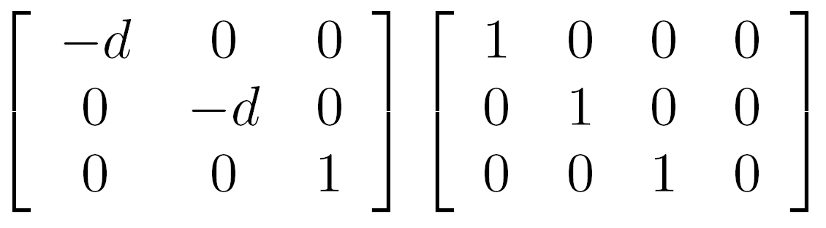
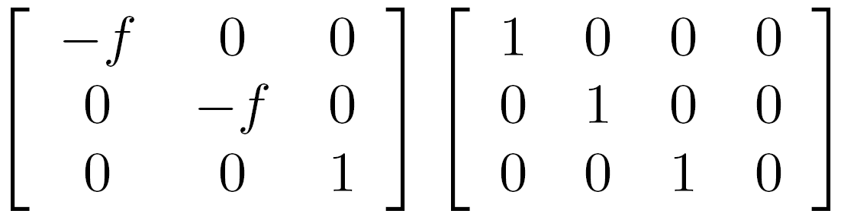

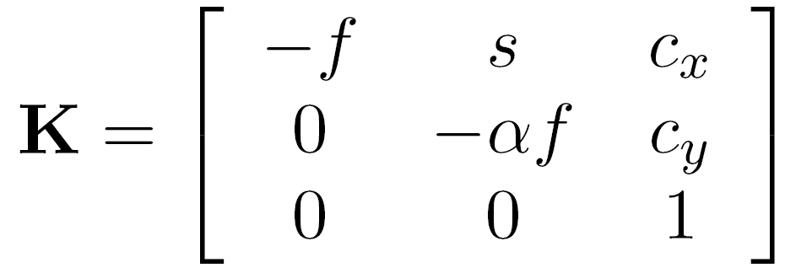



Perspective projection
(converts from 3D rays in camera coordinate system to pixel coordinates)
(intrinsics)
in general,
(upper triangular matrix)
: aspect ratio (1 unless pixels are not square)
: skew (0 unless pixels are shaped like rhombi/parallelograms)
: principal point ((0,0) unless optical axis doesn’t intersect projection plane at origin)

Slide 47
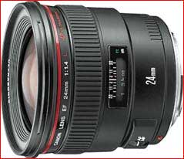



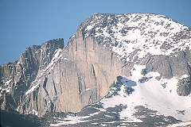
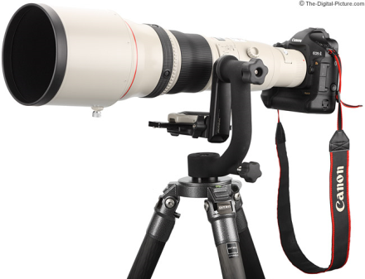
Focal length
Can think of as “zoom”
Also related to field of view
24mm
50mm
200mm
800mm

Slide 48


Field of view
http://www.dslrsolutions.net/3298/using-your-hands-as-focal-length-calculator/

Slide 49


Slide 50


Slide 51


Slide 52


Slide 53

Notes:
http://www.stsite.com/camera/telephoto-wideangle.php
Wide angle deepens
Telephoto magnifies and pulls it in

Slide 54

http://petapixel.com/2013/01/11/how-focal-length-affects-your-subjects-apparent-weight-as-seen-with-a-cat/

Slide 55


Projection matrix
intrinsics
projection
rotation
translation
This part converts 3D points in world coordinates to 3D rays in the camera’s coordinate system. There are 6 parameters represented (3 for position/translation, 3 for rotation).
The K matrix converts 3D rays in the camera’s coordinate system to 2D image points in image (pixel) coordinates.

Slide 56


Projection matrix
intrinsics
projection
rotation
translation
(t in book’s notation)

Slide 57


Projection matrix
(t in book’s notation)
or

Slide 58
Projection matrix
=
0
(in homogeneous image coordinates)

Slide 59
Questions?

Slide 60

Perspective distortion
Problem for architectural photography: converging verticals
Source: F. Durand

Slide 61


Perspective distortion
Problem for architectural photography: converging verticals
Solution: view camera (lens shifted w.r.t. film)
Tilting the camera upwards results in converging verticals
Keeping the camera level, with an ordinary lens, captures only the bottom portion of the building
Shifting the lens upwards results in a picture of the entire subject
http://en.wikipedia.org/wiki/Perspective_correction_lens
Source: F. Durand

Slide 62
Perspective distortion
Problem for architectural photography: converging verticals
Result:
Source: F. Durand

Slide 63
Perspective distortion
What does a sphere project to?
Image source: F. Durand

Slide 64


Perspective distortion
The exterior columns appear bigger
The distortion is not due to lens flaws
Problem pointed out by Da Vinci
Slide by F. Durand

Slide 65

Perspective distortion: People

Slide 66

Distortion
No distortion
Pin cushion
Barrel
Radial distortion of the image
  Caused by imperfect lenses
  Deviations are most noticeable for rays that pass through the edge of the lens

Slide 67



Slide 68


Correcting radial distortion
from Helmut Dersch

Slide 69



Distortion

Slide 70




Modeling distortion
Project
to “normalized”
image coordinates
Apply radial distortion
Apply focal length
translate image center
To model lens distortion
  Use above projection operation instead of standard projection matrix multiplication

Slide 71
Other types of projection
Lots of intriguing variants…
(I’ll just mention a few fun ones)

Slide 72

360 degree field of view…
Basic approach
  Take a photo of a parabolic mirror with an orthographic lens (Nayar)
  Or buy one a lens from a variety of omnicam manufacturers…
    See http://www.cis.upenn.edu/~kostas/omni.html

Slide 73



Tilt-shift
http://www.northlight-images.co.uk/article_pages/tilt_and_shift_ts-e.html
Titlt-shift images from Olivo Barbieri
and Photoshop imitations

Slide 74


Rotating sensor (or object)
Rollout Photographs © Justin Kerr
http://research.famsi.org/kerrmaya.html
Also known as “cyclographs”, “peripheral images”

