Slide 1
CS5540: Computational Techniques for Analyzing Clinical Data
Prof. Ramin Zabih (CS)
Prof. Ashish Raj (Radiology)

Slide 2
Cycles and pulses
Cycle
Pulse
www.uptodate.com
Note: cycle is standard terminology, but pulse is not. The ECG literature calls these “waves” but we want to be more general than just ECG.

Slide 3
Convolution in action

Slide 4
Convolution as a dot product
Note: technically this is correlation
Same as convolution when symmetric
[… 19 20 -4 17 93 …]
[1 -1] = 19 – 20 = -1
[1 -1] = 20 – (-4) = 24
[1 -1] = -4 – 17 = -21
This seems like a lot of mechanism to get somewhere totally obvious

Slide 5
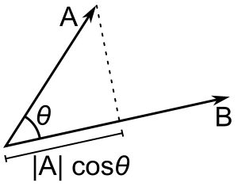
Geometric intuition
Taking the dot product of two vectors
Recall [a b c][e f g] = ae + bf + cg
Basically the projection of a vector on another
The normalized vector with the biggest projection on x is, of course: x!
Useful intuition for transforms, etc.

Slide 6
Normalization
Matched filter must be normalized
Want to find our template in the ECG data
What looks like [1 2 6]?
Obviously, [… 1 2 6 …] does (score = 41)
What about [… 150 100 50…]?
Subtract mean from both template and ECG
Ex: [-1 1] template
Also need to normalize the “energy” to 1
Sum of squares

Slide 7
Convolution and edge detection
Strategy: smooth (convolve with a Gaussian) then find zero crossings
We can also look for inflection points (2nd derivative is zero) after smoothing
Or we can look for big changes in the ECG
Sort of what we did with the matched filter
Can do smoothing at the same time!

Slide 8
Convolution’s properties
Convolution is also popular because it is a surprisingly deep topic
With lots of connections to other areas
Central limit theorem
Multiplication of polynomials
Etc, etc.

Slide 9
Gaussian convolution
The standard way to smooth data is to convolve with a Gaussian
Related to Gaussian noise assumption
Gaussian noise assumption itself comes from one of the Gaussian’s many amazing properties, the Central Limit Theorem

Slide 10
Random variables
A discrete random variable assigns each integer a probability
Ex: a perfect coin or a die
The assignment function is the density
What happens when we toss a two dice and add them up?
This is another random variable
Q: What is the density?
A: Convolution of the dice density with itself

Slide 11
Limit theorems
Let’s throw more and more dice, adding up their totals
Ex: 1000 dice
Sum is from 1000 to 6000
If the dice density is uniform, we’ll typically get around 3500
What about an arbitrary density?
Central limit theorem: we will end up with a Gaussian

Slide 12
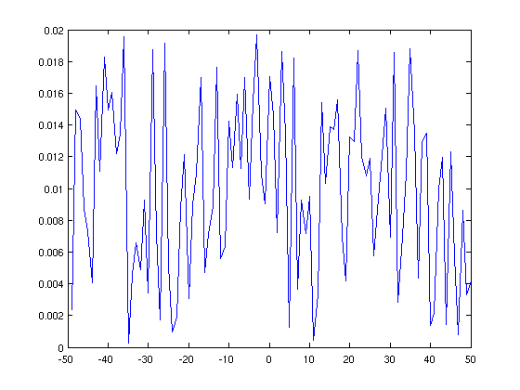
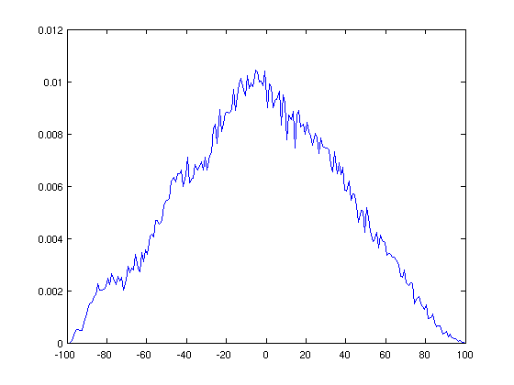
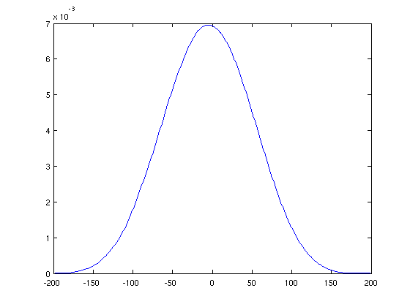
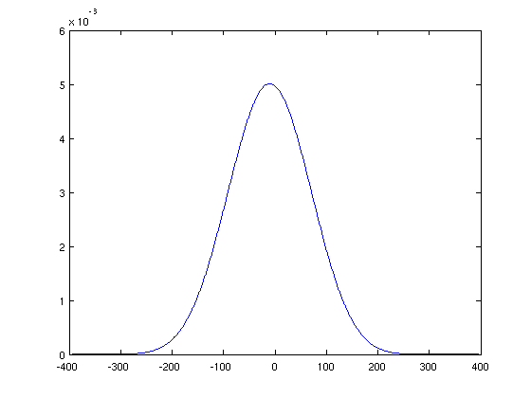
Illustration
How fast does this become Gaussian?

Slide 13
Convolution and edges
We want to smooth then find zero crossings or big increases/decreases
There is some nice math that tells us we can do this in a single step
It was actually illustrated in the matched filter

Slide 14
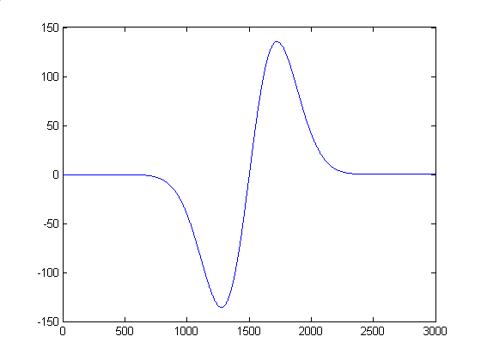
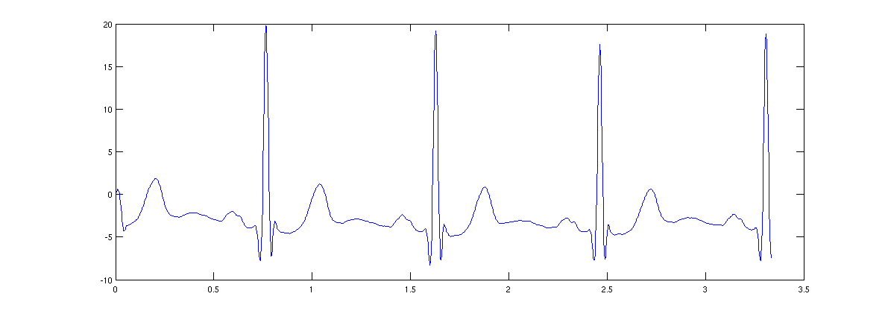
Pulse finding example

Slide 15
Linearity
Scalars don’t matter
Scalars in Y, not T (the latter is scale invariance, which is much harder)
Addition doesn’t matter
Formally, for any two ECG’s X,Y and scalars a,b we have
H(aX + bY) = a H(x) + b H(y)
Many devices/systems are linear when they are well behaved

Slide 16
Shift invariance
Shift the input, shift the output
Or: starting point doesn’t matter
Note that fixed shift itself is a convolution

Slide 17
LSI systems
Many important systems have both of these properties
Linear Shift Invariant
Aka Linear Time Invariant

Slide 18
LSI and convolution
Convolution is an LSI operation
Pretty obvious (think about local averaging)
But any LSI is actually convolution with something, which is easy to find
Why would this be true??

Slide 19
Unit impulse response
Unit impulse: [… 0 1 0 …]
Any input is the sum of scaled and shifted unit impulses
Example: to get [1 6 -10] we:
Take the unit impulse shifted once left: [1 0 0]
Add 6 times the unit impulse, no shift: [1 6 0]
Subtract 10 times the unit impulse, shifted right

