Slide 1
Alternative Switching Technologies:
Wireless Datacenters
Hakim Weatherspoon
Assistant Professor, Dept of Computer Science
CS 5413: High Performance Systems and Networking
April 17, 2017
Slides from the “On the Feasibility of Completely Wireless Datacenters” at the ACM/IEEE
Symposium on Architectures for Networking and Communications Systems (ANCS),
October 2012.

Slide 2
Where are we in the semester?
Overview and Basics
  Overview
  Basic Switch and Queuing (today)
  Low-latency and congestion avoidance (DCTCP)
Data Center Networks
  Data Center Network Topologies
  Software defined networking
    Software control plane (SDN)
    Programmable data plane (hardware [P4] and software [Netmap])
  Rack-scale computers and networks
  Disaggregated datacenters
  Alternative Switching Technologies
  Data Center Transport
  Virtualizing Networks
  Middleboxes
Advanced topics

Slide 3
Where are we in the semester?
Interested Topics:
  SDN and programmable data planes
  Disaggregated datacenters and rack-scale computers
  Alternative switch technologies
  Datacenter topologies
  Datacenter transports
  Advanced topics

Slide 4

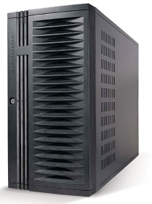
Hybrid: packet/(optical-)circuit switched network
configuration
Traffic demand
Controller
configuration
optical transceivers
Notes:
>2min too long !!!
C-Through use a centralize controller to collect traffic demands and configure optical circuits. The controller collect per-rack traffic demand vector from all the servers and aggregate them into a cross-rack traffic matrix. Then it compute a optimal configuration that can maximize the traffic volume that can be offload to optical network using a polynomial Edmonds’ alg. Everytime when the optical circuits are reconfigured, it will notified servers to tear down the path and configure it and then notify them about the new configuration. In a large data center, there could a significant overhead for the control traffic. But many ways can be used to reduce the overhead of control traffic.
For example, for traffic demand collection, servers only need to send to the controller when the demands change dramatically, traffic demand vectors can be aggregated within rack first, then send to the control. The configuration notification can be done using multicast.

Slide 5
Hybrid: packet/(wireless-)circuit switched network
configuration
Traffic demand
Controller
Mirror on the ceiling
wireless transceivers
“Mirror mirror on the ceiling: Flexible wireless links for data centers”,
X. Zhou, Z. Zhang, Y, Zhu, Y. Li, S. Kumar, A. Vahdat, B. Y. Zhao, and H. Zheng,
ACM SIGCOMM, August 2011, pages 443—454.
Notes:
>2min too long !!!
C-Through use a centralize controller to collect traffic demands and configure optical circuits. The controller collect per-rack traffic demand vector from all the servers and aggregate them into a cross-rack traffic matrix. Then it compute a optimal configuration that can maximize the traffic volume that can be offload to optical network using a polynomial Edmonds’ alg. Everytime when the optical circuits are reconfigured, it will notified servers to tear down the path and configure it and then notify them about the new configuration. In a large data center, there could a significant overhead for the control traffic. But many ways can be used to reduce the overhead of control traffic.
For example, for traffic demand collection, servers only need to send to the controller when the demands change dramatically, traffic demand vectors can be aggregated within rack first, then send to the control. The configuration notification can be done using multicast.

Slide 6
Goals for Today
On the Feasibility of Completely Wireless Datacenters
  J. Y. Shin, E. G. Sirer, H. Weatherspoon, and D. Kirovski, IEEE/ACM Transactions on Networking (ToN), Volume 21, Issue 5 (October 2013), pages 1666-1680.

Slide 7



Conventional Datacenter
Core Switch
…
Aggregate Switch
Top of Rack Switch
…

Slide 8
Going Completely Wireless
Opportunities
  Low maintenance : no wires
  Low power: no large switches
  Low cost: all of the above
  Fault tolerant: multiple network paths
  High performance: multiple network paths
Which wireless technology?

Slide 9
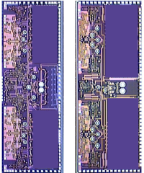
60GHz Wireless Technology
Short range
  Attenuated by oxygen molecules
Directional
  Narrow beam
High bandwidth
  Several to over 10Gbps
License free
  Has been available for many years
Why now?
Rx
Tx
CMOS Integration
  Size < dime
  Manufacturing cost < $1
7 mm
5 mm
[Pinel ‘09]

Slide 10
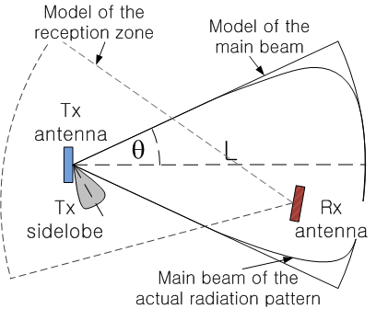
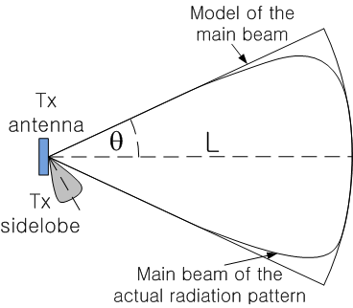
60 GHz Antenna Model
One directional
  Signal angle between 25° and 45°
  Maximum range < 10 m
  No beam steering
Bandwidth < 15Gbps
  TDMA (TDD)
  FDMA (FDD)
Power at 0.1 – 0.3W
How to integrate to datacenters?

Slide 11
Designing Wireless Datacenters
Challenges
  How should transceivers and racks be oriented?
  How should the network be architected?
  Interference of densely populated transceivers?

Slide 12
Completely Wireless Datacenters
Motivation
Cayley Wireless Datacenters
  Transceiver placement and topology
    Server and rack designs
  Network architecture
    MAC protocols and routing
Evaluation
  Physical Validation: Interference measurements
  Performance and power
Future
Conclusion

Slide 13
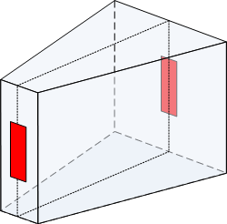

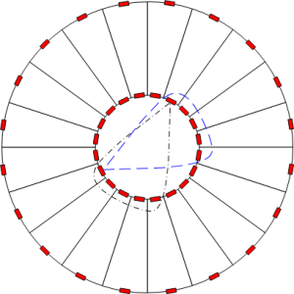
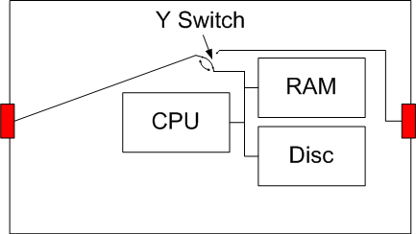
Transceiver Placement:
Server and Rack Design
3D View
Rack
Server
3-way switch (ASIC design)
Inter-rack space
Intra-rack space
2D View
How do racks communicate with each other?

Slide 14
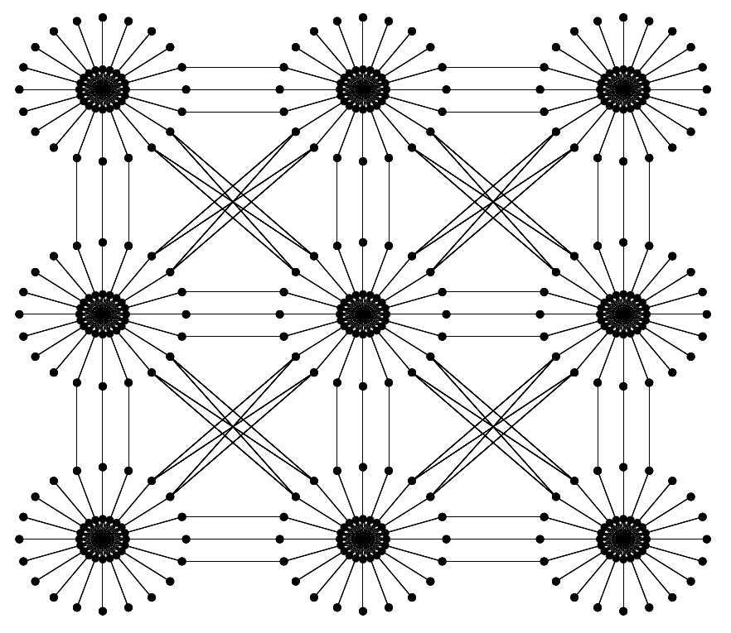

Cayley Network Architecture: Topology

Slide 15
Masked Node Problem and MAC
Most nodes are hidden terminals to others
  Multiple (>5) directional antennae
  => Masked node problem
  Collisions can occur
Dual busy tone multiple access [Hass’02]
  Out of band tone to preserve channels
  Use of FDD/TDD channels as the tone

Slide 16
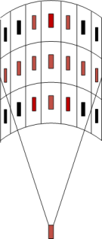
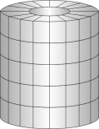
Cayley Network Architecture: Routing
Geographical Routing
Inter rack
  Diagonal XYZ routing
Turn within rack
  Shortest path turning
Within dst rack to dst server
  Up down to dst story
  Shortest path to dst server

Slide 17
Completely Wireless Datacenters
Motivation
Cayley Wireless Datacenters
  Transceiver placement and topology
    Server and rack designs
  Network architecture
    MAC protocols and routing
Evaluation
  Physical validation: Interference measurements
  Performance and power
Future
Conclusion

Slide 18
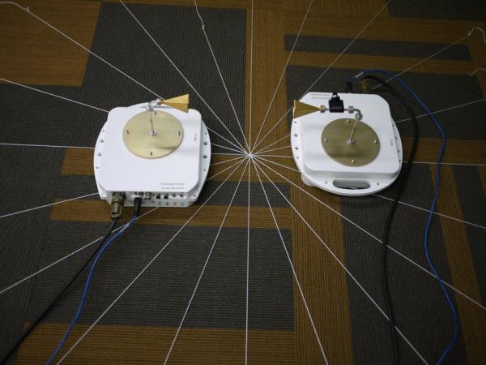
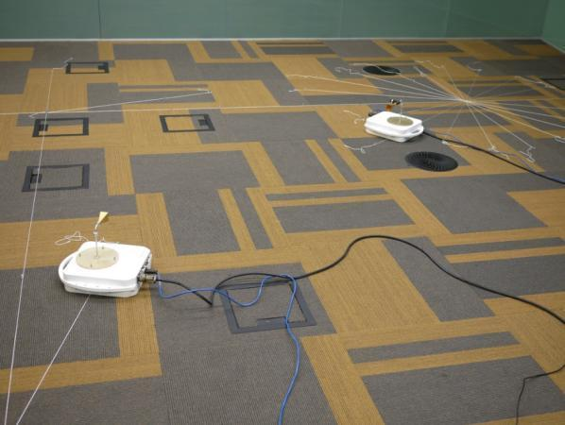
Hardware Setup for Physical Validation
Use of a conservative platform
Real-size datacenter floor plan setup
Validation of all possible interferences
Intra-rack communications
Inter-rack communications

Slide 19
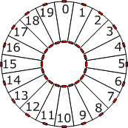
Physical Validation: Interference Evaluation
(Signal angle θ = 15° )

Slide 20
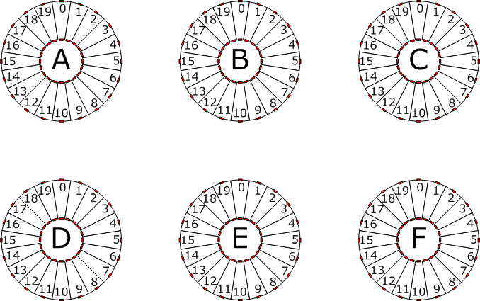
Physical Validation: Interference Evaluation
(Signal angle θ = 15° )
Edge of signal:
can be eliminated
Potential Interference:
can be blocked using conductor
curtains

Slide 21
Evaluation
Performance: How well does a Cayley datacenter perform and scale?
  Bandwidth and latency
Failure tolerance: How well can a Cayley datacenter handle failures?
  Server, story, and rack failure
Power: How much power does a Cayley datacenter consume compared to wired datacenters

Slide 22
Evaluation Setup
Simulate 10K server datacenter
  Packet level: routing, MAC protocol, switching delay, bandwidth
Conventional datacenter (CDC)
  3 Layers of oversubscribed switches (ToR, AS, CS)
    (1, 5, 1), (1, 7, 1) and (2, 5, 1)
    Latency: 3-6us switching delay
    Bandwidth: 1Gbps server
FAT-tree: Equivalent to CDC (1,1,1)
Cayley wireless datacenter
  10Gbps bandwidth
  1 Transceiver covers 7 to 8 others
  Signal spreading angle of 25°
  Low latency Y-switch (<< 1us)
(1,5,1)
(1,7,1)
(1,1,1)
(2,5,1)
Core
2
1.4
10
1
Aggregate
10
10
10
5
Top of Rack
10
10
10
10

Slide 23
Evaluation Setup
Uniform random
  Src and dst randomly selected in entire datacenter
MapReduce
  Src sends msg to servers in same row of rack
  Receiver sends msg to servers in same column of rack
  Receivers send msg to servers inside same pod with 50% probability

Slide 24
Bandwidth
Burst of 500 x 1KB packets per server sent
Cayley datacenters have the most bandwidth
s

Slide 25
Latency
Uniform random benchmark
MapReduce benchmark
Cayley datacenters typically performs the best

Slide 26
Fault Tolerance
Cayley datacenters are extremely fault tolerant
25%
55%
77%
99%

Slide 27
Power Consumption to Connect 10K Servers
Conventional datacenter (CDC) *
  Depending on the oversubscription rate 58KW to 72KW
Cayley datacenter
  Transceivers consume < 0.3W
  Maximum power consumption: 6KW
Less than 1/10 of CDC power consumption
Switch Type | Typical Power
Top of rack switch (ToR) | 176W
Aggregation switch (AS) | 350W
Core switch (CS) | 611W
* Cost and spec of Cisco 4000, 5000, 7000 series switches

Slide 28
Discussion and Future Work
Only scratched the surface
  How far can wireless datacenters go with no wires?
Need larger experiment/testbed
  Interference and performance of densely connected datacenter?
Scaling to large datacenters (>100K servers)?
Scaling to higher bandwidth (> 10Gbps)?

Slide 29
Conclusion
Completely wireless datacenters can be feasible
Cayley wireless datacenters exhibit
  Low maintenance
  High performance
  Fault tolerant
  Low power
  Low cost

Slide 30
References
S. Pinel, P. Sen, S. Sarkar, B. Perumana, D. Dawn, D. Yeh, F. Barale, M. Leung, E. Juntunen, P. Vadivelu, K. Chuang, P. Melet, G. Iyer, and J. Laskar. 60GHz single-chip CMOS digital radios and phased array solutions for gaming and connectivity. IEEE Journal on Selected Areas in Communications, 27(8), 2009.
Z.J. Hass and J. Deng. Dual busy tone multiple access (DBTMA)-a multiple access control scheme for ad hoc networks. IEEE Transactions on Communications, 50(6), 2002.
PEPPM. Cisco Current Price List. http://www.peppm.org/Products/cisco/price.pdf, 2012.

Slide 31
Related Work
 | Link Technology | Modifications Required | Working Prototype
Helios (SIGCOMM ‘10) | Optics w/ WDM 10G-180G (CWDM) 10G-400G (DWDM) | Switch Software | Glimmerglass, Fulcrum
c-Through (SIGCOMM ’10) | Optics (10G) | Host OS | Emulation
Flyways (SIGCOMM ‘11, HotNets ‘09) | Wireless (1G, 10m) | Unspecified
IBM System-S (GLOBECOM ‘09) | Optics (10G) | Host Application; Specific to Stream Processing | Calient, Nortel
HPC (SC ‘05) | Optics (10G) | Host NIC Hardware

