Slide 1
CS 5412: Lecture 9 Timestamped Data
Ken Birman
Spring, 2022

Slide 2
Today: Drill down on Time
Last time we discussed time more as an active aspect of a coordinated system (one of a few dimensions in which an IoT system might be active).
But once a sensor reading is captured and stored, there is also a temporal aspect to data analysis.
What can we say about time for data and events “inside” a data store?

Slide 3
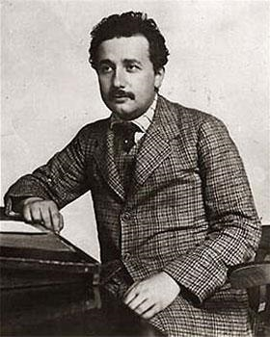
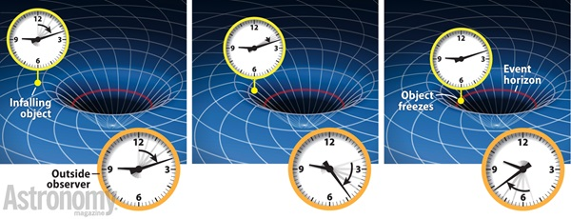
Time in the real world
Einstein was first to really look closely at this topic.
It led to his theory of relativity: Time has no absolute meaning.
But Einstein was thinking about particles moving at near the speed of light, or near black holes. Do those ideas apply in other settings?

Slide 4
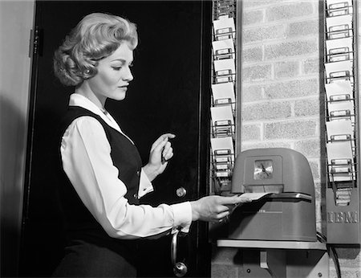
Time in computer Systems
Often, we put “timestamps” on IoT sensor records
In IoT, time is tricky to work with for many reasons:
Even with GPS recievers, it can be hard to get a good fix, so time can drift
IoT sensors often lack GPS and their clocks need to be reset via an event, but then might drift by seconds per day
Sensors can also fail, and this includes their clocks.
Thus a timestamped event may have inaccurate time!

Slide 5
In what ways can we talk about Time?
First, whenever we use time in an IoT setting, it is important to track the time source and the associated skew:
Without GPS time, sensor time will drift by seconds/day
With GPS time, clocks can be accurate to within about 1ms
With special purpose hardware for synchronization, the machines in a cloud would be able to share a clock and be accurate to a few us.
… but today’s cloud computers don’t have that form of shared clocks, and if virtualized, clocks can be quite inaccurate! A total mess!
Notes:
GPS is common but it does add hardware and consume power, so sensors won’t have a GPS unit unless there is a really good reason to do so. Otherwise they depend on humans to set the clock (like a household temperature unit) or they run a network clock synchronization protocol. Those work well, but are only accurate up to the (unknown) variability of the network delay.

Slide 6
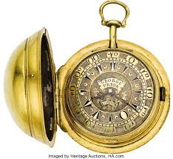
vendors prefer limited accuracY!
Several recent security problems have involved an attacker who places a monitoring program on the same machine that some security code is on. The attacker is assumed to have the source code for the application it is attacking.
The monitoring program measures timing properties of the memory and caching hardware at very high accuracy and is able to deduce contents of the memory state of the attacked program.
It seems doubtful that this would work, but several exploits show that it really does work! To reduce the risk, cloud vendors make it hard to measure time.
Notes:
Meanwhile, within the cloud, the operators are trying hard to make time imprecise, at fine-grained resolution (milliseconds or less). This surprises people!

Slide 7
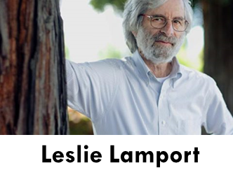
Lamport’s Causal Order
Leslie Lamport considered this issue, but in computing systems
He actually started as a physicist inspired by Einstein, but went on to formalize distributed protocols, and won the Turing Award
Primarily a theoretician, but he also was the author of Latex
Especially good at elegant ways of posing problems and solving them
He suggested that an important aspect of consistency should involve “consistency with respect to past events”. He calls this “causal” consistency
Drill down: Consistency
Notes:
OK, time for a little theory.

Slide 8
How does he define causality?
Suppose that event A occurs in a data center, and then later event B.
Did A “cause” B to happen?
What if A was at 10am, and B at 11:30pm. Does knowing time help?
What if A was a command to register a new student, and B was an internal action that creates her “meal card” account?
What if A was an email from the department asking me about my teaching preferences, and B was my reply?
Drill down: Consistency
Notes:
Lamport wants us to think about cause-effect.

Slide 9
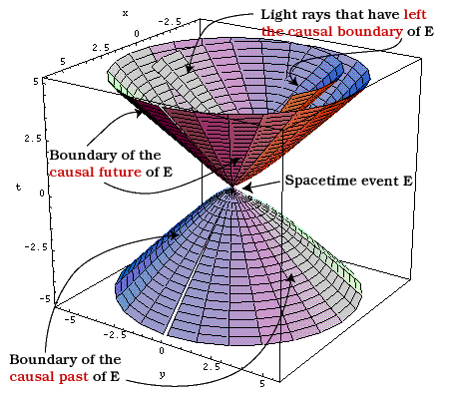
How does he define causality
For Leslie, event A causes event B if there was a computation that somehow was triggered by A, and B was part of it. Inspired by physics!
But this is hard to discover automatically.
Instead, Leslie focused on potential causality: A “might” have caused B.
Under what conditions is this possible?
Somehow, information must flow from A to B.
Drill down: Consistency
Notes:
The analogy with physics is actually what originally inspired him.

Slide 10
Notation for representing causality
Leslie proposes that we write A → B if A potentially caused B.
He suggests that we use the words “happened before” for →
Now the question arises: is → just a mathematical concept, or can we build a practical tool for tracking causality in real systems?
Drill down: Consistency
Notes:
When you see an arrow in a sentence, read it as “happens before”. Try that out on the ones above: “A happens before B”.
The happens before relationship is partial: we might have A → B or B → A, but sometimes neither property holds. In particular, if A and B are concurrent, neither happens-before property will hold.

Slide 11
Why would we want to track A → B?
Consider the Securities and Exchange Commission.
For them, A might be “information about stock X” and B “a trade of X”.
An insider trade occurs if someone with non-public information takes advantage to trade a stock before that information comes out. So if “John learned that the IBM quantum computer showed promise”, then bought IBM stock, perhaps John violated the insider trading law.

Slide 12
Lamport’s point
Simply seeing data records in which John talks to his friend at IBM at 10:00am and then buys IBM stock at 10:01am might not be “proof” of criminality. These days the cloud might participate in all of these events.
If the records were timestamped by the identical clock, and the clock isn’t faulty, this really would be proof.
But if the records came from different computers, clock imprecision could be creating an illusion. If we track actual →, we would be confident.

Slide 13
Tracking A → B
Leslie first considered normal clocks. But they don’t track →
Here, he took his inspiration from Einstein
“Time is an illusion.” Einstein went on to draw space-time diagrams.
So Leslie asked: “Can we use space-time diagrams as the basis of a new kind of “logical clock”?
If A → B, then LogicalClock(A) < LogicalClock(B)
If LogicalClock(A) < LogicalClock(B), then A → B
Drill down: Consistency
Notes:
Next, Leslie suggests that we think of a clock as a system call, one that returns a number.
Call this number a “timestamp”.
LogicalClock(A) might mean “what would A’s clock read, right now?”
In Lamport’s approach, this is a number, like 187 or 223. If we label event A with the number, we “timestamped” A.
So read that last part this way:
If A happens before B, then we want to be sure that the LogicalClock on A will have a smaller time value than the one on B.
And similarly, If the LogicalClock on A has a value smaller than the one on B, it would be great if we could conclude that event A happened before event B.

Slide 14
Developing a solution
Suppose that every computer (P, Q, …) has a local, private integer
Call these LogicalClock_{P} and LogicalClock_{Q} etc.
Each time something happens, increment the clock.
Now, if A and B happen at P, the LogicalClock_{P} can tell us that A → B.
But what if A is on machine P, and B happens on Q?
Drill down: CAP Consistency
Notes:
More terminology.

Slide 15
A space-time Diagram for this case
X
A
P sends M
P
Q
Drill down: Consistency
Notes:
Here you can see that X is before A, and A is before B. So X is before B. Just illustrates a few examples of ways happens-before can arise.

Slide 16
A space-time Diagram for this case
X
A
P sends M
P
Q receives M
B
Q
Drill down: Consistency
Notes:
Here you can see that X is before A, and A is before B. So X is before B. Just illustrates a few examples of ways happens-before can arise.

Slide 17
A space-time Diagram for this case
Uncoordinated counters don’t solve our problem
Here, A and B end up with the identical Time, so we incorrectly conclude that A did not happen before B
X
A
P sends M
P
LogicalClock_{P}
0 1 2 3
Q receives M
B
Q
LogicalClock_{Q}
0 1 2
Drill down: Consistency
Notes:
Now if we just count events, we can’t use those counters to track happens before.
We get nonsense.
So Leslie said this won’t do the job.

Slide 18
Aha!
But notice that in the diagram, the “receive” occurs when LogicalClock_{B} = 1.
Yet the “send” of M was at LogicalClock_{A} = 3.
So Lamport proposes this fix:
Each time an interesting event occurs at P, increment LogicalClock_{P}
If P sends M to Q, include LogicalClock_{P} in M. When Q receives M, LogicalClock_{Q} = Max(LogicalClock_{Q}, LogicalClock_{M}) + 1
Drill down: Consistency
Notes:
Lamport’s scheme is basically that you adjust your clock to always advance. And in particular if you get a message someone sent at (their) time 3, your clock should read 4 for the next event you perform. If your clock was still at 2, just set it forward.
This ensures that time never jumps backward, unexpectedly, which is something we wouldn’t want a clock to do. If we didn’t adjust the clock, the receive would be timestamped 2, and it would look like the message was sent at time 3 but arrived at time 2. And that would be like sending email to yourself yesterday!
Lamport’s simple formula for incrementing the LogicalClock works that way.

Slide 19
A space-time Diagram for this case
X
A
P sends M
P
LogicalClock_{P}
0 1 2 3
LogicalClock_{M} = 3
Q computes:
LogicalClock_{Q} = max(0, 3) + 1
Q receives M
B
Q
LogicalClock_{Q}
0 4 5
Drill down: Consistency
Notes:
Now the “logical clocks” work properly. If A happens before B, B will have a bigger logical clock time than A.

Slide 20
We now have a cheap partial solution!
With Lamport’s logical clocks, we pay a small cost (one integer per machine, to keep the clock, and some space in the message)
Let’s use LogicalClock(X) to denote the relevant LogicalClock value for x. We can time-stamp events and messages.
If A → B, then LogicalClock(A) < LogicalClock (B)
But… if LogicalClock (A) < LogicalClock (B), perhaps A didn’t happen before B!
Drill down: Consistency
Notes:
Lamport’s clocks solve half of our goal, but not the whole goal.
The “if” part works. But not the “else” part.

Slide 21
A space-time Diagram for this case
With logical clocks, even if P and Q never talk, we might have Time(A) < Time(B)
Here, if we claim that LogicalClock(A) < LogicalClock (B) ⇒ A → B, this is nonsense! In fact ¬(A → B), ¬(B → A). (A and B are “concurrent”)
A
P
LogicalClock_{P}
0 1
Firewall blocks all traffic: P can’t communicate to Q
X
Y
B
Q
LogicalClock_{Q}
0 1 2 3
Drill down: Consistency
Notes:
In this example, P and Q never talk, yet event A (it happens on machine P) is timestamped 1, and B (over on Q) gets timestamp 3. Now, you can see that 1 < 3, but also that there was no way that A caused B, or influenced B.
This is why the “else” part isn’t working for us.

Slide 22
Logical clocks only work in one direction.
Logical clocks approximate the causal happens-before relationship, but only in an “if-then” sense, not “If and only if”.
Yet, they are useful: Lamport gives many examples where this suffices.
We actually can do better, but at the “cost” of higher space overhead.
Drill down: Consistency

Slide 23
Detecting insider trading
The S.E.C.* wants to detect that “John learned of the good news from Lilly, CEO of Zebra Corp. Then he purchased stock before the market heard.”
If A was John learning, and B was the stock purchase, then the SEC wants to look at LogicalClock(A) < LogicalClock(B), and conclude “A → B”.
But logical clocks don’t let us conclude this. And John might insist that “I kept a log of call times, and I spoke to Lilly after the IBM market announcement. Perhaps some clock drifted and the S.E.C. has its time sequence wrong.”
* Securities Exchange Commission

Slide 24
Intuition behind vector clocks
Suppose that we had a fancier clock that could act like logical clocks do (with the “take the max, then add one” rule).
But instead of a single counter, what if it were to count “events in the causal past of this point in the execution”, tracking events on a per-process basis?
For example, a VectorClock value for A = [5,7] might mean “event A happens after 5 events at P, and 7 events at Q”.

Slide 25
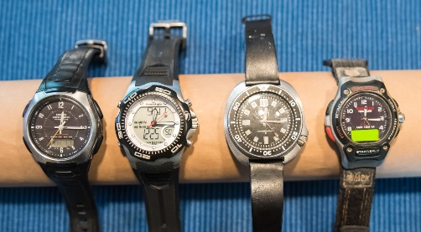
Vector Clocks are easy to implement
A vector clock has one entry per machine. VT(A) = [3, 0, 7, 1]
If an event occurs at P, P increments its own entry in the vector
When Q receives M from P, Q computes an entry-by-entry max, then increments its own entry (because a “receive” is an event, too)
VectorClock comparison rule:
Define VT(A) < VT(B) if VT(A) ≤ VT(B), Now, VT(A) < VT(B) iff A → B but VT(A) ≠ VT(B)
Drill down: Consistency
Notes:
These are a fancier kind of clock that do solve the problem we just saw, but usually we don’t need to work with them. In fact in cs5412 we will never mention them again. In contrast we actually will use LogicalClock counters.
The vector clock needs one counter per process which makes these large. In a cloud you might have 10M processes running concurrently even in a single datacenter. We wouldn’t want a vector 10M entries long. In fact they can be compressed, but we won’t fuss with that in CS5412.

Slide 26
A space-time Diagram for this case
Case A: Suppose that P and Q never interact.
With vector clocks we can see that A is concurrent with X, Y and B. We can use the comparison rule to show this, for example that ¬(A → B) and ¬(B → A).
A
P
VectorClock_{P}
[0,0] [1,0]
Firewall blocks all traffic: P can’t communicate to Q
X
Y
B
Q
VectorClock_{Q}
[0,0] [0,1] [0,2] [0,3]
Drill down: Consistency
Notes:
Revisiting our bad case, but now using vector clocks. You can see them: [1,0] means “1 on P’s clock and 0 on Q’s clock”.

Slide 27
A space-time Diagram for this case
Maximum computed here. No need to increment the local timer unless this receive is viewed as a “significant event” for your application,.
Case B: P sends a message to Q after A, and it is received before B at Q.
The vector timestamps show that A happens before B (and also, before Y).
A
P
VectorClock_{P}
[0,0] [1,0]
Now the firewall is gone and a message gets through!
X
Y
B
Q
VectorClock_{Q}
[0,0] [0,1] [1,2] [1,3]
Drill down: Consistency
Notes:
Notice that when the receive occurred, Q’s clock jumped from [0,1] to [1,2]. We learned that P’s clock is at 1 (or maybe larger, by now), and also one more event just happened at Q (the receive). So the vector clock is accounting for every aspect of this.
And now, if we compare A at time [1,0] with B at time [1,3] we can see that A happens before B! Vector clocks work for Lamport’s full set of goals!
Just the same, we won’t be using them this semester.

Slide 28
Vector Clocks solve the S.E.C. problem!
A: John spoke to his friend Lilly.
Then the message M was to tell his stock broker to “Buy IBM futures ASAP!” B was the purchase. Our goal: Deduce that A → B using just a database with information about A, and information about B, including timestamps.
We just saw that VectorClock(A) < VectorClock(B) ⇒ A → B!

Slide 29
So why not always use vector clocks?
They represent happens-before with full accuracy, which is great.
But you need one vector entry per process in your application. For a small μ-service this would be fine, but if the vector would become large, the overheads are an issue.
So, we try to use a LogicalClock before considering a VectorClock.

Slide 30
More fun with Causality
Working with Mani Chandy (CalTech), Lamport also showed that you can use → to define “now” in a way that makes sense even for a fully distributed system
He draws a complex space-time picture, perhaps this one:
A
D
P
H
Q
B
R
C
F
S
G
T
E
U
Drill down: Consistency
Notes:
Moving on, what about a system where we want to make a snapshot? The issue here is how to read the data at “wall clock” (like your watch) 10am and get a sensible answer.
Recall that actual clocks on today’s real machines or sensors have so-so clock synchronization. If they just write something down when their local clocks read 10am you can get nonsense because messages are flying around at microsecond speeds, which is way finer resolution than clock synchronization.

Slide 31
Consistent Cuts and Snapshots
They asked: Suppose I visit each node, each at some point in time. Can we extend consistency to cover such a case (“consistent cut”)
Or even fancier: what if each node makes a checkpoint for me when I visit it along a cut. Can we end up with a “consistent snapshot”, like a photo?
Drill down: Consistency

Slide 32
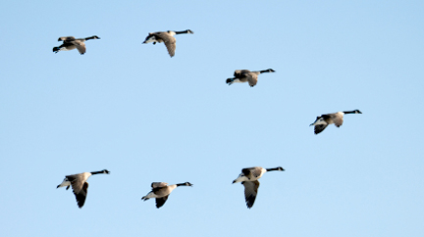
Consistent and inconsistent snapshot
Truth: 7 Geese in a V formation
Imagine taking photos of our geese one by one and creating a tiled mashup
Drill down: Consistency
Notes:
Leslie and Mani Chandy thought about this and realized that the issue is a bit like assembling one sensible photo by stitching together a set of sub-photos. Like this one. Imagine that each “box” is one camera in an IoT system with 4x7 cameras. Ideally they would trigger instantaneously and simultaneously and a snapshot of the sky would show each goose once, each in one frame, in perfect sync.
But just saying “snap at time 10am” wouldn’t do this. They might be out of sync due to clock imprecision.

Slide 33
Consistent and inconsistent snapshot
Truth: 7 Geese in a V formation
But suppose they were in motion while you did this
Drill down: Consistency
Notes:
For example, suppose our geese reached this state after a few more milliseconds.

Slide 34
Consistent and inconsistent snapshot
Truth: 7 Geese in a V formation
Without coordination, some vanish, some are duplicated!
You might even see a goose that shifted to avoid collision with another goose, but see that other goose in a much earlier place, before it even got close.
Drill down: Consistency
Notes:
Well, if some cameras ran that much late, we would get this messy photo and it actually shows some geese twice! The shape of the flock is totally lost and the image is an impossible mashup state.
An IoT system really faces this problem!!!! This is a real scenario!

Slide 35
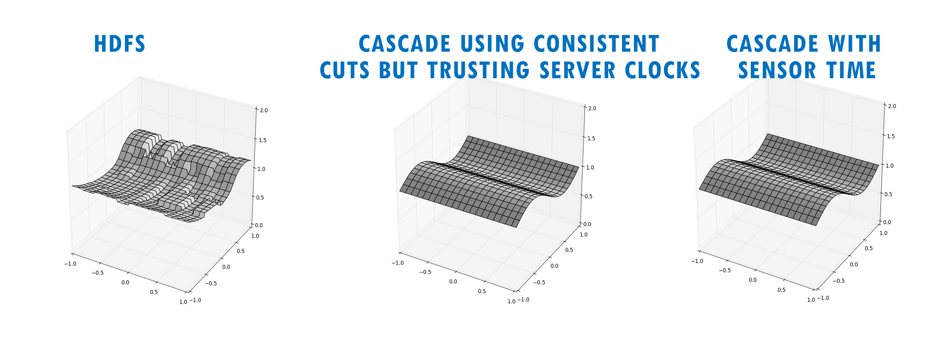
This is the same issue we saw in our lecture on Cascade
Inconsistent data is a problem. How does Cascade achieve consistency?

Slide 36
Consistent Snapshot
If we use the method of Chandy and Lamport we get a consistent snapshot: there won’t be any duplicates or mashup effect!
Goal of a consistent snapshot is to let us combine data from multiple processes (machines) in a distributed system, but only count each thing once, with no causal gaps or duplication.
Drill down: Consistency
Notes:
Leslie and Mani found a way to map that snapshot question to logical clocks! It won’t actually cover the full set of real-time issues but at least we can avoid the mess of one machine claiming some messages were received that another machine claims it hasn’t yet sent, for example.
In CS5412 we aren’t going to look at this algorithm in detail. But there are several ways to do it. One is to just shut the whole system down temporarily, wait for everything to pause, then ask each machine for its photo or whatever, then resume. This will work.
A second is to ask the machines for photos that were concurrent with some VectorClock time. This works well. There is even a way to ask for photos at some specific LogicalClock time, and this can work too.
The actual algorithm Chandy and Lamport proposed employs a kind of two-phase commit. Machines just make the snapshot when the protocol tells them to, but the protocol is implemented in such a way that they can prove that it will collect photos at times along some consistent cut. So this is a fourth way to do it.

Slide 37
Consistent Cuts and Snapshots
Recall: Lamport looks at “pictures” of such a system, like these
A “cut” across the system
D
P
H
Q
B
R
C
F
S
G
T
E
U
Drill down: Consistency
Notes:
Here is how they say to do it. You tell the machines to run an algorithm (I won’t have time to explain how it works, just assume you can look it up if you ever need it) and it makes photos at times that are consistent with each other.
Guaranteed: you won’t end up with a mashup of different geese.
Of course not everyone worries about photos of flocks of geese. But their trick is actually also useful for things like auditing a bank or checking for deadlock.
A bad audit might count some money twice, or miss some. A bad deadlock detector might sense deadlocks that aren’t real. With a consistent cut, if you audit along the cut, you compute the proper bank state. And you can package this up into a simple library method that cloud computing builders can work with.
So this is one case where we don’t agree with CAP. If you are auditing a bank, you need the C in CAP. But you can use Leslie’s ideas to get consistency of this kind, at low cost, and with great scaling. Eric just isn’t always right. Still, CAP makes sense as a starting place. The trick is to know that when you need consistency, there are ways to get it, and they aren’t always hugely costly.

Slide 38
Consistent Cuts and Snapshots
A cut is consistent if no “message arrows” go backwards through it
… this cut is a consistent one.
D
P
H
Q
B
R
C
F
S
G
T
E
U
Drill down: Consistency

Slide 39
Consistent Cuts and Snapshots
A cut is inconsistent if “message arrows” do go backwards through it
… this cut is inconsistent. C → D, and the cut included D, yet it omits C.
A backwards message
D
P
H
Q
B
R
C
F
S
G
T
E
U
Drill down: Consistency
Notes:
Mani and Leslie’s algorithm would never take a picture of machine S before it sent some message, but then mash it with a picture of machine P after that message arrives. And this, in fact, would have been inconsistent behavior, so we should be glad it won’t make that mistake.
For geese: we won’t show the same goose twice: at place S, and at place P.
For money, we won’t show the same money in two accounts, even though really it was just being moved.
For deadlock, we won’t show P waiting for a lock Q holds, and Q waiting for P, unless there is a genuine locking cycle.
Consistent cuts and snapshots are awesome this way. A cut is just what happens if you compute “along” the red line. A snapshot is what happens if you checkpoint all the computers, along the red line, then combine the checkpoints.

Slide 40
A consistent Cut is like a photo
It shows a state the system might actually have once been in
You could use that state for garbage collection, or to do an audit of a bank, or to detect deadlocks.
But an inconsistent cut is broken. It omits parts of the past and any conclusion from it would be incorrect. A real system could never have been in an inconsistent state of this kind.
Drill down: Consistency

Slide 41
How to create a consistent snapshot
One option is to briefly pause the whole system.
When all processes have paused, make snapshots of their “state”. Also record the contents of any message channels.
This is provably a consistent snapshot. But the pause might be noticeable

Slide 42
Fancier algorithm
Chandy and Lamport also have a fancier “online” algorithm
We will only give an overview today, but you can find all the details in their paper (linked to the syllabus).
It avoids the need to pause the system, but does require sending messages.

Slide 43
The Online Chandy/Lamport algorithm
Each process is assumed to have a checkpoint mechanism, and a channel “recording” tool. Snapshot = {(checkpoint, channel-contents)} from all processes.
To start a snapshot, some process
1. Takes a checkpoint
2. Turns on the channel records for its connections to other processes.
3. Sends them a message: “Snapshot in progress”
4. When it receives “Snapshot is in progress” from a process, it turns off the channel recorder. Once all channels are recorded, its snapshot is done.

Slide 44
The Online Chandy/Lamport algorithm
D to B recorder
B
B to A recorder
Checkpoint B
A
Checkpoint A
D
C to A recorder
D to C recorder
Checkpoint D
C
Checkpoint C
Note that we don’t need a channel recording for channels we received “snapshot underway” from at the outset. Those have “empty” state

Slide 45
Cascade has an even easier option
In Cascade, as data is accumulated, it becomes stable and that portion of the log or history won’t change again.
This enables Cascade to use a special kind of timestamp to “find” a consistent cut in the logs. The cut is just a point in each log such that the collection of log “prefixes” is closed under →.
The Cascade algorithm doesn’t pause the system or send extra messages

Slide 46
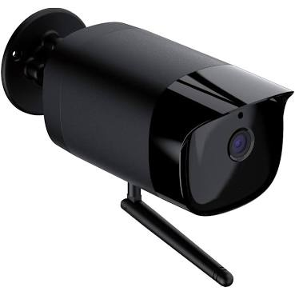
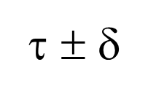
Visualizing Cascade COnsistency
Put(k,v)
Each Cascade shard has its own Paxos-based log
Put(k,v)
Put(k,v)
(ε, τ)
Stable portion
Put(k,v)
λ
Put(k,v)
λ
λ
time
λ
Each λ is triggered by an upcall from a “watcher” monitoring some key (or pattern)
Unstable tail
A temporal query for time τ sees a consistent cut at τ ± δ_{clock}.
Queries to unstable data must wait, but updates are stable within 50us.

Slide 47
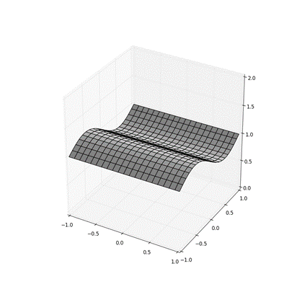
Every Get “sees” a consistent cut
Cascade allows you to get an object for a specific instant in time.
A time-indexed get of multiple objects returns data along a consistent cut.
This allows you to “collect” data into a vector, array or higher dimensional tensor. Our animation was a 3-D tensor: time, plus a 15x15 array of values from power-grid sensors (synchrophasor IoT devices)

Slide 48
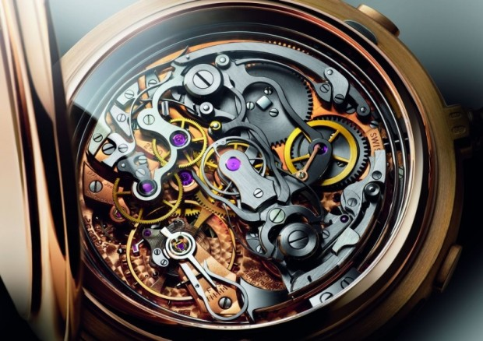
Summary
Systems with imperfect clocks, should integrate causality with their clock, not rely purely on clock timestamps.
This is done with Lamport’s “causal” timestamp or a vector timestamp.
A causal timestamp is just one integer, so many systems use it
A vector timestamp would cover all cases, but needs one integer per machine. So these vectors can be too large for practical use.
The mechanism is already integrated into Cascade

