Slide 1
CS 5412/Lecture 19: Making The Cloud Friendlier for Object-Oriented Computing
Ken Birman
Spring, 2022

Slide 2
Today’s main topic
The cloud was built mostly from Linux systems, yet Linux was created to support interactive computing applications in offices and hospitals, databases (big files, but record-oriented), text editing.
As a result, object orientation has turned out to be an awkward match!
In Lecture 18 we talked about LINQ and how it extends the concept of a collection of objects to support SQL inside languages like C++ and Python. Today we will look at how big cloud systems deal with OO costs.

Slide 3
Today’s two Sub-topics
First half of the lecture: The Ceph object oriented file system. Looks like a normal POSIX file system, but optimized for object-oriented uses.
Second half: Costs of the object-oriented model in a real air traffic control system (Ken worked on it… another bad-news/good-news stories…)

Slide 4
First Topic
Ceph File System

Slide 5
Modern systems are object oriented
Coded in languages like Java or C++
Managing huge amounts of data by creating immense data structures
Modular: there may be multiple microservices that talk to one-another through the key-value store, the file system, message buses and message queues. These should be optimized for the use case.

Slide 6
… issues
There may be a LOT of files. Linux file systems aren’t so great for this (like a directory with a billion objects in it).
Linux/POSIX lack suitable locking/synchronization API (POSIX had a solution but it was never adopted broadly)
Objects tend to be very small or very large. The Linux file system is optimized for Linux file size distributions and lifetime distributions.

Slide 7
CEPH project
Created by Sage Weihl, a PhD student at U.C. Santa Cruz
Later became a company and then was acquired into Red Hat Linux
Now the “InkStack” portion of Linux offers Ceph plus various tools to leverage it, and Ceph is starting to replace HDFS worldwide.
Ceph is similar in some ways to any standard cloud file system, but was created separately. Many big data systems are migrating to Ceph.

Slide 8
Three perspectives
First is the standard POSIX file system API. You can use Ceph in any situation where you might use GFS, HDFS, NFS, etc.
Second is the Ceph MetaData layer. This is a subsystem with its own API that manages objects… but doesn’t store data
Third is the RADOS object storage layer. It holds the data but doesn’t know about the folders (directories) in which data is organized.

Slide 9
object formats are “invisible” to Ceph
The actual format of the objects stored in the system are defined and “owned” by the applications using Ceph, not by Ceph itself.
Ceph tries to be extremely efficient, but it still is seeing serialized data (byte vectors), not objects with fields and methods it could invoke.

Slide 10
Ceph: A Scalable, High-Performance Distributed File System
Original slide set from OSDI 2006
Sage A. Weil, Scott A. Brandt, Ethan L. Miller, Darrel D. E. Long

Slide 11
Contents
Goals
System Overview
Client Operation
Dynamically Distributed Metadata
Distributed Object Storage
Performance

Slide 12
Goals
Scalability
Storage capacity, throughput, client performance. Emphasis on HPC.
Reliability
“…failures are the norm rather than the exception…”
Performance
Dynamic workloads

Slide 15
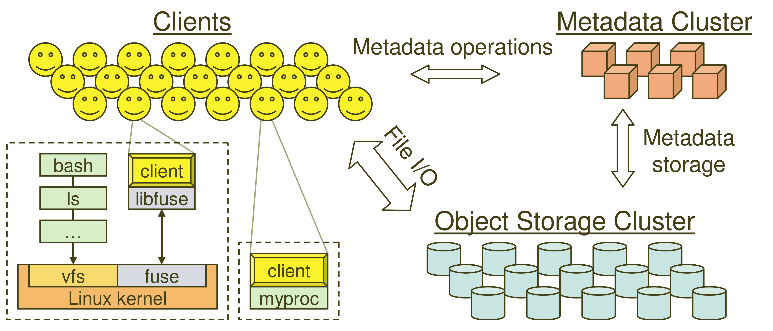
System Overview

Slide 16
Key Features
Decoupled data and metadata
CRUSH
Files striped onto predictably named objects
CRUSH maps objects to storage devices
Dynamic Distributed Metadata Management
Dynamic subtree partitioning
Distributes metadata amongst MDSs
Object-based storage
OSDs handle migration, replication, failure detection and recovery

Slide 17
Client Operation
Ceph interface
Nearly POSIX
Decoupled data and metadata operation
User space implementation
FUSE or directly linked
FUSE is a software allowing to implement a file system in a user space

Slide 18
Client Access Example
Client sends open request to MDS
MDS returns capability, file inode, file size and stripe information
Client read/write directly from/to OSDs
MDS manages the capability
Client sends close request, relinquishes capability, provides details to MDS

Slide 19
Synchronization
Adheres to POSIX
Includes HPC oriented extensions
Consistency / correctness by default
Optionally relax constraints via extensions
Extensions for both data and metadata
Synchronous I/O used with multiple writers or mix of readers and writers

Slide 20
Distributed Metadata
“Metadata operations often make up as much as half of file system workloads…”
MDSs use journaling
Repetitive metadata updates handled in memory
Optimizes on-disk layout for read access
Adaptively distributes cached metadata across a set of nodes

Slide 21
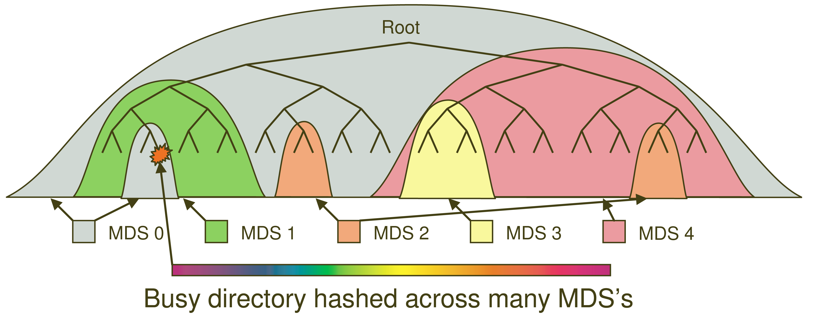
Dynamic Subtree Partitioning

Slide 22
Distributed Object Storage
Large files are split into a set of objects
Objects are members of placement groups
Placement groups are distributed across OSDs.

Slide 23
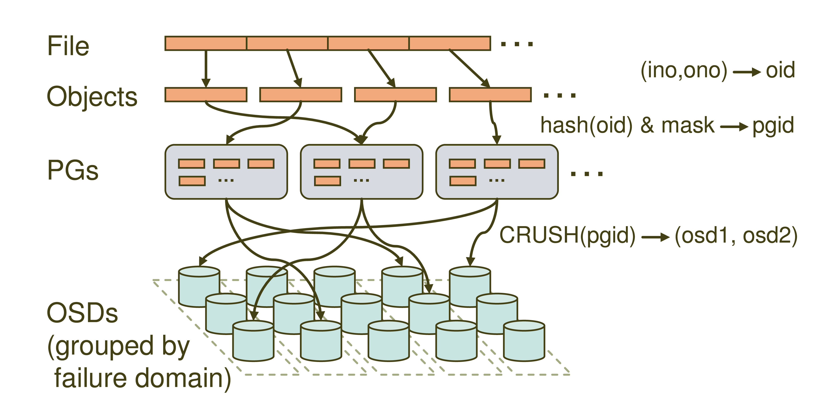
Distributed Object Storage

Slide 24
CRUSH: A specialized Key Hashing Function
CRUSH(x): (osdn1, osdn2, osdn3)
Inputs
x is the placement group
Hierarchical cluster map
Placement rules
Outputs a list of OSDs
Advantages
Anyone can calculate object location
Cluster map infrequently updated

Slide 25
Data distribution
(not a part of the original PowerPoint presentation)
Files are striped into many objects
(ino, ono) → an object id (oid)
Ceph maps objects into placement groups (PGs).
hash(oid) & mask → a placement group id (pgid)
CRUSH assigns placement groups to OSDs, using what seems to be a “shard”
CRUSH(pgid)→ a replication group, (osd1, osd2)

Slide 26
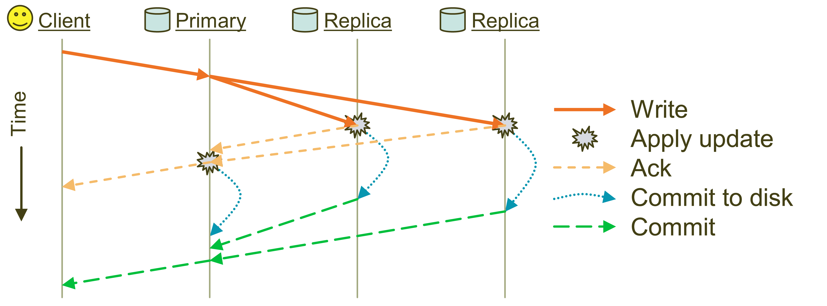
Replication: Reliable but not Paxos
Objects are replicated on OSDs within same PG
Client is oblivious to replication

Slide 27
Failure Detection and Recovery
Down and Out
Monitors check for intermittent problems
New or recovered OSDs peer with other OSDs within PG

Slide 28
Acronyms Used in Performance Slides
CRUSH: Controlled Replication Under Scalable Hashing
EBOFS: Extent and B-tree based Object File System
HPC: High Performance Computing
MDS: MetaData server
OSD: Object Storage Device
PG: Placement Group
POSIX: Portable Operating System Interface for uniX
RADOS: Reliable Autonomic Distributed Object Store

Slide 29
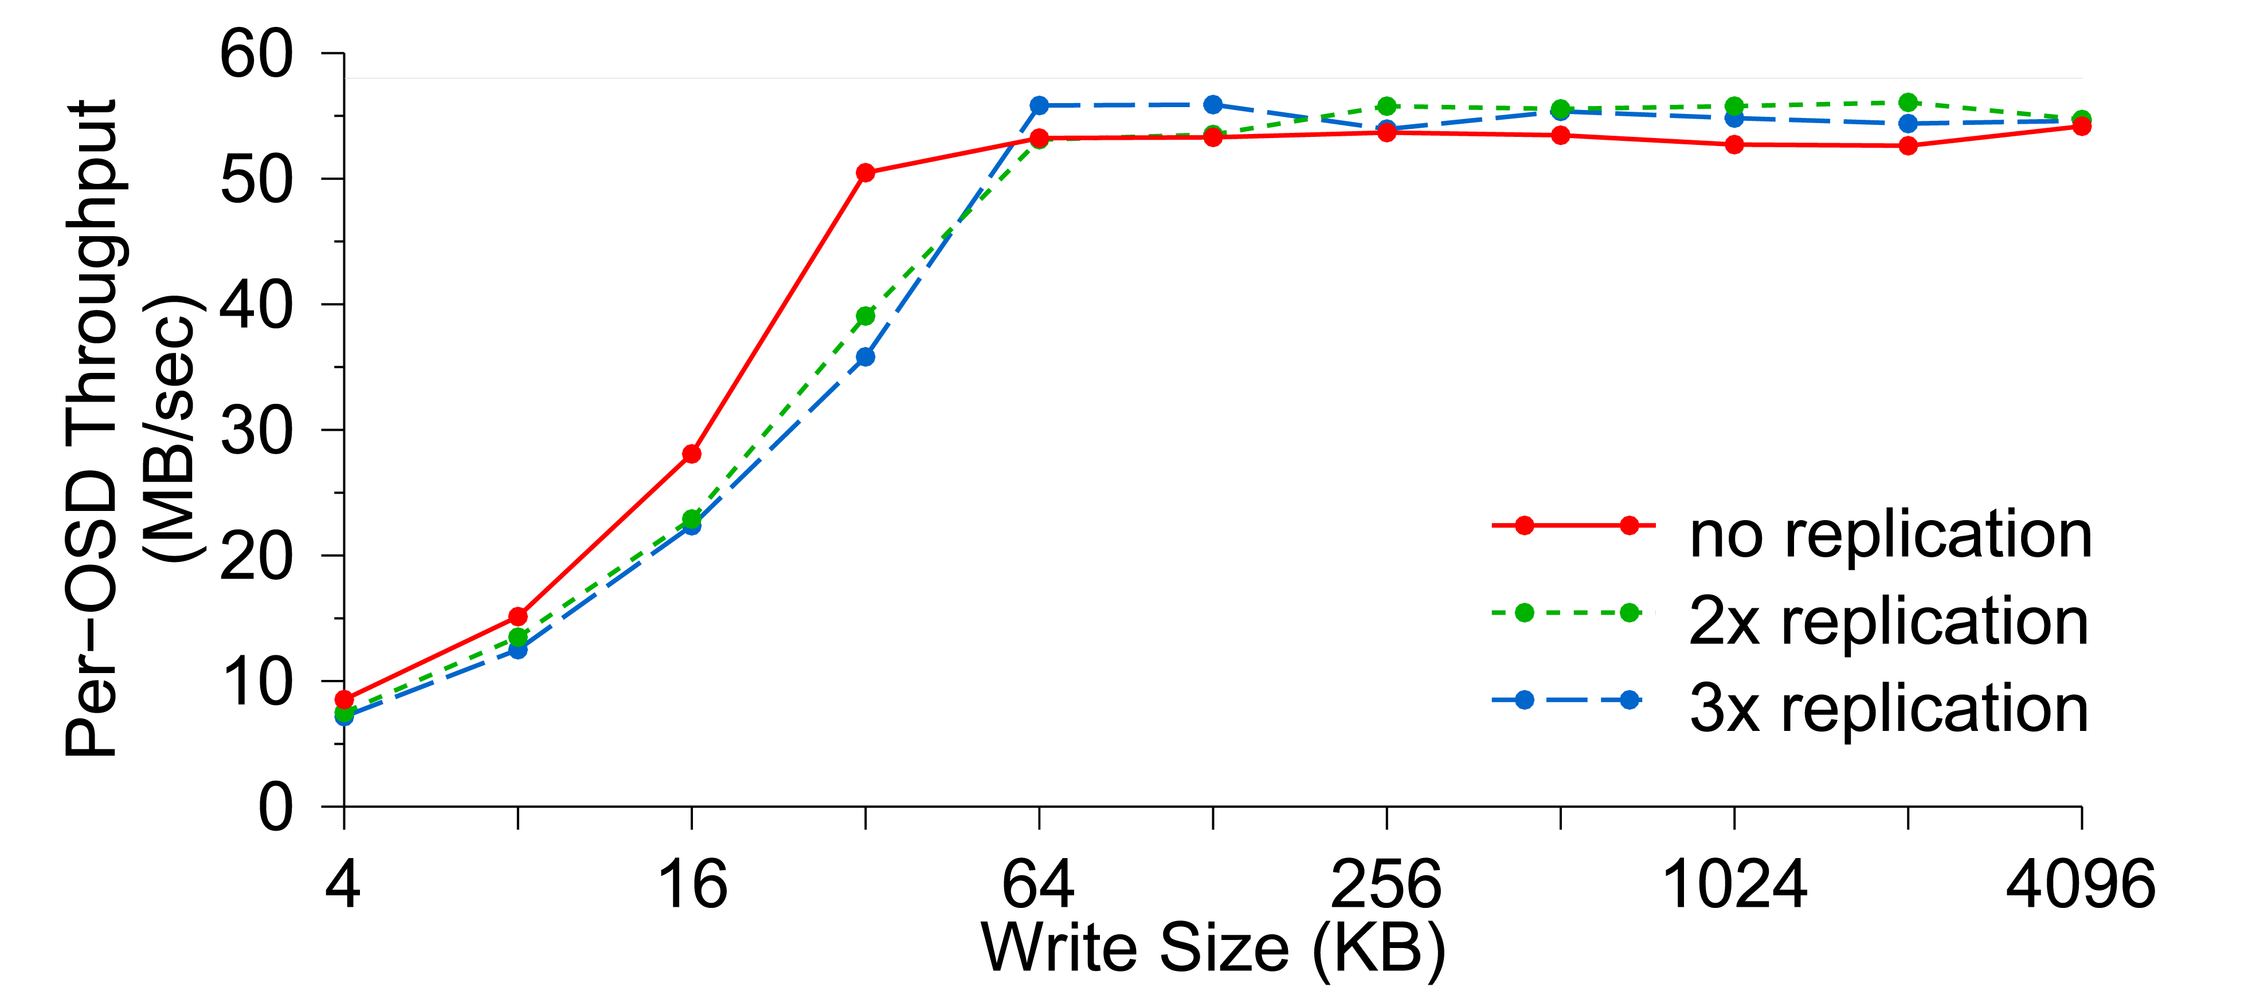
Per-OSD Write Performance

Slide 30
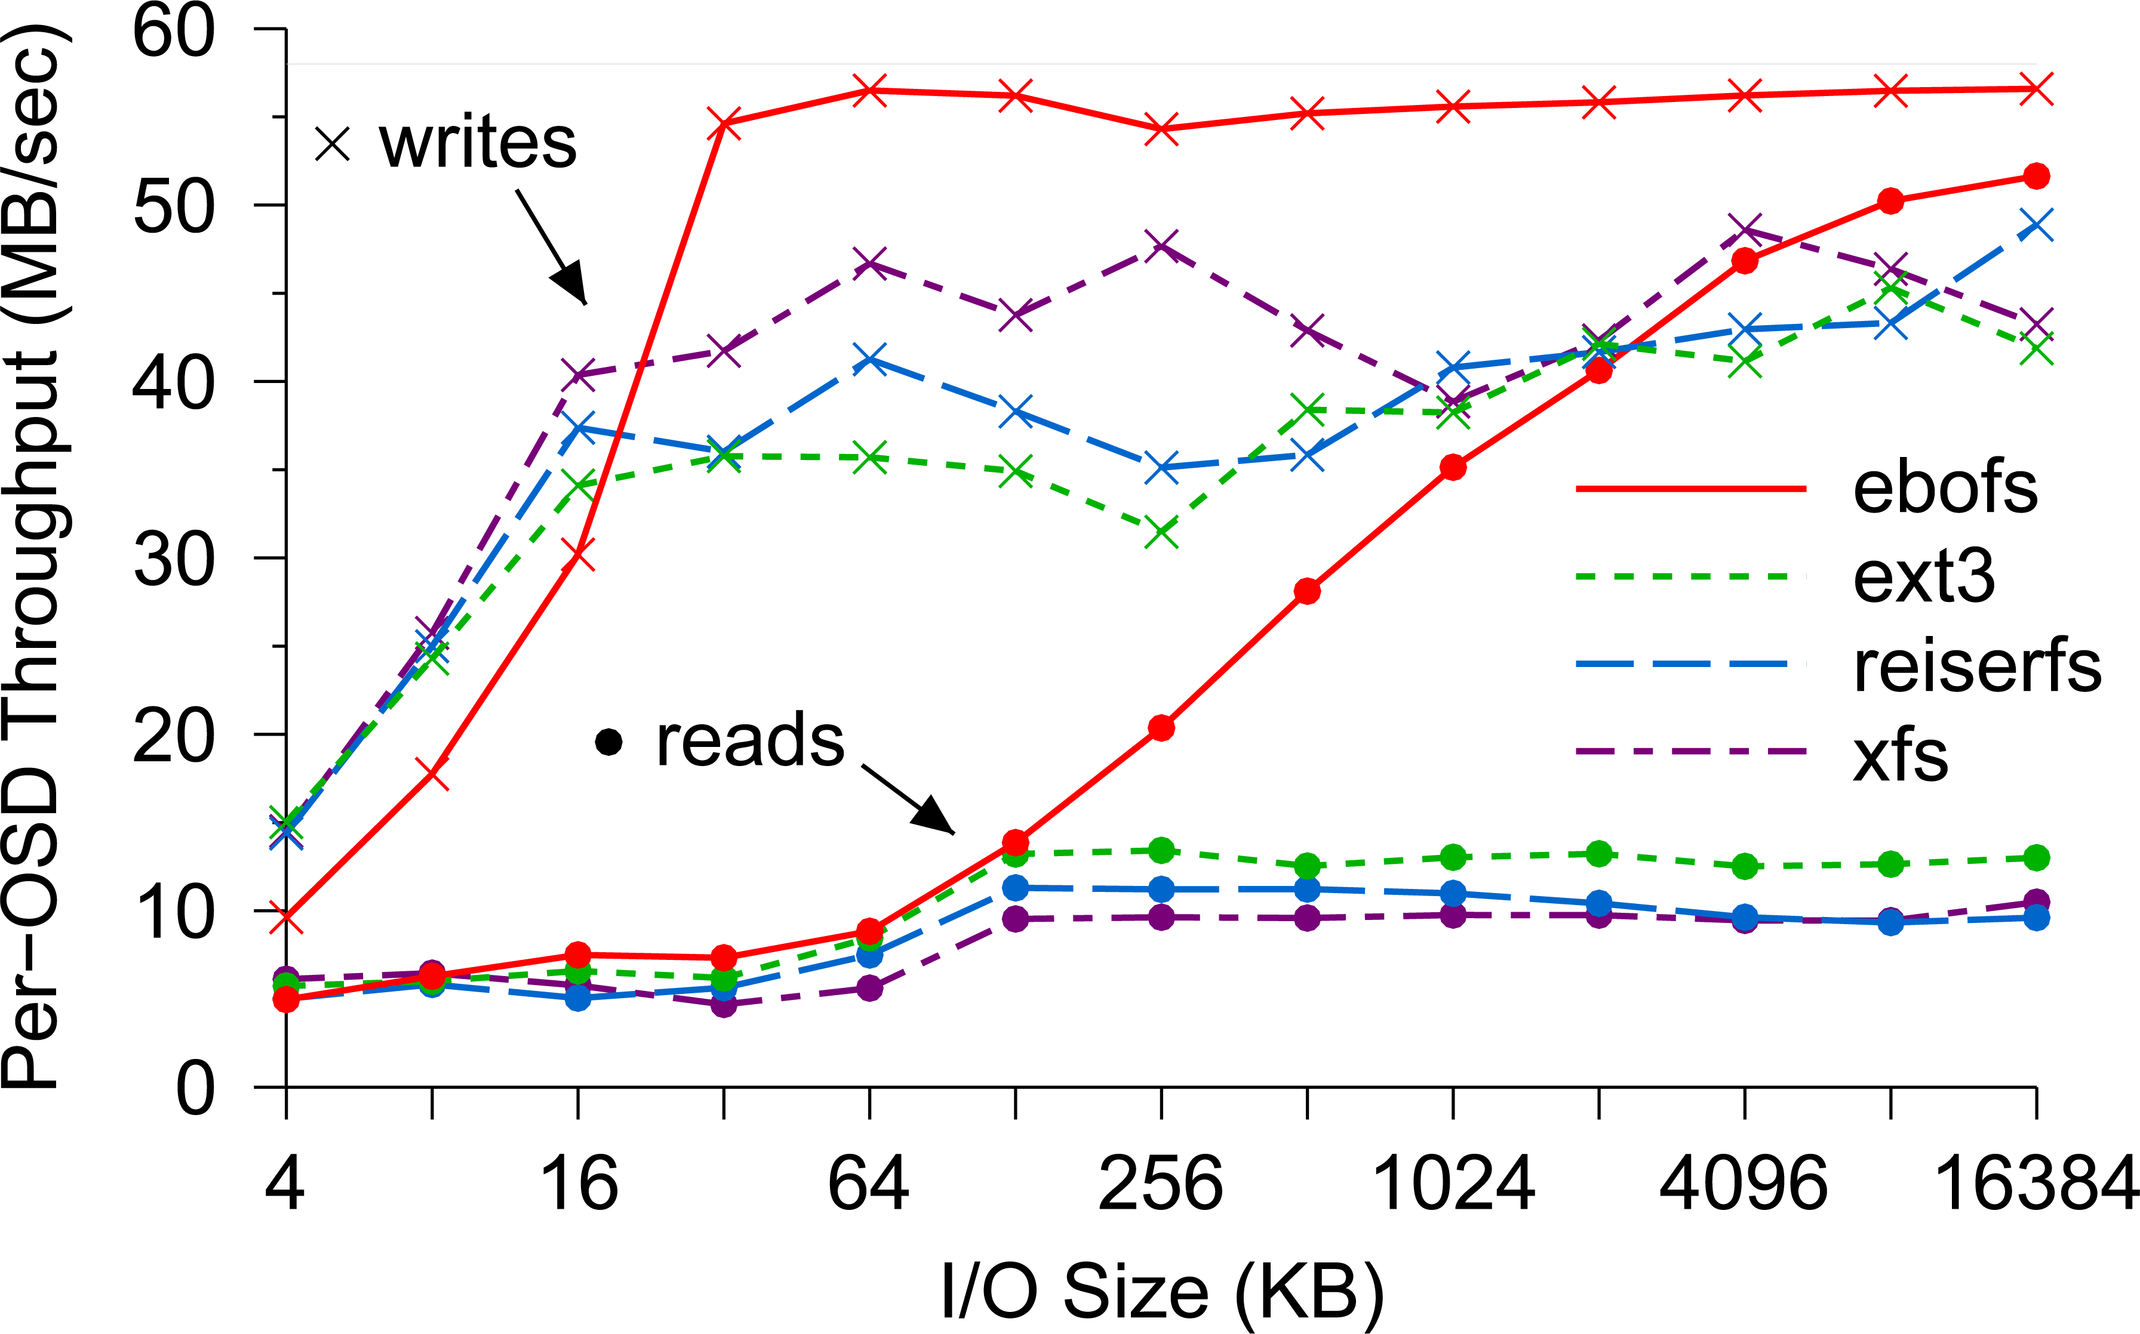
EBOFS Performance

Slide 31
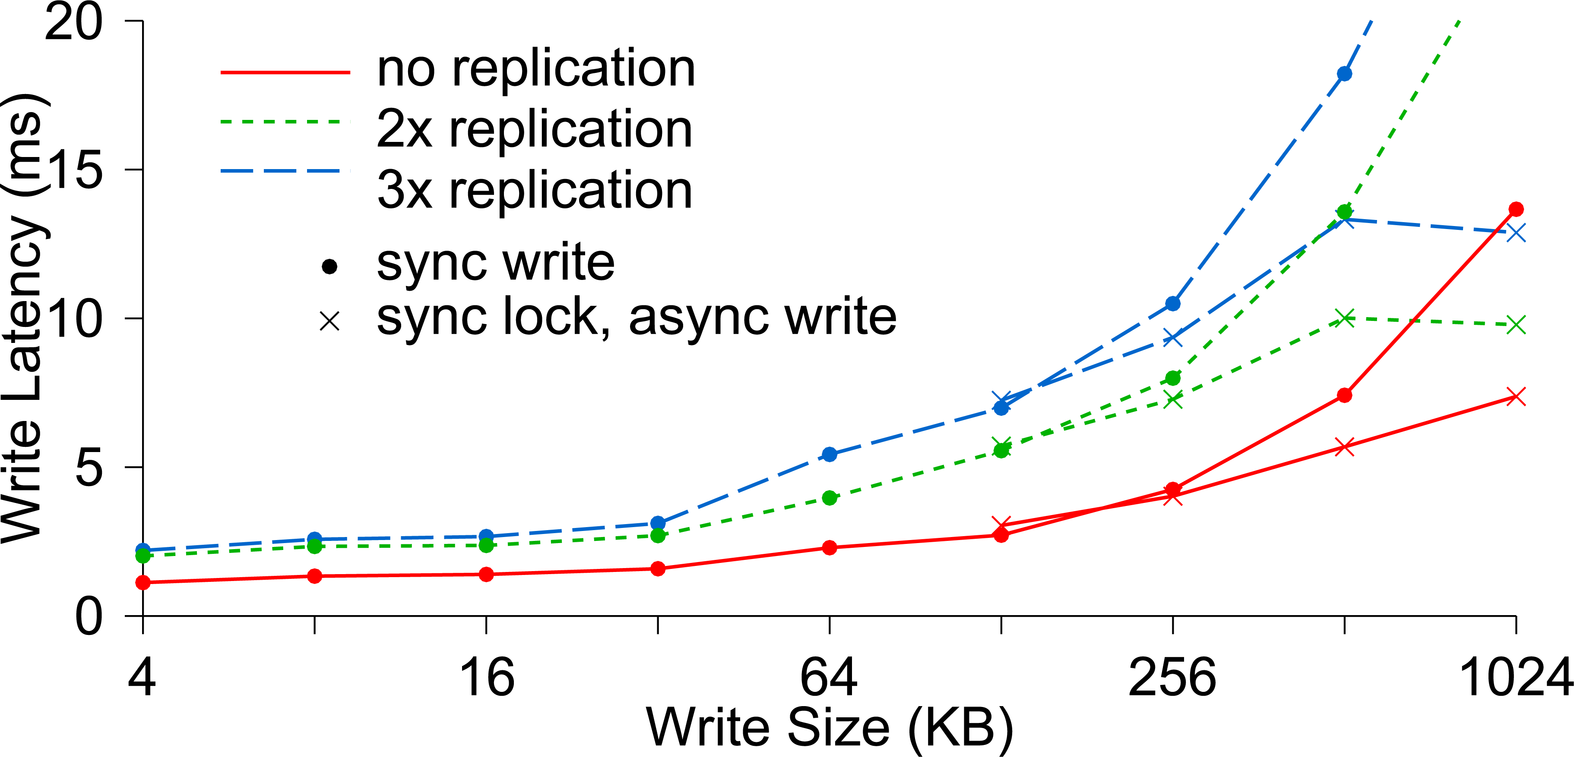
Write Latency

Slide 32
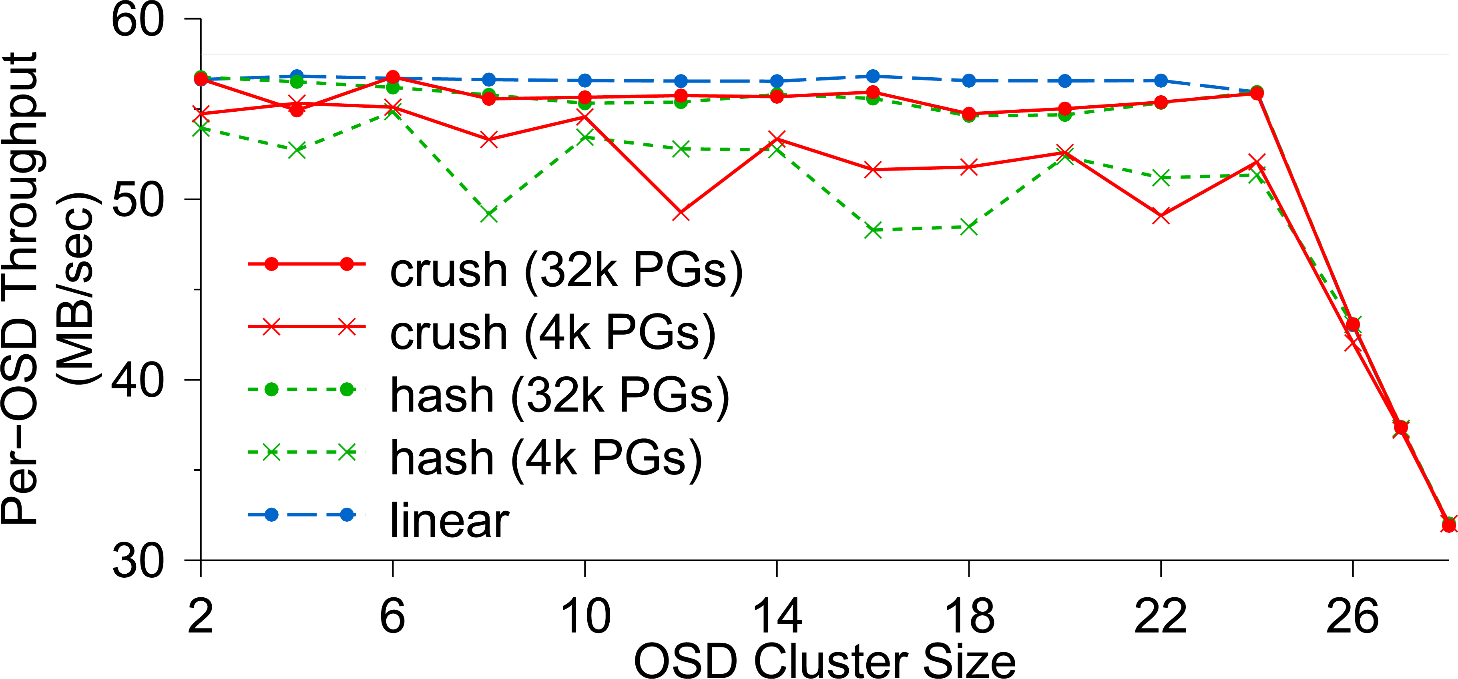
OSD Write Performance

Slide 33
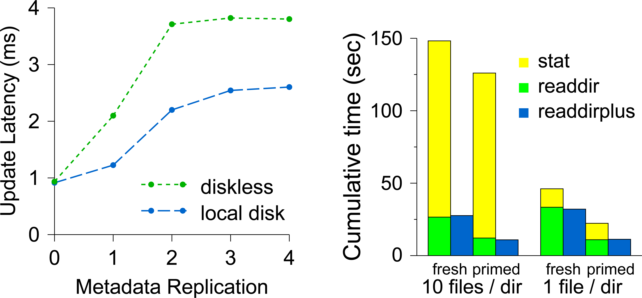
Diskless vs. Local Disk
Compare latencies of (a) a MDS where all metadata are
stored in a shared OSD cluster and (b) a MDS which has a
local disk containing its journaling

Slide 34
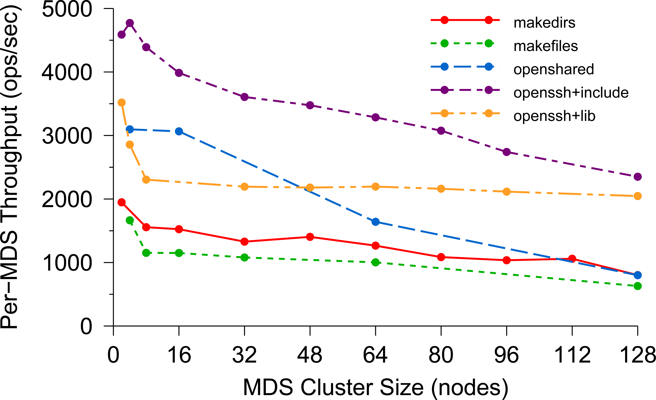
Per-MDS Throughput

Slide 35
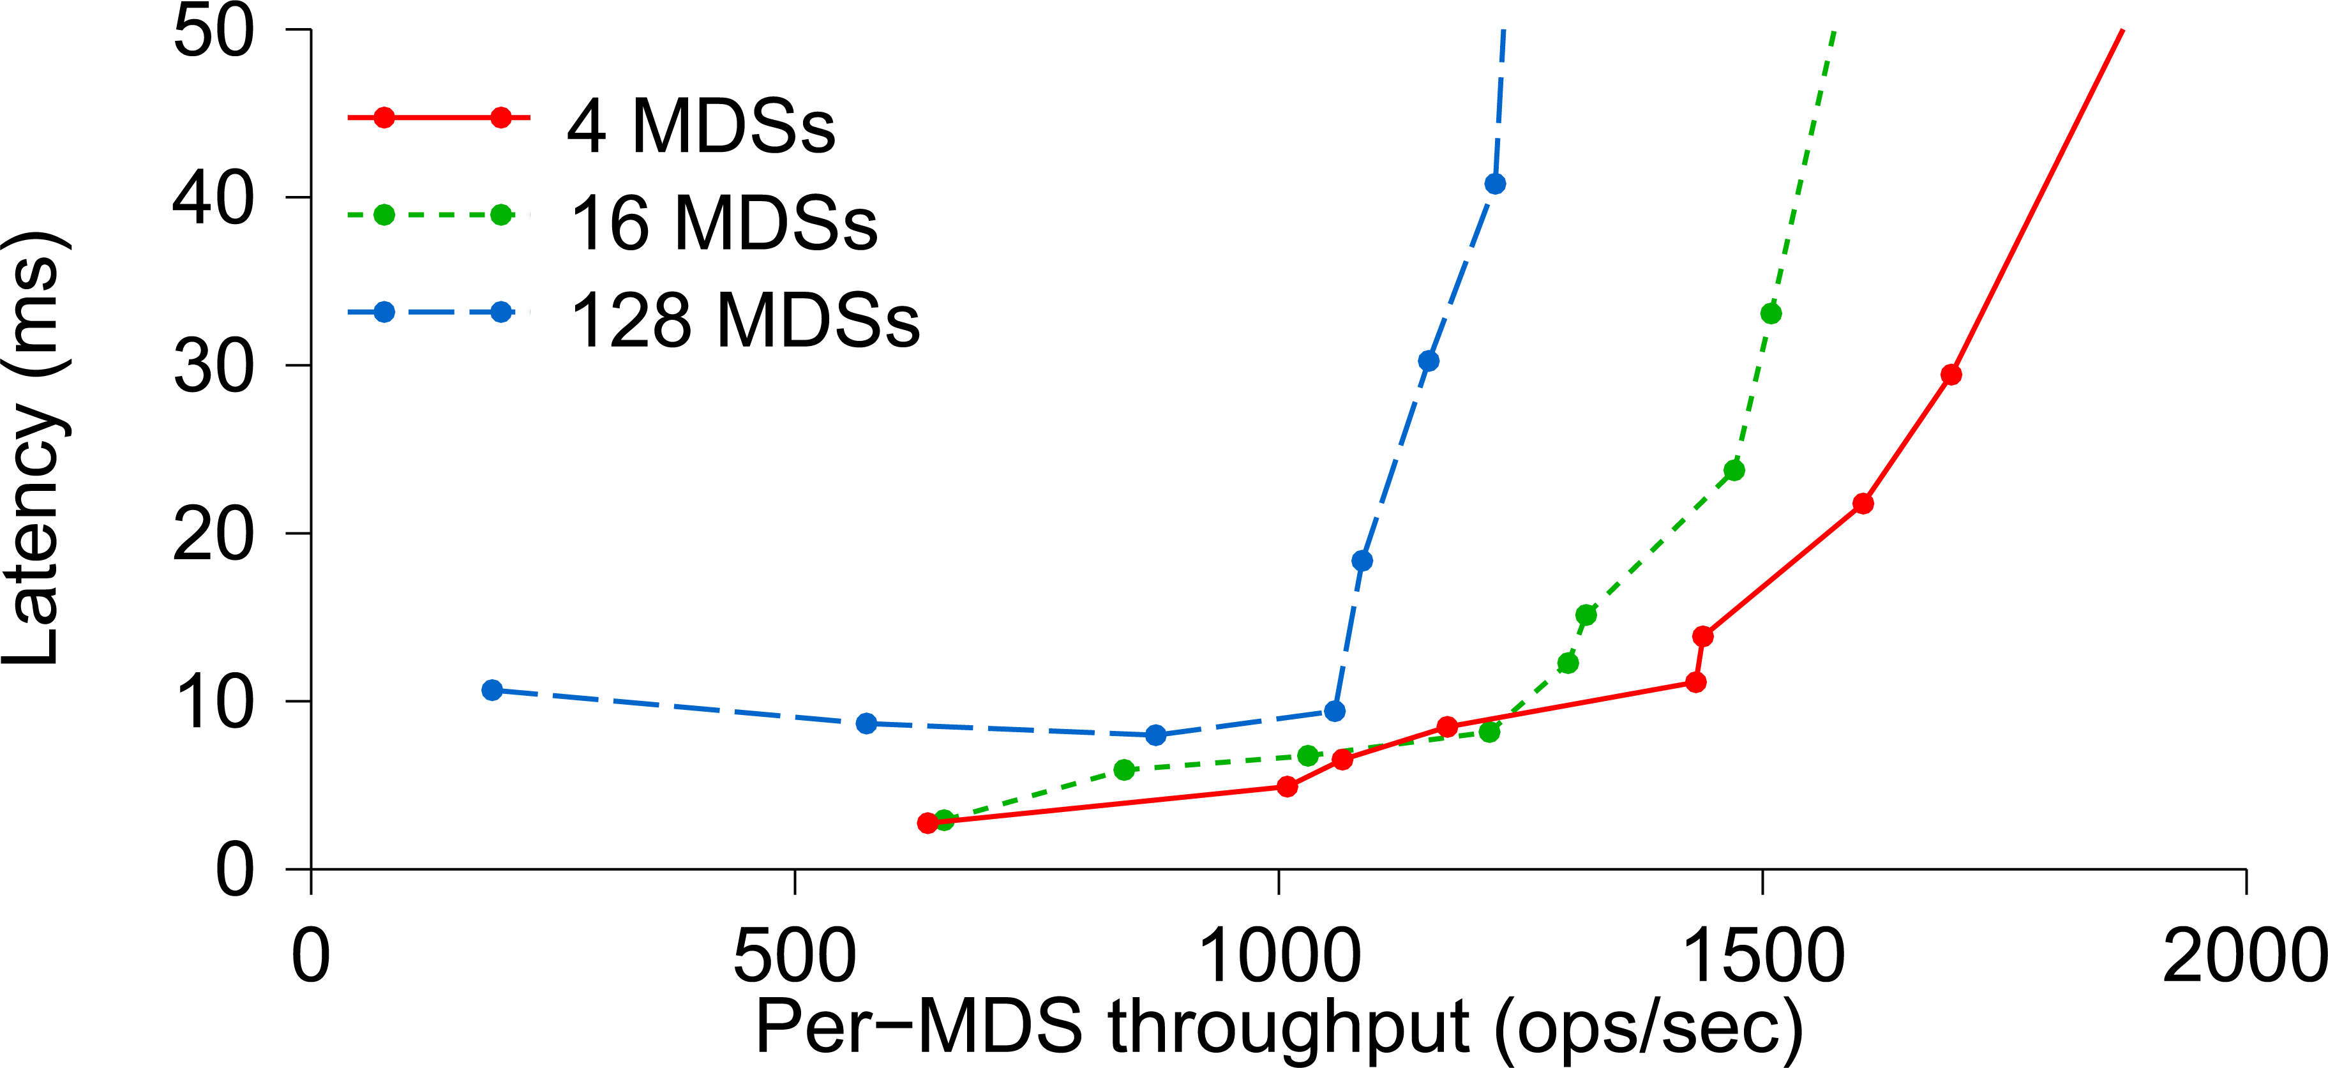
Average Latency

Slide 36
Lessons learned
If applications are object oriented, they will write huge numbers of variable-size records (some extremely large).
POSIX directories are awkward. A B+ tree index works much better.
Treat the records as byte arrays, track meta-data in one service and data in a second one. Both share the RADOS layer for actual data storage.

Slide 37
Second (Different) Topic
Overheads of object orientation

Slide 38
Let’s Drill down on that remark about doubled overheads
We say that Ceph is more costly when used as a file system, and less so when used directly as a key-value storage layer via RADOS.
This illustrates a cost associated with abstraction. When we adopt the wrong API, the translation between that API and the true one can add overheads.
These costs matter – and we’ll see that now in a second example.

Slide 39
CORBA and OMG
Ceph is really an outgrowth of a consortium called the “Object Management Group” or OMG.
They proposed a standard way to translate between internal representations of objects and byte array external ones. They call this the Common Object Request Broker Architecture or CORBA.
We can think of an application using Ceph as a kind of CORBA use case.

Slide 40
Understanding Costs for CORBA’s universal Representations: ATC System
A modern air traffic control system might have a structure like this:
Flight plan manager tracks current and past flight plan versions
Message bus
. . .
Microservices for various tasks, such as checking future plane separations, scheduling landing times, predicting weather issues, offering services to the airlines
Air traffic controllers update flight plans
Flight plan update broadcast service
WAN link to other ATC centers

Slide 41
Understanding Costs for CORBA’s universal Representations: ATC System
Notice first that this architecture is actually a lot like Ceph or HDFS:
The meta-data server in Ceph and HDFS is “like” the database of flight plan versions
The copies near the controllers are “like” the RADOS storage unit or the HDFS store.
And the message bus is “like” a live notification service for watched files

Slide 42
Understanding Costs for CORBA’s universal Representations: ATC System
Also, think about objects in an ATC system:
Flight plans: these are elaborate objects that might hold 10MB of data and could have a great many internal fields
Many other kinds of objects are used too. Each microservice probably has a notifications channel of its own, and uses it to talk to individual controllers or sets of them about relevant issues
“Attention: In 2h 31m, BA 123 will approach US 654 on approach to CDG. Plan corrective action to avoid a violation of flight separation rules.”

Slide 43
Understanding Costs for CORBA’s universal Representations: ATC System
An ATC system has many components, far more than were shown.
Often these are based on high-quality legacy versions and hence there can be many programming languages in simultaneous use.
Often we will see C/C++, Java, C#, F#, O’Caml, etc.
Some use of Python and Fortran and Ada.
With CORBA, we can easily integrate many modules into a single system

Slide 44
But how often will we (DE)serialize?
Each time an object is read or written (from disk or network)
Each time an object is passed from one module to another
Time →
ATC controller
Version Mgr
Message Bus
ATC rules checker
. . .
Overhead →
Points at which we might do serialization/deserialization

Slide 45
Universal representations are costly!
It is very easy for a CORBA application to spend all its time on this one action.
Ceph designers were aware of that, and decided it should only be done under application control.
Thus Ceph is “object oriented” and yet reflects a choice not to have the whole system understand every kind of object

Slide 46
How do ATC systems avoid these costs?
The trick is to use “lazy” record access.
The ATC record is the main object being shared. Suppose that we have two versions of an ATC object while in memory:
Version A: The object is fully resident in memory and you can access all fields, edit it to create a new version, etc.
Version B: All the same methods are offered, but the in-memory data is limited to a URL pointing to the record in the flight plan database

Slide 47
Why two “identical” object variants?
Notice how easy it is to switch from representation B to A (or back).
In an ATC system most components don’t really look at the data fields and for this reason, most components would be happy with representation B. But a small object with just a URL in it is very cheap to serialize!
With “lazy deserialization”, we would convert from form B to form A only when an application tries to touch the data.

Slide 48
Old Single version approach
Each time an object is read or written (from disk or network)
Each time an object is passed from one module to another
Time →
ATC controller
Version Mgr
Message Bus
ATC rules checker
Wasted work!
. . .
Overhead →
Points at which we might do serialization/deserialization

Slide 49
Dual version approach
We only do a costly action when the component will actually touch the inner data fields!
Time →
ATC controller
Version Mgr
Message Bus
ATC rules checker
Here we fetch the full data for the flight plan from the flight plan database
. . .
Overhead →
Dual scheme reduces overheads!
A A B B B B B B B B B A B B B

Slide 50
How should we store the flight plan records?
The need is for a very simple append-only log managed by the version manager.
It is easy to recognize this as a use case for state machine replication.
This situates the central safety question in one specific component, where we can formalize it and use mathematical tools to prove that each plan has just one sequence of versions, used consistently by all components.

Slide 51
How should we Implement the flight plan manager component?
A (key-value) sharded service built on Derecho would be an ideal choice.
Derecho has been proved correct in several ways: by hand, but also using a machine-verified proof in the Ivy protocol verification tool.
It is also scalable and extremely fast: important because this role is central.

Slide 52
Revisiting the structure
If this one component is correct, the whole system can be proved safe!
A modern air traffic control system might have a structure like this:
Flight plan manager tracks current and past flight plan versions
Message bus
. . .
Microservices for various tasks, such as checking future plane separations, scheduling landing times, predicting weather issues, offering services to the airlines
Air traffic controllers update flight plans
Flight plan update broadcast service
WAN link to other ATC centers

Slide 53
Summary – CEPH
Ceph is a file system that was created by taking the HDFS model, but then extending it to be better matched to properties of object-oriented code.
This is very popular, although it does bring overheads.
Ceph uses a simple but “weak” form of data replication. It doesn’t guarantee consistency.

Slide 54
Summary – corba
Here we saw a different form of object-oriented overhead, arising in applications that adopt the standard CORBA approach to interoperability.
CORBA buys flexibility but brings steep costs.
Those costs can be managed by understanding the architecture and designing the application to avoid triggering costly serialization/deserialization.

Slide 55
Broader Insight linking these subtopics
Innovation brings challenges.
As the world has shifted towards object oriented languages like Java, C++, Python with its object features, etc., we are finding that they pay steep overheads if you adapt them naively to run on standard platforms.
But with modest effort, they can perform extremely well in the cloud.

