Slide 1
CS5412 / Lecture 16 smart contracts with Multiple Organizations
Ken Birman
Spring, 2022

Slide 2
Broad overview
In the lecture on Monday we learned that
It is appealing to use blockchain for IoT data in settings like farms
This poses challenges not seen in cryptocurrency settings, like intermittent networking
We can extend the blockchain model to solve those problems. Vegvisir did this by tolerating forks (using a dag model) and introducing a support blockchain operated by witnesses (permissioned with proof of stake, not proof of work)
But that was a research system; today there are no products like Vegvisir.
Today we will explore a second such scenario

Slide 3
Broad overview
We’ve mentioned hospitals that might use a blockchain to assist in electronic medical records management
What exactly are the challenges here?
They include maintaining confidence that the EMR database and the blockchain are properly synchronized, and semantics of smart records
There is also a broader issue of trust. The Stellar system is one effort that tries to address the trust problem

Slide 4
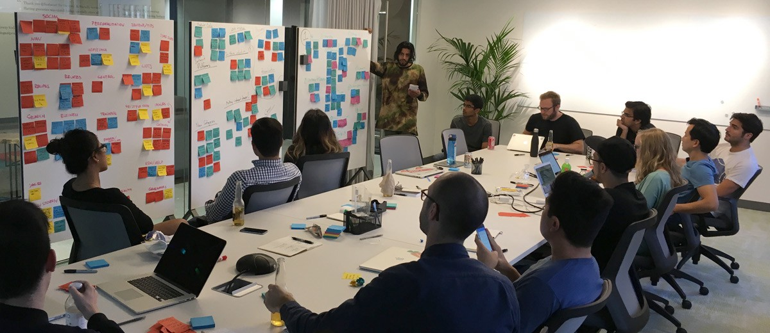
Today: Brainstorming about a real Blockchain use case!
Consider the challenge of running a multi-hospital consortium structure in which one patient might be seen by physicians at more than one different medical center.
Example: In New York City, the “tri-institutional medical consortium” includes Cornell Weill, Sloan Kettering, NYU
A patient with a complex condition could have treatments in all three

Slide 5
Example
Mrs. Sally Smith is admitted for abdominal pain at Cornell Weill. Various diagnostic procedures are performed. Cornell starts treating an infection.
She turns out to require surgery, which is done in the gastroenterology surgical unit at NYU.
There is a follow-up cancer treatment at the Sloan Kettering Medical Center. Meanwhile, she also has infection follow-ups at Cornell, and surgical post-op visits to NYU.

Slide 6
The issue? 3 sets of medical records!
Each of these organizations has a distinct electronic medical record management system, which for legal reasons (HiPPA) must be managed by each individual hospital.
Yet each also needs a way to see the records created by the others, in order to ensure that the complex condition Mrs. Smith is being treated for is correctly managed.
HiPPA doesn’t deal very well with this form of sharing.

Slide 7
Current approaches and issues
Right now, each hospital maintains its own distinct record
Sometimes these records disagree in ways that may have billing consequences, so hospitals employ full time staff to resolve such issues.
Causes include different opinions about a diagnosis, errors entering data, different rules employed by the different hospital IT systems, etc.

Slide 8
Medical Records and the cloud
What roles can the cloud play in medical record management?
In early EMR systems, the answer was very simple: none. For a long time, medical records systems were treated as “on your own premises only”.
But over time, this became more and more expensive and unworkable. Eventually, a form of hybrid cloud emerged.

Slide 9
Term: Hybrid cloud
We have seen this mentioned in past lectures.
A hybrid cloud is any system that combines elements from the home system and the cloud, or even from multiple distinct cloud providers.

Slide 10
Term: Hybrid cloud
A hybrid cloud is any system that combines elements from the home system and the cloud, or even from multiple distinct cloud providers.
These could run on the home system or be migrated to the cloud.
For example, a company could take a database that used to run on its own servers and “port” it to run on AWS. Hybrid cloud allows them do this in a very transparent way.

Slide 11
Porting an Enterprise system to a cloud
Cloud hosted EHR records system
Stub relays requests to the cloud
Home hosted EHR records system
Hybrid cloud uses a version of the App Service to manage machines on your behalf. Your EHR system is a microservice!
Client system
Web services first tier is like a function tier

Slide 12
Porting an Enterprise system to a cloud
We end up “redirecting” what used to be remote procedure calls from clients to the home-hosted server. Now they become web-service requests forwarded to the cloud, and the answers come back in the same web-service format.
But this can be hidden in the library used by clients to talk to the service.
In principle, you just recompile and things work as they did previously!

Slide 13
Why was this beneficial?
Notice first that it could actually be slower than the original solution!
But modern networks are fast, and network delay isn’t the only concern.
The cloud has:
Cutting edge hardware,
Automated management tools
Sharing (amortized costs)
Huge storage and compute capacity

Slide 14
So…
By adopting the cloud, the hospital can change the computer room into some other use of the space, like a surgical suite.
The IT staff can become more effective and won’t need to do as much hands-on management of the servers.
Upgrades are done by the cloud vendor, not by the IT staff.

Slide 15
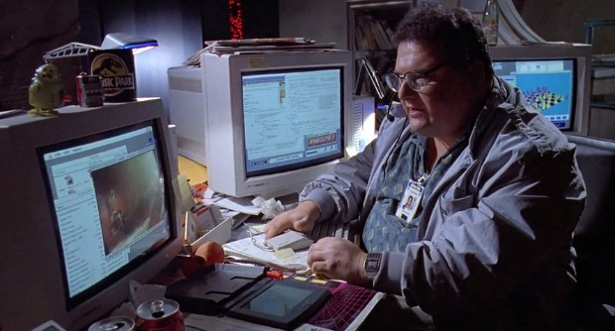
Downsides?
Dennis… the evil hacker. He wants to download and sell Haley Beiber’s medical records to the paparazzi.
The hospital can’t access its own EHR records unless the network is up and the cloud provider is operating normally.
Security and privacy aspects of HiPPA: What if Amazon has an evil employee who plans to sell data about celebrity patients?
What if the disk on which data is stored gets upgraded and the old one isn’t wiped clean?

Slide 16
Some reassuring Cloud Features
The web connections use TLS (https): all the data is encrypted
The cloud itself uses the Virtual Private Cloud concept we discussed. Your microservice lives in an isolated “security environment”.
All the files stored by your application are automatically encrypted by the file system before being written, and the keys are kept at your home system, not on the cloud. So if the disk were stolen, it can’t be deciphered.

Slide 17
Technology really can help
By splitting secret keys among multiple repositories, we can guard against failure that could otherwise destroy a key, while also ensuring that k out of N portions are needed to reconstruct the actual key.
In a secure cloud, keys aren’t kept in memory for more than a few microseconds. Instead, any key we will use for a long period is “mapped” to a different key managed by the hardware keys built into the trusted computing hardware module (TCB). This temporary key can only be used on a particular machine, with the help of the hardware itself.

Slide 18
More reassuring Features
There are also human-factors steps taken by the big vendors.
They ensure that any person who has access to secure keys doesn’t have access to the physical data center, and that any person who has a way to modify the operating system code can’t access keys or hardware.
There are also steps taken to ensure that connectivity from the home site to the cloud is redundant, from multiple ISPs (tunneling over mTCP).

Slide 19
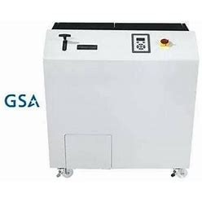
Hard disk drive “shredder”
To reassure customers, cloud operators have begun to contractually commit that used storage devices will be destroyed
This small device will shred a hard disk into recyclable metal waste. It even has a government seal of approval!

Slide 20
Where does this get us?
Individual organizations, like hospitals, have some elements of their electronic health records on the cloud, and the trend is to move more and more functionality over time. HiPPA concerns slow this down, but it is advancing even so.
But even if they happen to be on the same cloud, they can’t just share records with one-another other than by creating specialized mirroring.

Slide 21
Hospital Y treats a patient from hospital X
In today’s approach, each pair of cooperating hospitals establishes a form of secure replication channel.
For example, X might send records about Mrs. Smith to Y, specifically needed for Y to carry out this treatment.
Y might then share back some of its records of the treatment, so that X has the needed data to track her overall plan of care.

Slide 22
X and Y must audit all sharing
Each hospital has a legal obligation to track which records have been shared (outgoing or incoming), and precisely why.
This extends to other organizations too, such as laboratories that do testing, private practices where physicians might see some patients in an office setting, etc.
It is natural to think of Blockchain as a technical tool for such uses.

Slide 23
Blockchain: A “partial” match
The tamperproof audit trail aspects are a good fit here.
We can track these EHR record transfers in a blockchain, and it gives us a proof of which records moved from institution to institution.
We can also track individual accesses to those records. Now we know that Dr. Marshall accessed the records of Mrs. Smith from hospital Y.

Slide 24
The real problem is that a blockchain isn’t a database!
For higher level machine-learning tools that could ask “is it appropriate for Dr. Marshall to make this access?”, we would need more of a database representation!
In fact, in general, both human and computer users of this data will want to query it.
But a blockchain isn’t a database!

Slide 25
There is a lot of work to close the gap
Many companies offer SQL interfaces so that their blockchains can be viewed as if they were databases.
This isn’t always very performant, but by creating secondary indices (like our B+ tree from hw2), we can ensure that common query patterns are executed very rapidly.
Then an administrator could, for example, check to see whether Dr. Marshall made this access as part of a treatment activity.

Slide 26
Would Cloud safety features Stop the Nedry Exploit?
Remember that Dennis Nedry… wrote the code!
Dennis wants you to think everything is being audited and tracked, but actually he plans to steal Mrs. Smith’s health records and sell them without being caught.
If the records themselves are encrypted, he might be blocked, but a legitimate medical access might be delayed or blocked too…

Slide 27
Dennis Could try…
He might modify the audit-update or query code to try and fool you. Perhaps he takes the legitimate sensor records, changes them right away, and then logs the modified versions. Is anything checking this risk?
“Chief security officer: Check that all EHR record accesses are properly authorized.”
“System: Confirmed, no problems detected.”

Slide 28
A skeptic might want more proof
… but here things get very difficult.
Does HiPPA allow us to show the skeptic the entire audit trace? What if Dennis gets a job as an auditor?
Or could we somehow construct a machine-checkable proof that the query response is a correct and complete one?

Slide 29
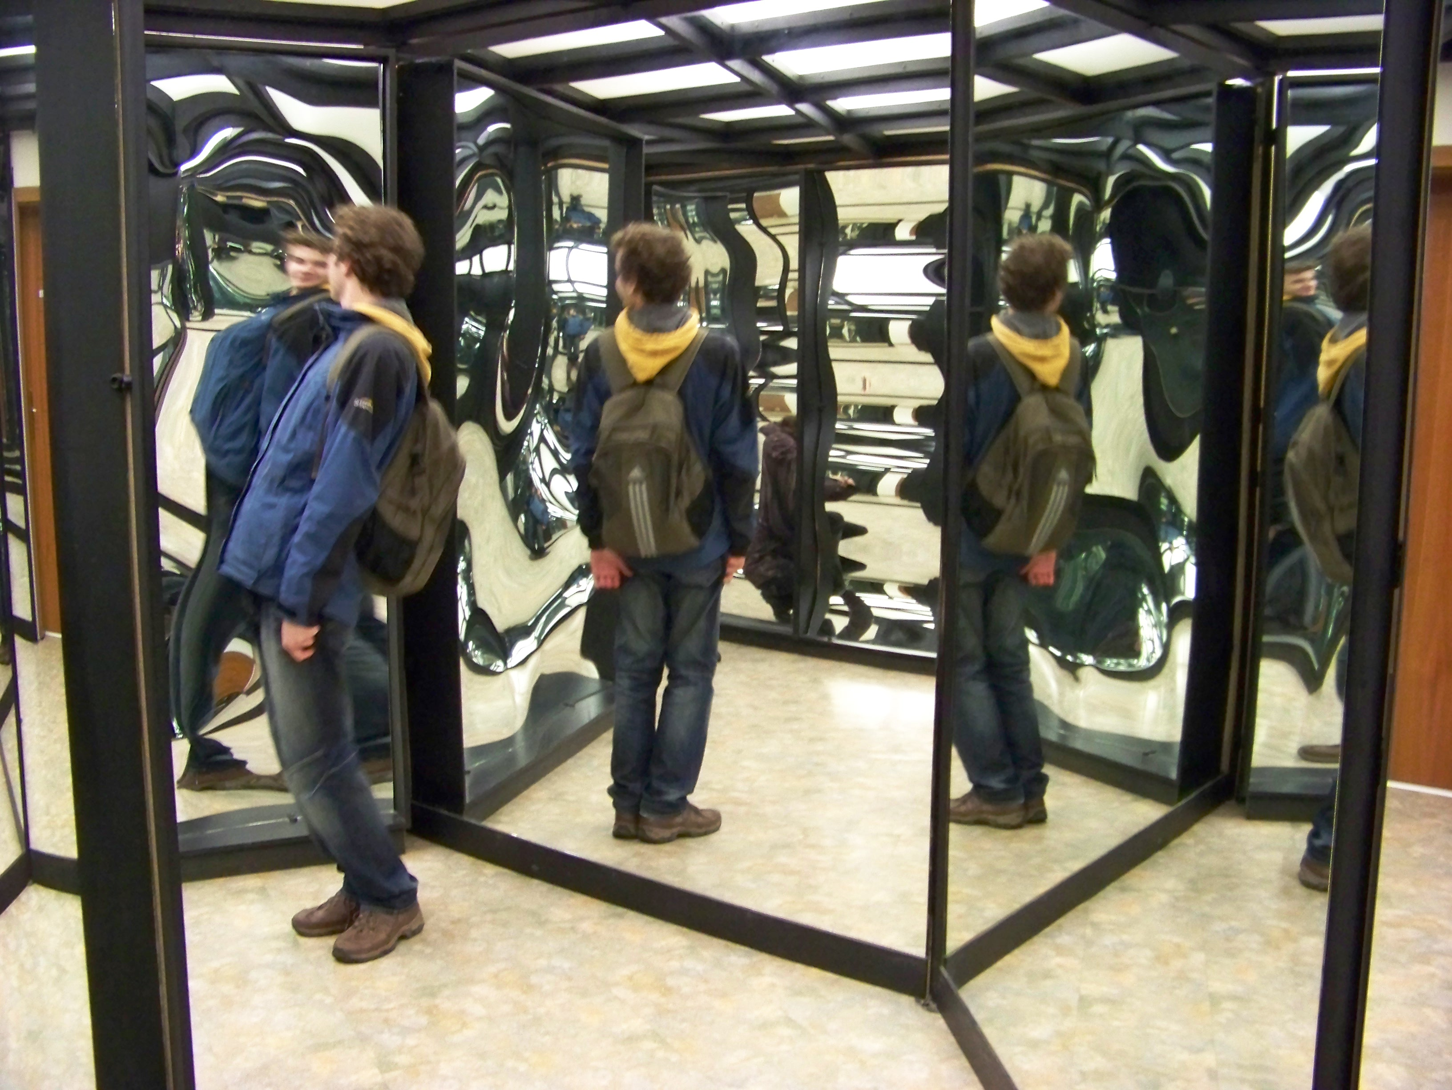
WAN mirroring can help!
Suppose that as we generate our blockchain, we also make a lot of mirror copies on other datacenters. They “countersign” the replicas.
Thus if WAN datacenter X logs event A, a skeptic can actually fetch the signed log from X but can also get countersigned mirror copies at Y, Z…
Having many signed copies makes it hard to rewrite entire logs from start to finish: with so many copies to check, the auditor will sense tampering!

Slide 30
Other settings with similar needs
Suppose our hospital sees a surge of food poisoning. Now the health workers wish to trace all the main events between when a load of spinach was harvested to when it reached the consumers.
The team is hoping to pinpoint an event. Perhaps, “on the Smith family farm, these cases were transported on a pickup truck that previously was used to transport a load of cow manure.”
But it can be extremely hard to capture enough state to do that!

Slide 31
More such settings
Inter-bank transactions
Supply chain tracking for industrial activities such as manufacturing plants
Tracking the maintenance of hardware in the field, for things like power grid technology with very sensitive roles

Slide 32
Many such cases need even more!
The smart contracts concept from Ethereum can appear to be a great fit for banking transactions or other complex kinds of records.
But here we trust that the Ethereum “code” describing the event is correct and unambiguous.
The potential of a blockchain to roll back (instability of the last records) is especially worrying.

Slide 33
Example of how rollback causes issues
Suppose that Dan sells chewing gum to Frank for $1.
Our blockchain record may record that “upon receipt of $1 from Frank, Dan will hand Frank the chewing gum.”
But now Frank decides to earn some money. He washes Sally’s car and for this she will pay him $3, and he will use $1 of this to buy the gum. The record is added to the blockchain.

Slide 34
… we can create endless dependencies!
… actually, Sally wrote him a check. Frank needs to deposit it.
… the bank needs to clear the check.
… Sally’s bank account has plenty of money, but is blocked by her visa card, which is trying to collect what they claim is an unpaid bill.
… the Visa card company actually made an error. Sally did pay the bill (someone else with the same first and last name is in arrears). They agreed to fix this, but haven’t done so yet.

Slide 35
… we can create endless dependencies!
Visualizing these dependencies. Remember: the blockchain can roll back at any time, erasing the last few records!
Buy gum. Frank must pay Sam $1 | Visa locked Sally’s account by mistake | Sally writes a check to pay Sam for washing car | Frank can’t cash the check! He must wait | Visa unlocks Sally’s account |  | Frank retries. Now Sally’s check clears | Frank pays Sam

Slide 36
Cascading effect of rollbacks
The last 5 or 6 blocks of records are considered unstable, meaning they could be overwritten by other records.
Blockchain becomes stable after about an hour, but in Frank’s case, that won’t be enough. He needs the last record in the chain to stabilize!
Even worse: what if the amount being paid depends on some future thing?

Slide 37
Hospitals and Banks should use permissioned blockchain with true commit
The selection of the blockchain product becomes very important.
If you use a permissionless blockchain with rollback, the consequences of rollback become issues for your application. If you pick a permissioned blockchain with a fairly quick and firm commit, and no further rollbacks, your application won’t experience problems as long as it waits for commit
Only well-informed developers can safely use these technologies!

Slide 38
Future dependency
Frank, Sally and Dan are creating a startup company. It will revolutionize newspaper stands in big cities, and they will split the insane profits.
They call it “stand”. Even the name will be worth millions billions.
The blockchain record of the agreement might say: “when stand.com is sold, Frank and Dan will receive 30% of the proceeds each, after deducting costs, and Sally will receive 40%.”

Slide 39
… but the “amount” could vary!
Depending on the records added to the chain in the future, the costs could change, and hence the amounts they will be paid could change.
What are the semantics for “costs”?
When should costs be evaluated? When can the transaction finalize?

Slide 40
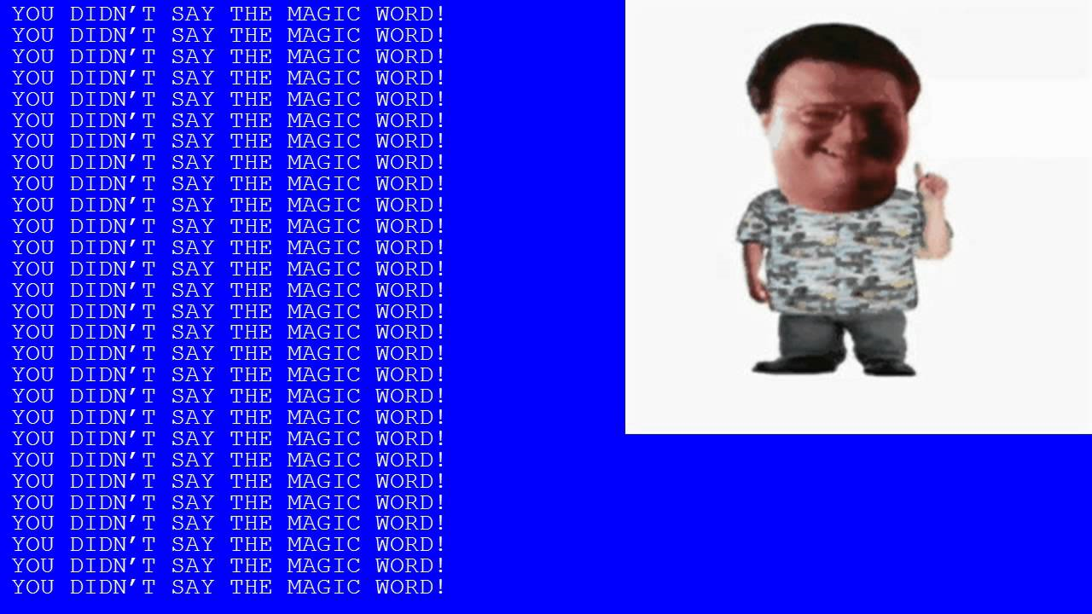
Can IoT help?
On the positive side, we can capture records from our IoT devices and store them into the blockchain, too. We can even have them signed by the devices to “prove” that this is really what the device detected.
And we could have enough sensors to make it hard to conceal things.
But ultimately, if Dennis Nedry understands how the system works, he won’t have any real difficulty evading it.

Slide 41
Biggest concern of all
What Rumsfeld called the “Unknown unknowns”.
It ain’t what you know that’ll get you. It’s what you know that just ain’t so.
-- Attributed to Samuel Clemens (Mark Twain)

Slide 42
Patterns of trust
One big area of discussion relates to situations where there are multiple blockchains managed by different organizations and you don’t have equal trust in all of them.
For example, maybe an Ithaca resident only trusts credit union banks, but not big banks. Meanwhile, a hard core Wall Street capitalist only trusts really big banks and would never trust CFCU or AFCU.
So how can the Ithaca person get a mortgage that the Wall Street person is actually issuing? Somehow their different blockchains need to talk to each other!

Slide 43
Do I trust you?
In our hospital setting, each big hospital has its own network of labs and providers and insurance partners
Each trusts its own partners, but not the partners of the other big hospitals. In fact this is a legal obligation: a hospital must only share EMR records with organizations and people who are trusted to access them
Can blockchains incorporate a concept of trust?

Slide 44
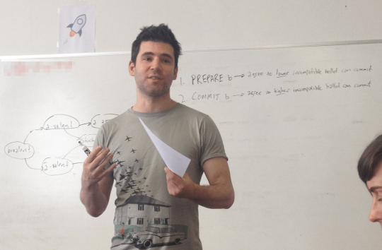
Stellar: Tackling this issue
Stellar co-founder David Mazieres
A company called Stellar has created a blockchain model with many blockchains. The key idea is to use a version of a state machine replication protocol called RAFT to replicate blockchain records across the set of blockchains.
If person P trusts {X,Y,Z} then any record associated with person P is required to be stored by a quorum (majority) of the set {X,Y,Z}.

Slide 45
Stellar with two companies
What if a record involves this mortgage that P is basically obtaining from Q? Then we take their two trust sets: P trusts {A,B,C,D,E}. Q trusts maybe {X,Y,Z} (or they can share some trust, this is fine too).
Stellar asks for a majority from each of the trust sets. So we end up putting the mortgage record into a quorum from {A,B,C,D,E} and also a quorum from {X,Y,Z}. Now anyone P “cares about” would be able to see the record. And similarly for anyone Q trusts.

Slide 46
Witnesses in Stellar
This insight leads to a policy:
A logged record is initially pending
When a majority of some trust set witness the record, it becomes trusted with respect to that majority
When the record is trusted by all the trust sets from the transitive closure of the parties involved in the record, the record is supported and can be treated as a committed database update

Slide 47
Challenges with Stellar
If the trust sets are static, the idea is pretty simple and it is obvious that it will work in a simple way.
But suppose that trust varies over time. Maybe CFCU and AFCU merge, or perhaps some banker decides to not trust UBS bank anymore.
So now the quorum sets aren’t constant. We have to “re-replicate” to preserve our invariant. With concurrency and failures it gets messy!

Slide 48
… But stellar is up and running
The company is basically a financial clearing firm for big customers that need to do international money transactions and track them for audits
They had $10B per day of average transactions in 2022, and are growing rapidly.
This demonstrates demand for auditable financial services, not just anonymous ones that evade scrutiny and regulatory oversight.

Slide 49
What Can we conclude?
Mostly, the conclusion here is that the enthusiasm for blockchain is way ahead of the reality of the standard systems, but that some of the more mundane uses are exciting, real, impactful and perhaps very beneficial!
Everyone is going wild dreaming up fancy use cases. But perhaps the real value is in use cases that look technically easy and kind of dull.
Bottom line: the fancy scenarios are very speculative but the mundane ones are worth pursuing.

Slide 50
One of Ken’s “Tales of Woe”
We take client-server computing for granted… but it was nearly on one of those gravestones!
In the earliest days, Digital Equipment Corporation invented client-server with the introduction of their VaxClusters architecture. A huge advance!
The market was exponential – DEC was on track to become the largest computer company ever. Then it suddenly imploded and was acquired!
Notes:
This may feel like a digression, but the core question I’m asking is very relevant: what happens if a technology rolls out too soon and gets ahead of itself by lacking needed features?

Slide 51
Why did early client-server fail?
The concept was absolutely right! Yet the customers were unhappy.
The early products felt like a research prototype, not professional.
The “life cycle” of a full client-server deployment had not yet been thought through, hence there were a huge number of missing tools and features.
Notes:
Today everything does use client server. But today we have a lot more support to debug issues and manage our systems.
In those days all these tools were lacking.
They aren’t very fancy in most cases and many were created by random system administrators who built them for some simple practical reason and made them open source for others to use. Still, without them, problems snowballed.

Slide 52
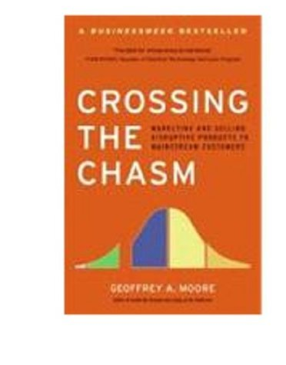
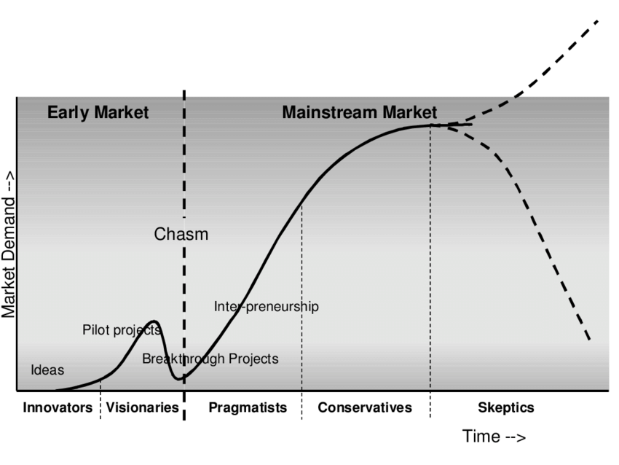
Crossing the Chasm (Moore, 2009)
Where is Blockchain heading?
A customer
Unhappy with Client-Server v1, she gives up on it!
Notes:
This is a classic book about technology introductions and success/failure

Slide 53
Factors that limit uptake
Early enthusiasm / bleeding edge always moves on to the next better thing, so the first adopters are certain to wander away.
Conservative customers want to be “the first to be last” and wait for the mainstream uptake to occur.
If you move too quickly, you simply overextend and fall into the chasm.

Slide 54
Summary
Real world uses that seem ideal for IoT and Blockchain are very common
Yet it can be a real puzzle to actually build the solutions! Aim low, for now.
Simply seeing a match doesn’t really solve anything. The details are hard!

