Slide 1
CS5412 / Lecture 8
Replication and Consistency (Part II: Practical Options)
Ken Birman
Spring, 2021

Slide 2
Recap
Eric Brewer told us that stale data and inconsistency is fine. Why worry? And in fact this worked for cloud computing web sites, like Amazon.com
But his CAP model doesn’t fit well with IoT settings that involve watching real-world devices and controlling real-world actions. Consistency matters for these cases: we need data that isn’t stale, we need fault-tolerance, and we need scalability too!
So we discussed state machine replication and virtual synchrony.
Notes:
Today we’ll look at building a new μ-service using Derecho as a tool to simplify some of the really hard steps.

Slide 3
Recap: State Machine Replication
This is a model in which we have deterministic programs
They see one update at a time and apply the updates in the same order. There is a communications version of this (atomic multicast) and a log-append version (persistent replicated logging).
If our replicas start up in sync, they stay in sync.

Slide 4
Recap: Virtual Synchrony
The idea was to break down a distributed systems into a
Multicast protocol. Sends messages only while membership is stable.
Membership service. Tracks which processes are in the system, and
what role each process is playing (like which shard it is in).
State transfer mechanism. Uses checkpointing to initialize a joining process.
In virtual synchrony, membership changes only when updates are frozen and vice-versa. The multicast and state transfer logic becomes much simpler.

Slide 5

Classic Paxos
To understand the issue, it may help to start by
understanding a little about classic Paxos.
We’ll focus on the behavior of the system when membership is fixed. This is because modern systems use virtual synchrony or a similar mechanism so that Paxos is always paused when membership must be changed.

Slide 6
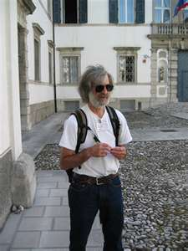
Leslie Lamport’s vision
Leslie starts with 2F + 1 processes (for example, to
tolerate 1 crashed processes, we need 3 in total).
Paxos tolerates processes that get overloaded and don’t reply, but later recover and act normally. Membership is not changed in such cases.
The state is stored on logs – this is a persistent append-only update model.

Slide 7
Leslie didn’t use virtual synchrony
At the time, he wasn’t familiar with my model.
So he assumed that the membership was fixed, and that some processes simply couldn’t be reached due to being crashed – a temporary problem. Crashed processes would later restart on their own.
His idea: each update just needs to reach a majority of the members.

Slide 8
Quorum policy: Updates (writes)
To achieve high availability, allow an update to make progress without waiting for all the copies to acknowledge it.
Require that a “write quorum” (QW) must participate in the update
Easy to implement this requirement using a 2-phase commit protocol
Basic approach: Leader asks the loggers (“acceptors”) to log an update. But it won’t commit unless QW respond “success”. So we have a request phase and then a commit phase: a 2-phase commit.

Slide 9
(2-phase commit “oversimplifies”)
Each of the two phases can require a few rounds of messages.
This relates to cases with concurrent updates occurring, or where some processes actually do fail and then recover with some data loss.
We won’t get into those details in CS5412.

Slide 10
How does Paxos read data?
The central issue is that due to being failed when an update occurred, some acceptors (some log copies) might lack certain writes.
To compensate, Paxos has a client (a “learner”) read multiple replicas. Then the learner merges the log contents, which fills in any gaps.
Accordingly, we define the read quorum, QR to be large enough to overlap with any prior update that was successful. E.g. might have QR = 2

Slide 11
Verify that they overlap
So: we want
  QW + QR > N: Read overlaps with updates
  QW + QW > N: Any two writes, or two updates, overlap
The second rule is needed to ensure that any pair of writes on the same item occur in an agreed order
R1
R2
R3
N = 3
Q_{W} = 2
Q_{R} = 2
Write x=7
Read x

Slide 12


Visualizing this
R1
R2
R3
leader
Acceptor
Acceptor
Acceptor
Logs, one per acceptor
learners
client
The client asks the leader to add a message to the Paxos logs. Paxos is like a “postal system”. The leader will be in charge of this request.
The system “discusses” the letter for a while (the first phase, which picks the slot in the log, stores the letter in the log, and reaches QW acceptors).
Once the update is “committed” the learners can execute the command

Slide 13
So… Paxos is like a single append-only log, but implemented with many logs!
Thinking of Paxos as a way to make a durable log of messages is the right way to view the classic protocol. Logs are on disk and are durable.
We use multiple logs, but the way we merge them when learning causes them to behave like one gap-free log.
Atomic multicast keeps everything in memory. It runs much faster, but the application would need to handle any logging.

Slide 14
Paxos Ballot numbers
So… Paxos thinks of the log as a series of slots to be filled with updates.
But the first phase might not succeed on the first try. What if fewer than QW acceptors are able to accept some update?
This leads to the idea of “ballots” – the first phase loops, with the leader trying to get QW successes on a series of proposals, each with an increasing ballot number. (Of course, ideally, we succeed right away).

Slide 15
In Failure-Free Synchronous Runs
(“prepare”, ⟨1,1⟩)
(“accept”, ⟨1,1⟩ ,v₁)
1
1
1
1
1
2
2
2
.
.
.
.
.
.
.
.
.
(“ack”, ⟨1,1⟩, ⟨0,0⟩,⊥)
n
n
n
(“accept”, ⟨1,1⟩ ,v₁)
Simple Paxos implementation
always trusts process 1
decide v₁

Slide 16
Criticisms of Paxos
The protocol is very slow and clumsy.
It has a proof of correctness, which is great, but is also very complex and many implementations have had bugs. Over the decades more and more Paxos implementations have been proposed and proved to implement state machine replication, but by now it is no longer clear what Paxos “is”!
In fact the classic Paxos protocol wasn’t even invented by Lamport! There were at least three prior systems using it.

Slide 17

Leslie Lamport’s Reflections
“Inspired by my success at popularizing the consensus problem by describing it with Byzantine generals, I decided to cast the algorithm in terms of a parliament on an ancient Greek island.
“To carry the image further, I gave a few lectures in the persona of an Indiana-Jones-style archaeologist.
“My attempt at inserting some humor into the
subject was a dismal failure.

Slide 18
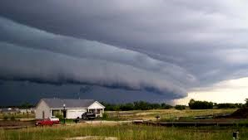
Derecho to the rescue!
A Derecho is a powerful wind
Derecho is a system created at Cornell that implements a new version of Paxos in which we also tried to leverage modern datacenter networks.
It can support atomic multicast or durable (logged) Paxos.
It runs on standard TCP but also supports a new and more modern
hardware implementation of TCP in which the memory of one
computer can be read or written directly from some other computer.
This is called remote direct memory access: RDMA.
When setting up Derecho, a configuration file tells it which to use.

Slide 19
Derecho is a software library
Derecho is a C++ library that handles membership, atomic multicast and persistent logging.
It is designed specifically to support sharded micro-services in modern datacenter settings.
The developer builds a new microservice by linking against the library.
Notes:
Derecho currently covers most but not all aspects of launching and registering a new μ-service on Azure or AWS. The missing elements relate to the way that you actually tell Azure or AWS to install the thing: right now this must be done by hand-editing a JSON file. Someone needs to write code to auto-generate the JSON file. Not hard, very valuable, but we need someone to just do it.
You also have to build a Derecho “configuration” file. Same comment: this is done by hand right now, and perhaps could be auto-generated someday in the future. But the file is easy to edit and understand.
Then there is a question of running the Azure or AWS command that causes this JSON file to get read by the cloud manager layer. Reading it will trigger creation of the μ-service (Azure will automatically launch the N program instances, and the rest is automated by Derecho).
And once all of this is done, you would create ANOTHER such file, in JSON, to tell the Azure IoT Hub (or its AWS cousin) to run your event-triggered functions and to “bind” them to the new μ-service. By doing so, the event-triggered function gets permission to issue requests to the μ-service using RESTful RPC. Whew!

Slide 20
Derecho is extremely fast
As much as 10,000x faster than standard Paxos protocols.
In fact we can even prove that Derecho is an optimal Paxos solution: no Paxos protocol can eliminate any delays from Derecho. Decisions occur as early as they safely can be performed.
However, modern developers don’t really want a C++ library. So we are creating Cascade, a new DHT for the IoT cloud, layered on Derecho.

Slide 21
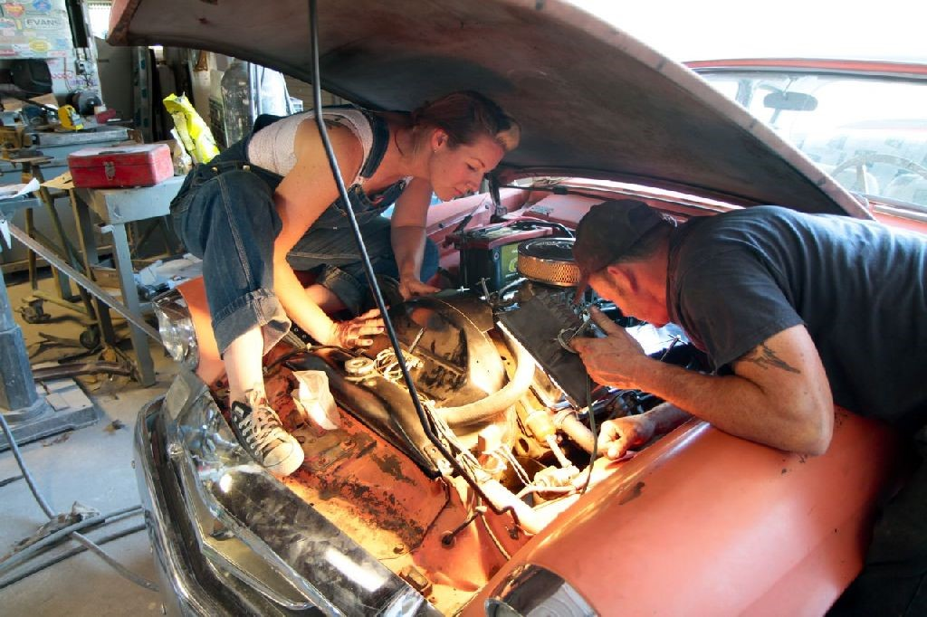
Derecho Internals

Slide 22
Motivation: Consider Paxos on a fast network
P
Q
R
“Ack”
“Ack”
“Here is 100B message m”
“Are you till prepared to commit m?”
“Commit m”

Slide 23
Motivation: Consider Paxos on a fast network
P
Q
R
TIMELINE, PROCESS P
“Ack”
“Ack”
“Here is 100B message m”
“Deliver m”
“Garbage collect m”
P
1.5us
0.75us + 100B/12.5GB/s = 0.750000008us
1.5us
1.5us
4.5us + 12 messages (limit: 75M/s)

Slide 24
Motivation: Consider Paxos on a fast network
P
Q
R
TIMELINE, PROCESS P
“Ack”
“Ack”
“Here is 100B message m”
“Deliver m”
“Garbage collect m”
Peak possible performance?
P
Time to perform one 100B reliable multicast? 4.5us + “noise”
… based on time expended, limited to 222,222/s
12 network operations out of 75M: limited to 6.25M/s
This network could have transferred 56KB of data in 4.5u
… we left 99.8% capacity “unused”!
0.75us + 100B/12.5GB/s = 0.750000008us
1.5us
1.5us
1.5us
4.5us + 12 RDMA messages (limit: 75M/s)

Slide 25
A few ideas
Have all the 3 members perform concurrent updates… now we might get some overlap and push our efficiency… to 0.6% ☹
Run lots of threads… maybe 10 per process. We aim for 6% efficiency (but locking and scheduling delays will cut this sharply) ☹
Batch 1000 messages at a time. ☺ But now the average message waits until 500 more have turned up. Latency soars to 2.25ms ☹

Slide 26
At Best, You get something like this…
P
Q
R
Messy and unpredictable with sudden bursts of data movement… Unlikely to perform well ☹

Slide 27
Better: Separate Data Plane and Control Plane, make them lock-free
Data plane: The actual data messages. Send them continuously, as soon as new updates show up
Control plane: Responsible for deciding when it is safe to deliver (“commit”). Receivers continuously report their acks, in an all-to-all pattern. This way every process can deduce that messages are deliverable.

Slide 28
Better: Separate Data Plane and Control Plane, make them lock-free
P
Q
R

Slide 29
Better: Separate Data Plane and Control Plane, make them lock-free
P
Q
R
P
Q
R

Slide 30
Better: Separate Data Plane and Control Plane, make them lock-free
P
Q
R
P
Q
R
Data plane runs steadily
Control information exchanged continuously

Slide 31
How to put these into order?
Q
P
R
Derecho uses round-robin order: one message from P, then one from Q, etc.
If a process has nothing to send, Derecho generates a “null message” from it, so that the others won’t have to pause.
This rule allows processes to stream data at high speeds without pausing.

Slide 32
how Derecho gets its speed
By “aligning” the flow of information with the network and not waiting for round-trip responses, it can run at the full network speed continuously.
Derecho never pauses unless the application no longer has data to send.
Analogous real-world situation: filling a bucket from a steady stream of water (Derecho), versus filling it one cup at a time (Paxos).

Slide 33
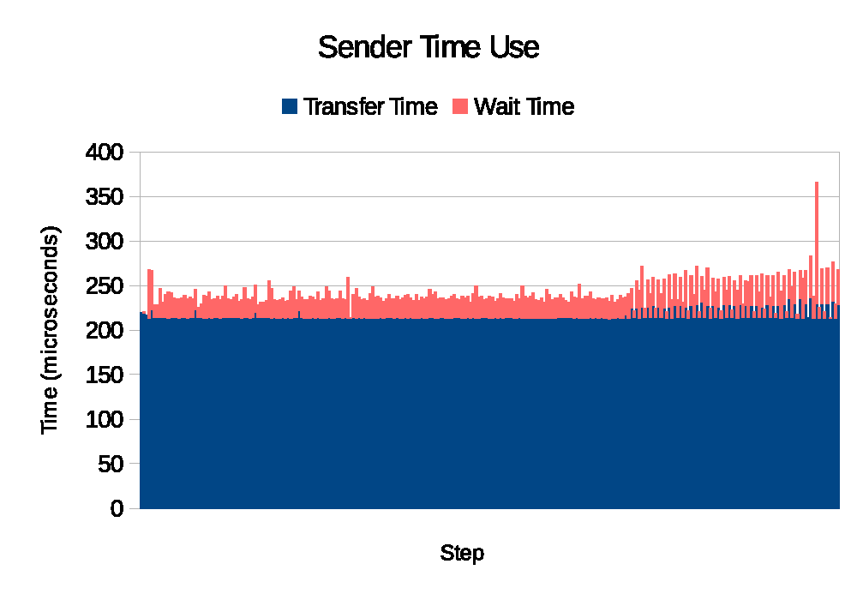
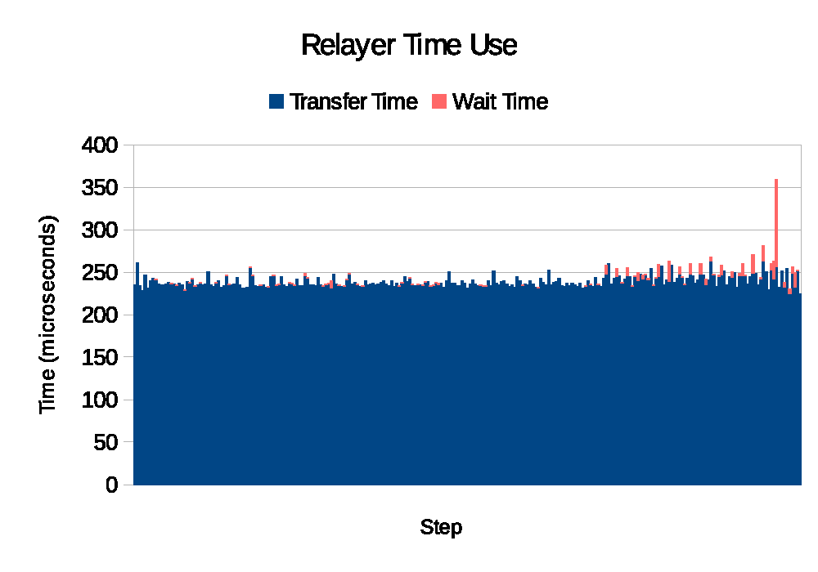
Derecho keeps the network busy (blue) and spends very little time in protocol software (pink)
This snapshots Derecho under continuous heavy load

Slide 34
Derecho’s Epoch Mechanism in action
Warm-started
spare processes
Derecho focuses on sharded services for modern cloud settings, and it packages this fast version of atomic multicast or Paxos with an automated way to organize the application into shards

Slide 35
Derecho’s Epoch Mechanism in action
Copies state from some active member
Warm-started
spare processes
For example, if a failure occurs, Derecho automatically repairs it.

Slide 36
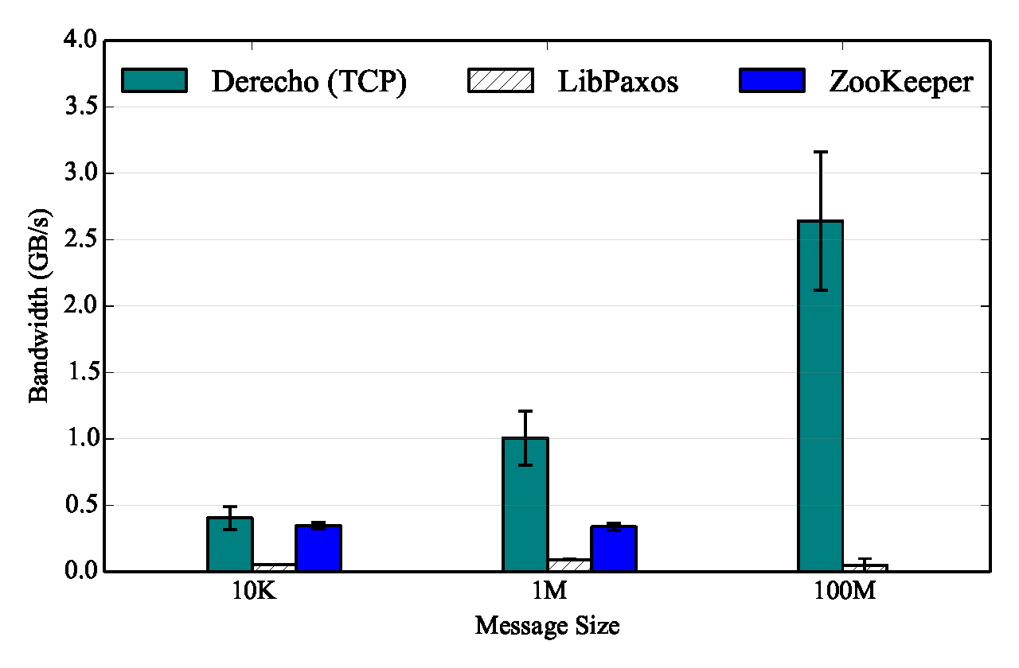
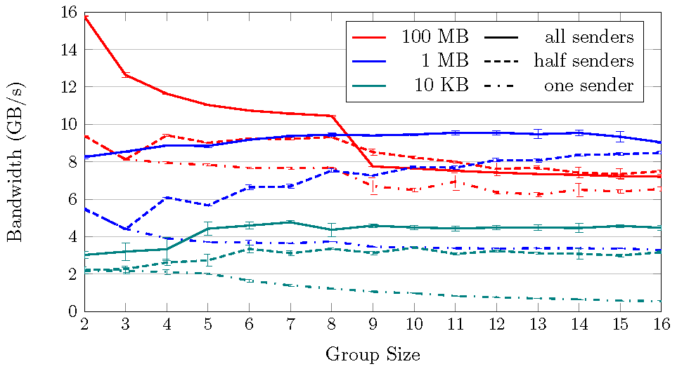
Atomic Multicast performance
Mellanox 100Gbps RDMA on ROCE (fast Ethernet)
100Gb/s = 12.5GB/s
Derecho can make 16 consistent replicas at 2.5x the bandwidth of making one in-core copy
memcpy (large, non-cached objects): 3.75GB/s
Derecho is faster than LibPaxos or Zookeeper even on TCP
Derecho Atomic Multicast on RDMA

Slide 37

Our New Toy: Cascade

Slide 38
So why do we need more?
Derecho is a C++ library for sharded data + atomic multicast/Paxos.
Not everyone is a C++ coding wizard, so only really good developers can use Derecho directly.
Cascade project starts with Derecho and turns it into… a DHT for IoT!

Slide 39
Cascade is…
A DHT with a fancy, flexible API (for example, versioned put, notifications when (key-value) pairs of interest change)
Layered on Derecho: Blazingly fast!
Customizable: You can integrate your own code into Cascade using the watch-a-key feature

Slide 40

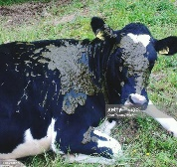

Cascade is designed to be customized
Does this
cow have
mastitis?
Is this cow
clean enough
to milk?
Which cow
is this?
A single Cascade server can support
multiple customized services
Cascade “instances” within datacenter

Slide 41

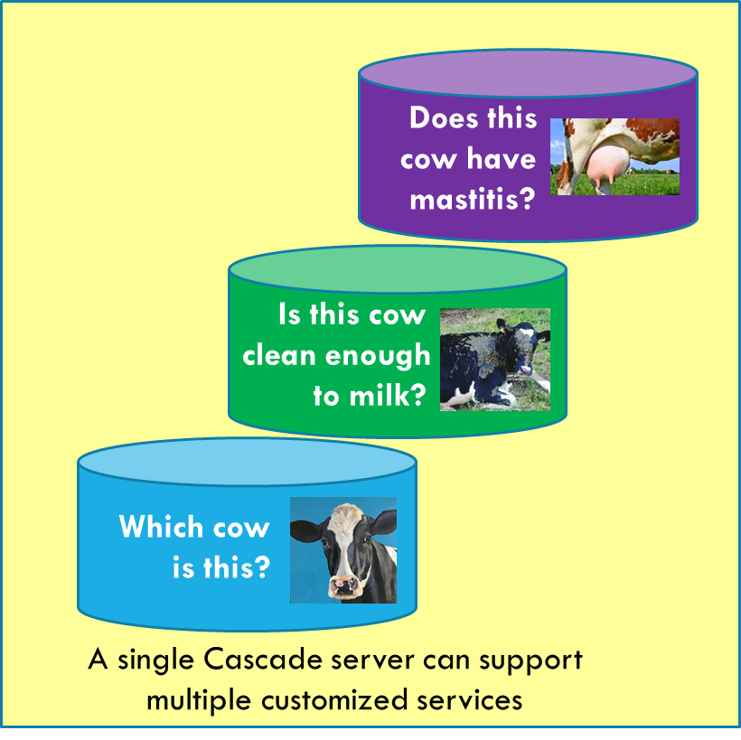
Cascade is designed to scale
Does this
cow have
mastitis?
WAN replication via read-only mirroring, using Zhen Xiao’s WAN Agent.
Is this cow
clean enough
to milk?
Which cow
is this?
A single Cascade server can support
multiple customized services
Cascade “instances” within datacenter

Slide 42
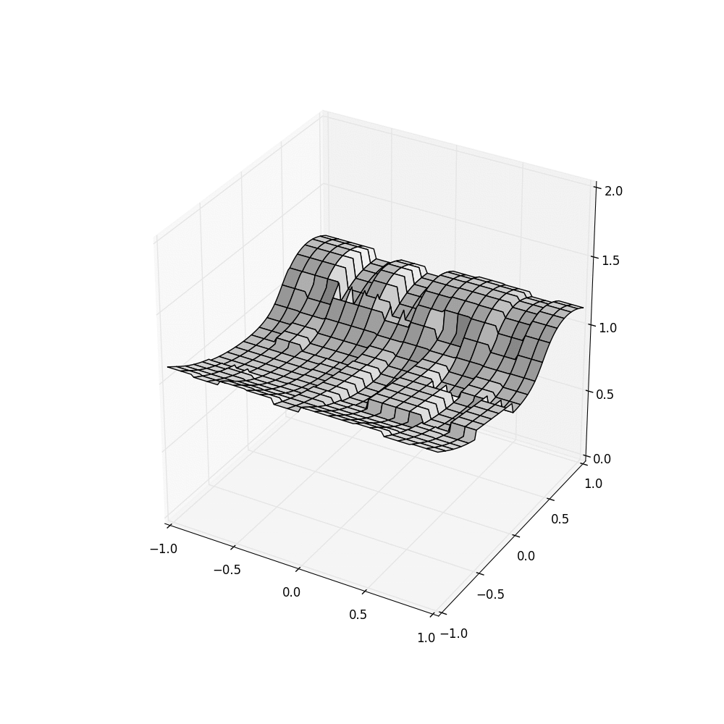
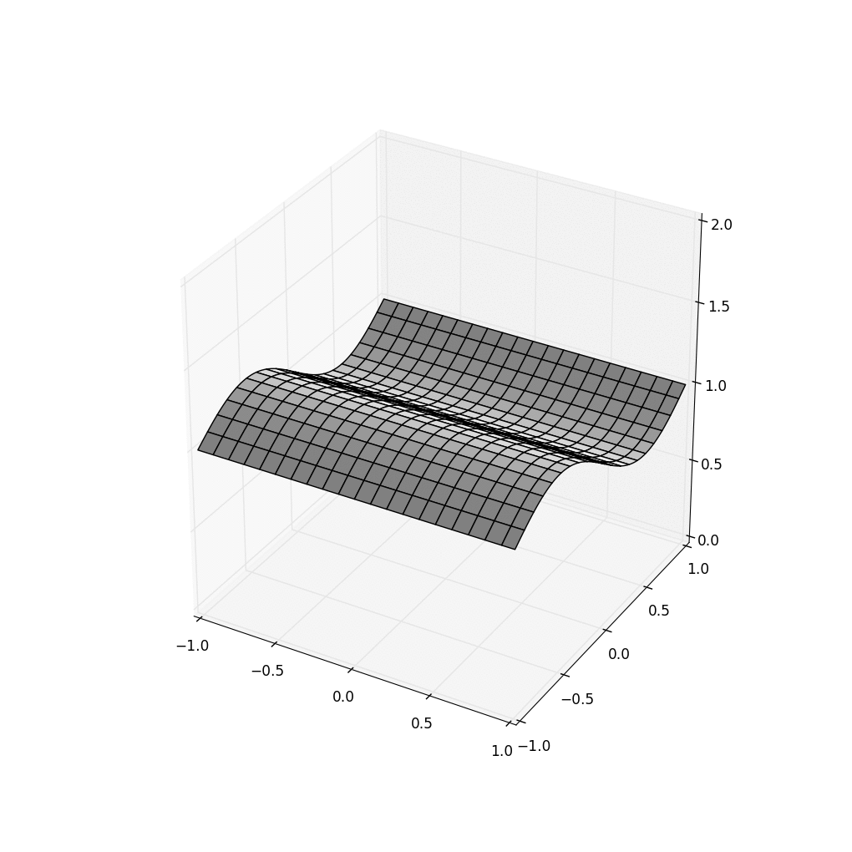

Cascade offers strong consistency
HDFS Cascade using Consistent Cascade With
cuts but trusting Server clocks SENSOR Time
Cascade consistent cuts + GPS-timestamped sensor data result in clean
input to the D-AI algorithm (in this case, a simple visualization)

Slide 43
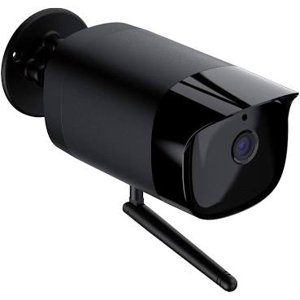

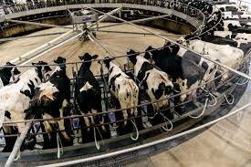

A realistic Dairy Image Pipeline
Dairy Farm
Data Center
Image Pipeline
Front End
(As an external client)
The Farm Server (IoT Edge)
Cascade Image pipeline
Frame
Extractor
Frame
Sampler
WAN
Video clip
store
Frame
Server

Slide 44


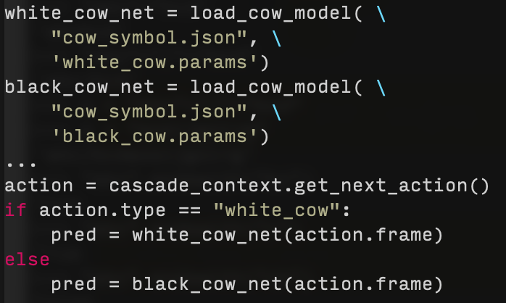
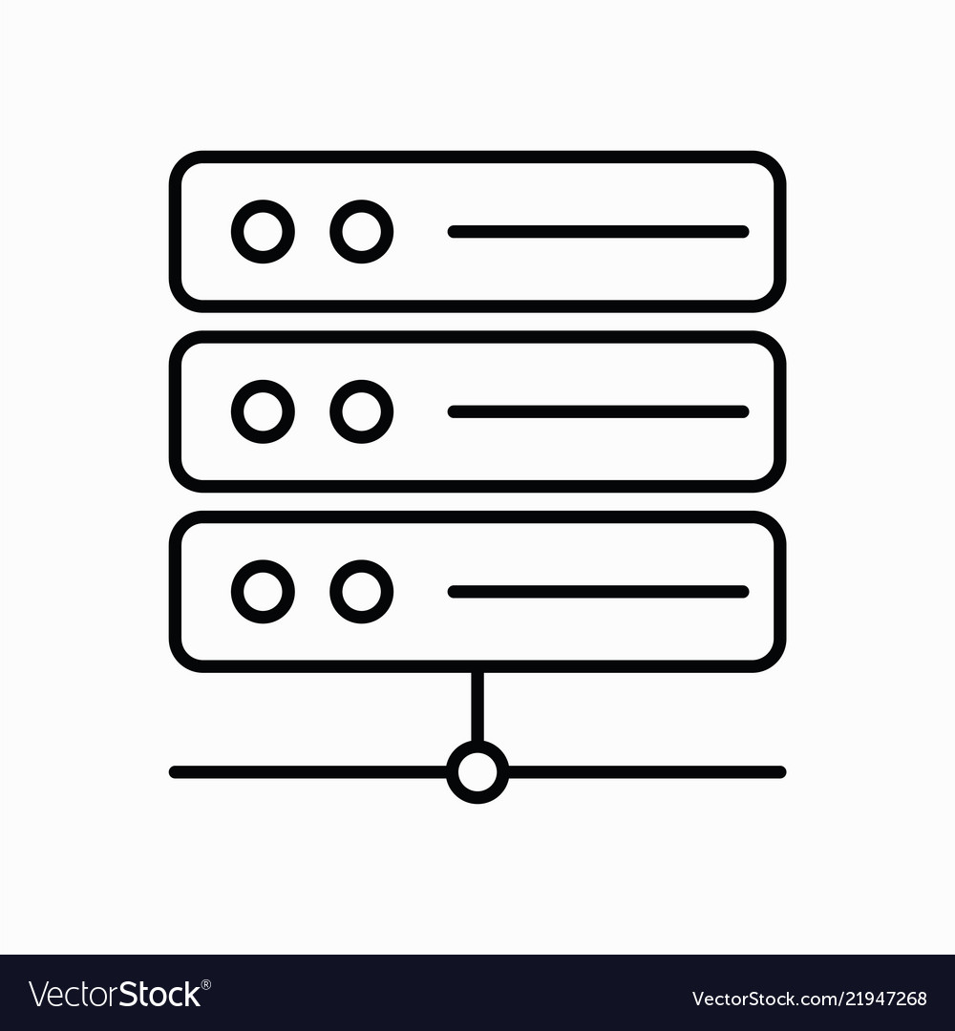






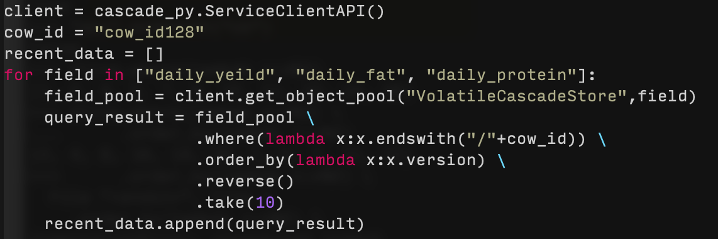
… DETAILED VERSION (PyLINQ ON MSFT AZURE)
Date | cow_id | daily_yield | daily_fat | … | daily_protein
12/3/20 | 1 | 14 | 3.96 | … | 2.89
… | … | … | … | … | …
1/10/21 | 237 | 20 | 4.42 | … | 4.55
<field>/<cow_id>{<ts(ver)>}
daily_protein/cow_id1{ver_1} = 2.89
Integrate daily data
Download blobs from Azure &
Store to Cascade VCSS subgroup
Upload daily date to Azure Blob Storage
Date | cow_id | …
12/3/20 | 1 | …
… | … | …
12/3/20 | 237 | …
daily_fat/cow_id237{ver_38} = 4.42
Cascade backend
Filtered image frames
Store to subgroup VCSS
Trigger image analysis
Farm server
Action = black_cow_infer
Streaming image frames through TCP portal
External Client to Cascade
CV model
Image analysis
cow id: 127
LINQ query to retrieve data of most recent 10 days from Cascade about cow 128
Probability of calving
in next 8h is: 80%
ML Model
birth prediction

Slide 45
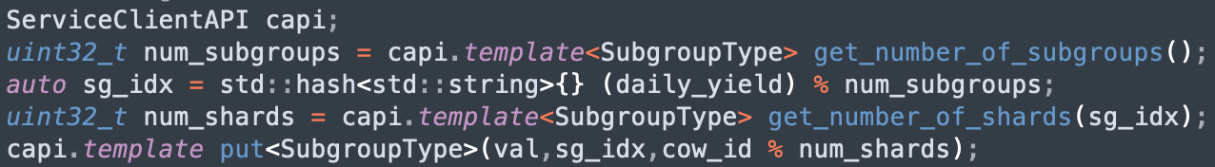
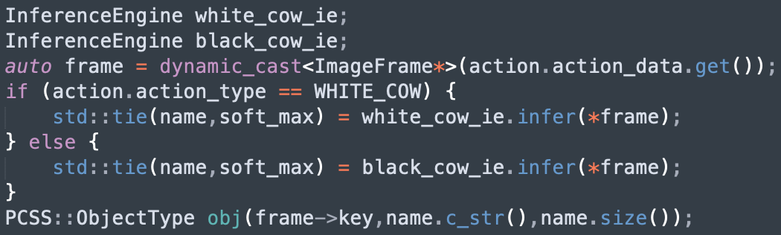
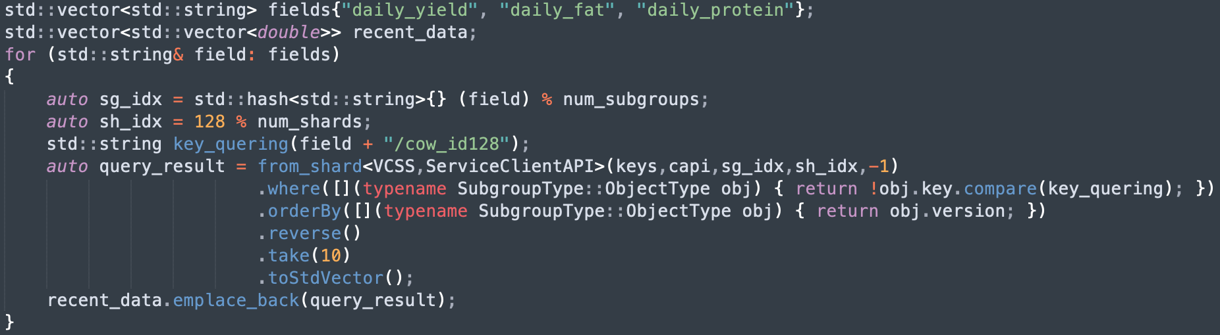
C++ IS SIMILAR (BUT MORE EFFICIENT)
Date | cow_id | daily_yield | daily_fat | … | daily_protein
12/3/20 | 1 | 14 | 3.96 | … | 2.89
… | … | … | … | … | …
1/10/21 | 237 | 20 | 4.42 | … | 4.55
<field>/<cow_id>{<ts(ver)>}
daily_protein/cow_id1{ver_1} = 2.89
Integrate daily data
Download blobs from Azure &
Store to Cascade VCSS subgroup
Upload daily date to Azure Blob Storage
Date | cow_id | …
12/3/20 | 1 | …
… | … | …
12/3/20 | 237 | …
daily_fat/cow_id237{ver_38} = 4.42
Cascade backend
Filtered image frames
Store to subgroup VCSS
Trigger image analysis
Farm server
Action = black_cow_infer
Streaming image frames through TCP portal
External Client to Cascade
CV model
Image analysis
cow id: 127
LINQ query to retrieve data of most recent 10 days from Cascade about cow 128
Probability of calving
in next 8h is: 80%
ML Model
birth prediction

Slide 46

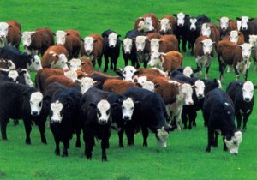
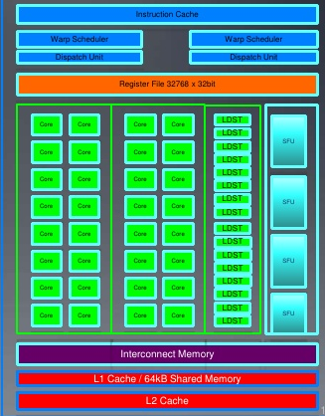
Inside A Cascade μ-Service
Skip this transfer for any ML objects already cached in the GPU device!
Request for classification runs as a lambda
Application Layer
We really want the data
to be “ideally” positioned or
copied directly to the perfect
place…
Cascade Storage Layer
RDMA directly into GPU memory
Image to classify
ML model, configuration, parameters
Accelerator Layer
GPU
GPU-accelerated kernel initiated from the lambda

Slide 47
Summary
We actually can have C+A if P isn’t needed – the key is to have the microservice hold the needed state in replicated objects, and then to align the Paxos protocol with the properties of the hardware
The resulting performance is amazing… but people don’t want to use a C++ library these days. They work in higher level AI packages like Tensor Flow and Databricks, and those run on DHTs.
So, Cornell is now building Cascade: A DHT that leverages Derecho.

