Slide 1
Lecture 5: Making DHTs do magic tricks!
Ken Birman
Spring, 2020

Slide 2
Today’s agenda: Two parts
Understanding how to put “anything at all” into a DHT for:
Scalability: the capacity is determined only by how many servers we have (and how replicated the shards are)
Performance: DHTs can hold data in memory. When deciding between a DHT approach and a big disk, because modern datacenter networks are much faster than disk I/O, we can count on much faster access to DHT data
In the second half of the lecture, we’ll look at other issues a DHT creates
Notes:
Our fundamental hope is to spread a massive data set widely, so that it can be held in memory. Then we want to be able to get very fast access. A normal disk might have a 100us delay on a modern system (and perhaps even more on a slow disk storage device: 25ms isn’t unusual for a USB memory stick). With a DHT we can send messages on a fast network and could get a response in 1 or 2 us: perhaps 100x faster! So many systems think of the DHT as a fast storage solution.
Then they might use it mostly for caching. The famous API is called memcached, and is supported by products like Cassandra, Dynamo or Cosmos.
But we can use DHTs for much more than just as a cache.

Slide 3
Reminder: DHT benefits (and why)
The DHT idea can be traced back to work by people at Google, and to papers like the Jim Gray paper on scalability.
We take some service and structure it into shards: sub-services with the identical API, but handling disjoint subsets of the data.
We need some way to know where to place each data item. We use a key here: the key is a kind of unique name for the data item, and by turning it into an integer modulo the number of shards, we find the target shard.
Notes:
This is all just a quick reminder

Slide 4
DHT picture
put(key,value) get(key)
Client application
DHT Service on many nodes
Shards on 2-nodes each, using state-machine replication

Slide 5
An annoying limitation
We are not given any way to do locking or 2-phase commit. In fact Jim Gray showed us that locking across shards would be ineffective.
A get or put is an atomic action on a single shard. For fault-tolerance, the shard update can use state machine replication (atomic multicast or Paxos).
With this approach we get “unlimited” scaling, and we can even keep all the data in memory (as long as the number of shards is big enough).
Notes:
Also a quick reminder

Slide 6
Another issue
Data can be scattered around. In fact, this is the whole idea!
With the basic get and put API, this forces us to access each item separately. If related data was clustered at one shard, we could design fancier APIs that could get more work done in one atomic step.
Core issue: The DHT was created by a cloud operator and uses a hashing scheme you don’t control. Different keys tend to go to different shards.

Slide 7
Side remark
In fact it isn’t horrendously costly that the items are scattered around
Those 100 us retrieval delays are very small and you might be able to fetch all your data in parallel, by issuing concurrent put/get requests.
Moreover, if the DHT was created by someone else, you probably can’t extend the API with your own fancier operations.
So this limitation is really only relevant if you are building your own μService using a DHT sharding approach.

Slide 8
DHTs work best for data that doesn’t change after it is initially stored
Once a web page has been uploaded, we probably won’t update it again. A web page that won’t change is an example of immutable data.
A DHT is ideal for this kind of data. Locking isn’t useful for a big read-only data set even if we didn’t have sharding!
Web pages are mostly built by reading immutable data. This is one reason DHTs became so popular: they work flawlessly here!

Slide 9
Example: An NPR news Article
This error message from a popular news site, NPR, is clearly caused by not finding data in a DHT!
They probably stored their articles in the DHT, but somehow got an error when trying to fetch this article to build my web page. It could be an example of CAP: When a DHT resizes elastically, sometimes it makes errors for a few seconds afterwards…
Notes:
It can be done! In fact this is a very common thing. This NPR web page probably was created by a first tier that talked to a bunch of microservices. Apparently one of them either was a DHT, or used a DHT, and got an error. Rather than crash, it generated some content that led us to see this nicely reported error message. In fact it looks like there were two errors: first some kind of no-such-key event, and then a second one when trying to build a smart error report.

Slide 10
But an NPR news story is too easy.
For the first few years, big search companies focused on just downloading snapshots of web pages and offering quick ways to find things.
Over time, however, there was an appreciation that the social network is the bigger opportunity. And these evolve rapidly over time.
So we saw a growing need to store data that does change.

Slide 11
How to Store “Anything” at large scale
These data sets are huge – MUCH too big for any single computer.
Yet not only do we want to hold the data for access, we want super-fast access: we want the data to be in memory, not on disk!
A DHT can solve this for us. The network I/O cost is a factor, but is still much faster than disk I/O. And modern datacenter networks, with the fastest software, can push network delays down to the 1-2us range.
Notes:
So now here is the puzzle: What if we are trying to store something that isn’t just a (key,value) pair?

Slide 12
How to Store “Anything” at large scale
Puzzle: A DHT officially just holds (key, value) data:
The key is an integer. Some permit various sizes: 64 bits, 128, 256.
The value is generally either another integer, or a byte array.
Some DHTs are specialized for (integer, byte[]), and some for (integer,integer). These often are used “together” for flexibility.
So how can we come up with a key for “anything at all”? And how can we use this value model to store “anything at all”?
Solution: We use serialization. This converts an object to a byte array.
Notes:
DHTs are often specialized by vendors because this allows them to optimize very heavily. Any uncertainty about object sizes can be confusing and make it harder to get the peak speed. DHTs can be used in pairs, though, or even have one product that offers two specialized modes. This lets you first store a big object in the DHT that stores big byte arrays, using some kind of unique storage identifier. Then you can use its storage key in other DHT records configured to run in the “smaller fixed size” version. That’s common right now.
Serialization is just a standard term for taking some in-memory object and creating a byte-array for storing that object on a file, or sending it on the network.

Slide 13
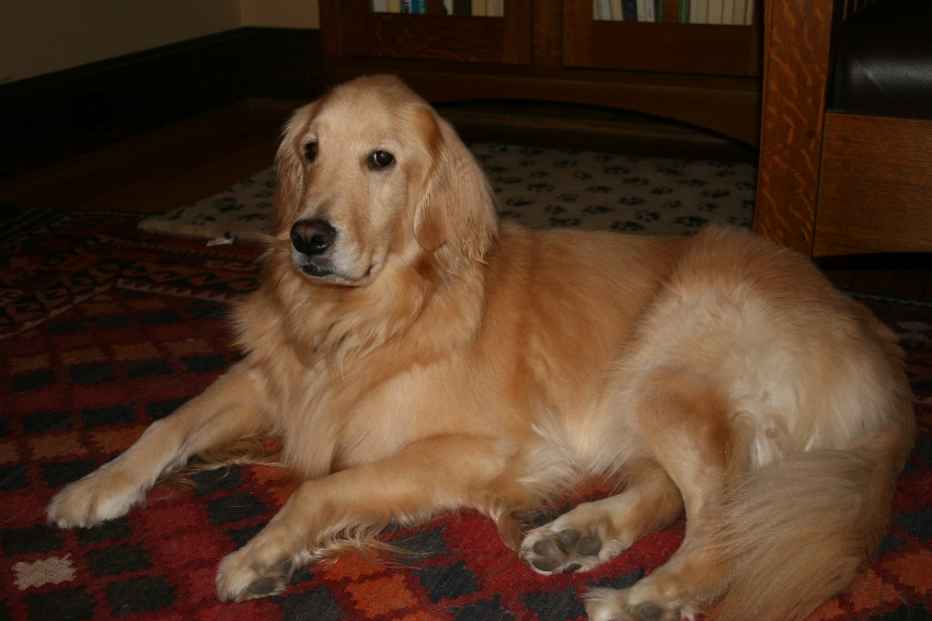
Coming up with suitable DHT keys
You need a unique name for the objects you are storing.
For example: Ken’s dog was named Biscuit. But “Biscuit” is not a unique name. The DHT could have some other object with that name too.
On the other hand, “Ken Birman/pet/Biscuit” is a unique key, and we can hash it with SHA64 or SHA128 into a unique integer.
Notes:
The question of deciding what the key should be is surprisingly confusing at first. The core problem is that the key must be unique (at least for the application, but perhaps even unique “globally” in the whole data center). This leads us towards keys that look like file system pathnames. But the DHT itself normally wants the key to just be a number, which it then hashes and then considers modulo the number of shards. So our challenge is to convert a natural name to this unnatural kind of key.

Slide 14
… But that rule might not work in general.
Some pet owners really love to use the same name for every pet.
How would you come up with a genuinely unique key?
Microsoft and AWS both have “registry” services that are able to generate them.
But now you run into the problem of having a key that has no obvious connection to the name of the object.
Notes:
An overly simple form of key would easily clash even in a single user’s single application. And because a DHT might be shared with many users, poor key choices would be very disruptive.

Slide 15
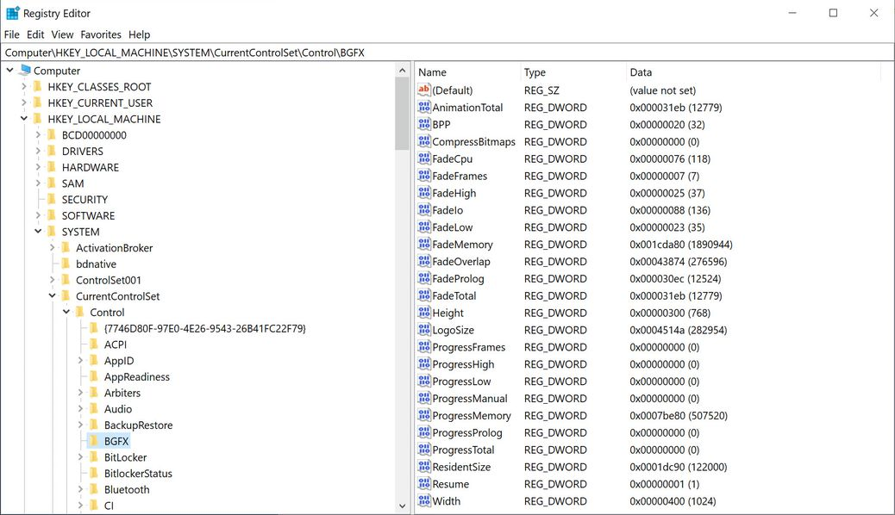
Example: Microsoft Registry
Notes:
Generally, we have the system help us. We either use a definitely unique pathname (a string) and then convert it to a hash code as the key, or we just ask for help from the operating system. In this example we see both string names (unique for this local computer, which has a unique system name at a higher level), or in one case, we see a generated key. Then on the right we see (for some specific selected key) a whole list of (name, data) pairs,.

Slide 16
Name Spaces and keys
“What is in a name? That which we call a rose By any other name would smell as sweet…”
Juliet, in Shakespeare’s Romeo and Juliet
A name space is some sort of user-oriented, semantically sensible, place to store names of objects. We could actually have one object in many name spaces, if the same object makes sense in different situations.
The namespace is used as a “service” to map from a name that makes sense to the user, to a unique internal key that makes sense in a DHT.
A cloud file system always has a namespace server as one component. We think of the storage servers as a separate, distinct, component.
Notes:
It is important to understand that we can general build services to keep track of the mapping from a user-friendly name to a unique key. We call these “name space” services. Thus it would be unusual for a human user to ever see the key actually in use for the DHT. We humans mostly see string names, probably path names.

Slide 17
Ken’s Pets
So we could, for example, have a kind of table listing all the pets Ken has had, with information about them
This table would be a “name space” if we the photo list was a list of keys
Pet Name | Period | Species | Photo List | Health Status
Nerd | 1961-1962 | Gerbil | Empty | Deceased
Susie | 1970-1986 | Keeshund | IMG-17171, … | Deceased
Biscuit | 2003-2013 | Golden Retriever | IMG-22187, … | Deceased
Notes:
You can also have a table in which each row is considered as a separate object. KensTable/row3 could be a name for this kind of data.

Slide 18
Many things can be given Unique keys
We could have a unique key for each row in a table.
We could have a unique key for each photo in a photo album. The album itself could be “named” but also have a key: its value would be a list of the keys for photos in the album.
Cloud systems use this approach very broadly!

Slide 19
Could keys “collide”?
Yes, if the keys don’t have a large enough range of values, or the random number generator isn’t very effective.
Most cloud systems favor fairly large keys, like 256 bits. And some key generators use a variety of tricks to make sure that they won’t give out the same key twice. A random number generator wouldn’t necessarily work.
Collisions would cause problems because two different objects would end up sharing what should be a unique name – a serious inconsistency.

Slide 20
What probably happened in the NPR site?
It probably wasn’t a key collision.
In fact, I get news alerts for certain kinds of news stories, like confirmed first-encounters with space aliens. So… NPR posts a first-encounter story. And I receive an immediate alert!
The story was saved into a DHT, but maybe the DHT replication scheme is a bit slow, or it was resizing just at that moment for elasticity reasons. Until it “settles”, the key is correct but the story just can’t be found.
Notes:
The point here is that even a DHT can be transiently inconsistent if we try to look at it right as an insert is occurring, or just as it is being resized elastically,

Slide 21
How did this relate back to CAP?
CAP was all about how we often face these choices:
Give a super fast response on a web page, or an instant notification
But this means not waiting for the elastic reconfiguration to finish, or for the replicated update to fully propagate to all the replicas.
We might operate in an inconsistent way, briefly!
CAP says: you can’t have all three from {C,A,P} at the same time.
Relax consistency to get better availability and respond immediately even if a service you would have liked to check with is temporarily not responsive.

Slide 22
Suppose we had a list of photos
The list itself is a data structure of objects that are linked by pointers.
The objects could be something like a photo description, and the photo (or other kinds of photo properties: “meta-data”).
Notes:
As we get more and more fancy, we need a more systematic approach.

Slide 23
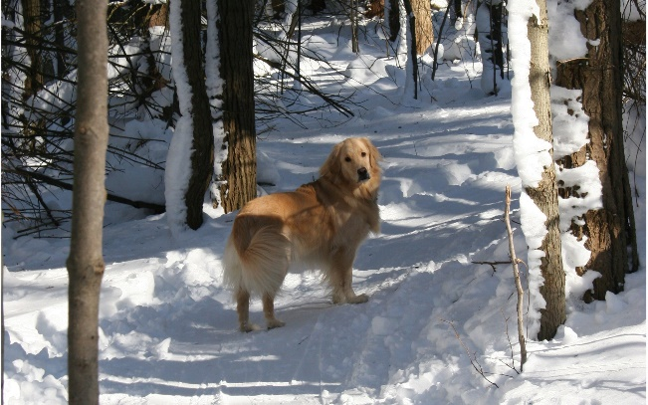
How to Store “Anything” at large scale
class myPet {
int uid;
animal species;
hashset<string,photo> photo_collection;
….
}
myPet biscuit {
uid := 5731,
species := animal::dog,
photo_collection := { [“on a rug”, •], [“in the woods”, •]}
}
These objects all have type names the application understands, data that matches. But the DHT wouldn’t know these object types! Amazon created the DHT long before you wrote the code defining this class.
Notes:
A core problem we face is that the DHT was created years ago by Amazon or Azure. They didn’t know we would want to store this list of pets into it. They don’t even know the definitions of the objects in your Python or Java code. So the DHT itself can’t just accept objects – it needs them to be converted to some standard form.

Slide 24
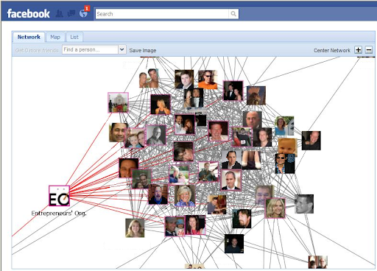
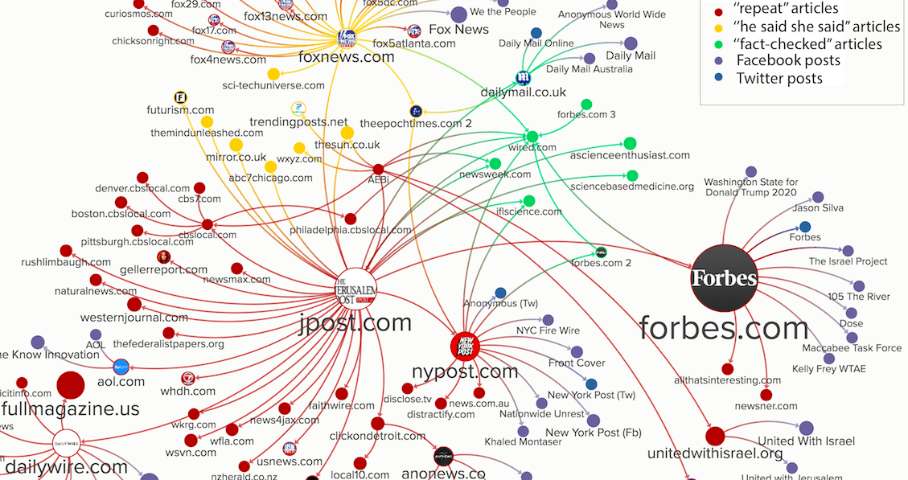
Next issue: Cloud Data forms a huge, complicated Graph
Ken belongs to Entrepreneurs’ Org
The entrepreneurs shared a viral (completely exaggerated, basically fake) story about a complete cure for cancer.

Slide 25
Serialization concept
With a single object, a serializer just emits a self-describing data structure as a byte array, listing the field-types and their values.
If an object has sub-fields, it uses a recursive descent to serialize the inner object too. The self-describing byte array has a way to represent: “this is an object too, and the next 184 bytes describe it”.
The serializer output is often larger than the original object

Slide 26
Also, Recursion only helps for what is logically a “single node”
The serializer knows how to do recursive serialization but only for what is logically a single object (and its subobjects).
Key = “Ken Birman/pets/Photos of Biscuit” Value = [ 0xFF 0xA6 0x1B 0x00 0x99 0x11 0x03 0xFF 0xFF … ]
A deserializer is used to recreate the data structure. This is also sometimes called marshalling and demarshalling.

Slide 27
Reasons serialization can be costly
We generally like the byte array to be in a “hardware-independent format”, meaning that both Intel and ARM (and other devices) can reconstruct the object into their local data representation.
There are several opinions about the best byte-order for integers
Floating point formats are hardware-specific
Some systems null-terminate strings; others just view a string as bytes
Memory “alignment” rules differ from machine to machine.
Compilers can make additional optimization choices

Slide 28
What about a more complex structure?
In homework 2 we are looking at using a DHT to hold a massive B-Tree
They keep data sorted, which is useful, and you can do “range queries”
You can also estimate the “statistics” of a data set, needed in AI/ML
The B-Tree is much too large to hold on one computer.
The data can be something complicated, but in addition, inner nodes have “pointers” to child nodes.
Notes:
The message on this slide is that while we can use this recursive serialization for objects small enough to fit on one DHT node, it would go wrong if we end up with massive byte arrays that are too big to fit. So with something like a giant B-Tree with billions of nodes, we’ll need some way to spread the data structure itself out within the DHT.

Slide 29
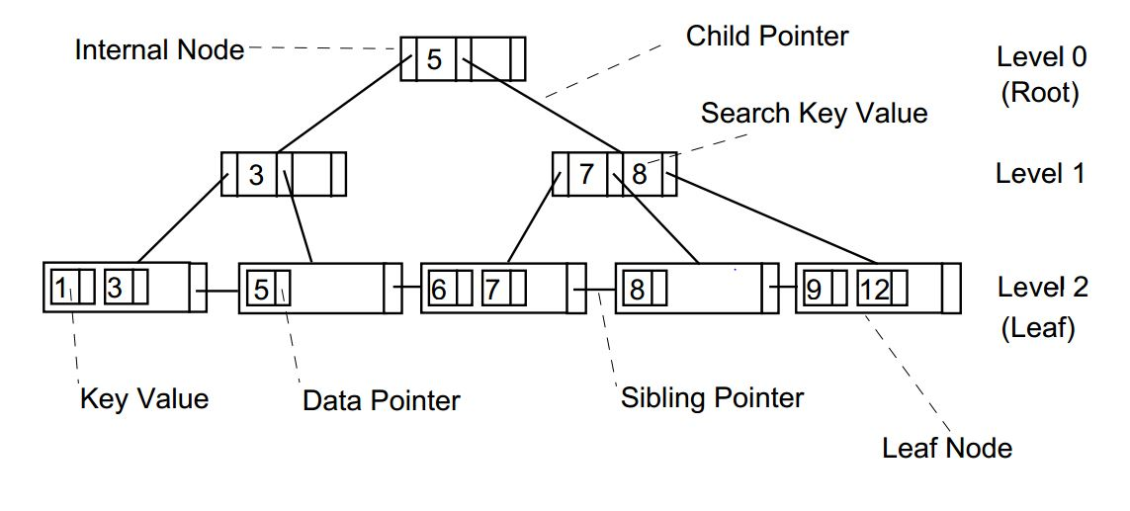
A 2,3 B-Tree example (Wikipedia)
Notes:
Reminder for anyone who doesn’t remember the 2-3 B-Tree idea.

Slide 30
Good news
(“Ken Birman/pets/Biscuit”,
)
We can use the idea of replacing pointers with some form of key or node-id. Pick an approach that makes sense in the given situation.
A node-id is probably just a 32-bit integer.
A key might need to be 256 bits in size: wasteful, if not needed.
If a B-Tree uses memory pointers, it only can make sense on one single computer (server). But if it uses node-ids as “pointers”, this works even if the nodes are stored in different DHT shards!
Notes:
There is a kind of trivial way to map the B-Tree nodes into a DHT: Give each node a node-id and use that as a key. Then the DHT will hash the value, which randomizes, and then use the hashed value to find the shard.

Slide 31
How can an integer node-id be used as if it was a pointer?
How does a pointer work in Java or Python or C++?
We have an object in memory at some location.
The pointer might point to that location, or to a structure that describes the object (in Java and Python, the structure approach is used. C++ uses a genuine pointer to the actual data and code).
At runtime, we make sure the operation is legal (in Java and Python, this is for runtime error detection and polymorphism). Then we access the data directly.
Notes:
Some people have difficulty around the idea that we can use a node-id as a replacement for a pointer.

Slide 32
Modified behavior?
We would need to check: is this node-id for a local node, or one in some other DHT shard?
If local, return a pointer to it.
If remote, fetch it via a network RPC. Allocate memory (temporarily) to hold the copy. If the application modifies the object, write it back using another RPC. Free the memory when the access is finished.
In homework 2, you will “hide” this in a getter/setter

Slide 33
What will this cost?
Now every node access might require a DHT get operation.
We can do a bit better: if we run our B-Tree logic on the same computers that run our DHT, then local get operations will be free. Only remote ones will be costly.
In Homework 2 we do this and even go one step further: we imagine building a kind of smart B-Tree search that can do a “piece” of a search. It talks to the local DHT shard, and goes as far as it can, then tells where to check next.

Slide 34
What will this cost?
This idea of a combined DHT + B-Tree can go even further.
You can do a smarter node-id numbering scheme, or even a smarter hash function for the DHT, or both.
In Homework 2 we challenge you to come up with the best possible mix of node-id numbering scheme and hashing scheme, to minimize network costs.

Slide 35
DHTs can be “too general” for some uses
At Facebook, the early work on social networking used one shared DHT.
But the social networking graph was huge, very complicated, and very heavily used. Facebook decided that it was just not an efficient solution.
They redesigned it, and later in the course we will learn about their solution: Facebook TAO, a specialist for social network graph storage.

Slide 36
A worry about garbage collection!
When we use a distributed solution, such as a DHT, we often need to make copies of objects. For example, server A uses get to fetch a copy of some node that resides on server B.
But these copies then occupy memory, and we need to free that memory when finished with the copy. Otherwise, memory will leak and the server will eventually crash.
Fortunately, modern languages automate this step (in C++, use shared pointer template for the same behavior).

Slide 37
What about storage in the DHT itself?
A DHT doesn’t necessarily know how to garbage collect the (key,value) objects stored into it!
It does keep track: each DHT object has a user-id (who created it), and the user’s account gets charged for the space consumed.
Benefits? Total control, plus keys only need to be unique for the user or the application, not across the whole cloud.
Problem: Many people are careless about freeing up the space!

Slide 38
DHT cleanup suggestions
Always give an expiration time for every (key,value) tuple. If you want to keep an object longer, use a longer expiration time, but not infinite.
In your code, try to explicitly delete any temporary content you load into a DHT. Put it there, run for a while, but then delete it.
Commercial products offer fancier and powerful features, such as “delete these objects when such-and-such a server shuts down.” Use them!

Slide 39
The cloud can be a very expensive place
When used properly, a cloud is often cheaper than owning hardware.
This is because you are sharing costs such as buying it and managing it with other users, and your share is potentially much lower.
But carelessness in storage management can leave all sorts of junk that might never be deleted, and you will be charged for it!

Slide 40
Other things to think about
Some DHT products allow you to control the hash function they will use. But this is not a standard thing – many do not.
Every DHT allows you to pick your own keys. And most DHTs tell you what hash function they will use, so you can pick keys “intelligently” if you wish.
Hot spots can be an issue. Even uniformly random inserts might be clumpy. And you can’t know which keys will be queried: some may be very popular

Slide 41
ONE DHT? Or one per application?
Amazon and Azure both urge you to use their DHT products: AWS Dynamo and Azure Cosmos.
But this means that many applications and even many users would potentially share the same storage infrastructure!
Is this a bad thing?

Slide 42
Issues to think about
The DHT server will be more efficient in its use of space if shared by many users, so it will be ecologically greener and hence cheaper to use.
It will also stay busy all the time. If we plan to own a server and power it up, keeping it busy makes a lot of sense. But a shared server could become a hot spot because of some other user who pounds on some specific DHT item and overloads that shard.
Your performance would suffer, and yet you have no way to know why!

Slide 43
Sharing can create security issues
Another form of leakage arises if data from one application or one user becomes visible to some other application or user, without permissions.
A DHT with distinct key spaces shouldn’t leak information, but there could be software bugs or even performance behaviors that actually do reveal sensitive content, unintentionally.
We will discuss this in a future lecture. It is not a huge risk, but it is worth being aware of it.

Slide 44
Summary
Almost anything can be stored into a DHT. The cloud does this. But it isn’t free: you need to be clever to encode your application into a DHT.
Think about keys, object sizes, access patterns, costs. Be wary of “leakage” (neglecting to delete temporary data) or you will get a BIG monthly bill!
In homework 2, one of the challenge questions at the end focuses on minimizing access costs. This is typical of the issues seen in cloud systems that need to sort huge data sets, and that put the B-Tree nodes in a DHT.

