Slide 1
CS 5412/Lecture 13. Ceph: A Scalable High-Performance Distributed File System
Ken Birman
Spring, 2020

Slide 2
HDFS limitations
Although many applications are designed to use the normal “POSIX” file system API (operations like file create/open, read/write, close, rename/replace, delete, and snapshot), some modern applications find POSIX inefficient.
Some main issues:
HDFS can handle big files, but treats them as sequences of fixed-size blocks. Many application are object-oriented
HDFS lacks some of the “file system management” tools big-data needs

Slide 3
CEPH project
Created by Sage Weihl, a PhD student at U.C. Santa Cruz
Later became a company and then was acquired into Red Hat Linux
Now the “InkStack” portion of Linux offers Ceph plus various tools to leverage it, and Ceph is starting to replace HDFS worldwide.
Ceph is similar in some ways to HDFS but unrelated to it. Many big data systems are migrating to the system.

Slide 4
Key ideas in Ceph
The focus is on two perspectives: object storage for actual data, with much better ways of tracking huge numbers of objects and automatic “striping” over multiple servers for very large files or objects. Fault-tolerance is automatic.
MetaData Management. For any file or object, there is associated meta-data: a kind of specialized object. In Ceph, meta-data servers (MDS) are accessed in a very simple hash-based way using the CRUSH hashing function. This allows direct metadata lookup
Object “boundaries” are tracked in the meta-data, which allows the application to read “the next object.” This is helpful if you store a series of objects.

Slide 5
Ceph has three “APIS”
First is the standard POSIX file system API. You can use Ceph in any situation where you might use GFS, HDFS, NFS, etc.
Second, there are extensions to POSIX that allow Ceph to offer better performance in supercomputing systems, like at CERN.
Finally, Ceph has a lowest layer called RADOS that can be used directly as a key-value object store.

Slide 6
Why talk directly to RADOS? Serialization/Deserialization!
When an object is in memory, the data associated with it is managed by the class (or type) definition, and can include pointers, fields with gaps or other “subtle” properties, etc.
Example: a binary tree: the nodes and edges could be objects, but the whole tree could also be one object composed of other objects.
Serialization is a computing process to create a byte-array with the data in the object. Deserialization reconstructs the object from the array.

Slide 7
Good and bad things
A serialized object can always be written over the network or to a disk.
But the number of bytes in the serialized byte array might vary. Why?
… so the “match” to a standard POSIX file system isn’t ideal. Why?
This motivates Ceph.

Slide 8
Ceph: A Scalable, High-Performance Distributed File System
Original slide set from OSDI 2006
Sage A. Weil, Scott A. Brandt, Ethan L. Miller, Darrel D. E. Long

Slide 9
Contents
Goals
System Overview
Client Operation
Dynamically Distributed Metadata
Distributed Object Storage
Performance

Slide 10
Goals
Scalability
Storage capacity, throughput, client performance. Emphasis on HPC.
Reliability
“…failures are the norm rather than the exception…”
Performance
Dynamic workloads

Slide 13
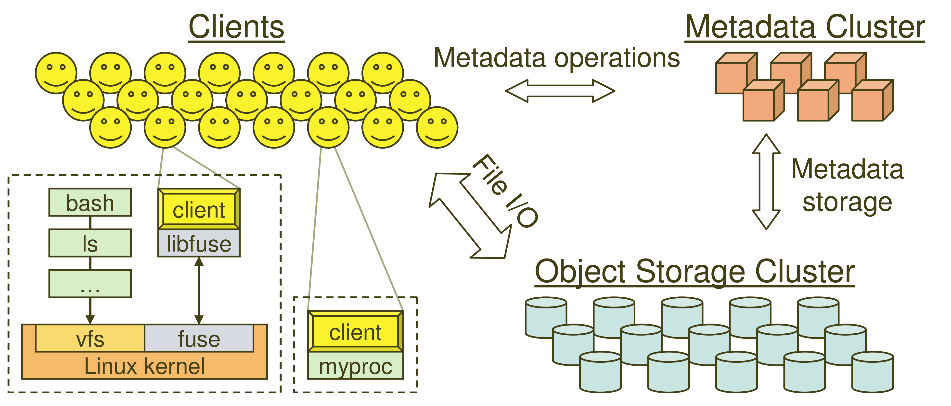
System Overview

Slide 14
Key Features
Decoupled data and metadata
CRUSH
Files striped onto predictably named objects
CRUSH maps objects to storage devices
Dynamic Distributed Metadata Management
Dynamic subtree partitioning
Distributes metadata amongst MDSs
Object-based storage
OSDs handle migration, replication, failure detection and recovery

Slide 15
Client Operation
Ceph interface
Nearly POSIX
Decoupled data and metadata operation
User space implementation
FUSE or directly linked
FUSE is a software allowing to implement a file system in a user space

Slide 16
Client Access Example
Client sends open request to MDS
MDS returns capability, file inode, file size and stripe information
Client read/write directly from/to OSDs
MDS manages the capability
Client sends close request, relinquishes capability, provides details to MDS

Slide 17
Synchronization
Adheres to POSIX
Includes HPC oriented extensions
Consistency / correctness by default
Optionally relax constraints via extensions
Extensions for both data and metadata
Synchronous I/O used with multiple writers or mix of readers and writers

Slide 18
Distributed Metadata
“Metadata operations often make up as much as half of file system workloads…”
MDSs use journaling
Repetitive metadata updates handled in memory
Optimizes on-disk layout for read access
Adaptively distributes cached metadata across a set of nodes

Slide 19
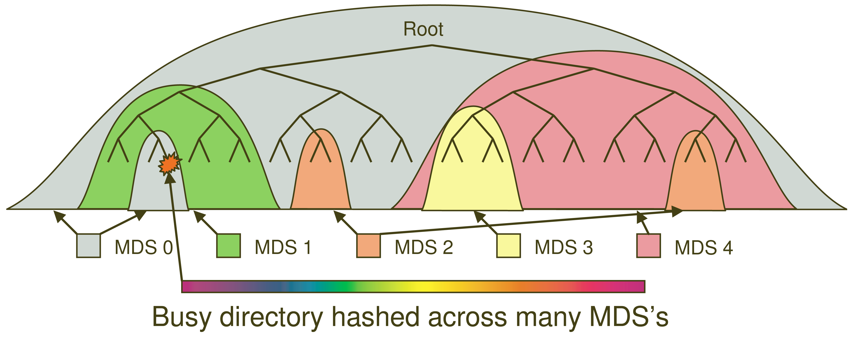
Dynamic Subtree Partitioning

Slide 20
Distributed Object Storage
Files are split across objects
Objects are members of placement groups
Placement groups are distributed across OSDs.

Slide 21
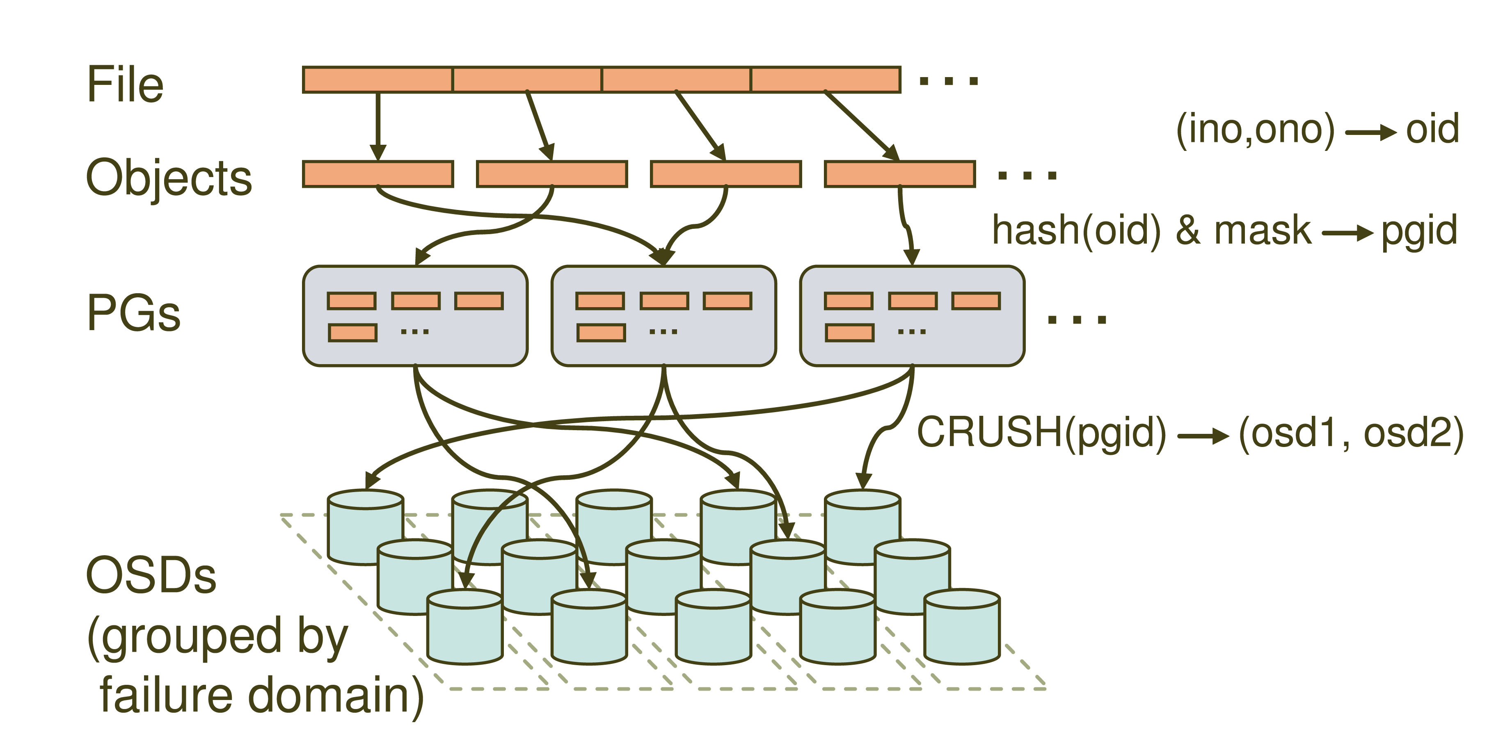
Distributed Object Storage

Slide 22
CRUSH: A specialized Key Hashing Function
CRUSH(x): (osdn1, osdn2, osdn3)
Inputs
x is the placement group
Hierarchical cluster map
Placement rules
Outputs a list of OSDs
Advantages
Anyone can calculate object location
Cluster map infrequently updated

Slide 23
Data distribution
(not a part of the original PowerPoint presentation)
Files are striped into many objects
(ino, ono) → an object id (oid)
Ceph maps objects into placement groups (PGs)
hash(oid) & mask → a placement group id (pgid)
CRUSH assigns placement groups to OSDs
CRUSH(pgid)→ a replication group, (osd1, osd2)

Slide 24
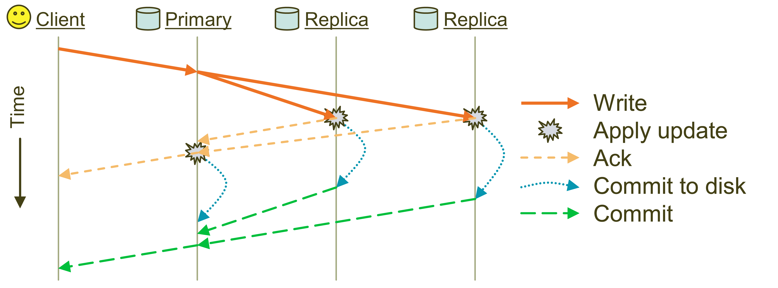
Replication: Reliable but not Paxos
Objects are replicated on OSDs within same PG
Client is oblivious to replication

Slide 25
Failure Detection and Recovery
Down and Out
Monitors check for intermittent problems
New or recovered OSDs peer with other OSDs within PG

Slide 26
Acronyms Used in Performance Slides
CRUSH: Controlled Replication Under Scalable Hashing
EBOFS: Extent and B-tree based Object File System
HPC: High Performance Computing
MDS: MetaData server
OSD: Object Storage Device
PG: Placement Group
POSIX: Portable Operating System Interface for uniX
RADOS: Reliable Autonomic Distributed Object Store

Slide 27
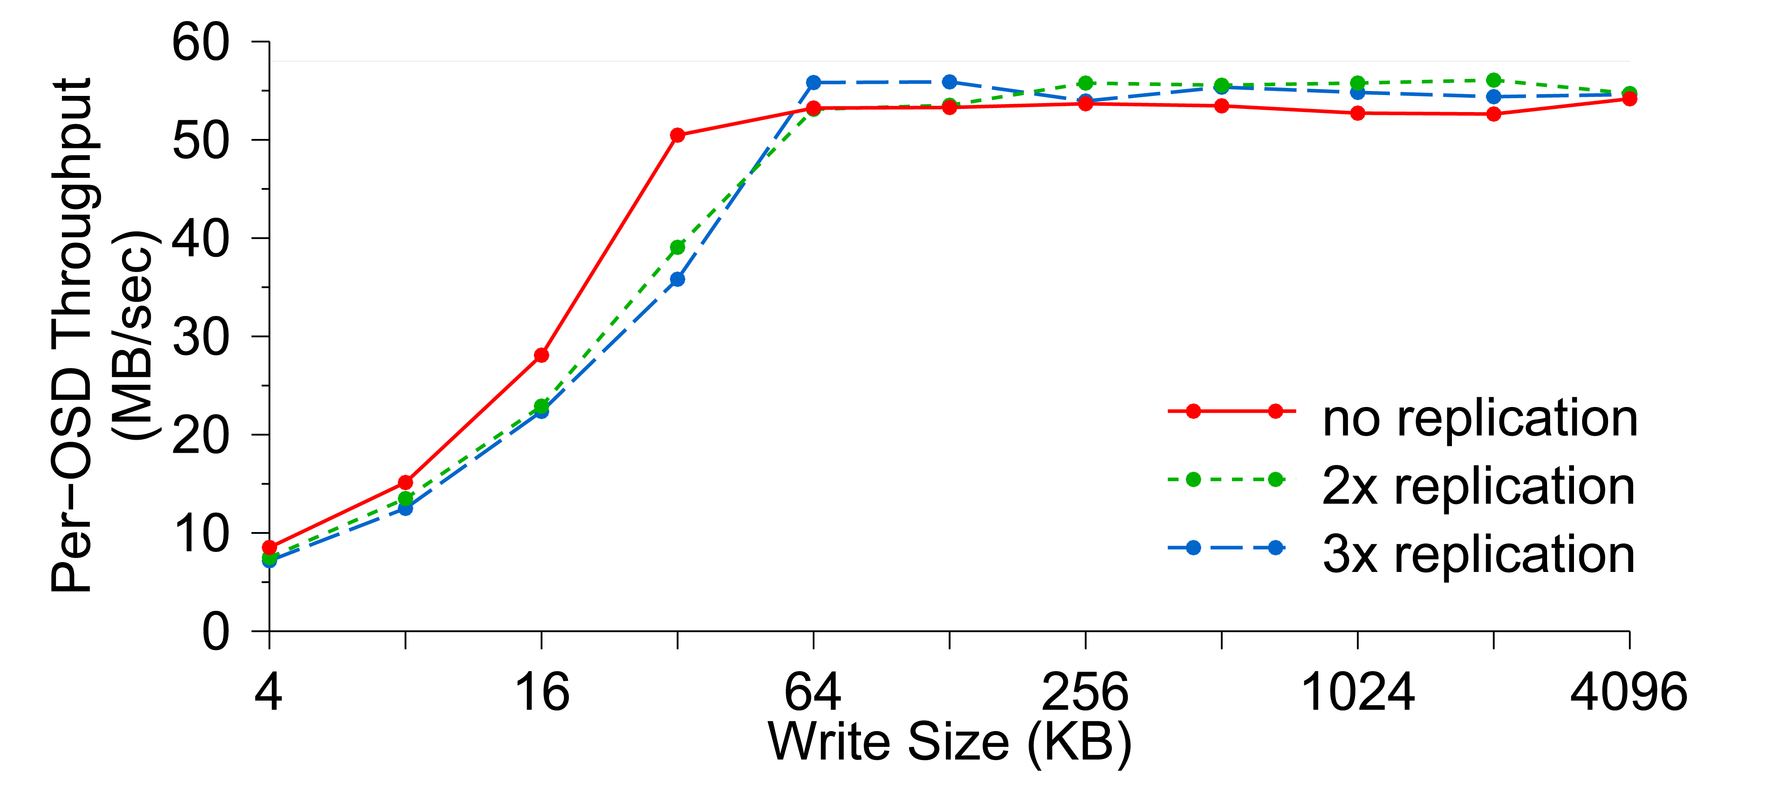
Per-OSD Write Performance

Slide 28
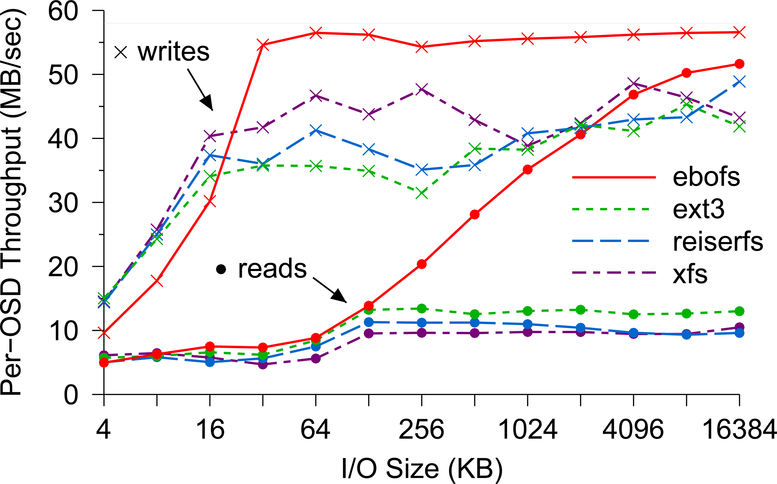
EBOFS Performance

Slide 29
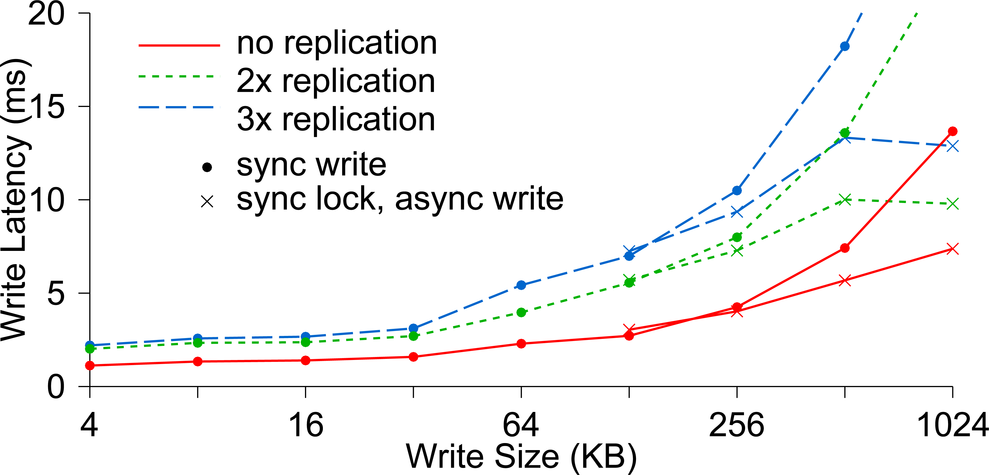
Write Latency

Slide 30
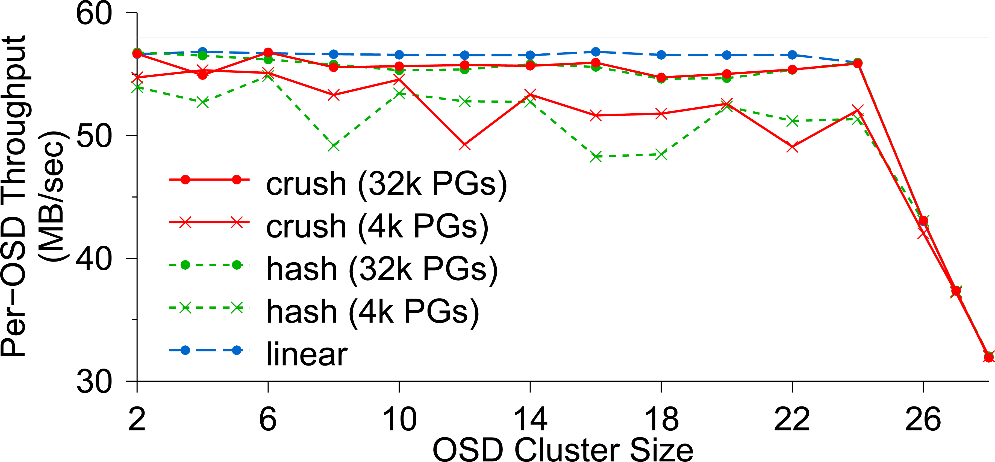
OSD Write Performance

Slide 31
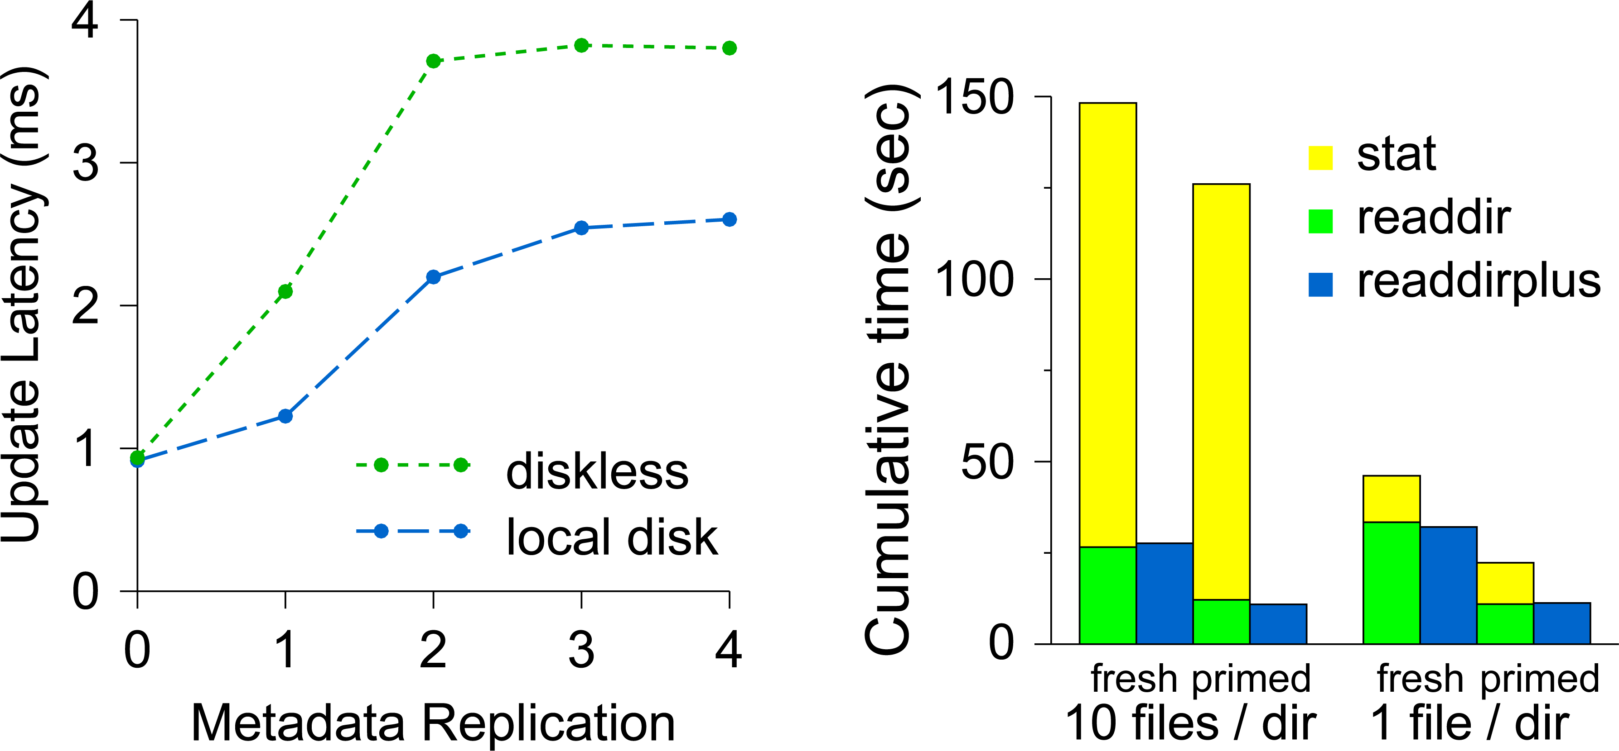
Diskless vs. Local Disk
Compare latencies of (a) a MDS where all metadata are
stored in a shared OSD cluster and (b) a MDS which has a
local disk containing its journaling

Slide 32
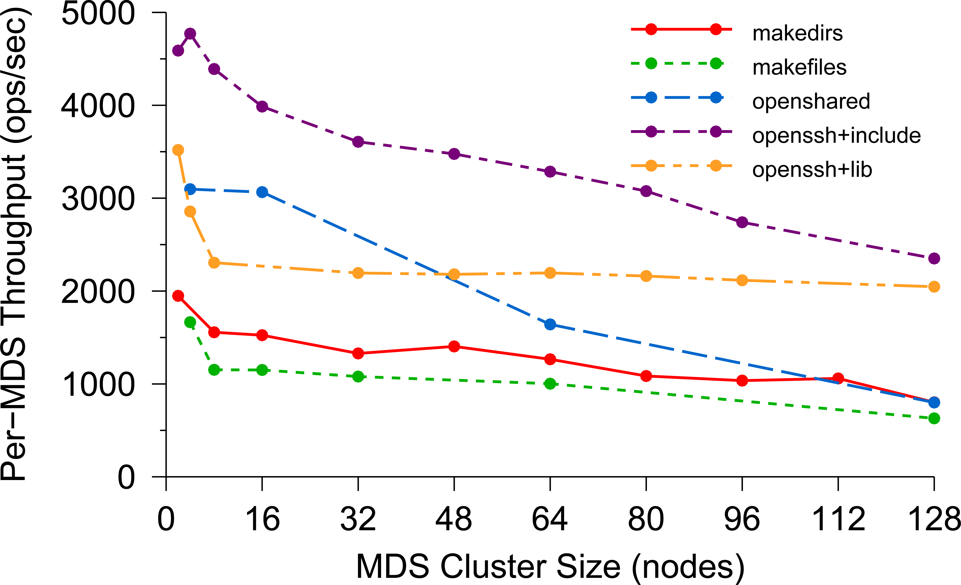
Per-MDS Throughput

Slide 33
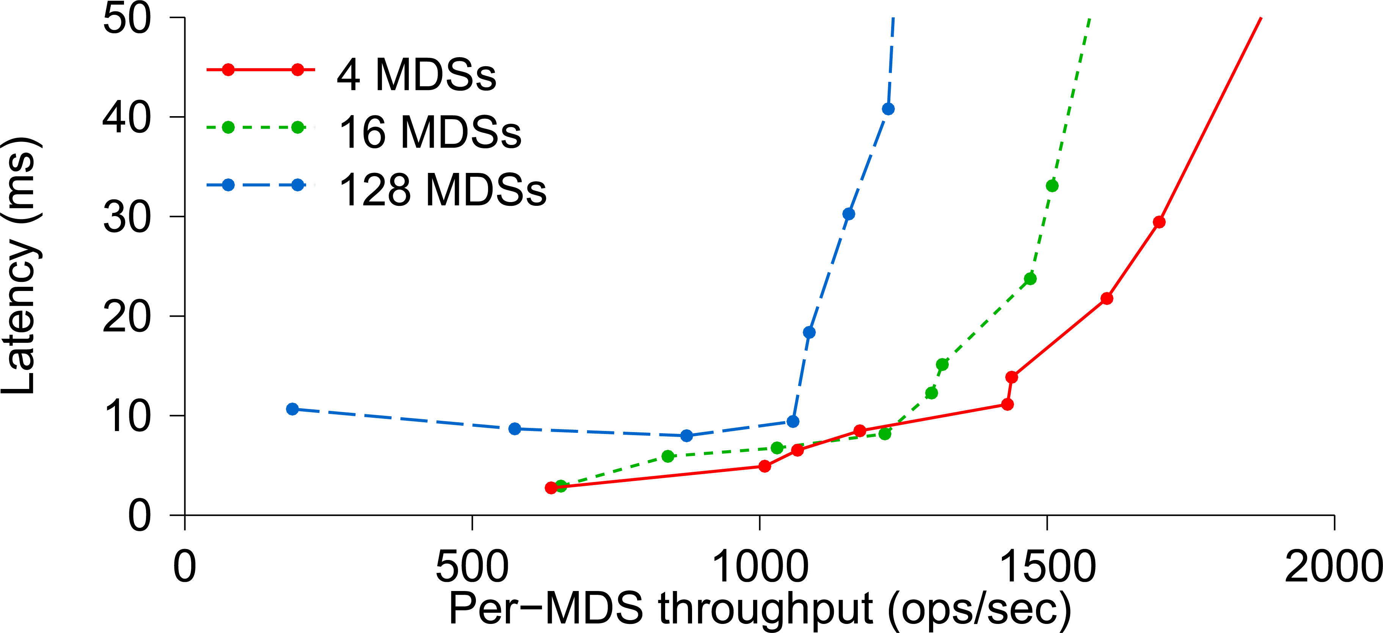
Average Latency

Slide 34
Lessons learned
If applications are object oriented, they will write huge numbers of variable-size records (some extremely large).
POSIX directories are awkward. A B+ tree index works much better.
Treat the records as byte arrays, track meta-data in one service and data in a second one. Both share the RADOS layer for actual data storage.

Slide 35
Let’s switch topics a tiny bit
What are the application level costs of this kind of object orientation? To answer the question, let’s jump one level up and think about an object oriented system that might use tools like Ceph, but in which the application itself is our central focus.
Core issue: how costly is it that a system like Ceph is treating the object as a byte array?

Slide 36
CORBA and OMG
Ceph is really an outgrowth of a consortium called the “Object Management Group” or OMG.
They proposed a standard way to translate between internal representations of objects and byte array external ones. They call this the Common Object Request Broker Architecture or CORBA.
We can think of an application using Ceph as a kind of CORBA use case.

Slide 37
Understanding Costs for CORBA’s universal Representations: ATC System
A modern air traffic control system might have a structure like this:
Flight plan manager tracks current and past flight plan versions
Message bus
. . .
Microservices for various tasks, such as checking future plane separations, scheduling landing times, predicting weather issues, offering services to the airlines
Air traffic controllers update flight plans
Flight plan update broadcast service
WAN link to other ATC centers

Slide 38
Understanding Costs for CORBA’s universal Representations: ATC System
Notice first that this architecture is actually a lot like Ceph or HDFS:
The meta-data server in Ceph and HDFS is “like” the database of flight plan versions
The copies near the controllers are “like” the RADOS storage unit or the HDFS store.
And the message bus is “like” a live notification service for watched files

Slide 39
Understanding Costs for CORBA’s universal Representations: ATC System
Also, think about objects in an ATC system:
Flight plans: these are elaborate objects that might hold 10MB of data and could have a great many internal fields
Many other kinds of objects are used too. Each microservice probably has a notifications channel of its own, and uses it to talk to individual controllers or sets of them about relevant issues
“Attention: In 2h 31m, BA 123 will approach US 654 on approach to CDG. Plan corrective action to avoid a violation of flight separation rules.”

Slide 40
Understanding Costs for CORBA’s universal Representations: ATC System
An ATC system has many components, far more than were shown.
Often these are based on high-quality legacy versions and hence there can be many programming languages in simultaneous use.
Often we will see C/C++, Java, C#, F#, O’Caml, etc.
Some use of Python and Fortran and Ada.
With CORBA, we can easily integrate many modules into a single system

Slide 41
But how often will we (DE)serialize?
Each time an object is read or written (from disk or network)
Each time an object is passed from one module to another
Time →
ATC controller
Version Mgr
Message Bus
ATC rules checker
. . .
Overhead →
Points at which we might do serialization/deserialization

Slide 42
Universal representations are costly!
It is very easy for a CORBA application to spend all its time on this one action.
Ceph designers were aware of that, and decided it should only be done under application control.
Thus Ceph is “object oriented” and yet reflects a choice not to have the whole system understand every kind of object

Slide 43
How do ATC systems avoid these costs?
The trick is to use “lazy” record access.
The ATC record is the main object being shared. Suppose that we have two versions of an ATC object while in memory:
Version A: The object is fully resident in memory and you can access all fields, edit it to create a new version, etc.
Version B: All the same methods are offered, but the in-memory data is limited to a URL pointing to the record in the flight plan database

Slide 44
Why two “identical” object variants?
Notice how easy it is to switch from representation B to A (or back).
In an ATC system most components don’t really look at the data fields and for this reason, most components would be happy with representation B. But a small object with just a URL in it is very cheap to serialize!
With “lazy deserialization”, we would convert from form B to form A only when an application tries to touch the data.

Slide 45
Old Single version approach
Each time an object is read or written (from disk or network)
Each time an object is passed from one module to another
Time →
ATC controller
Version Mgr
Message Bus
ATC rules checker
Wasted work!
. . .
Overhead →
Points at which we might do serialization/deserialization

Slide 46
Dual version approach
We only do a costly action when the component will actually touch the inner data fields!
Time →
ATC controller
Version Mgr
Message Bus
ATC rules checker
Here we fetch the full data for the flight plan from the flight plan database
. . .
Overhead →
Dual scheme reduces overheads!
A A B B B B B B B B B A B B B

Slide 47
How should we store the flight plan records?
The need is for a very simple append-only log managed by the version manager.
It is easy to recognize this as a use case for state machine replication.
This situates the central safety question in one specific component, where we can formalize it and use mathematical tools to prove that each plan has just one sequence of versions, used consistently by all components.

Slide 48
How should we Implement the flight plan manager component?
A (key-value) sharded service built on Derecho would be an ideal choice.
Derecho has been proved correct in several ways: by hand, but also using a machine-verified proof in the Ivy protocol verification tool.
It is also scalable and extremely fast: important because this role is central.

Slide 49
Revisiting the structure
If this one component is correct, the whole system can be proved safe!
A modern air traffic control system might have a structure like this:
Flight plan manager tracks current and past flight plan versions
Message bus
. . .
Microservices for various tasks, such as checking future plane separations, scheduling landing times, predicting weather issues, offering services to the airlines
Air traffic controllers update flight plans
Flight plan update broadcast service
WAN link to other ATC centers

Slide 50
Summary
Ceph is a file system that was created by taking the HDFS model, but then extending it to be better matched to properties of object oriented code.
But it also reflects a decision that Ceph will not be aware of the data representation used, and leaves that to the users. This could have high costs, but there are ways for smart developers to work around them.
Ceph also uses a simple but “weak” form of data replication. It doesn’t guarantee consistency.

