Slide 1
CS5412/Lecture 10 Consistent Storage For IoT
Ken Birman
CS5412 Spring 2020

Slide 2
Consider a Smart Highway
We have lots and lots of sensors deployed
Cars are getting some form of “guidance” and if they accept it (and maybe pay a fee) get to drive faster.
Would we run into consistency issues of the sort seen in Lecture 9?

Slide 3
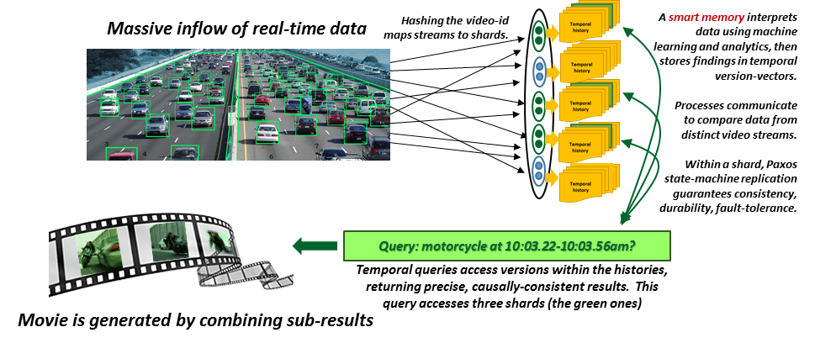
Smart Highway
Function tier implements this “routing” but doesn’t do more, so we won’t discuss it – the real work in this example is in the blob store.
Blob store
Notes:
This image shows a smart highway with sensors (lots of them) that are able to identify cars (green boxes) and in this particular case, abnormal things too (like a motorcycle between the lanes). In fact that happens to be Trinity from the Matrix with the keymaker, and in fact she is driving the wrong way on the highway.
Data is being relayed to our cloud over connections (middle) and into a sharded storage layer (dots organized into shards of two processes per shard, five shards in total) that stores the data into a time-indexed storage layer, like a file system.
Then someone is trying to query the system to make a “film” showing every law that the motorcycle broke during this 30-second period. But of course we wouldn’t trust a film like that if it could be based on inconsistent data. It might show the same thing twice or some even not at all, or show cars in the wrong relative locations.

Slide 4
Machine Learning tasks in this system
Deciding which images are worth overloading: done on camera
Deciding if an image should be retained: Occurs in the smart service that will then hold the data, if it is retained…
… later this same smart service responds when asked “did camera HW101-018 capture any images of a women with a passanger on a motorcycle at 10:02.035am on January 21 2017?”
Deciding which images to use in the “movie” we are creating to document Trinity’s crazy driving

Slide 5
Tracking Trinity…
In this example, we are doing a few things all at once
Data is being captured by IoT sensors and uploaded via a function tier (it doesn’t do much).
We are relaying it into a key-value storage layer, and saving it in some sort of sharded, replicated form
A “query” is pulling up images that show Trinity with the KeyMaker on her motorcycle)

Slide 6
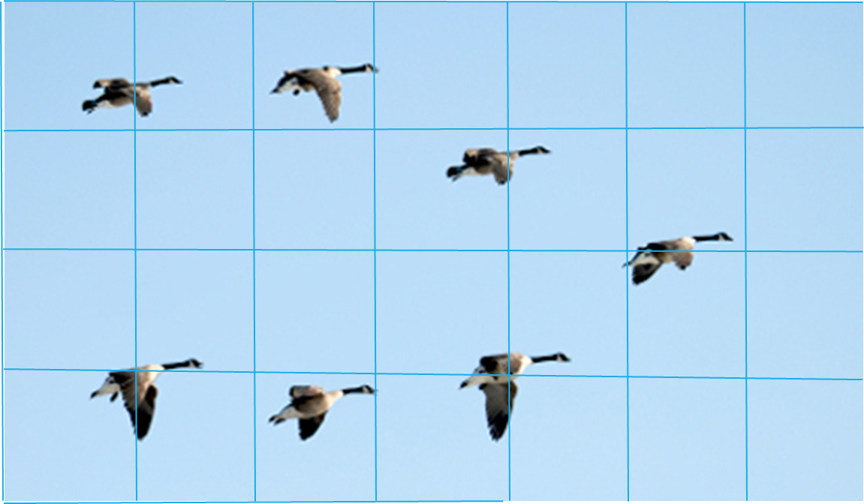
RemindeR: Flock of Geese
In the last lecture we saw how the concept of a causal snapshot can help us create consistent views of a distributed system.
Can we use that same idea here?
Goals: We want temporally precise and causally consistent data, and then will search it for clear images of Trinity’s ride.

Slide 7
Animation: A wave in an aquarium
To illustrate this point visually, we made a simulation.
Rather than a flock of geese, it simulates a wave in an aquarium, or a phase-shift in a power grid, as sampled by a grid of sensors. We captured this “IoT data” into files.
Then we took snapshots and made a movie.

Slide 8
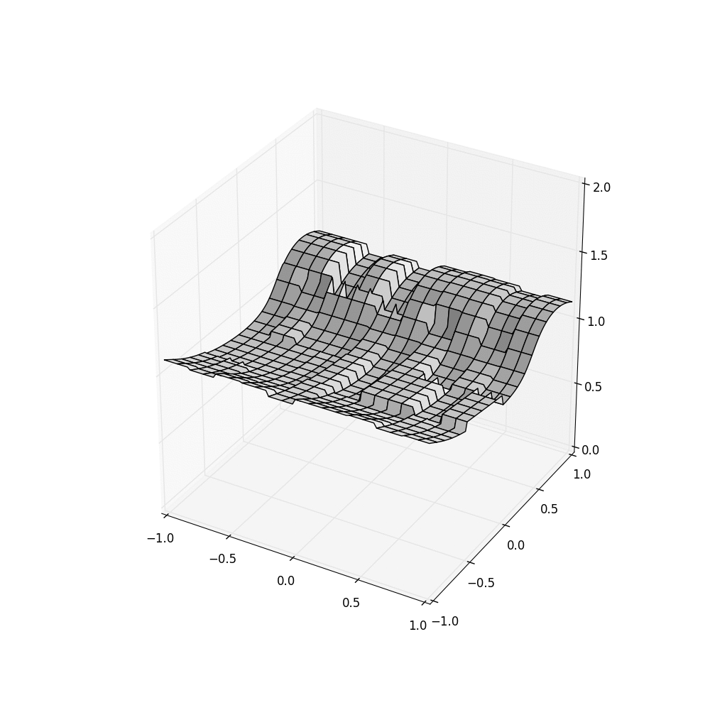
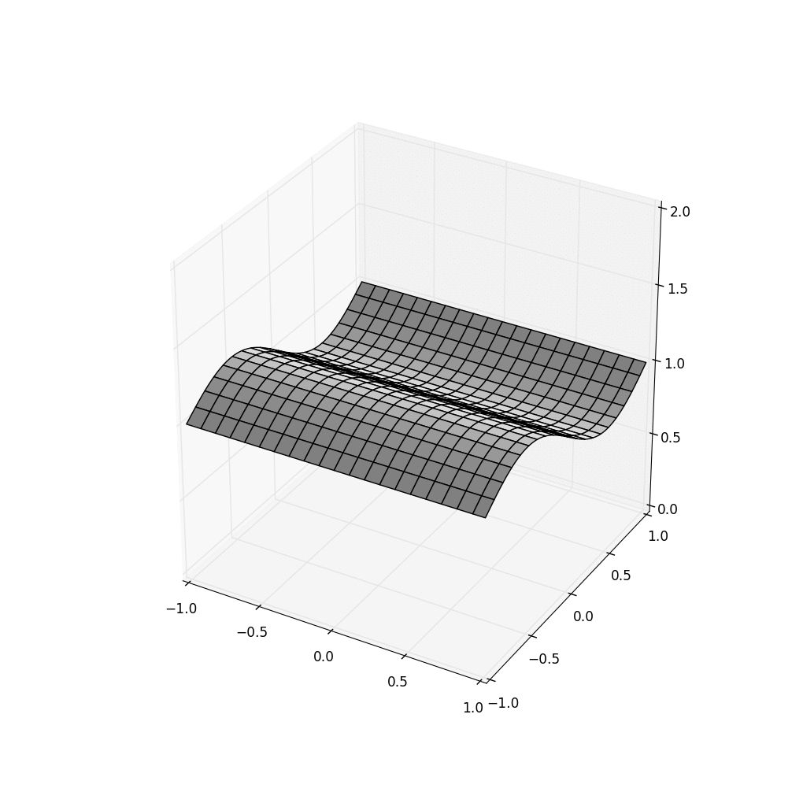
Consistency Problem: HDFS does badly!
HDFS
FFFS+Server Time FFFS+Sensor TIME
Existing file systems (like HDFS on the left) make mistakes when handling real-time data. But we can fix such problems (right).
Notes:
These animations actually show a “wave” photographed by 400 camera sensors. Each little box is one camera, and each camera shows a tiny area at a 20 fps rate.
Then we ask for data in snapshots at 5fps to make our animation.
You can see how badly today’s cloud file systems do! But we can do better (middle and right). The FFFS is a fancier file system that understands time and causality.

Slide 9
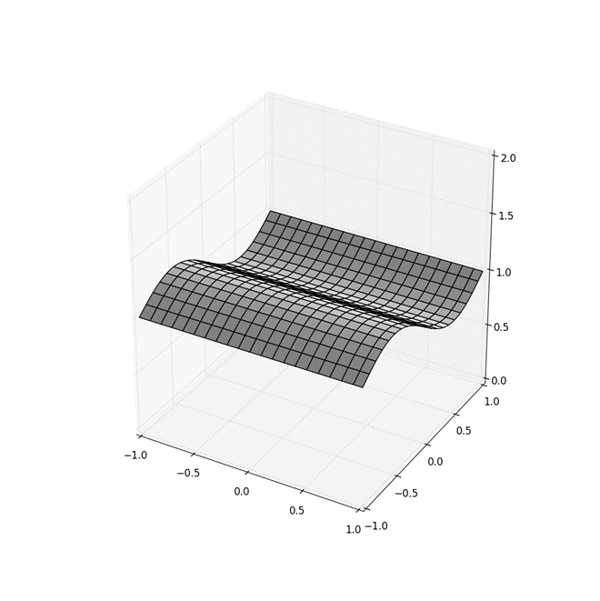
What actually happens here?
Each “cell” is like a small photo.
A new sensor reading is like a new photo.
Here we see a blue sensor, a yellow, a green and a pink one that each send 6 photos over a period of time.
Sensor id→
Amplitude →
Time →

Slide 10
What made HDFS so noisy?
It was confused about time. Sometimes a snapshot included data from the frame prior to the one we wanted, or after it.
Sometimes data was completely missed. This is because HDFS is slow to “settle” down after an update.
Sometimes it violated the gap-freedom property: inconsistent cuts!

Slide 11
Why would there be a causal connection between sensor values?
In fact there isn’t: Those are completely independent and parallel
But we often construct secondary indices (like our B-Tree in hw2)
Those depend on the data in them, and can evolve through versions too, which creates a more complex happens-before relationship that fits Lamport’s model well.

Slide 12
Why is consistency such a big deal?
Many machine learning systems are “tolerant” of noise, but HDFS was way worse than just noisy: it was inconsistent!
We might not trust the system when it tracks Trinity.
Inconsistent inputs can defeat any algorithm!

Slide 13
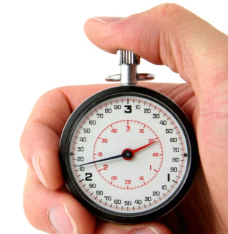
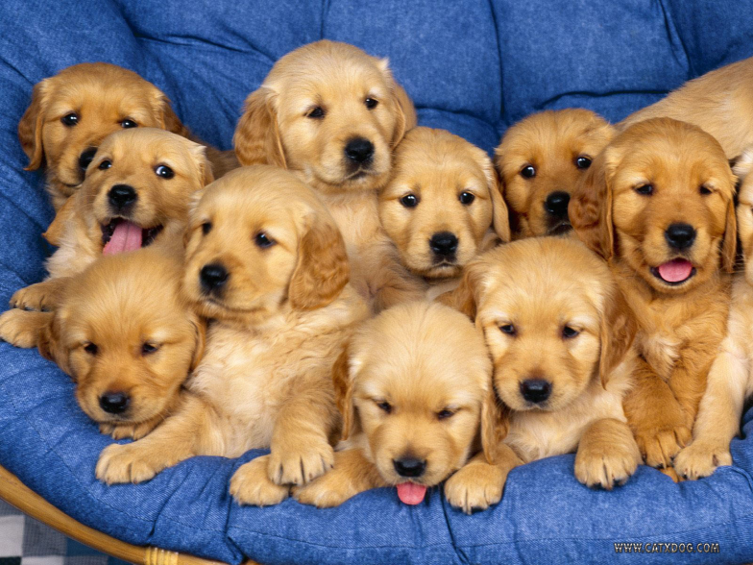
Smart Systems Need Consistency!
As we saw, one dimension concerns time
After an event occurs, it should be rapidly processed
Any application using the platform should see it soon
Another centers on coordination and causality
Replicate for fault-tolerance and scale
Replicas should evolve through the same values, and data shouldn’t be lost
Notes:
This connects back to lecture 6.

Slide 14
Freeze FramE File System (FFFS_{v1})
This was created by the 2019 TA, Theo Gkountouvas, with Weijia Song!
The idea was to bring Lamport’s model into the file system.
Fhey took advantage of the fact that HDFS has a snapshot API, even though it didn’t work. FFFS “reimplements” this API!

Slide 15
How does it work?
Normal file systems only store one copy of each file.
FFFS starts by keeping every update, as a distinct record. The file system state at a particular moment is accessed by indexing into the collection of records and showing the “last bytes” as of that instant in time.
So FFFS looks just like a normal file system to its users.
Notes:
Students in CS5412 sometimes are troubled that one system can have so many interfaces. FFFS was actually built, initially, by taking HDFS and modifying the internal implementation to track versions.
But there is also an object oriented layer, Ceph, that can run over HDFS. So it can run on FFFS too. It uses the file system as its “block store”. Through the Ceph API, the same file system suddenly looks object oriented. For structured data, Ceph is very popular because it handles a number of tasks the user would otherwise need to address.
HDFS or FFFS are file systems, and as such, may not seem like a distributed system in the Chandy/Lamport sense, but actually both are: the implementation of HDFS has a process to handle file names and other “meta data” like access times and seek pointer, and then a set of processes (sharded) to hold the data and replicate it for fault-tolerance. FFFS shares this identical model.

Slide 16
Reminder: Consistent cuts
We talked about this on Tuesday.
Lamport suggested “visiting” machines in a distributed system at a set of instants that represent a gap-free snapshot of the execution.
Math term: “closed under the → relationship”
If B is included in the set, than any A → B is included too.
He calls this a consistent snapshot. A consistent cut is the same but doesn’t include the full history (it looks just at the state when you visited the machines, at that moment).

Slide 17
How does it work?
[T-δ…
…T+δ]
Due to clock skew, T could fall anywhere in [T-δ, T+δ]
FFFS keeps a history of versions of the data it receives
When you overwrite file records, it keeps the old version too!
Data is indexed by time, but also by logical time.
When you ask for a snapshot at time T, FFFS needs to ask the servers what data each has for each sensor.

Slide 18
How does it work?
[T-δ…
…T+δ]
Due to clock skew, T could fall anywhere in [T-δ, T+δ]
FFFS is smart about Lamport’s → relationship
It tracks down the candidate values to return using the time, T
Above, notice that A happens at P, and C at Q, and A → C
In fact, A could have “caused” C. Information about A reached C
FFFS tracks causality, so that if some read returns C, FFFS would return A or some subsequent state for P.
In effect, FFFS does temporal reads along a consistent cut.

Slide 19
What if you do many Reads? Consistent cuts!
T₀ T₁ T_{2…}
In effect, each time your application does a read from a set of files, that operation occurs along a consistent cut that:
Is as accurate as FFFS_{v1} can make it, given clock precision limits
If T’ ≥ T, the cut for T’ includes everything the cut for T included
If you read multiple files, the results are causally consistent
Reads are deterministic (other readers see the same data)
Notes:
In this example we are showing how FFFS might handle requests for a snapshot at time T, and then at T’. Think of the 5fps data: time 10:00:00.000 and time 10:00:00.200
FFFS may not have perfect time accuracy but it does its best and also tracks causality and won’t give back data that seems to violate causal order. We get the green cuts shown on the left (in fact the red ones too, but T and T’ match the green ones). All of these cuts are consistent – FFFS only returns data on consistent cuts, and ones matched to the requested times. HDFS doesn’t have this property.
Notice also that each cut definitely includes the events from the prior cut. Time moves forward.
And this is how the video on the right was made!

Slide 20
In our Highway example?
When we query, we want the machine-learning tool to see data as a series of consistent snapshots across the full data set.
Then it can select data that includes video-snippets of Trinity with exactly one snippet per unit of time, no overlaps, no “lies”.
Thought question: How does the overlap issue relate to sensor overlap from the Meta system, discussed previously?

Slide 21
Revisit the Smart Highway
Use FFFS as the blob store!
Notes:
Here the idea is that maybe we are using machine learning to figure out Trinity’s path on the highway (which was terrifying!) With good data, we can reconstruct a reasonable approximation, and then illustrate it with video snippets to make our film.

Slide 22
File system API got in our way!
FFFS_{v1} is actually a bit slow, partly because it uses a file system API. To talk to it, you open files, read/write/seek/close/delete.
This is not ideally matched to modern ML, where we prefer to use computational patterns like MapReduce.
What we really would want is to have a set of servers host a DHT and right next to the DHT, also host the computational task.

Slide 23
A DHT is a much more natural choice
If we track “versions” than we can use a DHT put operation.
The key is the sensor id. In our animation we had 400 of them.
Each value is a byte-array with a “new reading” from the sensor. In fact these are really structured records that include highly accurate time (“synchrophasor measurements”).

Slide 24
Cascade: A DHT “like” FFFS_{v1}
So we decided to create a key-value store, versioned like FFFS, but with a sharded structure like key-value products.
We called it Cascade. It is starting to work now.
It was built using Derecho.

Slide 25
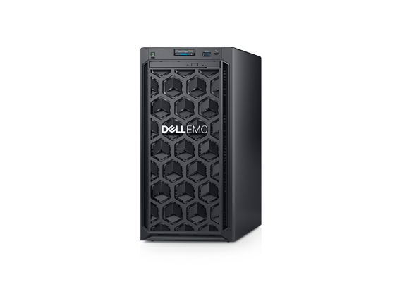
Concept: Servers that each hosts a shard of the DHT plus code to compute on sharded data
Some function we want to use in MapReduce
MapReduce can talk to the DHT shard without going over the network
A DHT “shard”
A server
On this one machine, we have both the code MapReduce will run and one of our DHT shards

Slide 26
Concept: Servers that each hosts a shard of the DHT plus code to compute on sharded data
Our datacenter has many servers…

Slide 27
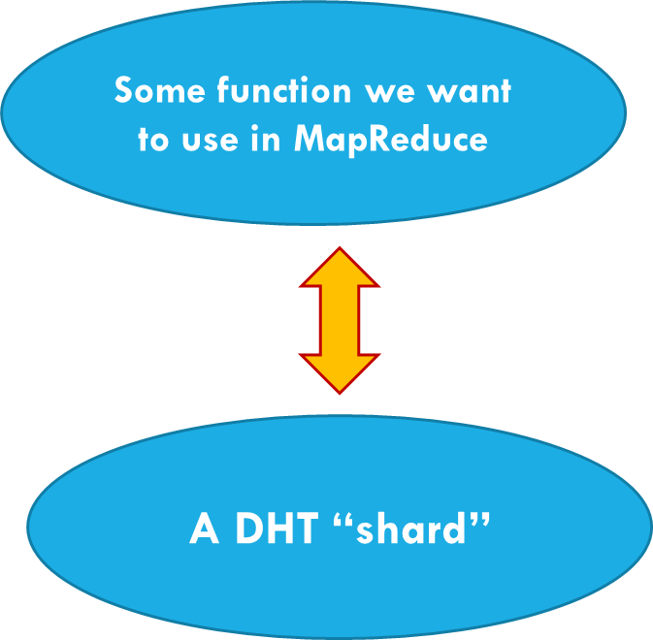
Our code is “side by side” with the shard and can access local data cheaply!
This looks like homework 2! A key-value DHT that lives on the same machines where some kind of logic is running. In homework 2, it was a B-Tree. In this example, it would be MapReduce or Hadoop…

Slide 28
Cascade API (FFFS_{v2})
Extremely simple:
Cascade::put(key, value),
Cascade::get(key[, time]). You can also query the version # for the object
Cascade::cput(key, value, new-intended-version-#)
Cascade::watch(key, Callback f)
The key could be a string, an integer, even a complex object.
The value could be a byte array, a photo, a video, and can be huge.
Notes:
The main APIs for the object store match those of a standard key-value store. But Derecho adds a “watch” callback that will do a call to a local function if the watched key changes. Obviously this callback occurs on the process where the key changed. But the function could then send a message or a multicast to other processes.

Slide 29
How your code “reaches” the DHT
If your code uses a key that maps to the same node where it is running now, the request is handled locally, with no network I/O.
If your key maps to some other shard, Cascade will fetch the object over a high-speed RDMA link. If you did a put, it will use Derecho state machine replication (multicast) to do the update.

Slide 30
Locality benefit
If the code is talking to the local shard, no locking or copying is required, which makes access ultra-fast!
We don’t need locks because any updates create new versions
Cascade actually does support version overwrite too, but in our example, it isn’t using that feature.
We won’t need to copy the data (which could be big!) since we can access it directly right where Cascade holds it

Slide 31
What if we need a GPU for fast compute?
Many ML algorithms are only feasible if we can do parallel computing on a GPU or TPU chip.
Cascade is smart enough to remember what it downloads into GPU memory. It won’t DMA the same object again and again.
In effect, Cascade “manages” GPU memory like a cache!

Slide 32
Map-Reduce On Data in Cascade
Map to k1, k2
Key-value pairs at “virtual time” T
We obtain a completely atomic MapReduce primitive within Derecho!
N x N Shuffle
AllReduce
Notes:
In particular, a subgroup with shards of size two, here) can implement MapReduce. This is shown here. Notice that the actual arrows would be a form of point-to-point message passing. Derecho supports both point to point and group multicast patterns.

Slide 33
Versioned objects
We configure the object store to track versions. put creates a new version:
key: The object store always tracks information on a per-object basis
version-number: Just an integer
time: If the object itself lacks a timestamp, we just use “platform” time.
Now get can lookup most current version, or a specific one, even by time.
The object store is optimized to leverage non-volatile memory hardware.

Slide 34
Storing deltas
Existing DHTs lack support for versioned data.
We implemented a highly optimized versioned data structure
We implement a temporal index, and cache frequently accessed data.
A server still manages a map (since many keys map to it), but you can think of the values for a specific key as being versioned.
Sometimes deltas are more efficient. If you have a function to compute the delta, we won’t even create a new version unless you tell us to.
Values (or deltas) are saved on NVMe & replicated for fault-tolerance.
Notes:
This is just a slide on a question of efficiency.
Sometimes a delta is MUCH smaller than the versions themselves would be.

Slide 35
Simplest case
We take a subgroup, shard it (for example, 2 replicas)
put maps your key to some shard. It holds the key,value pairs
Replication uses an atomic multicast based on Paxos, so all copies are in a consistent state.
There is just one “most current” value, held by the store.
get will fetch this most recently stored value.
watch uses multicast to inform any watchers each time value changes.
cput is like put, but only replaces the prior value if the version # matches
Notes:
The main “fancy” API here is the conditional put. It works like Put but checks that the version numbering hasn’t changed since the get was done. So you do a get, update the version, then a cput, and if this is successful, you “avoided” using a lock and yet got an atomic effect. If cput fails, no change was done and you can iterate by doing a new get, then trying again.

Slide 36
What if we don’t want versions?
Version numbering is standard in Cascade. But it doesn’t always track the version history.
For a given key, you can ask it to keep just the most current version, or you can ask it to keep all prior versions.
In our power grid example, we used the “all prior versions” approach, but for some kinds of data “just keep the current one” is best.

Slide 37
Sequences of versions
With concurrent applications, perhaps some task will do a get, then compute a new version, then put. But if some other task simultaneously does the same thing, they could try to create the same version.
In cput is a in the object store to address this kind of race condition. If an update races occurs, cput notices that a task is trying to overwrite a version that is already present. It “fails” so that the task can repeat the get and try again. This yields consistency without locking!
Notes:
With versions people sometimes worry about transactions that do a get, think about it, then write an update. You can run into conflicts if somehow two processes try to update the same (key,value) version.
One option is to use locking if that would be a risk, but locking can slow things down.
So in Derecho’s object store we offer a conditional put that only updates a version if the correct prior version is still loaded. If someone else updated it while you were thinking, the conditional put fails (“sorry, version 17 is not the most current one”) and you can retry.
The version numbering is implicit (a header field associated with the value – get fills it in initially, and then cput checks that the version currently in the store matches what get previously fetched. For cases where conflicts would be rare you can avoid locking entirely and still be certain to get consistency.

Slide 38
Why is avoiding locking so important?
In a database course you are taught to lock an object, read it, then write the new version and then commit.
But Jim Gray told us this won’t scale, so we don’t want to do that. It led to Eric Brewer’s CAP conjecture, and weak consistency.
Cascade has strong consistency from state machine replication plus versioning. cput avoids locking, avoiding Gray’s concern!

Slide 39
Why is avoiding locking so important?
Summary: conditional version put:
cput allows you to read a version. When you update it, you’ll do a cput but you also specify the required version number.
This will normally be successful.
But if the version was changed under your feet, you get an error. Then throw away the update and try again.

Slide 40
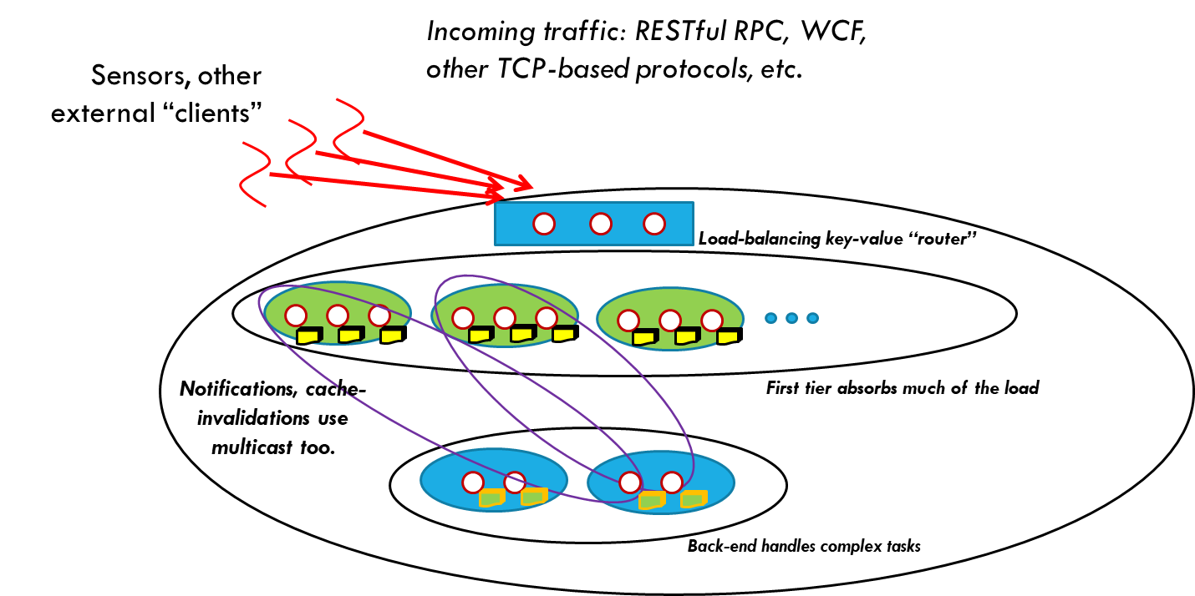
Object store as a file system
A file system is really an abstraction over a block store.
We plan to offer the Ceph object-oriented enhanced Posix API.
Here we configure the object store to be versioned and persistent.
Paxos for fault-tolerant updates, guaranteeing consistency.
This will offer back-compatibility, but for peak speed users should still use put/get/watch
Notes:
Once you have an object store you can turn it into a file system very easily by layering a file system API over the object layer.

Slide 41
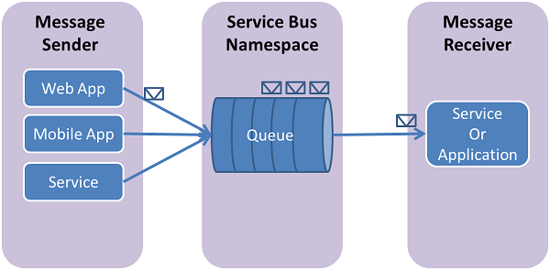
Object store as a “bus”
We can implement “publish” using put.
Acts as a message bus in the non-versioned case
Acts as a message queue in the versioned mode.
… and we can support “subscribe” using watch
Thus the object store can support pub-sub APIs such as the OMG DDS specification, Kafka, OpenSplice, etc. We can also offer message queuing APIs such as the Azure or AWS queuing services.
Notes:
Or a message bus (publish-subscribe system)

Slide 42
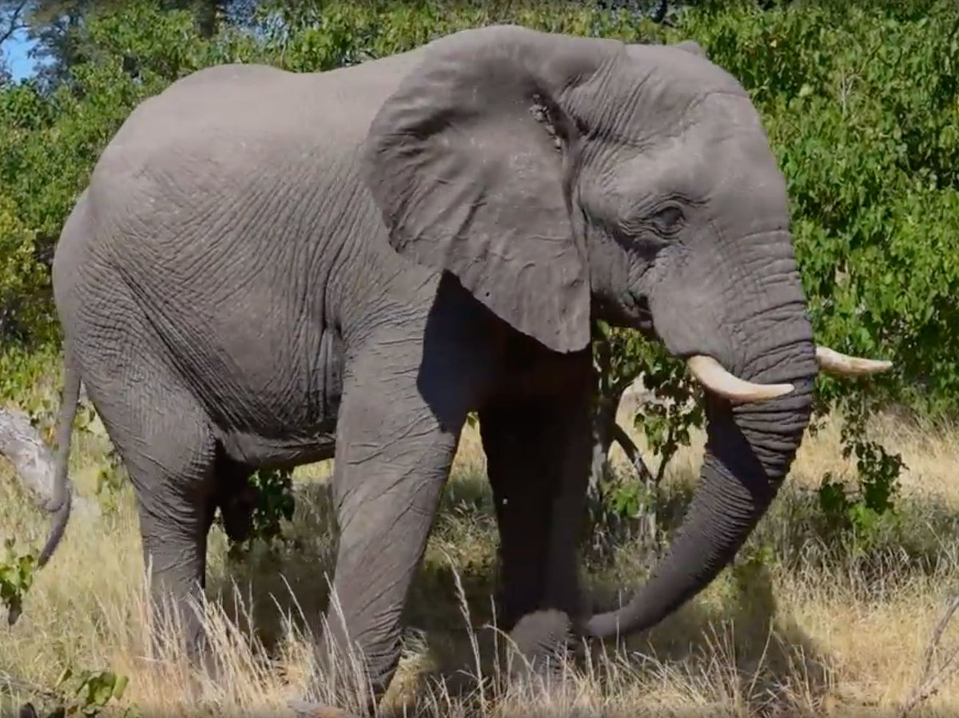
What about big objects?
If objects are large, and watchers just want “some” objects, we recommend a simple two step approach:
Create a uid, and put the (uid, obj) pair, first.
put a “meta-data” record that lists the uid.
Now, via get or watch, clients learn about the update from the meta-data, which can list various attributes.
They call get a second time to fetch object, if desired.
Notes:
A single object store can store more than one kind of data. So for example, it could store photos (maybe with one kind of key) and also “reports that new photos are available” (with some other kind of key).
This avoids having you receive photos you don’t actually want. Instead your code can decide which photos to pull from the object store.

Slide 43
How is Cascade implemented?
The entire key-value architecture is being built over Derecho
In effect, you talk to Cascade (put/get/watch) and it “translates” your actions into Derecho’s state machine replication operations, which run on RDMA (if available).
Effect is that your Cascade operation is extremely fast

Slide 44
A library? Or a μ-service?
Cascade can be set up as a separate μ-service on its machines.
In this configuraton it could replace a blob store, or a DHT like CosmosDB or Cassandra or Dynamo.
But your code wouldn’t run on the same machines.
Used as a library, Cascade can run on the same machine as your code. This eliminates extra copying and message passing.

Slide 45
Summary
Lamport’s ideas give us a way to fix the inconsistencies seen in existing cloud storage systems, like HDFS or the Azure blob store
In prior work, Cornell created a file system, FFFS_{v1} to show this.
Right now, the newer Cascade project is recreating the same options but in a (key,value) DHT approach that fits nicely with today’s most popular ML and AI platforms.

