Slide 1
CS5412/Lecture 11 The GeoScale Cloud
Ken Birman
CS5412 Spring 2019

Slide 2
Beyond the datacenter
Although we saw a picture of Facebook’s global blob service, we have talked entirely about technologies used inside a single datacenter.
How do cloud developers approach global-scale application design?
Today we will discuss “georeplication” and look at some solutions.

Slide 3
Where to start? Availability Zones
Companies like Amazon and Microsoft faced a problem early in the cloud build-out: servicing a data center can require turning it off!
Why?
Some hardware components are too critical to service while active, like the datacenter power and cooling systems, or the “spine” of routers.
Some software components can’t easily be upgraded while running, like the datacenter management system.
In fact there is a very long list of cases like these
Notes:
The basic idea is that you’ll replicate data over 3 data centers. Then they can upgrade one (so only 2 will be up, perhaps) and still tolerate 1 major outage (like a power generator failing).

Slide 4
Availability zones
So… they decided that instead of building one massive datacenter, they would put two or even three side by side.
When all are active, they spread load over them, so everything stays busy.
But this also gives them an option for shutting one down entirely to do upgrades (and with three, they would still be able to “tolerate” a major equipment failure in one of the two others).

Slide 5
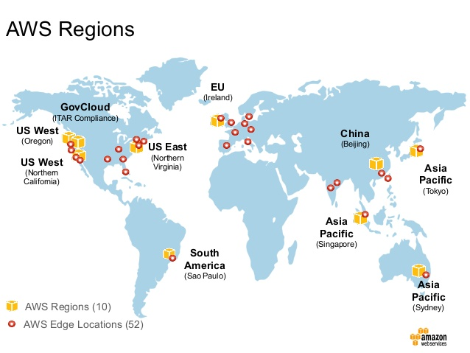
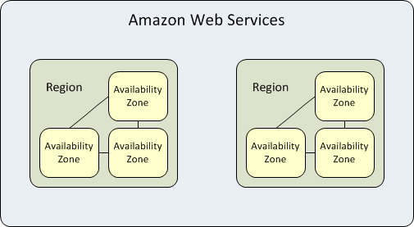
Availability Zones – Amazon AWS
AWS Edge is less capable
The AWS “region” has an availability zone structure
Notes:
AWS pioneered the approach. They use it globally.

Slide 6
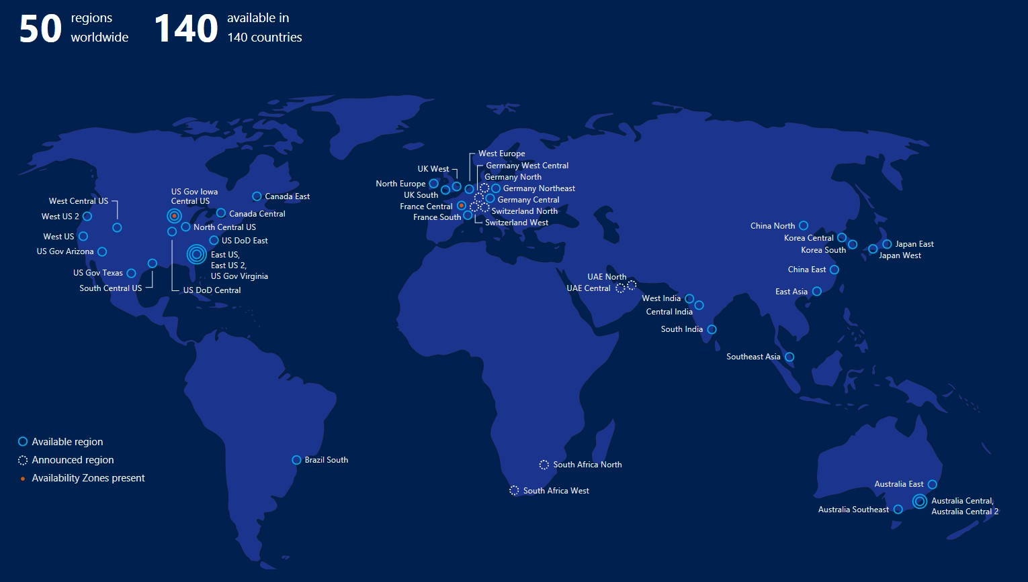
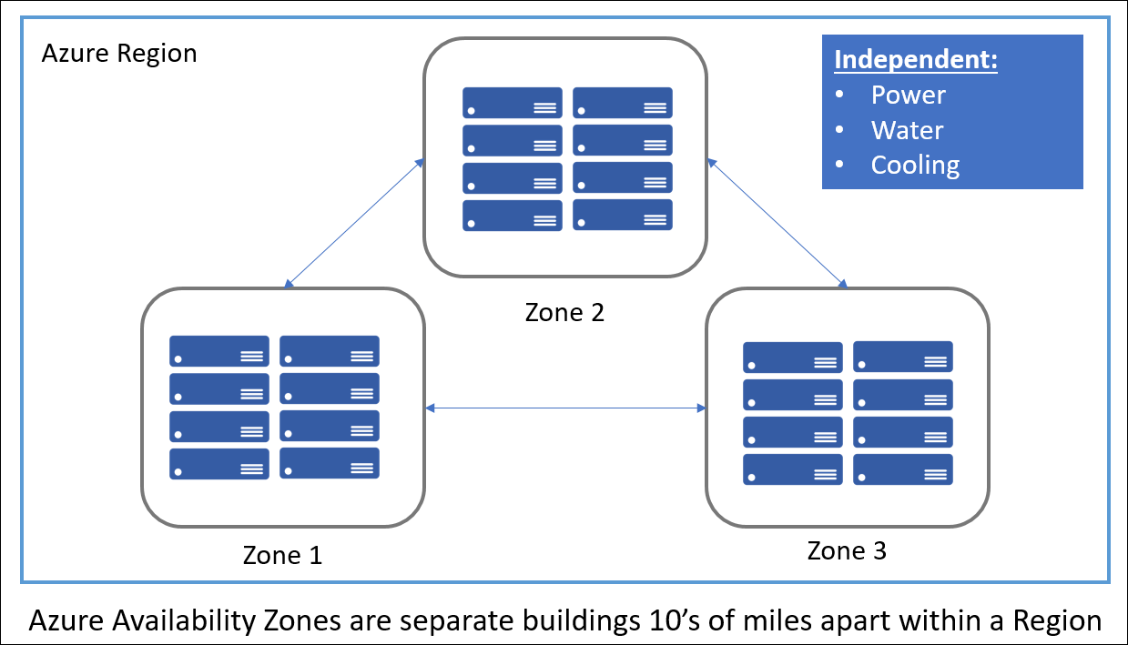
Availability Zones – Microsoft Azure
Notice the blue circles.
Those are regions with three zones.
Notes:
Microsoft is catching up, and has a similar (not identical) approach.

Slide 7
Models for high-availability Replication
Within a datacenter you can just make TCP connections and build your own chain replication solution, or download Derecho and configure it.
But communication between datacenters is tricky for several reasons. Those same approaches might not work well, or perhaps not at all.
Notes:
But you are forced to use the cloud’s built-in “zone aware” tools. You can’t just connect from one data center to another.

Slide 8
Connectivity limitations
Every datacenter has a firewall forming a very secure perimeter: applications cannot pass data through it without following the proper rules.
Zone-redundant services are provided by AWS and Azure and others to help you mirror data across zones, or even communicate from your service in Zone A to a “sibling” in Zone B.
Direct connections via TCP would probably be blocked: it is easy to connect into a datacenter but hard to connect out from inside!

Slide 9
Why do they restrict outgoing TCP?
The modern datacenter network can have millions of IP addresses inside each single datacenter.
But these won’t actually be unique IP addresses if you compare across different data centers: the addresses only make sense within a zone.
Thus a computer in datacenter A often would not have an IP address visible to a computer in datacenter B, blocking connectivity!

Slide 10
How does a browser overcome this?
Your browser is on the public internet, not internal to a datacenter.
So it sends a TCP connect request to the datacenter over one of a small set of datacenter IP addresses covering the full datacenter.
AWS, which hosts for many other sites, has a few IP addresses per site.
Some systems mimic this approach, others have their own ways of ensuring that traffic to Acme.com gets to Acme’s servers, even if hosted on their framework.
Notes:
In effect, you are always connecting from the outside to the inside, with browsers. Between data centers, you would be connecting from inside to inside, and that’s what they don’t allow.

Slide 11
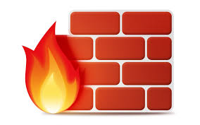
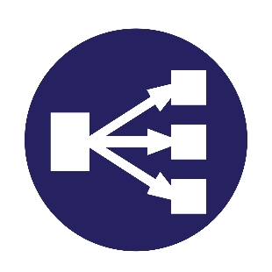
Arriving traffic: NAT Box
On arrival, packets are scanned for possible BOT traffic or DDoS attacks, then the IP addresses are translated to “load balance” work over the proper servers. This would be costly, but high-speed parallel hardware is used to do the needed work at line rates.
IP address looks like “NatBox”, connecting to “server17.Acme.com”
IP address looks like “myIP”, connecting to “Acme.com”
TCP connect to Acme.com
NAT box + load balancer
Client thread
(browser)
Blocks attacks
Notes:
NAT boxes are an amazing idea. You see one IP address outside the box, but might see millions of distinct ones inside the box – or in this case, inside the datacenter. The NAT box maps back and forth on the fly, at “wire speeds”.

Slide 12
How does it pull this trick off?
The NAT box maintains a table of “internal IP addresses (and port numbers) and the matching “external” ones.
As messages arrive, if they are TCP traffic, it does a table lookup and substitution, then adjusts the packet header to correct the checksum.
Thus “server17.Acme.com” cannot be accessed directly and yet your messages are routed to it, and vice versa.
Notes:
The slow step is recomputing the checksum, but they have a clever incremental trick for this that can run at the full data rate.

Slide 13
But with GeoReplication, this blocks your code from connecting to itself
If you have machine A.Acme.com inside AWS or Azure, and then try to connect to B.Acme.com, it works inside a single datacenter.
In fact you will be running in an “enterprice VLAN” or “VPC”: what seems to be a private cloud.
If you were to launch Ethereal or a similar sniffer you only see traffic from your own machines, not traffic from other datacenter tenants.
But if B was in a different datacenter, the connection simply won’t work.
Both A and B are behind NAT boxes, so neither can see the other!

Slide 14
OptioNs?
Some vendors do offer ways to make an A-B connection across datacenters in the same region (availability zone).
You need to use a special library they provide and otherwise, the connection would fail. And they charge for this service.
More common is to use some existing “Zone-aware” service
Notes:
With the A-B connection tools you can build your own mirroring technologies. But if you use their zone-aware tools, you also must use their zone-aware μ-services.

Slide 15
Zone Aware Services on Azure
Linux Virtual Machines
Windows Virtual Machines
Virtual Machine Scale Sets
Managed Disks
Load Balancer
Public IP address
Zone-redundant storage
SQL Database
Event Hubs
Service Bus
VPN Gateway
ExpressRoute
Application Gateway

Slide 16
A few worth noting
Zone-aware storage is a storage mirroring option.
Files written in zone A would be available as read-only replicas in zone B. B sees them as a read-only file volume under path /Zone/A/…
This is a very common way to share information between data centers.

Slide 17
A Few Worth Noting
The Azure Service Bus in its “Premium” configuration
This is a message bus used by services within your VPC to communicate.
Azure offers a configuration that automatically transfers data across zones under your control.
Again, you need to follow their instructions to set it up. They charge but the performance and rate have historically favored this model.
Basically, two queues hold messages, and then they use a set of side by side TCP connections to shuttle data in both directions. Very efficient!
Notes:
This is actually how you do the A-B mirroring on your own: your messages travel over the zone-aware service bus.

Slide 18
A Few Worth Noting
Azure’s zone-redundant virtual network gateway
Used when you really do want a connection of your own, via TCP
Setup is fairly sophisticated but they walk you through it.
In effect, creates a special “pseudo-public” IP address for your services, which can then connect to each other. Not visible to other external users
But performance might be balky: this isn’t their most performant option. And they charge by the megabyte transferred over the links.
Notes:
If you are prepared to pay, you can create a network spanning the data centers, but they don’t really invest to make this particularly appealing.

Slide 19
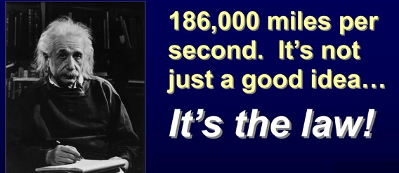
Heavy tailed Latency
A big concern with georeplication is erratic delays.
Within an availability zone, the issue is minimal: the networks are short (maybe blocks, maybe a few miles), so latencies are tiny.
But with global WAN links, latencies can be huge and variation grows.
Mean delay from New York to London: 90ms
Mean delay from New York to Tokyo: 103ms

Slide 20
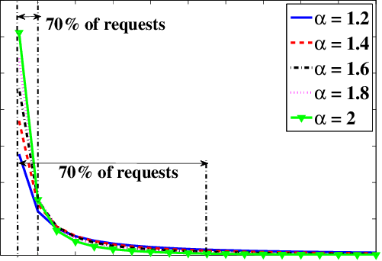
Heavy Tailed Latency
The number of events in the i’th popularity bin is proportional to$1/i∝$
Zipf’s law
Studies reveal “Zipf” latency distributions
Most traffic gets through very quickly
But some traffic takes extremely long. We say that these distributions are heavy- tailed if the “very slow” traffic adds up to a substantial portion of the total traffic.
Notes:
The idea is that the tail looks flat but if it is very long, might still have a lot of probability stashed below it.

Slide 21
Issue this raises
In protocols like Paxos, would we want to wait for all sites to respond, or just a quorum? Seemingly, a quorum is far better.
On the other hand, perhaps we would want all sites within an availability zone, but then wouldn’t need to wait for geo-replicas to respond?
Leads to a three-level concept of Paxos stability.
Locally stable in datacenter… Availability-zone stable… WAN stable
Notes:
So you want to think now about each message as a roll of the dice: most get through quickly but s o m e a r e v e r y s l o w. For no obvious reason at all.

Slide 22
What have experiments shown?
Basically, Paxos performs poorly with high, erratic latencies.
A big issue is that delay isn’t symmetric:
The path from Zone A to Zone B might be slow
Yet the path from Zone B to Zone A could be fast at that same instant.
So the outgoing proposals experience one set of delays, and replies from Paxos members experience different delays. You end up waiting “for everyone”
Notes:
Paxos would overcome this because of its quorum pattern if it was always the identical link that was slow. But if it is very random, them you end up with different slow nodes for different Paxos executions, and since they are running in a massive stream, the stream ends up needing the ones that were slow in some recent past iteration to catch up. So in the end, you wait for the slow nodes.

Slide 23
Google Spanner Idea: TrueTime
Google uses actual time as a way to build an asynchronous totally ordered data replication solution called Spanner.
Google TrueTime is a global time service that uses atomic clocks together with GPS-based clocks to issue timestamps with the following guarantee:
For any two timestamps, T and T’
If T’ was fully generated before generation of T started,
Then T > T’
Notes:
With TT timestamps, we have this new guarantee and can use it to do global ordering without synchronization! TT itself is coming from the global GPS system.

Slide 24
Why such a tortured definition?
With the guarantee they offer, if some operation B was timestamped T, and could possibly have seen the effects of operation A with timestamp T’, then we can order B and A so that A occurs before B.
The full API is very elegant and simple: TT.now(), TT.before(), TT.after(). TT.now() returns a range from TT.before() to TT.after().
The basic guarantee is that the true time is definitely in the range TT.now().
TT.before() is definitely a past time, and TT.after() is definitely in the future.

Slide 25
Implementing TrueTime
Google starts with a basic observation:
Suppose clocks are synchronized to precision δ
It is 10:00.000 on my clock, and someone wants to run transaction X.
What is the largest possible timestamp any zone could have issued?
My clock could be slow, and some other clock could be fast. So the largest (worst case) possible will be T+2 δ

Slide 26
Minimizing δ in TrueTime
Google uses a mix of atomic clocks and GPS synchronization for this. They synchronize against the mix every 30s, then might drift in between.
GPS can be corrected for various factors, including Einstein’s relativistic time dilation, and they take those steps.
In the end their value of δ is quite small (0-6ms). So at actual time 10am, transaction X might get a TT.after() timestamp like (10:00.006, zone-id, uid).
The zone id and uid are to break ties.

Slide 27
Spanner’s use of True Time
Spanner is a transactional database system (in fact using a key-value structure, but that won’t matter today).
Any application worldwide can generate a timestamped Spanner transaction.
These are relayed over the Google version message services. Their service delivers messages from Zone X to Zone Y in timestamp order.

Slide 28
Life of a Spanner Instance
Spanner has connections to perhaps hundreds of remote zones.
Transactions flow in on these connections, and it stores them until every zone has sent some transaction with a timestamp of value T_{stable} or larger.
Then it can apply all transactions with timestamps ≤ T_{stable}, in order.

Slide 29
Life of a Spanner instance
Message with tt=10:01.977
Message with tt=10:02.005
Message with tt=10:00.077
Message with tt=10:01.116
Message with tt=10:00.076
Message with tt=10:00.003
Message with tt=10:00.000
T_{stable} = 09:59.999
Notation: T_{stable} is the min. timestamp for incoming updates from the full set of input channels.
Totally ordered sequence of transactions with timestamps ≤ 9:59.999
Notes:
The idea is very simple: sort messages but also take advantage of knowing that once you see a message with time T from some source, you won’t see one with time T’<T.

Slide 30
A nice feature of Spanner
Think back to how CASD took worst-case assumptions and then created a slow protocol: It always delays until the worst-case delay has passed.
But Spanner can safely assume that the links to all its data centers are working, and it just waits to hear from all of them. If a data center is taken offline, Spanner is told, so then it won’t wait for that link.
Thus Spanner can make ordering decisions “as soon as possible”.

Slide 31
Why does this work?
If Spanner has received messages with timestamps > T_{stable} from every zone, it has seen every transaction with timestamp ≤ T_{stable}!
This is because the connections deliver messages in order, by timestamp.
If an earlier transaction were to show up, it would violate this rule.
So, if it now places those transactions into timestamp order (breaking ties by (zone-id, uid)), they can be applied to the global database in total order.

Slide 32
What limits spanner?
One limiting factor is that although the zone-to-zone data transfers run over large numbers of parallel TCP connections, the messages need to be put into order to obtain this “monotonicity” property.
A second limiting factor is Zipf-like latency with heavy tails: Spanner will often have to wait for “laggards”.
At global scale the effect can be significant (many seconds).

Slide 33
Paxos all over again?
With the classic implementation of Paxos, we have a back-and-forth interaction that traverses every link several times in both directions. Paxos experiences delays repeatedly.
With Google Spanner, there are global asynchronous flows but no back-and-forth coordination of this kind. So Spanner experiences delays once.
Intriguing observation: Derecho’s version of Paxos “behaves” like Spanner.
Notes:
We are actually planning to do some Derecho experiments soon with WAN links to see how the Derecho Paxos protocol will work in this situation.

Slide 34
What limits spanner?
Google researchers report that the most frustrating issue is that a transaction cannot even be processed locally without waiting this way!
In some situations, a speculative result may be acceptable: “If there are no conflicts, my transaction would run and you would win the auction!”
But in other settings, consistency is absolutely needed, so there is no choice.

Slide 35
Tricks to minimize impact
If a zone hasn’t been sending any transactions, it should “pause”.
Send a special “End of sequence” message
Cease to send new transactions
Other zones no longer need to wait.
Later, to resume, it will have to get permission to restart:
Send a “resume request”
Every other zone must acknowledge this before new transactions can start.

Slide 36
Other options?
With a “primary zone” model, we can shard our database and assign each shard a primary owner (only the owner zone can update that shard).
Then you can make the rule that the primary owner can always do transactions on shards that it owns, without waiting.
But if any transaction would need to access shards for which it isn’t primary, than all must use the Spanner ordering mechanism (you can’t mix methods).

Slide 37
What limits the primary zone method?
In some situations it is hard to know what shards a transaction would access before the transaction code actually executes.
For example, the keys a transaction will touch might be a function of the data it reads in some initial step. So until it executes, we don’t know the key set, and can’t know if those will all be local shards.
Spanner is really aimed at cases like these.

Slide 38
More remarks about IP Addresses
We have seen that with modern cloud systems, you could connect to Acme.com and be routed to Amazon.com instead.
In fact the modern cloud has considerable control over this, and you can influence that layer.
For each external client, when it initially connects, you can program the cloud DNS to route that specific request to a particular data center, and control whether or not the DNS record will be cached.

Slide 39
More control
You can use information in a cookie left on the client to advise the cloud on which of your servers would be the best one to handle a connection.
And you can select between a wide range of elasticity and routing and load-balancing “recipes” that are offered by the vendor.
In the next generation of routers (SDN routers) you’ll be able to even provide packet inspection rules that could route based on values in specific fields of the incoming request.

Slide 40
Mobility and Georeplication
With the advent of 5G, more and more IoT systems will include mobile clients in which the sensors are actually inside a vehicle like a car or plane.
5G hubs are very much like Azure IoT Edge, and in fact Azure IoT Edge may be a leading platform option for 5G services.
With mobile users, the user itself may have a dynamically changing IP address, and might be using multipath TCP to maintain connectivity.
Notes:
5G is the fancy new telephony standard. Basically, IoT but for phones.

Slide 41
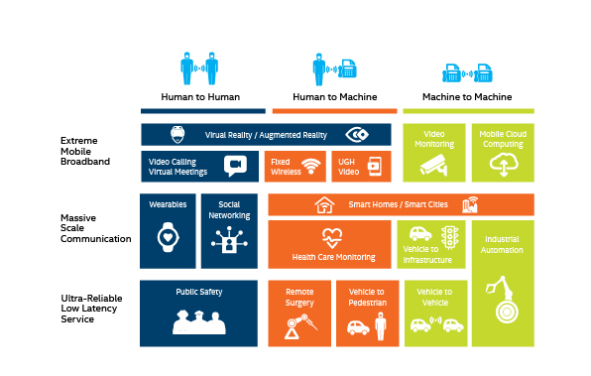
The path to 5G (Slides from an Industry “visioning” event)

Slide 42
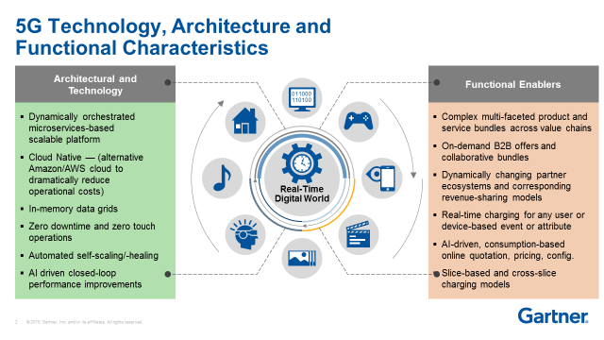
The path to 5G

Slide 43
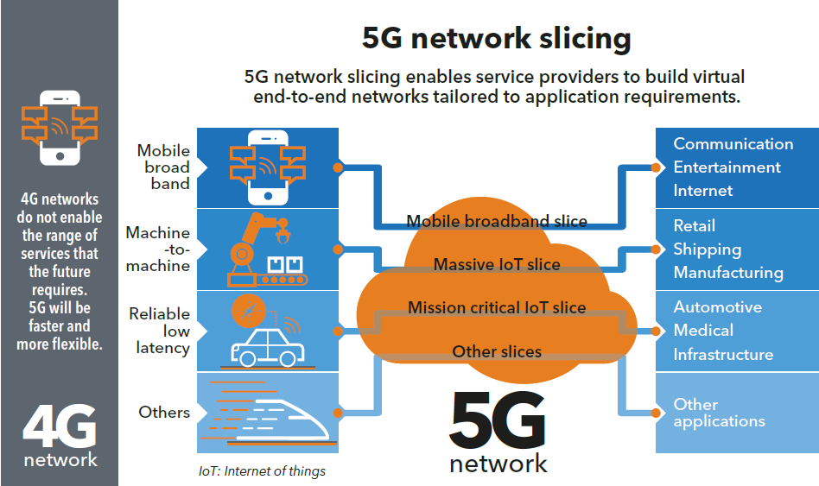
The path to 5G

Slide 44
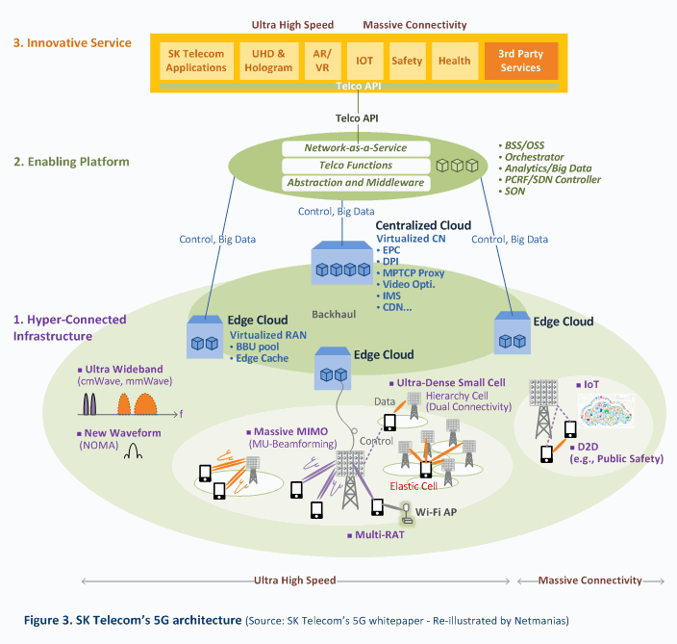
The path to 5G
They envision a service infrastructure of their own living on Azure IoT Edge or similar!
Is 5G just an IoT cloud integrated more closely to telecommunications?

Slide 45
Mobility and Georeplication
A multipath TCP session (like it sounds) is one where a single TCP connection could route over any of several pre-selected paths.
This can have some surprising latency effects, which multipath TCP “hides”. Moreover, without “help” from some form of stable intermediary service, a mobile client could end up switching from zone to zone which might expose inconsistencies.
5G services live in a more stable environment, and become the mobile user’s cache, and a gateway to the full cloud, much like the IoT sensor proxies we discussed.
Notes:
Multipath TCP is sometimes useful at scale or with mobile 5G, to route around slow links.

Slide 46
Summary
“...he doth bestride the narrow world/Like a Colossus...”
GeoReplication is best viewed as having two scales:
Availability Zone: Just neighboring data centers. With some cost, you can use TCP and build “normal” protocols. Derecho should work this way.
True global scope: Here, techniques like Google Spanner are best. Researchers have experimented with Paxos at global scope, but it performs poorly due to high-latency links.
The notion of wide-area stability is useful and might be worth using in other contexts.
5G mobility will introduce an additional layer of services

