Slide 1
Caching for Data Analysis
Ken Birman, Theo Gkountouvas

Slide 2
Data Analysis
Data processing is growing very fast compared to the hardware acceleration.
Volume
Complexity
Notes:
Data is growing very fast in terms of volume and complexity. This is why we need robust and scalable execution engines like Hadoop Map Reduce, Spark, or Tensorflow for Data Analysis. Today we are going to focus on Spark.

Slide 3
Spark RDDs
Spark uses Resilient Distributed Datasets (RDDs) as a core structure.
Word Count Example (Scala):
val textRDD = sc.textFile("hdfs://...")
val flatMapRDD = textRDD.flatMap(line => line.split(" "))
val mapRDD = flatMapRDD.map(word => (word, 1))
val counts = mapRDD.reduceByKey(_ + _)
counts.saveAsTextFile("hdfs://...")
textRDD
Input RDD(s): -
Operation: readFile
mapRDD
Input RDD(s): flatMapRDD
Operation: map
Notes:
RDDs just take other RDDs as input and they perform an operation at the result of the input RDDs which produces the results for the current RDD.

Slide 4
Lineage of RDDs and Lazy Execution
textRDD
Input RDD(s): -
Operation: readFile
flatMapRDD
Input RDD(s): textRDD
Operation: flatMap
mapRDD
Input RDD(s): flatMapRDD
Operation: map
val counts = mapRDD.reduceByKey(_ + _)
Notes:
Go through an example to explain Lazy evaluation (optional)

Slide 5
Lineage of RDDs and Lazy Execution
textRDD
Input RDD(s): -
Operation: readFile
flatMapRDD
Input RDD(s): textRDD
Operation: flatMap
Triggers execution
mapRDD
Input RDD(s): flatMapRDD
Operation: map
val counts = mapRDD.reduceByKey(_ + _)

Slide 6
Lineage of RDDs and Lazy Execution
textRDD
Input RDD(s): -
Operation: readFile
flatMapRDD
Input RDD(s): textRDD
Operation: flatMap
Needs results of operation
mapRDD
Input RDD(s): flatMapRDD
Operation: map
val counts = mapRDD.reduceByKey(_ + _)

Slide 7
Lineage of RDDs and Lazy Execution
textRDD
Input RDD(s): -
Operation: readFile
flatMapRDD
Input RDD(s): textRDD
Operation: flatMap
Has input RDDs
mapRDD
Input RDD(s): flatMapRDD
Operation: map
val counts = mapRDD.reduceByKey(_ + _)

Slide 8
Lineage of RDDs and Lazy Execution
textRDD
Input RDD(s): -
Operation: readFile
flatMapRDD
Input RDD(s): textRDD
Operation: flatMap
Needs result of operation
mapRDD
Input RDD(s): flatMapRDD
Operation: map
val counts = mapRDD.reduceByKey(_ + _)

Slide 9
Lineage of RDDs and Lazy Execution
textRDD
Input RDD(s): -
Operation: readFile
flatMapRDD
Input RDD(s): textRDD
Operation: flatMap
No input RDDs
mapRDD
Input RDD(s): flatMapRDD
Operation: map
val counts = mapRDD.reduceByKey(_ + _)

Slide 10
Lineage of RDDs and Lazy Execution
textRDD
Input RDD(s): -
Operation: readFile
flatMapRDD
Input RDD(s): textRDD
Operation: flatMap
Execute operation
mapRDD
Input RDD(s): flatMapRDD
Operation: map
val counts = mapRDD.reduceByKey(_ + _)

Slide 11
Lineage of RDDs and Lazy Execution
textRDD
Input RDD(s): -
Operation: readFile
“Hello World!”
“Hello Ithaca”
flatMapRDD
Input RDD(s): textRDD
Operation: flatMap
Provide results
mapRDD
Input RDD(s): flatMapRDD
Operation: map
val counts = mapRDD.reduceByKey(_ + _)

Slide 12
Lineage of RDDs and Lazy Execution
textRDD
Input RDD(s): -
Operation: readFile
flatMapRDD
Input RDD(s): textRDD
Operation: flatMap
[“Hello”,”World”,
“Hello”, “Ithaca”]
mapRDD
Input RDD(s): flatMapRDD
Operation: map
val counts = mapRDD.reduceByKey(_ + _)

Slide 13
Lineage of RDDs and Lazy Execution
textRDD
Input RDD(s): -
Operation: readFile
flatMapRDD
Input RDD(s): textRDD
Operation: flatMap
[(“Hello”,1),(”World”,1),
(“Hello”,1),(“Ithaca”,1)]
mapRDD
Input RDD(s): flatMapRDD
Operation: map
val counts = mapRDD.reduceByKey(_ + _)

Slide 14
Lineage of RDDs and Lazy Execution
textRDD
Input RDD(s): -
Operation: readFile
flatMapRDD
Input RDD(s): textRDD
Operation: flatMap
mapRDD
Input RDD(s): flatMapRDD
Operation: map
{“Hello”:2,”World”:1,
“Ithaca”:1}
val counts = mapRDD.reduceByKey(_ + _)

Slide 15
Dataflow – Logical Plan (Operations)
map
filter
Input
join
filter
Output
map
Input
Notes:
The logical plan is provided by the data analyst and it is a DAG graph like this one.
Each Input/Output can be a stream or a file. Boxes are operations we perform in top of data. We have one-to-one operations (light green) which are typically called narrow transformations and many-to-one operations (yellow/gold) which we typically call wide transformations.

Slide 16
Dataflow – Execution Plan (Tasks)
map
filter
join
filter
map
filter
join
filter
map
join
filter
map
Notes:
Multiple tasks per operation are created by partitioning the input space for this operation. Each task is executed by a different executor (process). One physical server can typically host multiple executors.
If one executor fails we need to re-execute the whole execution up to this point. Shuffle phases like the one in the middle might perform extra intermediate steps (e.g. writing to persistent storage) for efficiency.
What happens if an executor fails?

Slide 17
Why caching in Spark is essential?
Cache intermediate results
Avoid re-execution of operations.
Save mostly CPU-cycles instead of I/O.
1
count
1
1
2
2
filter
map
1
reduce
Notes:
The same operation might be executed multiple times without caching intermediate reports, although we just need to execute it once. Notice that caching intermediate results in the Spark context means that we mainly save computation cycles vs I/O operations (traditional approaches).

Slide 18
Multiple choices for of caching
NONE (Default)
MEMORY_ONLY
MEMORY_ONLY_SER
MEMORY_AND_DISK
MEMORY_AND_DISK_SER
DISK_ONLY
…
Notes:
MEMORY_ONLY->Only use memory for caching (simpler mode).
MEMORY_AND_DISK-> Use both memory and disk (complicated, difficult to reason).
DISK_ONLY->Use only disk (when memory is sparse).
SER->Serialize data and then cache (I guess more useful when the result is large and it can be compressed significantly).

Slide 19
User decides what to cache in Spark
Users have to define what they want to cache by using cache() or persist() keywords after RDD.
Static analysis for what to cache is harder than traditional cases. Instead of caching only initial data, Spark has the ability to cache intermediate results, too.
Multiple choices about where to cache complicate things (Memory, SSD, Disk, etc.).
Caching might lead to worse results than simply re-executing (especially with SSD, Disks, Serialization).
Notes:
Cache and persist do not trigger execution of RDDs like passing the result to an output stream. Instead, when the result is calculated by lazy execution of Spark they make sure to cache it. It is simply an annotation for Spark to know what to cache or not.

Slide 20
Eviction Policy
Spark uses LRU for default eviction policy. Unlike selection about what to cache, eviction is automatic.
However, classic eviction policies do not exploit structure of the graph.

Slide 21
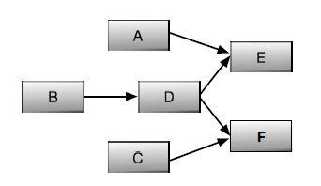
Why LRU is not so good?
Notes:
D is referenced twice. It is the only one that should be cached. LRU would cache the most recent results instead.

Slide 22
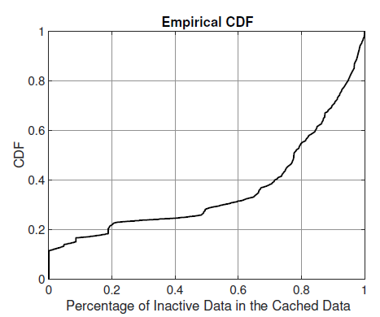
Experimental Study on Spark Bench (15 jobs)
Notes:
Red point means that data that is ranked in the middle of the cache according to LRU score has 75%-80% of being inactive (not used again). The area above the line is the average percentage of inactive data (>50%).

Slide 23
LRC: Dependency-Aware Cache Management for Data Analytics Clusters
Yinghao Yu, Wei Wang, Jun Zhang, Khaled Ben Letaief

Slide 24
Definition (Reference Count):
For each data block b, the reference count is define as the number of child blocks that are derived from b, but have not yet been computed.

Slide 25
LRC: Least Reference Count
Notes:
All blocks have one active reference besides D which has 2. If we compute the result of B then B has 0 active references and it will be evicted from cache since it is not going to be needed in the future.

Slide 26
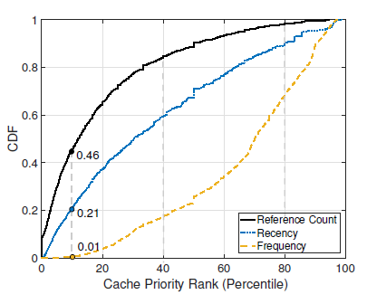
LRC: Least Reference Count
Unused blocks with zero active references are evicted.
Reference count is a better indicator for caching.
Notes:
With 10% cache size / workload size we get 46% hits with LRC, 21% with LRU and 1% with LFU.

Slide 27
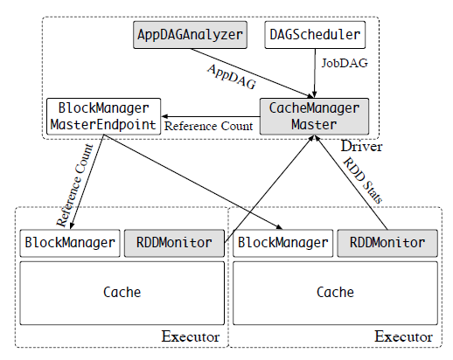
Solution - Architecture
Notes:
2 cases:
Increase reference count when a job is submitted.
Decrease reference count when a reference is made (read).
Notice this needs global communication between executors unlike LRU or LFU that can work independently (disadvantage)

Slide 28
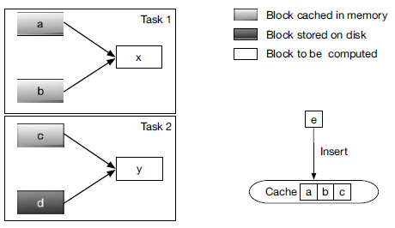
Problem – Is this enough?
Notes:
Suppose a,b,c,d have the same reference count.
D does not fit in memory.
What do we evict from memory when e is inserted?

Slide 29
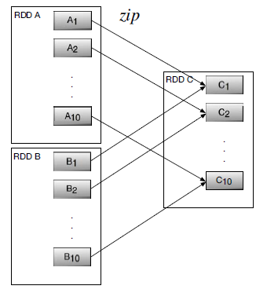
Problem – Peer Dependencies
If results of $A_{i}$ are not cached, then $B_{i}$ results should not be cached and vice-versa.
Latency will remain the same if $A_{i}$ and $B_{i}$ results have similar size even if we cache one of them (the other is going to be the bottleneck.

Slide 30
Definition (Effective Reference Count):
Let block 𝑏 be referenced by task 𝑡. We say this reference is effective if task 𝑡’s dependent blocks, if computed, are all cached in memory.

Slide 31
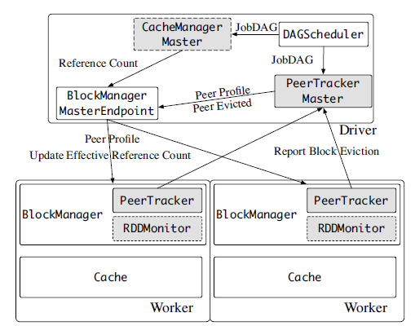
Solution - LERC
Notes:
Optional slide (similar to the one before with the additional logic mentioned which makes things slightly more complicated).

Slide 32
Experiments – Platform and Setting
Amazon EC2
Cluster with 20 nodes of type m4.large
2.4 GHz Intel Xeon E5-2676 v3 (Haswell) processor
8 GB memory
Zip application
10 different independent jobs
100 A blocks and 100 B blocks that are zipped together
8 GB total size

Slide 33
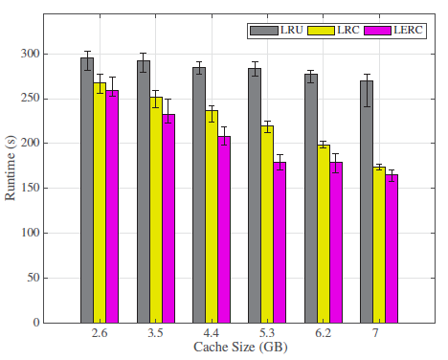
Experiments - Performance

Slide 34
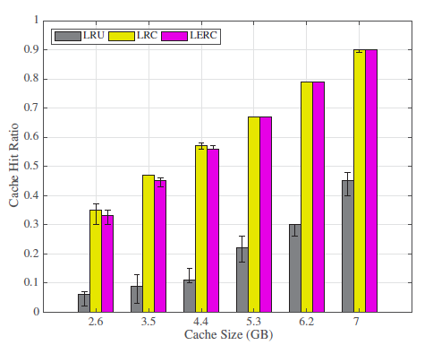
Experiments – Overall Cache Hit
Notes:
Notice that LERC might have less cache hit rate than LRC, but has better performance. Why is that? Is cache hit rate a good indicator for performance (think of the case we discussed earlier with peer dependencies)

Slide 35
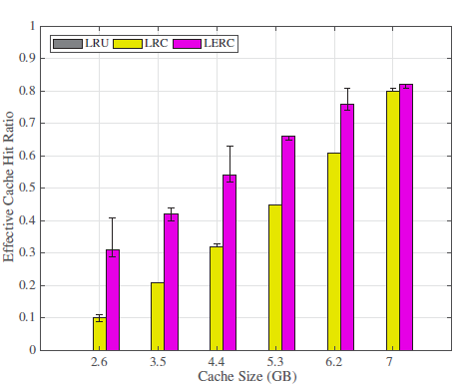
Experiments – Effective Cache Hit
Notes:
Effective cache hit much better. Counts only if all the peers are cached.

Slide 36
Temporal Caching [Work in Progress]
Theodoros Gkountouvas, Weijia Song, Haoze Wu, Ken Birman

Slide 37
Time-Series Data
Timestamped Data
Large amount
High frequency
Temporal Queries
Sophisticated queries (ML, Optimization)
Can be divided to:
Fixed Temporal Queries
Sliding Temporal Queries

Slide 38
Example – NYC taxi data
Notes:
Illuminated are the origins and destinations of taxi trips. The more light the more popular a spot is.

Slide 39
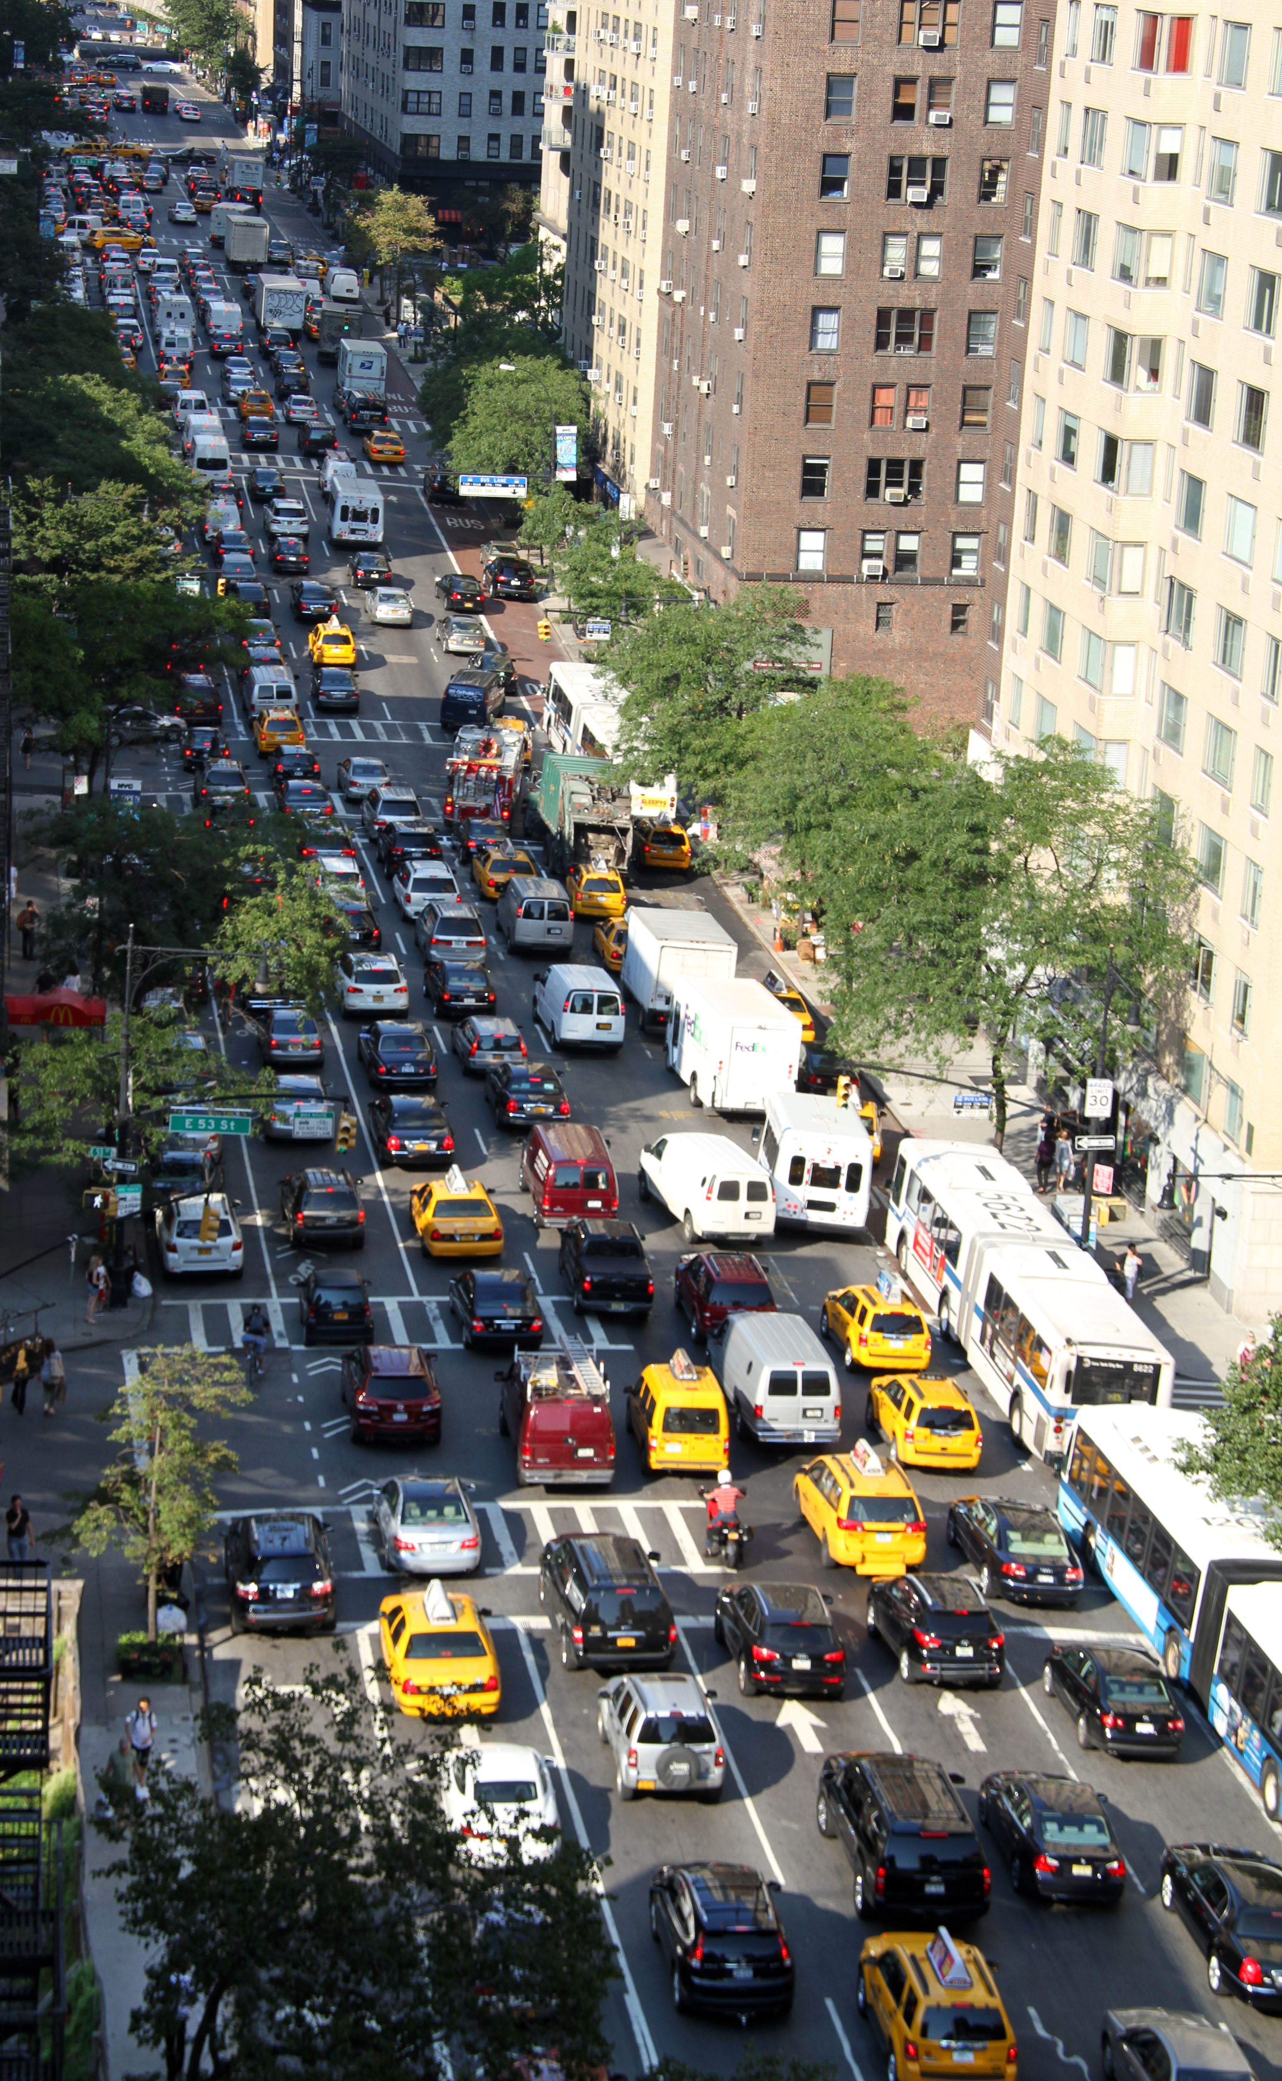
Fixed Temporal Query - Example
Notes:
Detect what happened at a specific date when traffic was very bad.

Slide 40
Fixed Temporal Query - Explanation
Space
Traffic
Day
Current
Time
Time

Slide 41
Fixed Temporal Query - Explanation
Space
Traffic
Day
Current
Time
Time

Slide 42
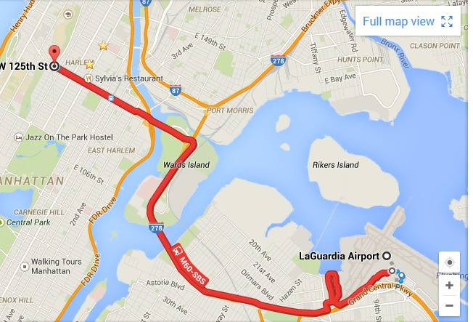
Sliding Temporal Query - Example
[IEEE TIST,2015,Wang]
Notes:
Given an origin and destination spot, predict the trip time.

Slide 43
Sliding Temporal Query - Explanation
Org(LaGuardia)
Dest(Manhattan)
Space
Current TIme
- 1 Week
Current
Time
Time
Notes:
Traffic has weekly patterns. We use last week’s data to predict traffic today. Also we need an estimation for the specific origin, destination pair. Sliding temporal queri

Slide 44
Sliding Temporal Query - Explanation
Org(LaGuardia)
Dest(Manhattan)
Space
Current Time
- 1 Week
Current
Time
Time
Notes:
As time moves on the points of interest move accordingly.

Slide 45
ARIMA for Time-Series Data
ŷ_{t} = μ + ϕ₁ y_{t-1} +…+ ϕ_{p} y_{t-p} - θ₁e_{t-1} -…- θ_{q}e_{t-q}
Generic model for making predictions for time-series data.
Trip Estimation application we saw before uses ARIMA to make the prediction. To date, it is one of the most accurate approaches for this type of prediction.
ARIMA predictions make by construction sliding temporal queries to the underlying data.
Notes:
Notice that μ, φ, and θ are parameters of the model, t corresponds to current time, y is just a variable that we observe over time (time-series data) and e is the error (actual value – predicted value ).

Slide 46
Temporal Caching
Claim : Traditional cache eviction techniques (LRU,LFU) are unable to capture the nature of Sliding Temporal Queries.
Question : Can we devise better cache eviction policies for Sliding Temporal Queries?

Slide 47
LFU – Counting References
28 Jan 2017
6-7AM
RC:0
RC:0
RC:0
21 Jan 2017
6-7AM
21 Jan 2017
7-8AM
21 Jan 2017
8-9AM
Notes:
Example to justify our claim. Let us assume that we are using a sliding temporal query that accesses last week’s files at the same hour slot.

Slide 48
LFU – Counting References
28 Jan 2017
6-7AM
RC:0
RC:0
RC:0
21 Jan 2017
6-7AM
21 Jan 2017
7-8AM
21 Jan 2017
8-9AM

Slide 49
LFU – Counting References
28 Jan 2017
6-7AM
RC:1
RC:0
RC:0
21 Jan 2017
6-7AM
21 Jan 2017
7-8AM
21 Jan 2017
8-9AM

Slide 50
LFU – Counting References
28 Jan 2017
6-7AM
RC:1
RC:0
RC:0
21 Jan 2017
6-7AM
21 Jan 2017
7-8AM
21 Jan 2017
8-9AM

Slide 51
LFU – Counting References
28 Jan 2017
7-8AM
RC:1
RC:0
RC:0
21 Jan 2017
6-7AM
21 Jan 2017
7-8AM
21 Jan 2017
8-9AM

Slide 52
LFU – Counting References
28 Jan 2017
7-8AM
RC:1
RC:0
RC:0
21 Jan 2017
6-7AM
21 Jan 2017
7-8AM
21 Jan 2017
8-9AM

Slide 53
LFU – Counting References
28 Jan 2017
7-8AM
RC:1
RC:1
RC:0
21 Jan 2017
6-7AM
21 Jan 2017
7-8AM
21 Jan 2017
8-9AM

Slide 54
LFU – Counting References
28 Jan 2017
8-9AM
RC:1
RC:1
RC:0
21 Jan 2017
6-7AM
21 Jan 2017
7-8AM
21 Jan 2017
8-9AM

Slide 55
LFU – Counting References
28 Jan 2017
8-9AM
RC:1
RC:1
RC:0
21 Jan 2017
6-7AM
21 Jan 2017
7-8AM
21 Jan 2017
8-9AM

Slide 56
LFU – Counting References
28 Jan 2017
8-9AM
RC:1
RC:1
RC:1
21 Jan 2017
6-7AM
21 Jan 2017
7-8AM
21 Jan 2017
8-9AM
Notes:
Not a particular indication about what is the nature of the query, Does not favor any particular object. The objects that are going to be accessed have 0 references.

Slide 57
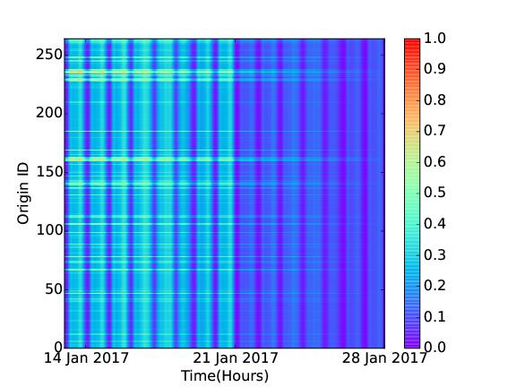
LFU – Sliding Temporal Queries
We calculate:
$$rr(rid,wt)= \frac{rc(rid,wt)}{nrQueries}$$
We normalize:
$$nrr\left(rid,wt\right)=$$
$$\frac{rr(rid,wt)}{\max_{rid^{′},wt′}\{rr(rid^{′},wt^{′})\}}$$
Notes:
Data to justify our claim. We use the trip prediction application queries as case study. The red area is going to be accessed heavily in the upcoming 4 hours but LFU does not rank this data particularly high.
Reference Ratio is Reference count divided by number of queries.
We normalize the results such that the maximum ratio is 1.

Slide 58
Count References in Relative Timeline
Pin current time as a constant time point (no shift).
Sliding temporal queries will access data that is identified by constant time now. For our previous example we would access data at time:
Current Time – 1 Week
no matter when we make the query.
Effectively, sliding temporal queries look like fixed queries for the relative timeline now.

Slide 59
Counting References on Relative Timeline
28 Jan 2017
6-7AM
curTime
-1 week
+1 hour
curTime
-1 week
+2 hour
curTime
-1 week
RC:0
RC:0
RC:0
21 Jan 2017
6-7AM
21 Jan 2017
7-8AM
21 Jan 2017
8-9AM

Slide 60
Counting References on Relative Timeline
28 Jan 2017
6-7AM
curTime
-1 week
+1 hour
curTime
-1 week
+2 hour
curTime
-1 week
RC:0
RC:0
RC:0
21 Jan 2017
6-7AM
21 Jan 2017
7-8AM
21 Jan 2017
8-9AM

Slide 61
Counting References on Relative Timeline
28 Jan 2017
6-7AM
curTime
-1 week
+1 hour
curTime
-1 week
+2 hour
curTime
-1 week
RC:1
RC:0
RC:0
21 Jan 2017
6-7AM
21 Jan 2017
7-8AM
21 Jan 2017
8-9AM

Slide 62
Counting References on Relative Timeline
28 Jan 2017
7-8AM
curTime
-1 week
+1 hour
curTime
-1 week
+2 hour
curTime
-1 week
RC:1
RC:0
RC:0
21 Jan 2017
6-7AM
21 Jan 2017
7-8AM
21 Jan 2017
8-9AM

Slide 63
Counting References on Relative Timeline
28 Jan 2017
7-8AM
curTime
-1 week
+1 hour
curTime
-1 week
+2 hour
curTime
-1 week
RC:1
RC:0
RC:0
21 Jan 2017
6-7AM
21 Jan 2017
7-8AM
21 Jan 2017
8-9AM

Slide 64
Counting References on Relative Timeline
28 Jan 2017
7-8AM
curTime
-1 week
+1 hour
curTime
-1 week
+2 hour
curTime
-1 week
RC:2
RC:0
RC:0
21 Jan 2017
6-7AM
21 Jan 2017
7-8AM
21 Jan 2017
8-9AM

Slide 65
Counting References on Relative Timeline
28 Jan 2017
8-9AM
curTime
-1 week
+1 hour
curTime
-1 week
+2 hour
curTime
-1 week
RC:2
RC:0
RC:0
21 Jan 2017
6-7AM
21 Jan 2017
7-8AM
21 Jan 2017
8-9AM

Slide 66
Counting References on Relative Timeline
28 Jan 2017
8-9AM
curTime
-1 week
+1 hour
curTime
-1 week
+2 hour
curTime
-1 week
RC:2
RC:0
RC:0
21 Jan 2017
6-7AM
21 Jan 2017
7-8AM
21 Jan 2017
8-9AM

Slide 67
Counting References on Relative Timeline
28 Jan 2017
8-9AM
curTime
-1 week
+1 hour
curTime
-1 week
+2 hour
curTime
-1 week
RC:3
RC:0
RC:0
21 Jan 2017
6-7AM
21 Jan 2017
7-8AM
21 Jan 2017
8-9AM

Slide 68
LFU on Relative Timeline – Sliding Temporal Queries
We calculate:
$$rr(rid,wt)= \frac{rc(rid,wt)}{nrQueries}$$
We normalize:
$$nrr\left(rid,wt\right)=$$
$$\frac{rr(rid,wt)}{\max_{rid^{′},wt′}\{rr(rid^{′},wt^{′})\}}$$

Slide 69
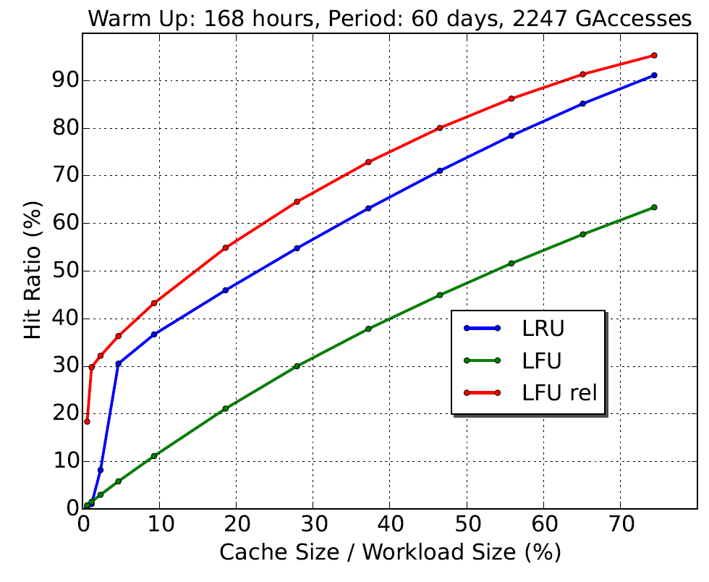
Evaluation

Slide 70
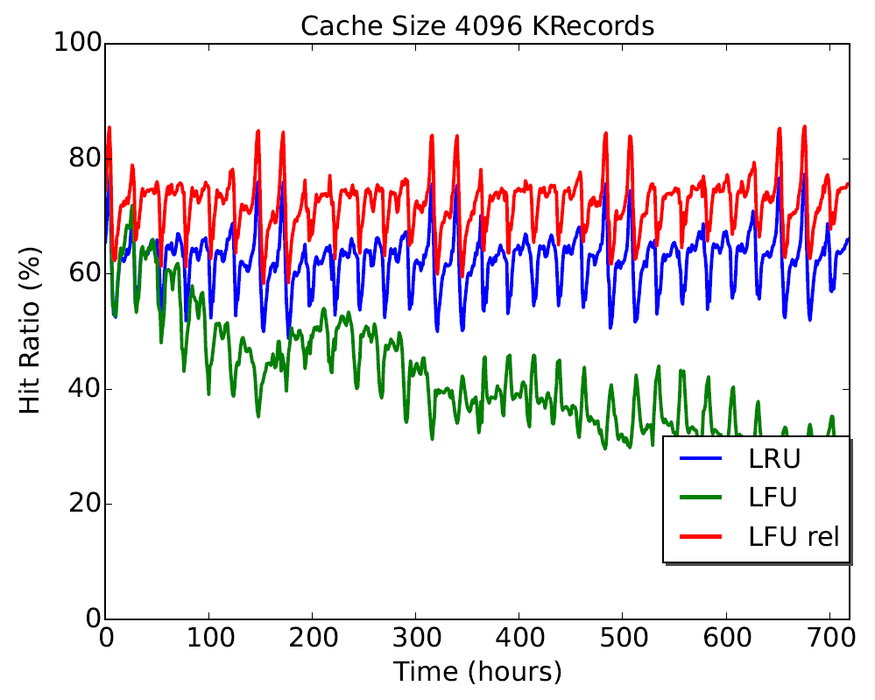
Evaluation

Slide 71
Future Work-Dataflow Cache for Time-Series Data.
O1
src
O3
sink
O2
Cache
Notes:
How to combine the two things we learned today. Still an open question.

Slide 72
Questions

