Slide 1
Lecture 1 Project Organization
Ken Birman, Theo Gkountouvas, Soham Sankaran

Slide 2
Project – IoT application
Input
Sensor Data
Data Analysis
Machine Learning/Optimization
Output
Visualization of Data
Control Actions
Recommendations
Alarms

Slide 3
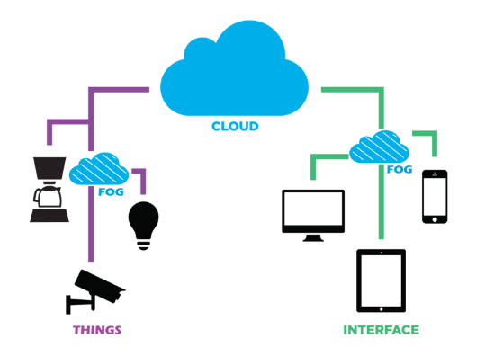
Project – IoT Architecture

Slide 4
Project – Technical Challenges
Data Collection
Integrate data from possibly multiple sources
Integrate data from third-party sources (Weather)
Data Analysis
Utilize ML/Optimization tools to analyze data.
Scalability
Scale up to million/thousands devices
Hardware on Site*
Tune devices on site to work accordingly
Cost-Effective Solutions
Notes:
Some of the challenges might differ for different projects.

Slide 5
Project Organization
Group Formation and Project Idea (February 20th)
Project Plan (March 6th)
Intermediate Report (March 27th)
Peer Reviews (April 13th)
Final Report (April 24th)
Presentation/Poster/Demo (April 25th-April 26th)
Exception might be made, since your presence is required.
Notes:
Rough timeline. Official one will be announced in CMS.

Slide 6
Project Grading
Project accounts for 50% of your total grade.
5% -> All Reports besides Final
5% -> Peer Reviews
10% -> Final Report
10% -> Poster
10% -> Presentation
10% -> Demo
+5% -> Presentation in BOOM (April 24th).
The course grade would be assigned to M.Eng. projects as well. Note that prelim matters as well.
Notes:
This is a rough points breakdown. The real breakdown might slightly differ.

Slide 7
Group Formation & Project Idea
List of group Members
Name, Net ID
If this is an M.Eng. project mention who is taking the M.Eng. credits.
Two paragraphs about the project idea.
What are you trying to achieve?
Why is it useful?
Briefly mention how you are going to do it (input data, analysis, etc.) in one paragraph.

Slide 8
Intermediate & Final Report
Should consist of the following sections:
Motivation (idea, why it is useful, etc.)
Background (what is the current state?)
CS-ANSC Innovation-Implementation
Evaluation
Conclusions

Slide 9
Projects with ANSC
Pros
Get bonus +5% for project.
Cooperate with inter-disciplinary students.
Do something impactful.
*Interact with animals.
Cons
Have a specific goal. Provide a concrete solution.
Interact with ANSC students.
Closely monitored by instructors (weekly updates).
Notes:
Same or similar project might be assigned to multiple teams.
Week meeting might be scheduled on TA hours.

Slide 10
Special Projects
Recommended for:
M.Eng. Projects
Undergrad students/groups that want to pursue Ph.D. careers
Students that want to have impact
Might differ from typical IoT projects.
Notes:
These projects include Blockchain (Yoghurt) technologies, Derecho (Weijia, Sagar, Ken), other CALS projects. These are unique projects.

Slide 11
Recitation Lectures
Lecture 2:
Lecture about ANSC
Lecture 3:
Project Recommendations
Lectures 4-14:
Project Technologies
Project Related Questions/Issues
Revisit Course Material
Notes:
Lectures 4-14 are still flexible. They can change according to students’ will.

Slide 12
Azure Accounts
Once you form groups, you will receive some Azure credits for your project.
We will have examples using Azure technologies in the next lectures.
Other Cloud vendors might be used. We will not provide funding or assistance for them.
Notes:
Other Cloud vendors have similar technologies.

