Slide 1
TRANSACTIONAL DATABASES AND Transactional Memory
Ken Birman
Spring, 2018

Slide 2
Back to our core agenda
A few weeks ago we basically set out this agenda:
Understand today’s standard cloud, with stale caches (CAP).
CAP weakens consistency, so we discussed Lamport’s → concept.
We showed how Lamport’s ideas can improve an edge file system: FFFS
We looked at evolution towards a more active edge with machine-learned models (like Facebook TAO) computed at the back but used at the edge
We saw how hardware like RDMA, SSD, and NUMA can offer speedups, but also saw that they are not trivial to use

Slide 3
But Lamport’s → is very low-level
Today, let’s wind back to the start and look at a different form of consistency
Early storage systems just were file systems, but with lots of concurrency we saw frequent data corruption bugs.
Led to the idea of transactions. What role do these have in the cloud?
Notes:
Not a lot of notes on these slides -- they are very high level.

Slide 4
A 5-lecture Roadmap!
Lecture 1: Transactions
Lecture 3: Transactions on DHTs
Lecture 3: Transactions on DHTs
Lecture 2: DHTs
Lecture 2: DHTs
Lecture 4: FaRM RDMA DHT
Lecture 5: HeRD and FASST
(Old topic) RDMA
(Old topic) RDMA

Slide 5
Transactions as a Database Concept
Our first subtopic

Slide 6
Concept: A “transaction”
Jim Gray was a pioneer in the community that invented the transactional model
A transaction is a sequence of operations that access data (e.g. by reading and writing database records, or variables in memory).
It typically has a begin and commit point, and may support abort.
Commit: Retains the changes to databases or variables.
Abort: Rolls back to the initial state, as if the transaction never ran. Some models allow explicit abort requests, some don’t

Slide 7
The ACID properties
One common way to explain transactions is to say that they offer
Atomicity: Executes to commit, or rolls back (aborts).
Consistency: Database respects invariants after commit.
Isolation: Even if transactions run concurrently, no interference occurs.
Durability: A committed update won’t later be lost.
People first explored this concept during the 1960s.

Slide 8
The ACID properties
ACID was a huge success in the early days.
It gave us the basis for modern relational databases and OLTP systems (a whole course, and I can’t teach you all of that, so I won’t try!)
In the early cloud, pre-2005, we tended to see a three tier database structure:
Tier one: Receives web page request, builds page by issuing queries
Tier two: Scalable interface to the database system itself.
Back-end: The database system, often a high-end SQL Server or Oracle machine.
But at cloud-scale ACID promises more than it delivers… Problems emerged

Slide 9
Today’s Lecture
Look at transactions from a mile high.
Core idea is simple enough to easily explain.
When building cloud apps we often have this model in mind, and often use some aspects of it.
But we will also see that several attempts to just apply the model as-is to the cloud failed, and we’ll touch on the reasons.

Slide 10
Serializability
R:w
R:z
W:x
z = x + y;
y += x;
x = z-y;
w = 2*w+x=1;
R:w
R:z
W:y
Read x
Read y
z = x+y
R:x
R:y
W:z
R:x
R:y
W:z
Serializability: Consider a set of (committed) transactions.
Define a serial execution to be the result of executing those transactions one by one, as if each happened to run at a time (in an idle system).
A transactional execution is serializable if it runs concurrently and yet leaves a result indistinguishable from some possible serial execution.
… in effect, we can’t tell that the execution was concurrent. … If you ask “is it serializable” while transactions are active, you just roll back any active transactions, and consider only committed ones.
Notes:
In the textbook I show how these examples can be reduced to a math notation.

Slide 11
Serializability
Serializable transactions are a simple way to think about concurrency.
You write transactional code to maintain correctness, assuming:
Data was in a correct state when your transaction started
No other transactions were running at the time
… the runtime system will compile your code to be correct and will run it in a way that maximizes actual concurrency, yet hides any “issues”!

Slide 12
Commercial importance
Transactions are universally supported in
Transaction processing systems (OLTP). These typically make updates to files containing business data, but the underlying data might not be tabular
Relational databases. These use a table structure (relation) and have a schema that connects the relations into a single large database. They may also enforce consistency invariants, have virtual relations, etc.
We previously mentioned SQL: this is the most widely used set of operators for accessing relational databases.
Modern languages like C#/.NET and Java have language-embedded SQL support and ways to connect the program to external databases

Slide 13
Implementation
Generally, by read/write locking.
The transaction just locks the things it accesses to ensure that no other transaction can modify them while your transaction is running.
Must be careful to avoid deadlock.
The main alternative is for the platform to track “versions” of data and make sure the versions a transaction reads and writes are serializable.

Slide 14
Locking: Example
Thread
Lock and read X
Lock Set: {X}
{X,Y}
{X,Y,Z} (released)
Lock and read Y
Compute for a while
Lock and write Z
This illustrates “two phase locking”
Acquisition phase: To access a data object, the transaction should get a read lock if you will only read it, and a write lock if your code might update it.
Release phase: Locks are held until the transaction reaches the commit/abort, then released as a group.
If a deadlock occurs, the transaction aborts, then can retry after a short delay.
Commits

Slide 15
Deadlock Example
A B
Lock X... Y... Wants Z…
Locks Z…
Locks Z…
Wants X…
Thread A locks X and Y, then needs a write lock on Z. Z is locked by B.
Now, thread B requests a write lock on X.
Thus A is waiting for B, and B is waiting for A. Deadlock!
Arises only with transactions that update at least some of variables.
Does not arise if all transactions acquire locks in some agreed order!

Slide 16
Ordered Locking: Deadlock Free
Consider our example: A had a lock on X and wanted a lock on Z, but B had a lock on Z and was asking for a lock on X.
So one thread locked in order X…Z and the other in order Z…X
You can prove that all deadlocks involve wait cycles, and that cyclic wait implies that some thread must have locked “out of order”. Hence if we can agree on a locking order and respect it, transactions never deadlock!
Notes:
The proof is in the textbook, if you would like to see it.

Slide 17
Commit… local case
If a transaction is running at a single location, we need to keep a copy of the original version of any data it modified.
At the commit point, we can discard that set of copies. If it aborts, to roll back, we simply rewrite the old data back into place.
For data stored on disk, this requires a log of the old values.
We call it a write-ahead log. The commit/abort decision is also logged.
The log has either old values, or proposed changes.
Programs write to the log, then flush, then make the changes, then discard the log. If a crash occurs, the procedure repeats after restart.
Notes:
Again, this is very detailed in the textbook chapter on transactions.

Slide 18
Commit: Distributed Case
We use a protocol called “2-phase commit”
Leader
{
Are you able to commit txn 12334?
DHT nodes it modified
Phase 1
{
Yes… Yes… Yes…
12334:commit
Phase 2
Commit changes and release locks
Log of transaction outcomes

Slide 19
Observations
With this simple scheme, serializability is guaranteed (easily to prove).
But performance turns out to be poor at cloud-scale.
The dangers of replication and a solution. Gray, Helland, O'Neil, Shasha. Proceedings of ACM SIGMOD, 2006: 25, 2 (June 1996), 173-182.
The paper shows that if concurrent transactions do conflicting updates, deadlock, livelock and rollback are major issues. Databases will slow down as a factor of N^5, where N is the number of machines.
One of the most important papers about databases ever written.
Notes:
Jim’s paper is fantastic. It all comes down to having multiple leader programs that try to do updates but keep banging into each other due to accessing the same variables and locks. This triggers long delays and sometimes causes aborts. Without doing something to prevent this risk, Jim argues, it will flare up for sure.

Slide 20
Rescuing the model
Transactions are simple to use. Can we make them work?

Slide 21
Business Transactions (OLTP)…
An early idea for transactions in the cloud was to build “chains” of smaller mini-transactions, with some form of “undo” sequence if one of the transactions happens to abort. Originally called “transaction sagas”.
Today, these are called “business transactions” and web-oriented OLTP platforms typically support them.
Undo A
Undo B
Undo C
Do A
Do B
Do C

Slide 22
Business Transactions: Benefits
By splitting a large transaction into lots of smaller steps, which run separately, we reduce the length of time when locks are held and the chance of conflicts.
We might now be able to “shard” the database by hashing data items into distinct servers, and run mini-transactions on each shard, separately.
Or we can break large databases into multiple μServices

Slide 23
BASe concept
BASE was a method of turning true transactions into a form of business transactions and originated at eBay and Amazon.
You start with a normal transaction, but remove the “begin” and “commit” and then basically try to fix the problems that arise. “Basically Available, Soft-State oriented, but with Eventual Consistency”.
If you have good support for business transactions, it can work.

Slide 24
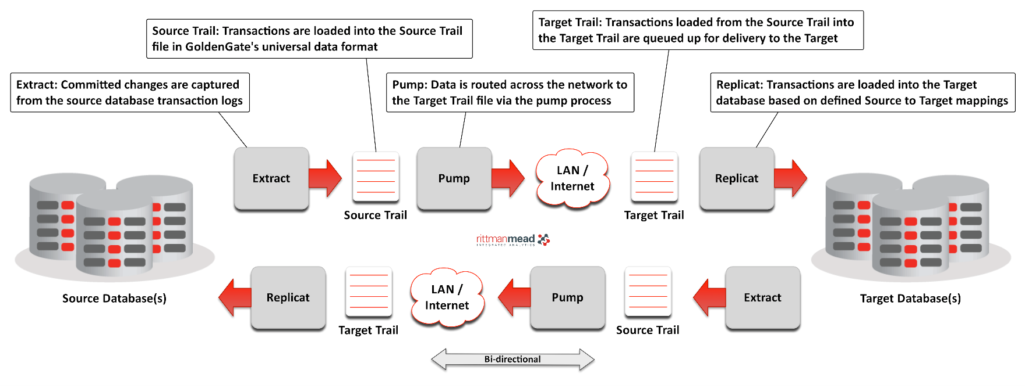
Professional solutions become quite elaborate

Slide 25
Business transactions: Known issues
Suppose that A books your flight from Ithaca to Detroit on Delta
Transaction B books your flight from Detroit to Bangalore on Air India, grabbing the last discounted seat in the coach class.
And Transaction C reserves the hotel for your job interview in “Technology City”
Transaction C fails, because the hotel is fully booked.
But meanwhile, someone else was denied a coach seat on the Air India flight.

Slide 26
How would “true” transactions differ?
That second transaction (the other person) would have waited.
When your transaction aborted because of the hotel issue, the other person would have received the discounted coach seat.
So in this situation, true transactions do behave differently.

Slide 27
Would “true” transactions be better?
… many business transaction systems can cope with minor issues like these.
Tradeoff is similar to CAP:
Do you prefer a “stronger” form of consistency/correctness? … Knowing that it will harm performance … and that the problem domain has inherent limitations in any case?
Most developers opt for better OLTP performance and scalability!

Slide 28
Forking off Transactions
A related idea: what about “launching” a transaction from inside some other transaction? One could perhaps use a similar “undo” strategy?
Like forking a thread, but this forks a mini-business-transaction.
This was explored in a research system called Argus
If the parent transaction aborts the child is an “invalidated” context
In effect, the child glimpsed a future timeline that won’t actually occur.
The inconsistency might easily send it into an infinite loop
Notes:
The next slides show various ideas people proposed. None of them work.
With forked off transactions you launch little programs from INSIDE a transaction and send them out to do stuff in the external lock scope. Seemed like a good idea at the time, to the inventors.

Slide 29
Movie version
Child thinks that its Mom and Dad met on prom night and fell in love
But in the actual world, the Mom and Dad meeting doesn’t occur after all because of some kind of glitch.
So child, technically, will not be born…
Business transaction terminology:
The child must be terminated
Notes:
Nope, it was a very bad idea. Child termination seems kind of cruel… plus it was super expensive. And those child transactions could have had children too…

Slide 30
The rescue isn’t going well
Nothing seems to work!

Slide 31
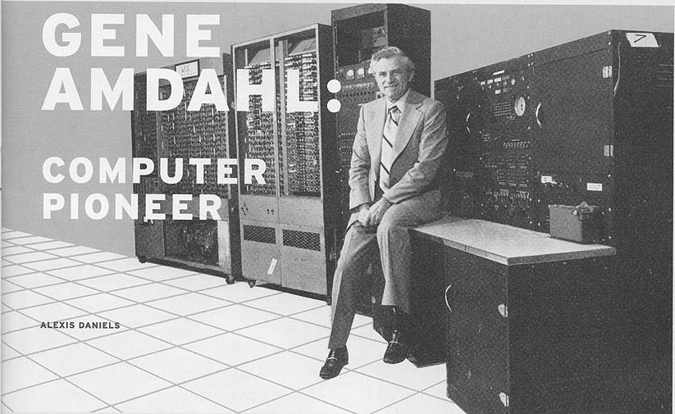
Observations
In our last lecture we saw that locking can already harm performance. We are seeing a second instance of that, in distributed transactions.
But there is also a secondary issue involving loss of concurrency.
While thread A is waiting for thread B to finish some action, A isn’t active. So we have a new kind of critical path that “spans” from A to B.
Amdahl's law: The maximum speedup of a parallel program will be limited by the sequential length of its critical path.
Long transactions can eliminate the benefit of concurrency.

Slide 32
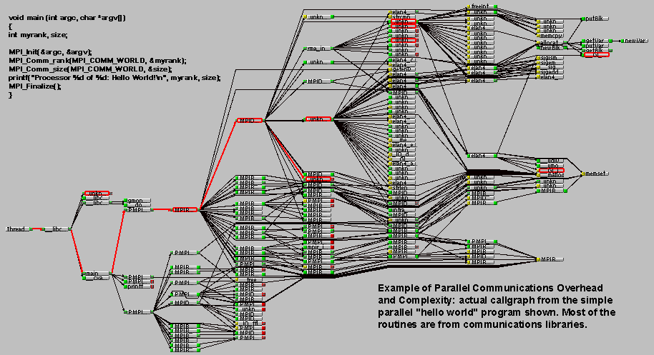
Amdahl’s Law in Action
Critical Path highlighted

Slide 33
Transactions: Summary
They have value in the cloud, but must be used with enormous care.
We generally can’t treat the whole cloud as a big transactional system.
This was the core insight gained back in 2005, when the big database products hit their limits.
In fact, Eric Brewer’s CAP theorem was really trying to make this point!

Slide 34
Snapshot Isolation
A CAP-like idea for read-only transactions

Slide 35
CAP “Destroys” transactional consistency
We can’t use CAP with transactions: inconsistent caching ruins consistency.
But one idea is to have the cache itself understand transactional model.
This leads to a concept of a cache using snapshot isolation.
Notes:
This is a way to hack the caching mechanism by storing multiple versions and run read-only transactions on the cached read-only versions.
It works pretty well, actually.

Slide 36
Snapshot Isolation on one slide
Basically, the cache tracks “version history” of data items and each new read sees a version that makes sense given the previous reads and the versions they saw.
Like a photo montage, where the photos really do fit together
Each read-only transaction “sees” versions that co-existed in time.
Enables read-only applications on first-tier servers to run fully from cache, with very high performance.

Slide 37
Snapshot isolation in one picture
Begin Read X; Read Y; Read Z; Commit
X = 5
X = 10
X = 3
X = 37
X
Y
Z
Y = -1
Y = 73
Y = 415
Z = 2
Z = 3
Z = 0
Z = 1
The cache actually has many versions of X, Y and Z. But once the first read happens to see X=3, the options for Y and Z are constrained.

Slide 38
Look familiar?
This is a variation on the Chandy/Lamport idea of a consistent snapshot!
The specific way of doing it is actually almost exactly how Freeze Frame File System decides what data to return if a user reads from several objects at the “same time”, and they were being updated so rapidly that even at the same time, there are multiple eligible versions.
Snapshot isolation is very powerful, and rather easy to implement.

Slide 39
Snapshot Isolation “versus” CAP
CAP is used with non-transactional data like images. It works well.
For transactional content, people split their applications into subsystems, break big databases into sharded ones, end up with graphs of mini-transactions and a supervisory control structure: Business transactions.
For this setting, snapshot isolation offers a way to do caching without breaking the underlying mechanisms.
Notes:
So this is a way to evade CAP. But it was never a real theorem in any case.

Slide 40
Transactions as a programming tool in Java or similar languages
Using transactions inside a normal program

Slide 41
Transactions as a programming tool
There have also been several ideas for moving transactions directly into programming languages.
If we had time, we would look at Microsoft’s LINQ for .NET. This embeds database queries directly into C#
But today we won’t look at that, and will finish up on a different way of using transactions as a programming tool in Java.
Notes:
Short summary: the PL people hoped to trick us into using transactions without noticing. But it didn’t work out, either.

Slide 42
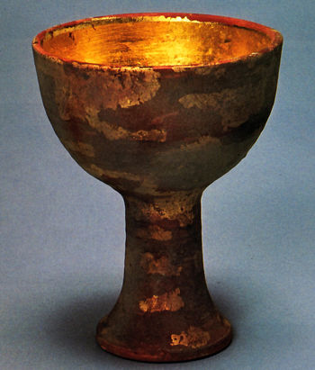
Transactional Memory
Holy Grail.
Starting with a famous paper by Moss and Herlihy in 1993, the research community has been pursuing a form of “holy grail”
They were inspired by an even earlier proposal by Tony Hoare
He called it “monitors” and modern object-oriented synchronization is based on it
The idea is to create a new model for method invocations that automatically handles concurrency. They called it transactional memory and targeted NUMA machines
The goal is to create a class of objects in which transactional atomicity is built into the execution model

Slide 43
Standard Object oriented programming style
class Cube { int length = 10; int breadth = 10; int height = 10; public static int numOfCubes = 0; public static int getNoOfCubes() { return numOfCubes; } public Cube() { numOfCubes++; } public finalize() { numOfCubes--; } }
Unsafe with concurrent callers: this code could “lose” Cubes

Slide 44
With Transactional Memory
Adding atomic makes the class safe with no other changes!
atomic class Cube { int length = 10; int breadth = 10; int height = 10; public static int numOfCubes = 0; public static int getNoOfCubes() { return numOfCubes; } public Cube() { numOfCubes++; } public finalize() { numOfCubes--; } }
Notes:
So the idea was very elegant. For NUMA multicore programmers it seemed ideal.
On the other hand, we know now about memory coherence costs, locks, DRAM locations… “atomic” doesn’t say anything about that stuff.
Those costs were what killed this concept.

Slide 45
Guarantees of Transactional Memory
The compiler must generate the needed synchronization logic
The execution “looks” as if deadlock-free locking had been employed
The transactional concept can be hidden or exposed in limited ways
For example, many variants include some form of “abort return”
Others automatically do an “abort” if a method throws an exception.

Slide 46
How they Proposed to implement this
Suggested a modification to the memory-management hardware
It would tell the compiler which memory pages (or even cache lines) had been read, and written, by the module
Given this data, there are algorithms for deciding whether to allow a transaction to commit, or forcing it to abort.
If compiler estimates that code will execute quickly enough, locking can be completely eliminated!

Slide 47
Some complications
It turned out that the hardware isn’t so easy to support, and major chip vendors (after trying hard) stopped offering it.
Compiler community came up with software ways to approximate the behavior of the hardware: Software Transactional Memory, or STM.
STM can be used on any standard platform with no special hardware
Best versions use hardware if available, switch to compiled logic if not
This became a “hot topic” for the programming languages community

Slide 48
More Complications
What if methods are recursive, or modules issue calls to one-another?
Not very transparent to just rule that out.
So the compilation community explored a model called “nested” atomicity
If A is a transactional scope, and performs atomic operation B…
… then when B commits, the updates become part of A’s context, and if B aborts, we revert to the context A was in when it performed B.

Slide 49
More complications
What if A forks off a thread?
Is the entire thread a part of transaction A?
Or should the thread be viewed as a “top level” activity, in which case issues of child transactions reappear.
This was never really resolved in a satisfactory way

Slide 50
More complications
Not every atomic method will turn out to run quickly
Locking is much better in such cases: long transactions are far more likely to have conflicts with other transactions, forcing one or both to abort.
One idea: a program can “learn” as it runs: if abort rate seems a bit too high, switch from optimistic mode to locking mode.
But it can be very hard to come up with an ordered locking policy.
And without ordering on locks, deadlocks will be an issue.
Notes:
Summary: it worked. But it was

Slide 51
More complications
Recall our discussion of NUMA memory management and L2 cache issues
How will atomic methods avoid accidentally triggering very slow execution as a consequence of true sharing, coherent locking, or “false” sharing?
Compiler people tried very hard to find solutions
None were really portable enough to work on a full range of NUMA hardware, and many were very costly

Slide 52
Wrap Up
What we’ve learned today

Slide 53
Summary and Take-AWay
Transactional atomicity is a well understood, mature technology. It is the topic for entire courses; we only mention it because it is “part” of many cloud systems.
Today’s cloud uses transactional ideas in many situations:
In databases, even distributed ones with data spread over many computers.
Via snapshot isolation, in caching for read-only tier one/two services
In memory updates when threads run concurrently in one program.
Basic concept and tools are available on every platform, and even embedded into programming languages (like the .NET LINQ feature)

Slide 54
A powerful tool!
When they fit the use case, transactions are like magic!
You write concurrent code, but pretend that it will run without any concurrency, in isolation.
The model enforces this “pretense” for you, using locking. But the one gotcha is that sometimes the locking costs become prohibitive.

Slide 55
Summary and Take-AWay
Transactions turn out to work best when we can convince ourselves that the overheads won’t soar, and when users can “visualize” the costly steps.
When people have turned to transactions as a magic wand (as in the work on transactional memory models for Java), the costs often got out of control because programmers couldn’t predict the overheads.
Those uses of transactions have generally been less successful.

