Slide 1
Moving Machine Learning to the Edge
Ken Birman
Spring, 2018

Slide 2
Recap of Lecture 4
Even smart sensors can’t really be all that smart…

Slide 3
Our main question
Existing cloud models shield the back-end by having a massively scaled first-tier that handles most requests instantly, using cached data
The second tier subsystems hold this data, and include scalable DHTs
But by the time the second tier gets updates, a long time has elapsed!
(seconds to minutes are common, and even hours in some situations)
CAP + BASE “teach” that this is hard to avoid, so we should embrace it.

Slide 4
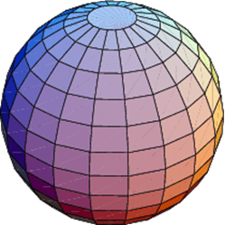
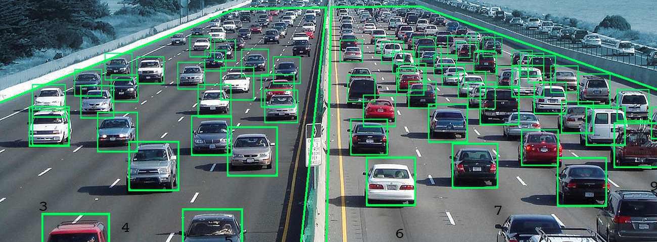
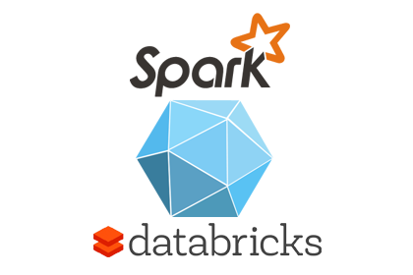
BUT Delays are too large for Fog Apps
Cloud File System
Cloud File System
Delay: Seconds
Delay: Milliseconds
Cloud File System
Cloud File System
Cloud File System
Cloud File System
Cloud File System
Cloud File System
Cloud File System
Cloud File System
First tier reacts using stale data
Data appended to files
Delay: Minutes-Hours
Tier 2 Services
Tier 2 Services
Delay: Many minutes or even hours
Tier 2 Services
Tier 2 Services
Tier 2 Services
Files
Machine-Learned Knowledge Models
Databases
Data Analytics (Parallel Processing)

Slide 5
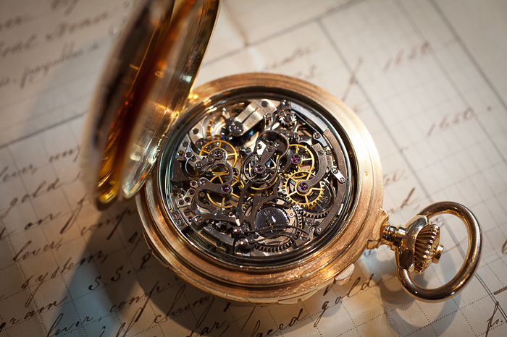
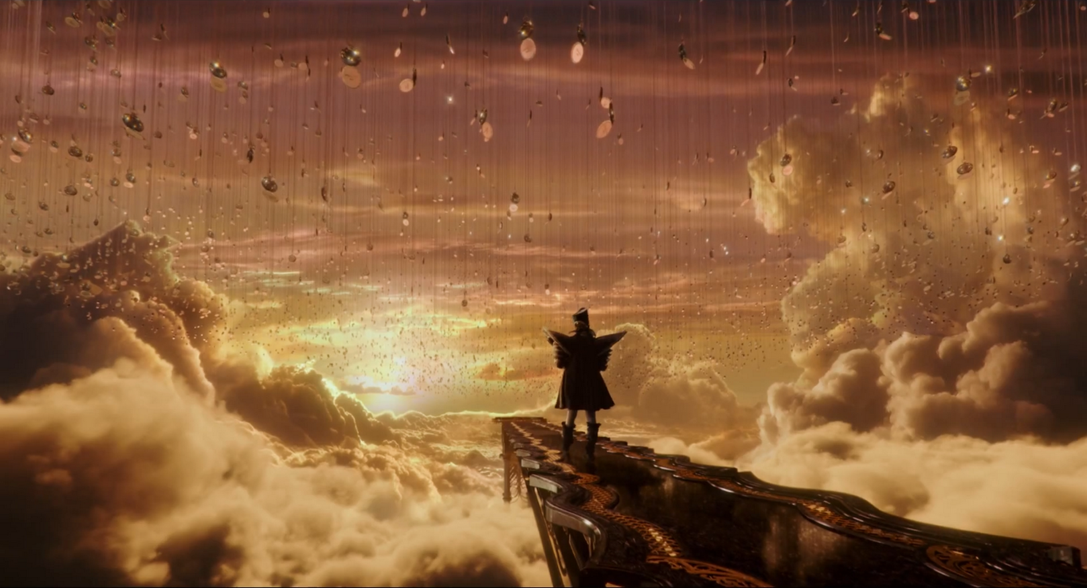
What we learned in Lectures 3, 4
We focused on better understanding of time
Lamport helped us understand what ordering and “causality” mean
FFFS was an example of a system that used Lamport’s ideas.
… with it, you can capture data that has time in the sensor records … and you can “surf in time” efficiently and rapidly
But even if we had FFFS in tier 2, we wouldn’t have a complete fog story. Where would the AI/ML live?

Slide 6
Back-end: Why is it slow?
There are many styles of back-end systems
The most famous ones are build from MapReduce/Hadoop and run on a subsystem called Spark. These are used for data reduction and analytics, and to train machine-learning models. Each batch can compute for minutes or longer.
A second class of back-end systems are seen in vision and image processing applications, such as Facebook’s Haystack

Slide 7
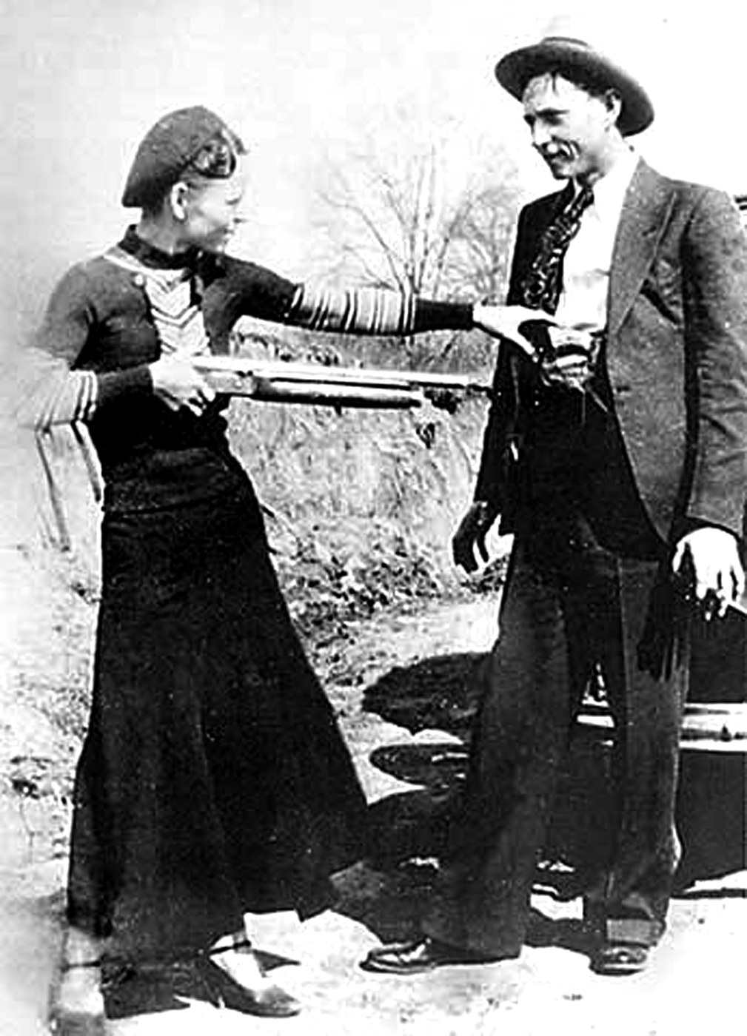
Microsoft Cosmos
Primary
Backup
Each layer is a specialist for certain tasks
Microsoft Cosmos is a “documented” example of such a back-end system (they have talked about it in conferences and white papers)
A huge compute system with half a million nodes
Objects arrive with recipes:
Compress this image, yielding img-1234.zip. Make a backup.
Edge-extract and segment the image, yielding img-1234.segs + replica
Tag the content, yielding img-1234.tags + replica
Notes:
Cosmos is a typical data processing “pipeline” spread over a half million computers. Microsoft Azure uses it for photo processing. Facebook and Google do similar stuff.
You can read about it through online materials but that’s not the point. We want you to understand the idea of a processing pipeline such as this.
Also, keep in mind that beyond processing, these computed artifacts may need to be stored for a while. Cosmos is a form of smart memory: it is able to take something like an image, figure out what is in the image (terms like segmentation, tagging, cross-image correlation… machine learning concepts), then store the computed information. The “memory” is the collection of file storage units (remember how GFS systems spread data over lots of computers – this is just the same, but with more than we talked about in the GFS slides). The smartness is the AI code used for these transformations, but in fact the code may be kind of dumb just the same. It basically takes some parameters (the fancy term is “machine learned model”. The dumb term is “matrix with numbers in it”), runs a task (fancy: “classifier”. Dumb: “function that outputs something”), then perhaps forwards the result, perhaps stores it.
So Cosmos is a smart memory. A data concentrator might want to use it. Cosmos might benefit from using FFFS for data with time in it, since FFFS improves accuracy.

Slide 8
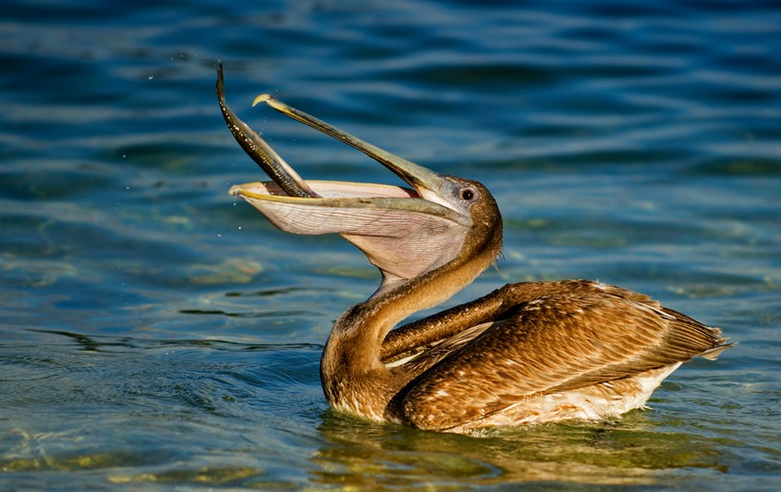
We end up with a pipeline, for each task
Cosmos doubles as a storage server, until data is offloaded to a back-end store they call Pelican (“shingled” storage)
For reliability, objects are stored in duplicate (but objects can also be recomputed from an upstream input if needed, so two replicas suffice except for “important” things that would also be slow to regenerate.)
Sometimes, a downstream artifact generates a new pipeline of tasks: we tag an image but the tagging connects us to other recipes…
Each “layer” of Cosmos is specialized in different tasks

Slide 9
Test Your understanding
Why is everything replicated?
Does it always suffice to have one primary and one replica?
Can selection of primary and backup machines be totally randomized?
Why have layers? Can’t every machine in every layer do every task?
Why not duplicate the computation too, and not just the data?
Right now, Cosmos selects a primary machine for each task, and it computes whatever is needed, then it makes one or more replicas.
Notes:
Remember James Hamilton and the three R’s?

Slide 10
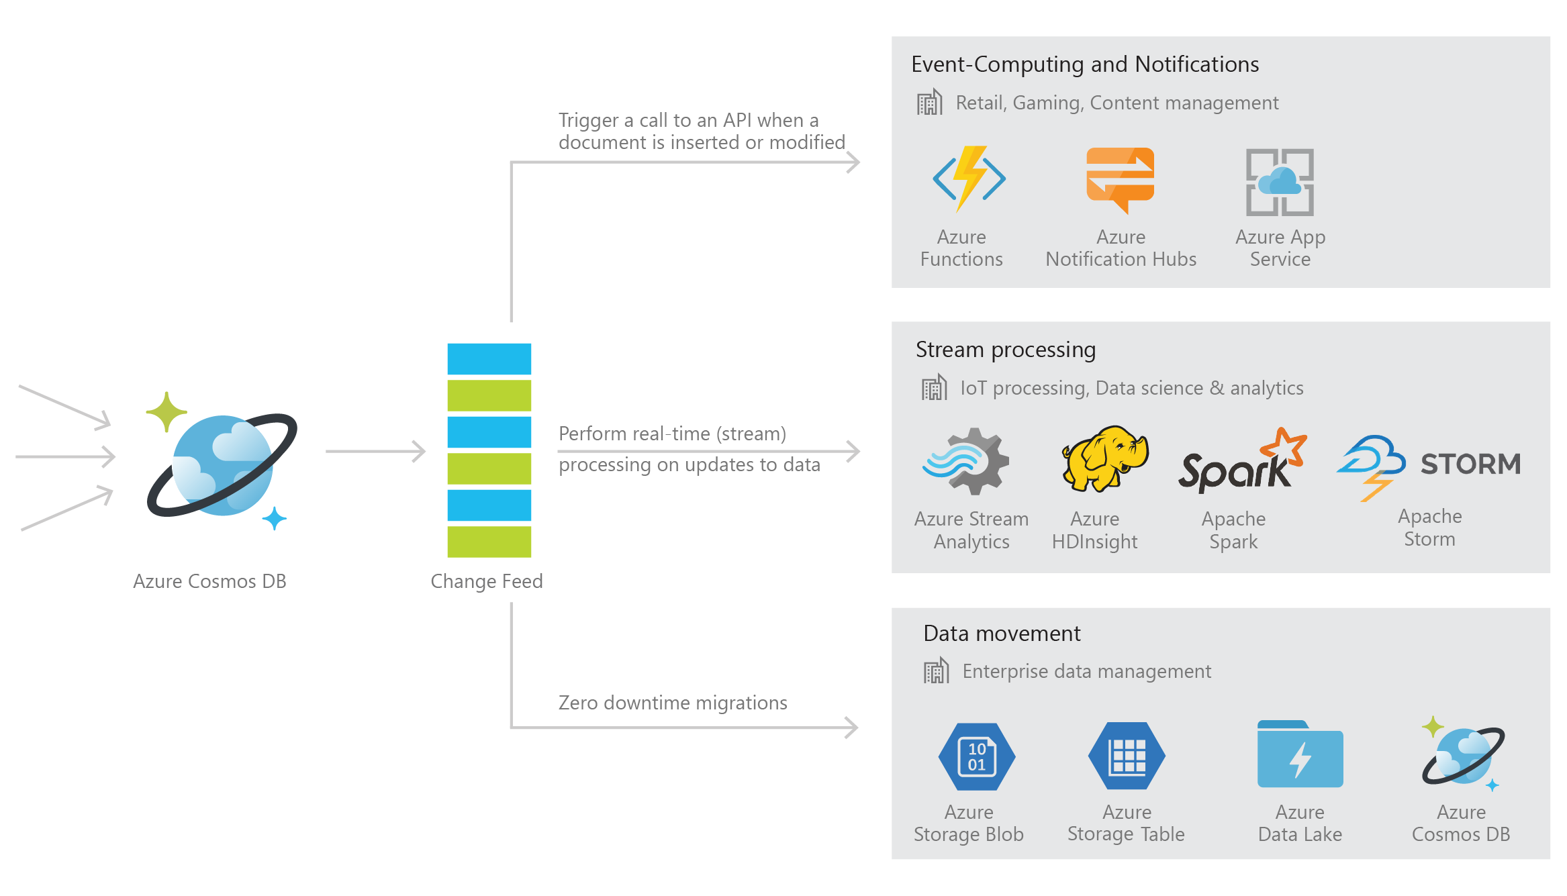
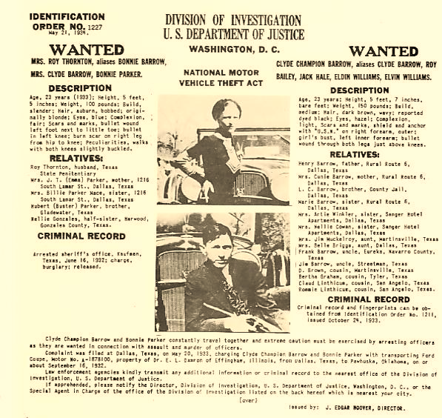
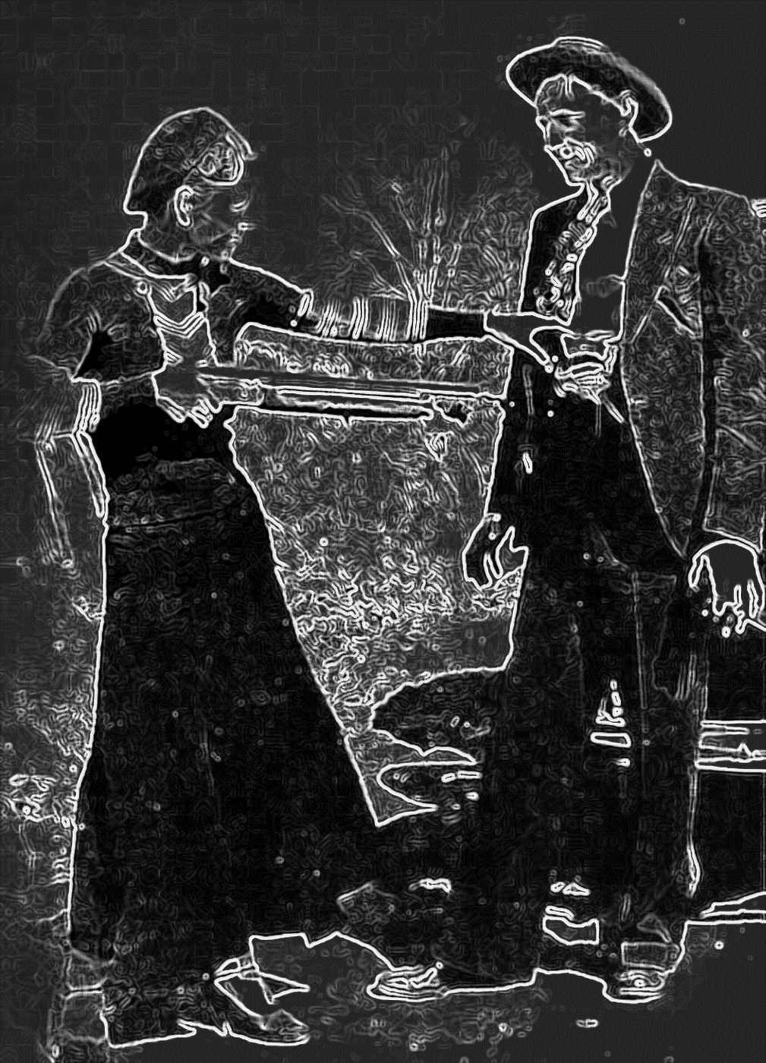
We end up with a pipeline, for each task
Aunt Bonnie
. . .
Do your uncle and aunt match those wanted criminals?
Uncle Clyde
Capture, compress image
Edge extract and segment image
Tag content
Tag lets us look up other recipes. This is an old FBI most-wanted poster
Azure Cosmos DB Product
Notes:
And guess what: Cosmos is an actual service you can use. One of hundreds of microservices on Azure. They charge for some; others are free.

Slide 11
We can’t speed the backend up!
This is a real problem
The backend isn’t slow because it was designed poorly, although there are definitely opportunities for improvement.
It is slow because the tasks are hard and operate on immense data sets.
Notes:
The backend is where they created that fancy machine learned model.
The ways of doing this just take time, often many minutes, sometimes hours.

Slide 12
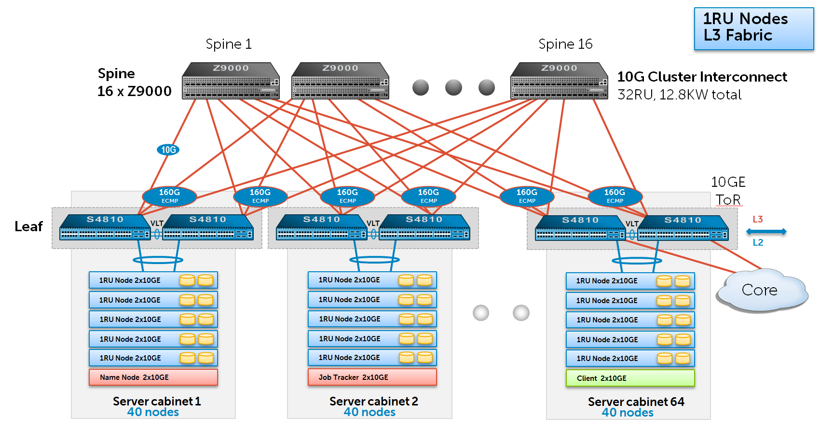
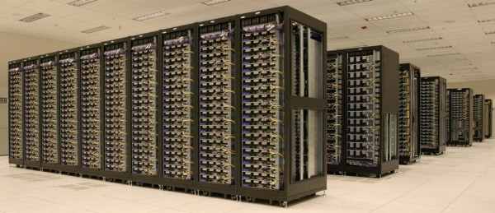
Today: a very “long” pipeline
Data acquisition…. Global File System… Hadoop jobs
GFS
Machine learning typically lives here, at the back
Delay: milliseconds… Seconds…. Hours

Slide 13
New: Move Some ML tasks to the edge
Data acquisition…. Global File System… Hadoop jobs
ML was at the back
We create a smart data concentrator tier and it runs here, at the edge of the datacenter
GFS
Machine learning typically lives here, at the back
Delay: milliseconds… Seconds…. Hours
Delay: milliseconds…
Notes:
Best bet: refactor. Split off some ML tasks (just some) and move them up front. Leave others in back where they are slow to access and slow to run, but we don’t need to recode them.
Minimal recoding is the way to keep everyone happy…

Slide 14
New: Move Some ML tasks to the edge
Data acquisition…. Global File System… Hadoop jobs
Split the ML in half. Leave some at the back
We create a smart data concentrator tier and it runs here, at the edge of the datacenter
GFS
Machine learning typically lives here, at the back
Delay: milliseconds… Seconds…. Hours
Delay: milliseconds…

Slide 15
Why just “some” tasks?
The key idea is to leave most of the backend alone.
This preserves the huge investment in backend software
Nobody wants to rewrite all of that.
But we’ll factor out just some specific elements, and move those to the front
Namely, aspects that have to be instantly reactive
Leads to the idea of brilliant sensors controlled by concentrators

Slide 16
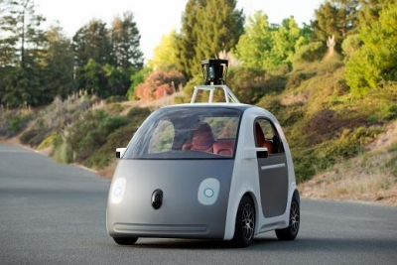
Cloud-hosted Data Concentrator
What if we move to a model in which each sensor has a cloud-hosted manager that lives in the cloud and does things on its behalf?
The “manager” role is sometimes called a “concentrator” or “aggregator” because one of these cloud services could handle many sensors
Back-End
Tier-1 Concentrator
Notes:
So we have part of our picture now. This concentrator thing? It probably lives on the edge, has a u-service similar to Cosmos+FFFS available to it, handles real-time tasks. The stuff the backend can handle still gets sent back there. We don’t expect instant responses from the back.

Slide 17
New FOG-Capable Cloud Model
Cloud File System
Cloud File System
Delay: Seconds
Delay: Milliseconds
Cloud File System
Cloud File System
Cloud File System
Cloud File System
Cloud File System
Cloud File System
Cloud File System
Cloud File System
Back end is still slow, but now it isn’t under such time pressure
Smart data concentrator tier reacts instantly!
Data appended to files
Delay: Minutes
Tier 2 Services
Tier 2 Services
Delay: Many minutes or even hours
Tier 2 Services
Tier 2 Services
Second tier now holds data that doesn’t change as quickly, like “models”
Tier 2 Services
Files
Machine-Learned Knowledge Models
Databases
Data Analytics (Parallel Processing)

Slide 18
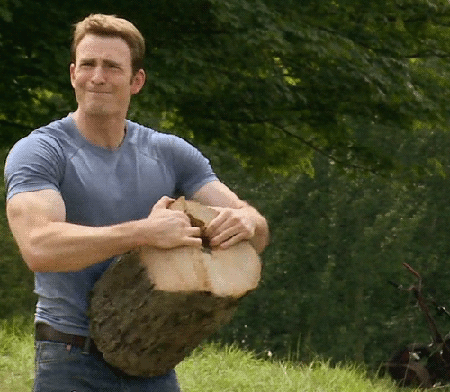
How can Machine Learning be split into two halves this way?
Half will run in the first-tier data concentrators, half in the back-end.
To answer this question, we really have to make a choice.
One option would be to dive into the back-end systems and learn more about machine learning techniques and models, the MapReduce computational framework, TensorFlow, etc.
This is not a good fit for our class because
Understanding the machine learning concepts is a big job
Our focus is on “infrastructure”, not “application functionality”

Slide 19
Yet we need some sense of what these models might look like!
To solve this, today we will “dive deep” by looking at Facebook’s TAO system.
TAO represents the knowledge Facebook maintains (and updates) about the social network graph
It is actually a good example of what machine learning people consider when they talk about very large graphical computations.

Slide 20
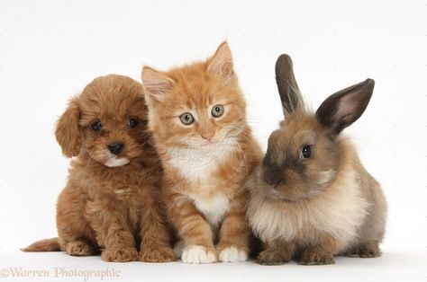
Categories of machine learning
Broadly speaking, machine learning systems either
Capture and represent some form of real-world data obtained from some form of web interactions or sensors, as TAO turns out to do.
Or they compute some form of learned model.
Typically, this by developing a general-purpose model for some task
Training data is obtained, and a computation runs to fit the model to the data
Trained model takes the form of parameter values for the model (big!)

Slide 21
Models are a new kind of BLOB!
In fact, for the “infrastructure” system, a model is no different from a photo or a video or some other large object: just bits.
But the patterns of access are often quite different. As we study TAO, think about the ways that applications using TAO would access the data.
Recall that the main we we know about for spreading data over a large warehouse of computers is with a DHT (key-value store). Jumping around in a DHT is expensive!
So we will need to ask: can machine learned models be “sharded”? How?

Slide 22
TAO is not easy to understand!
We will be looking at a 25 minute talk on a system that took 2 years to build. TAO is the most impressive existing edge system of its kind!
We’re ok with you “focusing on the big picture” here… But we encourage you to read the actual paper (it is slow going).
They give details – more than we require you to know. By reading it you can deeply understand what they did, how they evaluated it, how it performs.

Slide 23
TAO Facebook’s Distributed Data Store for the Social Graph
Cornell PhD who worked with Professor van Renesse. Graduated in 2010
Now one of several people with the title “Director of Engineering”
He owns the distributed systems area: the Facebook “edge”
Nathan Bronson, Zach Amsden, George Cabrera, Prasad Chakka, Peter Dimov, Hui Ding, Jack Ferris, Anthony Giardullo, Sachin Kulkarni, Harry Li, Mark Marchukov, Dmitri Petrov, Lovro Puzar, Yee Jiun Song, Venkat Venkataramani
Presented at USENIX ATC – June 26, 2013
Notes:
So now we are going to take the Facebook slides on their TAO system and actually look at their slides. Why do this?
Well, this is real, and we might as well be as real as possible whenever possible.
Facebook considers TAO to be the core of its entire social networking system.

Slide 24
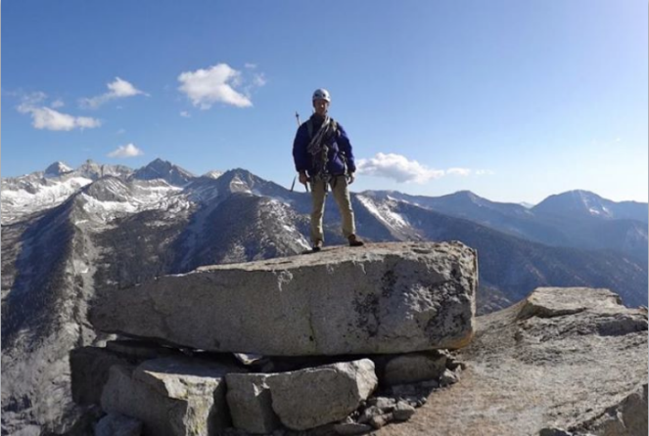
The Social Graph
USER
LOCATION
AT
GPS_DATA
FRIEND
AUTHOR
CHECKIN
PHOTO
USER
Carol
POST
LIKE
PHOTO
FRIEND
LIKE
LIKE
USER
LIKE
USER
USER
EXIF
COMMENT
EXIF_INFO
USER
COMMENT
(hypothetical encoding)
AUTHOR
Notes:
NOTES: spend less time here
So what is the social graph? The most basic nodes are obviously users and their relationships, but we also use it to model physical things and to encode all of a users activity on Facebook.
Consider this post, where I uploaded a photo of myself at the top of a climb in the Sierras.
…
OK, so now we have a flexible and powerful representation of the data behind this post, how do we go about rendering it?

Slide 25
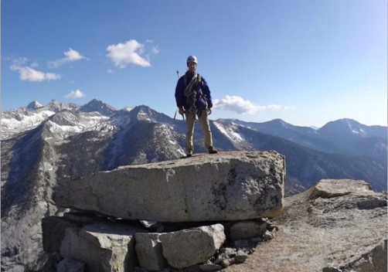
Dynamically Rendering the Graph
USER
Web Server (PHP)
LOCATION
AT
GPS_DATA
FRIEND
CHECKIN
AUTHOR
PHOTO
USER
Carol
POST
LIKE
PHOTO
FRIEND
LIKE
USER
LIKE
USER
LIKE
USER
EXIF
UPLOAD_ FROM
COMMENT
EXIF_INFO
USER
COMMENT
APP
iPhoto
AUTHOR
Notes:
Now that we have this flexible and fine-grained representation of the content of this post, we need to actually turn it into HTML. We do this in a straightforward fashion, by having the web servers query the graph, filter, aggregate, and then render the result. A fundamental feature of the Facebook workload is that we do this aggregation every time; we dynamically render the site during every request.

Slide 26
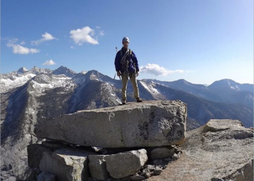
Dynamically Rendering the Graph
TAO
USER
Web Server (PHP)
LOCATION
GPS_DATA
AT
AUTHOR
FRIEND
CHECKIN
PHOTO
LIKE
USER
Carol
PHOTO
POST
FRIEND
LIKE
USER
LIKE
USER
LIKE
USER
EXIF
UPLOAD_ FROM
COMMENT
EXIF_INFO
USER
COMMENT
APP
iPhoto
AUTHOR
1 billion queries/second
many petabytes of data
Notes:
Okay, so now we’ve got enough boxes and arrows on the screen that I can show you where TAO fits. For the data types it handles, TAO is responsible for the right side of the picture.
TAO is a service that stores the graph and allows the web servers to read and write it.
So how do we go about actually turning the typed nodes and typed edges into HTML? At a high level, we basically dynamically render from the graph every time.
No page caching
Dynamically generate the page every time

Slide 27
TAO opts for NoSQL Model
Most TAO applications treat the graph like a very restricted form of SQL database: it looks like SQL.
But first, they limit the operations: it isn’t full SQL.
And then they don’t guarantee the ACID properties.
In fact the back end of TAO actually is serializable, but it runs out of band, in a batched and high-volume way (BASE: eventually, consistency happens).
The only edge consistency promise is that they try to avoid returning broken association lists, because applications find such situations hard to handle.

Slide 28
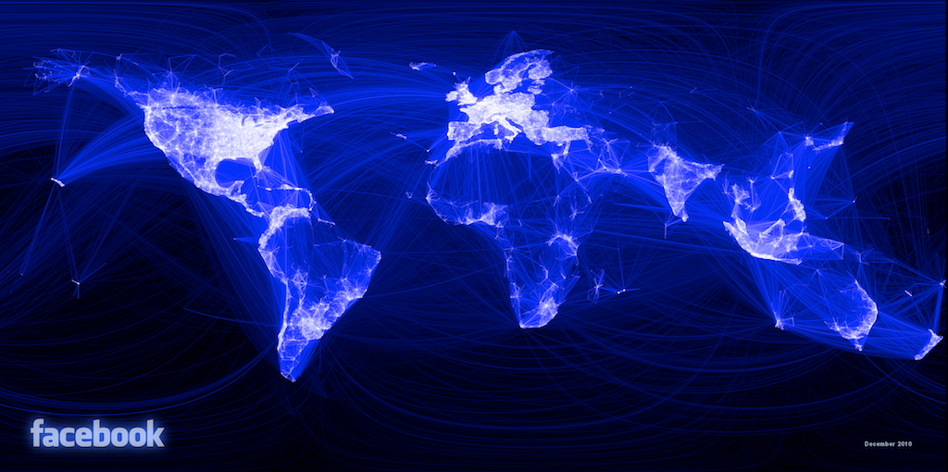
What Are TAO’s Goals/Challenges?
Efficiency at scale
Notes:
Efficiency at scale – more than 1 G qps, many PB of data
Dynamic data dependency resolution requires multiple rounds of graph queries to render page, so reads need to be fast. Our data centers are geographically distributed, so reads need to come from the local data center.
Facebook is a communication medium, so modifications to the graph should become immediately available.
Query amplification …

Slide 29
Dynamic Resolution of Data Dependencies
POST
1
CHECKED_IN
COMMENT
AUTHOR
ATTACH
LIKED_BY
LOCATION
COMMENT
PHOTO
USER
Carol
USER
2
AUTHOR
UPLOAD_ FROM
USER
3
APP
iPhoto
Notes:
Let’s dig a little deeper into how the web server renders the page. The edges are dynamic data dependencies that we resolve by doing multiple query rounds

Slide 30
What Are TAO’s Goals/Challenges?
Efficiency at scale
Low read latency
Timeliness of writes
High Read Availability
Notes:
Efficiency at scale – more than 1 G qps, many PB of data
Dynamic data dependency resolution requires multiple rounds of graph queries to render page, so reads need to be fast. Our data centers are geographically distributed, so reads need to come from the local data center.
Facebook is a communication medium, so modifications to the graph should become immediately available.
Query amplification …

Slide 31
Graph in Memcache
memcache
(nodes, edges, edge lists)
Web Server (PHP)
Obj & Assoc API
mysql
USER
LOCATION
GPS_DATA
AT
AUTHOR
FRIEND
CHECKIN
PHOTO
LIKE
USER
Carol
PHOTO
POST
FRIEND
LIKE
USER
LIKE
USER
LIKE
USER
EXIF
UPLOAD_ FROM
COMMENT
EXIF_INFO
USER
COMMENT
APP
iPhoto
AUTHOR
Notes:
Facebook’s workload has had these constraints for a long time, even before we constructed a graph-specific data store. 6 or 7 years ago engineers developed the objects and associations API …

Slide 32
Objects = Nodes
Associations = Edges
Identified by unique 64-bit IDs
Typed, with a schema for fields
Identified by <id1, type, id2>
Bidirectional associations are two edges, same or different type
id: 1807 =>
type: POST
str: “At the summ…
<1807,COMMENT,2003>
time: 1,371,704,655
id: 2003 =>
type: COMMENT
str: “how was it …
<308,AUTHORED,2003>
time: 1,371,707,355
id: 308 =>
type: USER
name: “Alice”
<2003,AUTHOR,308>
time: 1,371,707,355
Notes:
objects …
associations …
If you consider the edges out of a particular node, there is often a natural ordering. For the association between a post and its comments, for example, …
The time-ordering of edges is so common in the social graph that we make it part of the API, using it to express the outbound edges as an ordered list instead of a set. We call this an association list.

Slide 33
Association Lists
<id1, type, *>
Descending order by time
Query sublist by position or time
Query size of entire list
id: 1807 =>
type: POST
str: “At the summ…
<1807,COMMENT,4141>
time: 1,371,709,009
newer
id: 4141 => type: COMMENT
str: “Been wanting to do …
<1807,COMMENT,8332>
time: 1,371,708,678
id: 8332 => type: COMMENT
str: “The rock is flawless, …
<1807,COMMENT,2003>
time: 1,371,707,355
id: 2003 => type: COMMENT
str: “how was it, was it w…
older
Notes:
…
So in addition to the ability to query a single object or association, we also include in the API the ability to return a portion of a single association list.
The API only provides operations to read an object, an association, or an association list. This effectively means that the only fields that are indexed are ids, types, and time.

Slide 34
Inverse associations
Bidirectional relationships have separate a→b and b→a edges
inv_type(LIKES) = LIKED_BY
inv_type(FRIEND_OF) = FRIEND_OF
Forward and inverse types linked only during write
TAO assoc_add will update both
Not atomic, but failures are logged and repaired
Nathan
FRIEND_OF
FRIEND_OF
AUTHORED_BY
Carol
AUTHOR
LIKES
LIKED_BY
“On the summit”

Slide 35
Objects and Associations API
Reads – 99.8%
Point queries
obj_get 28.9%
assoc_get 15.7%
Range queries
assoc_range 40.9%
assoc_time_range 2.8%
Count queries
assoc_count 11.7%
Writes – 0.2%
Create, update, delete for objects
obj_add 16.5%
obj_update 20.7%
obj_del 2.0%
Set and delete for associations
assoc_add 52.5%
assoc_del 8.3%
Notes:
TODO: replace wall of text with pie chart

Slide 36
What Are TAO’s Goals/Challenges?
Efficiency at scale
Low read latency
Timeliness of writes
High Read Availability

Slide 37
Independent Scaling by Separating Roles
Stateless
Web servers
TAO
Cache
Objects
Assoc lists
Assoc counts
Sharded by id
Servers –> read qps
Sharded by id
Servers –> bytes
Database
Notes:
Even though database has cache, this system lets us tune
Practical advantages to this system:
mature storage layer
complete tool set for free – backups, replication, bulk migrations, data export
incremental turn-up

Slide 38
Subdividing the Data Center
Inefficient failure detection
Many switch traversals
Web servers
Cache
Many open sockets
Lots of hot spots
Database
Notes:
The separation of cache and databases gives us linear scaling, but only up to a point. Hot spots in the cache become more numerous as the individual servers account for a smaller fraction of the total capacity. There are a fixed number of ports on cost-effective ethernet switches, so the networking even in a single building is not homogeneous between every server. Every web server talks to every cache server, which starts to stress the operating system. The communications stack in the web server also needs to detect failures in cache servers, so as the number of distinct clients grows the failure detectors get less effective. We can reduce the impact of all of these problems by subdividing both the web and cache servers, and arranging for web servers to talk to a subset of cache servers that is fewer switch hops away.

Slide 39
Subdividing the Data Center
Web servers
Cache
Distributed write control logic
Thundering herds
Database

Slide 40
Follower and Leader Caches
Web servers
Follower cache
Leader cache
Database

Slide 41
What Are TAO’s Goals/Challenges?
Efficiency at scale
Low read latency
Timeliness of writes
High Read Availability

Slide 42
Write-through Caching – Association Lists
Web servers
Ensure that range queries on association lists always work, even when a change has recently been made. Not ACID, but “good enough” for TAO use cases.
X –> Y
ok
Follower cache
X,A,B,C
Y,A,B,C
X,A,B,C
Y,A,B,C
refill X
X –> Y
ok
refill X
Leader cache
X,A,B,C
Y,A,B,C
X –> Y
ok
Database
X,…
Y,…
Notes:
Using invalidates to repair the cache after a write works fine for objects, because they are individually invalidated. If we invalidate one of the edges in an association list, however, we will also have to discard all of the edges that come after it. In this example, we want to update the first element of an association list containing X, A, B, and C. The write proceeds in the same way as before, but instead of sending an invalidation we send a refill message. This causes any caches that hold X to requery the containing association list from the leader.
Refills have the nice property that they are idempotent, so we don’t have to send them synchronously as part of the write, and we can log them for replay if they fail.
Idempotent cache consistency messages are very useful from an operational perspective.

Slide 43
Asynchronous DB Replication
Master data center
Replica data center
Web servers
Writes forwarded to master
Follower cache
Inval and refill embedded in SQL
Leader cache
Database
Delivery after DB replication done

Slide 44
What Are TAO’s Goals/Challenges?
Efficiency at scale
Low read latency
Timeliness of writes
High Read Availability

Slide 45
Key Ideas
TAO has a “normal operations” pathway that offers pretty good properties, very similar to full ACID.
But they also have backup pathways for almost everything, to try to preserve updates (like unfollow, or unfriend, or friend, or like) even if connectivity to some portion of the system is disrupted.
This gives a kind of self-repairing form of fault tolerance. It doesn’t promise a clean ACID model, yet is pretty close to that.

Slide 46
Improving Availability: Read Failover
Master data center
Replica data center
Web servers
Follower cache
Leader cache
Database

Slide 47
TAO Summary
Efficiency at scale Read latency
Separate cache and DB
Graph-specific caching
Subdivide data centers
Write timeliness
Write-through cache
Asynchronous replication
Read availability
Alternate data sources

Slide 48
Single-server Peak Observed Capacity
Notes:
TODO: maybe add a number for each of the high-level points?

Slide 49
Write latency
Notes:
TAO’s writes are performed synchronously in the master region, so a write in a slave region includes an inter- region round trip. Figure 11 compares the latency in two data centers, the master and a remote region 58.1 milliseconds away (average round trip). Average write latency in the master region was 12.1 msec; in the remote region it was 74.4 = 58.1 + 16.3 msec.

Slide 50
More In the Paper
The role of association time in optimizing cache hit rates
Optimized graph-specific data structures
Write failover
Failure recovery
Workload characterization

Slide 51
Back to our theme… what did we learn?
TAO has first-tier and back-end elements, and faces the exact same challenges we expect to see in fog computing!
It solves them by moving a representation of the social network graph into the second tier. The real database lives in the back, and the second-tier version tracks it and tries to keep up with updates.
But updates are “tentatively” applied directly as soon as they occur, so that within a region, if “Sally likes Jim”, that region immediately behaves as if the update was already applied to the back-end systems.
Geographically remote regions may see that same event after delay.

Slide 52
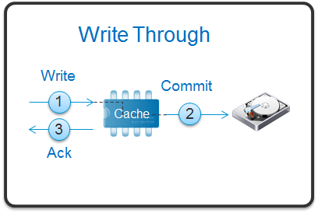
Concept: Write-through cache
In fact, TAO behaves like an extremely sophisticated write-through cache.
Such a cache allows both reads and writes, and it retains a copy of the new data from a write.
Then it passes the write to the back-end. This presumes that all writes will be successful, so there is no concept of an “abort”.
Even so, if the cache is ever inconsistent, the front-end could temporarily show some sort of evidence of inconsistency, and the write might even make this worse. Later, it will self-correct. Applications must be careful!

Slide 53
Uses of write-through caching
Cloud storage systems often have a write-through cache (DRAM) to “hide” the latency of actually talking to the SSD medium (Flash, or 3D-Xpoint).
With battery-backing a write-through cache can be as reliable as NVRAM
File systems use write-through caching when you update disk files. You need to explicitly call “fsync” or “fflush” to be sure the data was actually written out to the disk.

Slide 54
… so TAO is simply reusing the idea!
It may sound like a very exotic and different kind of technology
Yet the concept behind TAO’s handling of delay is very familiar!
This is common in the cloud.
What about sharding? For TAO, this is less simple.

Slide 55
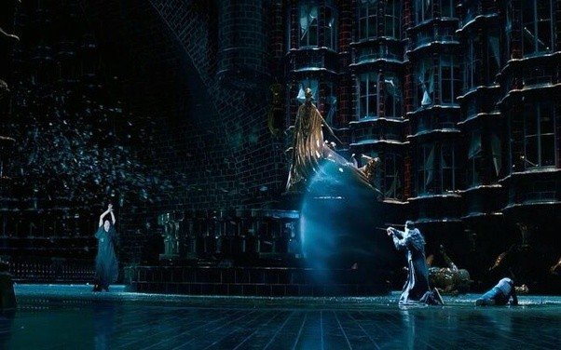
Sharding concept
We touched on it previously: it arises when we have a conceptually large database, but split it into portions (shards) using hashing.
Sharding requires agreement on the keys used for hashing, and on the hash function to be used. Some systems dynamically adjust the rule.
Then, for each access, you take the key, hash it, and it takes you to a component that has ownership for that portion of the data. Usually, shards are replicated for fault-tolerance (2 or 3 replicas in total).
So, a shard is just a piece of a key-value database.

Slide 56
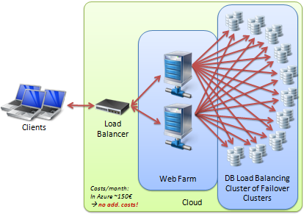
Key-value databases
These can really be anything
For example, suppose we had a standard relational database.
In a relational database, each “row” has a unique key.
So we could spread our database over a key-value storage layer
The storage capacity would be huge, although performance will be slow if you try to “scan” the whole layer sequentially. Parallel scans would be fast, though: you just ask all the DHT members to scan, then combine their sub-portions of your query result.

Slide 57
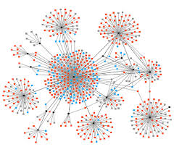
Sharding in TAO
Because TAO is a graph of social relationships, there is a kind of natural clustering: like the famous “Small Worlds” model.
Sometimes, by careful analysis, we can find a good way to split such a graph so that each cluster can live in a different shard.
Other systems just replicate the whole graph, and “shard” using some other hashing policy on a key that probably doesn’t cluster the graph itself very well.

Slide 58
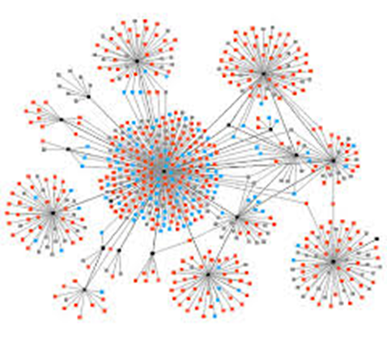
Sharding in TAO
TAO uses this second approach
It maintains second-tier servers that hold the whole TAO graph, but then it also maintains caches closer to the applications using TAO.
With luck, your local cache ends up with the portion of TAO relevant to your current set of Facebook users.
Then your Facebook tasks will compute without needing to talk to the regional TAO server.
Nobody ever gets to issue queries directly to the back-end databases.

Slide 59
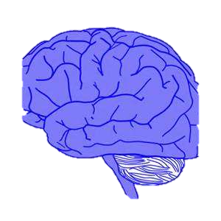
Summary
First-tier part
Machine-learned model
Back-end part
Edge data concentrators will need to own some ML tasks
Forces us to split things up, in two sense:
Data must be sharded and replicated, for fault-tolerance and speed
The ML model must split into a front-end portion and a back-end potion
Cosmos is an example of a sharded system, but runs entirely in the back
TAO is an example of a sharded system that moves some ML functionality to the second tier, in support of “smarter” first-tier behavior

Slide 60
Difference: First Tier ML versus Back-End
First tier must be:
Extremely sharded and scalable: we will spread it on thousands of nodes, each with some limited sub-role (like monitoring a section of the highway)
Highly responsive: it sees new events and must instantly classify them and perhaps be able to immediate react without consulting back-end systems
Updates the “short term” model as it runs, but can’t learn a totally new model
Back end is a long slow pipeline:
Here, we replicate because the model was hard to compute, and shard for computational parallelism
Learns and then disseminates the “long term” model, which will be cached for rapid access by the first-tier machines

Slide 61
Graphical Models: TAO
The back-end of a cloud runs machine-learning applications that do things like training models (Bayesian, Neural Network, etc…)
An important class of models are graphical models that reflect social networking relationships. TAO is a very good example.
The same mix of delay issues we face in fog computing also arise in TAO because Facebook users are so dominated by the social network.
TAO solves these using a mix of the concepts we’ve been exploring: layers of caching, a form of data concentrator, sharding, etc.
Notes:
Another fancy word: graphical models. This means: we ran an ML system and trained it on some data, and its output was in the form of a graph. The graph has nodes and edges, and might be very big (like billions of nodes, tens of billions of edges).
But it doesn’t necessarily mean much more than that. The nodes and edges hold the learned model, which often takes the form of a weight factor, or a numerical matrix (a “tensor”)
For what purpose? Exactly what are these numbers? Well, if you take a machine learning course you’ll see hundreds of ways that they turn AI/ML decisions into computations parameterized by numbers. These are where those numbers are stored.
For example, a node that understands certain faces might have a matrix used to figure out if the face has a beard, or hair, or both, or neither. Why? Well, perhaps this particular node is part of a system for recommending that it is time for a haircut. Stuff like that.

