Slide 1
Secure and Private ways to query Sensor Data
Edward Tremel
Spring, 2018

Slide 2
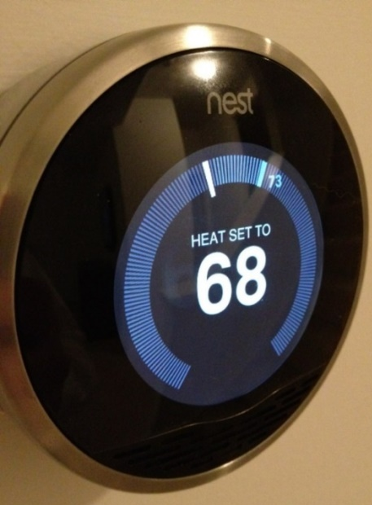
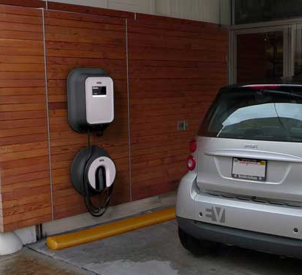
smart sensors
Live outside the cloud and have local compute capability
Connected to home devices
  Heater and air conditioner
  Hot water tank
  Rooftop solar cells
  Wall-mounted battery units
  Electric car charger
  Smart appliances with voice commands

Slide 3
Smart Devices Know WAY too much!
A smart sensor knows a lot about your lifestyle:
  When you are awake, asleep, showering, watching TV
  Whether you are at home or away
  How far you drive every day
  All of your voice commands
Would you share this personal information with your utility company? Or Amazon? Or your curious neighbors?
Better to not connect sensors to the outside world at all

Slide 4
But They Need To Be Connected
Smart devices aren’t as useful without connecting to the cloud
Recall the smart cars: we are skeptical that they can really operate in
a totally autonomous way. A smart highway helps… but lives in the cloud
Good voice recognition may depend on cloud-hosted FPGA array
computing devices, and really good image analysis may need this too
The cloud can do global things, like scheduling electric power for whole cities. Your home, operating autonomously, might not be able to do that

Slide 5
Today’s Topic
A dilemma: how can a smart sensor talk to the cloud, yet not reveal sensitive data?
This can be done in some situations
Using anonymization and privacy-preserving techniques
As long as queries are fairly simple and just aggregate data
As it happens, summation queries are widely used for machine learning!

Slide 6
Limitations of Anonymous Queries
Can all smart-sensor problems be solved this way?
Example: Speech recognition
Could hide the identity of the speaker, but cloud will lack context
Decoding each remark in isolation harder without prior knowledge of conversation
Could tag requests with context information (a cookie), but easy for cloud to figure out speaker’s identity
Notes:
Some tasks, like speech understanding, are more problematic.
We can probably hide the identity of the speaker by means of a technique called “onion routing”, but if we do, the cloud will lack context for understanding the remark.
We could perhaps send a cookie with context information, but if the cloud cheats, it will easily figure out who the speaker was.

Slide 7
Possible Solution
For speech understanding, one promising direction is based on a hardware feature called “SGX” from Intel
It allows the cloud to compute on behalf of an end-user in a way that blocks the cloud itself from “seeing” the data or the computation.
SGX is a little slow, but when combined with a big FPGA array for speech processing in hardware, could solve the problem!

Slide 8
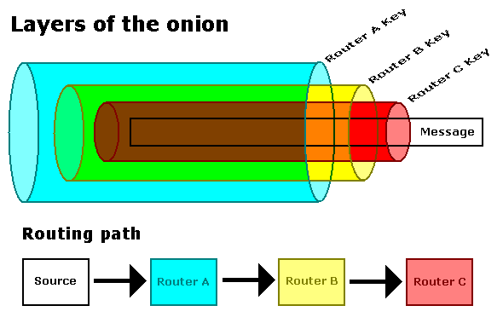
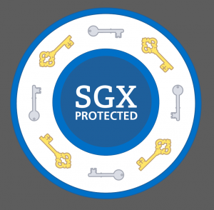
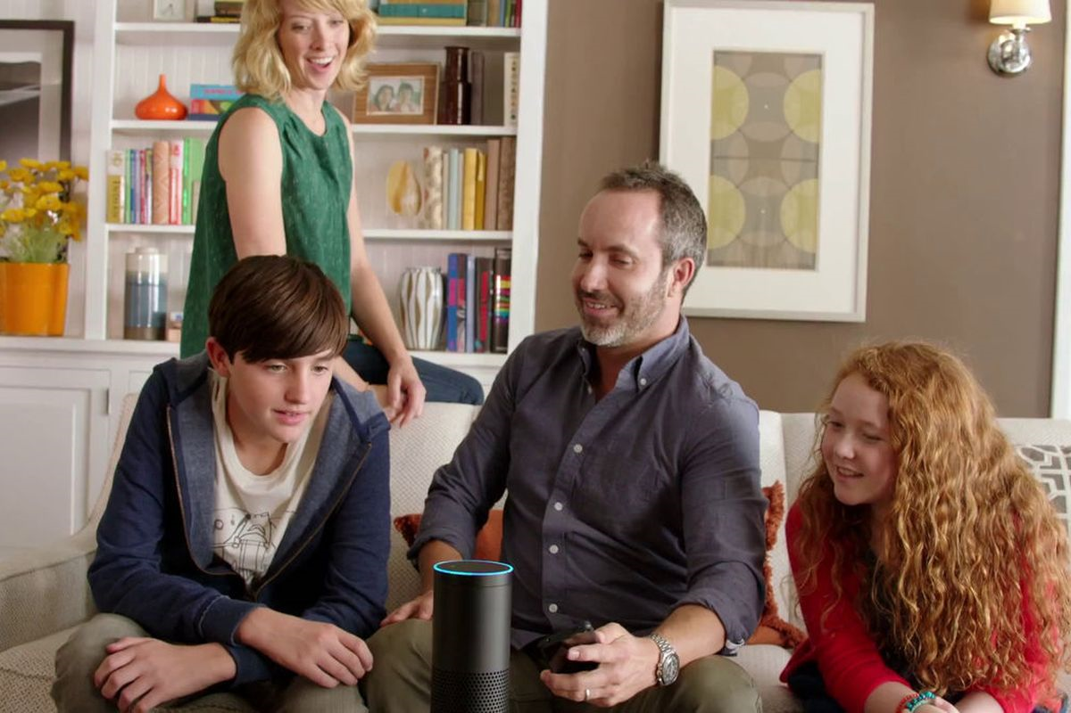
Secure cloud-processed speech

Slide 9
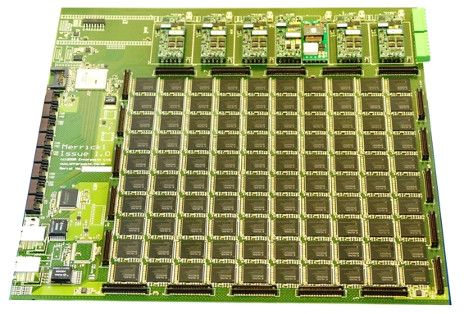
Inside the SGX protection ring
Protected application: “normal” code but isolated in a form of virtual machine with a firewall
FPGA array for speech understanding
Your family “owns” this key. The cloud itself lacks a copy of it!

Slide 10
A Limited Amount of Trust
A common model: View the cloud as honest, but curious to learn secrets
  Executes code correctly, audited by US and European governments
  Monitors everything it can, tries to learn more about customers
SGX Enclave + FPGA inside is cloud-hosted, but secure, for one user
  Only one client can talk to enclave, only client learns result
If we want to evaluate a query that sums data over many users, SGX isolation won’t help.
Notes:
By having the cloud operate the SGX enclave and putting the FPGA array and its data inside, we create a cloud-hosted but very secure solution just for this one user. Only the client can talk to this one enclave, and only the client learns result.

Slide 11



Distributed Queries
Setup: Lots of smart sensors connected to network
Registered to same cloud service
Devices can send messages to each other

Slide 12
Distributed Queries
Goal: Service operator can query an aggregate of sensor data (sum, average, count, etc.)
Operator should not learn any device’s individual data
Devices should not learn each other’s data

Slide 13
Overview
Operator
Operator broadcasts query
Sensors encrypt their data and randomly exchange it with each other
Sensors decrypt the data and combine it to produce aggregate result
Result sent back to operator
Query
Response
Shuffle & Combine Data

Slide 14

Device-to-Device Communication
First concern: Curious operator could watch all network traffic between devices
Give each device a public key, indexed in public service
Send messages only over encrypted SSL connections
Cert(B)
ID(B)?
$$Enc_{B}\left(M\right)$$
A
B

Slide 15

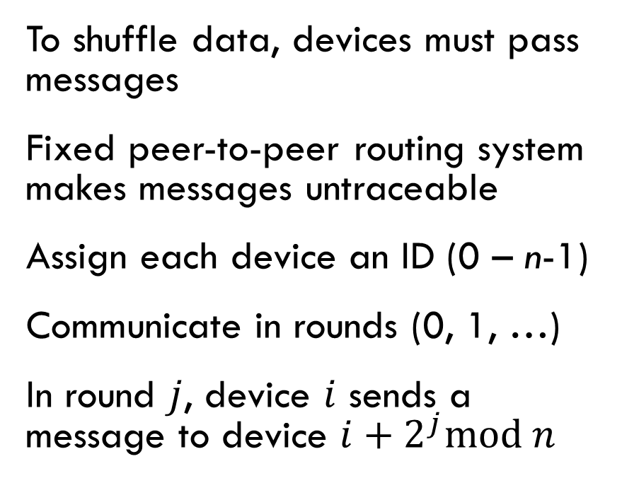
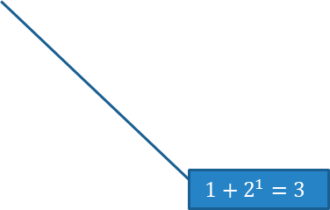
Peer-to-Peer Overlay
Devices are vertices
Messages are edges
Device ID
To shuffle data, devices must pass messages
Fixed peer-to-peer routing system makes messages untraceable
Assign each device an ID (0 – n-1)
Communicate in rounds (0, 1, …)
In round $j$, device $i$ sends a message to device $i+2^{j}\text{mod} n$
0
1
2
3
…
n-1
0
$$0+2^{0}=1$$
1
Time (rounds)
2
3
…
$$1+2^{1}=3$$
n-2
Every device sends a message in each round

Slide 16
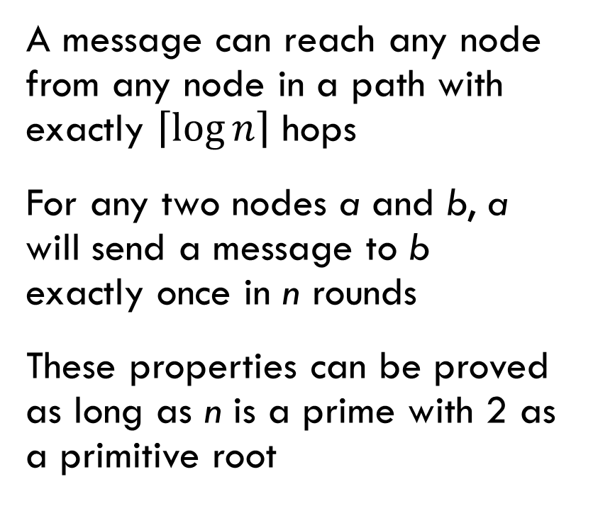
Features of the Overlay
5 devices, IDs 0 to 4
Device ID
A message can reach any node from any node in a path with exactly $\left\lceil \log{n}\right\rceil$ hops
For any two nodes a and b, a will send a message to b exactly once in n rounds
These properties can be proved as long as n is a prime with 2 as a primitive root
0
1
2
3
4
0
Example: Message paths originating from node 0
1
Time (rounds)
2
3
4
5
6

Slide 17
Onion Routing on the Overlay
Choose a path to destination along allowable forwarding links
Encrypt message multiple times
  First, destination’s key
  Then each hop’s key in reverse order
  Each time, add ID of next hop to plaintext
Upon receiving a message, decrypt one layer, read next destination
0
1
2
3
4
0
1
2
3

Slide 18
Sending Anonymous Messages
Device ID
Pick a path through the overlay
  On each round, stay or forward
  Nodes must always send a message, but it can be empty
Onion-encrypt message with each hop’s key
Paths can overlap, nodes bundle together messages to send in the same round
0
1
2
3
4
5
6
7
8
9
10
0
1
2
Round #
3
4
5
6
7

Slide 19
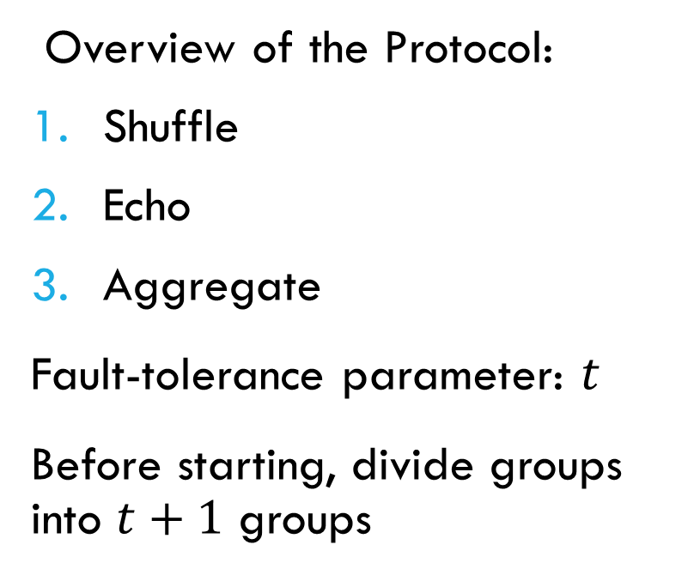
Anonymous Queries
Query
Operator
t+1 groups
…
Overview of the Protocol:
Shuffle
Echo
Aggregate
Fault-tolerance parameter: $t$
Before starting, divide groups into $t+1$ groups
Shuffle
…
Echo
…
Aggregate
…

Slide 20
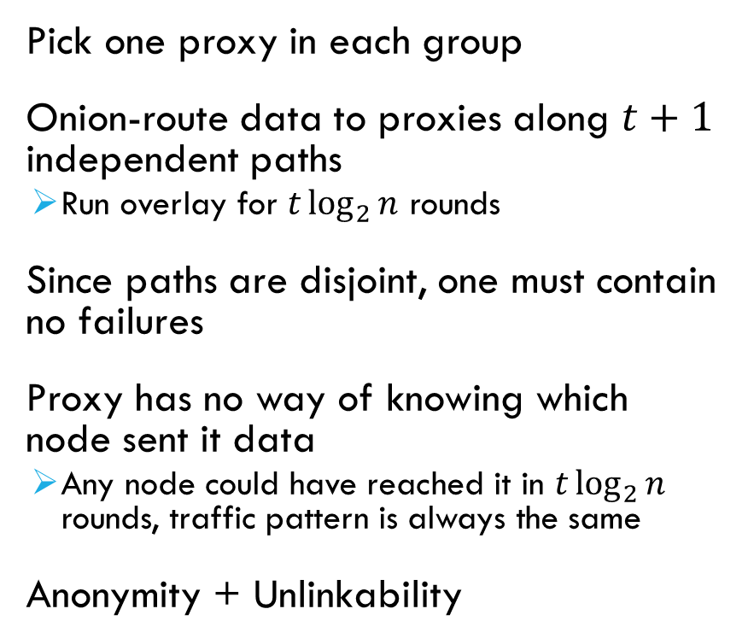
Shuffle
Device ID
0
1
2
3
4
5
6
7
8
9
10
Pick one proxy in each group
Onion-route data to proxies along $t+1$ independent paths
  Run overlay for $t\log_{2}{n}$ rounds
Since paths are disjoint, one must contain no failures
Proxy has no way of knowing which node sent it data
  Any node could have reached it in $t\log_{2}{n}$ rounds, traffic pattern is always the same
Anonymity + Unlinkability
0
1
2
3
4
5
6

Slide 21
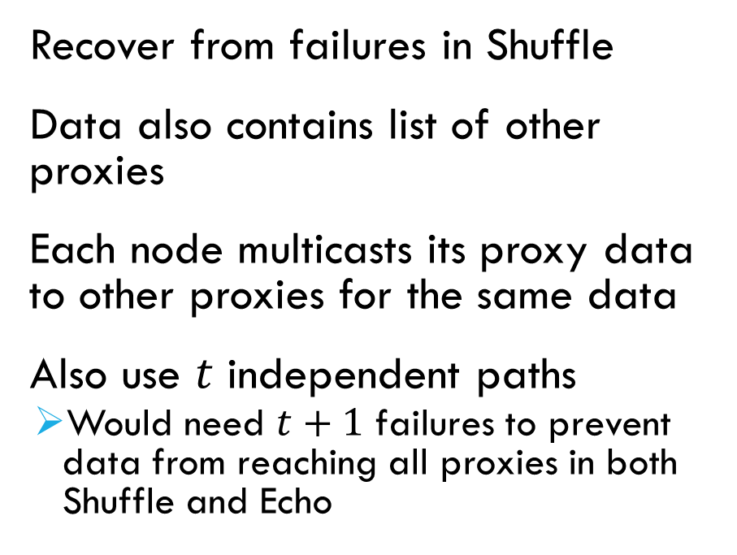
Echo
Recover from failures in Shuffle
Data also contains list of other proxies
Each node multicasts its proxy data to other proxies for the same data
Also use $t$ independent paths
  Would need $t+1$ failures to prevent data from reaching all proxies in both Shuffle and Echo
0
1
2
3
4
5
6
7
8
9
10
(path details omitted for brevity)
Proxies for node 0’s data

Slide 22
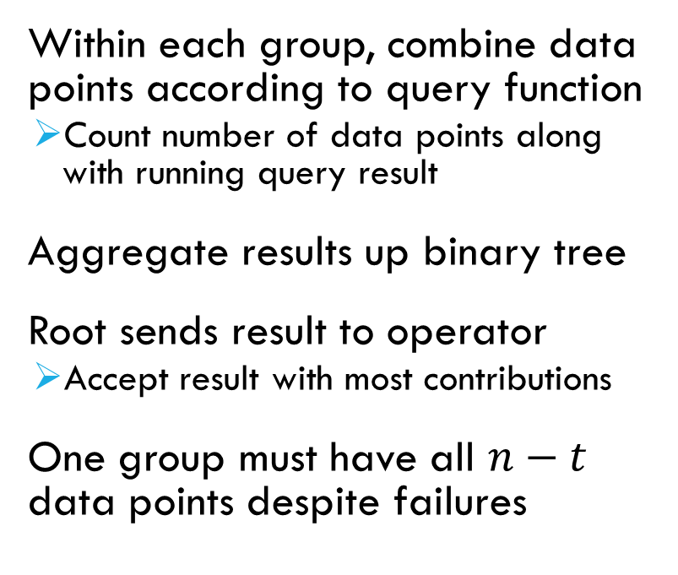
Aggregate
Within each group, combine data points according to query function
  Count number of data points along with running query result
Aggregate results up binary tree
Root sends result to operator
  Accept result with most contributions
One group must have all $n−t$ data points despite failures
…
…
…

Slide 23
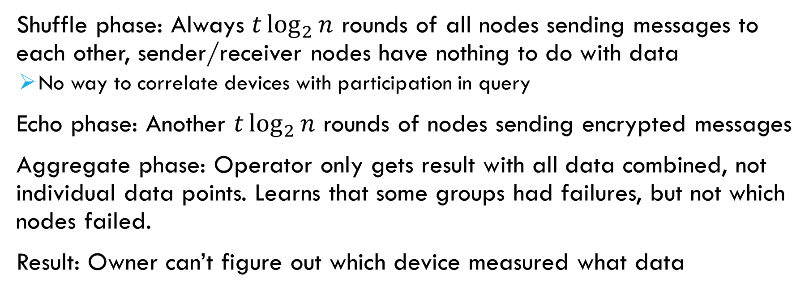
What did The Operator Learn?
Shuffle phase: Always $t\log_{2}{n}$ rounds of all nodes sending messages to each other, sender/receiver nodes have nothing to do with data
  No way to correlate devices with participation in query
Echo phase: Another $t\log_{2}{n}$ rounds of nodes sending encrypted messages
Aggregate phase: Operator only gets result with all data combined, not individual data points. Learns that some groups had failures, but not which nodes failed.
Result: Owner can’t figure out which device measured what data

Slide 24
What if Devices Are Malicious?
If some devices are compromised (hacked), they are Byzantine adversaries
Fortunately, their behavior is already constrained by the protocol
  Can’t read or change encrypted messages
  Message-passing overlay is fixed, every node can calculate it independently, so out-of-turn messages will be dropped
What can they do?
  Drop messages – looks like a crash failure
  Submit lots of data, or really bad data

Slide 25
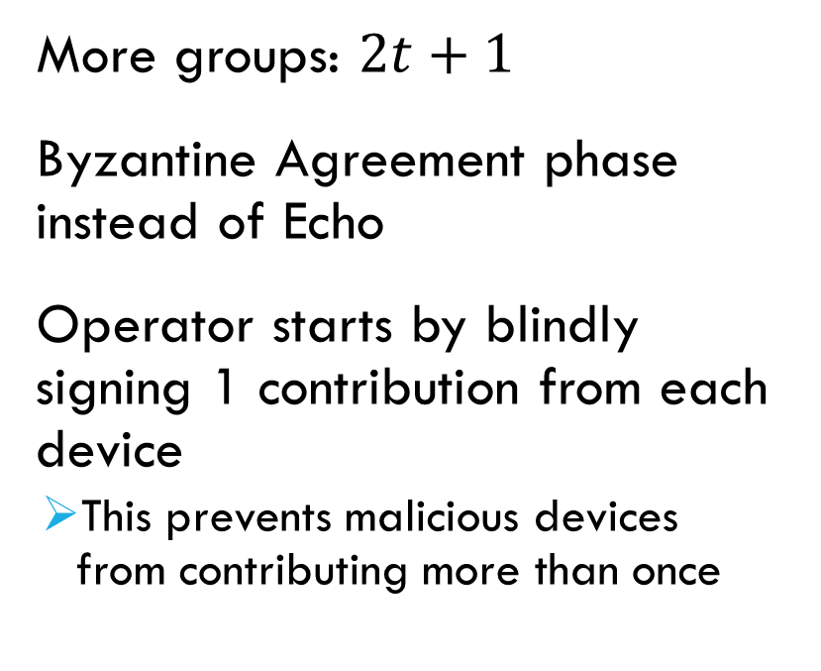
BFT Query Protocol
Setup
Operator
2t+1 groups
…
More groups: $2t+1$
Byzantine Agreement phase instead of Echo
Operator starts by blindly signing 1 contribution from each device
  This prevents malicious devices from contributing more than once
Shuffle
…
Agreement
…
…
Aggregate
…

Slide 26


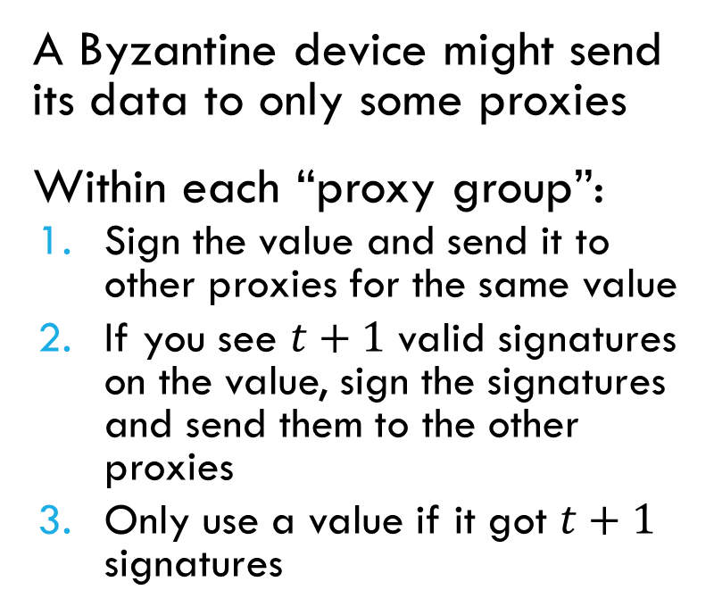



Byzantine Agreement
“57”, {1,3,4}
“57”, {1,3,4}
???
A Byzantine device might send its data to only some proxies
Within each “proxy group”:
  Sign the value and send it to other proxies for the same value
  If you see $t+1$ valid signatures on the value, sign the signatures and send them to the other proxies
  Only use a value if it got $t+1$ signatures
0
1
2
3
4
$${Sig}_{3}\left(57, \left\{1,3,4\right\}\right)$$
$$Sig_{1}\left(57, \left\{1,3,4\right\}\right)$$
$$Sig_{1}\left(\begin{aligned}Sig_{3}\left(57, \left\{1,3,4\right\}\right), \\ Sig_{1}\left(57, \left\{1,3,4\right\}\right)\end{aligned}\right)$$
$$Sig_{4}\left(\begin{aligned}Sig_{1}\left(57,\left\{1,3,4\right\}\right), \\ Sig_{3}\left(57,\left\{1,3,4\right\}\right)\end{aligned}\right)$$
$$Sig_{3}\left(\begin{aligned}Sig_{1}\left(57, \left\{1,3,4\right\}\right), \\ Sig_{3}\left(57,\left\{1,3,4\right\}\right)\end{aligned}\right)$$

Slide 27
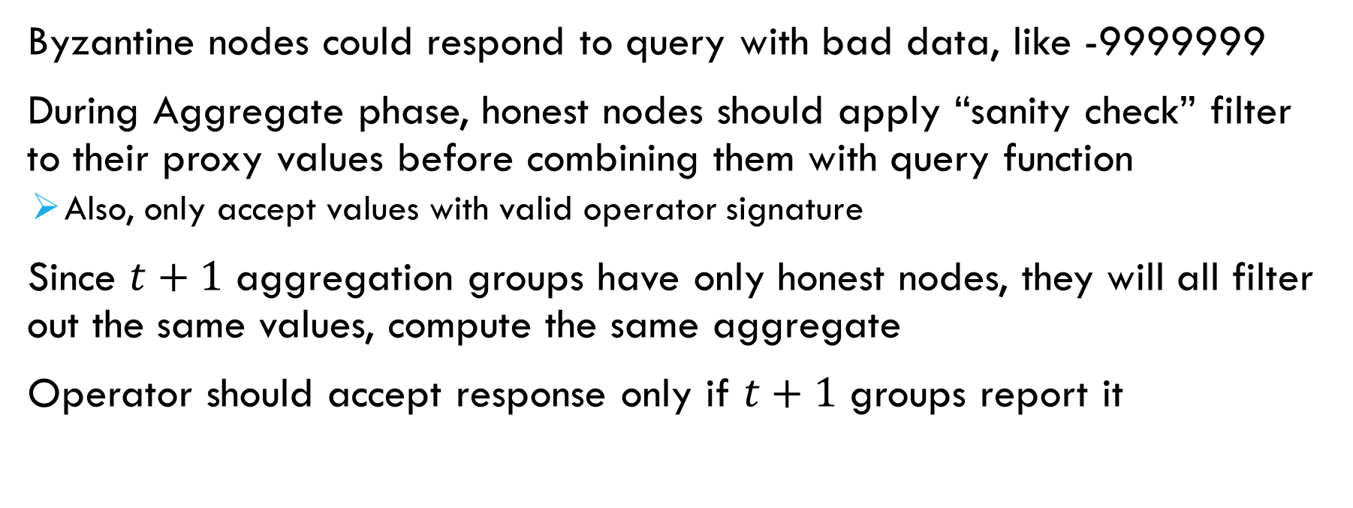
Filtering and Majority Vote
Byzantine nodes could respond to query with bad data, like -9999999
During Aggregate phase, honest nodes should apply “sanity check” filter to their proxy values before combining them with query function
  Also, only accept values with valid operator signature
Since $t+1$ aggregation groups have only honest nodes, they will all filter out the same values, compute the same aggregate
Operator should accept response only if $t+1$ groups report it

Slide 28
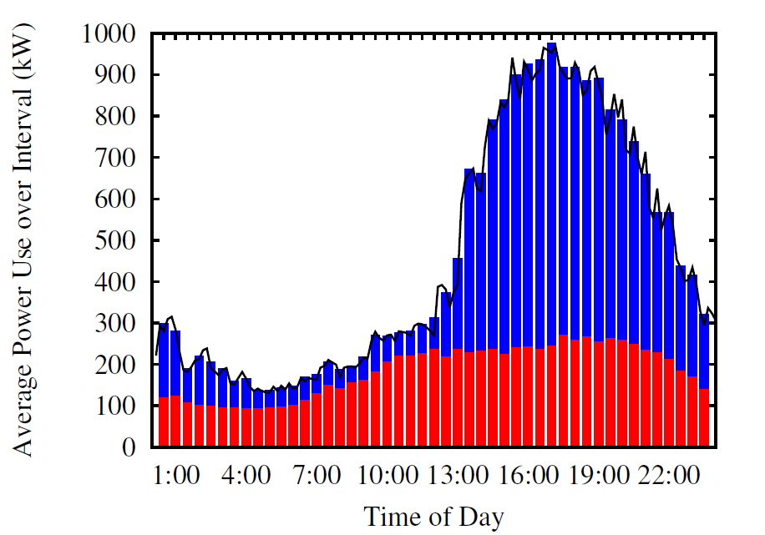
Evaluation
Simulated Query Completion Time
Query Completion Time, BFT Mode
Query Data Collected by Simulated Utility
Shiftable load
Non-shiftable load
True consumption
Communication Cost Per Query

Slide 29
Conclusion
Smart devices know a lot of sensitive data, can invade your privacy
Instead of trusting a service provider with the data, leave it on devices
Can aggregate data from devices without revealing individual contributions
Can tolerate failures, and even Byzantine faults, by adding replication

