Slide 1
Connecting Spark to Files Containing Data
Ken Birman
CS5412

Slide 2
Today’s Lecture borrows from a slide set from a Spark user community meeting
Spark was first introduced at Berkeley as a way to speed up Hadoop using in-memory caching. The RDD objects it supports were really just a “representation” of the recipe for computing each cacheable object from input sources.
Then Spark focused on scheduling, and cache retention policies.
But it was quickly adopted and became a world-wide “craze”

Slide 3
RDD model rapidly expanded
Today, the RDD model is really a full programming language.
RDD coding looks like SQL or Python or Scala, depending on what you are doing
Basic idea remains the same, but the coverage of the recipes Spark can compute for you through the RDD objects has greatly expanded.

Slide 4
Today’s lecture
We will start by looking at some examples of RDD programming done at Cornell by Theo when he was doing experiments on the Freeze Frame File System.
Then we’ll see an open-source slides set a class on RDDs taught by the DataBricks company, in Asia at a big data conference.

Slide 5
RDD Example From Eaton ARPA-e research
Theo Gkountouvas

Slide 6
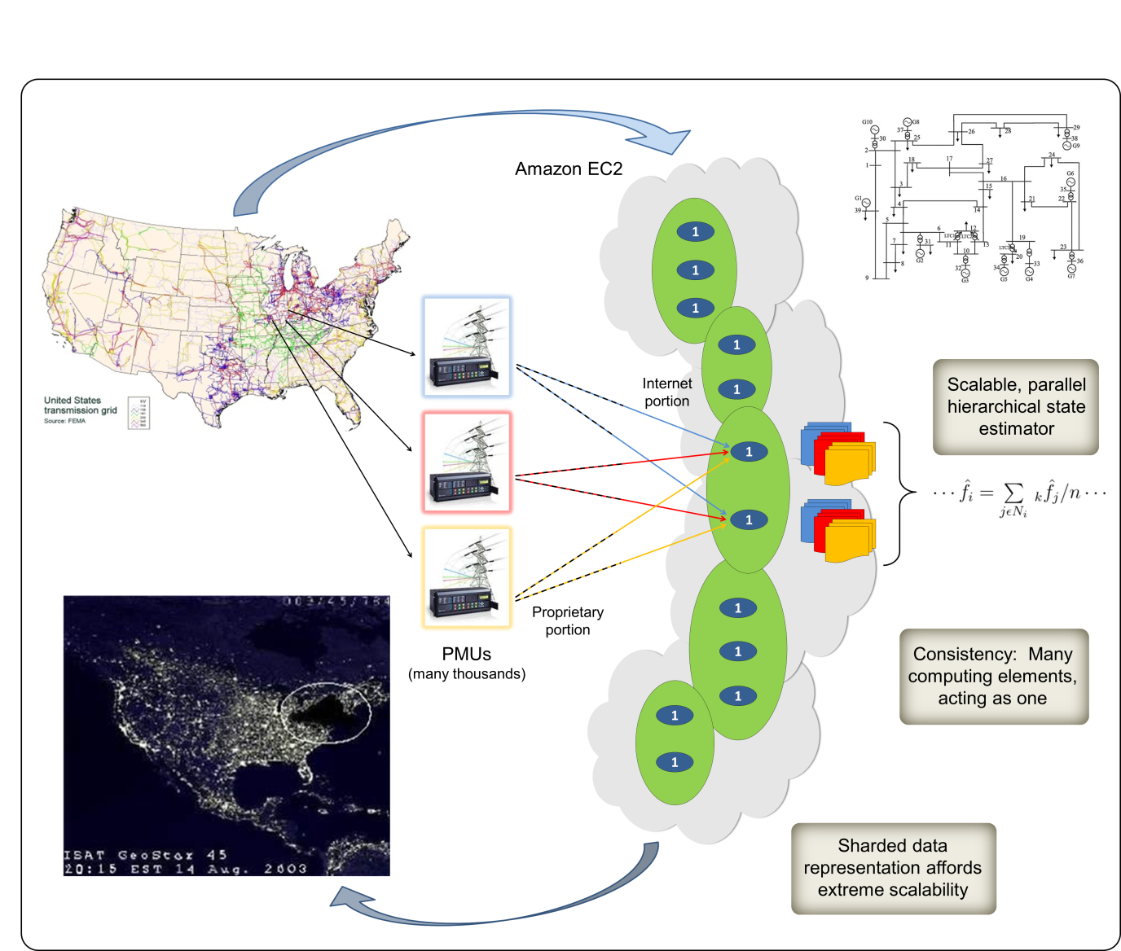
GridCloud: Mile high perspective
The intelligence lives in the cloud: machine learning that watches the real-time data stream in and reacts. The external infrastructure is mostly dumb sensors and actuators

Slide 7
Data flow: Redundant
SPARK data analytics parallel processing framework
Data collectors (k per sensor, to tolerate k-1 crash faults)
RDDs (one per sensor)
Smart sensor
File in FFFS
K TCP links
FFFS files (one per sensor)
Redundancy for fault-tolerance and to improve real-time performance up to the stage where the files are stored. Then FFFS reliability takes over.

Slide 8
Eaton Project
Receive data every minute from many different homes. Each home has a central sensor that is responsible for aggregating monitoring information as well as controlling several electrical devices.
Our goal for now is to aggregate the monitored consumptions in KVolts as well as keep track of missing (or received information). We assume that the data is already stored in FFFS and we have to write Python code for Spark to perform this analysis.

Slide 9
Code
Initial RDD
curTs = long(time.time())
initialRDD = sc.textFile("fffs://10.0.0.10:9000/home/theo/data/sensor[0-9]*.dat@u" + str(curTs))
deserializedRDD = initialRDD.map(deserialize)
processedRDD = deserializedRDD.map(lambda x: (0, 0.0, 0.0, 0.0) if x[1] <= curTs - 60 else (1, x[2], x[3], x[4]))
filteredRDD = processedRDD.filter(lambda x: x[0] == 1)
res = filteredRDD.reduce(lambda x, y: (x[0]+y[0], x[1]+y[1], x[2]+y[2], x[3]+y[3]))
print res
Get current time curTS in seconds.
Spark Context sc maintains information about spark instances, spark configuration as well as location of data in FFFS instances (collocation of computation in the same physical node as the stored data).
Fetch all recent files generated at some time before curTS.

Slide 10
RDD Code
Initial RDD
map
curTs = long(time.time())
initialRDD = sc.textFile("fffs://10.0.0.10:9000/home/theo/data/sensor[0-9]*.dat@u" + str(curTs))
deserializedRDD = initialRDD.map(deserialize)
processedRDD = deserializedRDD.map(lambda x: (0, 0.0, 0.0, 0.0) if x[1] <= curTs - 60 else (1, x[2], x[3], x[4]))
filteredRDD = processedRDD.filter(lambda x: x[0] == 1)
res = filteredRDD.reduce(lambda x, y: (x[0]+y[0], x[1]+y[1], x[2]+y[2], x[3]+y[3]))
print res
Deserialized RDD
Deserialize raw packets.
Format of data: [(SensorID, TS, WHCons, ACCons, EVCons)]

Slide 11
RDD Code
Initial RDD
map
curTs = long(time.time())
initialRDD = sc.textFile("fffs://10.0.0.10:9000/home/theo/data/sensor[0-9]*.dat@u" + str(curTs))
deserializedRDD = initialRDD.map(deserialize)
processedRDD = deserializedRDD.map(lambda x: (0, 0.0, 0.0, 0.0) if x[1] <= curTs - 60 else (1, x[2], x[3], x[4]))
filteredRDD = processedRDD.filter(lambda x: x[0] == 1)
res = filteredRDD.reduce(lambda x, y: (x[0]+y[0], x[1]+y[1], x[2]+y[2], x[3]+y[3]))
print res
Deserialized RDD
map
Processed RDD
Keep only relevant information.
Missing packets are encoded as (0, 0.0, 0.0, 0.0)
Packets are encoded as (1, WHCons, ACCons, EVCons)

Slide 12
RDD Code
Initial RDD
map
curTs = long(time.time())
initialRDD = sc.textFile("fffs://10.0.0.10:9000/home/theo/data/sensor[0-9]*.dat@u" + str(curTs))
deserializedRDD = initialRDD.map(deserialize)
processedRDD = deserializedRDD.map(lambda x: (0, 0.0, 0.0, 0.0) if x[1] <= curTs - 60 else (1, x[2], x[3], x[4]))
filteredRDD = processedRDD.filter(lambda x: x[0] == 1)
res = filteredRDD.reduce(lambda x, y: (x[0]+y[0], x[1]+y[1], x[2]+y[2], x[3]+y[3]))
print res
Deserialized RDD
map
Processed RDD
filter
Filtered RDD
Filter out missing packets.
Not needed. Erase for efficiency (just an example).

Slide 13
RDD Code
Initial RDD
map
curTs = long(time.time())
initialRDD = sc.textFile("fffs://10.0.0.10:9000/home/theo/data/sensor[0-9]*.dat@u" + str(curTs))
deserializedRDD = initialRDD.map(deserialize)
processedRDD = deserializedRDD.map(lambda x: (0, 0.0, 0.0, 0.0) if x[1] <= curTs - 60 else (1, x[2], x[3], x[4]))
filteredRDD = processedRDD.filter(lambda x: x[0] == 1)
res = filteredRDD.reduce(lambda x, y: (x[0]+y[0], x[1]+y[1], x[2]+y[2], x[3]+y[3]))
print res
Deserialized RDD
map
Processed RDD
filter
Filtered RDD
reduce
(Number of Packets,
Total WHCons, Total ACCons, Total EVCons)

Slide 14
OPtimizations
Repeating (Real-Time Calculation)
Set curTS to curTS + 60 (next minute)
Sleep until curTS
Repeat again
Distribute Load Manually
Use initialRDD = sc.parellelize(initialRDD) for manually creating partitions (executors dynamically handle them).
You can also set the number of partitions manually.

Slide 15
Discussion
It is fairly easy to link the Spark RDD model to real sensor data in FFFS, and to do simple operations on it, like this check for missing data.
A significant application could be “custom coded” at multiple layers: the sensor can be configured (smart sensor), the data collection layer can filter or transform data (smart memory), the RDD can transform data (as shown), and the Spark analytics we run on the RDD can do it too!
As a developer, you would favor the option that is easiest to code for your specific use case.

Slide 16
Deeper dive on RDD coding
RDD Basics
Creating RDDs
RDD Operations
Passing Functions to Spark
Common Transformations and Actions
Persistence (Caching)

Slide 17
RDD Basics
Each RDD is split into multiple partitions, which may be computed on different nodes of the cluster. RDDs can contain any type of Python, Java or Scala objects, including user-defined classes.
Users create RDDs in two ways
by loading an external dataset
by distributing a collection of objects

Slide 18
RDD Basics
Loading a text file as an RDD of strings using SparkContext.textFile()
Creating an RDD of strings with textFile() in Python
>>> lines = sc.textFile("README.md")
RDDs offer two types of operations: transformations and actions
Transformations construct a new RDD from a previous one
>>> pythonLines = lines.filter(lambda line: "Python" in line)
Actions, compute a result based on an RDD
>>> pythonLines.first()

Slide 19
RDD Basics
Spark only computes them in a lazy fashion, the first time they are used in an action
lines = sc.textFile(...)
once Spark sees the whole chain of transformations, it can compute just the data needed for its result
first() action, Spark only scans the file until it finds the first matching line
>>> pythonLines.first()

Slide 20
RDD Basics
Use persist to load a subset of your data into memory and query it repeatedly
>>> pythonLines.persist(StorageLevel.MEMORY_ONLY_SER)
>>> pythonLines.count()
>>> pythonLines.first()

Slide 21
RDD Basics
A Spark program and shell session works as follows:
Create some input RDDs from external data.
Transform them to define new RDDs using transformations like filter().
Ask Spark to persist() any intermediate RDDs that will need to be reused.
Launch actions such as count() and first() to kick off a parallel computation, which is then optimized and executed by Spark.

Slide 22
Creating RDD
Two ways to create RDDs: loading an external dataset and parallelizing a collection in your driver program.
One way to create RDDs is to take an existing in-memory collection and pass it to SparkContext’s parallelize method
Python parallelize example
lines = sc.parallelize(["pandas", "i like pandas"])
Scala parallelize example
val lines = sc.parallelize(List("pandas", "i like pandas"))
Java parallelize example
JavaRDD<String> lines = sc.parallelize(Arrays.asList("pandas", "i like pandas"));

Slide 23
Creating RDD
A second way to create RDDs is to load data in external storage
Python textFile example
lines = sc.textFile("/path/to/README.md")
Scala textFile example
val lines = sc.textFile("/path/to/README.md")
Java textFile example
JavaRDD<String> lines = sc.textFile("/path/to/README.md");

Slide 24
RDD Operations
RDDs support two types of operations, transformations and actions.
Transformations are operations on RDDs that return a new RDD, such as map and filter
Actions are operations that return a result back to the driver program or write it to storage, and kick off a computation
such as count and first
Spark treats transformations and actions very differently, so understanding which type of operation you are performing will be important.
how to check the type? transformations return RDDs whereas actions return some other data type.

Slide 25
RDD Operations: Transformations
Transformations are operations on RDDs that return a new RDD
transformed RDDs are computed lazily, only when you use them in an action
element-wise (not for all cases)
Question: we have a log file, log.txt, with a number of messages, and we want to select only the error messages?

Slide 26
RDD Operations Transformation examples
Python filter example
inputRDD = sc.textFile("log.txt") errorsRDD = inputRDD.filter(lambda x: "error" in x)
Scala filter example
val inputRDD = sc.textFile("log.txt”)
val errorsRDD = inputRDD.filter(line => line.contains("error"))
Java filter example
JavaRDD<String> inputRDD = sc.textFile("log.txt");
JavaRDD<String> errorsRDD = inputRDD.filter( new Function<String, Boolean>() { public Boolean call(String x) { return x.contains("error");
} });
Note that the filter operation does not mutate the existing inputRDD. Instead, it returns a pointer to an entirely new RDD.

Slide 27
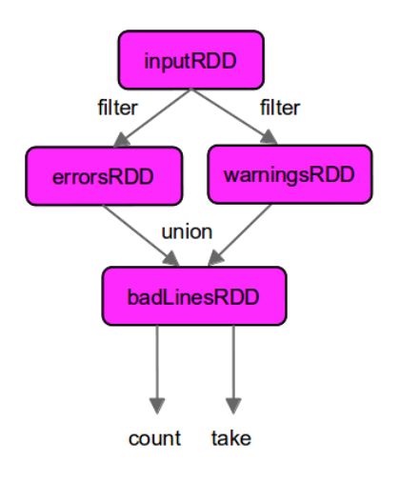
RDD Operations Transformations
union is a bit different than filter, in that it operates on two RDDs instead of one
Python union example
errorsRDD = inputRDD.filter(lambda x: "error" in x)
warningsRDD = inputRDD.filter(lambda x: "warning" in x)
badLinesRDD = errorsRDD.union(warningsRDD)
lineage graph: Spark keeps track of the set of dependencies between different RDDs

Slide 28
RDD Operations – ACTIONS Action Examples
Do something with our dataset
They are the operations that return a final value to the driver program or write data to an external storage system
Python error count example using actions
print "Input had " + badLinesRDD.count() + " concerning lines"
print "Here are 10 examples:" for line in badLinesRDD.take(10):
print line
take() to retrieve a small number of elements in the RDD at the driver program
collect() function to retrieve the entire RDD (shouldn’t be used on large datasets
it’s common to write data out to a distributed storage systems such as HDFS or Amazon S3

Slide 29
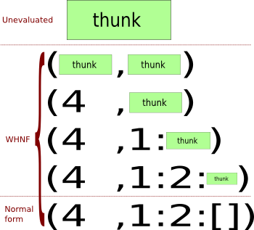
RDD Operations Lazy Evaluation
Transformations on RDDs are lazily evaluated, meaning that Spark will not begin to execute until it sees an action
Call a transformation on an RDD, the operation is not immediately performed
Internally records meta-data to indicate this operation has been requested
In Spark, there is no substantial benefit to writing a single complex map instead of chaining together many simple operations
http://en.wikibooks.org/wiki/Haskell/Laziness

Slide 30
Passing Functions to Spark Python
Three options for passing functions into Spark: pass in lambda expressions, pass in top-level functions, or locally defined functions
Passing a lambda in Python
word = rdd.filter(lambda s: "error" in s)
Passing a top-level Python function
def containsError(s):
return "error" in s
word = rdd.filter(containsError)

Slide 31
Passing Functions to Spark Python
Passing a function with field references (don’t do this!)
class SearchFunctions(object):
def __init__(self, query):
self.query = query
def isMatch(self, s):
return query in s
def getMatchesFunctionReference(self, rdd):
# Problem: references all of "self" in "self.isMatch"
return rdd.filter(self.isMatch)
def getMatchesMemberReference(self, rdd):
# Problem: references all of "self" in "self.query"
return rdd.filter(lambda x: self.query in x)
Python function passing without field references
class WordFunctions(object): ...
def getMatchesNoReference(self, rdd):
# Safe: extract only the field we need into a local variable
query = self.query return rdd.filter(lambda x: query in x)

Slide 32
Passing Functions to Spark Scala
In Scala, we can pass in functions defined inline or references to methods or static functions as we do for Scala’s other functional APIs
Scala function passing
class SearchFunctions(val query: String) {
def isMatch(s: String): Boolean = {
s.contains(query) } def getMatchesFunctionReference(rdd: RDD[String]): RDD[String] = {
// Problem: "isMatch" means "this.isMatch", so we pass all of "this" rdd.map(isMatch)
}
def getMatchesFieldReference(rdd: RDD[String]): RDD[String] = { // Problem: "query" means "this.query", so we pass all of "this"
rdd.map(x => x.split(query))
} def getMatchesNoReference(rdd: RDD[String]): RDD[String] = {
// Safe: extract just the field we need into a local variable
val query_ = this.query
rdd.map(x => x.split(query_))
}
}

Slide 33
Passing Functions to Spark Java
In Java, functions are specified as objects that implement one of Spark’s function inter‐ faces from the org.apache.spark.api.java.function package.
Standard Java function interfaces:
Function name | method to implement | Usage
Function<T, R> | R call(T) | Take in one input and return one output, for use with things like map and filter.
Function2<T1, T2, R> | R call(T1,T2) | Take in two inputs and return one output, for use with things like aggregate or fold.
FlatMapFunction<T, R> | Iterable<R> call(T) | Take in one input and return zero or more outputs, for use with things like flatMap.

Slide 34
Passing Functions to Spark Java
We can either define our function classes in-line as anonymous inner classes, or make a named class:
Java function passing with anonymous inner class
RDD<String> errors = lines.filter(new Function<String, Boolean>() {
public Boolean call(String x) { return s.contains("error"); }
});
Java function passing with named class
class ContainsError implements Function<String, Boolean>() {
public Boolean call(String x) { return x.contains("error"); }
}
RDD<String> errors = lines.filter(new ContainsError());

Slide 35
Passing Functions to Spark Java
Top-level named functions are often cleaner for organizing large programs
Java function class with parameters
class Contains implements Function<String, Boolean>() {
private String query; public Contains(String query) { this.query = query; }
public Boolean call(String x) { return x.contains(query); }
}
RDD<String> errors = lines.filter(new Contains("error"));
Java function passing with lambda expression in Java 8
RDD<String> errors = lines.filter(s -> s.contains("error"));

Slide 36
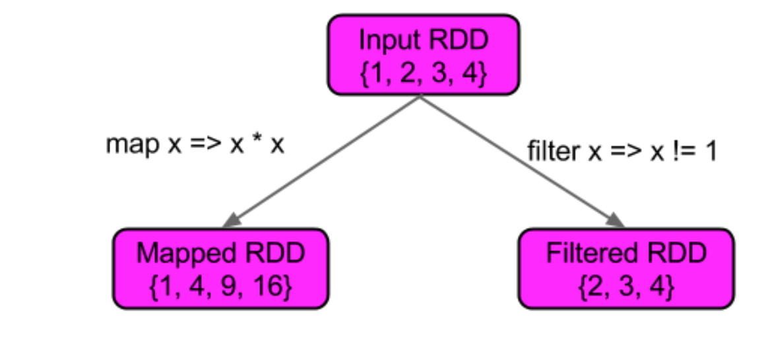
Basic RDDs Element-wise transformations
The two most common transformations you will likely be performing on basic RDDs are map, and filter
map transformation: takes in a function and applies it to each element in the RDD with the result of the function being the new value of each element in the resulting RDD
filter transformation take in a function and returns an RDD which only has elements that pass the filter function

Slide 37
Basic RDDs Element-wise transformations
Python squaring the value in an RDD
nums = sc.parallelize([1, 2, 3, 4]) squared = nums.map(lambda x: x * x).collect()
for num in squared:
print "%i " % (num)
Scala squaring the values in an RDD
val input = sc.parallelize(List(1, 2, 3, 4))
val result = input.map(x => x * x) println(result.collect().mkString(","))
Java squaring the values in an RDD
JavaRDD<Integer> rdd = sc.parallelize(Arrays.asList(1, 2, 3, 4)); JavaRDD<Integer> result = rdd.map(new Function<Integer, Integer>() {
public Integer call(Integer x) { return x*x; }
});
System.out.println(StringUtils.join(result.collect(), ","));

Slide 38
Basic RDDs Element-wise transformations
Python flatMap example, splitting lines into words
lines = sc.parallelize(["hello world", "hi"]) words = lines.flatMap(lambda line: line.split(" ")) words.first() # returns "hello”
Scala flatMap example, splitting lines into multiple words
val lines = sc.parallelize(List("hello world", "hi")) val words = lines.flatMap(line => line.split(" "))
words.first() // returns "hello”
Java flatMap example, splitting lines into multiple words
JavaRDD<String> lines = sc.parallelize(Arrays.asList("hello world", "hi")); JavaRDD<String> words = lines.flatMap(new FlatMapFunction<String, String>() {
public Iterable<String> call(String line) { return Arrays.asList(line.split(" "));
} });
words.first(); // returns "hello”

Slide 39
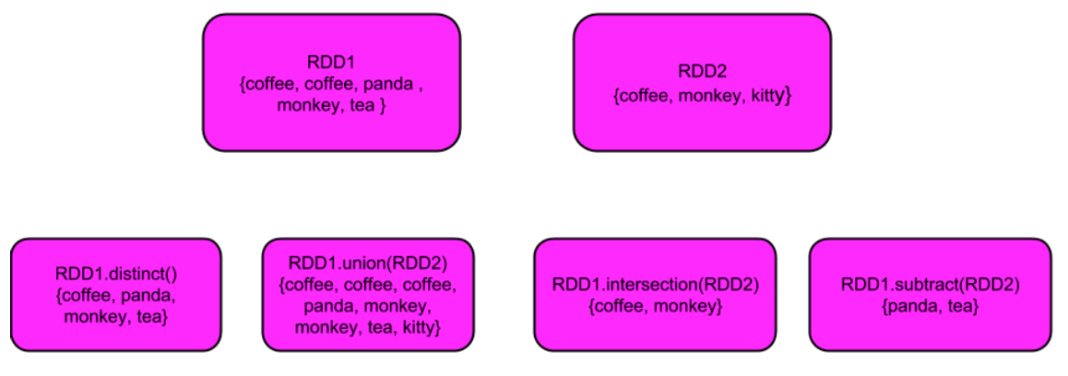
Basic RDDs Pseudo Set Operations
RDDs support many of the operations of mathematical sets, such as union and inter‐ section, even when the RDDs themselves are not properly sets.
Note that distinct() is expensive

Slide 40
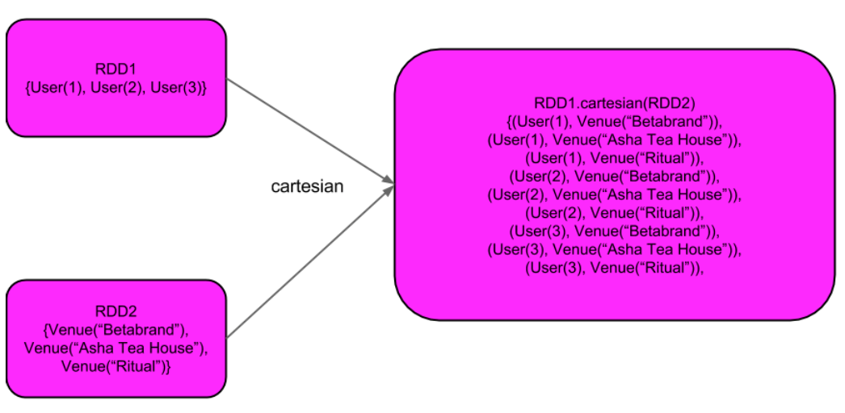
Basic RDDs Pseudo Set Operations
Compute a Cartesian product between two RDDs
The cartesian(other) transformation results in possible pairs of (a, b) where a is in the source RDD and b is in the other RDD
Cartesian product can be useful when we wish to consider the similarity between all possible pairs
such as computing every users expected inter‐ ests in each offer
take the Cartesian product of an RDD with itself, which can be useful for tasks like computing user similarity

Slide 41
Basic RDDs Pseudo Set Operations
Basic RDD transformations on an RDD containing {1, 2, 3, 3}
Function Name | Example | Result
map | rdd.map(x => x + 1) | {2, 3, 4, 4}
flatMap | rdd.flatMap(x => x.to(3)) | {1, 2, 3, 2, 3, 3, 3}
filter | rdd.filter(x => x != 1 ) | {2, 3, 3}
distinct | rdd.distinct() | {1, 2, 3}
sample(withReplacement, fraction,[seed]) | rdd.sample(false, 0.5) | non-deterministic

Slide 42
Basic RDDs Pseudo Set Operations
Two-RDD transformations on RDDs containing {1, 2, 3} and {3, 4, 5}
Function Name | Example | Result
union | rdd.union(other) | {1, 2, 3, 3, 4, 5}
intersection | rdd.intersection(other) | {3}
substract | rdd.subtract(other) | {1, 2}
cartesian | rdd.cartesian(other) | {(1, 3), (1, 4), ... (3,5)}

Slide 43
Basic RDDs Actions
The most common action on basic RDDs you will likely use is reduce
Reduce takes in a function which operates on two elements of the same type of your RDD and returns a new element of the same type
With reduce we can easily sum the elements of our RDD, count the number of elements, and perform other types of aggregations
Python reduce example
sum = rdd.reduce(lambda x, y: x + y)
Scala reduce example
val sum = rdd.reduce((x, y) => x + y)
Java reduce example
Integer sum = rdd.reduce(new Function2<Integer, Integer, Integer>() {
public Integer call(Integer x, Integer y) { return x + y;}
});

Slide 44
Basic RDDs Actions
With aggregate
supply an initial zero value of the type we want to return
supply a function to combine the elements from our RDD with the accumulator
supply a second function to merge two accumulators, given that each node accumulates its own results locally

Slide 45
Basic RDDs Actions
Python aggregate example
sumCount = nums.aggregate((0, 0),
(lambda x, y: (x[0] + y, x[1] + 1)),
(lambda x, y: (x[0] + y[0], x[1] + y[1]))))
return sumCount[0] / float(sumCount[1])
Scala aggregate example
val result = input.aggregate((0, 0))( (x, y) => (x._1 + y, x._2 + 1), (x, y) => (x._1 + y._1, x._2 + y._2))
val avg = result._1 / result._2.toDouble
http://stackoverflow.com/questions/26761087/explanation-of-the-aggregate-scala-function

Slide 46
Basic RDDs Actions
take(n) returns n elements from the RDD and attempts to minimize the number of partitions it accesses, so it may represent a biased collection.
The takeSample(with Replacement, num, seed) function allows us to take a sample of our data either with or without replacement.
Java aggregate example
class AvgCount {
public AvgCount(int total, int num) {
this.total = total;
this.num = num;
}
public int total;
public int num;
public double avg() {
return total / (double) num;
}
Function2<AvgCount, Integer, AvgCount> addAndCount =
new Function2<AvgCount, Integer, AvgCount>() {
public AvgCount call(AvgCount a, Integer x) { a.total += x; a.num += 1; return a;
} };
Function2<AvgCount, AvgCount, AvgCount> combine =
new Function2<AvgCount, AvgCount, AvgCount>() {
public AvgCount call(AvgCount a, AvgCount b) {
a.total += b.total;
a.num += b.num;
return a;
}
};
AvgCount initial = new AvgCount(0, 0); AvgCount result = rdd.aggregate(initial, addAndCount, combine);
System.out.println(result.avg());

Slide 47
Basic RDDs Basic actions on an RDD containing {1,2,3,3}
Function Name | Example | Result
collect() | rdd.collect() | {1,2,3,3}
count() | rdd.count() | 4
take(num) | rdd.take(2) | {1,2}
top(num) | rdd.top(2) | {3,3}
takeOrdered(num)(ordering) | rdd.takeOrdered(2)(myOrdering) | {3,3}
takeSample(withReplacement, num, [seed]) | rdd.takeSample(false,1) | non-deterministic
reduce(func) | rdd.reduce((x,y)=>x+y) | 9
fold(zero)(func) | rdd.fold(0)((x,y)=>x+y) | 9
aggregate(zeroValue)(seqOp,combOp) | rdd.aggregate(0,0)({case(x,y)=>(y._1()+x., y._2() + 1)}, {case(x,y) => (y._1()+x._1(), y._2()+x._2())}) | (9,4)
foreach(func) | rdd.foreach(func) | nothing

Slide 48
Basic RDDs Converting Between RDD Types
Some functions are only available on certain types of RDDs, such as average on numeric RDDs and join on key-value pair RDDs
Scala
In Scala the conversion between such RDDs (like from RDD[Double] and RDD[Numer ic] to DoubleRDD) is handled automatically using implicit conversions.
Java
In Java the conversion between the specialized types of RDDs is a bit more explicit.

Slide 49
Basic RDDs Converting Between RDD Types
Function Name | Equivalent Function*<A,B,…> | Usage
DoubleFlatMapFunction<T> | Function<T,Iterable<Double>> | DoubleRDD from a flatMapToDouble
DoubleFunction<T> | Function<T,double> | DoubleRDD from mapToDouble
PairFlatMapFunction<T,K,V> | Function<T,Iterable<Tuple2<K,V>>> | PairRDD<K,V> from a flatMapToPair
PairFunction<T,K,V> | Function<T,Tuple2<K,V>> | PairRDD<K,v> from a mapToPair
Java create DoubleRDD example
JavaDoubleRDD result = rdd.mapToDouble( new DoubleFunction<Integer>() {
public double call(Integer x) {
return (double) x * x;
}
});
System.out.println(result.average());

Slide 50
Persistence
Sometimes we may wish to use the same RDD multiple times
If we do this naively, Spark will recompute the RDD and all of its dependencies each time we call an action on the RDD
Scala double execute example
val result = input.map(x => x*x)
println(result.count())
println(result.collect().mkString(","))

Slide 51
Persistence
Persistence levels from org.apache.spark.storage.StorageLevel / py spark.StorageLevel
Level | Space Used | CPU time | In memory | On Disk | Nodes with data
MEMORY_ONLY | High | Low | Y | N | 1
MEMORY_ONLY_2 | High | Low | Y | N | 2
MEMORY_ONLY_SER | Low | High | Y | N | 1
MEMORY_ONLY_SER2 | Low | High | Y | N | 2
MEMORY_AND_DISK | High | Medium | Some | Some | 1
MEMORY_AND_DISK_2 | High | Medium | Some | Some | 2
MEMORY_AND_DISK_SER | Low | High | Some | Some | 1
MEMORY_AND_DISK_SER_2 | Low | High | Some | Some | 2
DISK_ONLY | Low | High | N | Y | 1
DISK_ONLY_2 | Low | High | N | Y | 2

Slide 52
Persistence
Scala persist example
val result = input.map(x => x*x)
result.persist(MEMORY_ONLY)
println(result.count())
println(result.collect().mkString(","))
If you attempt to cache too much data to fit in memory, Spark will automatically evict old partitions using a Least Recently Used (LRU) cache policy
memory-only: it will recompute these partitions the next time they are accessed
memory-and-disk: it will write them out to disk
Caching unnecessary data can lead to eviction of useful data and more recomputation time.
RDDs come with a method called unpersist() that lets you manually remove them from the cache.

Slide 53
Summary
An RDD is a small programmable fragment for computing some new data object using existing data objects (RDDs) or files as the data source.
The style of code is a mix of something like SQL queries (read-only) and a kind of functional “transformation” programming.
The resulting new data is a new file or a new object. RDDs can initiate actions and can be appended to a log, but cannot be used to update stored databases or write into the middle of files.

