Slide 1
Big Data Systems – Part 2
Ken Birman & Kishore Pusukuri, Spring 2018

Slide 2
PUTTING IT ALL TOGETHER
Reminder: Apache Hadoop Ecosystem
HDFS (Distributed File System)
HBase (Distributed NoSQL Database -- distributed map)
YARN (Resource Manager)
MapReduce (Data Processing Framework)

Slide 3
Hadoop Ecosystem: Processing
Map Reduce
Hive
Pig
Other Applications
Spark Stream
Processing
Data Ingest Systems
e.g., Apache Kafka, Flume, etc
Yet Another Resource Negotiator (YARN)
Hadoop Distributed File System (HDFS)
Hadoop NoSQL Database (HBase)

Slide 4
Apache Hive: SQL on MapReduce
Hive is an abstraction layer on top of Hadoop (MapReduce/Spark)
Use Cases:
Data Preparation
Extraction-Transformation-Loading Jobs (Data Warehousing)
Data Mining

Slide 5
Apache Hive: SQL on MapReduce
Hive is an abstraction layer on top of Hadoop (MapReduce/Spark)
Hive uses a SQL-like language called HiveQL
Facilitates reading, writing, and managing large datasets residing in distributed storage using SQL-like queries
Hive executes queries using MapReduce (and also using Spark)
HiveQL queries → Hive → MapReduce Jobs

Slide 6
Apache Hive
Structure is applied to data at time of read → No need to worry about formatting the data at the time when it is stored in the Hadoop cluster
Data can be read using any of a variety of formats:
Unstructured flat files with comma or space-separated text
Semi-structured JSON files (a web standard for event-oriented data such as news feeds, stock quotes, weather warnings, etc)
Structured HBase tables
Hive is not designed for online transaction processing. Hive should be used for “data warehousing” tasks, not arbitrary transactions.

Slide 7
Apache Pig: Scripting on MapReduce
Pig is an abstraction layer on top of Hadoop (MapReduce/Spark)
Use Cases:
Data Preparation
ETL Jobs (Data Warehousing)
Data Mining

Slide 8
Apache Pig: Scripting on MapReduce
Pig is an abstraction layer on top of Hadoop (MapReduce/Spark)
Code is written in Pig Latin “script” language (a data flow language)
Facilitates reading, writing, and managing large datasets residing in distributed storage
Pig executes queries using MapReduce (and also using Spark)
Pig Latin scripts → Pig → MapReduce Jobs

Slide 9
Apache Hive & ApachePig
Instead of writing Java code to implement MapReduce, one can opt between Pig Latin and Hive SQL to construct MapReduce programs
Much fewer lines of code compared to MapReduce, which reduces the overall development and testing time

Slide 10
Apache Hive vs Apache Pig
Declarative SQL-like language (HiveQL)
Operates on the server side of any cluster
Better for structured Data
Easy to use, specifically for generating reports
Data Warehousing tasks
Facebook
Procedural data flow language (Pig Latin)
Runs on Client side of any cluster
Best for semi structured data
Better for creating data pipelines
allows developers to decide where to checkpoint data in the pipeline
Incremental changes to large data sets and also better for streaming
Yahoo

Slide 11
Apache Hive vs ApachePig: example
Job: Get data from sources users and clicks is to be joined and filtered, and then joined to data from a third source geoinfo and aggregated and finally stored into a table ValuableClicksPerDMA
insert into ValuableClicksPerDMA select dma, count(*) from geoinfo join ( select name, ipaddr from users join clicks on (users.name = clicks.user) where value > 0; ) using ipaddr group by dma;
Users = load 'users' as (name, age, ipaddr); Clicks = load 'clicks' as (user, url, value); ValuableClicks = filter Clicks by value > 0; UserClicks = join Users by name, ValuableClicks by user; Geoinfo = load 'geoinfo' as (ipaddr, dma); UserGeo = join UserClicks by ipaddr, Geoinfo by ipaddr; ByDMA = group UserGeo by dma; ValuableClicksPerDMA = foreach ByDMA generate group, COUNT(UserGeo); store ValuableClicksPerDMA into 'ValuableClicksPerDMA';

Slide 12
Comment: “Client side”??
When we say “runs on client side” we don’t mean “runs on the
iPhone”. Here the client is any application using Hadoop.
So the “client side” is just “inside the code that consumes the Pig output”
In contrast, the “server side” lives “inside the Hive/HDFS layer”

Slide 13
Hadoop Ecosystem: Data Ingestion
Map Reduce
Hive
Pig
Other Applications
Spark Stream
Data Ingest Systems
e.g., Apache Kafka, Flume, etc
Yet Another Resource Negotiator (YARN)
Hadoop Distributed File System (HDFS)
Hadoop NoSQL Database (HBase)

Slide 14
Data Ingestion Systems/Tools (1)
Hadoop typically ingests data from many sources and in many formats:
Traditional data management systems, e.g. databases
Logs and other machine generated data (event data)
e.g., Apache Sqoop, Apache Fume, Apache Kafka (focus of this class)
Storage
HBase
Data Ingest Systems
HDFS

Slide 15
Data Ingestion Systems/Tools (2)
Apache Sqoop
High speed import to HDFS from Relational Database (and vice versa)
Supports many database systems, e.g. Mongo, MySQL, Teradata, Oracle
Apache Flume
Distributed service for ingesting streaming data
Ideally suited for event data from multiple systems, for example, log files

Slide 16
Concept: “Publish-Subscribe” tool
The Apache ecosystem is pretty elaborate. It has many “tools”, and several are implemented as separate μ-services.
The μ-services run in pools: we configure the cloud to automatically add instances if the load rises, reduce if it drops
So how can individual instances belonging to a pool cooperate?

Slide 17
Models for cooperation
One can have explicit groups, the members know one-another, and the cooperation is scripted and deterministic as a function of a consistent view of the task pool and the membership (Zookeeper)
But this is a more complex model than needed. In some cases, we prefer more of a loose coordination, with members that take tasks from some kind of list, perform them, announce completion.

Slide 18
Concept: “Publish-Subscribe” tool
This is a model in which we provide middleware to glue requestors to workers, with much looser coupling.
The requests arrive as “published messages”, on “topics”
The workers monitor topics (“subscribe”) and then an idle worker can announce that it has taken on some task, and later, finished it.

Slide 19
Apache Kafka
Functions like a distributed publish-subscribe messaging system (or a distributed streaming platform)
A high throughput, scalable messaging system
Distributed, reliable publish-subscribe system
Design as a message queue & Implementation as a distributed log service
Originally developed by LinkedIn, now widely popular
Features: Durability, Scalability, High Availability, High Throughput

Slide 20
What is Apache Kafka used for? (1)
The original use case (@LinkedIn):
To track user behavior on websites.
Site activity (page views, searches, or other actions users might take) is published to central topics, with one topic per activity type.
Effective for two broad classes of applications:
Building real-time streaming data pipelines that reliably get data between systems or applications
Building real-time streaming applications that transform or react to the streams of data

Slide 21
What is Apache Kafka used for? (2)
Lets you publish and subscribe to streams of records, similar to a message queue or enterprise messaging system
Lets you store streams of records in a fault-tolerant way
Lets you process streams of records as they occur
Lets you have both offline and online message consumption

Slide 22
Apache Kafka: Fundamentals
Kafka is run as a cluster on one or more servers
The Kafka cluster stores streams of records in categories called topics
Each record (or message) consists of a key, a value, and a timestamp
Point-to-Point: Messages persisted in a queue, a particular message is consumed by a maximum of one consumer only
Publish-Subscribe: Messages are persisted in a topic, consumers can subscribe to one or more topics and consume all the messages in that topic

Slide 23
Apache Kafka: Components
Logical Components:
Topic: The named destination of partition
Partition: One Topic can have multiple partitions and it is an unit of parallelism
Record or Message: Key/Value pair (+ Timestamp)
Physical Components:
Producer: The role to send message to broker
Consumer: The role to receive message from broker
Broker: One node of Kafka cluster
ZooKeeper: Coordinator of Kafka cluster and consumer groups

Slide 24
Apache Kafka: Topics & Partitions (1)
A stream of messages belonging to a particular category is called a topic (or a feed name to which records are published)
Data is stored in topics.
Topics in Kafka are always multi-subscriber -- a topic can have zero, one, or many consumers that subscribe to the data written to it
Topics are split into partitions. Topics may have many partitions, so it can handle an arbitrary amount of data

Slide 25
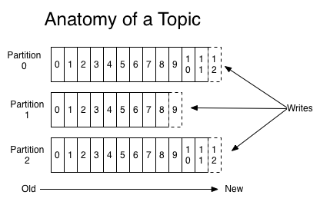
Apache Kafka: Topics & Partitions (2)
Each partition is an ordered, immutable sequence of records that is continually appended to -- a structured commit log.
Partition offset: The records in the partitions are each assigned a sequential id number called the offset that uniquely identifies each record within the partition.
For each topic, the Kafka cluster maintains a partitioned log that looks like this:

Slide 26
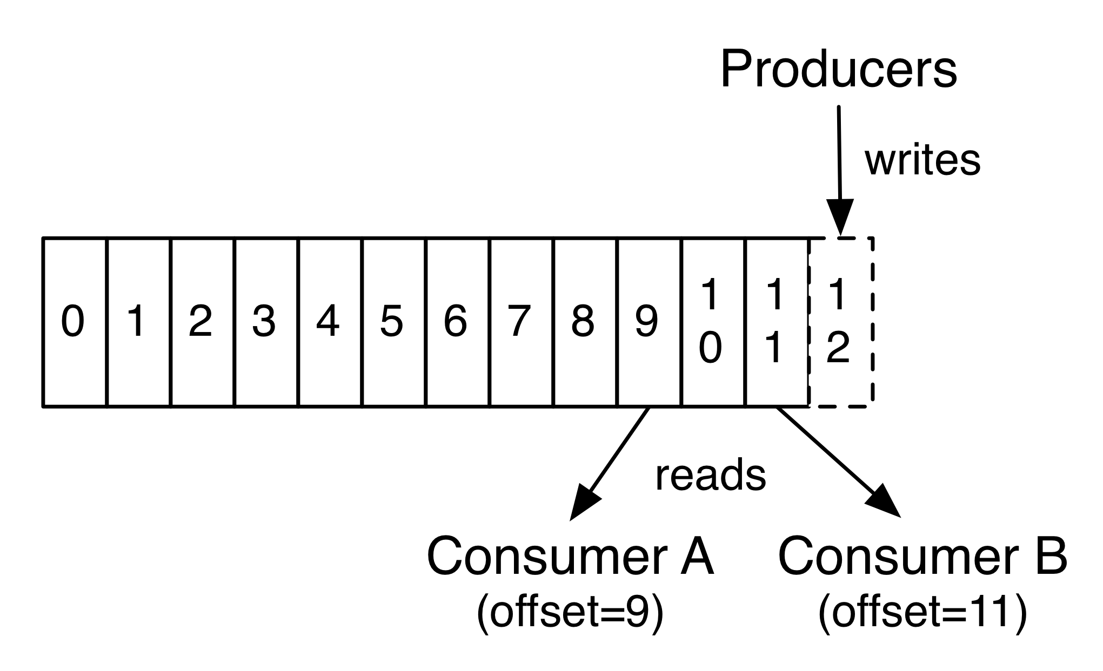
Apache Kafka: Topics & Partitions (3)
The only metadata retained on a per-consumer basis is the offset or position of that consumer in the log.
This offset is controlled by the consumer -- normally a consumer will advance its offset linearly as it reads records (but it can also consume records in any order it likes)

Slide 27
Apache Kafka: Topics & Partitions (4)
The partitions in the log serve several purposes:
Allow the log to scale beyond a size that will fit on a single server.
Handles an arbitrary amount of data -- a topic may have many partitions
Acts as the unit of parallelism

Slide 28
Apache Kafka: Distribution of Partitions(1)
The partitions are distributed over the servers in the Kafka cluster and each partition is replicated for fault tolerance
Each partition has one server acts as the “leader” (broker) and zero or more servers act as “followers” (brokers).
The leader handles all read and write requests for the partition
The followers passively replicate the leader. If the leader fails, one of the followers will automatically become the new leader.
Load Balancing: Each server acts as a leader for some of its partitions and a follower for others within the cluster.

Slide 29
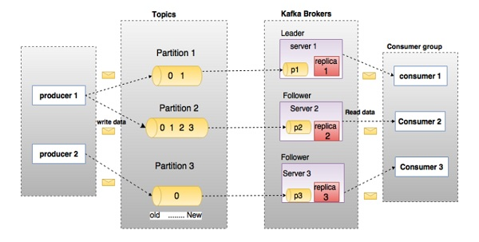
Apache Kafka: Distribution of Partitions (2)
Here, a topic is configured into three partitions.
Partition 1 has two offset factors 0 and 1.
Partition 2 has four offset factors 0, 1, 2, and 3.
Partition 3 has one offset factor 0.
The id of the replica is same as the id of the server that hosts it.

Slide 30
Apache Kafka: Components
Logical Components:
Topic: The named destination of partition
Partition: One Topic can have multiple partitions and it is an unit of parallelism
Record or Message: Key/Value pair (+ Timestamp)
Physical Components:
Producer: The role to send message to broker
Consumer: The role to receive message from broker
Broker: One node of Kafka cluster
ZooKeeper: Coordinator of Kafka cluster and consumer groups

Slide 31
Apache Kafka: Producers
Producers publish data to the topics of their choice.
The producer is responsible for choosing which record to assign to which partition within the topic.
Record to Topic: In a round-robin fashion simply to balance load or can be done according to some semantic partition function

Slide 32
Apache Kafka: Consumers
Consumer group: Balance consumers to partitions
Consumers label themselves with a consumer group name
Each record published to a topic is delivered to one consumer instance within each subscribing consumer group
If all the consumer instances have the same consumer group, then the records will effectively be load balanced over the consumer instances.
If all the consumer instances have different consumer groups, then each record will be broadcast to all the consumer processes.

Slide 33
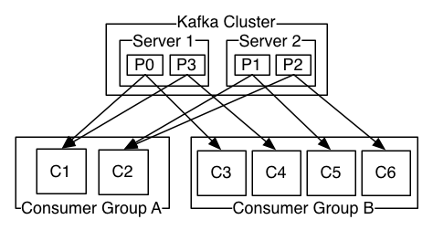
Apache Kafka: Producers & Consumers
Example:
A two server Kafka cluster hosting four partitions (P0 to P3) with two consumer groups (A & B). Consumer group A has two consumer instances (C1 & C2) and group B has four (C3 to C6).

Slide 34
Apache Kafka: Design Guarantees (1)
Records (or Messages) sent by a producer to a particular topic partition will be appended in the order they are sent.
A consumer instance sees records in the order they are stored in the log.
For a topic with replication factor N, we will tolerate up to N-1 server failures without losing any records committed to the log.

Slide 35
Apache Kafka: Design Guarantees (2)
Message Delivery Semantics:
At most once: Messages may be lost but are never redelivered.
At least once: Messages are never lost but may be redelivered.
Exactly once: Each message is delivered once and only once

Slide 36
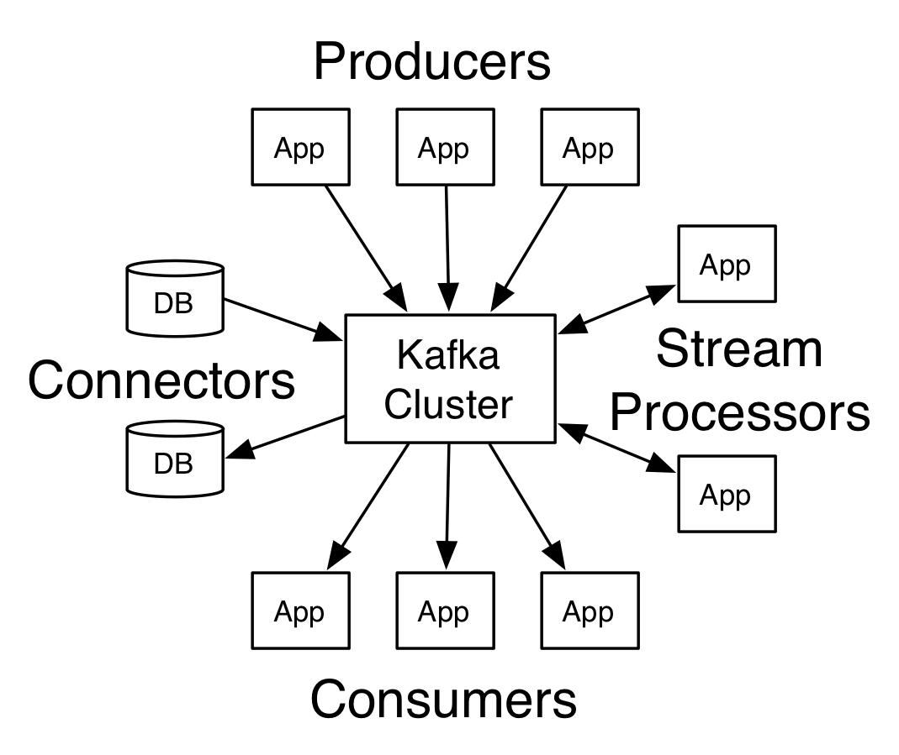
Apache Kafka: Four Core APIs (1)
Producer API: Allows an application to publish a stream of records to one or more Kafka topics
Consumer API: Allows an application to subscribe to one or more topics and process the stream of records produced to them
Streams API: Allows an application to act as a stream processor -- consuming an input stream from one or more topics and producing an output stream to one or more output topics

Slide 37
Apache Kafka: Four Core APIs (2)
Connector API:
Allows building and running producers or consumers that connect Kafka topics to existing applications or data systems.
For example, a connector to a relational database might capture every change to a table.

Slide 38
Kafka ← Messaging + Storage + Streaming
Messaging:
The consumer group allows you to divide up processing over a collection of processes (as a queue)
Allows you to broadcast messages to multiple consumer groups (as with publish-subscribe).
Storage: Data written to Kafka is written to disk and replicated for fault-tolerance.
Streaming: Takes continuous streams of data from input topics → Processing → Produces continuous streams of data to output topics.

Slide 39
Tricky aspects?
Using the publish-subscribe model for fault-tolerant request-reply interactions is actually not so simple.
Someone posts a request (easy), but now a random member of the worker pool wants to grab the request: a race condition.

Slide 40
Tricky aspects? (cont)
… to break the tie, your server logic publishes an announcement:
Worker W has taken over task T.
Everyone trusts the first such announcement, ignores later ones.
Then when worker W finishes, it announces “Task T is complete”.

Slide 41
Tricky aspects? (cont)
Now, we wire in a failure detector service, usually Apache Zookeeper. We arrange to publish “Worker W has failed” or “Worker Z has joined the pool”.
With this, everyone will notice if W owned task T, but then crashed. T can be reactivated, or reissued.
So the problem is solved… but notice that it wasn’t transparent!

Slide 42
… a form of group membership!
We’ve previously seen group membership. Here we have another case for that model!
This example is basically using Zookeeper + Apache to create virtual-synchrony groups, and the resulting semantics are basically identical to what Derecho does for Paxos (but much slower).
There is a whole mathematical theory, which we won’t cover, but it could be used to gain certainty that a solution is correct.

Slide 43
SUMMARY
Many big data systems are built using the standard Apache tools.
We’ve now seen a number of them.
The resulting systems are large and complex, often have many “moving parts”, and manage themselves.

