Slide 1
No Compromises: Distributed Transactions with Consistency, Availability, and Performance
Aleksandar Dragojevic, Dushyanth Narayanan, Edmund B. Nightingale, ´ Matthew Renzelmann, Alex Shamis, Anirudh Badam, Miguel Castro

Slide 2
A 5-lecture Roadmap!
Lecture 1: Transactions
Lecture 3: Transactions on DHTs
Lecture 3: Transactions on DHTs
Lecture 2: DHTs
Lecture 2: DHTs
Lecture 4: FaRM RDMA DHT
Lecture 5: HeRD and FASST
(Old topic) RDMA
(Old topic) RDMA
Notes:
We are now up to lecture 4 on this master plan.

Slide 3
FaRM technology at Microsoft
FaRM is an RDMA DHT created by Microsoft research but now used heavily in their social networking infrastructure (bing, Hotmail, etc). May become a part of Microsoft Azure someday.
These workloads are transactional, so the puzzle for FaRM developers was to show that we actually can support transactions on a DHT.
Their approach started by leveraging RDMA hardware. They were the first really famous cloud computing project to attempt this.

Slide 4
Distributed Transactions
Transaction
A unit of work that you want to treat as a “whole”
ACID
Distributed transaction provides powerful abstraction
Simplify building and reasoning about distributed systems
Previous implementations performed poorly
Believed to be inherently slow if applied to data in a DHT
Not widely used: everyone favors NoSQL right now.
Notes:
These slides were provided by them so there is a fair amount of overlap of terminology and so forth. But I left the slides as is simply because they do have a certain internal logic and coherence.

Slide 5
Hardware Trends
Modern cluster
Large main memory
Non-volatile memory
Fast network with RDMA
Notes:
So… we have normal machines (NUMA, but they won’t talk about that here), and RDMA, just like with Derecho and the SST. This actually runs on Infiniband for now but with that work we read about where Microsoft installed RDMA side by side with TCP over RoCE and got it working, presumably soon FaRM could be part of every Azure platform.

Slide 6
Remote Direct Memory Access (RDMA)
Read/ write remote memory
NIC (Network Interface Controller) performs DMA (direct memory access) request

Slide 7
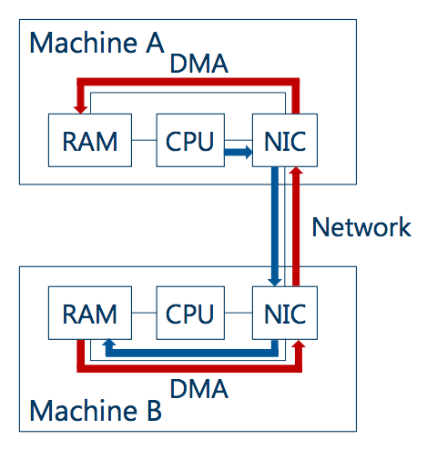
Remote Memory Direct Access (RDMA)
Notes:
A picture of RDMA in action. In this example, B has been granted access to A’s DRAM and A to B’s.
The one-sided RDMA mode used here is very rigid and controlled. A gets access only to a designated chunk of memory, not the whole thing (like a row in the SST), and vice versa. Each machine owns and manages its own memory, like we normally do on Linux (this is a Linux platform running C++ programs, or a Windows Server platform, still in C++). Nothing weird or different looking.

Slide 8
Remote Direct Memory Access (RDMA)
Read/ write remote memory
NIC performs DMA (direct memory access) request
Great performance
Bypasses the kernel
Bypasses the remote CPU

Slide 9
Hardware Trends
Modern cluster
Large main memory
Non-volatile memory
Fast network with RDMA
Eliminates storage and network bottlenecks but leaves the CPU bottlenecks

Slide 10
FaRM: No Need to Compromise
Main memory distributed computing platform
Use hardware effectively
Strict serializability
High performance
Durability
High availability
Notes:
ACID for NUMA memory!

Slide 11
Outline
FaRM background
Transaction protocol
Failure recovery
Evaluation

Slide 12
farm background

Slide 13
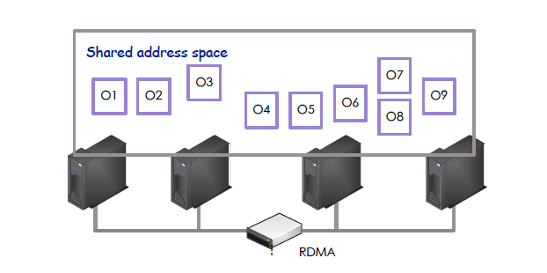
FaRM Programming Model
Distributed shared memory abstraction
FaRM API provides transparent access to local and remote objects
Notes:
The point here is that once A and B and C and D are all wired up with RDMA and FaRM, they all see the shared portion of the address space, cluster-wide. So all of them have access to all “objects” in the key-value store.

Slide 14
FaRM Programming Model
Application thread can start a transaction
Becomes the coordinator
During transaction, can execute arbitrary logic as well as read, write, allocate, free.
At the end of the execution, invoke FaRM to commit.
Notes:
You can do direct memory reads and writes – no need for message passing.

Slide 15
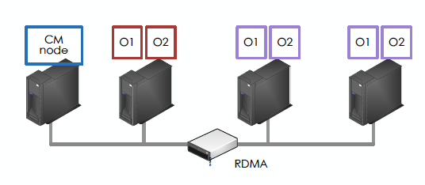
FaRM Architecture
Primary – backup for fault tolerance
Configuration Manager(CM)
Manage leases, detect failures, coordinate recovery
Notes:
Secretly, a second set of machines sits behind the first set and holds backups.

Slide 16
RDMA choices
RDMA supports two reliable modes: two-sided RDMA and one-sided RDMA, as well as several unreliable modes that include datagram transfers
FaRM uses one-sided RDMA
Nodes must first make a connection to peers. In FaRM, this results in an all-to-all connectivity pattern.
Then, each side can “authorize” the other side of a connection to do read or write operations in a designed region of memory.
With this permission, A can write directly in B’s memory. No action by B is needed, and B will not even receive an interrupt

Slide 17
RDMA Choices
But with very large numbers of long-lived RDMA pairs of this kind, the RDMA hardware can run into problems of several kinds
The NIC turns out to cache data associated with the mapped memory regions (the so-called “qpair” state for writing to them). This cache can become over-full and performance then degrades.
The NIC also caches the page mapping data from the IO Bus PTE. With large amounts of FaRM memory, the NIC memory for caching these PTE records will be exhausted, forcing an on-demand fetch, slow
Each active transfer has some state while the transfer is underway. With many concurrent transfers, NIC memory for active operations can overflow

Slide 18
Solutions
Number of FaRM servers is actually limited by the NIC capacity
FaRM runs on an older generation of NICs: 128 server limit
Newer NIC will allow scaleup to perhaps 1024 or more servers
FaRM configures the host machine to disable memory mapping for IO devices and employs 1MB pages (“huge” kernel pages). Relatively few DMA PTE records cover the entire local address space.
Careful attention to load balancing reduces risk of hot-spots that might have large numbers of simultaneous transfers into or from any single machine.
Notes:
FaRM has scaling limits (as would Derecho and its SST). FaRM uses an all-to-all connection and communication pattern and hits the limit fairly quickly, around 128 nodes on the NICs used in this paper and talk. 1024 on newer hardware.
Derecho’s limit is way larger: it makes all-to-all connections, but uses relatively few of them, so the NIC quickly learns to cache just the active ones. Thus it scales without hitting the NIC hardware issues.

Slide 19
More issues
With RDMA, the application needs to “poll” for I/O completion records. This can become costly if a single transfer involves a large number of I/Os.
Solution: RDMA is FIFO and completion records are optional. In a sequence of K transfers, only check for completion on the last transfer. This one event covers all the others.
When FaRM was developed, RDMA was unstable on RoCE. Solution: Infiniband
Notes:
In FaRM they do their best to perform batches of operations asynchronously and only check completion status now and then for whole batches at a time. This reduces overheads.

Slide 20
RDMA Read in FaRM

Slide 21
RDMA Read in FaRM

Slide 22
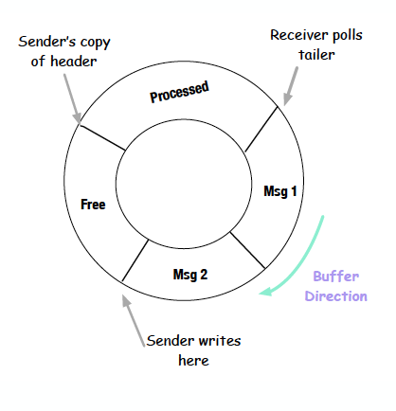
RDMA Write in FaRM
Notes:
You don’t see them as a user, but FaRM is actually working with a thing called a qpair, and each qpair has a round-robin buffer (shown here), and this is how the NIC talks to memory, using RDMA verbs. The details aren’t so important for us today, but are carefully covered in the paper linked to our web page.
So this is basically how CPU threads and FaRM NICs talk to one-another: via these round-robin buffers associated with qpairs, using the “verb” operation format.
In FaRM an active request is one on the pending outgoing transfers qpair. Then when it finishes, it gets moved to the inactive (terminated) list. If they asked for completion notices, the completion shows up on the “completed” qpair (this is why they call them pairs).

Slide 23
Lock-Free Atomicity for writes in FaRM
RDMA automatically provides atomicity for reads and writes if they access a single cache-line (objects of size 64 bytes or less, in current hardware)
So for small objects, no special care is needed: applications could read and write in the FaRM without worrying that a concurrent update might corrupt the data.
FaRM also includes a “test and set” operation
Useful when implementing locking
Required changes to the Mellanox firmware in the RDMA hardware
Notes:
The key thing to know is that the hardware provides atomic cache-line reads and writes, which FaRM can exploit. They added a test-and-set operation to allow atomic locking (recall from lecture 11, we had this concept that if we could only do atomic updates, 2-phase locking and 2-phase commit, a DHT could support transactions). So with FaRM we have atomic updates, locking… and in fact they have 2-phase commit.

Slide 24
Atomicity for Large writes in FaRM
Version numbers embedded into each “cache line” (normally 64 bytes)
When writing, create a new unique version number, write the data, then reread and check the version numbers.
If version numbers aren’t what you wrote, then your write was corrupted; retry
When reading, same rule allows you to notice if concurrent write changed some data
Notes:
If one object is big (like a long string), it might not fit in a cache-line (64-bytes). They have a way to handle that in which the compiler itself was modified.
Basically, big objects are stored as a kind of “struct” in C++ with a field added by the compiler, once per cache-line (e.g every 64th byte is the start of one of these inserted fields, and your string gets broken into substrings). The field has a version number.
They generate unique version numbers for each new write.
If you read your string but it has multiple different version numbers in it, someone else was writing at the same time, and you loop the read. A write rereads the object after writing, for the same reason.
They say that conflicts are rare and hence long periods of looped, failed, updates or reads are very unusual. But you do need to wonder about that.

Slide 25
Transaction protocol

Slide 26
FaRM Transaction Execution
Execute
C
P1
B1
P2
B2
One-sided RDMA read
Buffer writes as local
Notes:
This is about the 2-phase commit they added.
Key issue: what if the replication is still underway? Their idea: until the commit point, let replication run asynchronously. But at the commit point, pause and force the replicas into the proper state. Only commit when the data is properly mirrored.

Slide 27
Two Phase Commit
Execute
Prepare
Commit
C
P1
B1
P2
B2
Two round-trip message passing
Requires all machines’ CPU
Notes:
Notice how the prepare request to P1 triggered a message to B1, and an ack. That was how the primary (P1) made sure the backup (B1) was in sync.
Same for P2 and B2.
The commit also needs to reach the backups.

Slide 28
FaRM Commit
Use one-sided RDMA operations
Reduce message counts
Optimistic Concurrency Control (OCC) + read validation
Version number
Speculative execution -> lock write set -> validate read set (decision point) -> commit and unlock

Slide 29
FaRM Commit
Execute
Lock
C
P1
B1
P2
B2
Writes LOCK record to primary of written objects
Primary attempts to lock and sends back message reporting succeed or not
Notes:
This next part talks about how they added locking, which is actually optional. Of course if you don’t use it, you had better have a good reason to believe your code would be serializable. In practice normally transactions use 2-phase locking, but FaRM is being flexible here in case a trick like canonical ordering might let you avoid locking in some specific case.

Slide 30
FaRM Commit
Execute
Lock
Validate
Decision
C
P1
B1
P2
B2
Validates read set using one-sided RDMA

Slide 31
FaRM Commit
Execute
Lock
Validate
Replicate
C
P1
B1
P2
B2
Logs to Backups using COMMIT-BACKUP
Coordinator waits until receives all hardware ack

Slide 32
FaRM Commit
Execute
Lock
Validate
Replicate
Update and Unlock
C
P1
B1
P2
B2
Writes COMMIT-PRIMARY
Primary processes by updating and unlocking
Responds to application upon receiving one hardware ack

Slide 33
FaRM Commit
Execute
Lock
Validate
Replicate
Update and Unlock
Truncate
C
P1
B1
P2
B2
Coordinator truncates after receiving all ack from Primaries
Piggybacking in other log records
Backups apply updates at truncation time

Slide 34
FaRM Commit Correctness
Serialization point
Read-write Tx: all write locks acquired
Read-only Tx: last read
Equivalent to committing atomically at this point
Notes:
We won’t worry about the proof, but it is worth noting that it isn’t enough to just claim that the solution is correct. These algorithms are complex and require careful correctness proofs.

Slide 35
FaRM Commit Performance
Use primary - backup to reduce number of copies of data
Use one-sided RDMA extensively
P_{w}(f + 3) RDMA writes
P_{r} RDMA reads
Notes:
Next question is performance: how fast can FaRM run?

Slide 36
Failure recovery

Slide 37
One Sided Operations Complicate Recovery
CPU does not process remote access
Configuration change
Precise membership
Recovery
Drain logs before recovering
Notes:
It turned out that the limiting factor was the speed of one-sided RDMA, which was actually unexpectedly slow.
A second concern was that replication was slowing them down.
They include some slides now on how they sped that step up by running it asynchronously, in parallel with normal computing.

Slide 38
High Availability
Short failure detection time
Data available instantly
A backup promoted to primary
Use parallelism
New transactions in parallel with recovery
Recover transactions in parallel
Recover data in parallel

Slide 39
Failure Recovery Steps
Detect failure
Reconfiguration
Recover transactions
Recover data

Slide 40
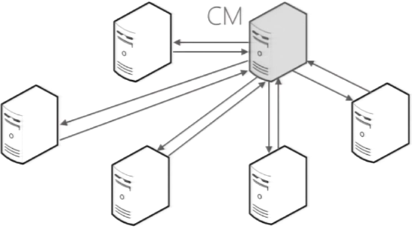
Failure Detection
FaRM uses leases to detect failure
Notes:
Detecting failures was the first real puzzle. We mentioned this in lecture 11. How can you know if P1 or B1 might have crashed? If you don’t get this right, your system becomes inconsistent (e.g. you don’t update P1 because you thought it was faulty, but someone else thinks P1 is fine and gets an old value from it, thinking that the value is current).
They use a service called Zookeeper to avoid such issues.

Slide 41
Failure Detection
Short lease interval, high availability

Slide 42
Reconfiguration
suspect S3
CM=S1
S2
S3
S4
Probe

Slide 43
Reconfiguration
ZooKeeper
suspect S3
<9,…> -> <10, {S1,S2,S4}, F, CM=S1>
CM=S1
REMAP
S2
S3
S4
Probe
Backup becomes primary, load balancing

Slide 44
Reconfiguration
ZooKeeper
suspect S3
<9,…> -> <10, {S1,S2,S4}, F, CM=S1>
CM=S1
REMAP
S2
S3
S4
Probe
NEW-CONFIG
NEW-CONFIG-COMMIT
NEW-CONFIG-ACK
Machines apply new configurations, stop accessing to affected region

Slide 45
Reconfiguration
ZooKeeper
suspect S3
<9,…> -> <10, {S1,S2,S4}, F, CM=S1>
CM=S1
REMAP
S2
S3
S4
Probe
NEW-CONFIG
NEW-CONFIG-COMMIT
NEW-CONFIG-ACK
Recovery starts after everyone stops accessing recovering regions

Slide 46
Transaction Recovery
C
NEW-CONFIG-COMMIT
P
Block
Drain
B1
Block
Drain
B2
Block
Drain
NEW-CONFIG
Process all the messages in logs that haven’t been processed
Notes:
When recovering, they have to patch up any missing updates that, for example, P1 didn’t see because for a while P1 was considered to be down. They use logs for this purpose.

Slide 47
Transaction Recovery
C
P
Block
Drain
Find Recovering
Lock
B1
Block
Drain
B2
Block
Drain
Region looks as it is before the failure

Slide 48
Transaction Recovery
Region is active
C
P
Block
Drain
Find Recovering
Lock
B1
Block
Drain
B2
Block
Drain
Operations on the region in parallel with recovery

Slide 49
Transaction Recovery
Region is active
C
Decide
Vote
P
Block
Drain
Find Recovering
Lock
B1
Block
Drain
Replicate logs
B2
Block
Drain
New coordinators are spread around cluster

Slide 50
Data Recovery
Need to re-replicate data at new backups
To tolerate failures in the future
Parallelize data replication
Done in background
Starts after locks acquired at all primaries
Paced
Notes:
Same deal if the backup was down but the primary was up.

Slide 51
Evaluation

Slide 52
Evaluation Settings
90 machines cluster, 5 machines ZooKeeper
256 GB DRAM, 16 cores
30 threads for foreground work, 2 threads for lease manager
2x Infiniband Mellanox ConnectX-3 56 Gbps
3 way replication (1 primary 2 backups)
Standard OLTP benchmarks
TATP, TPCC

Slide 53
TATP Performance
Read dominated
70% single read
10% read 2-4 rows
20% updates
Notes:
What you see here is that FaRM does great until the load hits a certain point, and then suddenly all the latencies soar. This is telling us that backlogs became infinite, basically that they overloaded FaRM. It was up to about 120 operations per microsecond at that point, with 90 machines generating and handling the load.
So that would be 120 million transactional operations per second on 90 machines! Pretty impressive if you check the comparable numbers like for the Oracle database product.

Slide 54
TPC-C Performance
Complex transactions
10% distributed
45% “new orders”
Notes:
With TPC (complex transactions from SQL) the rate of commits they can handle is limited to around 4M per second in the 90-machine cluster. This is very impressive, but notice how with more work presented to the cluster, the delay soars. In fact, as queues get longer, the maximum load they can handle actually drops, due to backlogs, causing the curve to double back (weird but not an unusual graph format in the systems community these days).

Slide 55
TPC-C Recovery
Notes:
Recovery took about 50ms in this example (1/20th of a second)

Slide 56
TPC-C Recovery
Notes:
Here they superimposed a second curve showing the background recovery task running. It took a while to read all the queued log records. They use two Y axis labels, one for the transactions/second (black and sits near 4M/second) and a second for log records processed to get the backup in sync with the primary again.
It took about 4 minutes to fully resync.

Slide 57
TATP 18 Machines Failing
Notes:
Here 18 out of 90 machines all crashed. Now the impact is much larger.

Slide 58
TATP CM Failure
Notes:
Now they messed with Zookeeper, the “configuration manager”.

Slide 59
Conclusion
FaRM transactions
Tailored to hardware in modern data centers
RDMA, low message counts, parallelism
High performance
High availability
Notes:
Summary: FaRM was really fast, but has limits.
Some limits: to get this speed they had to disable virtualization on their cluster of computers, configure Linux to use 1MB pages (these are way bigger than usual), and do all sorts of RDMA tricks, much as Derecho was forced to do.
For FaRM, it turns out that the active use of n x n connectivity is putting more pressure on the RDMA NIC than we saw in Derecho. Derecho has n x n qpairs too, but tends to only use small subsets: a single node might have 10,000 connections but only be using 9 of them actively at the same time (this is because only active RDMC sessions need qpairs, but those have a hypercube virtual overlay and hence any node only talks to its 3 neighbors). The SST has an all-to-all pattern, but in fact you only talk to other members of your shard while actively running.
So RDMC avoids an issue that matters way more in FaRM. They overload the NIC’s limited capacity to cache information for active qpair connections, or active DMA mappings, and this causes the NIC itself to perform poorly. They work around the issue by disabling DMA mapping and using big memory pages.

