Slide 1
Adapting the Transaction Model for Key-Value Storage
Ken Birman
Spring, 2018

Slide 2
A 5-lecture Roadmap!
Lecture 1: Transactions
Lecture 3: Transactions on DHTs
Lecture 3: Transactions on DHTs
Lecture 2: DHTs
Lecture 2: DHTs
Lecture 4: FaRM RDMA DHT
Lecture 5: HeRD and FASST
(Old topic) RDMA
(Old topic) RDMA
Notes:
So now we are on lecture 3 of our sequence!

Slide 3
Overview of next 3 lectures
Today we will do a broad-picture lecture: Can the transaction model be applied to sharded data? This is a big topic, so we will be shallow.
Next lecture dives down and looks at FaRM, an RDMA DHT that actually supports transactions. FaRM is an important component of Microsoft’s social media systems (but I’m not sure if you can access it in Azure yet).
The lecture after that looks at HeRD and FASST, which are similar to FaRM but claim to be far faster due to using RDMA in smarter ways. These are research papers, from a team at CMU.

Slide 4
Sharded storage (Key-value DHT service) scales really well!
Our DHT model is extremely effective, especially inside the datacenter
Unlike the WAN case, latencies are low, and membership is known
We’ll see that with modern networks, performance is even better
But the DHT model that scales is annoyingly limited
Easy to support get and put, the basic memcached API
But they are fully bought into CAP: no consistency at all.

Slide 5
NoSQL: Is it really the answer?
Some kinds of web applications can be coded in SQL and will still execute correctly without transactions.
Core problem:
Relational and OLTP data easily “fits” the key-value model
But some applications are more sensitive to inconsistency than others

Slide 6
NoSQL: Is it really the answer?
NoSQL works really well for:
Read-only workloads: if nothing is changing, then you’ll see consistent data, and yet didn’t need locks, didn’t need cache “coherence”, etc.
In the web, surprisingly many applications fit this case!
So to first approximation: use NoSQL models if your data never changes.
But if we care about fog computing… or other data that changes…
Notes:
This gets back to the point about Dynamo: NoSQL is a big source of bugs.
Can we do actual transactions on a DHT and get full ACID properties? Could SQL run on data in a DHT?

Slide 7
With dynamic updates
NoSQL can mash data from different periods of time together
If we have a “data structure” spread over the DHT, we might be unable to search it or update it
Even basic integrity constraints can be violated.

Slide 8
Transactions could solve this
With full transactions spanning the entire DHT, life would be easy
… so
Maybe we shouldn’t give up on transactions so casually!
Notes:
It would be nice to solve this, even if we can’t do a fully general solution.
A full solution would cover entire database products and would be the best of all. But sometimes you can’t have everything.
A partial solution would force us to shoehorn our code to match the partial model, but at least it would give us a real option for things that need consistency, if we can express them in a way that matches the partial thing.

Slide 9
So Why not just build a full database?
Recall that Jim studied this question, in work with colleagues at Microsoft
[The Dangers of Replication and a Solution. Jim Gray, Pat Helland, Patrick O'Neil, and Dennis Shasha. SIGMOD, 1996.]
Their finding: yes, it could work, but…
Simply spreading a database over n nodes, with no special attention to layout and then having the nodes share the workload is inefficient.
Worst case they looked at slowed down by O(n⁵)
Notes:
Unfortunately, as we learned a week ago, if you just spread a database over N nodes and have all the nodes allowed to initiate any operations at all, conflicts cause long locking delays and aborts, and performance tanks.
They slow down as n⁵: with even 2 nodes doing this, we see as much as a 32x slowdown under arbitrary workloads! This is horrible.
So n=1 is the only real option, for a fully general case.

Slide 10
Why so slow?
They identified a number of issues
When data is spread on n replicas, and they all do some work, concurrency control conflicts cause delays or abort/rollback/retry
As a result, each transaction may actually have to execute many times and this creates a dominating overhead, explaining the O(n⁵) cost
In “realistic” databases, it would be more like O(n³)… still a crazy cost!
Slow as molasses in January…

Slide 11
Jim’s suggestioN?
Split the single database into many subsets
A DHT seemingly has this property
Then do all the work on a primary node, and simply shadow the updates to backup nodes. But this is less feasible and not typical of a DHT
Notes:
Jim basically suggested breaking the database into many small sub-databases, or shards. Then run each shard with ONE primary leader, and just have a passive backup for fault-tolerance.
Now n=1.

Slide 12
Hacks
Without help from the DHT itself, how far can we get?
Assume that you are given a DHT that implements the memcached API, but has no “properties” at all
Could you sort of “force” it to be transactional?

Slide 13
Transactional Goal: Reminder
BeginTransaction; ReadOperations; WriteOperations; …. ReadOperations; WriteOperations; Commit; (or Abort;)
… we also need some way to support read and write locking.
BeginTransaction; DHTGet(…); DHTPut(…); …. DHTGet(…); DHTPut(…); Commit; (or Abort;)

Slide 14
DHT Details that become relevant
Any DHT backs up its data onto at least one or two spare nodes.
Usually, nodes right next to where your data is inserted.
Any of the K replicas can handle read requests
Node K
Node K+1
Node K+2
X
X
X

Slide 15
Concurrent access? confusing results
If reads occur while these updates are still propagating, they could end up accessing a prior copy on one of the replicas
For load-balance, many DHTs randomize reads over the set of replicas
So you could “put” (key,X), then “get(key)” and might not see X for a little while – even from the same thread, and certainly from different threads or programs on different nodes.
In most DHTs you actually don’t know when your “put” has finished.
Normally, soon after you do the operation, but no way to be sure.
Notes:
You can’t actually use the replicas for reads, unless you are ok with reads that return stale data. Even then, you might not get transactional guarantees.
So in fact n=1 is a very real issue. Even reads have to go to some single leader, per shard.
And we can’t support transactions that touch data in more than one shard at a time.

Slide 16
Locking: Seemingly impractical
A natural idea is to “put” a lock record, such as “Ken wants lock X”
You could key it by X
Then could, perhaps, arrange that whatever “get” returns tells you who owns X. But this won’t work because put and get lack consistency and get won’t guarantee atomicity.
Notes:
People have tried to hack around this. You can easily hack a locking mechanism, but that might not be as scalable as the DHT itself, since the weak consistency of the DHT could easily lead to malfunctioning locking, which you don’t want. Locking in a DHT usually is done with Zookeeper… and it doesn’t scale very well. So, Jim Gray’s thing, all over again.

Slide 17
Suppose the DHT operations were atomic
With more “determinism” and atomic put/get, life would improve
Now we can do locking via a kind of test-and-set variant of put
This would extend the normal memcached API; you can’t do it with traditional memcached put.
But you could certainly add a test-and-set operation to memcached
Notes:
Now, a better DHT could fix this. Can one create one? FaRM is Microsoft’s answer.

Slide 18
Suddenly the DHT looks like a memory!
Normal computer memories, for NUMA machines, have:
Cache line atomic instructions for reads and writes.
Test-and-set instructions to implement locking
In effect, we would have shifted from a DHT model to a “massive shared memory” NUMA model!
Correct algorithms for this form of shared memory are standard!

Slide 19
As we will see in Lecture 12, this exists!
Several research projects, and at least one commercial cloud service (a Microsoft Azure service called FaRM) have atomic distributed shared memory behavior
We will look closely at FaRM in the next lecture, and then at Herd and FaSST, which offer similar capabilities but made different design choices
The FaRM people like to think of their DHT as a big memory
In a normal memory, you access objects by address
In a DHT like FaRM, the key is “like” an address!
Notes:
We will look at it in lecture 12

Slide 20
Would we want transactions?
If we had a DHT with true atomicity semantics, like a large NUMA memory, it isn’t obvious we would want transactions.
In fact that would correspond to “transactional memory”, and as we saw, while the vision was inspiring, as a practical matter, transactional memory requires knowledge of exactly how the compiler implements the model
We might just use “standard” concurrent data structures

Slide 21
Flattening a data structure
One concern with DHTs that act like large NUMA storage systems is that when data doesn’t live at a single location, “jumping around” becomes costly.
The term “flattening” has emerged. It isn’t an ideal word for the idea:
Start with some database or structure that scatters data over more than one key (into more than one node of the DHT)
Reorganize it so a single parallel action suffices for every operation

Slide 22
Flattening a Data Structure
Start with a normal sequence of actions, but find a way to run them as a single highly parallel operation, concurrently.
Notes:
This is one of a few tricks that can get 5x speedups. Think of a “grab bag of issues and solutions”. We’re looking at a hard problem, Gray’s point shows that we can only solve it to a limited extent. So we need a bunch of techniques and maybe can pull off a limited solution.

Slide 23
parallel?
X
X
Y
Z
Z
Y
Not flattened Flattened
We often can’t arrange the data so that all our data will be on one machine
But if we can flatten the data structure, a set of parallel requests can be sent, each to some portion of the data.
It has to be a single phase of work, otherwise it isn’t “flat”
Costs will be similar to a single put or a single get.

Slide 24
Canonical ordering
Long-duration locks can often be avoided by doing things in some agreed ordering within each of the machines holding portions of the data.
For example, suppose that we are updating a tree, and reading the tree, and that our flat structure has multiple tree-nodes per machine.
If our updates and reads walk the same path from the root, we access the tree-nodes in the same order, and this avoids a need to hold locks.
Notes:
Reducing the need for locking can avoid hot-spots associated with lock mechanisms.

Slide 25
Example: Portion of a Flattened tree
In this example, a portion of a tree ended up on one machine.
When we access machine A, the logic of the request visits Tnodes X, Y, Z
Using a pre-decided order gives consistency without long-lasting locks
Machine A holds all three Tree-Nodes in this example.
TNode
TNode
Z
X
TNode
Y

Slide 26
What about replication?
In cloud storage systems, we often MUST have a replica of any data we work with, because failures are inevitable.
If we flatten a data structure with the goal that every action happens in one request-response “cycle”, how do we also keep replicas?
Answer: Concurrency can help

Slide 27
Chain Replication
Problem: Maintain a backup of X but don’t “slow down” our system
In a flat data structure, we can pick some node as the “head of the chain”
Updates are sent to it. It forwards to the next replica, then replies.
No need for locking. The “flow” of updates follows a pipelined path.
Primary of X
Replica of X
Replica of X
X
X’
X’’

Slide 28
Optimistic Chain Replication
Problem: Maintain a backup of X but don’t “slow down” our system
Here the head of the chain replies as soon as the update is done.
Leaves a small window when the update can be lost, but reduces delay.
Primary of X
Replica of X
Replica of X
X
X’
X’’

Slide 29
Redundant Representations
We replicate data if we make identical copies on multiple nodes, like for backups on the previous slide.
There is a second technique with a similar name that can be helpful when flattening: redundancy. We make copies but not just on the backup nodes.
By making redundant copies of data we can sometimes flatten data that might not have been possible to flatten if data lived just in one place

Slide 30
Redundant Representations
backup
A’ | B’ | C’ | D’ | E’ | F’ | G’
primary
A | B | C | D | E | F | G
3
6
7
9
11
22
23
In this list, the only way to know the value of the next or last node is to fetch it separately.
If we make a redundant copy of the next and last node, we can do a purely local check. Different from replication, which is when we maintain a backup “replica” for each node.
A | B | C | D | E | F | G
3
6
7
9
11
22
23
6
3
7
6
9
7
11
9
22
11
23
22
Notes:
Here the idea is that extra replicas can sometimes reduce the need to jump around in the DHT. But honestly, by now we are pushing into research-land. You don’t yet see commercial DHT products using techniques like this.

Slide 31
Redundant data: Pros and Cons
Pro: Query finds more of what it needs at a single place.
Con: When updating the data, we need to update the replica for fault-tolerance, but now also need to update the redundant copies.
A system like Derecho might help, if we can design a subgrouping structure to match the resulting multicast pattern for updates.

Slide 32
DHT organization can help too
The kind of DHT we have discussed so far takes a key, hashes it in a pseudo-random way, and this determines the node that owns the data
But some DHT designs (like CAN) skip the hashing step. At Cornell, Prof. Sirer built such DHTs (HyperDex).
Those versions can support “range queries” in a flattened way.

Slide 33
What is a range query?
Consider a smart car on a smart highway.
The car might ask “What objects are within 500m at this time?”
This is best understood as a portion of the highway
My current location, +/- 500m.
A “range” of space, within which a list of vehicles can be found

Slide 34
With HyperDex such queries are fast!
The internal organization of a DHT like HyperDex clusters data within similar key values.
HyperDex also allows the key itself to be a vector of values.
Redundancy is the key to enabling fast range queries in such cases
Ideally, you want all the data for a given range query to be available at some single node

Slide 35
Resulting approach has compromises
Definitely not full transactions in the SQL model!
But we may end up with a way to do atomic reads and writes when accessing data within any single DHT node
And with these techniques (flattening, redundancy, splitting), this can get us to that world of “one phase, parallel operations” we were seeking.

Slide 36
More issues experienced with DHTs
It can be very hard to debug a malfunctioning program
Suppose that my program loops and starts to do “Put” operations at random locations
I kill the program… but the DHT still is full of junk
So the question arises: unlike files, where you can easily see them by just listing the directory, how do we figure out where a DHT application has left data lying around, who created it, etc?

Slide 37
One common solution: Leases
With a “lease” model, when you insert data, you also specify a retention policy and a timing limit.
Policy could be “only as long as my program is still running”
Or it could be “As long as there is a pointer to this key in some other object”
DHT design limits how fancy retention rule can be, obviously.
Then you also put a timeout: “auto-delete this object after 30m”

Slide 38
DHT debugging Tools
Professional DHT solutions always include tools for debugging
These help you check to see when an object was created
… who created it
… whether it is being accessed, and how often
… whether the DHT as a whole has “hot spots” or “cold spots”
… whether more complex data structures are consistent

Slide 39
Hot and Cold spots
DHT keys are supposed to be hashed to a “random” number.
Question: will randomness give us even spacing and even loads?
(k,v) tuples
(k,v) tuples
(k,v) tuples
(k,v) tuples
(k,v) tuples
(k,v) tuples
(k,v) tuples
(k,v) tuples
(k,v) tuples
(k,v) tuples
Node X
Node Y
Node Z
Key space

Slide 40
Random doesn’t mean “evenly spaced”!
Many people have the wrong intuition about randomness
Random sequences are very bursty and can have all sorts of strange clumps or gaps
So a DHT is very likely to end up with uneven distributions of objects

Slide 41
Random doesn’t mean “evenly spaced”!
A further issue is that most applications have popularity “distributions”
Recall our Facebook caching examples
Popular photos were far more likely to be accessed again and again
So, in the DHT, those items get many more read requests.

Slide 42
Hot and Cold spots
DHT keys are supposed to be hashed to a “random” number.
Question: will randomness give us even spacing and even loads?
(k,v) tuples
(k,v) tuples
(k,v) tuples
(k,v) tuples
(k,v) tuples
(k,v) tuples
(k,v) tuples
(k,v) tuples
(k,v) tuples
(k,v) tuples
(k,v) tuples
Node X
Node Y
Node Z
Key space

Slide 43
Options for spreading load
In some DHTs, each node is inserted at K different spots
Instead of just using node-ID as the key, use node-ID.x, x=0…k-1
These should be pretty random locations
Individual roles may be hot or cold, but this tends to even load out

Slide 44
Options for Spreading load
Other DHTs are dynamically rebalanced in software
For example, Prof. Sirer created a DHT called Beehive in which the (k,v) tuples are replicated to a greater (or lesser) degree, based on popularity
He and his student found a way to ensure that access costs would be exactly O(1), even with very uneven loads
The trick was to track loading and periodically adjust the replication factors, so that as an item got hot, it also became more replicated.

Slide 45
There is always a “Catch”
These different techniques are somewhat at odds with simplicity
The merit of Chord was its extreme simplicity
These fancier approaches compensate for practical problems, but leave us with a more complex DHT, and the different aspects might potentially interfere with one-another in some situations, harming performance

Slide 46
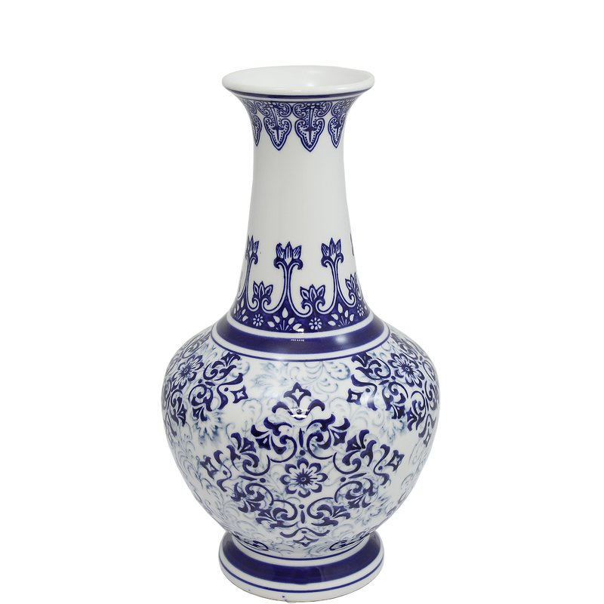
Summary
DHT is really a fragmentation “technology” (the term “sharding” is used).
A DHT with transactional get/put/test-and-set would be very helpful. Today we are forced to use NoSQL even when the fit is poor.
For one-shot transactions, we often “flatten” data structures. This is a cottage industry: modify data structures to work well in DHT settings.
If data replication were cheap enough, varying the size of shards can be really useful as flattening tool.
Notes:
So, to summarize, we wanted ACID for transactions on DHTs, but without triggering Jim Gray’s n⁵ slowdown issue. And it isn’t turning out to be trivial. Locking, 2-phase commit, aborts – these are costly, real issues. DHT data representations are not ideal: they spread stuff over lots of machines, so how can you avoid interactions with lots of machines? But those will be slow, unless we somehow “over-replicate” to create local read-only copies of things.
Still, this is the world we are in, once we shard our data.

