Slide 1
CS5412: Where Did My Performance Go?
Lecture XVIII
Ken Birman

Slide 2
Suppose you follow the rules…
You set out to build a fairly complex large-scale system for some kind of important task
  Maybe not as mission-critical as a power grid or an air traffic control system…
  … but on the other hand, smart cars are a hot topic, and robots, and many of these play safety critical roles
You use clean-room techniques, object oriented programming, cutting edge quality-assurance

Slide 3
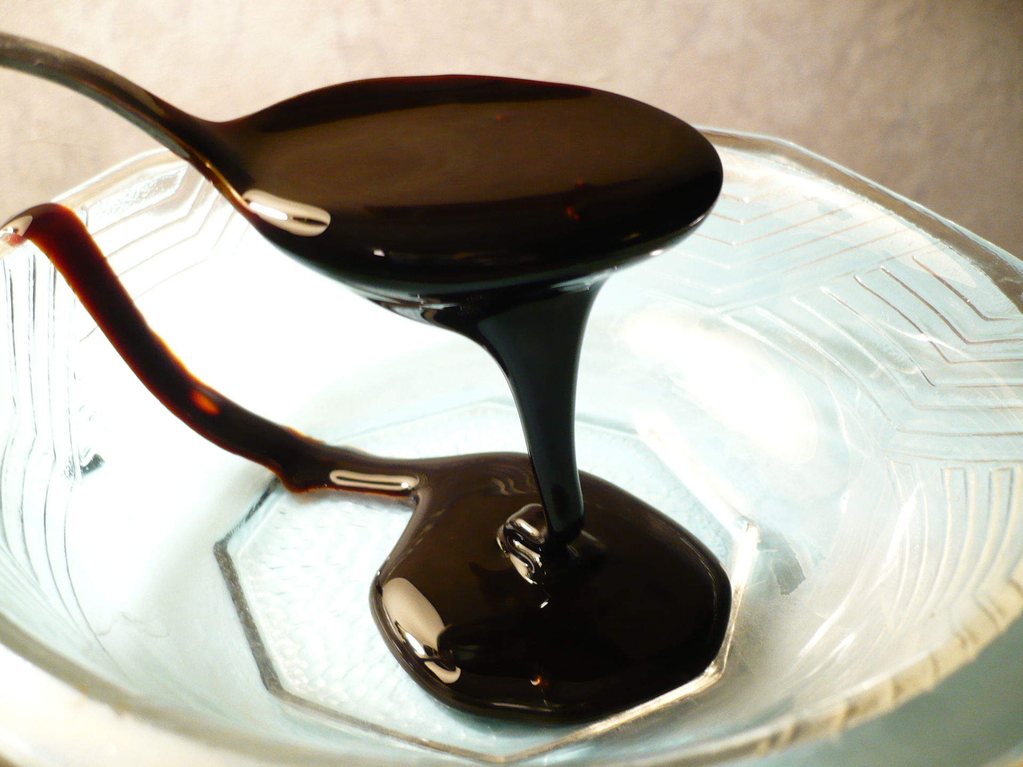
… and when you are done, the system is slow as molasses!
What makes complex systems so slow?
How can we run complex solutions in cloud settings without paying a huge performance cost?

Slide 4
Guesses you might make
Cost could be due to virtualization
  Argues for containers: they provide a half-way virtualized OS API but the benefit is reduced overhead
Costs could be due to scheduling/coresidency
  On the cloud we often share the computer
But costs might also come from the hybrid coding style and its associated overheads

Slide 5
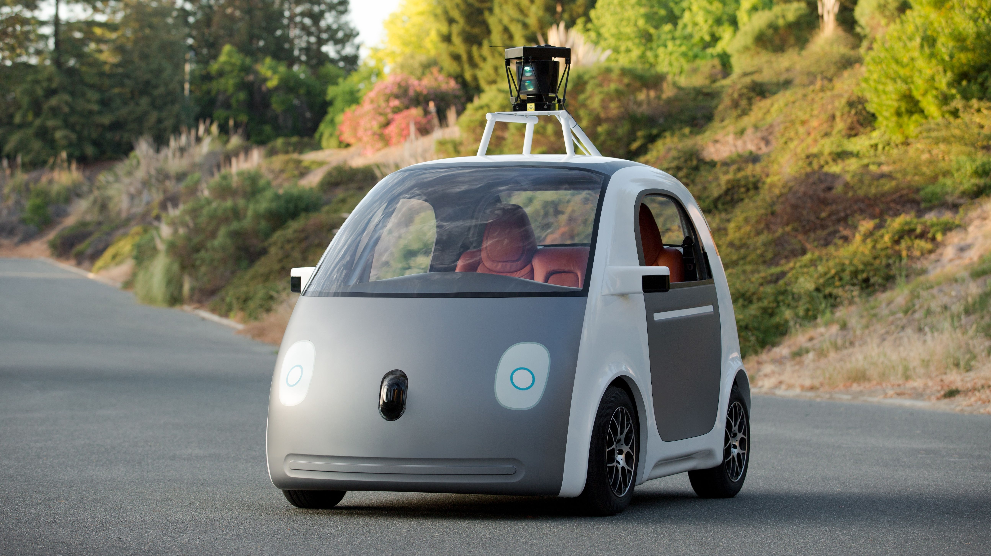
Example: A smart car platform
1
Gateway (backup)
log
3
2
log
Gateway (primary)
3
Multicast Notifications
4
6
Message Bus
Computational Services
Computational Services
Computational Services
5
5
5
(1) Automobile notifies system of a new event
(2, 3) System gateway accepts event, logs it locally and to a backup node
(4) Message bus (DDS) used to notify computational services
(5) Services compute routes, recommendations, etc.
(6) Multicast used to update knowledge database in the vehicle and also in other vehicles impacted by the event

Slide 6
Componentized design
There is a dominant trend towards building complex systems from “components”, which can be entire programs and might be coded in different languages. Each element in this design is probably created from multiple components
For example you could have a C# library used from C++/CLI and talking to other helper components written in C, standard C++ and Java, all on one platform
This implies frequent “domain crossing” events, which also require serialization and deserialization

Slide 7
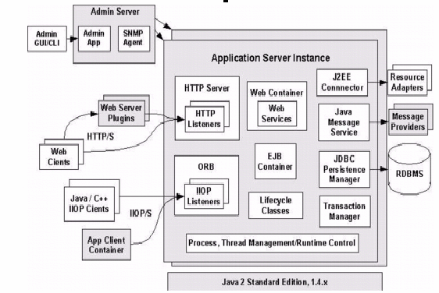
Componentized design
This example comes from the ORACLE Java.com site
Notice that in addition to your code there are many other helper components
Every modern system looks like this!

Slide 8
Where would costs arise?
Some events involve capturing images, video, lidar, etc. and might have large associated binary objects
To send messages in an object oriented setting
  Need to “serialize” data into out-form, often costly and the out-form can be much larger than the in-form
  Send it on the wire or log it to disk
  Later on reception (or reading it) must de-serialize
Question: how many times might this occur in this kind of architecture?

Slide 9
Complex objects
A first thing to realize is that most objects are fairly complex
A lidar image captured by a smart car would have the radar data but might also include GPS coordinates, vehicle orientation and speed, altitude, angle of the sun, any filters being applied…
So these have many fields that must be serialized

Slide 10
High costs of serialization
We use the term serialization when a computing system converts data from its internal form to some kind of external form that can go on disk, on a network, or be passed to a component in a different language
The external representation needs to be self-explanatory so that the receiving component can use it to build an object that matches what was sent
A common style of representation is to use text and format it using XML, like a web page

Slide 11
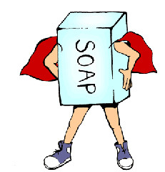
SOAP: Simple Object Access Protocol
SOAP is a widely supported standard for using this kind of “web page” as the basis for one component accessing another component
SOAP assumes an object to object style of interaction, but in practice a component could have many objects and can expose any of their static interfaces if the arguments are all by value.

Slide 12
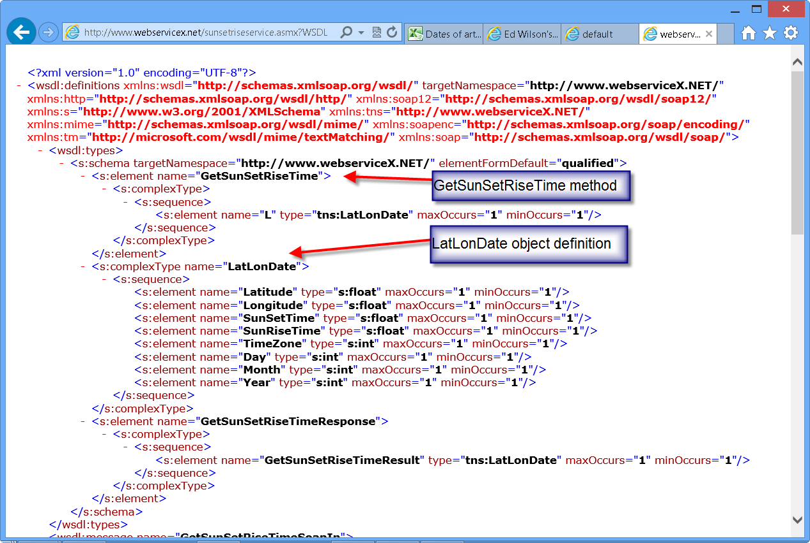
SOAP: Simple Object Access Protocol
SOAP is a widely supported standard for using this kind of “web page” as the basis for one component accessing another component
SOAP assumes an object to object style of interaction, but in practice a component could have many objects and can expose any of their static interfaces if the arguments are all by value.

Slide 13
SOAP representation
The SOAP request format includes things like the service being accessed, the version number of the API that the caller was compiled against, the request being issued, and the arguments that were supplied to the request.
Each argument could be a complex object, and it can include references to other objects as long as all of them are fully contained in a single “tree”
XML nesting is used to represent inner objects

Slide 14
SOAP representation
Later when the request finishes, the component can send back a reply
  This is done in a similar manner, using a SOAP response object, again with a header and so forth
SOAP type checks at every stage
  If a type exception arises, SOAP always throws it on the caller side, not on the service side
  This way if a server is upgraded, old clients that are launched accidentally won’t crash it

Slide 15
What makes serialization costly?
Generating the SOAP message can be surprisingly computationally expensive
  Recursively we need to visit each element
  For each one, make sure to output a “type description” and then emit the corresponding object
  Any value types will need to be converted accurately into a text form. For example, we can’t lose floating point precision in a SOAP request/response, unlike when you print a floating point number on the console
All of this makes messages big and slow to create

Slide 16
Why not use binary format?
Older systems often used binary representations and in fact there are many popular request/reply formats and representations
The super efficient ones assume same data representations on source and destination: same programming language, version (patches included), hardware architecture and operating system
But we can’t always be so lucky. SOAP is universal.

Slide 17
Costs of serialization, deserialization
CPU overheads to serialize (left) and deserialize (right), 10,000 times
Estimating the Cost of XML Serialization of Java Objects.
Imre, G. ; Charaf, H. ; Lengyel, L. IEEE Engineering of Computer
Based Systems (ECBS-EERC), 2013.

Slide 18
Example: A beverage distribution center
Suppose that we are just looking at a very simple case, like records sent from the cash-register at the Ithaca Imported Beverages company to the database it uses for inventory
They specialize in imported beers, so consider costs of serialization of a “beer record”
Example from M@X on DEV (www.maxondev.com)

Slide 19
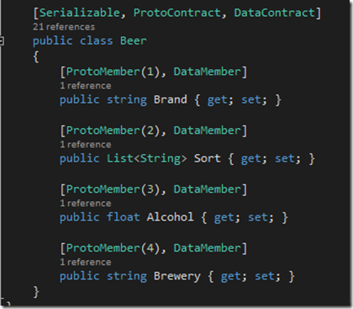
Size overheads: A “beer” object
C# example of a class that might describe a Belgian beer
It has a brand, a level of alcohol, a brewery, etc.
Notice that only some of these are fields with associated data and the data is very simple in this example!

Slide 20
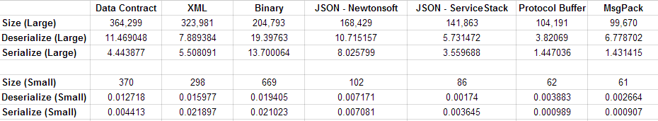
Tabular summary of costs
Space costs in bytes, time costs in ms

Slide 21
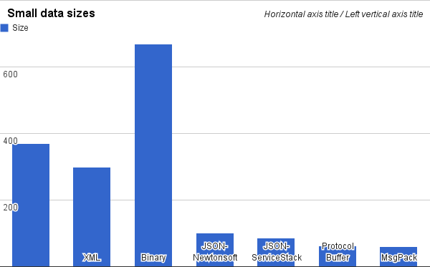
Time cost: Serialize a “beer” object

Slide 22
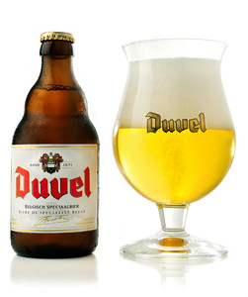
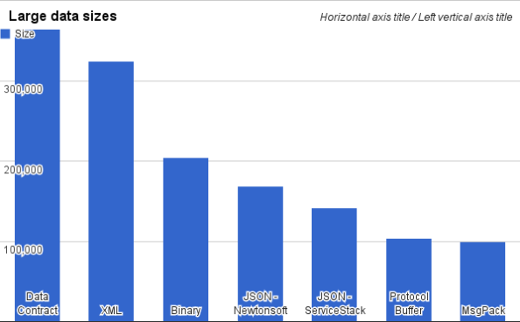
Time cost: List of all 1610 Belgian beers
http://en.wikipedia.org/wiki/List_of_Belgian_beer

Slide 23
How many such operations occur?
1
Gateway (backup)
log
3
2
log
Gateway (primary)
3
ulticast Notifications
4
6
Message Bus
Computational Services
Computational Services
Computational Services
5
5
5
We identified 6 steps, each requiring serialization/deserialization, but if elements are componentized, the total could be 5x or 10x more!

Slide 24
What can we do?
Even binary serialization wasn’t really so cheap
The only thing that turns out to be cheap is to send very simple messages with very simple content, like “one string”
So… can we magically transform our code into very simple code? Introducing… logging!

Slide 25
Key ideas: Very simple
Write the large complex objects into a reliable log service, just once.
  Logging means “append only, durable, file”
  You write it once, can read it later
Now we substitute a URL for the large object.
  We could modify the application itself
  Or we could create a “wrapper” for the object itself or for the libraries used in the application

Slide 26
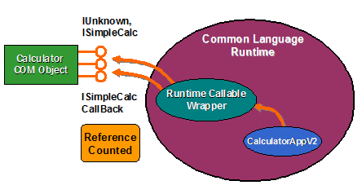
Concept: A “wrapper”
Start with a complex application…
you really don’t want to modify it
Identify some big objects it sends, and modify the setter/getter methods to first “memory-fy” it
  If we have the URL but not the object, fetch the object
  Then perform action as usual
A lazy fetch! Question: why will this help?

Slide 27
Concept: A “wrapper”
On receipt, object has just the URL
But if the application accesses data
we load the real content first
“URL”
Application
Logic
Wrapper
Log
Object
Application
Logic
Wrapper

Slide 28
Can it be totally transparent?
In many cases, a wrapper can completely hide the log from the real application
But if the object is modified, then transmitted, we need to create a new logged version, and use a new URL for it.
The log service won’t allow you to modify a logged object, only to create “new” logged objects

Slide 29
Data center logging services
This area was very ad-hoc for a while
Then the Berkeley “log structured file system” was proposed. LFS was really popular.
More recently, Corfu and Tango were introduced by Microsoft. These are logging services for situations where reliability and speed are paramount
  The slides that follow are from Mahesh Balakrishnan, one of the team leaders for this project at MSR

Slide 30

The shared log abstraction
. . .
clients
shared log API:
O = append(V)
V = read(O)
trim(O) //GC
O = check() //tail
remote shared log
read from anywhere
append to tail
clients can concurrently append to the log,
read from anywhere in its body, check the current tail, and trim entries that are no longer needed.

Slide 31

The CORFU design
application
CORFU API:
O = append(V)
V = read(O)
trim(O) //GC
O = check() //tail
smart client library
passive flash units:
write-once, sparse address spaces
CORFU
read from anywhere
append to tail
4KB
each entry maps to a replica set

Slide 32
Key ideas: Writes
Clients contend for the end of log, but when they gain access they hold a lock and can
  Write their data (via a DMA transfer to the NVRAM)
  The data is relayed
  On ack, they increase the end-of-log pointer & unlock
This gives a shared atomic log append abstraction with fault-tolerance (in this example, tolerates 1 fault, but it can be extended to tolerate k faults)

Slide 33
The CORFU protocol: reads
client
page 0
page 1
…
D1/D2
L₀
L₄
...
D3/D4
L₁
L₅
...
D5/D6
L₂
L₆
...
D7/D8
L₃
L₇
...
read(pos)
D1 D3 D5 D7
CORFU library
Projection:
D1 D2
D3 D4
D5 D6
D7 D8
read(D1/D2, page#)
D2 D4 D6 D8
CORFU cluster
L₀
L₁
L₂
L₃
L₄
L₅
L₆
L₇
.
.

Slide 34
Some CORFU users needed more!
One request involved “chain replication”
  Goal here is to have more than one CORFU server in a kind of chain, for greater read-load capacity
  Each server would still itself be fault-tolerant
A second request was for support of transactions
  For that they needed to add a Begin/Commit

Slide 35
Chain replication in CORFU
client C1
2
1
client C2
client C3
safety under contention:
if multiple clients try to write to same log position concurrently, only one wins
writes to already written pages => error
durability:
data is only visible to reads if entire chain has seen it
reads on unwritten pages => error
requires write-once semantics from flash unit

Slide 36
Transactions over streams
node 1
node 2
B
B
B
B
B
B
allocation ← table
aggregation tree →
A
A
A
A
A
A
beginTX
read A
write C
endTX
decision record with commit/abort bit
free list →
C
C
C
C
C
C
A
skip
C
skip
A
C
A
C
skip
A
skip
C
skip
A
C
A
C
0
skip
skip
B
C
B
skip
C
skip
C
B
skip
B
C
B
skip
C
skip
C
0
B
commit/abort?
has A changed?
yes, abort
commit/abort?
has A changed?
don’t know!
node 1 helps node 2

Slide 37
Distributed transactions over streams
node 1
node 2
B
B
B
B
B
B
allocation ← table
aggregation tree →
A
A
A
A
A
A
beginTX
read A, B
write C
endTX
free list →
C
C
C
C
C
C
A
skip
C
skip
A
C
A
C
skip
A
skip
C
skip
A
C
A
C
O
1
skip
skip
B
C
B
skip
C
skip
C
B
skip
B
C
B
skip
C
skip
C
0
1
B
commit/abort?
has B changed?
don’t know!
commit/abort?
has A changed?
don’t know!
node 1 and node 2 help each other!
distributed transactions without a distributed (commit) protocol!

Slide 38
No commit protocol?
With CORFU using chains this way, writing the commit record into the last CORFU log in the chain suffices and commits the entire transaction
In traditional 2PC we can’t do this because servers can fail and lose state, forcing abort. With CORFU, state is durable, so this never occurs.
  Sometimes called a “presumed commit” model
  Effect is that the 2PC protocol is eliminated!

Slide 39
Research insights
A durable, iterable total order (i.e., a shared log) is a unifying abstraction for distributed systems, subsuming the roles of many distributed protocols
It is possible to impose a total order at speeds exceeding the I/O capacity of any single machine
A total order is useful even when individual nodes consume a subsequence of it

Slide 40
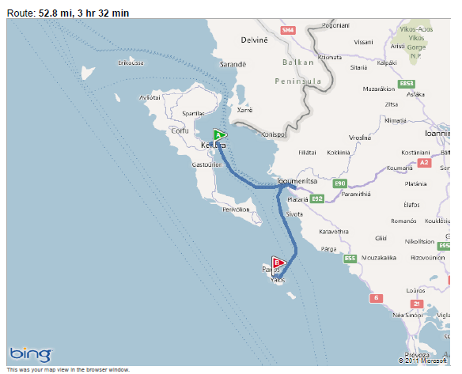
how far is CORFU from Paxos?

Slide 41
how far is CORFU from Paxos?
CORFU scales the Paxos acceptor role:
each consensus decision is made by a different set of acceptors
learners
L₀
L₁
L₂
L₃
L₄
L₅
L₆
L₇
.
.
L₀
L₁
L₂
L₃
L₄
L₅
L₆
L₇
.
.
streaming CORFU scales the Paxos learner role:
each learner plays a subsequence of commands
D1 D3 D5 D7
acceptors
acceptors
D2 D4 D6 D8
CORFU cluster

Slide 42
Conclusions
Wrap objects and use a logging service for higher performance in cloud settings
CORFU: High throughput NVRAM fault-tolerant log
Tango objects: data structures backed by a shared log with transactions

