Slide 1
CS5412: TIER 2 OVERLAYS
Lecture VI
Ken Birman

Slide 2
Recap
A week ago we discussed RON and Chord: typical examples of P2P network tools popular in the cloud
Then we shifted attention and peeked into the data center itself. It has tiers (tier 1, 2, backend) and a wide range of technologies
Many of those use a DHT “concept” and would be build on a DHT. But we can’t use Chord here!

Slide 3
Today’s focus
How can we create distributed hash tables optimized for use in cloud computing settings?
If you look deeply into systems like the ones we discussed last time, you’ll find DHT technology at the base. So with a DHT you can layer fancier things on top… but the DHT determines the speed!

Slide 4
First problem with Chord: Cost
Internal to a cloud data center a DHT needs to be blindingly fast
  Put operation should have cost no higher than 1 RPC directly to the nodes where the data will live
  Get operation could have a cost of 1 RPC
In Chord with as few as 1000 participants, costs can include 9 routing hops. So this is unacceptable

Slide 5

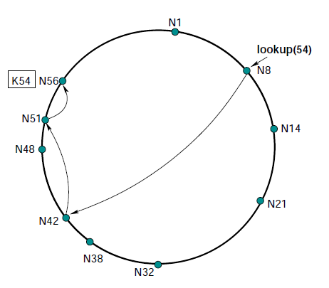

Another problem : Hot spots
As conditions in a network change
  Some items may become far more popular than others and be referenced often; others rarely: hot/cold spots
  Members may join that are close to the place a finger pointer should point... but not exactly at the right spot
  Churn could cause many of the pointers to point to nodes that are no longer in the network, or behind firewalls where they can’t be reached
This has stimulated work on “adaptive” overlays

Slide 6
Today look at three examples
Beehive: A way of extending Chord so that average delay for finding an item drops to a constant: O(1)
Pastry: A different way of designing the overlay so that nodes have a choice of where a finger pointer should point, enabling big speedups
Kelips: A simple way of creating an O(1) overlay that trades extra memory for faster performance

Slide 7
File systems on overlays
If time permits, we’ll also look at ways that overlays can “host” true file systems
CFS and PAST: Two projects that used Chord and Pastry, respectively, to store blocks
OceanStore: An archival storage system for libraries and other long-term storage needs

Slide 8
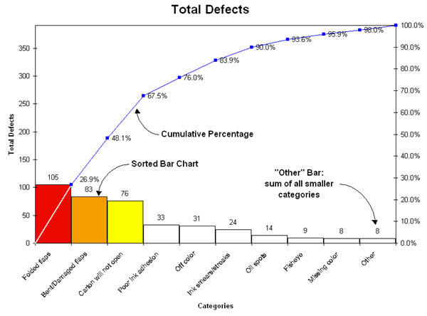
Insight into adaptation
Many “things” in computer networks exhbit Pareto popularity distributions
This one graphs
frequency by category
for problems with
cardboard shipping
cartons
Notice that a small subset
of issues account for most problems

Slide 9
Beehive insight
Small subset of keys will get the majority of Put and Get operations
  Intuition is simply that everything is Pareto!
By replicating data, we can make the search path shorter for a Chord operation
... so by replicating in a way proportional to the popularity of an item, we can speed access to popular items!

Slide 10
Beehive: Item replicated on N/2 nodes
If an item isn’t on “my side” of the Chord ring it must be on the “other side”
In this example, by replicating a (key,value) tuple over half the ring, Beehive is able to guarantee that it will always be found in at most 1 hop. The system generalizes this idea, matching the level of replication to the popularity of the item.

Slide 11
Beehive strategy
Replicate an item on N nodes to ensure O(0) lookup
Replicate on N/2 nodes to ensure O(1) lookup
. . .
Replicate on just a single node (the “home” node) and worst case lookup will be the original O(log n)
So use popularity of the item to select replication level

Slide 12
Tracking popularity
Each key has a home node (the one Chord would pick)
Put (key,value) to the home node
Get by finding any copy. Increment access counter
  Periodically, aggregate the counters for a key at the home node, thus learning the access rate over time
  A leader aggregates all access counters over all keys, then broadcasts the total access rate
    ... enabling Beehive home nodes to learn relative rankings of items they host
    ... and to compute the optimal replication factor for any target O(c) cost!

Slide 13
Notice interplay of ideas here
Beehive wouldn’t work if every item was equally popular: we would need to replicate everything very aggressively. Pareto assumption addresses this
Tradeoffs between parallel aspects (counting, creating replicas) and leader-driven aspects (aggregating counts, computing replication factors)
We’ll see ideas like these in many systems throughout CS5412

Slide 14
Pastry
A DHT much like Chord or Beehive
But the goal here is to have more flexibility in picking finger links
  In Chord, the node with hashed key H must look for the nodes with keys H/2, H/4, etc....
  In Pastry, there are a set of possible target nodes and this allows Pastry flexibility to pick one with good network connectivity, RTT (latency), load, etc

Slide 15
Pastry also uses a circular number space
d471f1
d467c4
Difference is in how the “fingers” are created
Pastry uses prefix match rather than binary splitting
More flexibility in neighbor selection
d462ba
d46a1c
d4213f
Route(d46a1c)
d13da3
65a1fc

Slide 16
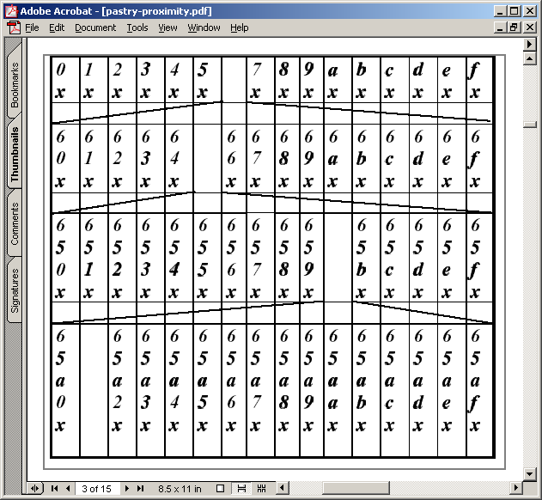
Pastry routing table (for node 65a1fc)
Pastry nodes also have a “leaf set” of immediate neighbors up and down the ring
Similar to Chord’s list of successors

Slide 17
Pastry join
X = new node, A = bootstrap, Z = nearest node
A finds Z for X
In process, A, Z, and all nodes in path send state tables to X
X settles on own table
  Possibly after contacting other nodes
X tells everyone who needs to know about itself
Pastry paper doesn’t give enough information to understand how concurrent joins work
  18th IFIP/ACM, Nov 2001

Slide 18
Pastry leave
Noticed by leaf set neighbors when leaving node doesn’t respond
  Neighbors ask highest and lowest nodes in leaf set for new leaf set
Noticed by routing neighbors when message forward fails
  Immediately can route to another neighbor
  Fix entry by asking another neighbor in the same “row” for its neighbor
  If this fails, ask somebody a level up

Slide 19
For instance, this neighbor fails

Slide 20
Ask other neighbors
Try asking some neighbor in the same row for its 655x entry
If it doesn’t have one, try asking some neighbor in the row below, etc.

Slide 21
CAN, Chord, Pastry differences
CAN, Chord, and Pastry have deep similarities
Some (important???) differences exist
  CAN nodes tend to know of multiple nodes that allow equal progress
    Can therefore use additional criteria (RTT) to pick next hop
  Pastry allows greater choice of neighbor
    Can thus use additional criteria (RTT) to pick neighbor
  In contrast, Chord has more determinism
    How might an attacker try to manipulate system?

Slide 22
Security issues
In many P2P systems, members may be malicious
If peers untrusted, all content must be signed to detect forged content
  Requires certificate authority
  Like we discussed in secure web services talk
  This is not hard, so can assume at least this level of security

Slide 23
Security issues: Sybil attack
Attacker pretends to be multiple system
  If surrounds a node on the circle, can potentially arrange to capture all traffic
  Or if not this, at least cause a lot of trouble by being many nodes
Chord requires node ID to be an SHA-1 hash of its IP address
  But to deal with load balance issues, Chord variant allows nodes to replicate themselves
A central authority must hand out node IDs and certificates to go with them
  Not P2P in the Gnutella sense

Slide 24
General security rules
Check things that can be checked
  Invariants, such as successor list in Chord
Minimize invariants, maximize randomness
  Hard for an attacker to exploit randomness
Avoid any single dependencies
  Allow multiple paths through the network
  Allow content to be placed at multiple nodes
But all this is expensive…

Slide 25
Load balancing
Query hotspots: given object is popular
  Cache at neighbors of hotspot, neighbors of neighbors, etc.
  Classic caching issues
Routing hotspot: node is on many paths
  Of the three, Pastry seems most likely to have this problem, because neighbor selection more flexible (and based on proximity)
  This doesn’t seem adequately studied

Slide 26
Load balancing
Heterogeneity (variance in bandwidth or node capacity
Poor distribution in entries due to hash function inaccuracies
One class of solution is to allow each node to be multiple virtual nodes
  Higher capacity nodes virtualize more often
  But security makes this harder to do

Slide 27
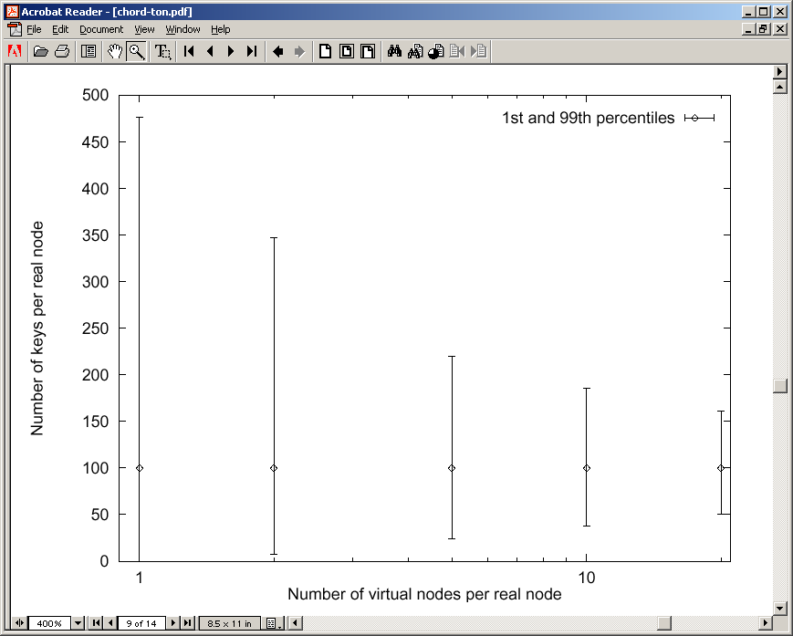
Chord node virtualization
10K nodes, 1M objects
20 virtual nodes per node has much better load balance, but each node requires ~400 neighbors!

Slide 28
Fireflies
Van Renesse uses this same trick (virtual nodes)
In his version a form of attack-tolerant agreement is used so that the virtual nodes can repell many kinds of disruptive attacks
We won’t have time to look at the details today

Slide 29
Another major concern: churn
Churn: nodes joining and leaving frequently
Join or leave requires a change in some number of links
Those changes depend on correct routing tables in other nodes
  Cost of a change is higher if routing tables not correct
  In chord, ~6% of lookups fail if three failures per stabilization
But as more changes occur, probability of incorrect routing tables increases

Slide 30
Control traffic load generated by churn
Chord and Pastry appear to deal with churn differently
Chord join involves some immediate work, but repair is done periodically
  Extra load only due to join messages
Pastry join and leave involves immediate repair of all effected nodes’ tables
  Routing tables repaired more quickly, but cost of each join/leave goes up with frequency of joins/leaves
  Scales quadratically with number of changes???
  Can result in network meltdown???

Slide 31
Kelips takes a different approach
Network partitioned into √N “affinity groups”
Hash of node ID determines which affinity group a node is in
Each node knows:
  One or more nodes in each group
  All objects and nodes in own group
But this knowledge is soft-state, spread through peer-to-peer “gossip” (epidemic multicast)!

Slide 32
Rationale?
Kelips has a completely predictable behavior under worst-case conditions
  It may do “better” but won’t do “worse”
  Bounded message sizes and rates that never exceed what the administrator picks no matter how much churn occurs
  Main impact of disruption: Kelips may need longer before Get is guaranteed to return value from prior Put with the same key

Slide 33
Kelips
110 knows about other members – 230, 30…
Affinity Groups:
peer membership thru consistent hash
Affinity group view
id | hbeat | rtt
30 | 234 | 90ms
230 | 322 | 30ms
0
1
2
N
−
1
110
230
202
N
members per affinity group
30
Affinity group pointers

Slide 34
Kelips
202 is a “contact” for 110 in group 2
Affinity Groups:
peer membership thru consistent hash
Affinity group view
id | hbeat | rtt
30 | 234 | 90ms
230 | 322 | 30ms
0
1
2
N
−
1
110
Contacts
N
230
202
members per affinity group
group | contactNode
… | …
2 | 202
30
Contact pointers

Slide 35
Kelips
“cnn.com” maps to group 2. So 110 tells group 2 to “route” inquiries about cnn.com to it.
Affinity Groups:
peer membership thru consistent hash
Affinity group view
id | hbeat | rtt
30 | 234 | 90ms
230 | 322 | 30ms
0
1
2
N
−
1
110
Contacts
N
230
202
members per affinity group
group | contactNode
… | …
2 | 202
30
Resource Tuples
Gossip protocol replicates data cheaply
resource | info
… | …
cnn.com | 110

Slide 36
How it works
Kelips is entirely gossip based!
  Gossip about membership
  Gossip to replicate and repair data
  Gossip about “last heard from” time used to discard failed nodes
Gossip “channel” uses fixed bandwidth
  … fixed rate, packets of limited size

Slide 37
Gossip 101
Suppose that I know something
I’m sitting next to Fred, and I tell him
  Now 2 of us “know”
Later, he tells Mimi and I tell Anne
  Now 4
This is an example of a push epidemic
Push-pull occurs if we exchange data

Slide 38
Gossip scales very nicely
Participants’ loads independent of size
Network load linear in system size
Information spreads in log(system size) time
1.0
% infected
0.0
Time →

Slide 39
Gossip in distributed systems
We can gossip about membership
  Need a bootstrap mechanism, but then discuss failures, new members
Gossip to repair faults in replicated data
  “I have 6 updates from Charlie”
If we aren’t in a hurry, gossip to replicate data too

Slide 40
Gossip about membership
Start with a bootstrap protocol
  For example, processes go to some web site and it lists a dozen nodes where the system has been stable for a long time
  Pick one at random
Then track “processes I’ve heard from recently” and “processes other people have heard from recently”
Use push gossip to spread the word

Slide 41
Gossip about membership
Until messages get full, everyone will known when everyone else last sent a message
  With delay of log(N) gossip rounds…
But messages will have bounded size
  Perhaps 8K bytes
  Then use some form of “prioritization” to decide what to omit – but never send more, or larger messages
  Thus: load has a fixed, constant upper bound except on the network itself, which usually has infinite capacity

Slide 42
Back to Kelips: Quick reminder
Affinity Groups:
peer membership thru consistent hash
Affinity group view
id | hbeat | rtt
30 | 234 | 90ms
230 | 322 | 30ms
0
1
2
N
−
1
110
Contacts
N
230
202
members per affinity group
group | contactNode
… | …
2 | 202
30
Contact pointers

Slide 43
How Kelips works
Node 175 is a contact for Node 102 in some affinity group
175
Hmm…Node 19 looks like a much better contact in affinity group 2
RTT: 235ms
Node 102
19
RTT: 6 ms
Gossip data stream
Gossip about everything
Heuristic to pick contacts: periodically ping contacts to check liveness, RTT… swap so-so ones for better ones.

Slide 44
Replication makes it robust
Kelips should work even during disruptive episodes
  After all, tuples are replicated to √N nodes
  Query k nodes concurrently to overcome isolated crashes, also reduces risk that very recent data could be missed
… we often overlook importance of showing that systems work while recovering from a disruption

Slide 45
Control traffic load generated by churn
O(Changes x Nodes)?
None
O(changes)
Kelips
Chord
Pastry

Slide 46
Summary
Adaptive behaviors can improve overlays
  Reduce costs for inserting or looking up information
  Improve robustness to churn or serious disruption
As we move from CAN to Chord to Beehive or Pastry one could argue that complexity increases
Kelips gets to a similar place and yet is very simple, but pays a higher storage cost than Chord/Pastry

