Slide 1
CS5412: Shedding Light On the Cloudy Future
Lecture XXV
Ken Birman

Slide 2
We’ve come a long way!
In 12 weeks we’ve looked at
The client side of cloud computing
The impact the cloud is having on the Internet
Issues associated with mobility and multihosting
The roles of various tiers of the cloud
All sorts of specific technologies: Browsers, RON, Chord, Pastry, Kelips, BitTorrent, BigTable, GFS, Astrolabe, T-Man, roles of virtualization, cloud economics…
CAP and FLP theorem, BASE, snapshot isolation
Paxos and Isis2, Byzantine Fault Tolerance, Gossip

Slide 3
Cloud (mis)conceptions
Many people assume that the cloud is basically a fancy name for Amazon EC2
In fact the cloud is really “about” federation and integration: Amazon and MSN and Google and even the HPC clusters operated by NOA
These services run on lots of systems and come together to provide integrated solutions to the user
Some rules of thumb that seem to have big payoffs: ways of building systems that are highly elastic and that put responsiveness and performance first, layering consistency and other properties in a “secondary goals”

Slide 4
Today’s cloud
Already a hundreds-of-billions of dollars per year industry and growing at a crazy rate
Yet only scratching the service: Almost entirely focused on applications that don’t provide guarantees
The even larger opportunity: a fully capable cloud that can tackle high assurance needs too

Slide 5
Who needs a high-assurance cloud?
The most popular and most standard solution often ends up dominating and pushing everything else off the table
If that trend plays out for the cloud, there won’t be any other options!

Slide 6
CS5412 perspective?
High assurance is definitely possible on a cloud
…. But it isn’t easy
Today you need to know a lot about some very esoteric technologies to build strongly assured cloud computing services that also perform and scale well
But with more research and better tools this could get easier.
Easy to see how the picture could be better in 5 years

Slide 7
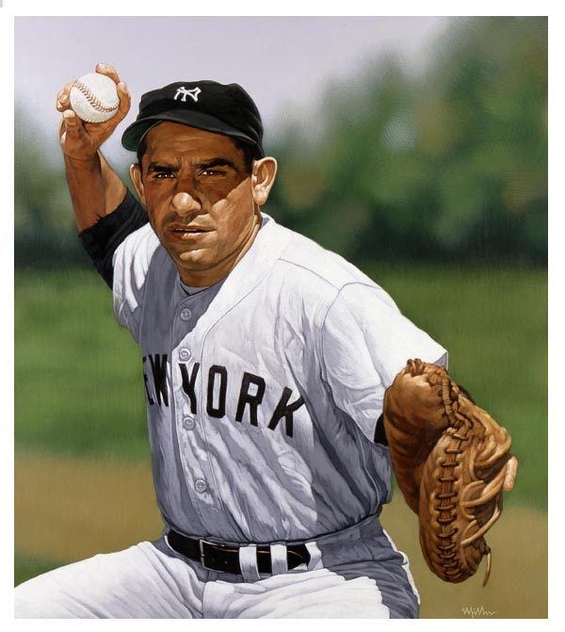
Yogi Berra’s warning
This seems to apply equally to those who predict wide use of the cloud for high assurance and those who are certain that the cloud will never offer strong properties!
“It’s tough to make predictions, especially about the future.”

Slide 8
How can one learn more?
For many people, learning by doing works best
The cloud is an incredible job-creation engine
All of you will have great job prospects!
Building things is a very good way to think issues through
Some of us should do basic research and create powerful new kinds of tools

Slide 9
Useful courses to consider
Security for large-scale distributed systems
Advanced networking
Mobile networks
Large-scale information systems
The “science of networks” (not the Internet)
Machine learning
Software Engineering

Slide 10
Rapidly growing cloud “industries”
Everything relating to applications for social/mobile computing
Healthcare systems, not just in the doctor’s office but also in the home and in your whole life
Building a smarter environment: the smart power grid, better traffic guidance systems, helping people in cities find parking, using “green” power

Slide 11
Navigating in a growth field
You might not get there on day one
Ideally, you find the ideal job right away, or perhaps your company has a unit and you switch to it
But some people will start in one job, then hear about something from a friend, and as they gain skills will also move closer to their target setting
Believe in yourself and maintain a clear vision and you can do amazing things over time

