Slide 1
Fast Modular Exponentiation
Di Chen
CS 5199 Nov 25, 2019

Slide 2
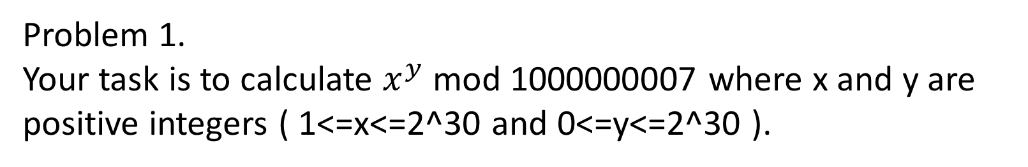

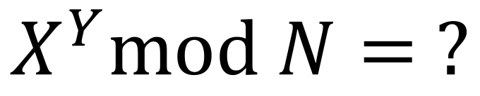
What is fast modular exponentiation?
$$X^{Y}mod N= ?$$
Problem 1.
Your task is to calculate $x^{y}$ mod 1000000007 where x and y are positive integers ( 1<=x<=2^30 and 0<=y<=2^30 ).
Brute force: $X^{Y}mod N=\left(…\left(\left(\left(X mod N\right) ∗X\right)mod N∗X…\right)∗X\right)mod N$
$$Y times: O(Y)$$
Python:
x**y % n ?

Slide 3
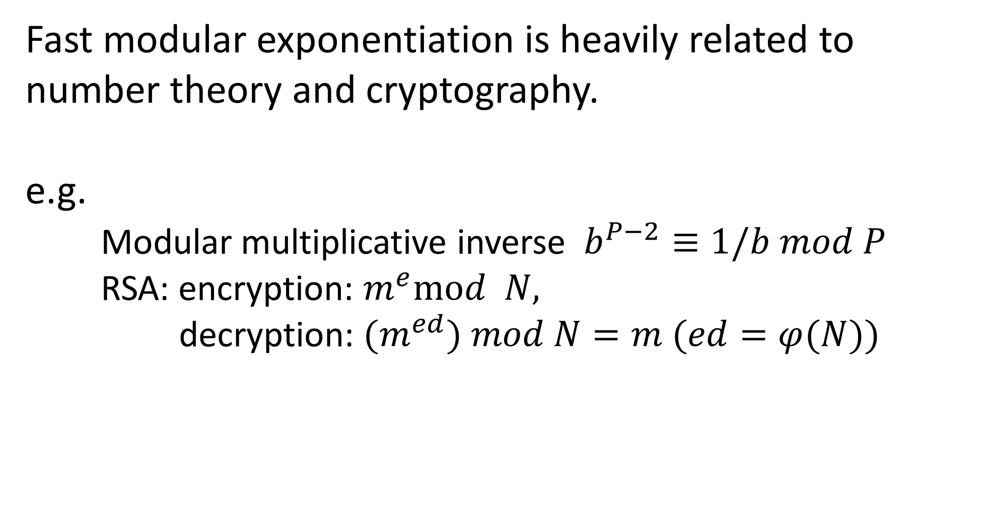
Why do we need modular exponentiation?
Fast modular exponentiation is heavily related to number theory and cryptography.
e.g.
Modular multiplicative inverse $b^{P−2}≡1/b$ $mod P$
RSA: encryption: $m^{e}mod N,$
decryption: ${(m}^{ed}) mod N=m (ed=φ(N))$

Slide 4
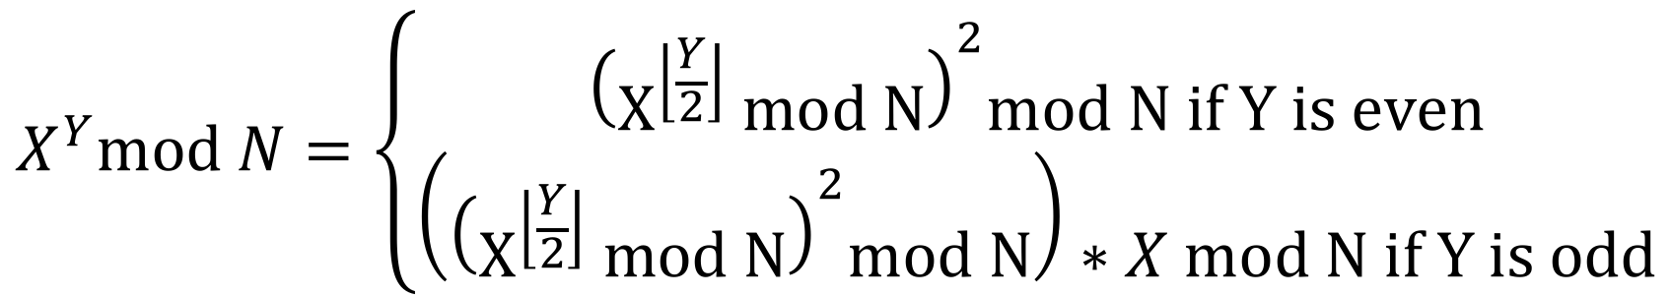

Fast Modular Exponentiation
$$\left(a∗b\right) mod n=(\left(a mod n)∗(b mod n\right)) mod n$$
$$X^{Y}mod N=\left\{\begin{aligned}{\left(X^{\left\lfloor \frac{Y}{2}\right\rfloor } mod N\right)}^{2}mod N if Y is even \\ \left({\left(X^{\left\lfloor \frac{Y}{2}\right\rfloor } mod N\right)}^{2}mod N\right)∗X mod N if Y is odd\end{aligned}\right.$$
We can save the value of $\left(X^{\left\lfloor \frac{Y}{2}\right\rfloor } mod N\right)$ to not compute it twice
$O\left(\log\left(n\right)\right)$

Slide 5
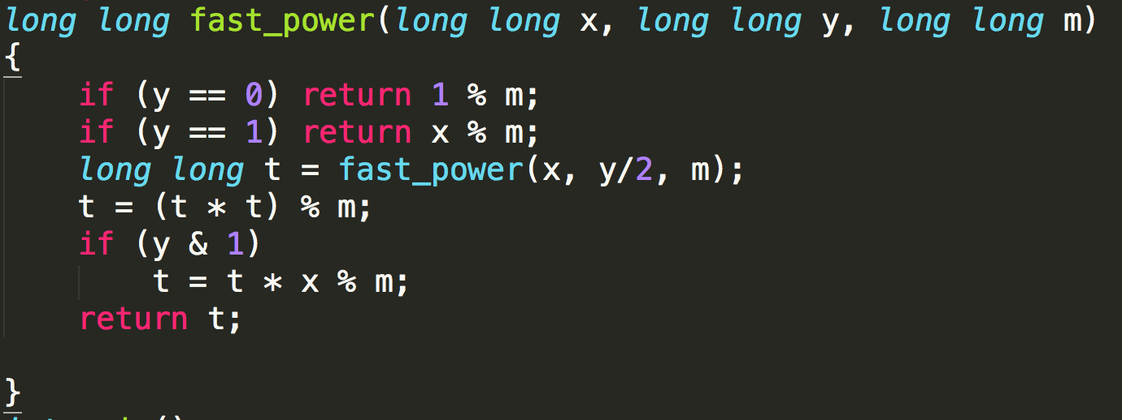
Fast Modular Exponentiation
Why long long?

Slide 6
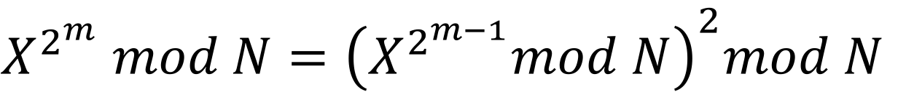
Fast Modular Exponentiation-V2
$$Y=a_{0}2^{0}+a_{1}2^{1}+…+a_{m}2^{m}$$
$X^{Y}=X^{a_{0}2^{0}+a_{1}2^{1}+…+a_{m}2^{m}}=X^{a_{0}2^{0}}∗X^{a_{1}2^{1}}$*…*$X^{a_{m}2^{m}}$
$X^{2^{m}} mod N={\left(X^{2^{m−1}}mod N\right)}^{2}mod N$
We can change the recursive function to a while-loop!

Slide 7
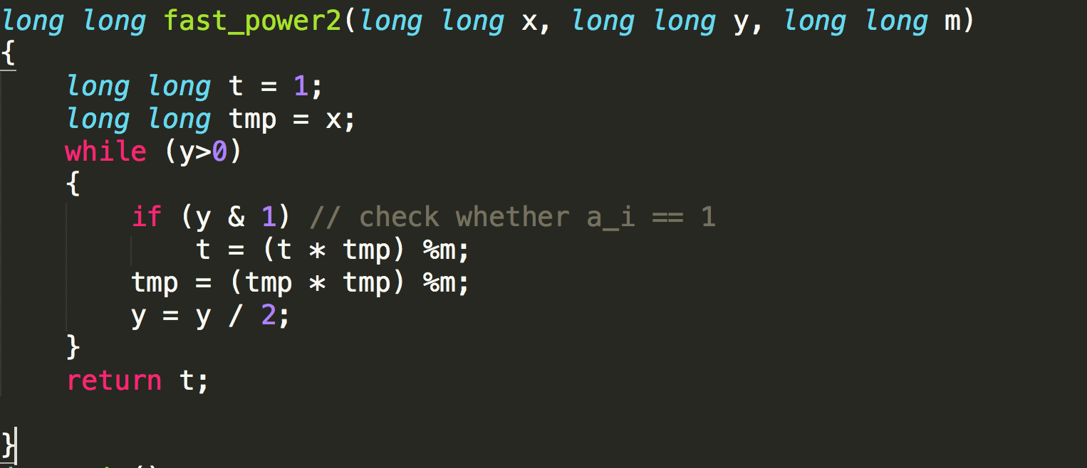
Fast Modular Exponentiation-V2

Slide 8
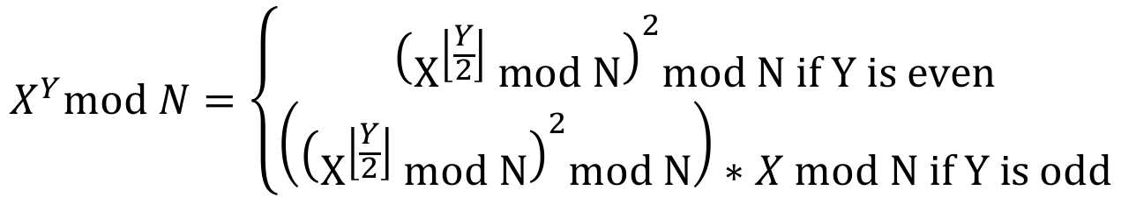
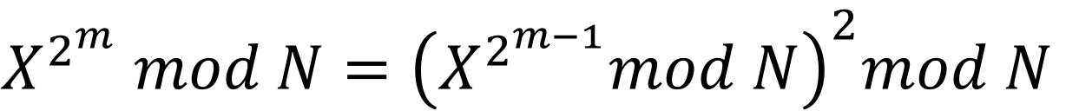
Rationale Behind the Fast Modular Exponentiation
$$X^{Y}mod N=\left\{\begin{aligned}{\left(X^{\left\lfloor \frac{Y}{2}\right\rfloor } mod N\right)}^{2}mod N if Y is even \\ \left({\left(X^{\left\lfloor \frac{Y}{2}\right\rfloor } mod N\right)}^{2}mod N\right)∗X mod N if Y is odd\end{aligned}\right.$$
We can save the value of $\left(X^{\left\lfloor \frac{Y}{2}\right\rfloor } mod N\right)$ to not compute it twice
$$Y=a_{0}2^{0}+a_{1}2^{1}+…+a_{m}2^{m}$$
$X^{Y}=X^{a_{0}2^{0}+a_{1}2^{1}+…+a_{m}2^{m}}=X^{a_{0}2^{0}}∗X^{a_{1}2^{1}}$*…*$X^{a_{m}2^{m}}$
$X^{2^{m}} mod N={\left(X^{2^{m−1}}mod N\right)}^{2}mod N$
This is just a doubling trick!

Slide 9
Recall: Fast Modular Exponentiation
long long overflow

Slide 10
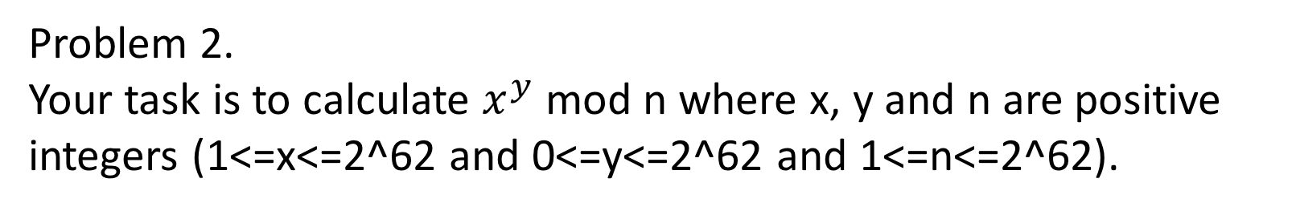
Big Number Modular Multiplication?
What if the X, Y, N are larger than 2^31?
Python?
Is there a way to do this in C++?
Problem 2.
Your task is to calculate $x^{y}$ mod n where x, y and n are positive integers (1<=x<=2^62 and 0<=y<=2^62 and 1<=n<=2^62).

Slide 11

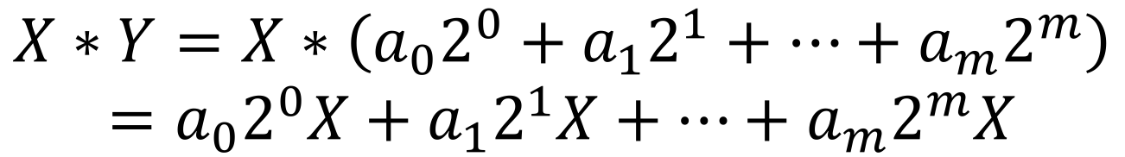
Big Number Modular Multiplication?
$$X∗Y mod N =？$$
$$Y=a_{0}2^{0}+a_{1}2^{1}+…+a_{m}2^{m}$$
$$X∗Y=X∗\left(a_{0}2^{0}+a_{1}2^{1}+…+a_{m}2^{m}\right)$$
$$=a_{0}2^{0}X+a_{1}2^{1}X+…+a_{m}2^{m}X$$
Doubling!

Slide 12
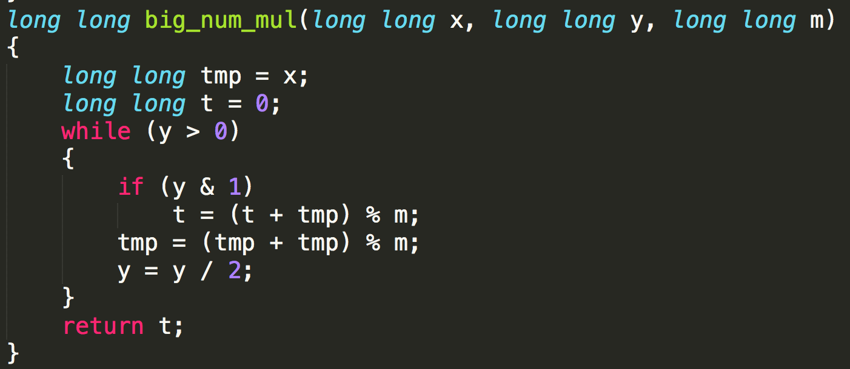
Big Number Modular Multiplication?

Slide 13
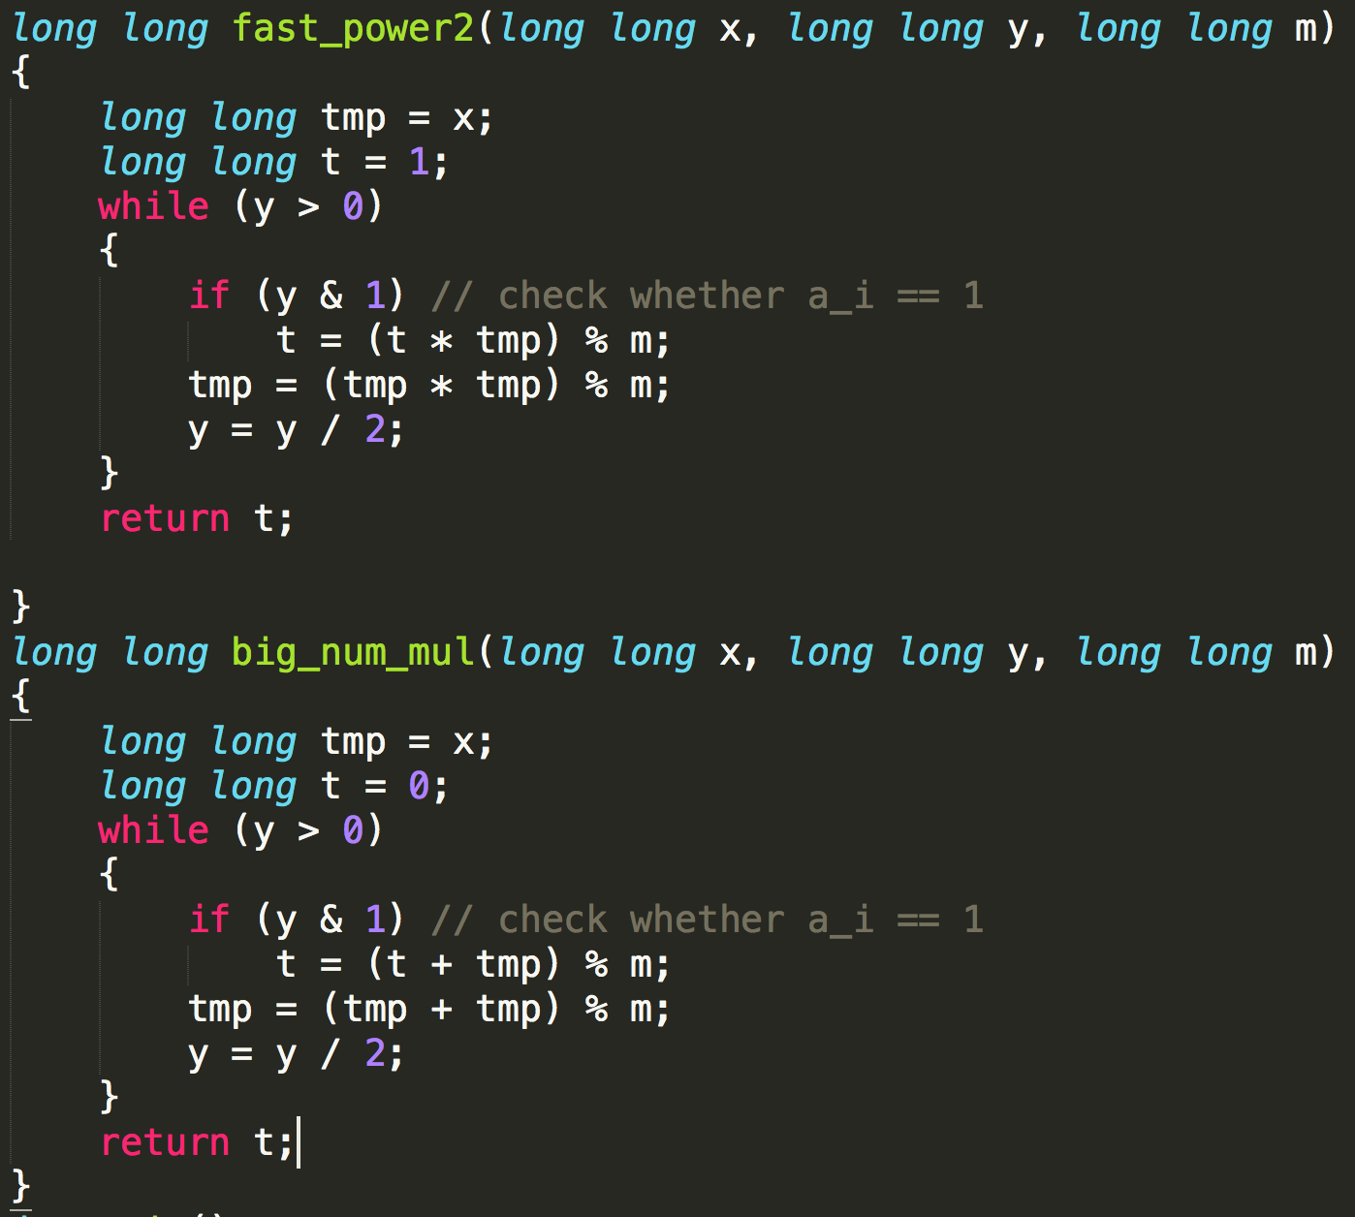
Fast Modular Exponentiation vs. Big Number Modular Multiplication
Initial value 1
multiply
Doubling on the exponent
tmp = tmp^2
Initial value 0
add
Doubling on the raw value
tmp = tmp * 2

Slide 14
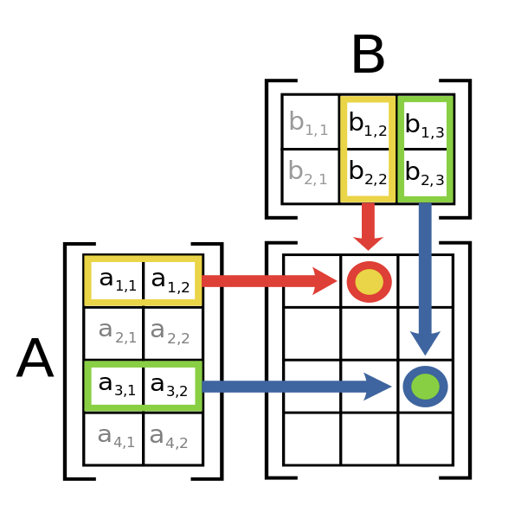
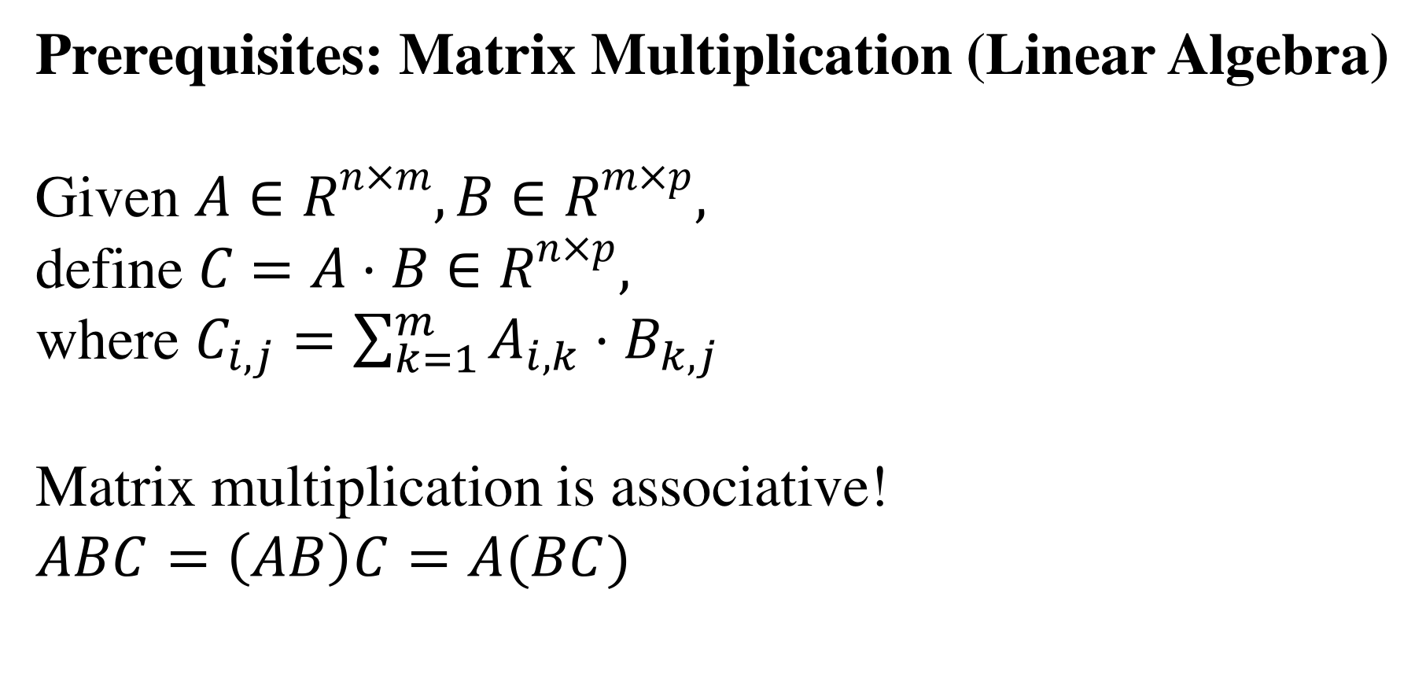
Fast Modular Exponentiation with Matrix
Prerequisites: Matrix Multiplication (Linear Algebra)
Given $A∈R^{n×m}, B∈R^{m×p},$
define $C=A⋅B∈R^{n×p},$
where $C_{i,j}=\sum_{k=1}^{m}{A_{i,k}{⋅B}_{k,j}}$
Matrix multiplication is associative!
$$ABC=\left(AB\right)C=A(BC)$$

Slide 15
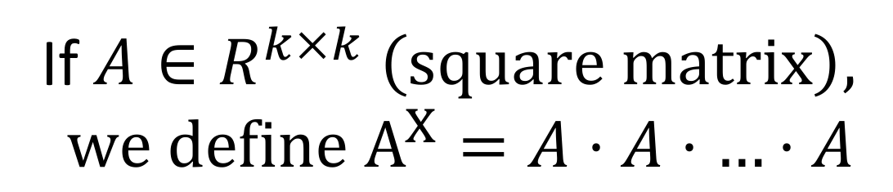
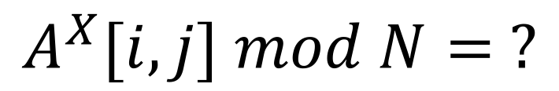
Fast Modular Exponentiation with Matrix
If$A∈R^{k×k} \left(square matrix\right),$
$$we define A^{X}=A⋅A⋅…⋅A$$
X times
$$A^{X}[i,j] mod N= ?$$

Slide 16
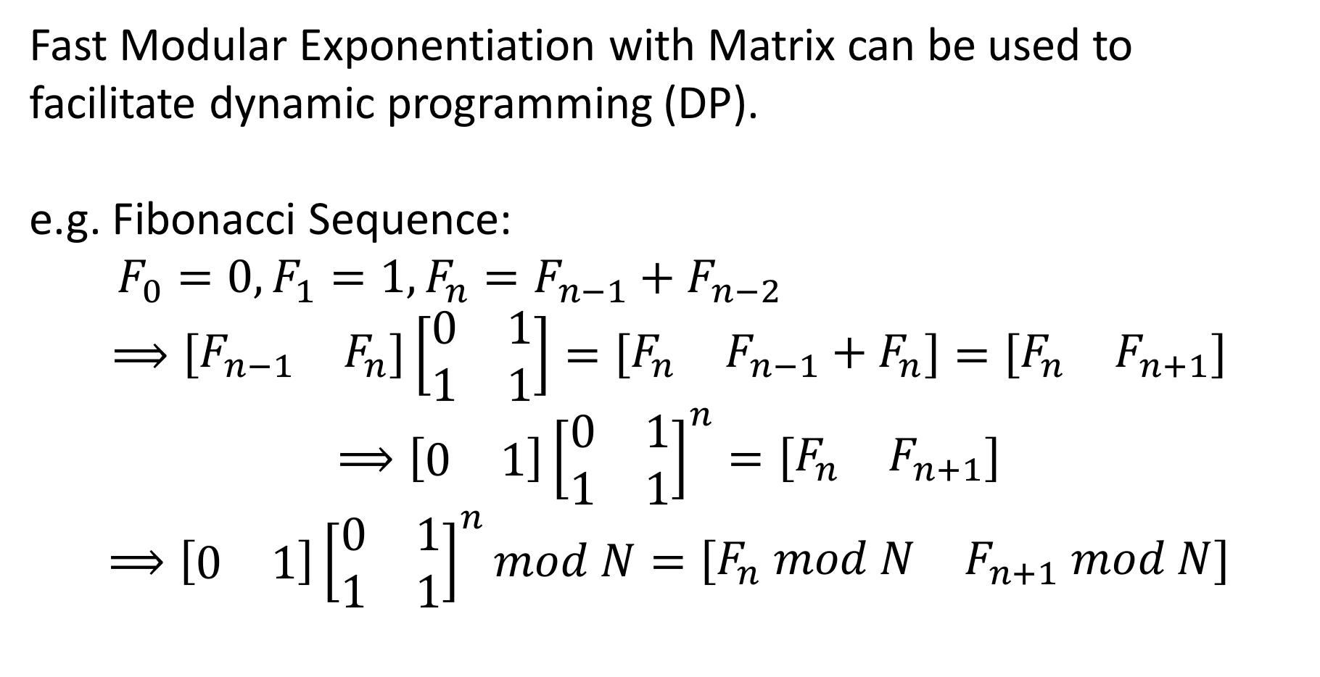
Why do we need Fast Modular Exponentiation with Matrix?
Fast Modular Exponentiation with Matrix can be used to facilitate dynamic programming (DP).
e.g. Fibonacci Sequence:
$F_{0}=0, F_{1}=1, F_{n}=F_{n−1}+F_{n−2}$
$$⟹\left[\begin{matrix}F_{n−1} & F_{n}\end{matrix}\right]\left[\begin{matrix}0 & 1 \\ 1 & 1\end{matrix}\right]=\left[\begin{matrix}F_{n} & F_{n−1}+F_{n}\end{matrix}\right]=\left[\begin{matrix}F_{n} & F_{n+1}\end{matrix}\right]$$
$$⟹\left[\begin{matrix}0 & 1\end{matrix}\right]{\left[\begin{matrix}0 & 1 \\ 1 & 1\end{matrix}\right]}^{n}=\left[\begin{matrix}F_{n} & F_{n+1}\end{matrix}\right]$$
$$⟹\left[\begin{matrix}0 & 1\end{matrix}\right]{\left[\begin{matrix}0 & 1 \\ 1 & 1\end{matrix}\right]}^{n}mod N=\left[\begin{matrix}F_{n} mod N & F_{n+1} mod N\end{matrix}\right]$$

Slide 17
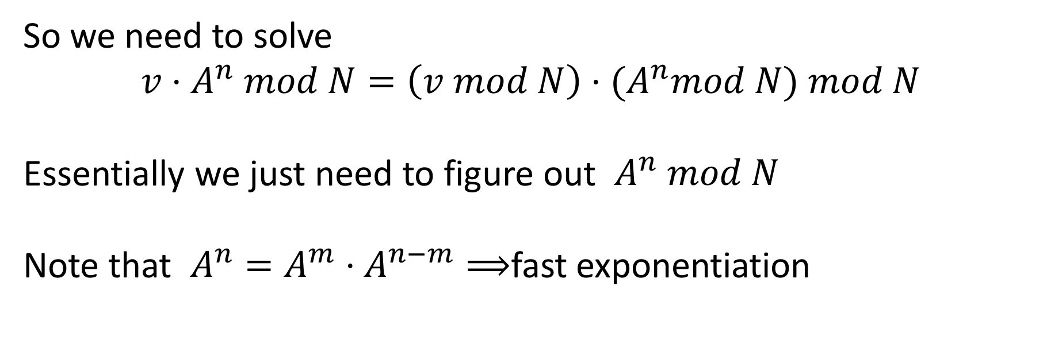
Why do we need Fast Modular Exponentiation with Matrix?
So we need to solve
$$v⋅A^{n} mod N=\left(v mod N\right)⋅{(A}^{n}mod N) mod N$$
Essentially we just need to figure out $A^{n} mod N$
Note that $A^{n}=A^{m}⋅A^{n−m}⟹$fast exponentiation

Slide 18
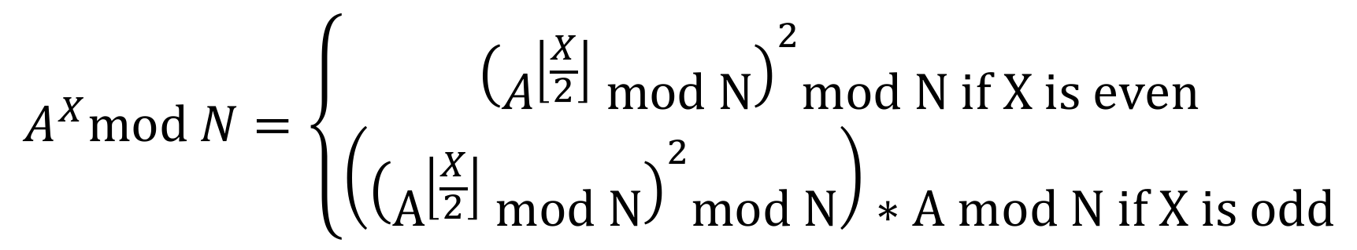

Fast Modular Exponentiation with Matrix
$$A^{X}mod N=\left\{\begin{aligned}{\left(A^{\left\lfloor \frac{X}{2}\right\rfloor } mod N\right)}^{2}mod N if X is even \\ \left({\left(A^{\left\lfloor \frac{X}{2}\right\rfloor } mod N\right)}^{2}mod N\right)∗A mod N if X is odd\end{aligned}\right.$$
This is pretty much the same as the Fast Modular Exponentiation except that we are doing matrix multiplication.
$$O(k^{3}\log{X})$$

Slide 19
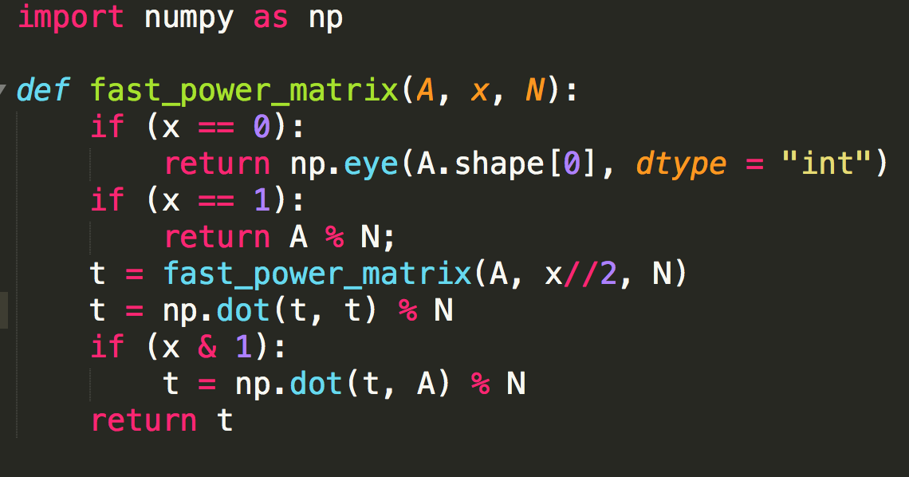
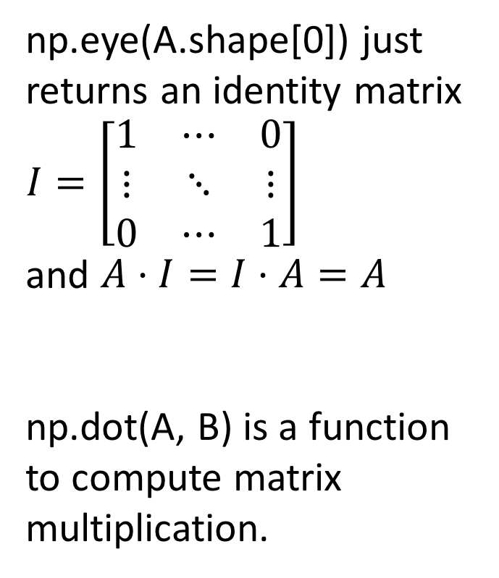
Fast Modular Exponentiation with Matrix
np.eye(A.shape[0]) just returns an identity matrix $I=\left[\begin{matrix}1 & ⋯ & 0 \\ ⋮ & ⋱ & ⋮ \\ 0 & ⋯ & 1\end{matrix}\right]$
and $A⋅I=I⋅A=A$
np.dot(A, B) is a function to compute matrix multiplication.

Slide 20
Fast Modular Exponentiation with Matrix (while-loop)
$$X=a_{0}2^{0}+a_{1}2^{1}+…+a_{m}2^{m}$$
$A^{X}=A^{a_{0}2^{0}+a_{1}2^{1}+…+a_{m}2^{m}}=A^{a_{0}2^{0}}⋅A^{a_{1}2^{1}}$ $⋅$… $⋅ A^{a_{m}2^{m}}$
We can change the recursive function to a while-loop!

Slide 21
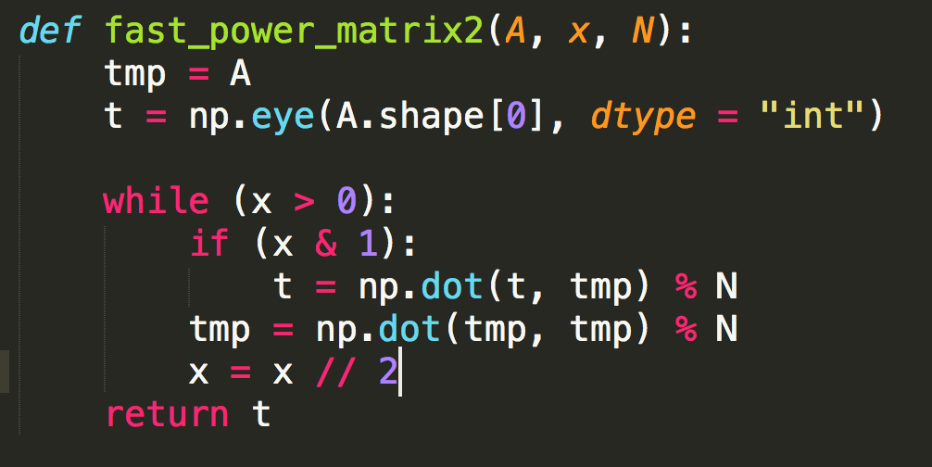
Fast Modular Exponentiation with Matrix (while-loop)

Slide 22
Exercise
You are climbing a stair case. It takes n steps to reach to the top. Each time you can either climb 1, 2 or 3 steps. In how many distinct ways can you climb to the top? Since the number is huge, we only want to know the answer mod 1000000007. (1<=n<=2^30)

Slide 23
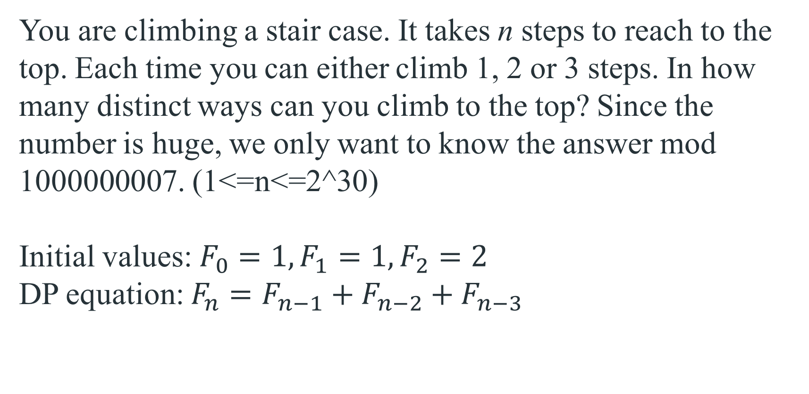
Exercise-1
You are climbing a stair case. It takes n steps to reach to the top. Each time you can either climb 1, 2 or 3 steps. In how many distinct ways can you climb to the top? Since the number is huge, we only want to know the answer mod 1000000007. (1<=n<=2^30)
Initial values: $F_{0}=1, F_{1}=1, F_{2}=2$
DP equation: $F_{n}=F_{n−1}+F_{n−2}+F_{n−3}$

Slide 24
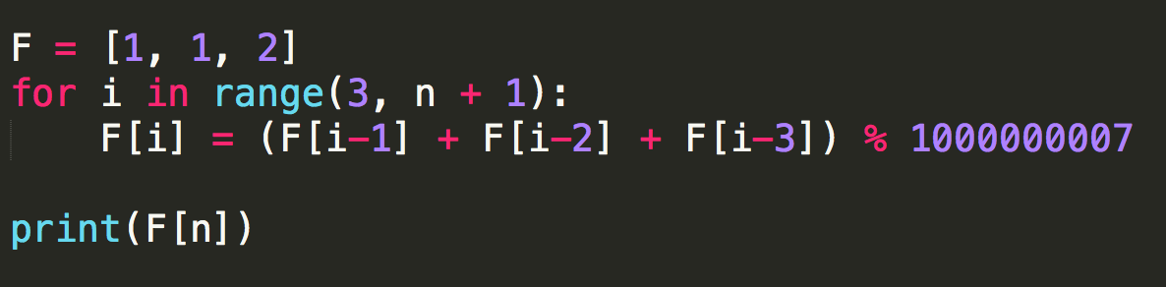
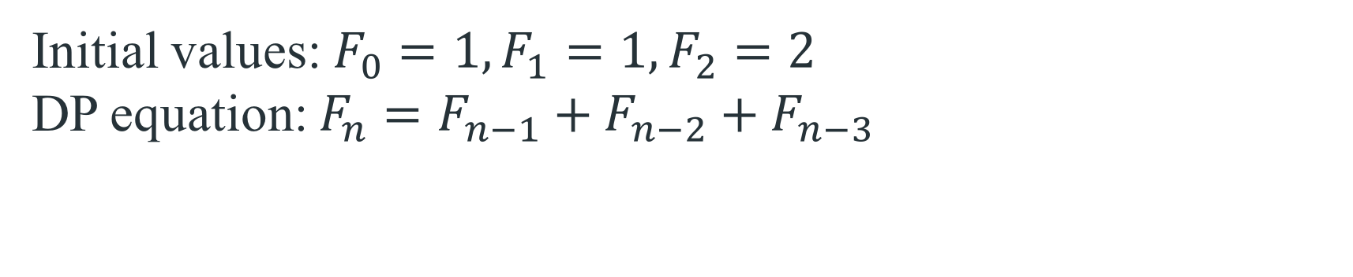
Brute Force
Initial values: $F_{0}=1, F_{1}=1, F_{2}=2$
DP equation: $F_{n}=F_{n−1}+F_{n−2}+F_{n−3}$
O(n)

Slide 25
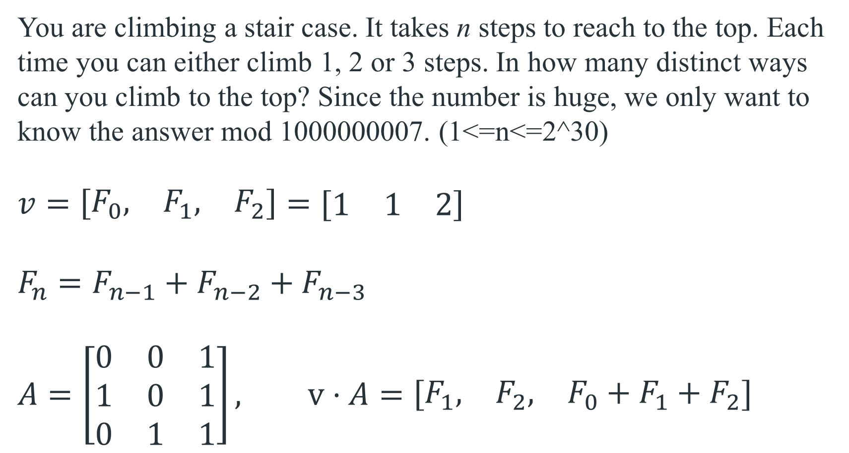
Use Matrix Multiplication to Handle DP
You are climbing a stair case. It takes n steps to reach to the top. Each time you can either climb 1, 2 or 3 steps. In how many distinct ways can you climb to the top? Since the number is huge, we only want to know the answer mod 1000000007. (1<=n<=2^30)
$v=\left[\begin{matrix}F_{0}, & F_{1}, & F_{2}\end{matrix}\right]=[\begin{matrix}1 & 1 & 2\end{matrix}]$
$F_{n}=F_{n−1}+F_{n−2}+F_{n−3}$
$$A=\left[\begin{matrix}0 & 0 & 1 \\ 1 & 0 & 1 \\ 0 & 1 & 1\end{matrix}\right], v⋅A=\left[\begin{matrix}F_{1}, & F_{2}, & F_{0}+F_{1}+F_{2}\end{matrix}\right]$$

Slide 26
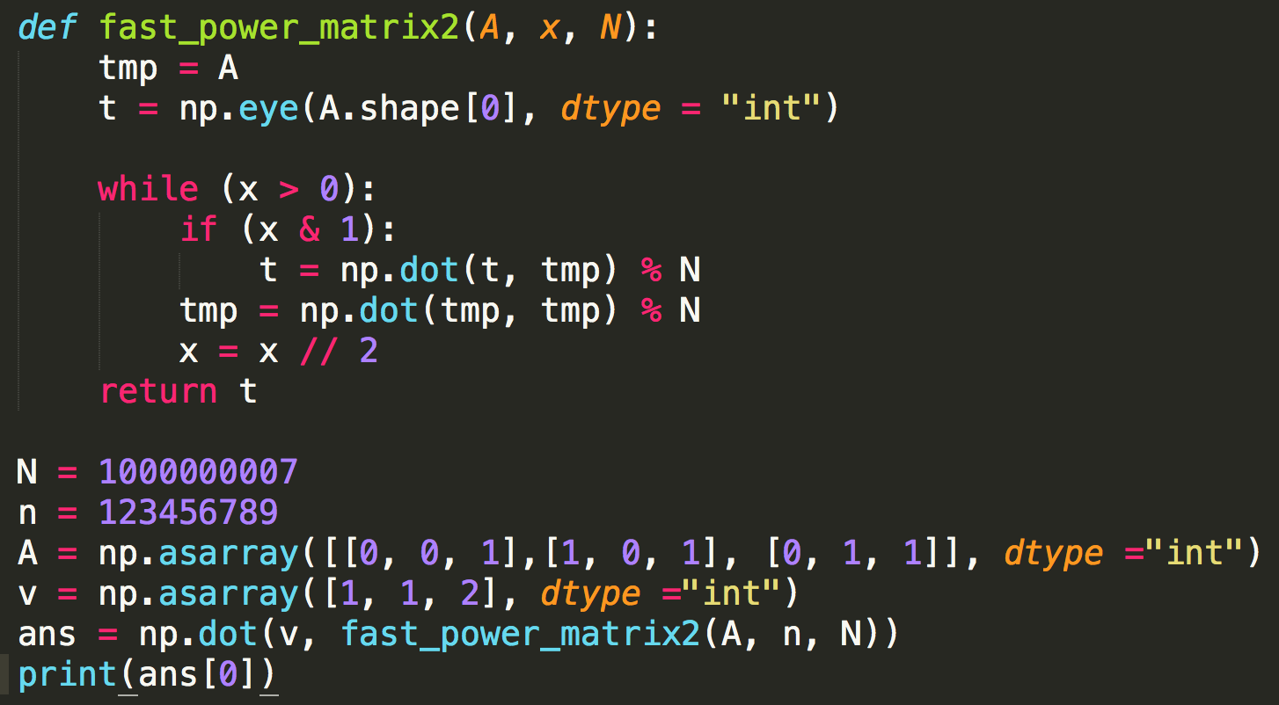
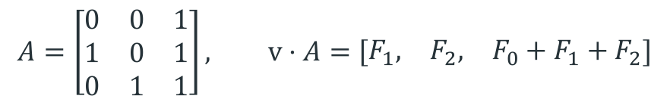
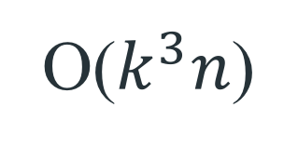
Use Matrix Multiplication to Handle DP
$$A=\left[\begin{matrix}0 & 0 & 1 \\ 1 & 0 & 1 \\ 0 & 1 & 1\end{matrix}\right], v⋅A=\left[\begin{matrix}F_{1}, & F_{2}, & F_{0}+F_{1}+F_{2}\end{matrix}\right]$$
$v=\left[\begin{matrix}F_{0}, & F_{1}, & F_{2}\end{matrix}\right]=[\begin{matrix}1 & 1 & 2\end{matrix}]$
$F_{n}=F_{n−1}+F_{n−2}+F_{n−3}$
O($k^{3}n$)

Slide 27
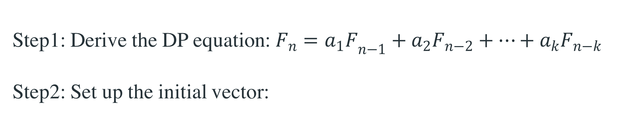

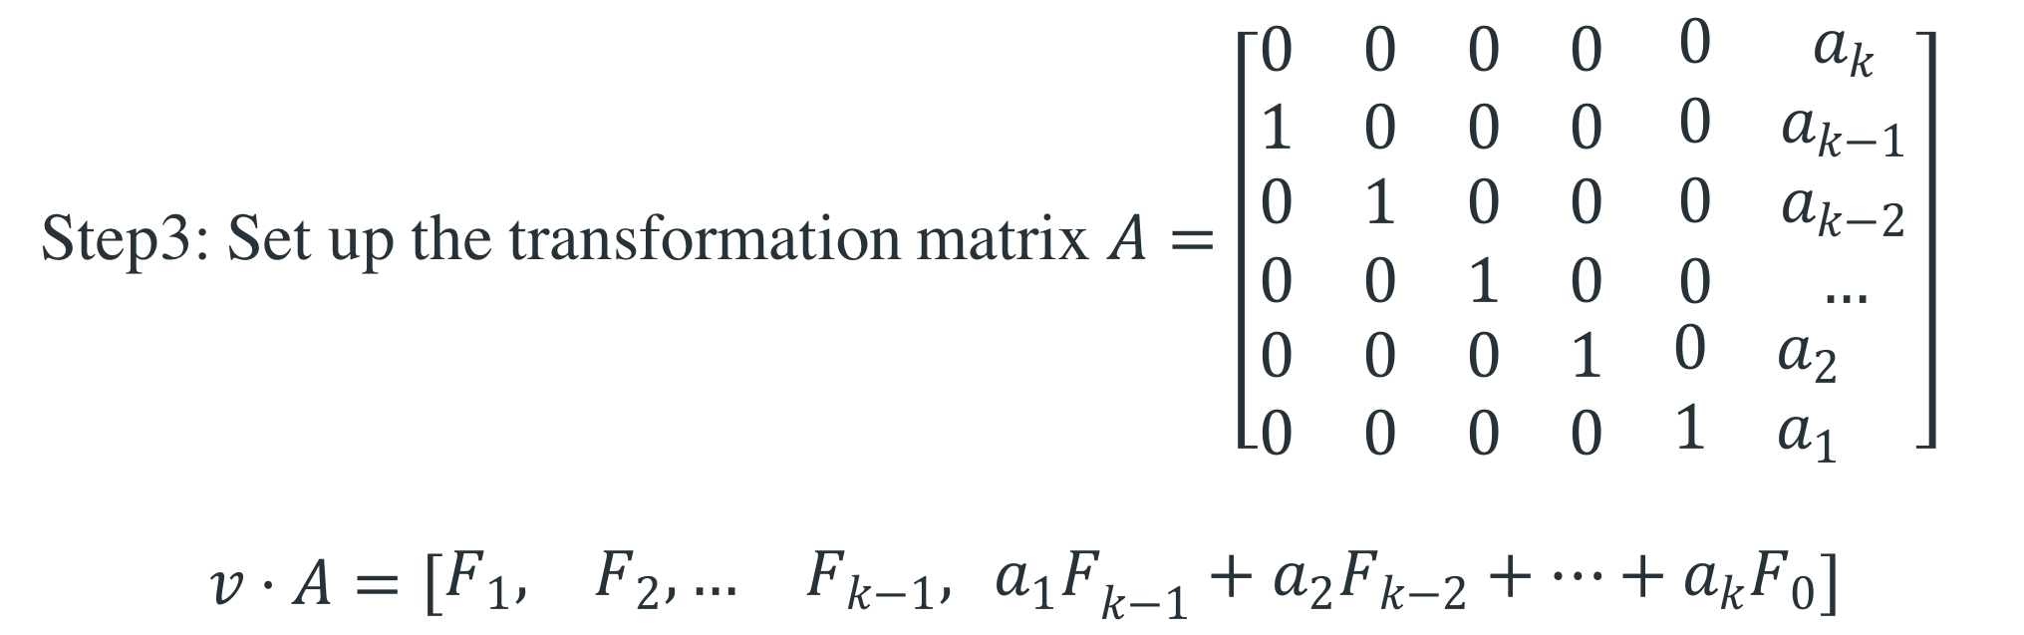
Exercise – How to construct our matrix A and v?
Step1: Derive the DP equation: $F_{n}={a_{1}F}_{n−1}+a_{2}F_{n−2}+…+a_{k}F_{n−k}$
Step2: Set up the initial vector:
$$v=\left[\begin{matrix}F_{0}, & F_{1}, …, & F_{k−1}\end{matrix}\right]$$
Step3: Set up the transformation matrix $A=\left[\begin{matrix}\begin{matrix}0 & 0 \\ 1 & 0\end{matrix} & \begin{matrix}0 & 0 \\ 0 & 0\end{matrix} & \begin{matrix}0 & a_{k} \\ 0 & a_{k−1}\end{matrix} \\ \begin{matrix}0 & 1 \\ 0 & 0\end{matrix} & \begin{matrix}0 & 0 \\ 1 & 0\end{matrix} & \begin{matrix}0 & a_{k−2} \\ 0 & …\end{matrix} \\ \begin{matrix}0 & 0 \\ 0 & 0\end{matrix} & \begin{matrix}0 & 1 \\ 0 & 0\end{matrix} & \begin{matrix}0 & a_{2} \\ 1 & a_{1} \end{matrix}\end{matrix}\right]$
$$v⋅A=\left[\begin{matrix}F_{1}, & F_{2}, … & F_{k−1},{{ a}_{1}F}_{k−1}+a_{2}F_{k−2}+…+a_{k}F_{0}\end{matrix}\right]$$

Slide 28
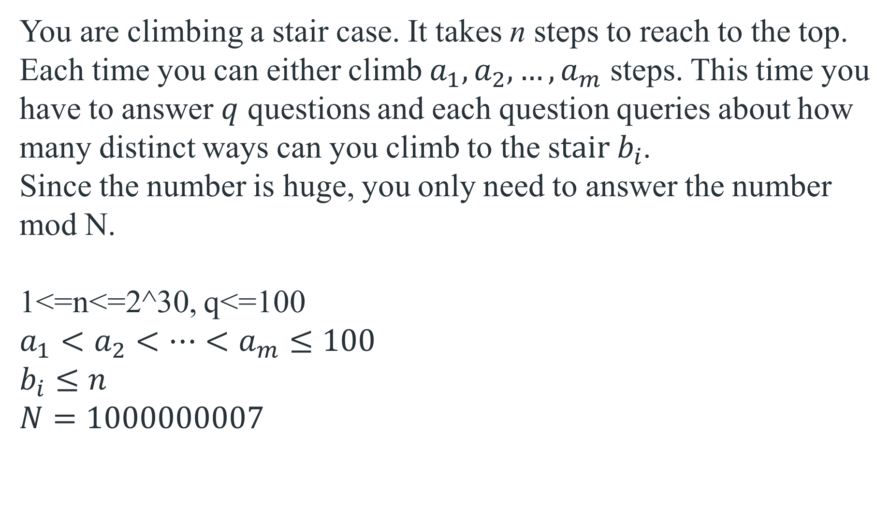
Exercise-2
You are climbing a stair case. It takes n steps to reach to the top. Each time you can either climb $a_{1},a_{2},…,a_{m}$ steps. This time you have to answer $q$ questions and each question queries about how many distinct ways can you climb to the s$tair b_{i}$.
Since the number is huge, you only need to answer the number mod N.
1<=n<=2^30, q<=100
$$a_{1}<a_{2}<…<a_{m}≤100$$
$$b_{i}≤n$$
$$N=1000000007$$

Slide 29
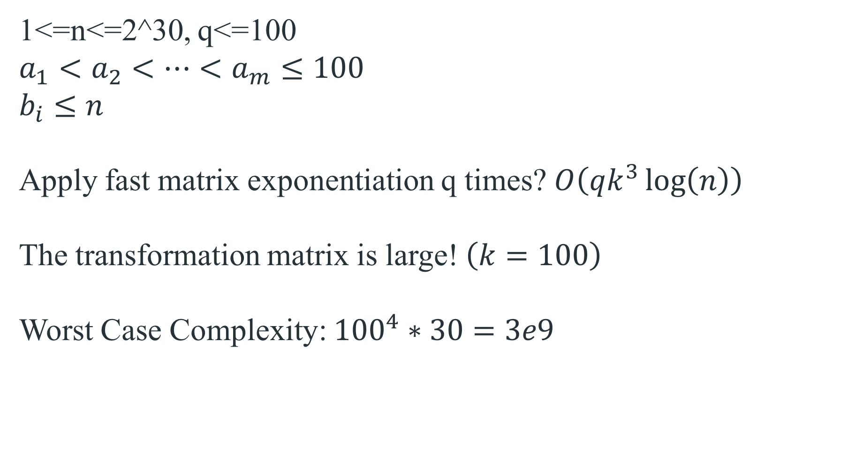
Exercise-2
1<=n<=2^30, q<=100
$$a_{1}<a_{2}<…<a_{m}≤100$$
$$b_{i}≤n$$
Apply fast matrix exponentiation q times? $O\left(qk^{3}\log\left(n\right)\right)$
The transformation matrix is large! $\left(k=100\right)$
Worst Case Complexity: ${100}^{4}∗30=3e9$

Slide 30
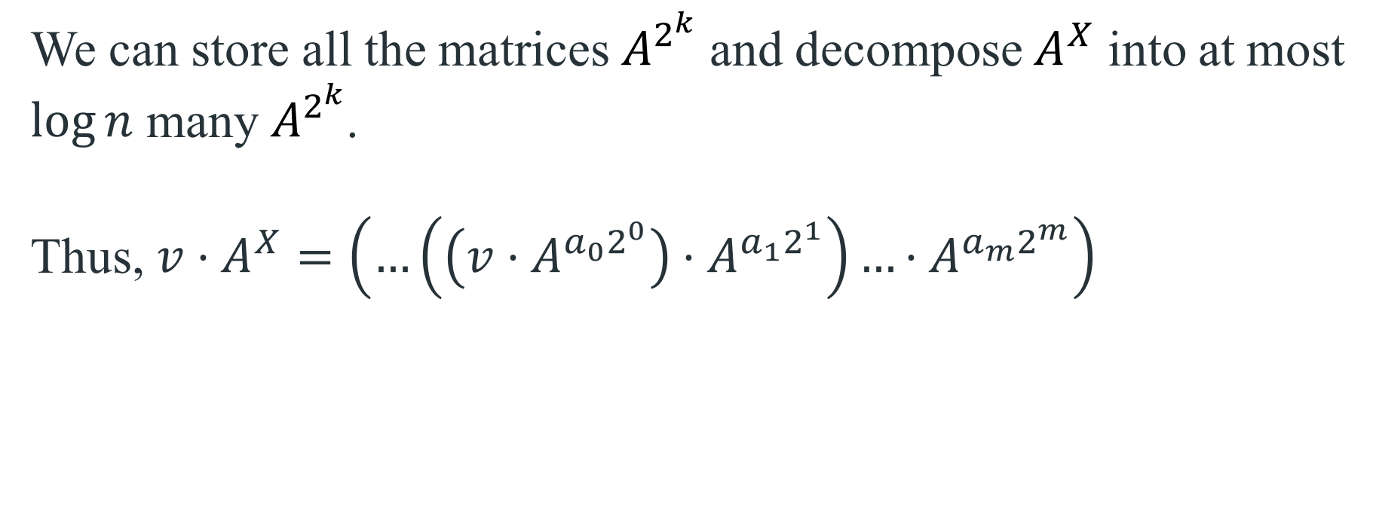


Exercise-2 Can we do it faster?
For all question, we have the same A but different X.
$$X=a_{0}2^{0}+a_{1}2^{1}+…+a_{m}2^{m}$$
$A^{X}=A^{a_{0}2^{0}+a_{1}2^{1}+…+a_{m}2^{m}}=A^{a_{0}2^{0}}⋅A^{a_{1}2^{1}}$ $⋅$… $⋅ A^{a_{m}2^{m}}$
We can store all the matrices $A^{2^{k}}$ and decompose $A^{X}$ into at most $\log{n}$ many $A^{2^{k}}$.
Thus, $v⋅A^{X}=\left(…\left(\left(v⋅A^{a_{0}2^{0}}\right)⋅A^{{a_{1}2}^{1}}\right)…⋅A^{a_{m}2^{m}}\right)$
$$O(k^{2})$$
$$O(k^{2}log⁡(n))$$

Slide 31
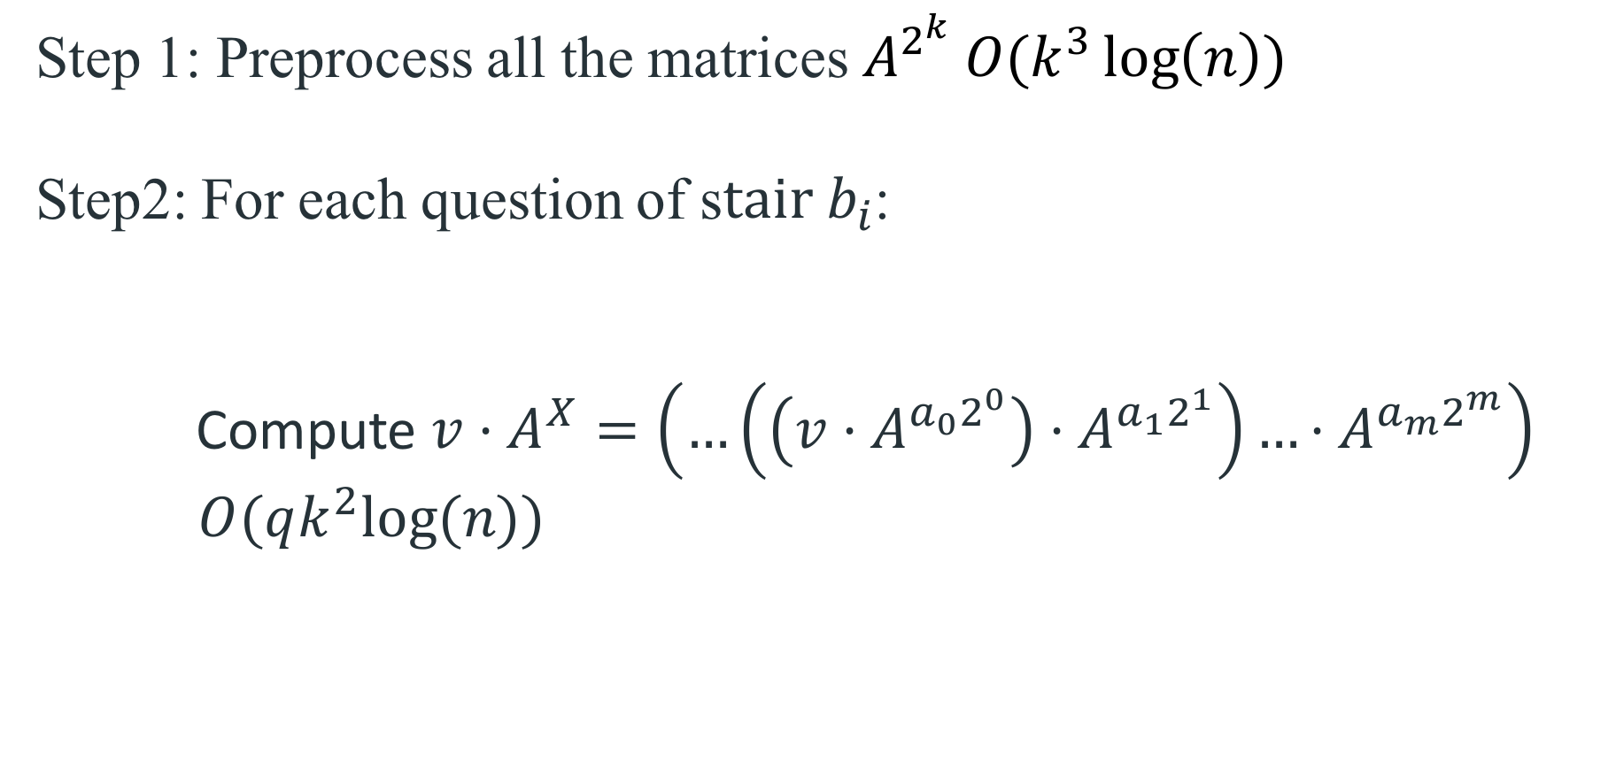

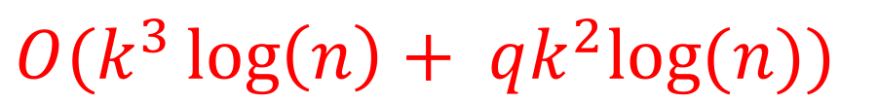
Exercise-2 Can we do it faster?
Step 1: Preprocess all the matrices $A^{2^{k}} O(k^{3}\log\left(n\right))$
Step2: For each question of s$tair b_{i}$:
Compute $v⋅A^{X}=\left(…\left(\left(v⋅A^{a_{0}2^{0}}\right)⋅A^{{a_{1}2}^{1}}\right)…⋅A^{a_{m}2^{m}}\right)$
$O(qk^{2}log⁡(n))$
$$b_{i}=a_{0}2^{0}+a_{1}2^{1}+…+a_{m}2^{m}$$
$$O(k^{3}\log\left(n\right)+ qk^{2}log⁡(n))$$

Slide 32
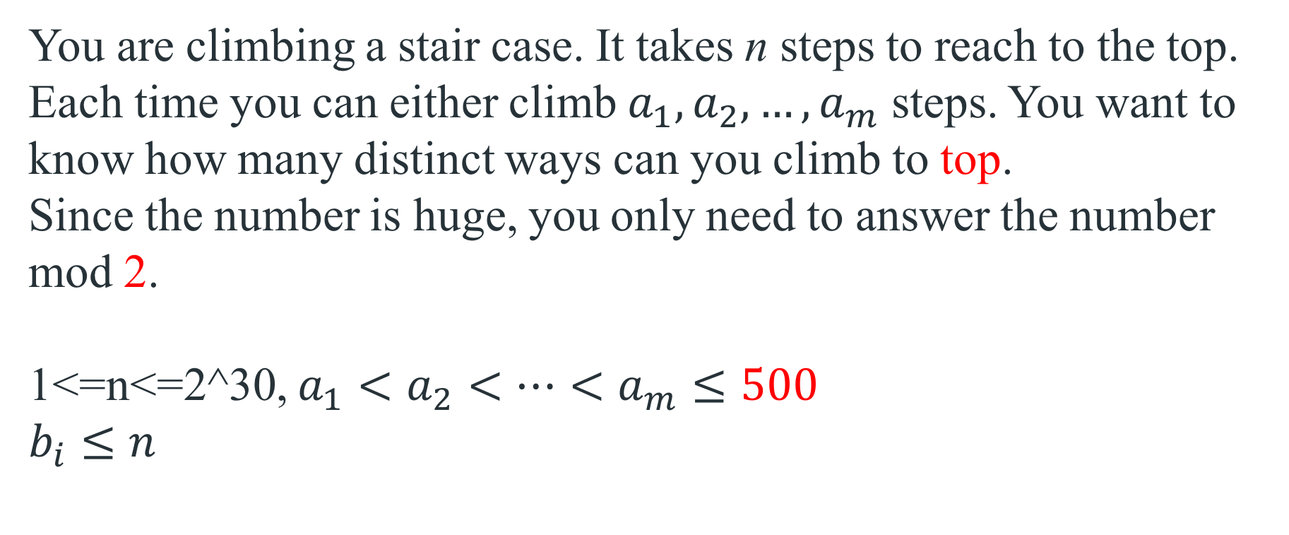
Exercise-3
You are climbing a stair case. It takes n steps to reach to the top. Each time you can either climb $a_{1},a_{2},…,a_{m}$ steps. You want to know how many distinct ways can you climb to top.
Since the number is huge, you only need to answer the number mod 2.
1<=n<=2^30, $a_{1}<a_{2}<…<a_{m}≤500$
$$b_{i}≤n$$

Slide 33
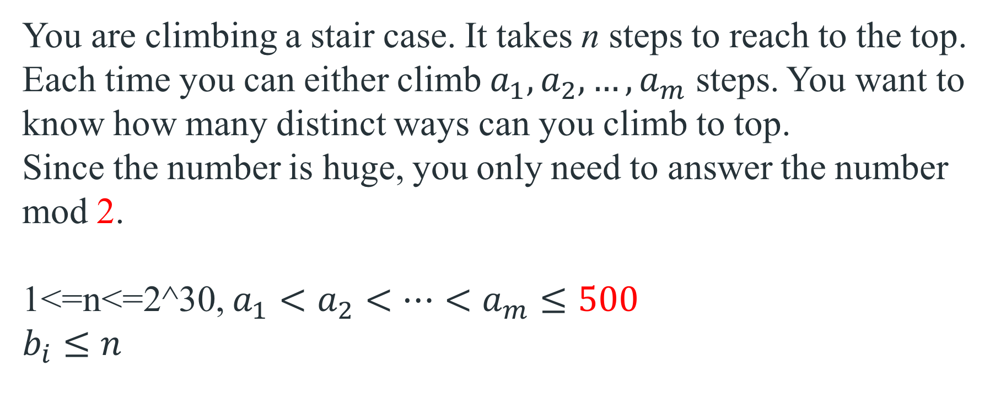
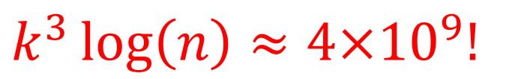
Exercise-3
You are climbing a stair case. It takes n steps to reach to the top. Each time you can either climb $a_{1},a_{2},…,a_{m}$ steps. You want to know how many distinct ways can you climb to top.
Since the number is huge, you only need to answer the number mod 2.
1<=n<=2^30, $a_{1}<a_{2}<…<a_{m}≤500$
$$b_{i}≤n$$
$$k^{3}\log\left(n\right)≈{4×10}^{9}!$$

Slide 34
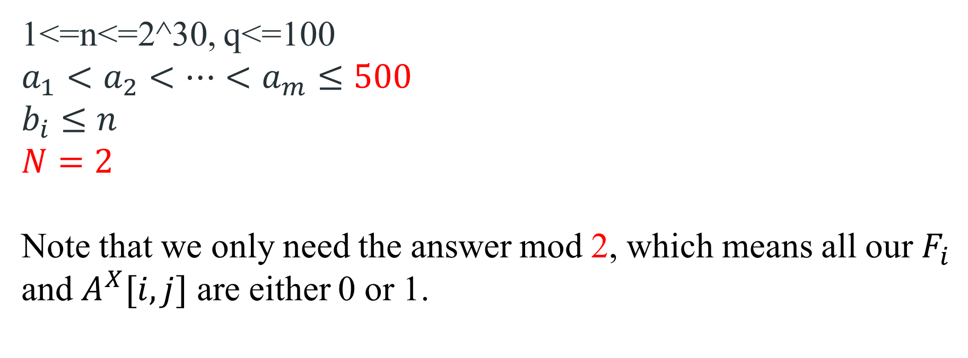
Exercise-3
1<=n<=2^30, q<=100
$$a_{1}<a_{2}<…<a_{m}≤500$$
$$b_{i}≤n$$
$N=2$
Note that we only need the answer mod 2, which means all our $F_{i}$ and $A^{X}[i,j]$ are either 0 or 1.

Slide 35
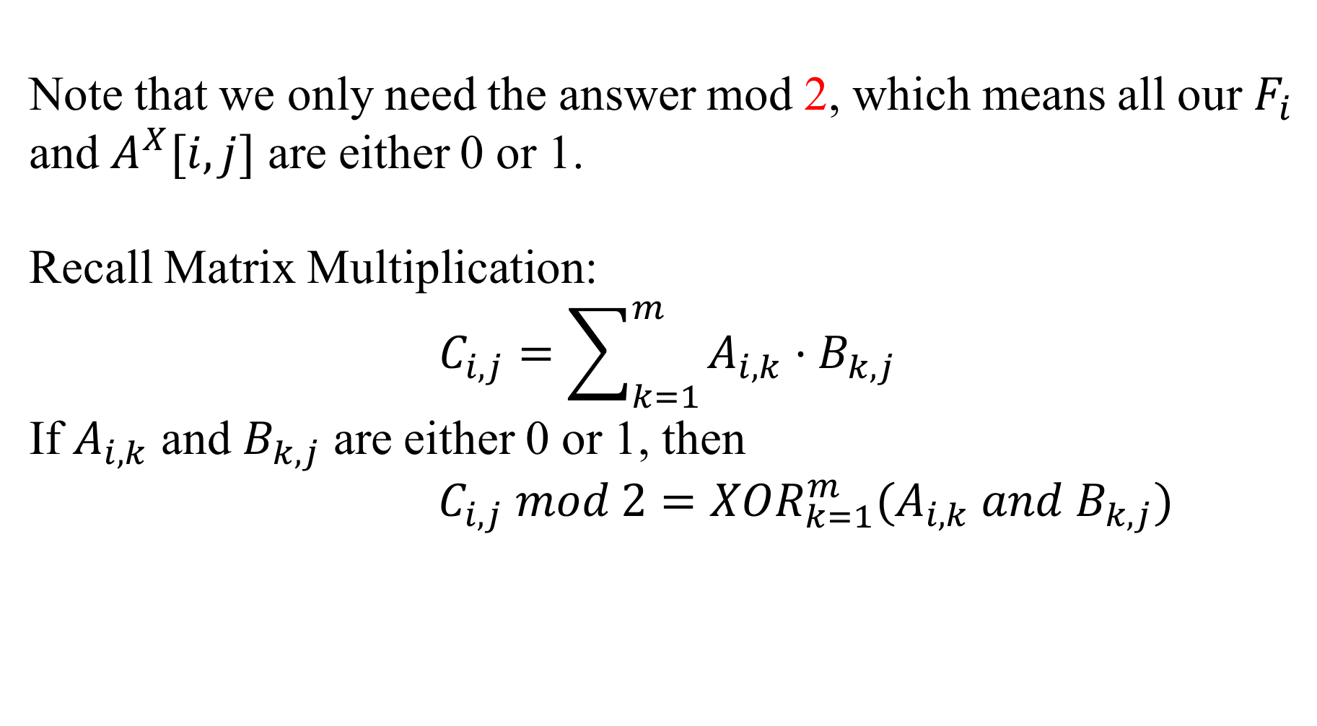
Exercise-3
Note that we only need the answer mod 2, which means all our $F_{i}$ and $A^{X}[i,j]$ are either 0 or 1.
Recall Matrix Multiplication:
$$C_{i,j}=\sum_{k=1}^{m}{A_{i,k}{⋅B}_{k,j}}$$
If $A_{i,k}$ and $B_{k,j}$ are either 0 or 1, then
$C_{i,j} mod 2=XOR_{k=1}^{m}(A_{i,k} and B_{k,j})$

Slide 36
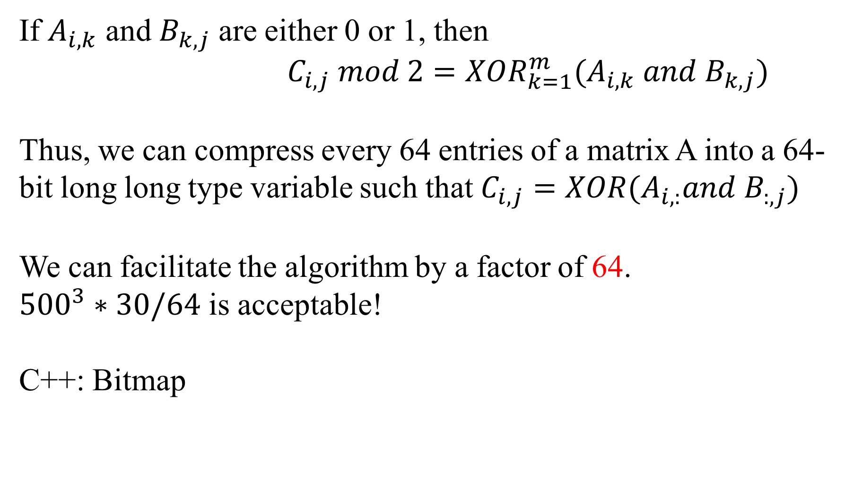
Exercise-3
If $A_{i,k}$ and $B_{k,j}$ are either 0 or 1, then
$C_{i,j} mod 2=XOR_{k=1}^{m}(A_{i,k} and B_{k,j})$
Thus, we can compress every 64 entries of a matrix A into a 64-bit long long type variable such that $C_{i,j}=XOR(A_{i,:}and B_{:,j})$
We can facilitate the algorithm by a factor of 64.
${500}^{3}∗30/64$ is acceptable!
C++: Bitmap

Slide 37
Q&A
Feedback Form:
https://forms.gle/5V7Gcc4TuVPjKgyx9

Slide 38
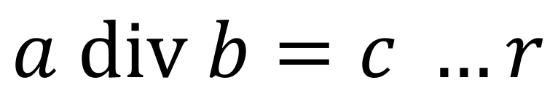
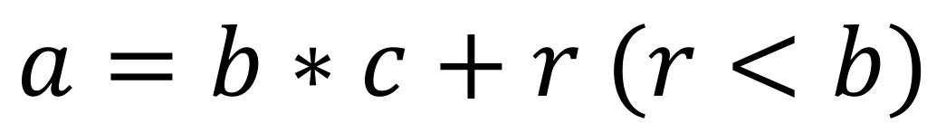
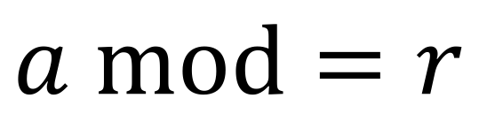
Prerequisites: Modulo Operation
$$a div b=c …r$$
dividend
divisor
quotient
remainder
$$a=b∗c+r (r<b)$$
$$a mod=r$$

Slide 39
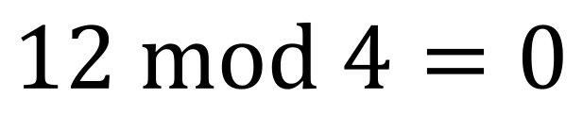
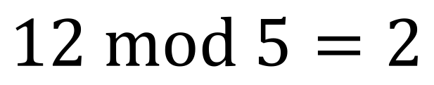
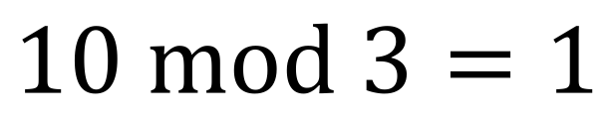

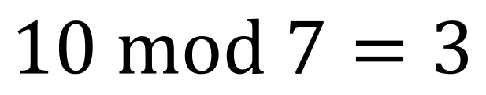
Prerequisites: Modulo Operation
Examples :
$$12 mod 4=0$$
$$12 mod 5=2$$
$$10 mod 3=1$$
$$10 mod 7=3$$
$$…$$

Slide 40

Prerequisites: Modulo Operation Properties
Distrbutive:
1. $\left(a+b\right) mod n=\left(a mod n+b mod n\right) mod n$
2. $\left(a∗b\right) mod n=(\left(a mod n)∗(b mod n\right)) mod n$
e.g.
(5 + 3) mod 4 = (5 mod 4 + 3 mod 4) mod 4 = (1 + 3) mod 4 = 0 = 8 mod 4
(5 * 3) mod 4 = ((5 mod 4) * (3 mod 4)) mod 4 = (1 * 3) mod 4 = 3 = 15 mod 4
Why?
$a = s∗n + r_{1}$, $b = t∗n + r_{2} ⟹ab=\left(st+r_{1} t+r_{2}s\right)n+r_{1} r_{2}$
$$⟹a+b=\left(s+ t\right)n+r_{1}+ r_{2}$$

Slide 41

Prerequisites: Modulo Operation Properties
Identity:
1.$(a mod n) mod n = a mod n$
2.$n^{x} mod n=0 \left(x≥1\right)$
3. If $P$ is a prime number, ${ab}^{P−1} mod P =a mod P$
(Fermat‘s little theorem, $b^{P−1} mod P=1$ )
Inverse:
1. $\left(\left(−a mod n\right)+a mod n\right) mod n =0$
2. $b^{−1} mod n$ denotes the modular multiplicative inverse, which is defined if and only if b and n are relatively prime, which is the case when the left hand side is defined: [($b^{−1}$ mod n)(b mod n)] mod n = 1.
special case:
$b^{−1} mod P=b^{P−2} mod P (b^{P−1} mod p=1)$

