Slide 1
CS 4700: Foundations of Artificial Intelligence
Bart Selman
selman@cs.cornell.edu
Module: Knowledge, Reasoning, and Planning
Part 2
Logical Agents
R&N: Chapter 7

Slide 2
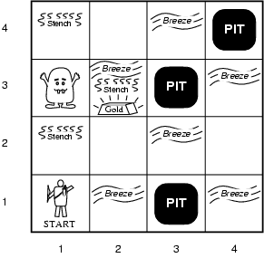
Illustrative example: Wumpus World
(Somewhat whimsical!)
Performance measure
gold +1000,
death -1000
(falling into a pit or being eaten by the wumpus)
-1 per step, -10 for using the arrow
Environment
Rooms / squares connected by doors.
Squares adjacent to wumpus are smelly
Squares adjacent to pit are breezy
Glitter iff gold is in the same square
Shooting kills wumpus if you are facing it
Shooting uses up the only arrow
Grabbing picks up gold if in same square
Releasing drops the gold in same square
Randomly generated at start of game. Wumpus only senses current room.
Sensors: Stench, Breeze, Glitter, Bump, Scream [perceptual inputs]
Actuators: Left turn, Right turn, Forward, Grab, Release, Shoot
Notes:
A cave consisting of rooms connected by passageways:
lurking somewhere in the cave is the wumpus, a beast that eats anyone who enters its room;
the wumpus can be shot by an agent, but the agent has only one arrow;
Some rooms contain bottomless pits that will trp anyone who wanders into these rooms – except the wumpus which is too big to fall;
Mitigating feature of living in this environment: finding gold (Michael Genesereth);
Agent always starts in square (1,1) facing to the right; locations of gold and the wumpus are chosen randomly, with uniform distribution, from the squares other than the start square; each square other than the start can be a pit with probability 0.2

Slide 3
Wumpus world characterization
Fully Observable No – only local perception
Deterministic Yes – outcomes exactly specified
Static Yes – Wumpus and Pits do not move
Discrete Yes
Single-agent? Yes – Wumpus is essentially a “natural feature.”

Slide 4
Exploring a wumpus world
The knowledge base of the agent
consists of the rules of the
Wumpus world plus the percept
“nothing” in [1,1]
Boolean percept
feature values:
<0, 0, 0, 0, 0>
None, none, none, none, none
Stench, Breeze, Glitter, Bump, Scream

Slide 5
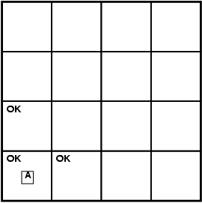
World “known” to agent
at time = 0.
T=0 The KB of the agent consists of
the rules of the Wumpus world plus
the percept “nothing” in [1,1].
By inference, the agent’s knowledge
base also has the information that
[1,2] and [2,1] are okay.
Added as propositions.
None, none, none, none, none
Stench, Breeze, Glitter, Bump, Scream

Slide 6
Further exploration
T = 0
T = 1
P?
A/B
P?
V
None, breeze, none, none, none
None, none, none, none, none
A – agent
V – visited
B - breeze
Stench, Breeze, Glitter, Bump, Scream
@ T = 1 What follows?
Pit(2,2) or Pit(3,1)
Where next?

Slide 7
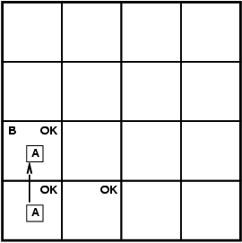
T=3
4
3
W
S
P?
S
2
P
1
P?
P
1 2 3 4
Stench, none, none, none, none
Stench, Breeze, Glitter, Bump, Scream
Where is Wumpus?
Wumpus cannot be in (1,1) or in (2,2) (Why?)➔ Wumpus in (1,3)
Not breeze in (1,2) ➔ no pit in (2,2); but we know there is
pit in (2,2) or (3,1) ➔ pit in (3,1)

Slide 8
We reasoned about the possible states the Wumpus world can be in, given our percepts and our knowledge of the rules of the Wumpus world.
I.e., the content of KB at T=3.
W
P
P
What follows is what holds true in all those worlds that satisfy what is known at that time T=3 about the particular Wumpus world we are in.
Example property: P_in_(3,1)
Models(KB) Models(P_in_(3,1))
Essence of logical reasoning:
Given all we know, Pit_in_(3,1) holds.
(“The world cannot be different.”)

Slide 9
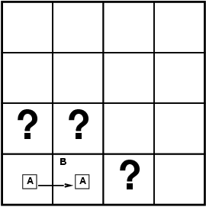
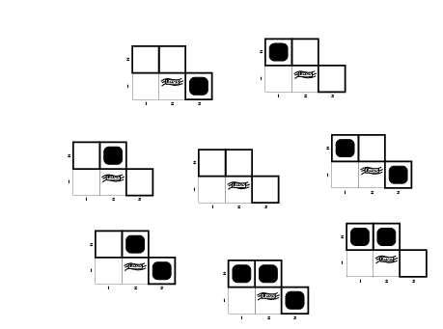
Formally: Entailment
Knowledge Base (KB) in the Wumpus World →
Rules of the wumpus world + new percepts
Situation after detecting nothing in [1,1], moving right, breeze in [2,1]. I.e. T=1.
Consider possible models for KB with respect to the cells (1,2), (2,2) and (3,1), with respect to the existence or non existence of pits
3 Boolean choices ⇒
8 possible interpretations
(enumerate all the models or
“possible worlds” wrt Pit location)
T = 1

Slide 10
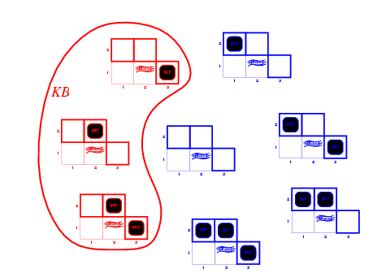
Is KB consistent with all
8 possible worlds?
Worlds
that violate KB
(are inconsistent
with what we
know)
KB = Wumpus-world rules + observations (T=1)
Q: Why does world violate KB?

Slide 11
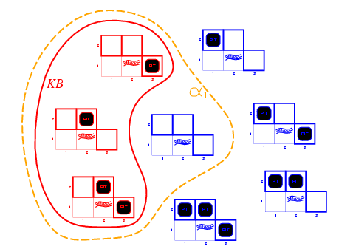
Entailment in Wumpus World
So, KB defines
all worlds that
we hold possible.
Queries: we want to know the properties of those worlds.
That’s how the semantics of logical entailment is defined.
Models of the KB and α1
Note: \alpha_1
holds in more
models than KB.
That’s OK, but we
don’t care about
those worlds.
KB = Wumpus-world rules + observations
α₁ = "[1,2] has no pit", KB ╞ α₁
In every model in which KB is true, α₁ is True (proved by “model checking”)

Slide 12
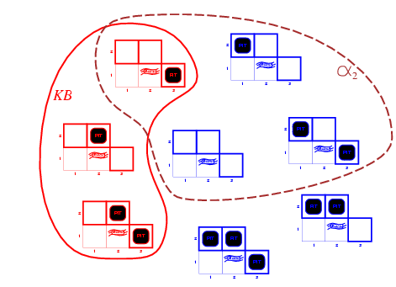
Wumpus models
KB = wumpus-world rules + observations
α2 = "[2,2] has no pit", this is only True in some
of the models for which KB is True, therefore KB ╞ α2
Model Checking
Models of α2
A model of KB where does NOT hold!
α2

Slide 13
Entailment via “Model Checking”
Inference by Model checking –
We enumerate all the KB models and check if α₁ and α₂ are
True in all the models (which implies that we can only use it
when we have a finite number of models).
I.e. using semantics directly.
Models(KB) Models( )

Slide 14
Example redux: More formal
P?
A/B
P?
V
None, none, none, none, none
None, breeze, none, none, none
Stench, Breeze, Glitter, Bump, Scream
A – agent
V – visited
B - breeze
How do we actually encode background
knowledge and percepts in formal language?

Slide 15
Wumpus World KB
Define propositions:
Let P_{i,j} be true if there is a pit in [i, j].
Let B_{i,j} be true if there is a breeze in [i, j].
Sentence 1 (R1): ¬ P_{1,1}
Sentence 2 (R2): ¬ B_{1,1}
Sentence 3 (R3): B_{2,1}
"Pits cause breezes in adjacent squares”
Sentence 4 (R4): B_{1,1} ⇔ (P_{1,2} ∨ P_{2,1})
Sentence 5 (R5): B_{2,1} ⇔ (P_{1,1} ∨ P_{2,2} ∨ P_{3,1})
etc.
Notes: (1) one such statement about Breeze for each square.
(2) similar statements about Wumpus, and stench
and Gold and glitter. (Need more propositional
letters.)
[Given.]
[Observation T = 0.]
[Observation T = 1.]

Slide 16
What about Time? What about Actions?
Is Time represented?
No!
Can include time in propositions:
Explicit time P_{i,j,t} B_{i,j,t} L_{i,j,t} etc.
Many more props: O(TN²) (L_{i,j,t} for agent at (i,j) at time t)
Now, we can also model actions, use props: Move(i, j, k, l ,t)
E.g. Move(1, 1, 2, 1, 0)
What knowledge axiom(s) capture(s) the effect of an Agent move?
Is this it?
What about i, j, k, and l?
What about Agent location at time t?

Slide 17
Move implies a change in the world state;
a change in the world state, implies a move occurred!
Improved:
For all tuples (i, j, k, l) that represent legitimate possible moves.
E.g. (1, 1, 2, 1) or (1, 1, 1, 2)
Still, some remaining subtleties when representing time and
actions. What happens to propositions at time t+1 compared to at
time t, that are *not* involved in any action?
E.g. P(1, 3, 3) is derived at some point.
What about P(1, 3, 4), True or False?
R&N suggests having P as an “atemporal var” since it cannot change over
time. Nevertheless, we have many other vars that can change over time,
called “fluents”.
Values of propositions not involved in any action should not change! “The Frame Problem” / Frame Axioms R&N 7.7.1

Slide 18
Successor-State Axioms
Axiom schema:
F is a fluent (prop. that can change over time)
For example:
i.e. L_1,1 was “as before” with [no movement action or bump into wall]
or resulted from some action (movement into L_1,1).

Slide 19
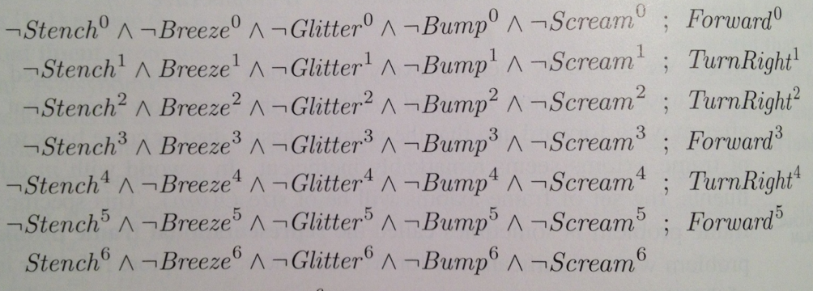
Some example inferences Section 7.7.1 R&N
Actions and inputs up to time 6
Note: includes turns!
Define “OK”:
In milliseconds, with modern SAT solver.

Slide 20
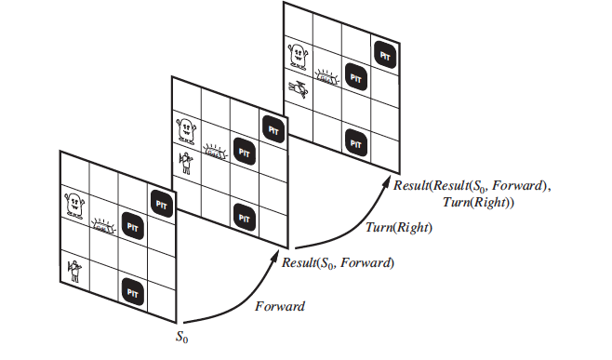
Alternative formulation: Situation Calculus R&N 10.4.2
No explicit time. Actions are what changes the world
from “situation” to “situation”. More elegant, but
still need frame axioms to capture what stays the same.
Inherent with many representation formalisms: “physical”
persistance does not come for free! (and probably shouldn’t)

Slide 21
Inference by enumeration / “model checking” Style I
The goal of logical inference is to decide whether KB╞ α, for some α.
For example, given the rules of the Wumpus World, is P₂₂ entailed? Relevant propositional symbols:
R1: ¬ P_{1,1}
R2: ¬B_{1,1}
R3: B_{2,1}
"Pits cause breezes in adjacent squares"
R4: B_{1,1} ⇔ (P_{1,2} ∨ P_{2,1})
R5: B_{2,1} ⇔ (P_{1,1} ∨ P_{2,2} ∨ P_{3,1})
?
Models(KB) Models( P₂₂ )
Inference by enumeration. We have 7 relevant symbols
Therefore 2⁷ = 128 interpretations.
Need to check if P₂₂ is true in all of the KB models
(interpretations that satisfy KB sentences).
Q.: KB has many more symbols. Why can we restrict ourselves
to these symbols here?
But, be careful, typically we can’t!!

Slide 22
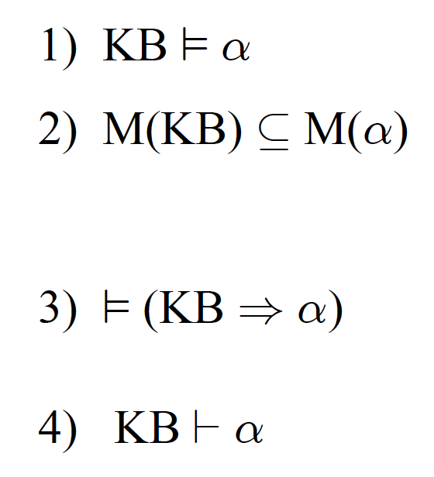
All equivalent Prop. / FO Logic
entailment
by defn. / semantic proofs / truth tables
“model checking” /enumeration
(style I, R&N 7.4.4)
deduction thm. R&N 7.5
soundness and completeness
logical deduction / symbol pushing
proof by inference rules (style II)
e.g. modus ponens (R&N 7.5.1)
Proof by contradiction
use CNF / clausal form
Resolution (style III, R&N 7.5)
SAT solvers (style IV, R&N 7.6)
most effective

Slide 23
Proof techniques
by defn. / semantic proofs / truth tables
“model checking”
(style I, R&N 7.4.4) Done.
soundness and completeness
logical deduction / symbol pushing
proof by inference rules (style II)
e.g. modus ponens (R&N 7.5.1)
Proof by contradiction
use CNF / clausal form
Resolution (style III, R&N 7.5)
SAT solvers (style IV, R&N 7.6)
most effective

Slide 24
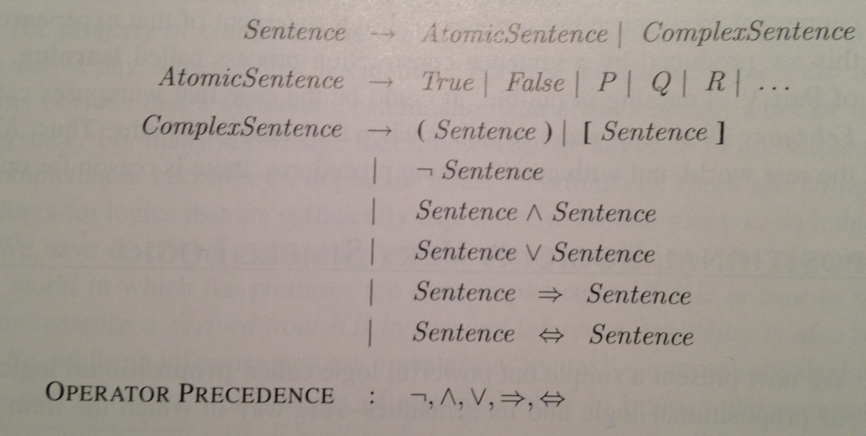
Aside
Standard syntax and semantics for propositional
logic. (CS-2800; see 7.4.1 and 7.4.2.)
Syntax:

Slide 25
Semantics
Note: Truth value of a sentence is built from its parts “compositional semantics”

Slide 26
Logical equivalences
(*)
(*) key to go to clausal (Conjunctive Normal Form)
Implication for “humans”; clauses for machines.
de Morgan laws also very useful in going to clausal form.

Slide 27
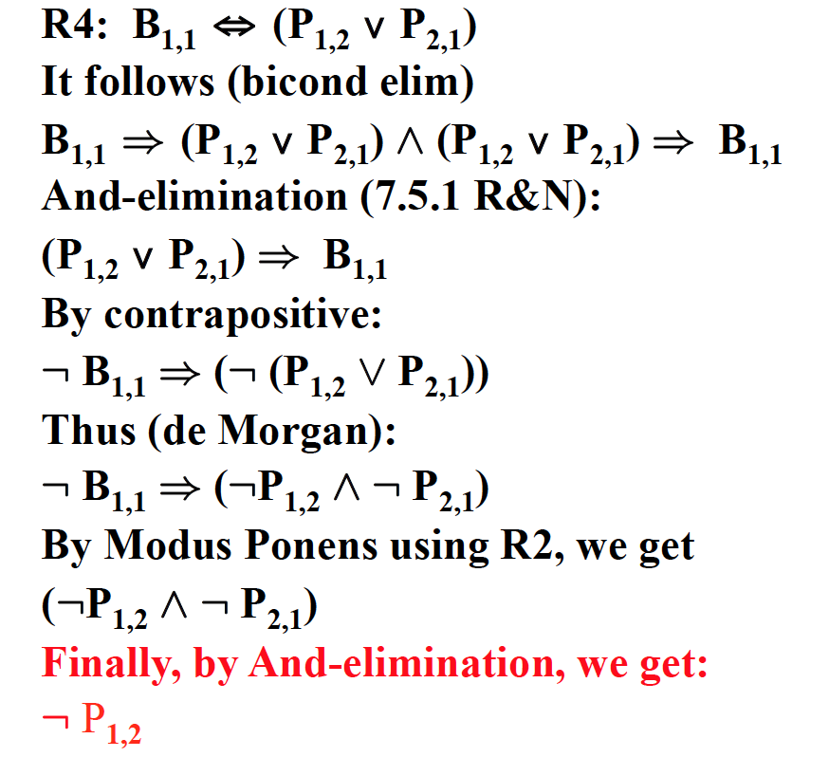
Style II: Proof by inference rules Modus Ponens (MP)
KB at T = 1:
R1: ¬P_{1,1}
R2: ¬B_{1,1}
R3: B_{2,1}
R4: B_{1,1} ⇔ (P_{1,2} ∨ P_{2,1})
R5: B_{2,1} ⇔ (P_{1,1} ∨ P_{2,2} ∨ P_{3,1})
P?
A/B
P?
V
Wumpus world
at T = 1
Note: In formal proof,
every step needs to be
justified.
So, we used R2 and R4.

Slide 28
Length of Proofs
Why bother with inference rules? We could always use a truth table
to check the validity of a conclusion from a set of premises.
But, resulting proof can be much shorter than truth table method.
Consider KB:
p_1, p_1 → p_2, p_2 → p_3, …, p_(n-1) → p_n
To prove conclusion: p_n
Inference rules: Truth table:
n-1 MP steps
2^{n}
Key open question: Is there always a short proof for any valid
conclusion? Probably not. The NP vs. co-NP question.
(The closely related: P vs. NP question carries a $1M prize.)

Slide 29
Style III: Resolution
First, we need a conversion to Conjunctive
Normal Form (CNF) or Clausal Form.
Let’s consider converting R4 in clausal form:
R4: B_{1,1} ⇔ (P_{1,2} ∨ P_{2,1})
We have:
B_{1,1} ) (P_{1,2} Ç P_{2,1})
which gives (implication elimination):
(: B_{1,1} Ç P_{1,2} Ç P_{2,1})
Also
(P_{1,2} ∨ P_{2,1}) ) B_{1,1}
which gives:
(: (P_{1,2} Ç P_{2,1}) Ç B_{1,1})
Thus,
(: P_{1,2} Æ : P_{2,1}) Ç B_{1,1}
leaving,
(: P_{1,2} Ç B_{1,1} )
(: P_{2,1} Ç B_{1,1} )
(note: clauses in red)
P?
A/B
P?
V
Wumpus world
at T = 1

Slide 33
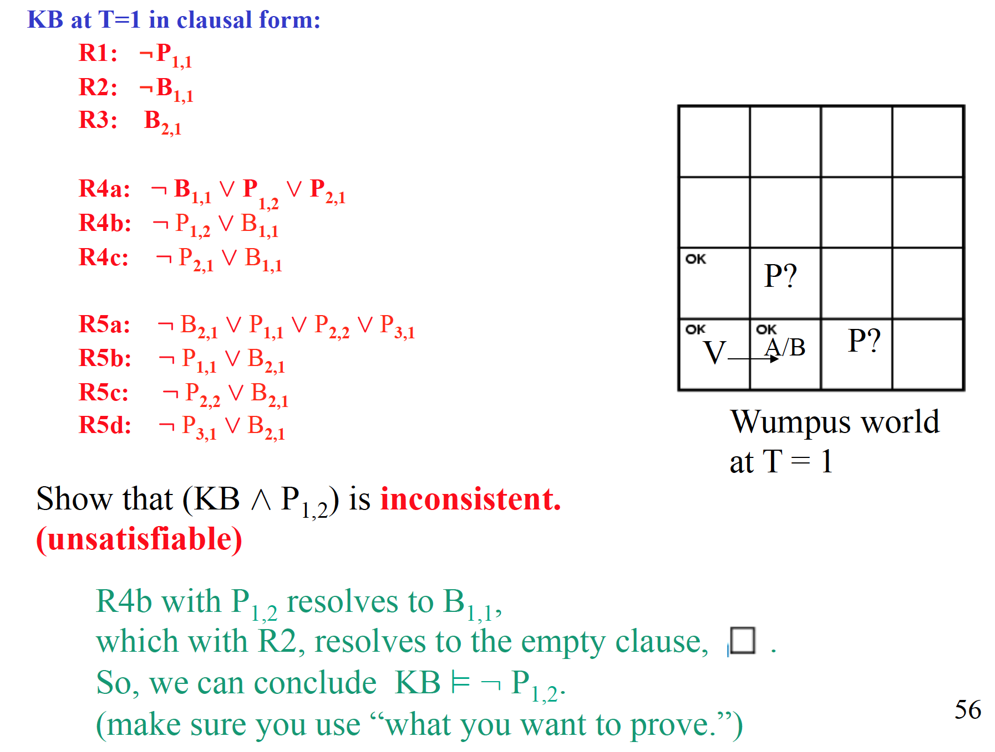

Slide 34
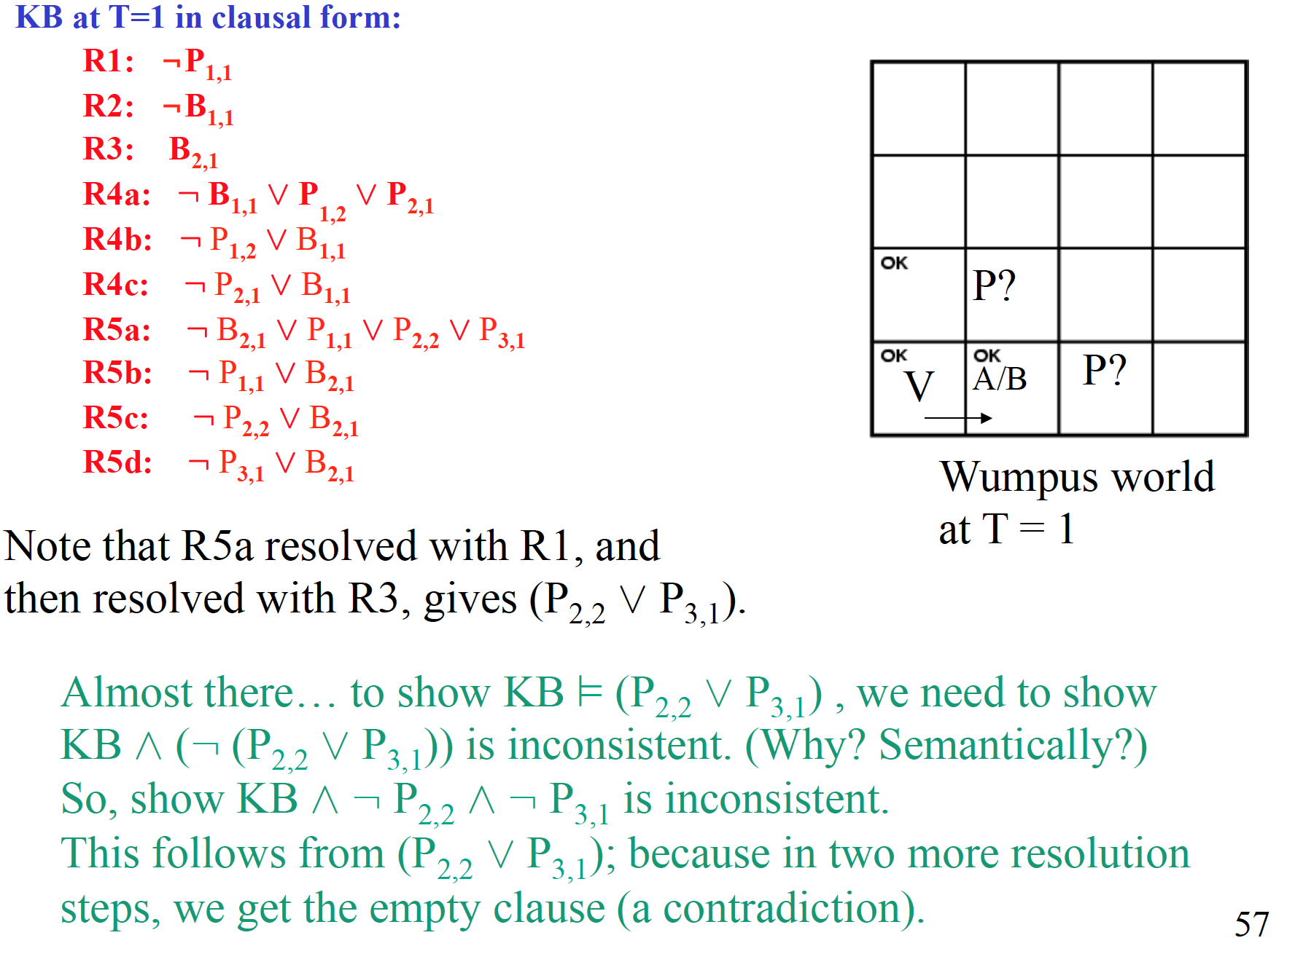
Another example
resolution proof

Slide 35
Length of Proofs
Consider KB:
p_1, p_1 → p_2, p_2 → p_3, …, p_(n-1) → p_n
To prove conclusion: p_n
Resolution. Assert (¬ p_n)
with (¬ p_(n-1) ∨ p_n) gives (¬ p_(n-1))
with (¬ p_(n-2) ∨ p_(n-1) gives (¬ p_(n-2))
…
with (¬ p_1) ∨ p_2) gives (¬ p_1)
with (p_1) gives empty clause (contradiction).
QED
Note how resolution mimics Modus Ponens steps.
n resolution steps
2^{n}
Inference rules: Truth table:
So, efficient on these proofs!

Slide 36
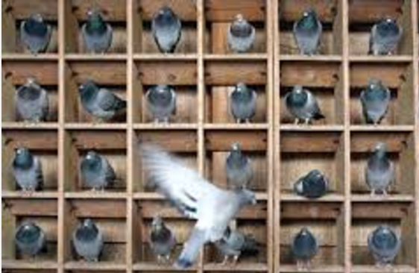
BUT…

Slide 37
SAT SOLVERS CAN
BE VIEWED AS DOING A
SPECIAL
FORM OF RESOLUTION

Slide 38
DPLL improvements
Backtracking + …
Component analysis (disjoint sets of constraints? Problem decomposition?)
Clever variable and value ordering (e.g. degree heuristics)
Intelligent backtracking and clause learning (conflict learning)
Random restarts (heavy tails in search spaces…)
Clever data structures
1+ Million Boolean vars & 10+ Million clause/constraints
are feasible nowadays. (e.g. Minisat solver)
Has changed the world of verification (hardware/software)
over the last decade (incl. Turing award for Clarke).
Widely used in industry, Intel, Microsoft, IBM etc.

Slide 39
All equivalent Prop. / FO Logic
ENDS LOGIC PART
entailment
by defn. / semantic proofs / truth tables
“model checking” /enumeration
(style I, R&N 7.4.4)
deduction thm. R&N 7.5
soundness and completeness
logical deduction / symbol pushing
proof by inference rules (style II)
e.g. modus ponens (R&N 7.5.1)
Proof by contradiction
use CNF / clausal form
Resolution (style III, R&N 7.5)
SAT solvers (style IV, R&N 7.6)
most effective

