Slide 1
CS 4700: Foundations of Artificial Intelligence
Bart Selman
selman@cs.cornell.edu
Logical Agents ---
Intro Knowledge Representation
& SAT encodings
R&N: Chapter 7

Slide 2
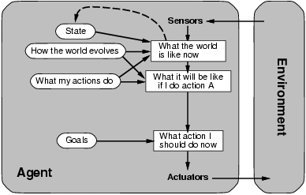
A Model-Based Agent
Requires: Knowledge and Reasoning

Slide 3
Knowledge and Reasoning
Knowledge and Reasoning:
humans are very good at acquiring new information by
combining raw knowledge, experience with reasoning.
AI-slogan: “Knowledge is power” (or “Data is power”?)
Examples:
Medical diagnosis --- physician diagnosing a patient
infers what disease, based on the knowledge he/she
acquired as a student, textbooks, prior cases
Common sense knowledge / reasoning ---
common everyday assumptions / inferences. e.g.,
(1) “lecture starts at four” infer pm not am;
(2) when traveling, I assume there is some way to get
from the airport to the hotel.

Slide 4
Logical agents:
Agents with some representation of the
complex knowledge about the world / its environment,
and uses inference to derive new information from that
knowledge combined with new inputs (e.g. via perception).
Key issues:
1- Representation of knowledge
What form? Meaning / semantics?
2- Reasoning and inference processes
Efficiency.

Slide 5
Knowledge-base Agents
Key issues:
Representation of knowledge → knowledge base
Reasoning processes → inference/reasoning
Knowledge base = set of sentences in a formal language representing facts about the world (*)
(*) called Knowledge Representation (KR) language

Slide 6
Knowledge Representation language candidate:
logical language (propositional / first-order)
combined with a logical inference mechanism
Why not use natural language (e.g. English)?
We want clear syntax & semantics (well-defined
meaning), and, mechanism to infer new information.
Soln.: Use a formal language.

Slide 7
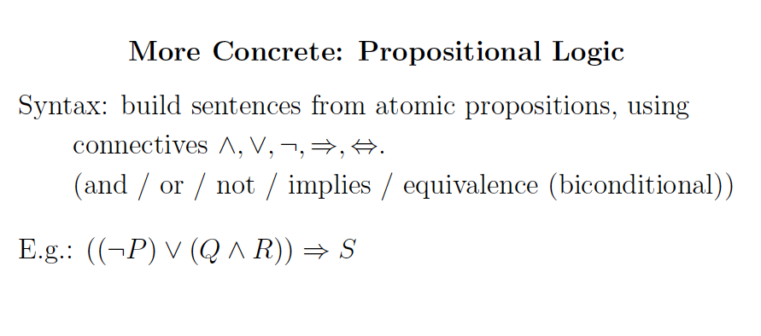

Slide 8
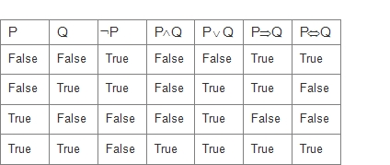
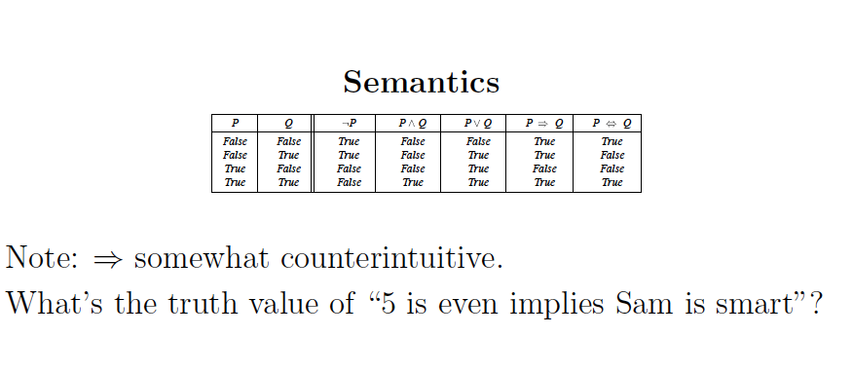
Semantics
P V Q
True
True
False
True
True!

Slide 9
Satisfiability

Slide 10
Propositional Satisfiability problem
Satifiability (SAT): Given a formula in propositional calculus, is there a model
(i.e., a satisfying interpretation, an assignment to its variables) making it true?
We consider clausal form, e.g.:
( a ∨ ¬b ∨ ¬ c ) AND ( b ∨ ¬ c) AND ( a ∨ c)
possible assignments
SAT: prototypical hard combinatorial search and reasoning problem. Problem is NP-Complete. (Cook 1971)
Surprising “power” of SAT for encoding computational problems
Modern SAT Solvers use this langauge.

Slide 11
SAT Solvers
Modern Satisfiability (SAT) solvers operating on the clausal form
are surprisingly *much* more efficient than other logic-based approaches
(e.g., pure resolution that will be discussed later)
The SAT solvers treat the set of clauses as a set of constraints (disjunctions) on Boolean variables, i.e., a CSP problem! Current solvers are very powerful. Can handle 1 Million+ variables and several millions of clauses.
Systematic: Davis Putnam (DPLL) + series of improvements
Stochastic local search: WalkSAT (issue?)
See R&N 7.6. “Ironically,” we are back to semantic model checking, but way more clever than basic truth assignment enumeration (exponentially faster)!

Slide 12
Satisfiability as an Encoding Language

Slide 13
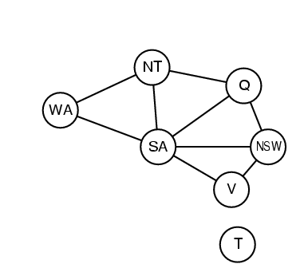
SAT Translation of Graph Coloring
Variables
NxK vars
C_{i,k} node i has color k
Total # colors: K. Total # nodes: N.
At least one of K colors per node i :
(C_{i,1} v C_{i,2} v C_{i,3} v ... V C_{i,K})
At most one color per node i :
(~C_{i,k} v ~C_{i,k’} ) for all k =/= k’
If node i and node j (=/= i) share an edge,
need to have different colors:
(~C_{i,l} v ~C_{j,l}) for all 1 <= I <= K
Note: Translation from
“problem” into SAT.
Reverse of usual
translation to show
NP-completeness.
Works also for (easy)
polytime problems!

Slide 14
Encoding Latin Square Problems in Propositional Logic
n x n square
Variables:
Each variables represents a color assigned to a cell.
Clauses:
Some color must be assigned to each cell
No color is repeated in the same row
No color is repeated in the same column
(clause of length n); n²
(sets of negative binary clauses); n(n-1)/2 n n
(example
Row i
Color k)
(sets of negative binary clauses);
n(n-1)/2 n n
(example
Colum j
Color k)

Slide 15
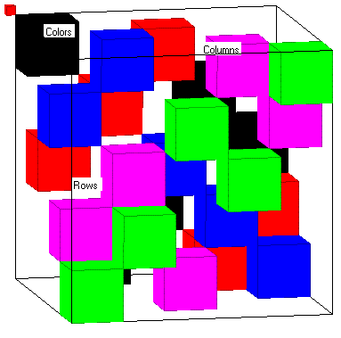
3D Encoding or Full Encoding
This encoding is based on the cubic representation of the quasigroup: each line of the cube contains exactly one true variable;
Variables:
Same as 2D encoding.
Clauses:
Same as the 2 D encoding plus:
Each color must appear at least once in each row;
Each color must appear at least once in each column;
No two colors are assigned to the same cell;

Slide 16
Dimacs format
At the top of the file is a simple header.
p cnf <variables> <clauses>
Each variable should be assigned an integer index. Start at 1, as 0 is used to indicate the end of a clause. The positive integer a positive literal, whereas a negative interger represents a negative literal.
Example
-1 7 0 → (¬ x1 ∨ x7)

Slide 17
Extended Latin Square 2x2
p cnf 8 24
-1 -2 0
-3 -4 0
-5 -6 0
-7 -8 0
-1 -5 0
-2 -6 0
-3 -7 0
-4 -8 0
-1 -3 0
-2 -4 0
-5 -7 0
-6 -8 0
1 2 0
3 4 0
5 6 0
7 8 0
1 5 0
2 6 0
3 7 0
4 8 0
1 3 0
2 4 0
5 7 0
6 8 0
order 2
-1 -1
-1 -1
A cell gets at most a color
No repetition of color in a column
1/2 3/4
5/6 7/8
No repetition of color in a row
A cell gets a color
1 – cell 11 is red
2 – cell 11 is green
3 – cell 12 is red
4 – cell 12 is green
5 – cell 21 is red
6 – cell 21 is green
7 – cell 22 is red
8 – cell 22 is green
A given color goes in each column
A given color goes in each row

Slide 18
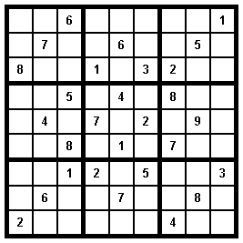
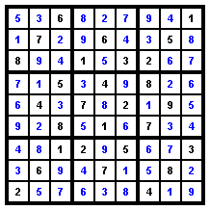
Underlying Latin Square structure
characterizes many real world applications
teams
A D E B C
C B A E D
D C B A E
E A C D B
B E D C A
1 2 3 4 5 6
1
2
3
4
5
6
X
R1
R4
R2
R5
R3
R1
X
R2
R5
R3
R4
teams
R4
R2
X
R3
R1
R5
R2
R5
R3
X
R4
R1
R5
R3
R1
R4
X
R2
R3
R4
R5
R1
R2
X
Design of Scientific Experiments
Scheduling and timetabling
Output ports
Input Port
Output Port
1
1
2
2
3
3
Input ports
4
4
Sudoku
CONFLICT FREE
LATIN ROUTER
Routing in
Fiber Optic Networks
Many more applications…

Slide 19
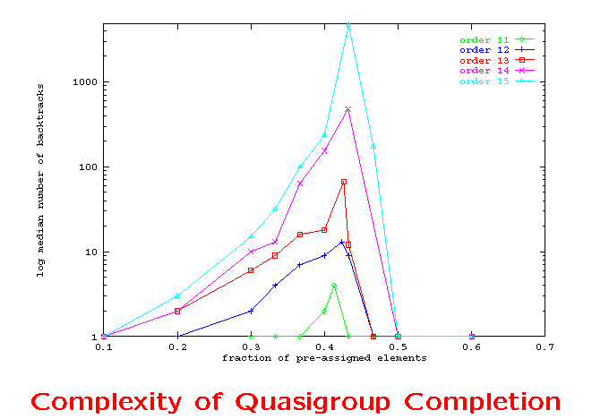
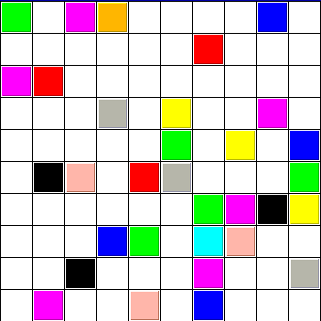
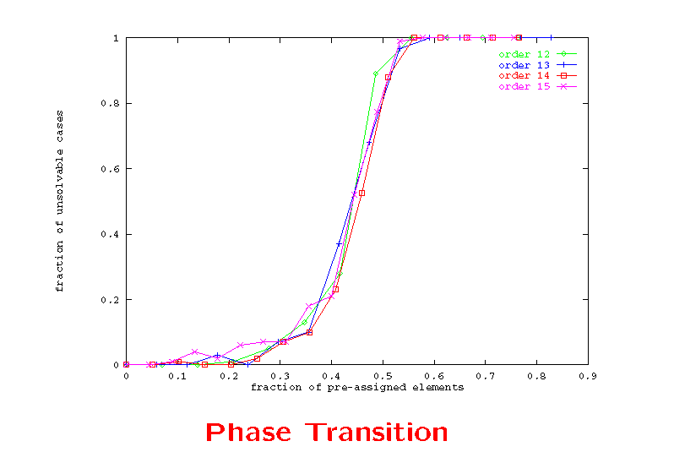
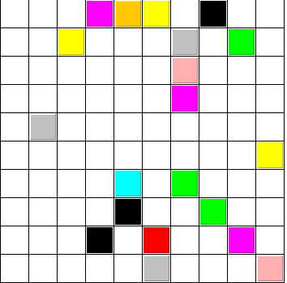
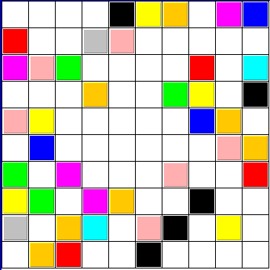
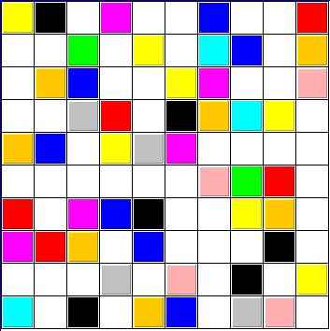
Latin Square Completion
Latin Square
(Order 4)
Critically
constrained area
NP-Complete
Better
characterization
beyond worst case?
EASY AREA
EASY AREA
Complexity of Latin Square Completion
Percentage of unsolvable instances
Time: 150
1820
165
20%
42%
50%
35%
42%
50%

Slide 20
SAT Solvers in the Real World

Slide 21
NASA Deep Space One Spacecraft: Remote Agent
Remote Agent (remote intelligent self-repair software) (RAX), developed at NASA and JPL, was the first artificial-intelligence control system to control a spacecraft without human supervision.
Remote Agent successfully demonstrated the ability to plan onboard activities and correctly diagnose and respond to faults in spacecraft components through its built-in REPL environment

Slide 22
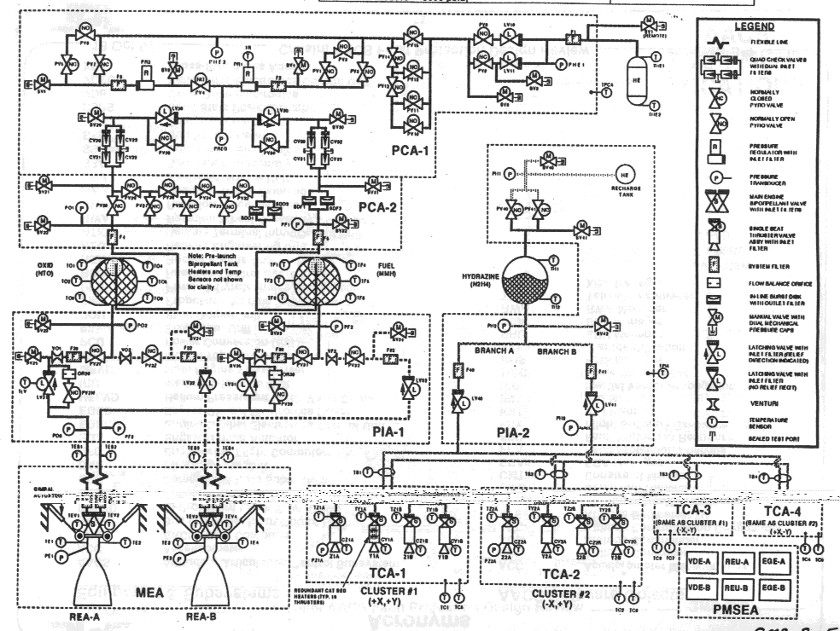
NASA Deep Space One: Remote Agent
Autonomous diagnosis & repair “Remote Agent”
Compiled systems schematic to 7,000 var SAT problem
Started: January 1996
Launch: October 15th, 1998
Experiment: May 17-21

Slide 23
Deep Space One
a failed electronics unit
Remote Agent fixed by reactivating the unit.
a failed sensor providing false information
Remote Agent recognized as unreliable and therefore correctly ignored.
an altitude control thruster (a small engine for controlling the spacecraft's orientation) stuck in the "off" position
Remote Agent detected and compensated for by switching to a mode that did not rely on that thruster.

Slide 24
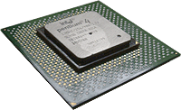
Significant progress in Satisfiability Methods
Software and hardware verification – complete methods are critical - e.g. for verifying the correctness of chip design, using SAT encodings
Applications:
Hardware and
Software Verification
Planning,
Protocol Design, etc.
Going from 50 variable in, 200 constraints
to 1,000,000+ variables and 5,000,000+ constraints
in the last 20 years

Slide 25
Progress in Last 20 years
Significant progress since the 1990’s. How much?
Problem size: We went from 100 variables, 200 constraints (early 90’s)
to 1,000,000+ variables and 5,000,000+ constraints in 20 years
Search space: from 10^30 to 10^300,000.
[Aside: “one can encode quite a bit in 1M variables.”]
Is this just Moore’s Law? It helped, but not much…
– 2x faster computers does not mean can solve 2x larger instances
– search difficulty does *not* scale linearly with problem size!
In fact, for O(2^n), 2x faster, how many more vars?
handles 1 more variable!!
Mainly algorithmic progress. Memory growth also key.
Tools: 50+ competitive SAT solvers available (e.g. Minisat solver)
See http://www.satcompetition.org/

Slide 26
Model Checking

Slide 27
Turing Award
Source: Slashdot

Slide 28
A “real world” example

Slide 29
Bounded Model Checking instance:
i.e. ((not x₁) or x₇)
and ((not x₁) or x₆)
and … etc.

Slide 30
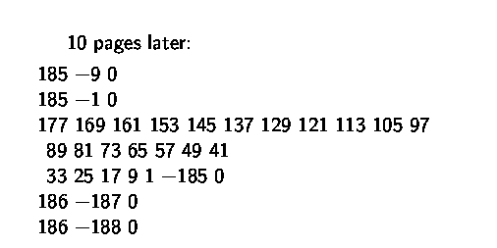
10 pages later:
…
(x₁₇₇ or x₁₆₉ or x₁₆₁ or x₁₅₃ …
or x₁₇ or x₉ or x₁ or (not x₁₈₅))
clauses / constraints are getting more interesting…

Slide 31
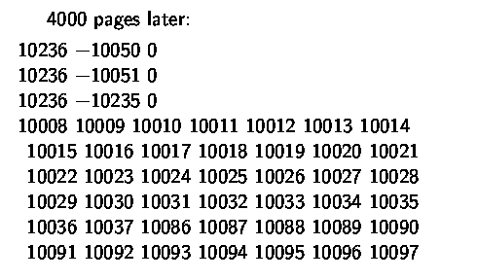
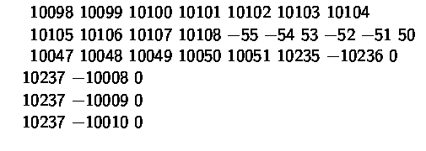
4000 pages later:
!!!
a 59-cnf clause…
…

Slide 32
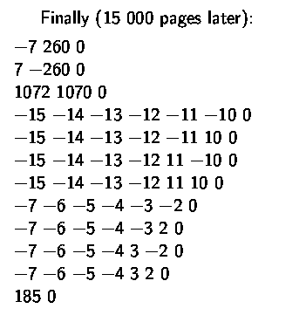
Finally, 15,000 pages later:
Note that:
… !!!
MiniSAT solver solves
this instance in less than one minute.

