Slide 1
CS 4700: Foundations of Artificial Intelligence
Prof. Bart Selman
selman@cs.cornell.edu
Machine Learning:
The Theory of Learning
R&N 18.5

Slide 2
Machine Learning Theory
Central question in machine learning:
How can we be sure that the hypothesis produced by a
learning alg. will produce the correct answer on
previously unseen examples?
Question in some sense too vague… Leads to the general problem of inductive inference: How can we generalize
from data?
Major advance: Computational Learning Theory
Valiant 1984; Turing Award 2010.

Slide 3
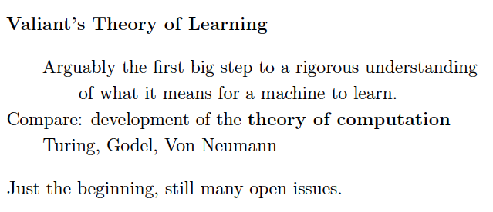

Slide 4
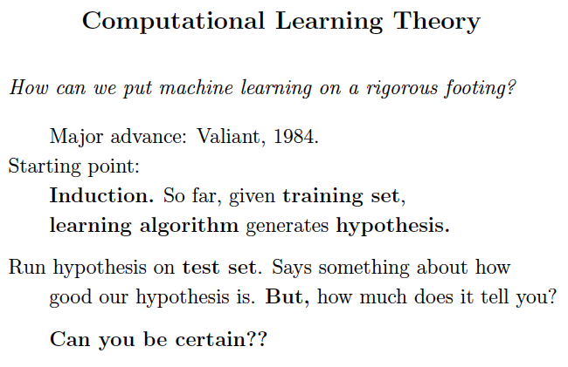

Slide 5
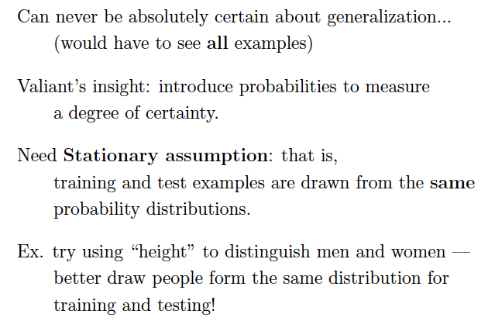

Slide 6
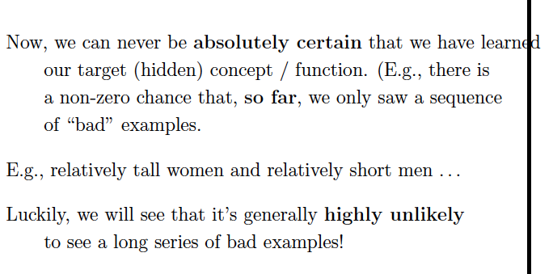
Probabilities to the rescue: certain “bad” events (e.g.
learner learns the wrong hypothesis)
become exponentially rare with enough data.

Slide 7
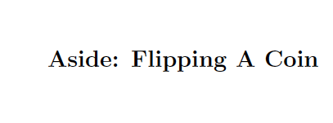

Slide 8
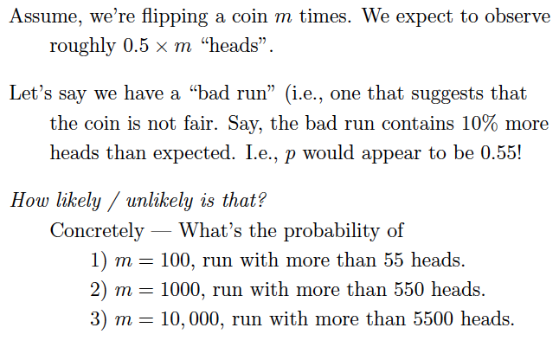
(or higher.)

Slide 9
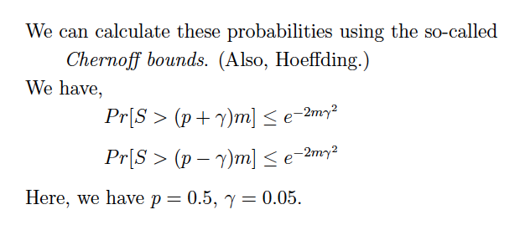
S = # of “heads”

Slide 10
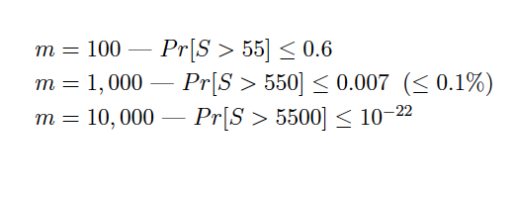
S = # of “heads”
Wow!
So, when flipping a fair coin 10,000 times, you’ll
“never, ever” see more than 5,500 heads. And, no one
ever will… I.e., with enough data, we can be very
certain that if coin is fair, we won’t see a “large” deviation
in terms of #heads vs. #tails.

Slide 12
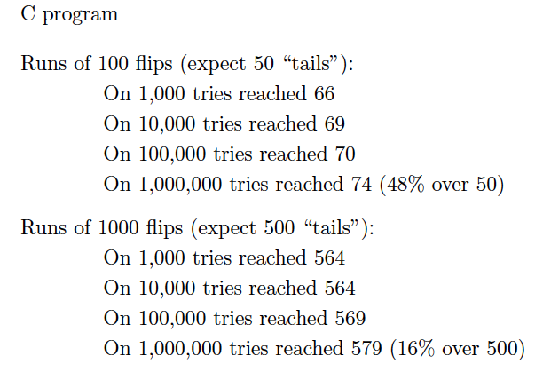

Slide 13
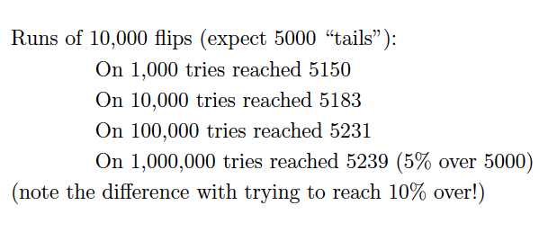

Slide 14
Also, makes interesting learning algorithms possible!

Slide 15
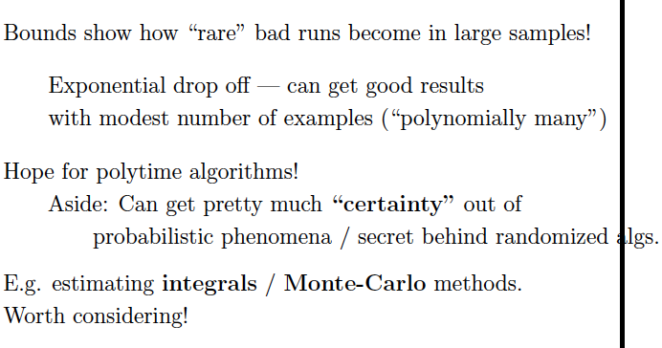

Slide 16
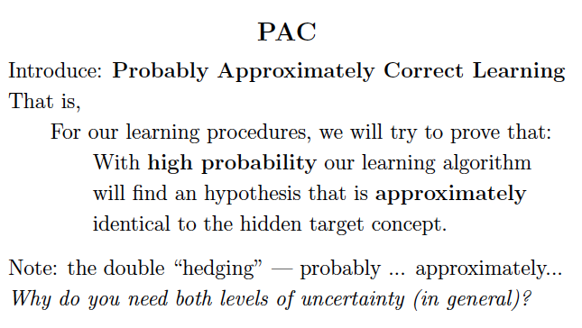
Two issues: (1) (Re: High prob.) May get a “bad” sequence of
training examples (many “relatively short men). Small
risk but still small risk of getting wrong hypothesis.
(2) We only use a small set of all examples (otherwise not
real learning). So, we may not get hypothesis exactly correct.
Finally, want efficient learning --- polytime!!

Slide 17
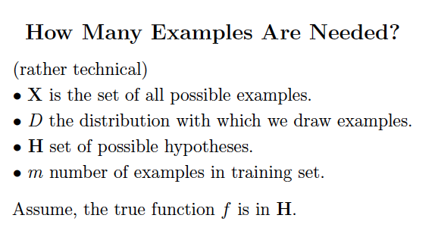
Valiant’s genius was to focus in on the “simplest” models
that still captured all the key aspects we want in a “learning
machine.” PAC role has been profound even though mainly
to shine a “theoretical” light.

Slide 18
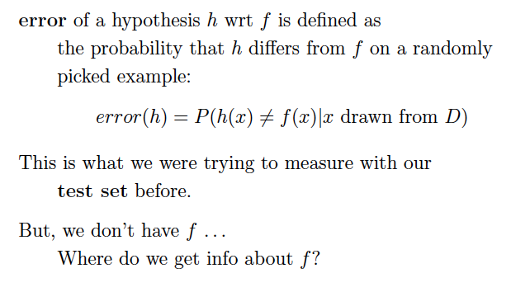

Slide 19
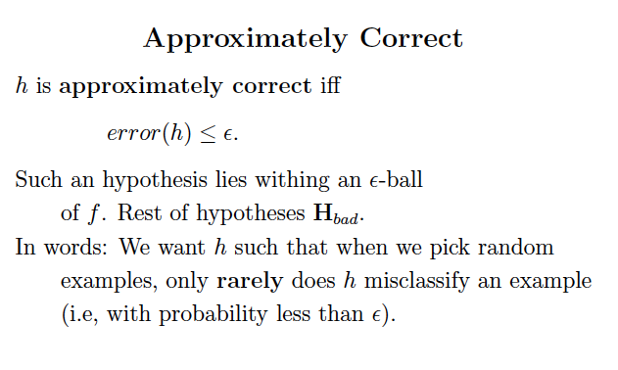

Slide 20
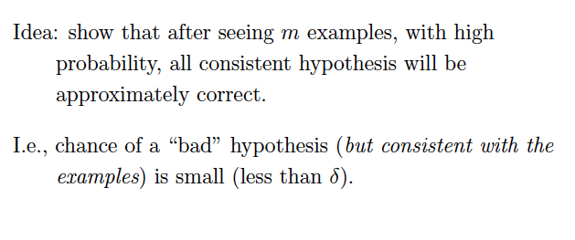
For our learning algorithm, we simply use a method that
keeps the hypothesis consistent with all examples seen
so far. Can start out with an hypothesis that says “No”
to all examples. Then when first positive example comes
in, minimally modify hypothesis to make it consistent with that
example. Proceed doing that for every new pos example.

Slide 21
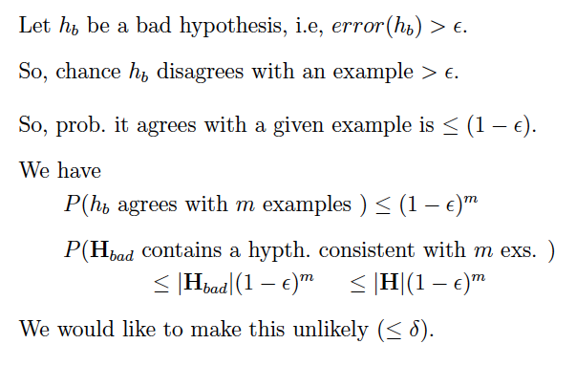
So, h_b could mistakenly be learned!
Note: we want to make it likely that all consistent
hypotheses are approximately correct. So, no “bad” consistent
hypothesis occur at all.

Slide 22
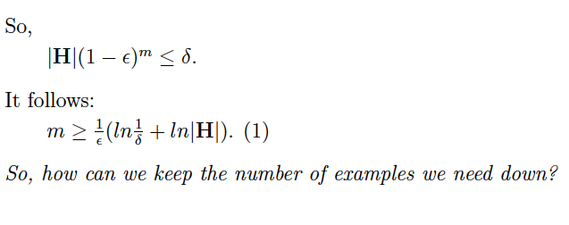
² and ± are assumed given
(set as desired)
Keep size hypothesis class H down.
Another showing of Ockham’s razor!

Slide 23
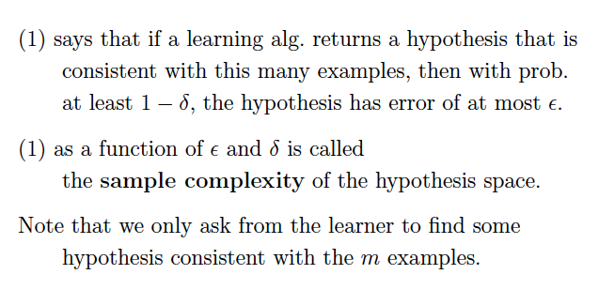
So, in this setting the requirements on our learning
algorithm are quite minimal. We do also want poly time
though.

Slide 24
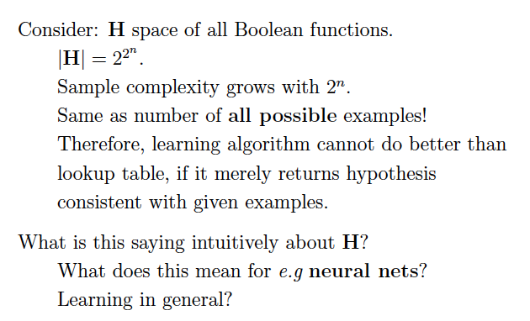
Aside: Shannon already noted that the vast majority
of Boolean functions on N letters look “random” and
cannot be compressed. (No structure!)

Slide 25
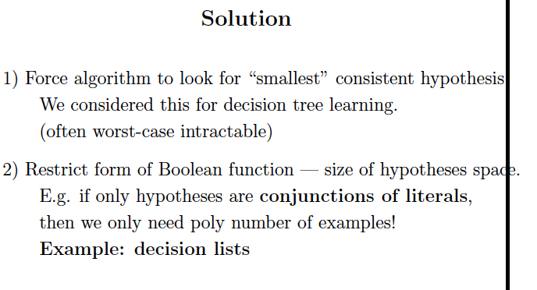

Slide 26
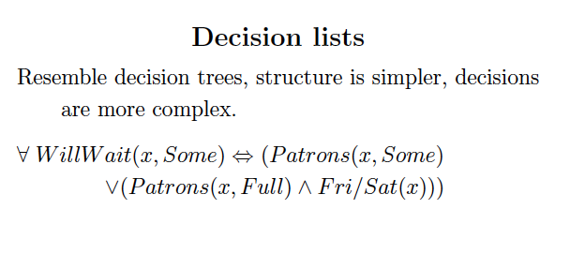

Slide 28
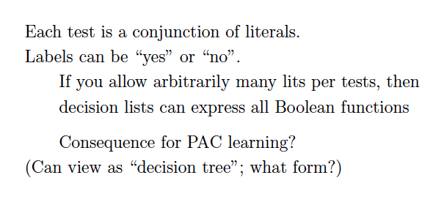

Slide 29
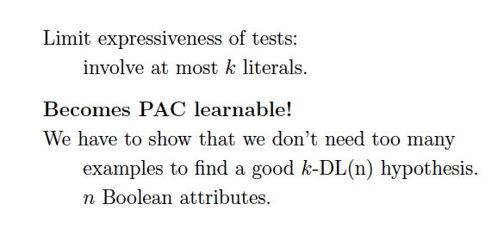

Slide 30
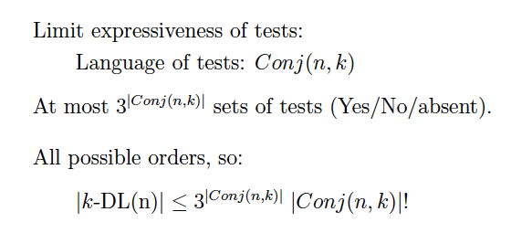

Slide 31
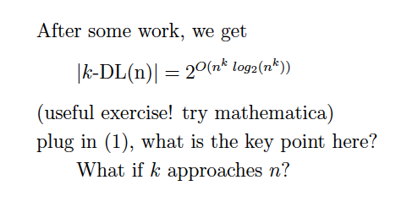

Slide 32
Still need polytime learning alg. to generate
a consistent decision list with m examples.

Slide 35
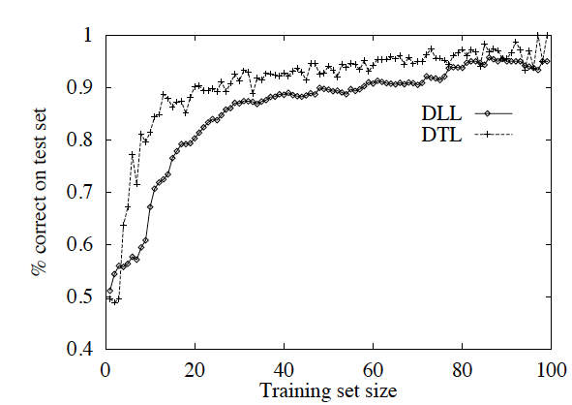

Slide 36
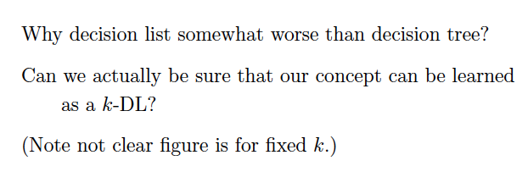

Slide 37
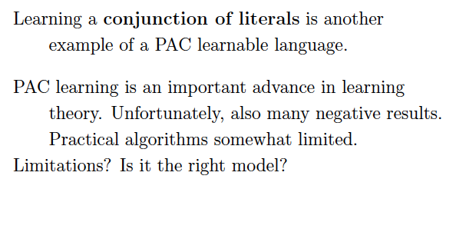

Slide 38
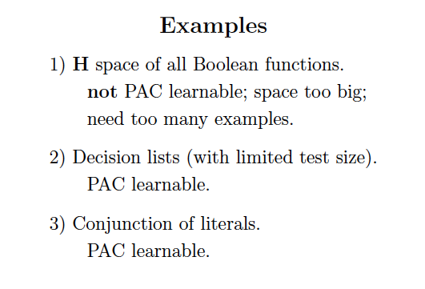

Slide 39
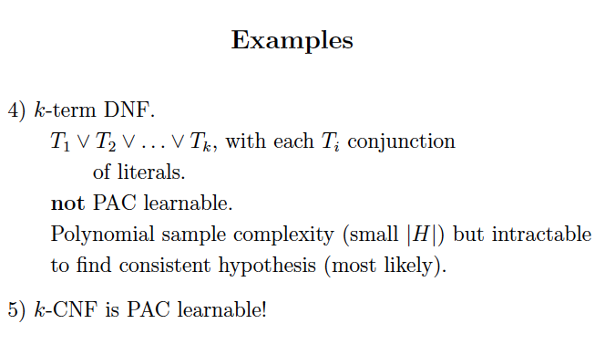

Slide 40
Some more PAC learnability examples.

Slide 41
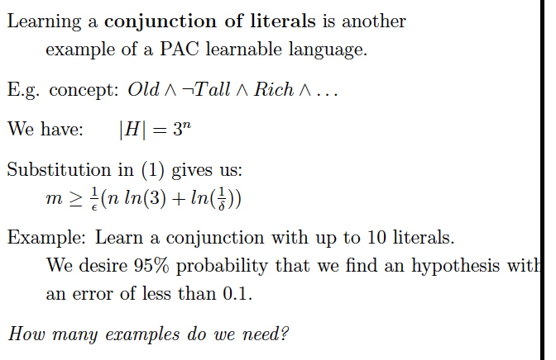

Slide 42
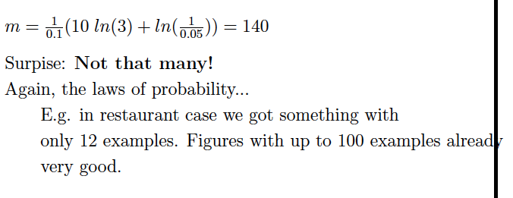

Slide 43
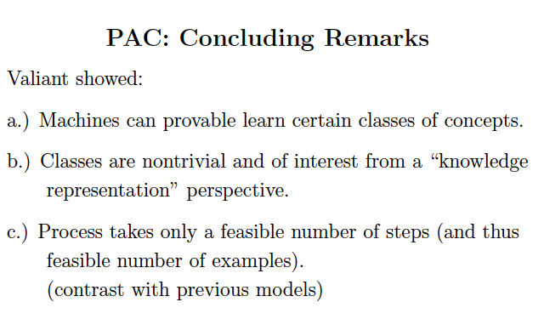

Slide 44
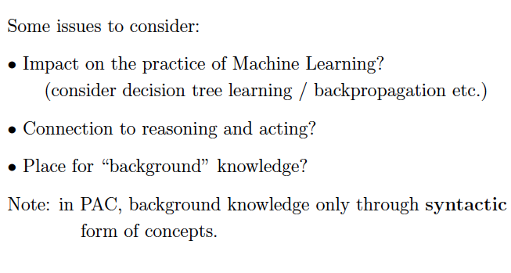

Slide 45
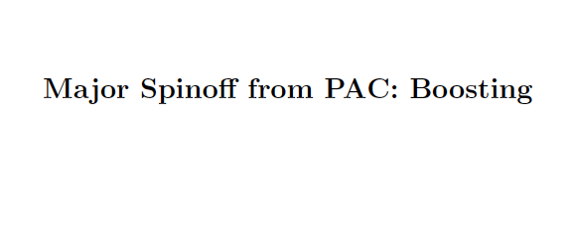

Slide 46
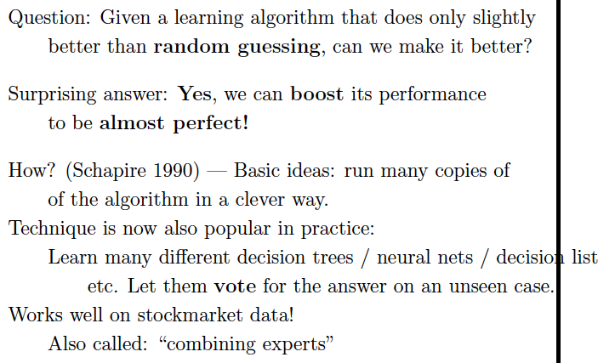

Slide 47
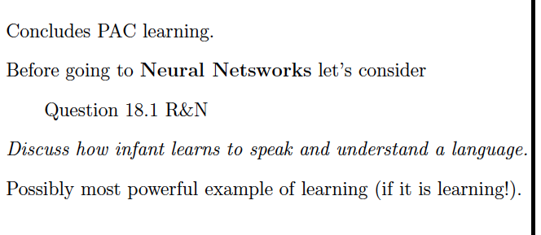

Slide 48
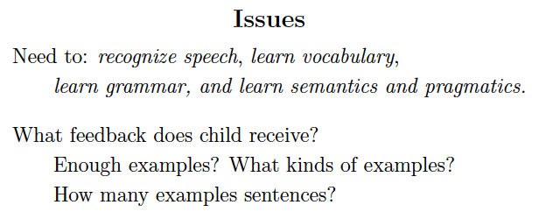

Slide 49
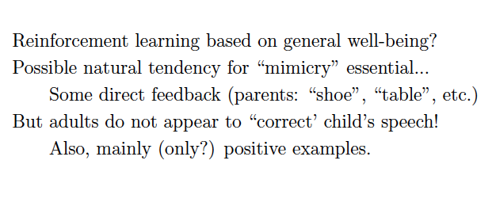

Slide 50
