Slide 1
Till now
Convolution
Fourier transforms

Slide 2
Image resizing

Slide 3
Why do we need to talk about resizing?
Need to zoom in to a region to get more details
Can we get more details?
Louis Daguerre, 1838

Slide 4
Why do we need to talk about resizing?
Far away objects appear small, nearby objects appear larger
Need to recognize objects at multiple scales
Resizing images to same size helps recognition

Slide 5
Why is resizing hard?
E.g, consider reducing size by a factor of 2
Simple solution: subsampling
Example: subsampling by a factor of 2

Slide 6
Why is resizing hard?
Dropping pixels causes problems

Slide 7
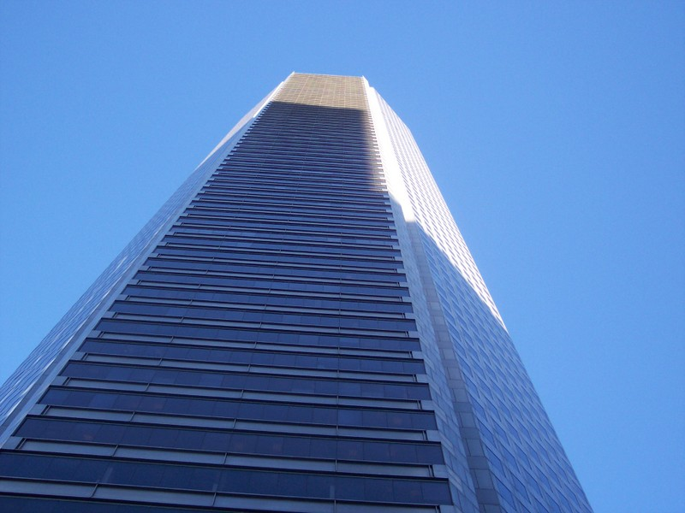
Before

Slide 8
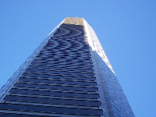
After subsampling
Aliasing!

Slide 9
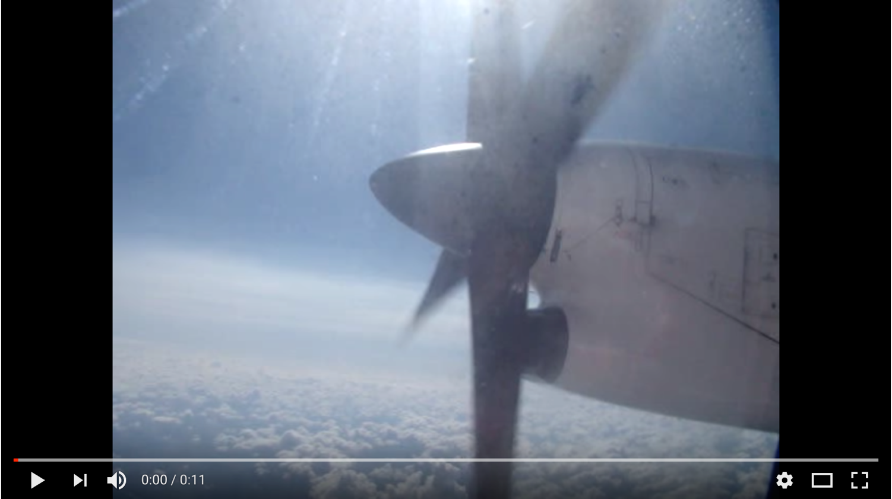
Aliasing in time

Slide 10
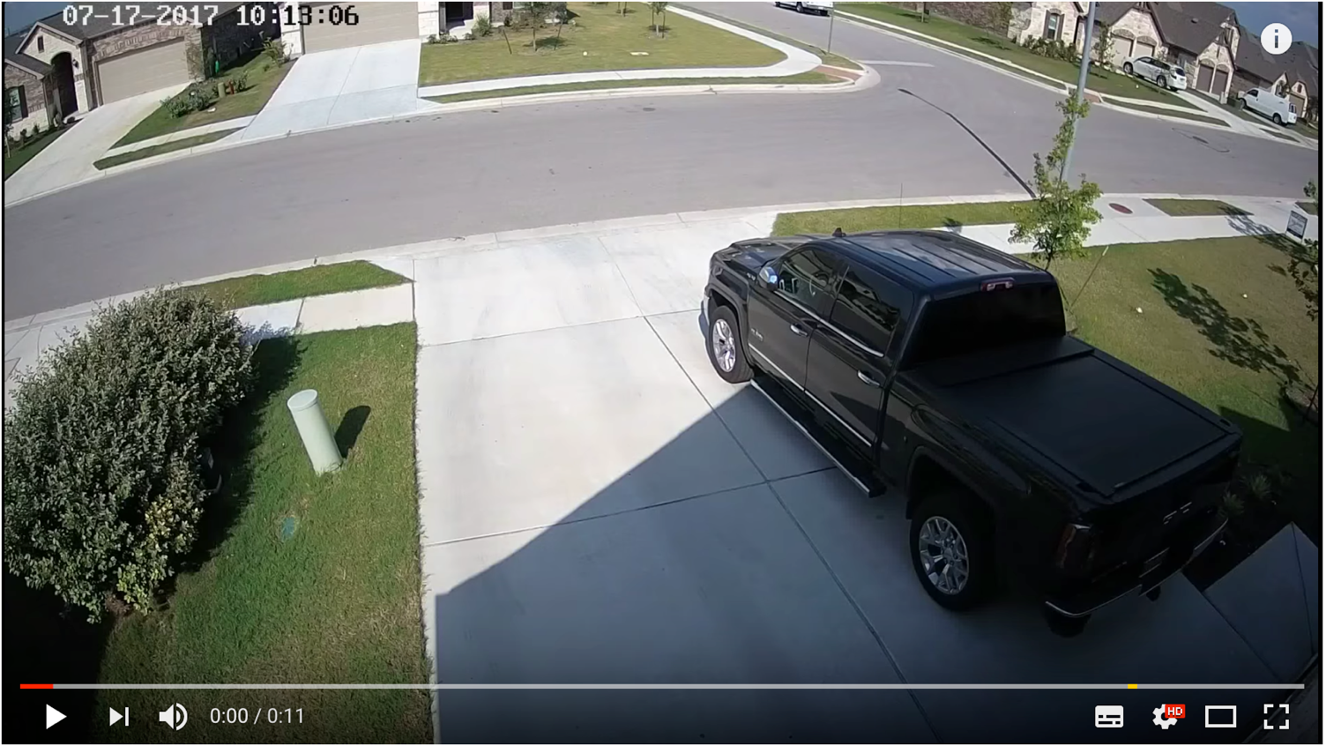
Aliasing in time

Slide 11
Why does aliasing happen?
We ”miss” things between samples
High frequency signals might appear as low frequency signals
Called “aliasing”
© Kavita Bala, Computer Science, Cornell University

Slide 12
Let’s look at it mathematically
Fourier basis signals
$B_{k}\left(n\right)=e^{\frac{i2πkn}{N}}$, time period N/k, frequency k/N
Suppose we sample every P pixels. Then we are only looking at the values
$\left[B_{k}\left(P\right), B_{k}\left(2P\right), …, B_{k}\left(nP\right), … \right]$
Consider two basis vectors $B_{k}$ and $B_{k+N/P}$
$B_{k+N/P} \left(nP\right)=e^{\frac{i2π\left(k+\frac{N}{P}\right)Pn}{N}}=e^{\frac{i2πkPn}{T}+i2πn(\frac{N}{P})(\frac{P}{N})}= e^{\frac{i2πkPn}{T}+i2πn}$ $=e^{\frac{i2πkPn}{N}}=B_{k}(nP)$

Slide 13
Let’s look at it mathematically
$B_{k}\left(nP\right)=B_{k+\frac{N}{P}}\left(nP\right)$
The two basis vectors look identical if we sample every P pixels
Our eyes see the lower frequency: aliasing
How do we avoid aliasing?
Remove high frequencies that may be aliased
Sample at a high enough rate (lower P)

Slide 14
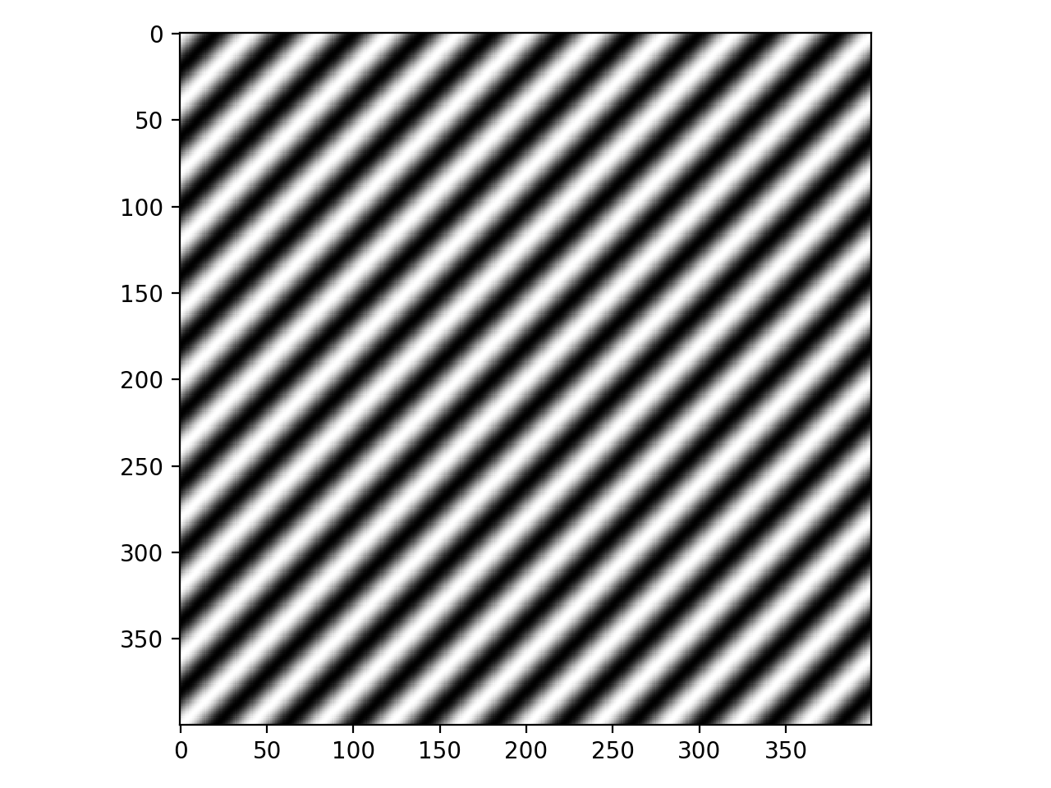
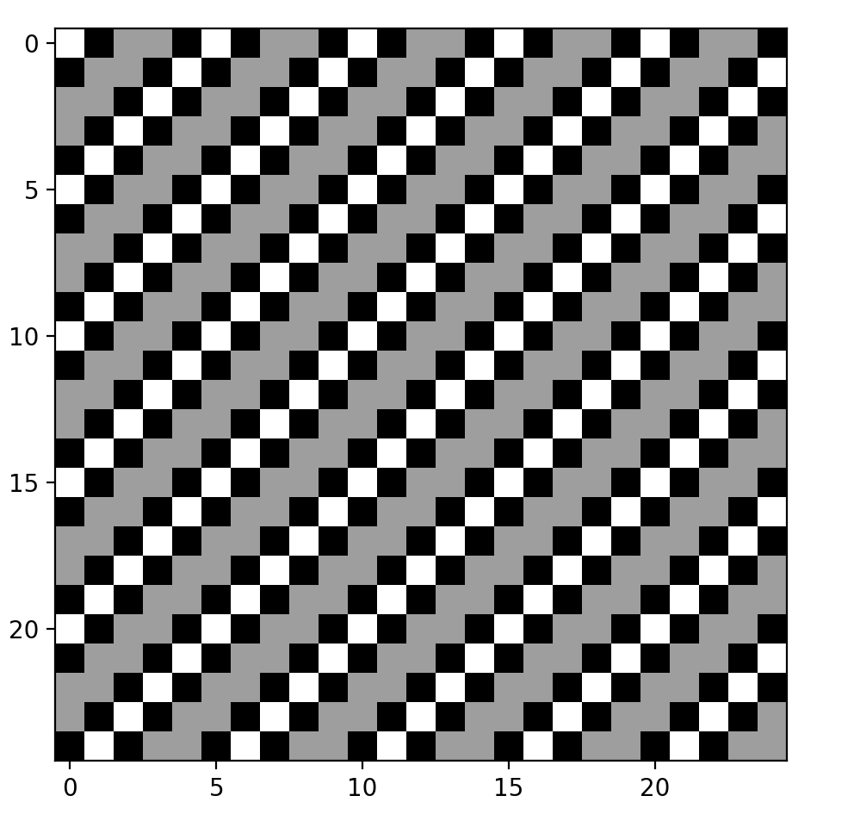
Subsampling Fourier basis
Subsampling by factor of 16
Subsampling by factor of 16

Slide 15
Avoiding aliasing
$${−k}_{max}$$
$$k_{max}$$
Suppose image has limited high frequency components
Fourier transform of x is X
Suppose X is non-zero only for $−k_{max}$ to $k_{max}$

Slide 16
Avoiding aliasing
$${−k}_{max}$$
$$k_{max}$$
When sampling once every P pixels, $−k_{max}$ is indistinguishable from $−k_{max}+N/P$
If image has both coefficients, they will get mixed
So we want that : $k_{max}<−k_{max}+\frac{N}{P}⇒ 2k_{max}<\frac{N}{P}$

Slide 17
Nyquist Sampling Theorem
$2k_{max}<\frac{N}{P}$
Basis $B_{k}$ has a time period of $\frac{N}{k}$ or frequency of $\frac{k}{N}$
$2k_{max}<\frac{N}{P}$
$$⇒\frac{2k_{max}}{N}<\frac{1}{P} \\ ⇒2ν_{max}< ν_{sample}$$
Need to sample at at least twice the rate of the highest frequency component

Slide 18
Avoiding aliasing
So how to avoid aliasing?
Make sure we don’t subsample too much
Sample at at least twice maximum frequency
Or remove high frequency components before subsampling
We lose details, but acceptable consequence of reducing image size
How do we remove high frequency components?
Low-pass filtering: blur !
Blur with Gaussian, then subsample!

Slide 19
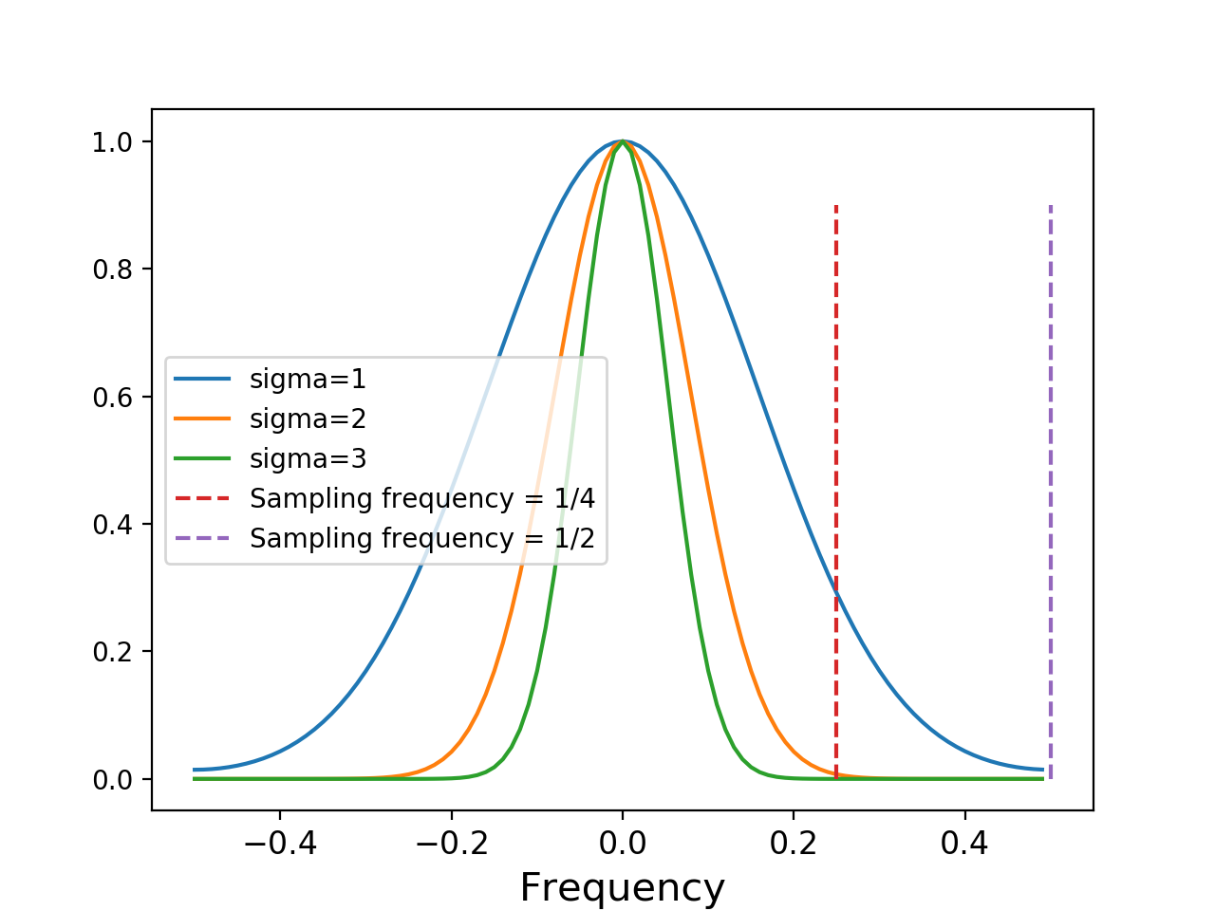
Subsampling the image
First smooth the image to remove high frequency components
How should we smooth?
One simple answer: blur with Gaussian
Recall that Fourier transform of Gaussian is Gaussian
Choose sigma so that frequencies above $\frac{ν_{sample}}{2}$ get killed

Slide 20
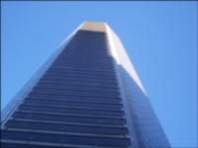
Subsampling before and after smoothing
Before
After

Slide 21
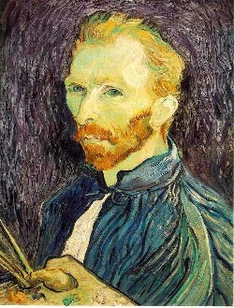
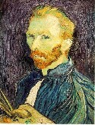
Another example
1/2
1/4 (2x zoom)
1/16 (4x zoom)
Why does this look so crufty? Aliasing!
Source: S. Seitz

Slide 22
Subsampling images correctly
G 1/8
G 1/4
Gaussian 1/2
Solution: filter the image, then subsample
Source: S. Seitz

Slide 23
Subsampling with Gaussian pre-filtering
Gaussian 1/2
G 1/4
G 1/8
Solution: filter the image, then subsample
Source: S. Seitz

Slide 24
Compare with...
1/2
1/4 (2x zoom)
1/8 (4x zoom)
Source: S. Seitz

Slide 25
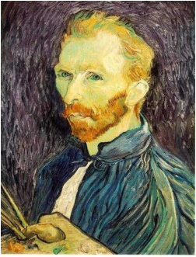
Gaussian pre-filtering
Solution: filter the image, then subsample
F₀
F₁
F₂
…
blur
subsample
blur
subsample
F₀ H
F₁ H
*
*

Slide 26
{
Gaussian pyramid
F₀
F₁
F₂
…
blur
subsample
blur
subsample
F₀ H
F₁ H
*
*

Slide 27
Gaussian pyramids [Burt and Adelson, 1983]
In computer graphics, a mip map [Williams, 1983]
Gaussian Pyramids have all sorts of applications in computer vision
Source: S. Seitz

Slide 28
Gaussian pyramids - Searching over scales

Slide 29
Gaussian pyramids - Searching over scales

Slide 30
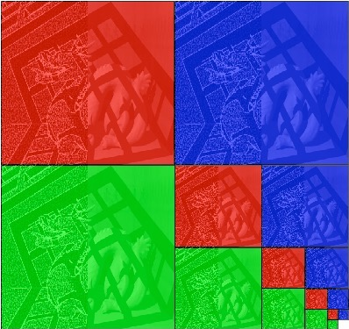
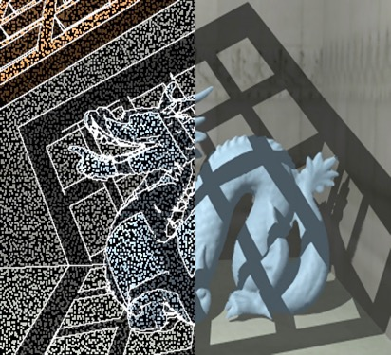
Memory Usage
What is the size of the pyramid?
Each color below is one pyramid
Together they are twice the original image in each dimension
Notes:
4/3

Slide 31
Going the other way
Need to zoom in to a region to get more details
Can we get more details?
When we reduced size, we had to remove high frequency components
Unlikely we can get those back
Louis Daguerre, 1838

Slide 32
