Slide 1
Object detection

Slide 2
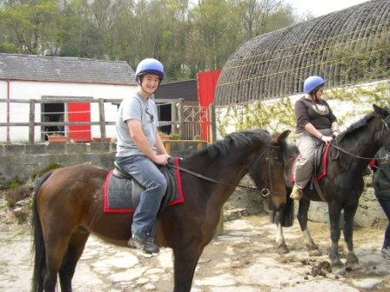
The Task
person 1
person 2
horse 1
horse 2

Slide 3
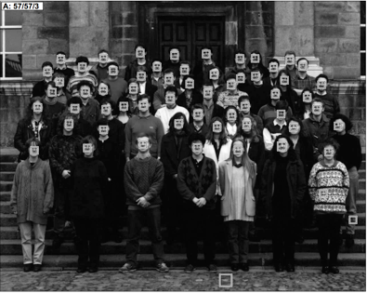
Datasets
Face detection
One category: face
Frontal faces
Fairly rigid, unoccluded
1990’s
Human Face Detection in Visual Scenes. H. Rowley, S. Baluja, T. Kanade. 1995.

Slide 4
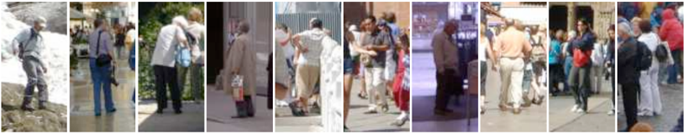
Pedestrians
One category: pedestrians
Slight pose variations and small distortions
Partial occlusions
Faces
1990’s
2000’s
Histograms of Oriented Gradients for Human Detection. N. Dalal and B. Triggs. CVPR 2005

Slide 5
PASCAL VOC
20 categories
10K images
Large pose variations, heavy occlusions
Generic scenes
Cleaned up performance metric
Faces
1990’s
2000’s
2007 - 2012

Slide 6
Coco
80 diverse categories
100K images
Heavy occlusions, many objects per image, large scale variations
Faces
1990’s
2000’s
2007 - 2012
2014 -

Slide 7

Evaluation metric

Slide 8
Matching detections to ground truth

Slide 9
Matching detections to ground truth
Match detection to most similar ground truth
  highest IoU
If IoU > 50%, mark as correct
If multiple detections map to same ground truth, mark only one as correct
Precision = #correct detections / total detections
Recall = #ground truth with matched detections / total ground truth

Slide 10
Tradeoff between precision and recall
ML usually gives scores or probabilities, so threshold
Too low threshold → too many detections → low precision, high recall
Too high threshold → too few detections → high precision, low recall
Right tradeoff depends on application
  Detecting cancer cells in tissue: need high recall
  Detecting edible mushrooms in forest: need high precision

Slide 11
Average precision
1
Precision
Recall

Slide 12
Average precision
1
Precision
Recall
1

Slide 13
Average average precision
AP marks detections with overlap > 50% as correct
But may need better localization
Average AP across multiple overlap thresholds
Confusingly, still called average precision
Introduced in COCO

Slide 14
Mean and category-wise AP
Every category evaluated independently
Typically report mean AP averaged over all categories
Confusingly called “mean Average Precision”, or “mAP”

Slide 15
Why is detection hard(er)?
Precise localization

Slide 16
Why is detection hard(er)?
Much larger impact of pose

Slide 17
Why is detection hard(er)?
Occlusion makes localization difficult

Slide 18
Why is detection hard(er)?
Counting

Slide 19
Why is detection hard(er)?
Small objects

Slide 20
Detection as classification
Run through every possible box and classify
How many boxes?
  Every pair of pixels = 1 box
  = O(N²)
  For 300 x 500 image, N = 150K
  2.25 x 10¹⁰ boxes!

Slide 21
Idea 1: scanning window
Fix size
  Can take a few different sizes
Fixed stride
Convolution with a filter
  Classic: compute HOG features over entire image

Slide 22
Dealing with scale

Slide 23
Dealing with scale
Use same window size, but run on image pyramid

Slide 24
Issues
Classifies millions of boxes, so must be very fast
Needs ultra-fine sampling of scales and object sizes, can still miss outlier sizes

Slide 25
Scanning window results on PASCAL
 | VOC 2007 | VOC 2010
DPM v5 (Girshick et al. 2011) | 33.7% | 29.6%
UVA sel. search (Uijlings et al. 2013) |  | 35.1%
Regionlets (Wang et al. 2013) | 41.7% | 39.7%
SegDPM (Fidler et al. 2013) |  | 40.4%
R-CNN | 54.2% | 50.2%
R-CNN + bbox regression | 58.5% | 53.7%
Reference systems
metric: mean average precision (higher is better)
Slide credit : Ross Girshick
Notes:
Now, let’s look at results on PASCAL in more detail.
First, here are reference systems including the most recently published top-performing methods.

Slide 26
Idea 2: Object proposals
Use segmentation to produce ~5K candidates
Selective Search for Object Recognition
J. R. R. Uijlings, K. E. A. van de Sande, T. Gevers, A. W. M. Smeulders
In International Journal of Computer Vision 2013.

Slide 27
Idea 2: object proposals
Many different segmentation algorithms (k-means on color, k-means on color+position, N-cuts….)
Many hyperparameters (number of clusters, weights on edges)
Try everything!
  Every cluster is a candidate object
  Thousands of segmentations -> thousands of candidate objects

Slide 28
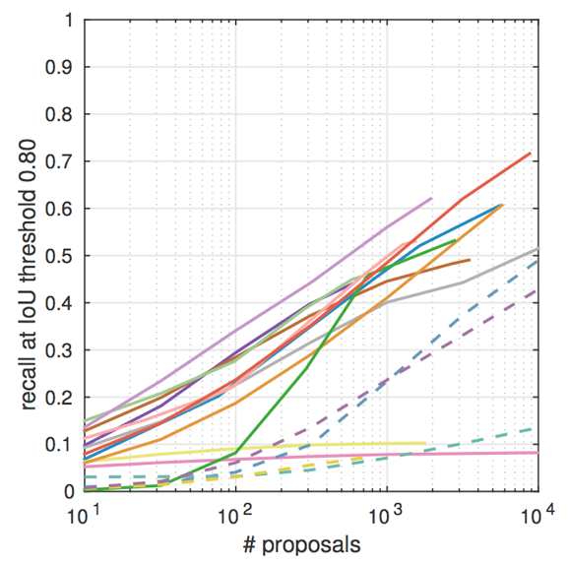
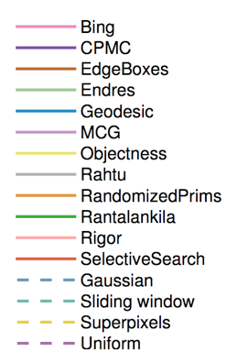
Idea 2: Object proposals
Tens of ways of generating candidates (“proposals”)
What fraction of ground truth objects have proposals near them?
What makes for effective detection proposals? J. Hosang, R. Benenson, P. Dollar, B. Schiele. In TPAMI

Slide 29
What do we do with proposals?
Each proposal is a group of pixels
Take tight fitting box and classify it
Can leverage any image classification approach
Horse

Slide 30
Proposal methods results
 | VOC 2007 | VOC 2010
DPM v5 (Girshick et al. 2011) | 33.7% | 29.6%
UVA sel. search (Uijlings et al. 2013) |  | 35.1%
Regionlets (Wang et al. 2013) | 41.7% | 39.7%
SegDPM (Fidler et al. 2013) |  | 40.4%
R-CNN | 54.2% | 50.2%
R-CNN + bbox regression | 58.5% | 53.7%
Reference systems
metric: mean average precision (higher is better)
Slide credit : Ross Girshick
Notes:
Now, let’s look at results on PASCAL in more detail.
First, here are reference systems including the most recently published top-performing methods.

Slide 31
Proposal methods results
 | VOC 2007 | VOC 2010
DPM v5 (Girshick et al. 2011) | 33.7% | 29.6%
UVA sel. search (Uijlings et al. 2013) |  | 35.1%
Regionlets (Wang et al. 2013) | 41.7% | 39.7%
SegDPM (Fidler et al. 2013) |  | 40.4%
R-CNN | 54.2% | 50.2%
R-CNN + bbox regression | 58.5% | 53.7%
Reference systems
metric: mean average precision (higher is better)
Slide credit : Ross Girshick
Notes:
Now, let’s look at results on PASCAL in more detail.
First, here are reference systems including the most recently published top-performing methods.

Slide 32
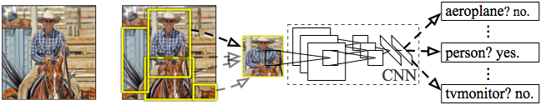
R-CNN: Regions with CNN features
Input
image
Extract region
proposals (~2k / image)
Compute CNN
features
Classify regions
(linear SVM)
Rich Feature Hierarchies for Accurate Object Detection and Semantic Segmentation
R. Girshick, J. Donahue, T. Darrell, J. Malik
IEEE Conference on Computer Vision and Pattern Recognition (CVPR), 2014
Slide credit : Ross Girshick
Notes:
Here’s a schematic of the system that we came up with.
Compared to previous state-of-the-art methods, R-CNN is relatively simple and does not rely on an ensemble of classifiers.
Let’s see how it works at test time.

Slide 33

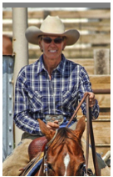
R-CNN at test time: Step 2
Input
image
Extract region
proposals (~2k / image)
Compute CNN
features
a. Crop
Slide credit : Ross Girshick
Notes:
Then, we crop out the region of interest...

Slide 34
R-CNN at test time: Step 2
Input
image
Extract region
proposals (~2k / image)
Compute CNN
features
227 x 227
a. Crop
b. Scale (anisotropic)
Slide credit : Ross Girshick
Notes:
...and scale it to a fixed size square so that it can be input into the CNN.

Slide 35

R-CNN at test time: Step 2
Input
image
Extract region
proposals (~2k / image)
Compute CNN
features
1. Crop
c. Forward propagate
Output: “fc7” features
b. Scale (anisotropic)
Slide credit : Ross Girshick
Notes:
We then forward propagate it through the network to produce a feature vector from the 7th layer, which we call fc7.

Slide 36

R-CNN at test time: Step 3
Input
image
Extract region
proposals (~2k / image)
Compute CNN
features
Classify
regions
person? 1.6
...
horse? -0.3
...
4096-dimensional
fc7 feature vector
linear classifiers
(SVM or softmax)
Warped proposal
Slide credit : Ross Girshick
Notes:
In step 3, we classify the region using a linear classifier on the four-thousand dimensional fc7 feature vectors.
We have one classifier per class that was trained to discriminate between well-localized instances of that class and poorly-localized instances.

Slide 37
Step 4: Object proposal refinement
Linear regression
on CNN features
Original
proposal
Predicted
object bounding box
Bounding-box regression
Slide credit : Ross Girshick
Notes:
Finally, we refine the original object proposals with a simple regression step.
We use a linear regressor on the CNN features to predict a new bounding box relative to the proposal.
This regression step improves localization and allows non-maximum suppression to be more effective.

Slide 38
R-CNN results on PASCAL
 | VOC 2007 | VOC 2010
DPM v5 (Girshick et al. 2011) | 33.7% | 29.6%
UVA sel. search (Uijlings et al. 2013) |  | 35.1%
Regionlets (Wang et al. 2013) | 41.7% | 39.7%
SegDPM (Fidler et al. 2013) |  | 40.4%
R-CNN | 54.2% | 50.2%
R-CNN + bbox regression | 58.5% | 53.7%
Reference systems
metric: mean average precision (higher is better)
Slide credit : Ross Girshick
Notes:
Now, let’s look at results on PASCAL in more detail.
First, here are reference systems including the most recently published top-performing methods.

Slide 39
R-CNN results on PASCAL
 | VOC 2007 | VOC 2010
DPM v5 (Girshick et al. 2011) | 33.7% | 29.6%
UVA sel. search (Uijlings et al. 2013) |  | 35.1%
Regionlets (Wang et al. 2013) | 41.7% | 39.7%
SegDPM (Fidler et al. 2013) |  | 40.4%
R-CNN | 54.2% | 50.2%
R-CNN + bbox regression | 58.5% | 53.7%
metric: mean average precision (higher is better)
Slide credit : Ross Girshick
Notes:
Here are our results using R-CNN.
R-CNN improves over the previous state-of-the-art by more than 30% relative and is the most dramatic improvement in object detection performance since the early years of the PASCAL challenge.

Slide 40
Training R-CNN
Train convolutional network on ImageNet classification
Finetune on detection
  Classification problem!
  Proposals with IoU > 50% are positives
  Sample fixed proportion of positives in each batch because of imbalance
Notes:
Now let’s talk about how R-CNN is trained.
Unlike image classification, detection training data is relatively scarce.
One key insight in this work is that when the target task has too little training data, we can use supervised pre-training on a data-rich auxiliary task and transfer the learned representation to detection.

Slide 41
Other details - Non-max suppression
0.9
0.8
How do we deal with multiple detections on the same object?

Slide 42
Other details - Non-max suppression
Go down the list of detections starting from highest scoring
Eliminate any detection that overlaps highly with a higher scoring detection
Separate, heuristic step

Slide 43
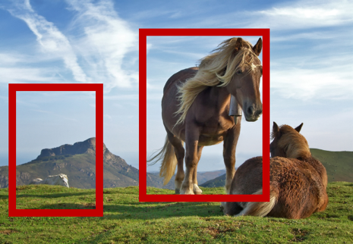
Speeding up R-CNN
CNN
CNN

Slide 44
Speeding up R-CNN
CNN

Slide 45
ROI Pooling
How do we crop from a feature map?
Step 1: Resize boxes to account for subsampling
Fast R-CNN. Ross Girshick. In ICCV 2015

Slide 46
ROI Pooling
How do we crop from a feature map?
Step 2: Snap to feature map grid

Slide 47
ROI Pooling
How do we crop from a feature map?
Step 3: Place a grid of fixed size

Slide 48
ROI Pooling
How do we crop from a feature map?
Step 4: Take max in each cell

Slide 49
Fast R-CNN
 | Fast R-CNN | R-CNN
Train time (h) | 9.5 | 84
Speedup | 8.8x | 1x
Test time / image | 0.32s | 47.0s
Speedup | 146x | 1x
mean AP | 66.9 | 66.0

Slide 50
Fast R-CNN
Bottleneck remaining (not included in time):
  Object proposal generation
Slow
  Requires segmentation
  O(1s) per image

Slide 51
Faster R-CNN
Can we produce object proposals from convolutional networks?
A change in intuition
  Instead of using grouping
  Recognize likely objects?
For every possible box, score if it is likely to correspond to an object
Faster R-CNN: Towards Real-Time Object Detection with Region Proposal Networks. S. Ren, K. He, R. Girshick, J. Sun. In NIPS 2015.

Slide 52
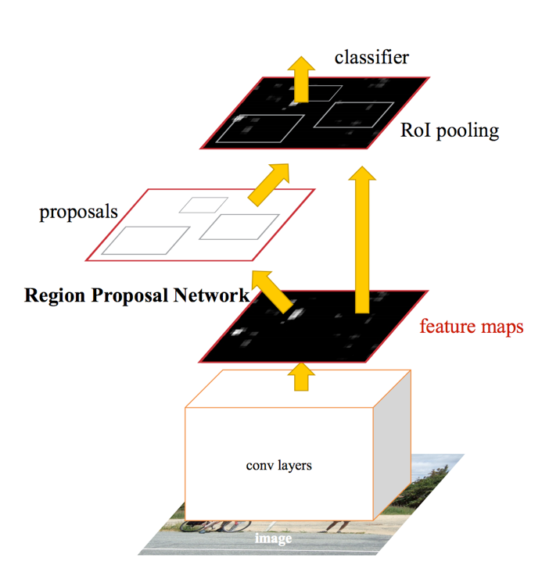
Faster R-CNN

Slide 53
Faster R-CNN
At each location, consider boxes of many different sizes and aspect ratios

Slide 54
Faster R-CNN
At each location, consider boxes of many different sizes and aspect ratios

Slide 55
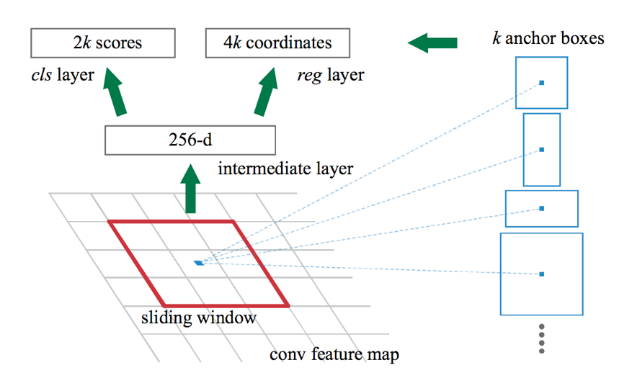
Faster R-CNN
At each location, consider boxes of many different sizes and aspect ratios

Slide 56
Faster R-CNN
s scales * a aspect ratios = sa anchor boxes
Use convolutional layer on top of filter map to produce sa scores
Pick top few boxes as proposals

Slide 57
Faster R-CNN
Method | mean AP (PASCAL VOC)
Fast R-CNN | 65.7
Faster R-CNN | 67.0

Slide 58
Impact of Feature Extractors
ConvNet | mean AP (PASCAL VOC)
VGG | 70.4
ResNet 101 | 73.8

Slide 59
Impact of Additional Data
Method | Training data | mean AP (PASCAL VOC 2012 Test)
Fast R-CNN | VOC 12 Train (10K) | 65.7
Fast R-CNN | VOC07 Trainval + VOC 12 Train | 68.4
Faster R-CNN | VOC 12 Train (10K) | 67.0
Faster R-CNN | VOC07 Trainval + VOC 12 Train | 70.4

Slide 60
The R-CNN family of detectors

