Slide 1
Photometric stereo

Slide 2
Radiance
Pixels measure radiance
This pixel
Measures radiance along this ray

Slide 3

Where do the rays come from?
Rays from the light source “reflect” off a surface and reach camera
Reflection: Surface absorbs light energy and radiates it back

Slide 4
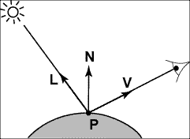
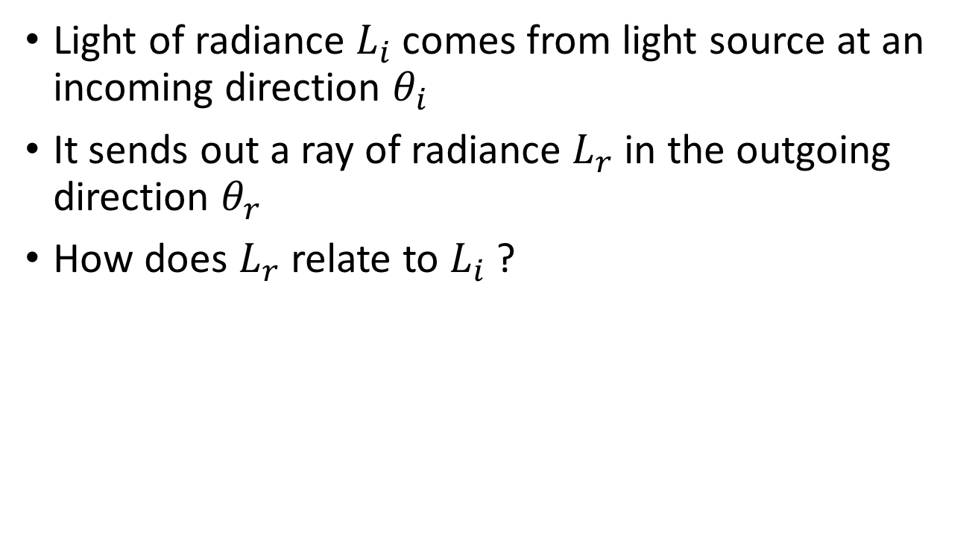
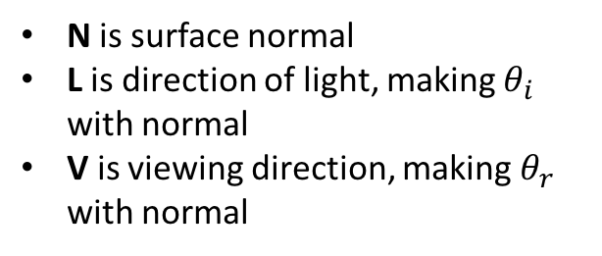


Light rays interacting with a surface
Light of radiance $L_{i}$comes from light source at an incoming direction $θ_{i}$
It sends out a ray of radiance $L_{r}$ in the outgoing direction $θ_{r}$
How does $L_{r}$ relate to $L_{i}$?
N is surface normal
L is direction of light, making $θ_{i}$ with normal
V is viewing direction, making $θ_{r}$ with normal
$$θ_{i}$$
$$θ_{r}$$

Slide 5

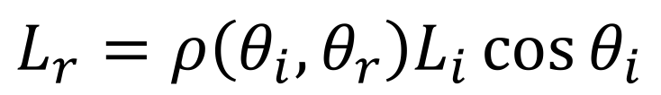

Light rays interacting with a surface
N is surface normal
L is direction of light, making $θ_{i}$ with normal
V is viewing direction, making $θ_{r}$ with normal
$$θ_{i}$$
$$θ_{r}$$
Output radiance along V
$$L_{r}=ρ\left(θ_{i},θ_{r}\right)L_{i}\cos{θ_{i}}$$
Incoming irradiance along L
Bi-directional reflectance function (BRDF)

Slide 6
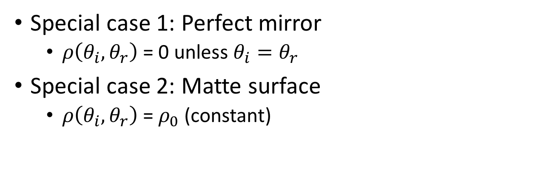
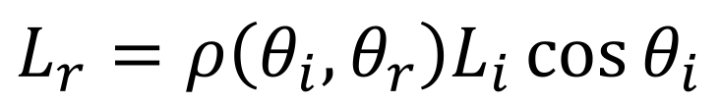
Light rays interacting with a surface
$$L_{r}=ρ\left(θ_{i},θ_{r}\right)L_{i}\cos{θ_{i}}$$
$$θ_{i}$$
$$θ_{r}$$
Special case 1: Perfect mirror
  $ρ\left(θ_{i},θ_{r}\right)$ = 0 unless $θ_{i}=θ_{r}$
Special case 2: Matte surface
  $ρ\left(θ_{i},θ_{r}\right)$ = $ρ_{0}$(constant)

Slide 7
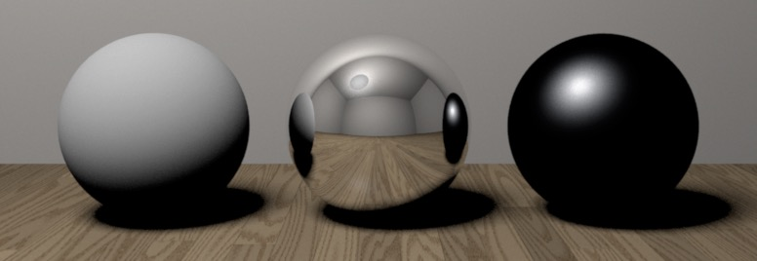

Special case 1: Perfect mirror
$ρ\left(θ_{i},θ_{r}\right)$ = 0 unless $θ_{i}=θ_{r}$
Also called “Specular surfaces”
Reflects light in a single, particular direction

Slide 8

Special case 2: Matte surface
$ρ\left(θ_{i},θ_{r}\right)$ = $ρ_{0}$
Also called “Lambertian surfaces”
Reflected light is independent of viewing direction

Slide 9

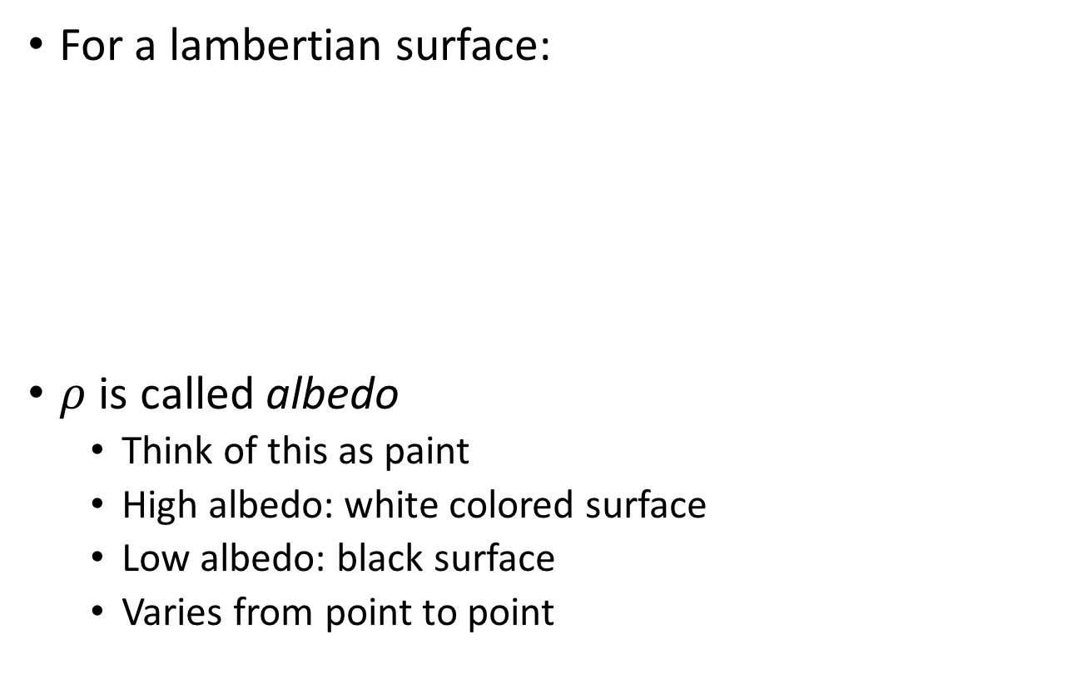
Lambertian surfaces
For a lambertian surface:
$ρ$ is called albedo
  Think of this as paint
  High albedo: white colored surface
  Low albedo: black surface
  Varies from point to point
$$θ_{i}$$
$$θ_{r}$$

Slide 10
Lambertian surfaces
Assume the light is directional: all rays from light source are parallel
  Equivalent to a light source infinitely far away
All pixels get light from the same direction L and of the same intensity L_{i}
$$θ_{i}$$
$$θ_{r}$$

Slide 11
Lambertian surfaces
Intrinsic Image Decomposition
Reflectance image
Shading image

Slide 12
Reconstructing Lambertian surfaces
Equation is a constraint on albedo and normals
Can we solve for albedo and normals?

Slide 13


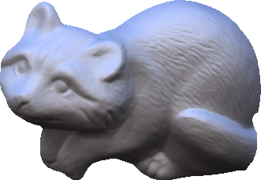
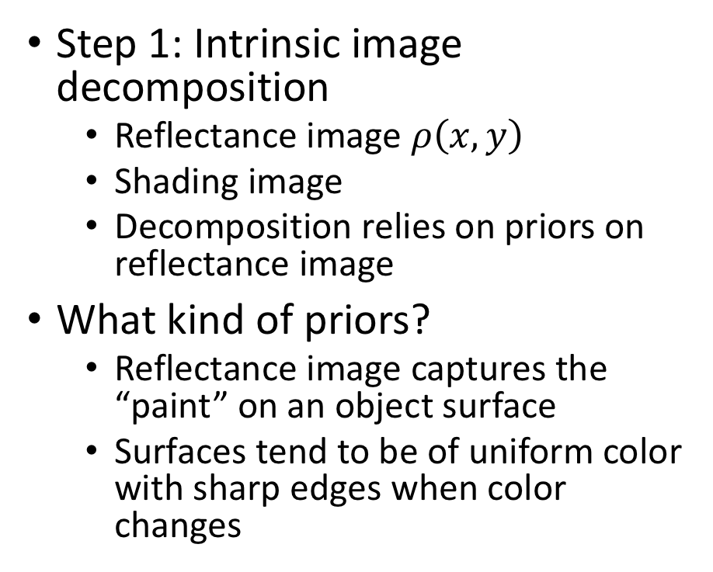
Solution 1: Recovery from a single image
Step 1: Intrinsic image decomposition
  Reflectance image $ρ\left(x,y\right)$
  Shading image
  Decomposition relies on priors on reflectance image
What kind of priors?
  Reflectance image captures the “paint” on an object surface
  Surfaces tend to be of uniform color with sharp edges when color changes
Images from Barron et al, TPAMI 13

Slide 14
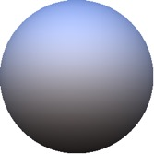
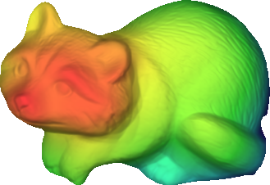
Solution 1: Recovery from a single image
Step 2: Decompose shading image into illumination and normals
  Called Shape-From-Shading
  Relies on priors on shape: shapes are smooth
Far
Near

Slide 15
Solution 2: Recovery from multiple images
Represents an equation in the albedo and normals
Multiple images give constraints on albedo and normals
Called Photometric Stereo
Image credit: Wikipedia

Slide 16
Multiple Images: Photometric Stereo
N
L₃
L₂
L₁
V

Slide 17

Photometric stereo - the math
Consider single pixel
Assume $L_{i}=1$
Write
G is a 3-vector
  Norm of G = $ρ$
  Direction of G = N

Slide 18

Photometric stereo - the math
Consider single pixel
Assume $L_{i}=1$
Write
G is a 3-vector
  Norm of G = $ρ$
  Direction of G = N

Slide 19
Photometric stereo - the math
Multiple images with different light sources but same viewing direction?

Slide 20
Photometric stereo - the math
Assume lighting directions are known
Each is a linear equation in G
Stack everything up into a massive linear system of equations!

Slide 21
Photometric stereo - the math
k x 3 matrix of lighting directions
k x 1 vector of intensities
3x1 vector of unknowns

Slide 22
Photometric stereo - the math
k x 1 k x 3 3 x 1
What is the minimum value of k to allow recovery of G?
How do we recover G if the problem is overconstrained?

Slide 23
Photometric stereo - the math
How do we recover G if the problem is overconstrained?
  More than 3 lights: more than 3 images
Least squares
Solved using normal equations

Slide 24
Normal equations
Take derivative with respect to G and set to 0

Slide 25
Estimating normals and albedo from G
Recall that

Slide 26
Multiple pixels
We’ve looked at a single pixel till now
How do we handle multiple pixels?
Essentially independent equations!

Slide 27
Multiple pixels: matrix form
Note that all pixels share the same set of lights

Slide 28
Multiple pixels: matrix form
Can stack these into columns of a matrix

Slide 29
Multiple pixels: matrix form
#pixels
3
#pixels
I
L^{T}
G
3
=
#lights
#lights

Slide 30
Estimating depth from normals
So we got surface normals, can we get depth?
Yes, given boundary conditions
Normals provide information about the derivative

Slide 31
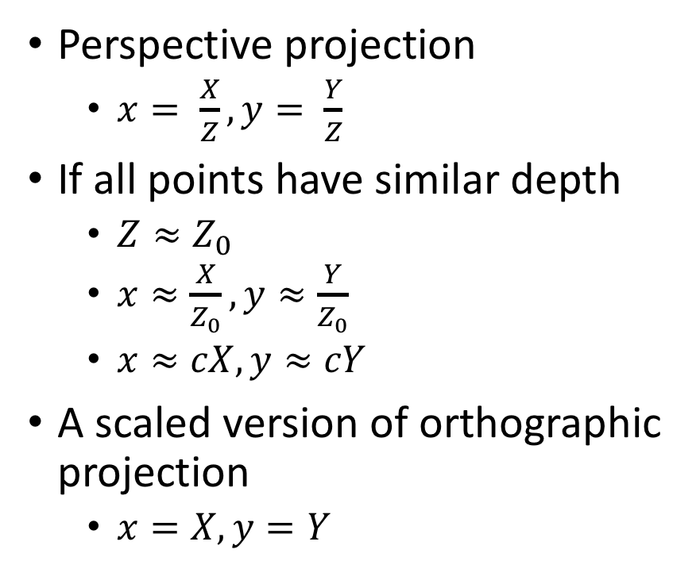
Brief detour: Orthographic projection
Perspective projection
  $x= \frac{X}{Z}, y= \frac{Y}{Z}$
If all points have similar depth
  $Z≈Z_{0}$
  $x≈\frac{X}{Z_{0}}, y≈\frac{Y}{Z_{0}}$
  $x≈cX, y≈cY$
A scaled version of orthographic projection
  $x=X, y=Y$
Perspective
Scaled orthographic

Slide 32



Depth Map from Normal Map
We now have a surface normal, but how do we get depth?
Assume a smooth surface
V₂
V₁
N
Get a similar equation for V₂
  Each normal gives us two linear constraints on z
  compute z values by solving a matrix equation
32

Slide 33
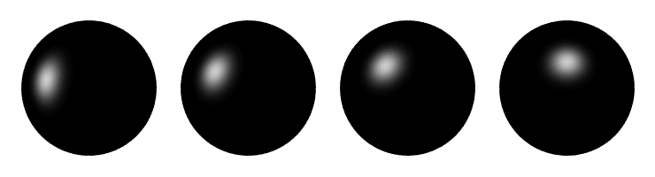
Determining Light Directions
Trick: Place a mirror ball in the scene.
The location of the highlight is determined by the light source direction.
33

Slide 34
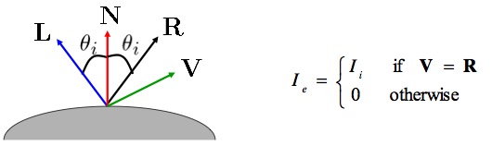
Determining Light Directions
For a perfect mirror, the light is reflected across N:
34

Slide 35

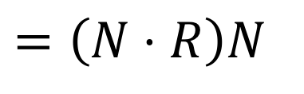
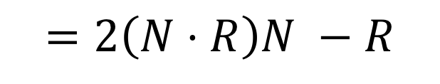
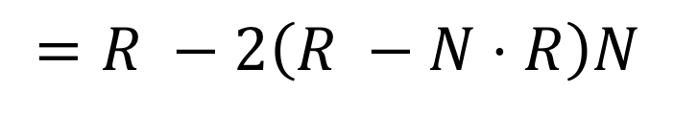
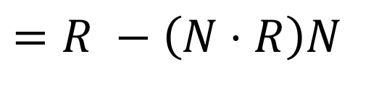
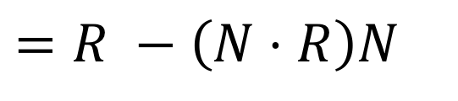
Determining Light Directions
N
$$=\left(N⋅R\right)N$$
L
||
||
R
$$=R −\left(N⋅R\right)N$$
$$=R −\left(N⋅R\right)N$$
= - 2
$$=R −2\left(R −N⋅R\right)N$$
$$=2\left(N⋅R\right)N −R$$
So the light source direction
is given by:
35

Slide 36


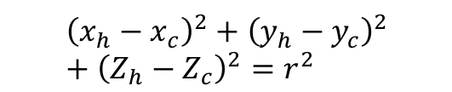




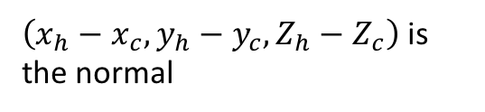
Determining Light Directions
Assume orthographic projection
Viewing direction R = [0,0,-1]
Normal?
$Z_{h}$ and $Z_{c}$ are unknown, but:
$${\left(x_{h}−x_{c}\right)}^{2}+{\left(y_{h}−y_{c}\right)}^{2}+{\left(Z_{h}−Z_{c}\right)}^{2}=r^{2}$$
$$(x_{h},y_{h}, Z_{h})$$
$$(x_{h},y_{h})$$
$\left(Z_{h}−Z_{c}\right)$ can be computed
$$(x_{c},y_{c}, Z_{c})$$
$\left(x_{h}−x_{c}, y_{h}−y_{c}, Z_{h}−Z_{c}\right)$ is the normal
$$(x_{c},y_{c})$$
Z=1

Slide 37
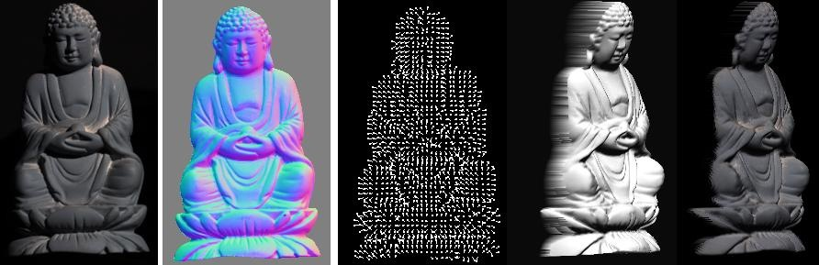
Photometric Stereo
What results can you get?
Input
(1 of 12)
Normals (RGB colormap)
Normals (vectors)
Shaded 3D
rendering
Textured 3D
rendering

Slide 38
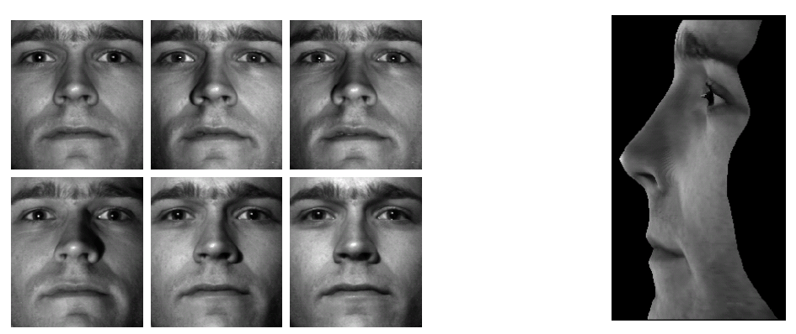
Results
from Athos Georghiades
38

Slide 39
Results
Input
(1 of 12)
Normals (RGB colormap)
Normals (vectors)
Shaded 3D
rendering
Textured 3D
rendering

Slide 40
Questions?

