Slide 1
Virtual Memory
Prof. Van Renesse & Sirer

Slide 2
Segments
Virtual Address Space
Device Registers
Stack
Note: overloaded term…
Chunks of virtual address space
Access Protection
User/Supervisor
Read/Write/Execute
Sharing
Code, libraries
Shared memory for IPC
Virtualization
Illusion of more memory than there really is
Kernel
Zero Init’d Data + Heap
Non-zero Init’d Data
Code
Stack
User
Zero Init’d Data + Heap
Non-zero Init’d Data
Code
0

Slide 3
Segment examples
Code
Execute-only, shared among all processes that execute the same code
Private Data
R/W, private to a single process
Heap
R/W, Explicit allocation, zero-initialized, private
Stack
R/W, Implicit allocation, zero-initialized, private
Shared Memory
explicit allocation, shared among processes, some read-only, others R/W

Slide 4
MMU
Translates virtual (or “logical”) addresses to physical addresses
Enforces R/W/X protection
Throws exceptions on illegal accesses
Unit: “page”
Typically 1, 2, 4, 8, or 16 Kbytes
Often also tracks read and write accesses
Physical page often called “page frame”

Slide 5
Address Translation Scheme
Address generated by CPU is divided into:
Page number (p) – used as an index into a page table which contains base address of each page frame in physical memory
Page offset (d) – combined with base address to define the physical memory address that is sent to the memory unit
For given virtual address space 2^{m} and page size 2^{n}
page number
page offset
p
d
m - n
n

Slide 6
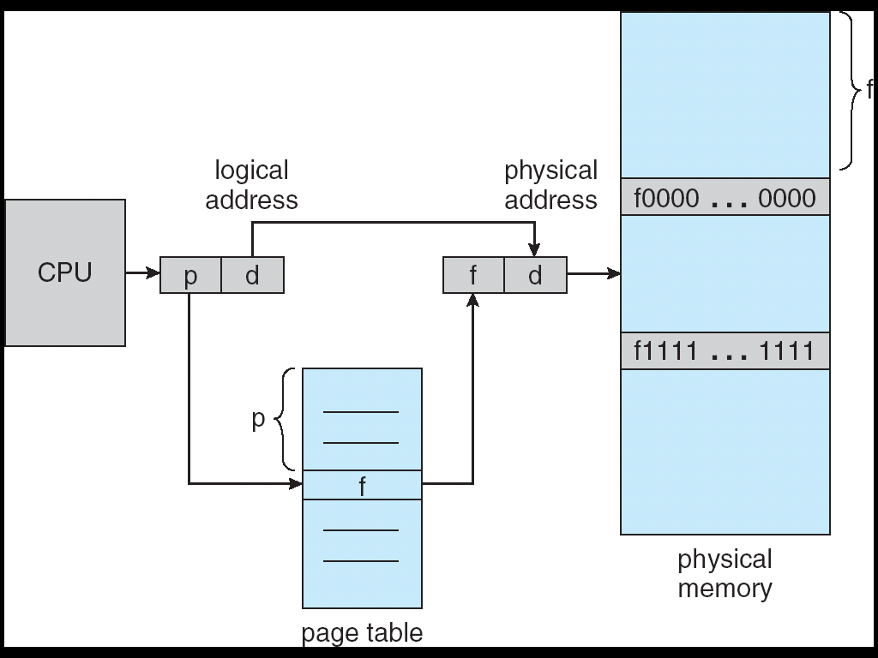
Paging Hardware
PTBR

Slide 7
Implementation of Page Table
Page table can be kept in main memory
Page-table base register (PTBR) points to the page table
Page-table length register (PRLR) indicates size of the page table
In this scheme every data/instruction access requires two memory accesses. One for the page table and one for the data/instruction.

Slide 8
Structure of the Page Table
Hierarchical Paging
Hashed Page Tables
Inverted Page Tables
Software vs. Hardware maintained…
For portability, most kernels maintain their own page tables
These have to be translated into MMU tables

Slide 9
Hierarchical Page Tables
Break up the logical address space into multiple page tables
A simple technique is a two-level page table

Slide 10
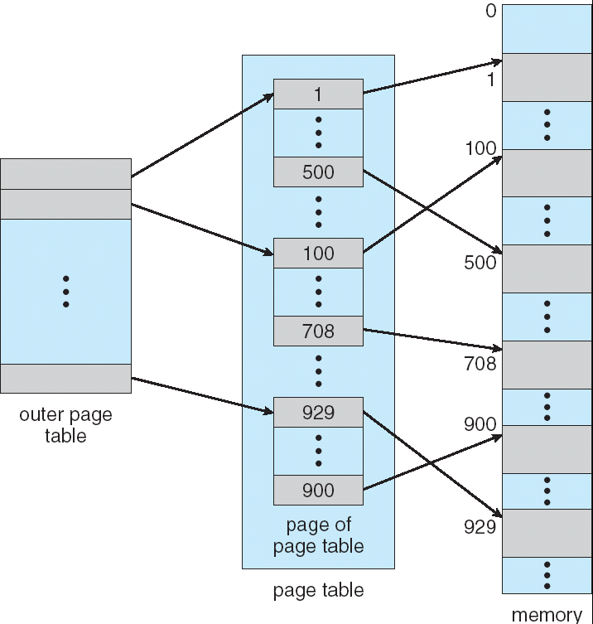
Two-Level Page-Table Scheme
PTBR

Slide 11
Two-Level Paging Example
A logical address (on 32-bit machine with 1K page size) is divided into:
a page offset of 10 bits (1024 = 2^10)
a page number of 22 bits (32-10)
Since the page table is paged, the page number is further divided into:
a 12-bit page number
a 10-bit page offset
Thus, a logical address is as follows:
page number
page offset
p_{i}
p₂
d
12
10
10

Slide 12
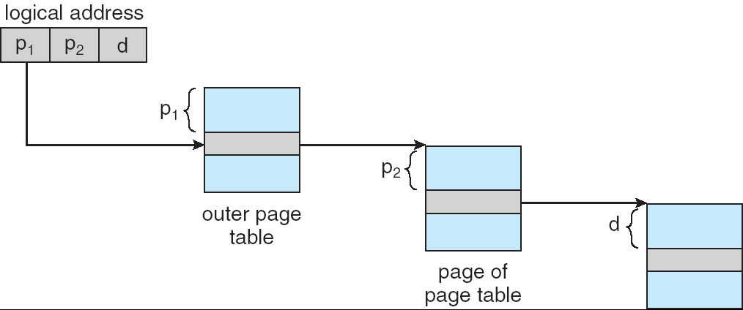
Address-Translation Scheme
PTBR

Slide 13
Hashed Page Tables
Common in address spaces > 32 bits
The virtual page number is hashed into a page table. This page table contains a chain of elements hashing to the same location.
Virtual page numbers are compared in this chain searching for a match. If a match is found, the corresponding physical frame is extracted.

Slide 14
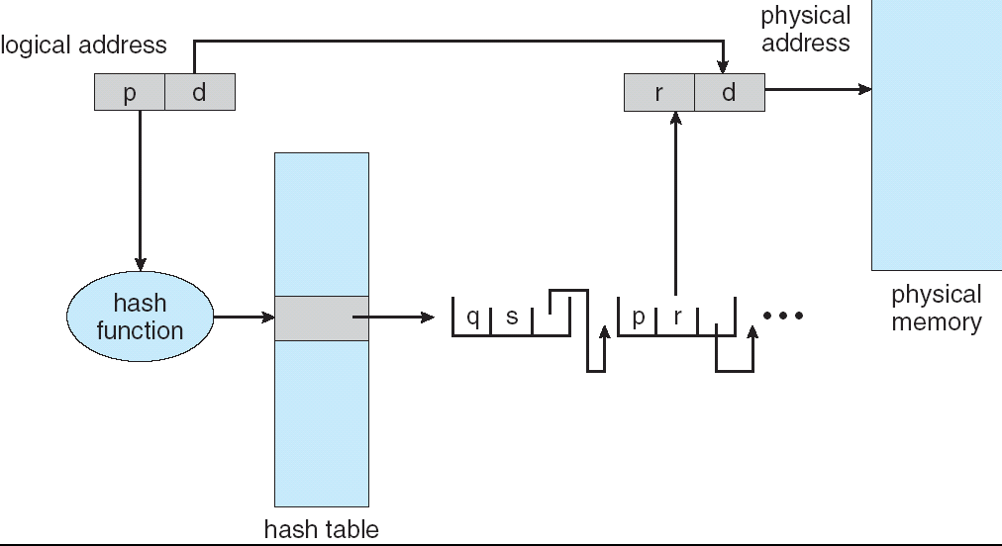
Hashed Page Table

Slide 15
Inverted Page Table
One entry for each real page of memory
Entry consists of the virtual address of the page stored in that real memory location, with information about the process that owns that page
Decreases memory needed to store each page table, but increases time needed to search the table when a page reference occurs
Use hash table to limit the search to one — or at most a few — page-table entries

Slide 16
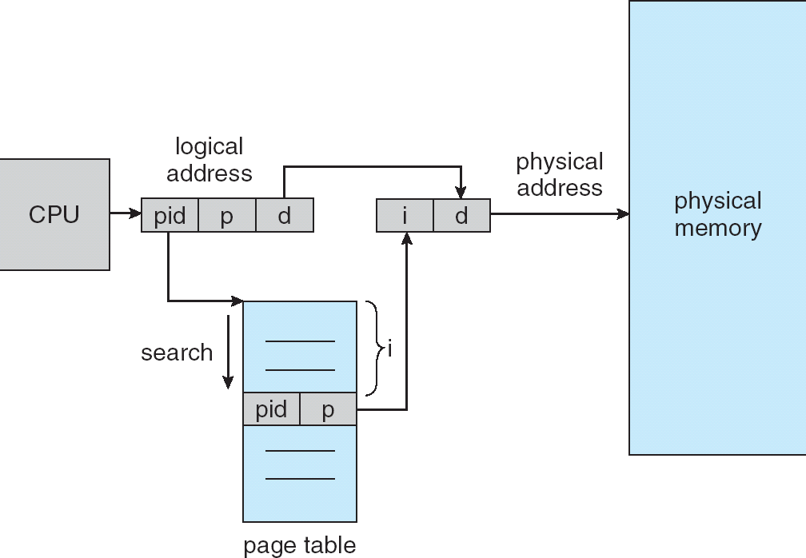
Inverted Page Table Architecture

Slide 17
Translation Look-aside Buffers (TLBs)
The multiple memory access problem can be solved by the use of a special fast-lookup hardware cache (an associative memory)
Allows parallel search of all entries.
Address translation (p, d)
If p is in TLB get frame # out (quick!)
Otherwise get frame # from page table in memory
And replace an existing entry
But which? (stay tuned)

Slide 18
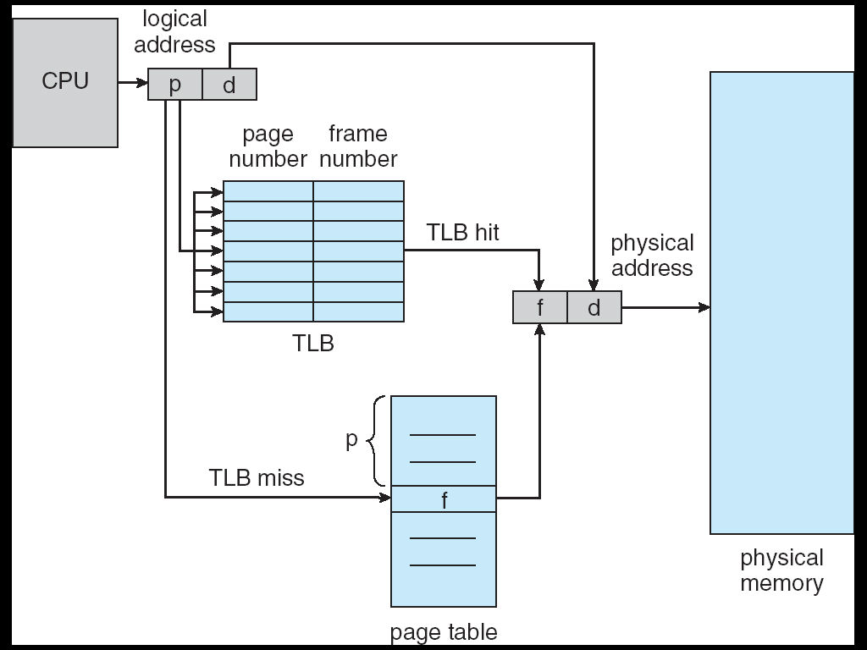
Paging Hardware With TLB

Slide 19
Software-Loaded TLB
Some older architectures support only a TLB
No hardware page tables
Upon a page fault, software updates the TLB
Simplifies operating system, but relatively expensive in terms of overhead

Slide 20
Updated Context Switch
Save registers of current process in PCB
Set up PTBR (base of top-level paging table)
This info is kept in the PCB
Flush TLB
Restore registers of next process to run
“Return from Interrupt”

Slide 21
“Demand Paging” (simplified)
Upon page fault:
Identify page in which fault occurred and reason
If access inconsistent with segment access rights, terminate process
If access within code segment:
Check to see if a frame with the code already exists
If not, allocate a frame and read code from executable file
If disk access required, another process can run in the mean time
Map page for execution only
Return from interrupt
If access within non-zero initialized data segment:
Allocate a frame and read data from executable file
Map page for R/W access
Return from interrupt
If access within zero-initialized data (BSS) or stack
Allocate a frame and fill page with zero bytes
Map page for R/W access
Return from interrupt

Slide 22
Copy-on-Write Segments
Useful for “fork()” and for initialized data
Initially map page read-only
Upon page fault:
Allocate a new frame
Copy frame
Map new page R/W
If fork(), map “other” page R/W as well

Slide 23
Pre-fetching
Disk/network overhead of fetching pages can be high
If a process accesses page X in a segment, the process is likely to to access page X+1 as well
Pre-fetch: start fetch even before page fault has occurred

Slide 24
(Virtual) Null Page
Often made inaccessible to all
Why?

Slide 25
Page Replacement
Pages are released upon termination of a process
But what happens if there is no free frame to allocate?
Select a frame and deallocate it
The frame to eject is selected using the Page Replacement/Eviction Algorithm
Unmap any pages that map to this frame
If the frame is “dirty” (modified), save it on disk so it can be restored later if needed
Upon subsequent page fault, load the frame from where it was stored
Goal: Select frame that minimizes future page faults
Note: strong resemblance to caching algorithms

Slide 26
Modified/Dirty Bits
Use modify (dirty) bit to reduce overhead of page transfers – only modified pages are written to disk, non-modified pages can always be brought back from the original source
Process text segments are rarely modified, can bring pages back from the program image stored on disk
If MMU does not support dirty bit, can simulate it by mapping a page “read-only” and mark it dirty upon first page fault

Slide 27
“Swapping”
Originally, a way to free frames by copying the memory of an entire process to “swap space”
Swap out, swap in a process…
This technique is not so widely used any more
“Swapping” now sometimes used as synonymous with “paging”

Slide 28
Page Replacement Algorithms
Random: Pick any page to eject at random
Used mainly for comparison
FIFO: The page brought in earliest is evicted
Ignores usage
OPT: Belady’s algorithm
Select page not used for longest time
LRU: Evict page that hasn’t been used the longest
Past could be a good predictor of the future
MRU: Evict the most recently used page
LFU: Evict least frequently used page

Slide 29
First-In-First-Out (FIFO) Algorithm
Reference string: 1, 2, 3, 4, 1, 2, 5, 1, 2, 3, 4, 5
3 frames (3 pages can be in memory at a time per process):
1, 2, 3, 4, 1, 2, 5, 1, 2, 3, 4, 5
4 frames: 1, 2, 3, 4, 1, 2, 5, 1, 2, 3, 4, 5
Belady’s Anomaly: more frames ⇒ more page faults
1
1
4
5
2
2
1
3
9 page faults
3
3
2
4
1
1
5
4
2
2
1
5
10 page faults
3
3
2
4
4
3

Slide 30
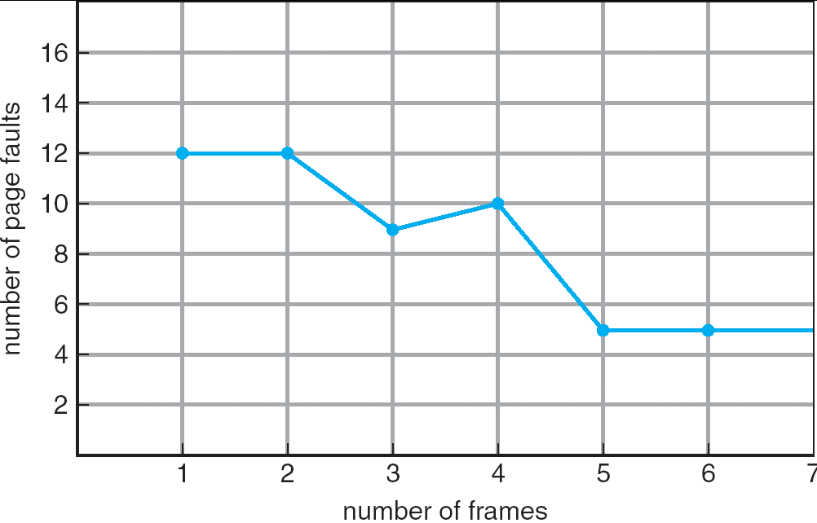
FIFO Illustrating Belady’s Anomaly

Slide 31
Optimal Algorithm (Belady)
Replace page that will not be used for longest period of time
4 frames example
1, 2, 3, 4, 1, 2, 5, 1, 2, 3, 4, 5
How do you know this?
Used for measuring how well your algorithm performs
1
4
2
6 page faults
3
4
5

Slide 32
OPT Approximation
In real life, we do not have access to the future page request stream of a program
No crystal ball, no way to know definitively which pages a program will access
So we need to make a best guess at which pages will not be used for the longest time

Slide 33
Least Recently Used (LRU) Algorithm
Reference string: 1, 2, 3, 4, 1, 2, 5, 1, 2, 3, 4, 5
8 page faults…
1
1
1
1
5
2
2
2
2
2
3
5
5
4
4
4
4
3
3
3

Slide 34
Implementing Perfect LRU
On reference: Timestamp each page
On eviction: Scan for oldest frame
Problems:
Large page lists
Timestamps are costly
Approximate LRU
LRU is already an approximation!

Slide 35
LRU: Clock Algorithm
Each page has a reference bit
Set on use
Allocation algorithm:
FIFO + reference bit (keep pages in circular list)
Scan: if ref bit is 1, set to 0, and try next.
If ref bit is 0, stop and evict.
Problem:
Low accuracy for large memory
R=1
R=1
R=0
R=0
R=1
R=0
R=1
R=1
R=0
R=1
R=0

Slide 36
LRU with large memory
Solution: Add another hand
Leading edge clears ref bits
Trailing edge evicts pages with ref bit 0
What if angle small?
What if angle big?
Sensitive to sweeping interval and angle
Fast: lose usage information
Slow: all pages look used
R=1
R=1
R=0
R=0
R=1
R=0
R=1
R=1
R=0
R=1
R=0

Slide 37
Other Algorithms
MRU: Remove the most recently touched page
Works well for data accessed only once, e.g. a movie file
Not a good fit for most other data, e.g. frequently accessed items
LFU: Remove page with lowest count
No track of when the page was referenced
Use multiple bits. Shift right by 1 at regular intervals.
MFU: remove the most frequently used page
LFU and MFU do not approximate OPT well

Slide 38
Allocating Pages to Processes
Global replacement
Single memory pool for entire system
On page fault, evict oldest page in the system
Problem: lack of performance isolation
Local (per-process) replacement
Have a separate pool of pages for each process
Page fault in one process can only replace pages from its own process
Problem: might have idle resources

Slide 39
Thrashing
Def: Excessive rate of paging
May stem from lack of resources
More likely, caused by bad choices of the eviction algorithm
Keep throwing out page that will be referenced soon
So, they keep accessing memory that is not there
Why does it occur?
Poor locality, past != future
There is reuse, but process does not fit model
Too many processes in the system

Slide 40
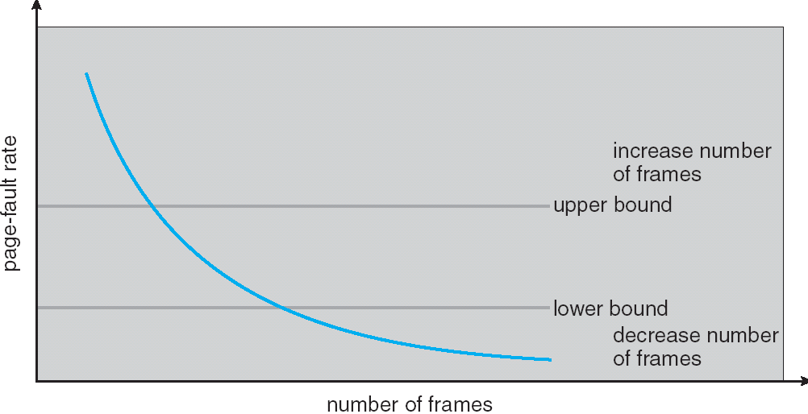
Page Fault Frequency
Thrashing viewed as poor ratio of fetch to work
PFF = page faults / instructions executed
if PFF rises above threshold, process needs more memory
not enough memory on the system? Swap out.
if PFF sinks below threshold, memory can be taken away

Slide 41
Working Set
Peter Denning, 1968
He uses this term to denote memory locality of a program
Def: pages referenced by process in last Δ time-units comprise its working set

Slide 42
Working Sets
The working set size is num pages in the working set
the number of pages touched in the interval [t-Δ+1..t].
The working set size changes with program locality.
during periods of poor locality, you reference more pages.
Within that period of time, you will have a larger working set size.
Goal: keep WS for each process in memory.
E.g. If Σ WS_{i} for all i runnable processes > physical memory, then suspend a process

Slide 43
Working Set Approximation
Approximate with interval timer + a reference bit
Example: Δ = 10,000
Timer interrupts after every 5000 time units
Keep in memory 2 bits for each page
Whenever a timer interrupts copy and sets the values of all reference bits to 0
If one of the bits in memory = 1 ⇒ page in working set
Why is this not completely accurate?
Cannot tell (within interval of 5000) where reference occurred
Improvement = 10 bits and interrupt every 1000 time units

