Slide 1
Other File Systems: NFS and GFS
Ken Birman

Slide 2
Distributed File Systems
Goal: view a distributed system as a file system
Storage is distributed
Web tries to make world a collection of hyperlinked documents
Issues not common to usual file systems
Naming transparency
Load balancing
Scalability
Location and network transparency
Fault tolerance
We will look at some of these today

Slide 3
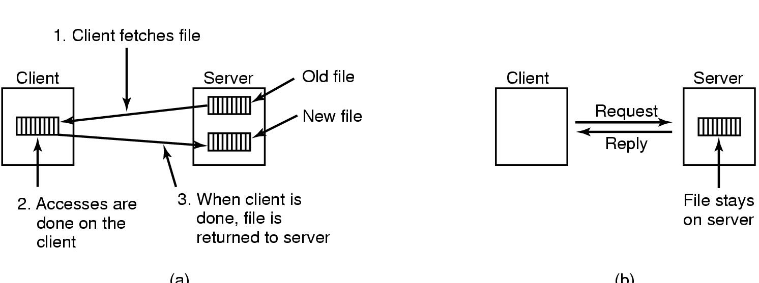
Transfer Model
Upload/download Model:
Client downloads file, works on it, and writes it back on server
Simple and good performance
Remote Access Model:
File only on server; client sends commands to get work done

Slide 4
Directory Hierarchy

Slide 5
Naming transparency
Naming is a mapping from logical to physical objects
Ideally client interface should be transparent
Not distinguish between remote and local files
/machine/path or mounting remote FS in local hierarchy are not transparent
A transparent DFS hides the location of files in system
2 forms of transparency:
Location transparency: path gives no hint of file location
/server1/dir1/dir2/x tells x is on server1, but not where server1 is
Location independence: move files without changing names
Separate naming hierarchy from storage devices hierarchy

Slide 6
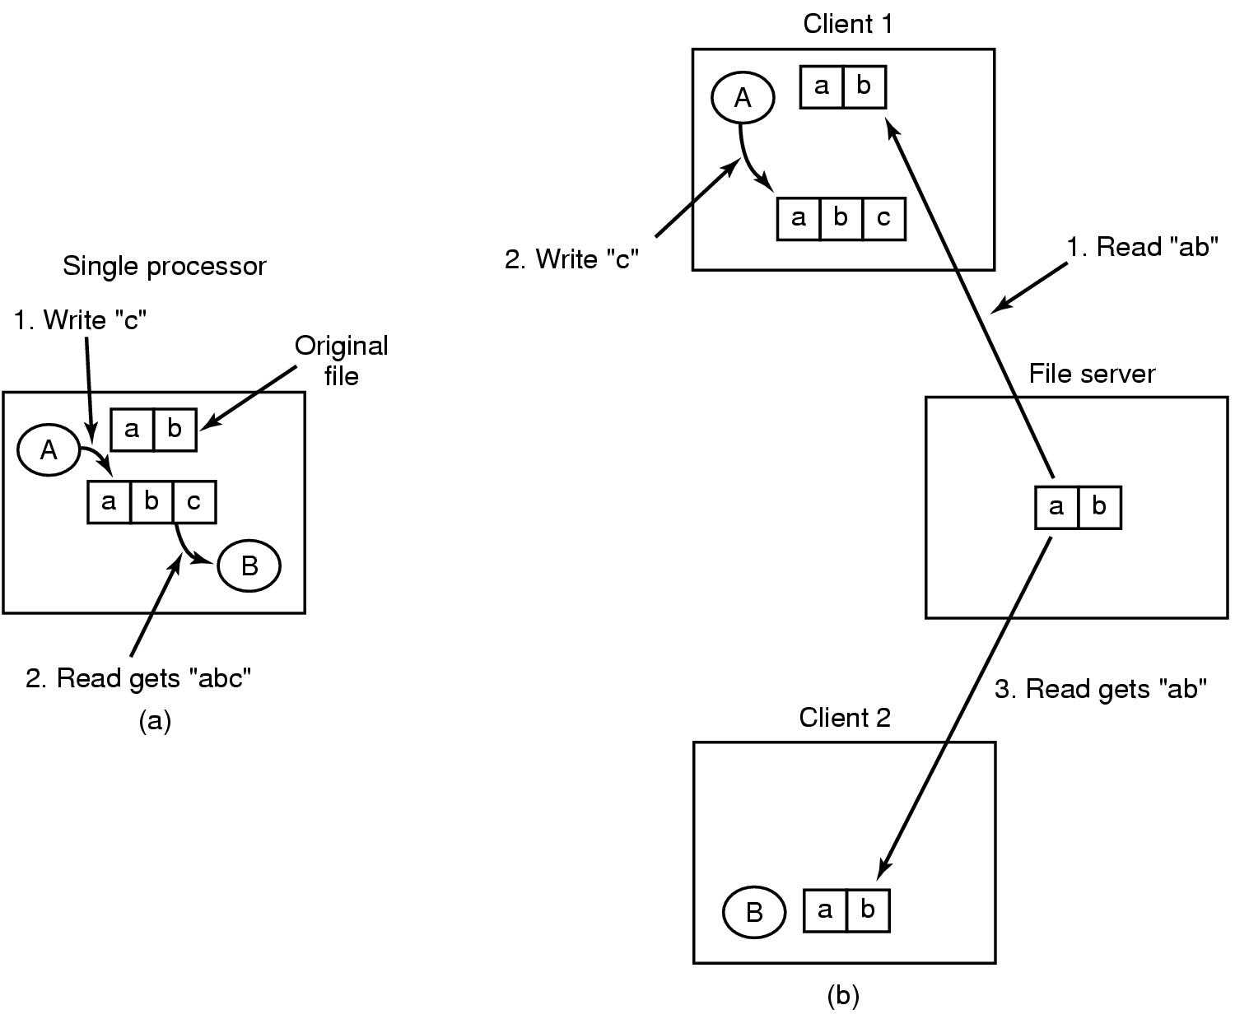
File Sharing Semantics
Sequential consistency: reads see previous writes
Ordering on all system calls seen by all processors
Maintained in single processor systems
Can be achieved in DFS with one file server and no caching

Slide 7
Caching
Keep repeatedly accessed blocks in cache
Improves performance of further accesses
How it works:
If needed block not in cache, it is fetched and cached
Accesses performed on local copy
One master file copy on server, other copies distributed in DFS
Cache consistency problem: how to keep cached copy consistent with master file copy
Where to cache?
Disk: Pros: more reliable, data present locally on recovery
Memory: Pros: diskless workstations, quicker data access,
Servers maintain cache in memory

Slide 8
File Sharing Semantics
Other approaches:
Write through caches:
immediately propagate changes in cache files to server
Reliable but poor performance
Delayed write:
Writes are not propagated immediately, probably on file close
Session semantics: write file back on close
Alternative: scan cache periodically and flush modified blocks
Better performance but poor reliability
File Locking:
The upload/download model locks a downloaded file
Other processes wait for file lock to be released

Slide 9
Network File System (NFS)
Developed by Sun Microsystems in 1984
Used to join FSes on multiple computers as one logical whole
Used commonly today with UNIX systems
Assumptions
Allows arbitrary collection of users to share a file system
Clients and servers might be on different LANs
Machines can be clients and servers at the same time
Architecture:
A server exports one or more of its directories to remote clients
Clients access exported directories by mounting them
The contents are then accessed as if they were local

Slide 10
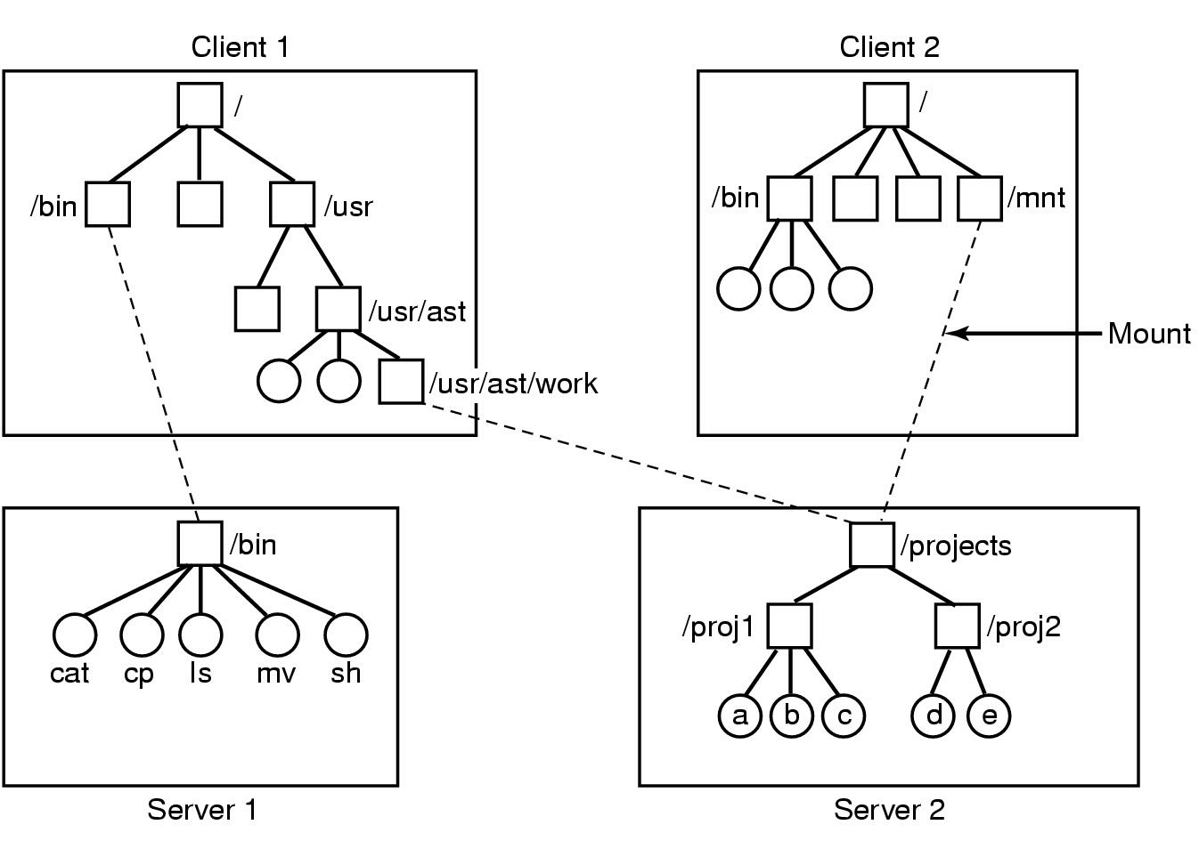
Example

Slide 11
NFS Mount Protocol
Client sends path name to server with request to mount
Not required to specify where to mount
If path is legal and exported, server returns file handle
Contains FS type, disk, i-node number of directory, security info
Subsequent accesses from client use file handle
Mount can be either at boot or automount
Using automount, directories are not mounted during boot
OS sends a message to servers on first remote file access
Automount is helpful since remote dir might not be used at all
Mount only affects the client view!

Slide 12
NFS Protocol
Supports directory and file access via RPCs
All UNIX system calls supported other than open & close
Open and close are intentionally not supported
For a read, client sends lookup message to server
Server looks up file and returns handle
Unlike open, lookup does not copy info in internal system tables
Subsequently, read contains file handle, offset and num bytes
Each message is self-contained
Pros: server is stateless, i.e. no state about open files
Cons: Locking is difficult, no concurrency control

Slide 13
NFS Implementation
Three main layers:
System call layer:
Handles calls like open, read and close
Virtual File System Layer:
Maintains table with one entry (v-node) for each open file
v-nodes indicate if file is local or remote
If remote it has enough info to access them
For local files, FS and i-node are recorded
NFS Service Layer:
This lowest layer implements the NFS protocol

Slide 14
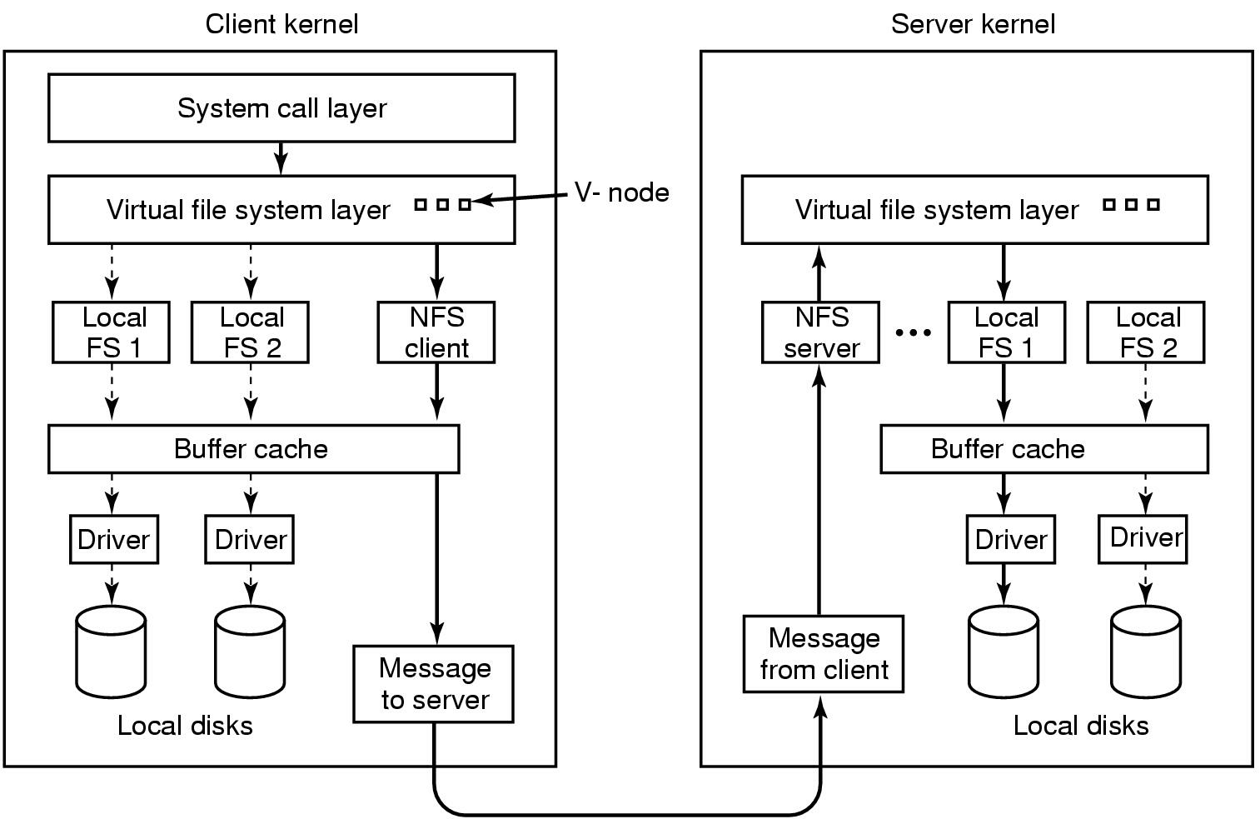
NFS Layer Structure

Slide 15
How NFS works?
Mount:
Sys ad calls mount program with remote dir, local dir
Mount program parses for name of NFS server
Contacts server asking for file handle for remote dir
If directory exists for remote mounting, server returns handle
Client kernel constructs v-node for remote dir
Asks NFS client code to construct r-node for file handle
Open:
Kernel realizes that file is on remotely mounted directory
Finds r-node in v-node for the directory
NFS client code then opens file, enters r-node for file in VFS, and returns file descriptor for remote node

Slide 16
Cache coherency
Clients cache file attributes and data
If two clients cache the same data, cache coherency is lost
Solutions:
Each cache block has a timer (3 sec for data, 30 sec for dir)
Entry is discarded when timer expires
On open of cached file, its last modify time on server is checked
If cached copy is old, it is discarded
Every 30 sec, cache time expires
All dirty blocks are written back to the server

Slide 17
Security
A serious weakness in NFS
It has two modes: a secure mode (but turned off by default) and an insecure mode
In insecure mode, it trusts the client to tell the server who is making the access
“I’m Bill Gates and I’d like to transfer some money from my account

Slide 18
The Google File System
From a slide set by Tim Chuang, U.W. Seattle

Slide 19
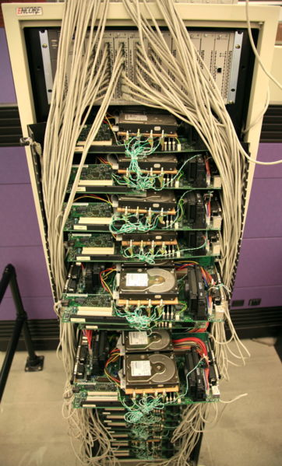
Introduction
First version was developed by Larry Page and Sergey Brin as a virtual file system – BigFiles.
Google File System was developed by Sanjay Ghemawat, Howard Gobioff, and Shun-Tak Leung to be the successor to BigFiles.

Slide 20
Design Assumptions
Built from many inexpensive commodity hardware that “often” fail.
Store a modest number of large files.
Support two kinds of reads – large streaming and small random reads.
Support large, sequential writes that append data to files.
Support for multiple clients that concurrently append to the same file.

Slide 21
Architecture
Single Master, multiple chunkservers.
Fixed chunk size of 64 MB.
Periodic communication between master and chunkservers with “HeartBeat” messages.
No file caching.

Slide 22
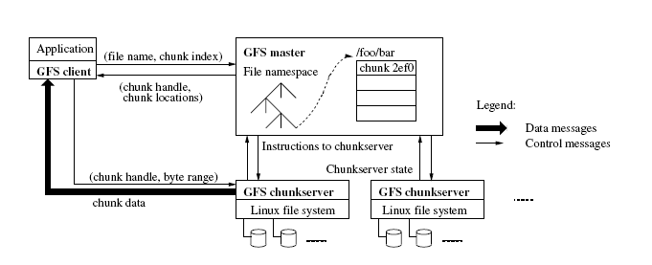
Simple Read Interactions

Slide 23
Effect?
User file request is “mapped” to a chunk
And the chunk can be accessed (via NFS) on some chunk server
If changed, master will later arrange to propagate the updates to other replicas that have the same chunk
But in any case it knows which chunk(s) are current and which server(s) have copies, so application won’t see inconsistency
Must lock files to be sure you’ll see the current version
Locking is integrated with the master sync mechanism

Slide 24
So…
Conceptually, an immense but very standard file system
Just like on Linux or Windows…
Except that some files could have petabytes of data
Only real “trick” is that to access them, you need to follow this chunk-access protocol

Slide 25
Why Such a Large Chunk Size?
Advantages:
Reduce clients’ need to interact with the master.
Reduce network overhead by keeping a persistent connection to the chunkserver.
Reduce the size of metadata stored on the master.

Slide 26
Why Such a Large Chunk Size?
Disadvantages:
Serious internal fragmentation when storing small files.
Chunkservers that contain many small files may become hot spots.

Slide 27
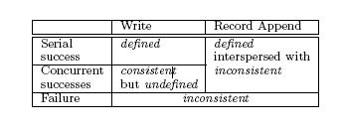
Guarantees offered by GFS
Relaxed consistency model
Atomic file namespace mutation with namespace locking.
Atomic Record Append.

Slide 28
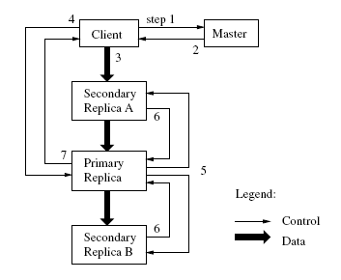
Leases and Mutation order

Slide 29
Fault-tolerance
Fast Recovery
Master and chunkservers are designed to restore their state and start in seconds.
Chunk Replication
Each chunk is replicated on mutiple chunkservers on different racks.
Master Replication
The master state is replicated for reliability.

Slide 30
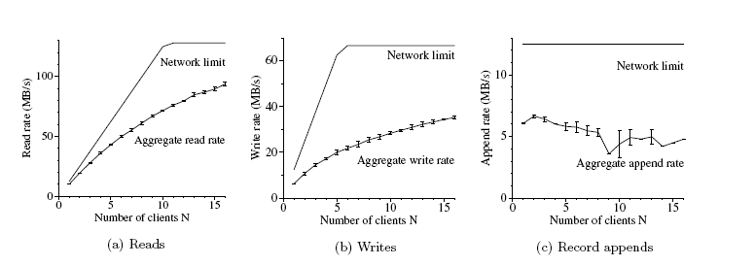
Performance Measurements
Notes:
These 3 charts show the aggregate throughputs of different operations for 1 master, 16 readers and 16 writers. Top curves show theoretical limits imposed by the network. Bottom curves show measured thruputs.
Shows the performance for random reads. The performance goes down as the number of readers increases as the network becomes more saturated.
Shows N clients write simultaneously to N distinct files. Each client writes 1GB of data to a new file in a series of 1 MB writes. Write is much slower because each byte has to be written to all of the chunk’s replicas.
Shows record apend performance. N clients append simultaneously to the same file. Performance is limited by the network bandwidth of the chunkserver, independent of the number of clients. The performance starts to drop slightly as the number of clients increases due to congestion and variances in network transfer rates seen by different clients.

Slide 31
Learning more
Ghemawat, Sanjay et al. “The Google File System”
Carr, David F. “How Google Works” http://www.baselinemag.com/c/a/Projects-Networks-and-Storage/How-Google-Works-%5B1%5D/4/
Wikipedia, “Google”
http://en.wikipedia.org/wiki/Google

Slide 32
Famous file systems surprises
Lots of gottcha’s…
Debugging an application using printf statements
Then it crashes…. What was the “last line it printed”?
Gottcha!
Printf is smart: collects 1024 bytes at a time and does block writes, at least normally (must call fflush() to override this behavior).
So the last line on the console might not be the last line it printed!

Slide 33
Famous file systems surprises
Process A writes to a file, then tells process B, on some other machine, to read the file
Will process B see the file?
Gottcha!
Maybe not: file I/O to the file system cache can be way ahead of the state of the disk itself
Must call fsync() first (and this may “hiccup” for a while)

Slide 34
Famous file systems surprises
Many old Linux applications create a file called “lock” to do locking
Because Linux lacked a standard distributed locking mechanism
So process A creates a file, “lock”
EEXISTS: A sleeps 10 seconds, then tries again
Gottcha!
With remote NFS, requests are sometimes automatically reissued. A could create the lock but its operation would fail anyhow…. A then waits for itself to release the lock!

Slide 35
Famous file systems surprises
What did you expect?
NFS? I made it!

