Slide 1
File Systems
Ken Birman

Slide 2
Storing Information
We often need to store information
Sometimes, the stored form has a life its own
Pictures of your friends, videos, songs
Sometimes, the stored data is for recovery
In case you want to restart the game later
Or perhaps your application is a little fragile and crashes now and then
Files are a good way for processes to cooperate
You do X, I’ll do Y and we’ll merge the results

Slide 3
File Systems
Three criteria for long-term information storage:
Should be able to store very large amount of information
Information must survive the processes using it
Should provide concurrent access to multiple processes
Solution:
Store information on disks in units called files
Files are persistent, and only owner can explicitly delete it
Files are managed by the OS
File Systems: How the OS manages files!

Slide 4
Today: User’s perspective of FS
Files
Naming, structure, types, access, attributes, operations
Directories
Structure, path and operations
Mounting file systems
File Protection

Slide 5
File Naming
Motivation: Files abstract information stored on disk
You do not need to remember block, sector, …
We have human readable names
How does it work?
Process creates a file, and gives it a name
Other processes can access the file by that name
Naming conventions are OS dependent
Usually names as long as 255 characters is allowed
Digits and special characters are sometimes allowed
MS-DOS and Windows are not case sensitive, UNIX family is

Slide 6
File Extensions
Name divided into 2 parts, second part is the extension
On UNIX, extensions are not enforced by OS
However C compiler might insist on its extensions
These extensions are very useful for C
Windows attaches meaning to extensions
Tries to associate applications to file extensions
You can see and even change these if you like

Slide 7
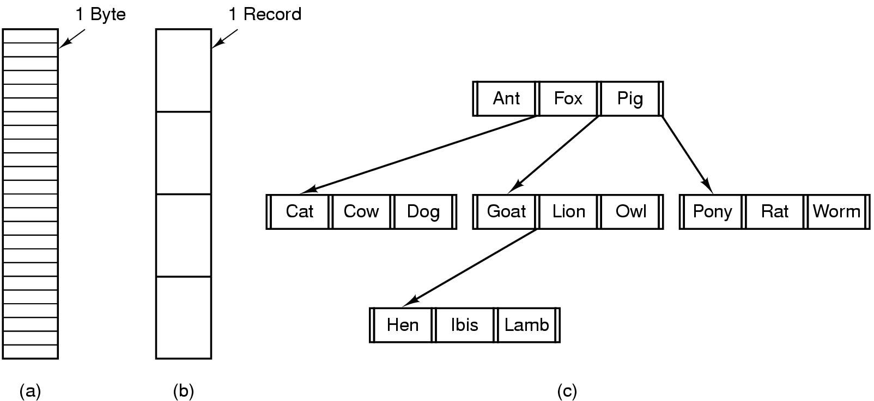
File Structure
Byte Sequence: unstructured, most commonly used
Record sequence: r/w in records, used earlier
Complex structures, e.g. tree
- Data stored in variable length records; location decided by OS

Slide 8
File Types
5 types of files
Regular files: contain user information
Directories: system files for maintaining structure of FS
Character special files: for serial I/O in UNIX
Block special files: to model disks in UNIX
Symbolic links
Regular files are usually:
ASCII files: lines of text
Useful for editing, portability across applications
Binary files: usually have an internal structure
Look at executables and archives in UNIX
Every OS needs a way to recognize its own executable!

Slide 9
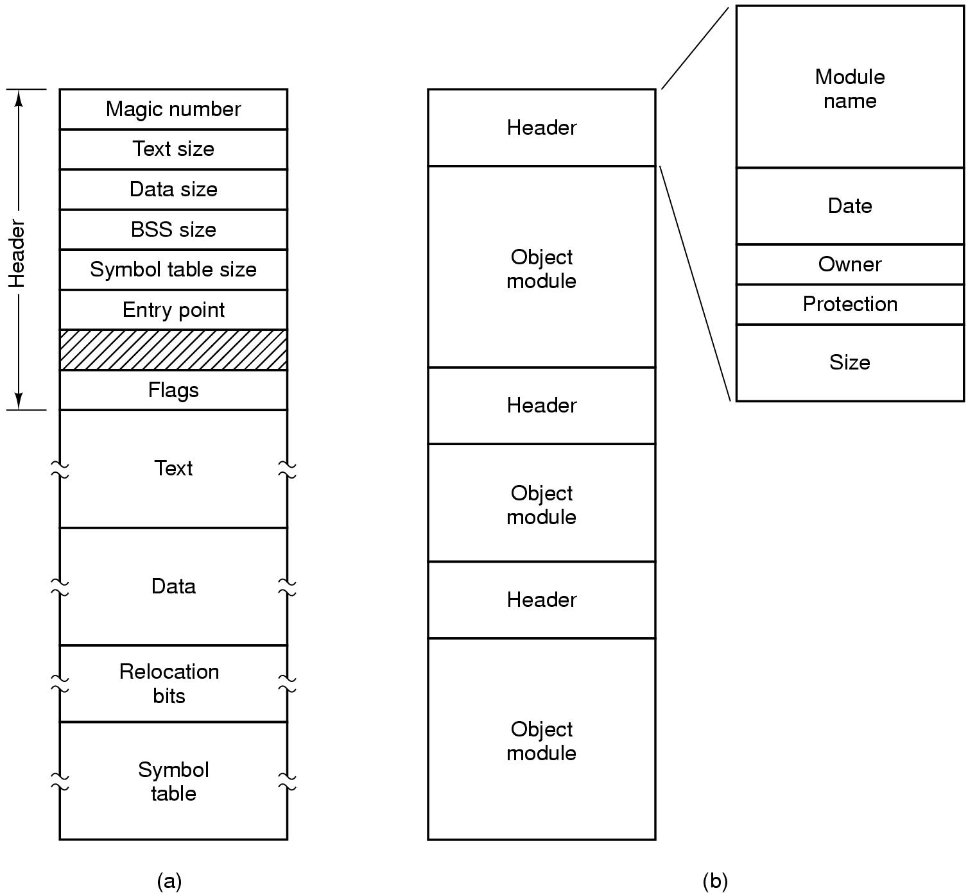
Executables and Archives

Slide 10
File Access
Sequential access
read all bytes/records from the beginning
cannot jump around, could rewind or forward
convenient when medium was magnetic tape
Random access
bytes/records read in any order
essential for database systems
2 possible reads
Specify disk block in read
move file marker (seek), then read or …

Slide 11
File Attributes
File-specific info maintained by the OS
File size, modification date, creation time, etc.
Varies a lot across different OSes
Some examples:
Name – only information kept in human-readable form
Identifier – unique tag (number) identifies file within file system
Type – needed for systems that support different types
Location – pointer to file location on device
Size – current file size
Protection – controls who can do reading, writing, executing
Time, date, and user identification – data for protection, security, and usage monitoring

Slide 12
File Operations
File is an Abstract Data Type
Some operations:
Create a file: find space in FS, add directory entry
Open: system fetches attributes and disk addresses in memory
Write a file: locate file and write at current position
Might need to increase the size attribute
Read a file: locate file, read from current position, store in buffer
Read/write pointer can be stored as per-process file pointer

Slide 13
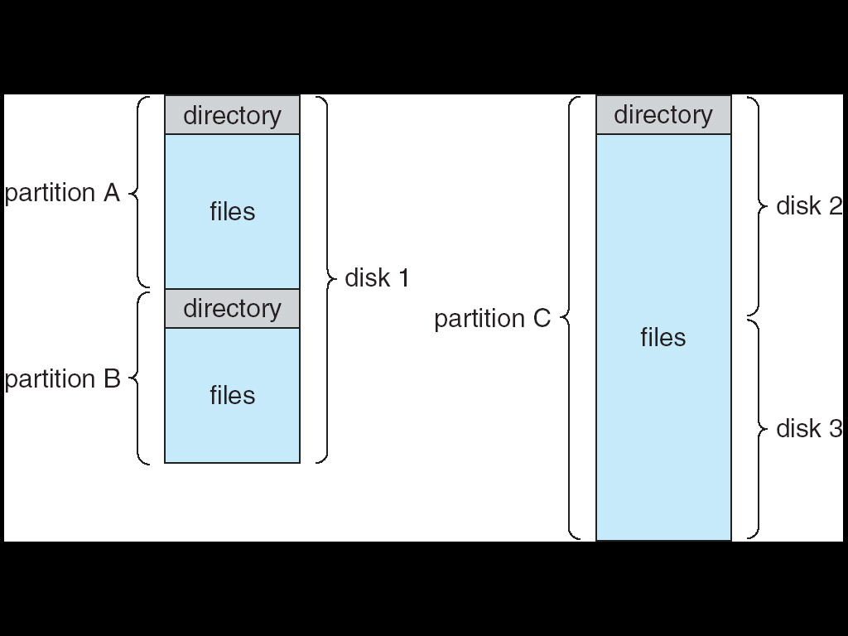
FS on disk
Could use entire disk space for a FS, but
A system could have multiple FSes
Want to use some disk space for swap space
Disk divided into partitions or minidisks
Chunk of storage that holds a FS is a volume
Directory structure maintains info of all files in the volume
Name, location, size, type, …

Slide 14
Directories
Directories/folders keep track of files
Is a symbol table that translates file names to directory entries
Usually are themselves files
How to structure the directory to optimize all of the foll.:
Search a file
Create a file
Delete a file
List directory
Rename a file
Traversing the FS
Directory
Files
F 1
F 2
F 3
F 4
F n

Slide 15
Single-level Directory
One directory for all files in the volume
Called root directory
Used in early PCs, even the first supercomputer CDC 6600
Pros: simplicity, ability to quickly locate files
Cons: inconvenient naming (uniqueness, remembering all)

Slide 16
Two-level directory
Each user has a separate directory
Solves name collision, but what if user has lots of files
Files need to be addressed by path names
Allow user’s access to other user’s files
Need for a search path (for example, locating system files)

Slide 17
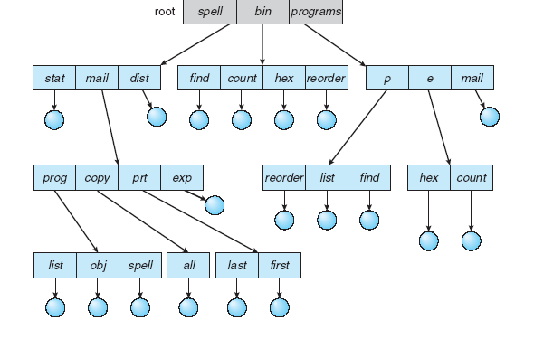
Tree-structured Directory
Directory is now a tree of arbitrary height
Directory contains files and subdirectories
A bit in directory entry differentiates files from subdirectories

Slide 18
Path Names
To access a file, the user should either:
Go to the directory where file resides, or
Specify the path where the file is
Path names are either absolute or relative
Absolute: path of file from the root directory
Relative: path from the current working directory
Most OSes have two special entries in each directory:
“.” for current directory and “..” for parent

Slide 19
Links
In Linux, a name is really a “link”
We adopt the view that the name (path) leads us to a kind of unique file identification number
Called an inode number and, on a given disk, it refers to the data structure representing the file
In Linux, multiple names can link to the same inode!
The file ends up with more than one name but there is just one file and everyone shares it
Permissions are a property of the file, not its name(s)

Slide 20
Shortcuts, Symbolic Links
On Windows, there is a different way to create a kind of link
A file on Windows only has one real name
But you can create a “shortcut” to the file
Linux has these too, in addition to true links. Calls them “symbolic links”
A shortcut, or symbolic link, is a file that has another file name inside it.

Slide 21
Pros and Cons
True links have advantages and disadvantages
The main disadvantage is that deleting a file may not get rid of it, which can be confusing
E.g. if two names point to “memo” and you delete one name (one link), the other still points to the file
But a nice feature of a true link is that it lets you think of the name space separately from the files per-se

Slide 22
Pros and Cons
Symbolic links (shortcuts)
Are super flexible: the file doesn’t even need to exist when you make the shortcut (like a URL)
But this is a problem too: the file has no idea that other names point to it, so when you delete the file, it goes away even if symbolic links persist
Thought question: suppose that “memo” has a symbolic link to it called “Mom’s Memo” and now I delete memo and create a new file called memo. What happens if I open “Mom’s Memo”? What it was a real link?

Slide 23
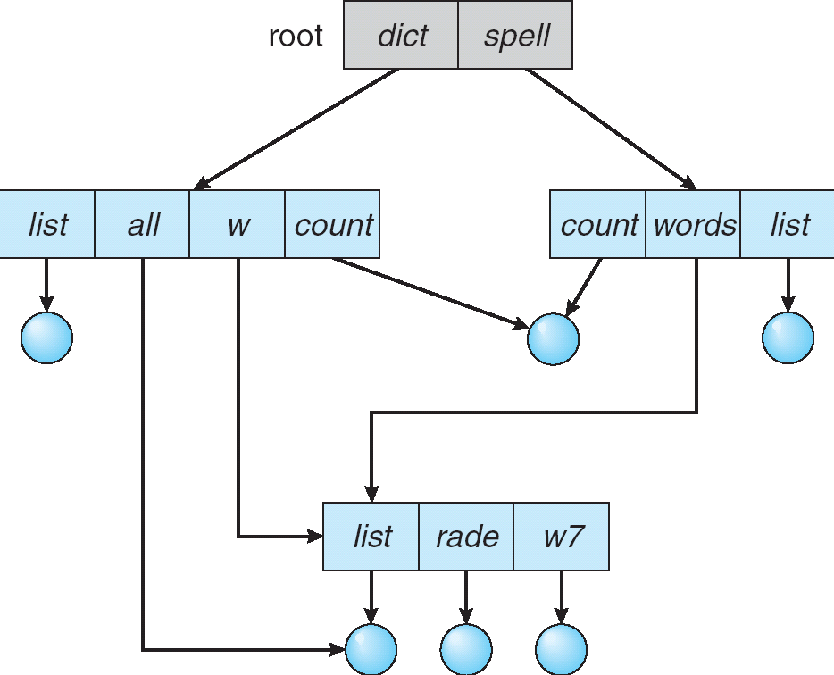
Acyclic Graph Directories
Share subdirectories or files

Slide 24
Acyclic Graph Directories
How to implement shared files and subdirectories:
Why not copy the file?
New directory entry, called Link (used in UNIX)
Link is a pointer to another file or subdirectory
Links are ignored when traversing FS
ln in UNIX, fsutil in Windows for hard links
ln –s in UNIX, shortcuts in Windows for soft links
Issues?
Two different names (aliasing)
If dict deletes list ⇒ dangling pointer
Keep backpointers of links for each file
Leave the link, and delete only when accessed later
Keep reference count of each file

Slide 25
File System Mounting
Mount allows two FSes to be merged into one
For example you insert your floppy into the root FS
mount(“/dev/fd0”, “/mnt”, 0)

Slide 26
Remote file system mounting
Same idea, but file system is actually on some other machine
Implementation uses remote procedure call
Package up the user’s file system operation
Send it to the remote machine where it gets executed like a local request
Send back the answer
Very common in modern systems

Slide 27
Executables in mounted file sys
A very controversial feature!
For example, in a USB disk
Executables enable features like “autoplay”… which are extremely popular
Although there are other ways to support autoplay, often it is done by running an “autoexec” file from the root
But should the OS trust the contents of a USB?
Who has it been sleeping with?

Slide 28
File Protection
File owner/creator should be able to control:
what can be done
by whom
Types of access
Read
Write
Execute
Append
Delete
List

Slide 29
Categories of Users
Individual user
Log in establishes a user-id
Might be just local on the computer or could be through interaction with a network service
Groups to which the user belongs
For example, “ken” is in “csfaculty”
Again could just be automatic or could involve talking to a service that might assign, say, a temporary cryptographic key

Slide 30
Linux Access Rights
Mode of access: read, write, execute
Three classes of users RWX
a) owner access 7 ⇒ 1 1 1 RWX
b) group access 6 ⇒ 1 1 0
RWX
c) public access 1 ⇒ 0 0 1
For a particular file (say game) or subdirectory, define an appropriate access.
owner
group
public
chmod
761
game

Slide 31
Unix executable files
In Linux, an executable file can be
A text file. In this case Linux runs the shell program on the file (treats the file as if it contained commands)
The first line of the file can specify which shell you prefer for it to use (Unix has several shells)
A very popular one is “Perl”
Linux executables can also specify
Setuid: means “run under the UID of the file owner”
Setgid: means “un under the GID of the file owner”
… used to control access to special applications, like medical records or accounting systems

Slide 32
Setuid “root” (“administrator”)
This is a very risky feature but common
It allows a program to gain complete control
Overrides all file system and other permissions
Basically, “become god”
Unix allows it… much debate about the right way to handle USB disks that contain setuid programs….

Slide 33
More issues with Linux
Just a single owner, a single group and the public
Pro: Compact enough to fit in just a few bytes
Con: Not very expressive
Access Control List: This is a per-file list that tells who can access that file
Pro: Highly expressive
Con: Harder to represent in a compact way

Slide 34
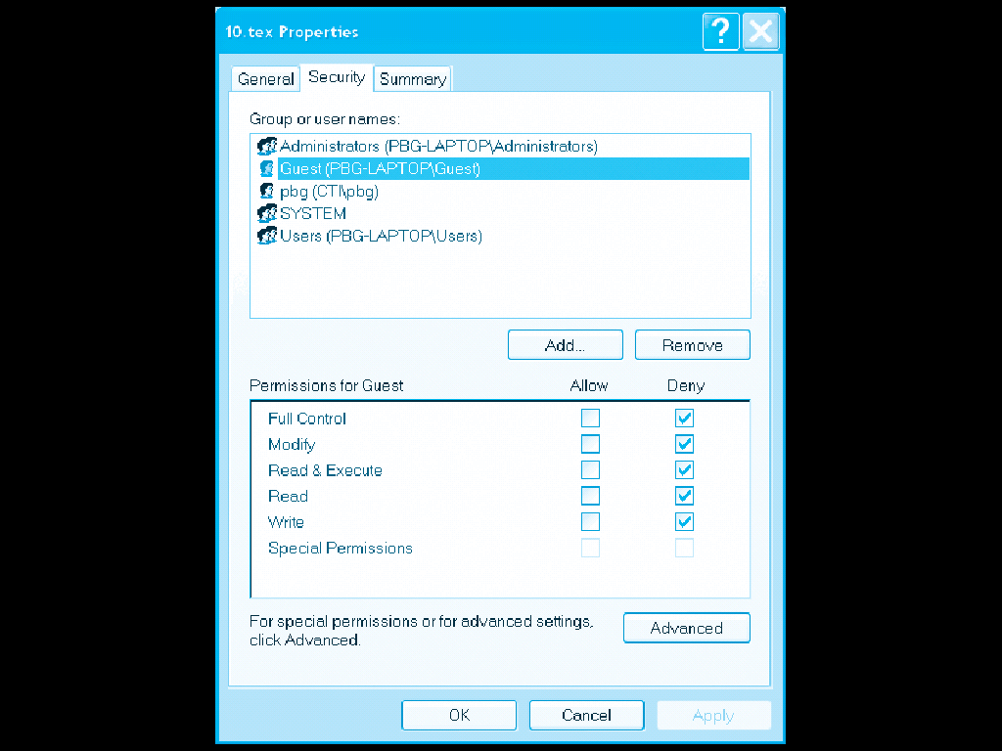
XP ACLs

Slide 35
Security and Remote File Systems
Recall that we can “mount” a file system
Local: File systems on multiple disks/volumes
Remote: A means of accessing a file system on some other machine
Local stub translates file system operations into messages, which it sends to a remote machine
Over there, a service receives the message and does the operation, sends back the result
Makes a remote file system look “local”

Slide 36
Unix Remote File System Security
Since early days of Unix, NFS has had two modes
Secure mode: user, group-id’s authenticated each time you boot from a network service that hands out temporary keys
Insecure mode: trusts your computer to be truthful about user and group ids
Most NFS systems run in insecure mode!
Because of US restrictions on exporting cryptographic code…

Slide 37
Spoofing
Question: what stops you from “spoofing” by building NFS packets of your own that lie about id?
Answer?
In insecure mode… nothing!
In fact people have written this kind of code
Many NFS systems are wide open to this form of attack, often only the firewall protects them

