Slide 1
Threads
Ken Birman

Slide 2
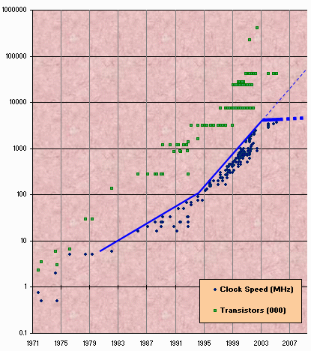
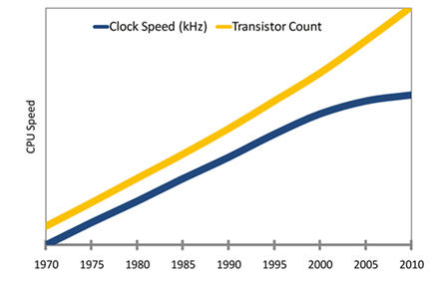
Moore’s Law and CPU speed
Transistor count still rising according to Moore’s Law
Clock speed flattening
Notes:
There is no "single cause" to the decrease in clock speeds in chips. There are quite a few compounding issues that have essentially stopped the increase in CPU clock frequencies.
1) Smaller die sizes do all sorts of weird things. I don't think ten years ago anyone would have seriously considered that optical lithography would take us down to (and below) the 45 nm technology node, which is actually below the wavelength of light. Leakage current (due to fun things like quantum tunneling) is making static power of a chip become more and more obvious. As a result, dynamic power needs to correspondingly decrease to keep chips from melting.
2) Designing at a faster clock is very expensive. CPU designers are used to using exotic architectures (domino logic, for instance) to account for faster clocks, but ASIC designers are not. Development for slower architectures (i.e., the classic static CMOS) has become a bigger part of the pie than CPU architectures. Developments in the former tend to migrate to the latter.
3) It's rather difficult to get data off of devices at high data rates. Multigigabit serializers are taking over major data paths. Although this doesn't have an inherent impact on CPU speeds, it means that bus speeds are becoming less important.
4) Pipelining only gets you so far. It's already common to use a pipeline simply to account for propagation delays along a wire. There's no way to improve those propagation delays short of optical interconnects. We're already past the point of considering RC time constants of interconnects. It's more common to hear about characteristic impedance (traditionally an RF phenomenon) of interconnects.
5) Memory bandwidth hasn't kept up with CPU bandwidth. At the absolute far end (graphics DDR RAM), it is possible to get about 1 GHz out of memory. However, more commonly used PC memories are not nearly so fast. As a result, the net benefit of a higher clock frequency is mitigated by any direct memory interactions.
6) Faster CPUs require bigger caches (to ensure that number 5 doesn't become as big of an issue - you don't want a CPU to have to go out to memory to do anything when memory is several orders of magnitude slower than the CPU). Bigger caches are incredibly expensive in terms of die area. This is why server processors are quite a bit more expensive than consumer CPUs.

Slide 3
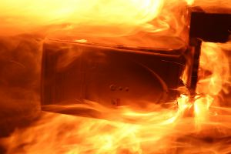
What this tells us?
It is getting harder to just speed up a chip
  One issue: the wires on the chip get very thin
  But more serious: heat becomes a problem
Heat dissipated by a chip rises roughly as the square of the clock speed!
  So: if the clock is four times as fast…
  … the chip produces sixteen times as much heat!
Chips are at risk of burning up

Slide 4
Multicores are the answer
Multicores are the answer to keeping up with increasing CPU performance despite:
  The memory wall (gap between CPU and memory speeds)
  The ILP wall (not enough instruction-level parallelism to keep the CPU busy)
  The power wall (higher clock speeds require more power and create thermal problems)
Consequence:
  Single-thread performance doesn’t improve…
  … but we can put more cores on a chip

Slide 5
Why?
Suppose you have four cores and each of them runs at 1/4th the speed of some hypothetical fast chip
  Your power consumption turns out to be less than four times the power consumption of one slow chip
    Because they share a lot of hardware
  And a fast chip would generate easily ten times as much heat as four slow chips, to do the same amount of work
But there’s one “issue”
  Programs need to use all those processors!

Slide 6
Multicores are everywhere
Dual-core commonplace in laptops
Quad-core in desktops
Dual quad-core in servers
All major chip manufacturers produce multicore CPUs
  SUN Niagara (8 cores, 32 concurrent threads)
  Intel Xeon (4 cores)
  AMD Opteron (4 cores)
  …

Slide 7
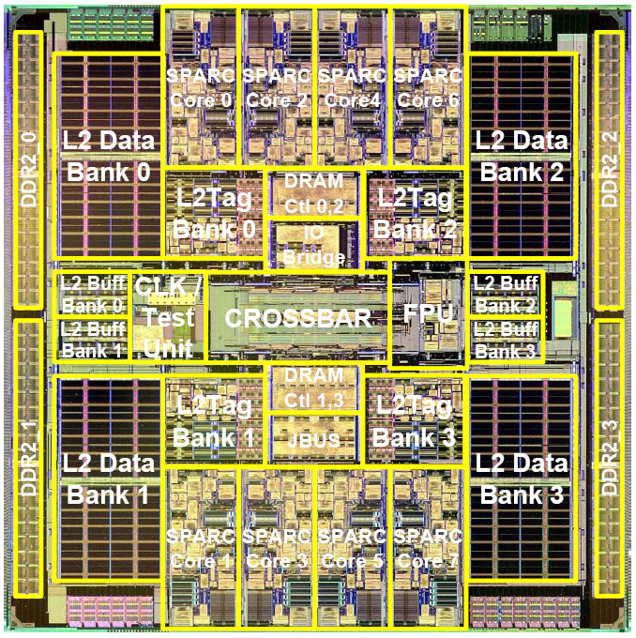
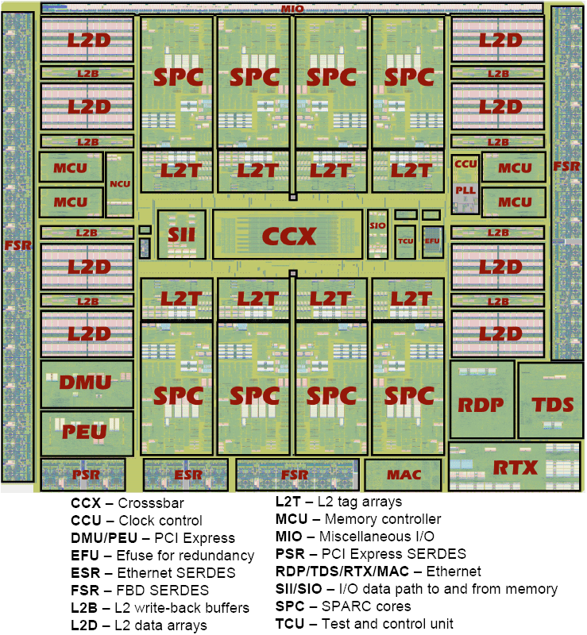
SUN’s Niagara CPU2 (8 cores)

Slide 8
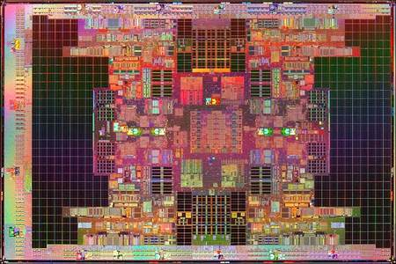
Intel Tukwila Itanium Chip (4 cores)

Slide 9
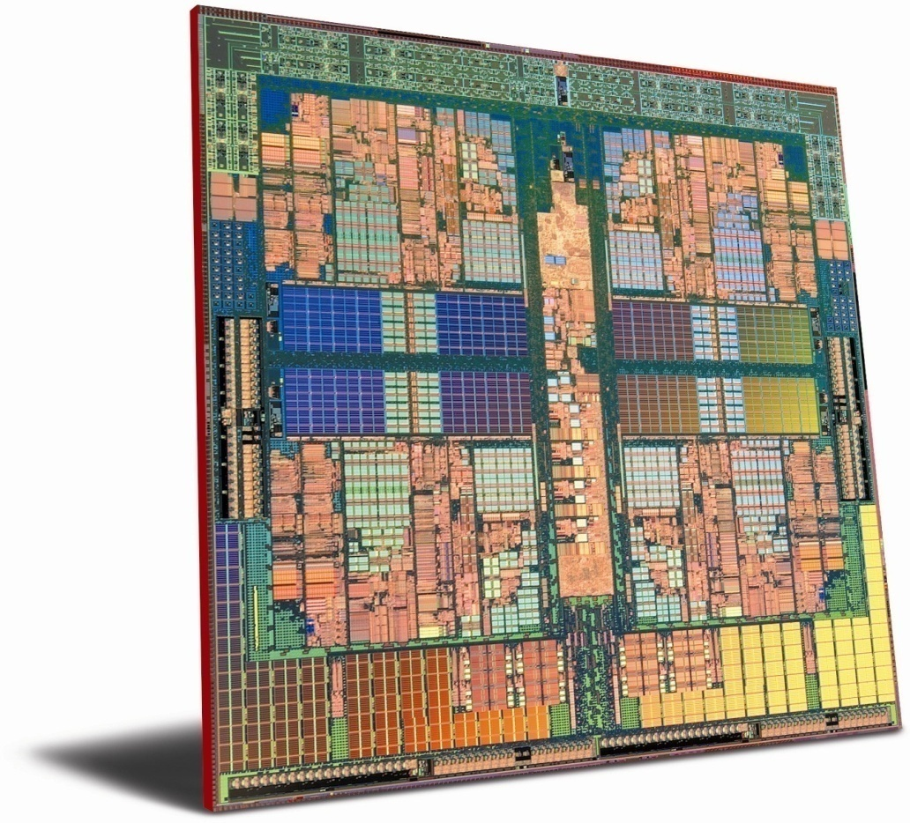
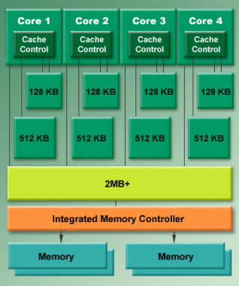
AMD Opteron (4 cores)
L1 cache
L2 cache
L3 cache
(shared)

Slide 10
Threads
On Tuesday we discussed processes that run in separate address spaces
  Two processes can execute the same program, but they will have distinct registers, stacks, data regions. Only the code is shared.
A thread (sometimes called a lightweight process) runs within a single process. Each thread
  Has its own registers and its own stack
  Threads share data with other threads in same process

Slide 11
Threads
With threads we can write programs that
  Stay busy when doing input/output (I/O) operations
  Exploit multicore parallelism
But exploiting threads isn’t trivial

Slide 12
Applications that use threads
Web browsers
  Each frame (mini-window) might have its own thread
Web servers
  Each request could be done with a separate thread.
Graphics or gaming application
  Each object could be rendered by its own thread

Slide 13
Case for Parallelism
main()
read_data()
for(all data)
compute();
write_data();
endfor
main()
read_data()
for(all data)
compute();
CreateProcess(write_data());
endfor

Slide 14
Case for Parallelism
Consider the following code fragment
for(k = 0; k < n; k++)
a[k] = b[k] * c[k] + d[k] * e[k];
CreateProcess(fn, 0, n/2);
CreateProcess(fn, n/2, n);
fn(l, m)
for(k = l; k < m; k++)
a[k] = b[k] * c[k] + d[k] * e[k];

Slide 15
Case for Parallelism
Consider a Web server
create a number of process, and for each process do
  get network message from client
  get URL data from disk
  compose response
  send response

Slide 16
Threads and Processes
Most operating systems adopt the view that processes are containers in which threads execute
Initially, a process is created with one thread
  It runs the main() procedure
But you can create additional threads
  They start by running any procedure you like
  Then they can create additional threads, or terminate
A process is expensive to create (fork/exec)
A thread is very cheap to create

Slide 17
Thread Creation: Java syntax
Create a new thread, start it. It will be initialized via a call to the constructor and then later, but we can’t predict precisely when, run() will be invoked.
public class Main {
Thread A = new ThreadDemo(“my name is A”), B = new ThreadDemo(“my name is B”);
….
A.start(); B.start();
….
}
public class ThreadDemo extends Thread {
private final String name; // Cannot later be changed
public void ThreadDemo(String s) { // Constructor initializes stuff
this.name = s;
}
public void run()
{
system.out.println(“Thread <“+this.name+”> is running”);
}
}
Prints “Thread <my name is A> is running”, “Thread <my name is B> is running” (in some order), then exits.

Slide 18
Thread Creation in Java
Once “started”, the “run” procedure will be invoked
public void run()
{
system.out.println(“Thread <“+this.name+”> is running”);
}

Slide 19

Multithreaded Processes

Slide 20
Cooperative (non-premptive) threads
Each thread runs until it decides to give up the CPU
main()
{
tid t1 = CreateThread(fn, arg);
…
Yield(t1);
}
fn(int arg)
{
…
Yield(any);
}

Slide 21
Cooperative Threads
Cooperative threads use non-preemptive scheduling
  Definition: one thread runs at a time, until it pauses by “yielding” the CPU
Advantages:
  Simple
    Scientific apps
Disadvantages:
  For badly written code
Scheduler gets invoked only when Yield is called
A thread should yield the processor when it blocks for I/O, e.g. to read from a file or the keyboard

Slide 22
Non-Cooperative Threads
No explicit control passing among threads
Rely on a scheduler to decide which thread to run
A thread can be pre-empted at any point
Often called pre-emptive threads
Most modern thread packages use this approach

Slide 23
User-Level Threads
For speed, implement threads at the user level
A user-level thread is managed by the run-time system
  user-level code that is linked with your program
Each thread is represented simply by:
  PC
  Registers
  Stack
  Small control block
All thread operations are at the user-level:
  Creating a new thread
  switching between threads
  synchronizing between threads

Slide 24
User-Level Threads
User-level threads
  the thread scheduler is part of a library, outside the kernel
  thread context switching and scheduling is done by the library
  Can either use cooperative or pre-emptive threads
    cooperative threads are implemented by:
      CreateThread(), DestroyThread(), Yield(), Suspend(), etc.
    pre-emptive threads are implemented with a timer (signal)
      where the timer handler decides which thread to run next

Slide 25
Example User Thread Interface
t = thread_fork(initial context)
  create a new thread of control
thread_stop()
  stop the calling thread, sometimes called thread_block
thread_start(t)
  start the named thread
thread_yield()
  voluntarily give up the processor
thread_exit()
  terminate the calling thread, sometimes called thread_destroy

Slide 26
Kernel threads
User threads can run with even a single CPU
  We simply use context switching when one blocks and another starts, just as the kernel does to run a process
But modern machines often have multiple cores
  This leads to the idea of a kernel thread
  Basically, a thread with its own core (CPU)
User sees the same thread API, but each kernel thread can switch among some set of user threads

Slide 27
Key Data Structures
your process address space
your program:
your data (shared by
all your threads):
for i (1, 10, I++)
thread_fork(I);
….
queue of thread control blocks
user-level thread code:
proc thread_fork()…
proc thread_block()…
proc thread_exit()...
per-thread stacks

Slide 28
User-Level vs. Kernel Threads
User-Level
Managed by application
Kernel not aware of thread
Context switching cheap
Create as many as needed
Must be used with care
Kernel-Level
Managed by kernel
Consumes kernel resources
Context switching expensive
Number limited by kernel resources
Simpler to use
Key issue: kernel threads provide virtual processors to user-level threads,
but if all of kthreads block, then all user-level threads will block
even if the program logic allows them to proceed

Slide 29
Common tradeoffs
Threads do have costs
  Especially, the stack space required
  With many threads, this becomes a serious burden
Modern machines have multiple cores… but rarely more than 2. At most 8 or 16.
  So we can’t just have one kernel thread per user thread
  Context switching costs can become a big overhead

Slide 30
Thread Hazards: Much like our race condition from last week!
int a = 1, b = 2, w = 2;
main() {
CreateThread(fn, 4);
CreateThread(fn, 4);
while(w) ;
}
fn() {
int v = a + b;
w--;
}

Slide 31
Concurrency Problems
A statement like w-- in C (or C++) is implemented by several machine instructions:
mov w,r4
sub $1,r4
mov r4,w
Now, imagine the following sequence, what is the value of w?
mov w,r4
______________
______________
______________
sub $1,r1
mov r4, w
mov r4,-(sp)
mov w,r4
sub $-1,w
mov r4,w
mov (sp)+,r4

Slide 32
Threads share global memory
When a process contains multiple threads, they have
  Private registers and stack memory (the context switching mechanism needs to save and restore registers when switching from thread to thread)
  Shared access to the remainder of the process “state”
This can result in race conditions

Slide 33
Two threads, one counter
Popular web server
Uses multiple threads to speed things up.
Simple shared state error:
  each thread increments a shared counter to track number of hits
What happens when two threads execute concurrently?
…
hits = hits + 1;
…

Slide 34
Shared counters
Possible result: lost update!
One other possible result: everything works.
  ⇒ Difficult to debug
Called a “race condition”
hits = 0
T1
T2
time
read hits (0)
read hits (0)
hits = 0 + 1
hits = 0 + 1
hits = 1

Slide 35
Race conditions: Improved defn
A timing dependent error involving shared state
  Whether it happens depends on how threads scheduled
  In effect, once thread A starts doing something, it needs to “race” to finish it because if thread B looks at the shared memory region before A is done, it may see something inconsistent
Hard to detect:
  All possible schedules have to be safe
    Number of possible schedule permutations is huge
    Some bad schedules? Some that will work sometimes?
  they are intermittent
    Timing dependent = small changes can hide bug

Slide 36
Scheduler assumptions
  If i is shared, and initialized to 0
  Who wins?
  Is it guaranteed that someone wins?
  What if both threads run on identical speed CPU
    executing in parallel
Process a:
while(i < 10)
i = i +1;
print “A won!”;
Process b:
while(i > -10)
i = i - 1;
print “B won!”;

Slide 37
Scheduler Assumptions
Normally we assume that
  A scheduler always gives every executable thread opportunities to run
    In effect, each thread makes finite progress
  But schedulers aren’t always fair
    Some threads may get more chances than others
  To reason about worst case behavior we sometimes think of the scheduler as an adversary trying to “mess up” the algorithm

Slide 38
Critical Section Goals
Threads do some stuff but eventually might try to access shared data
T1
T2
time
CSEnter();
  Critical section
CSExit();
CSEnter();
  Critical section
CSExit();
T1
T2

Slide 39
Critical Section Goals
Perhaps they loop (perhaps not!)
T1
T2
CSEnter();
  Critical section
CSExit();
CSEnter();
  Critical section
CSExit();
T1
T2

Slide 40
Critical Section Goals
We would like
  Safety: No more than one thread can be in a critical section at any time.
  Liveness: A thread that is seeking to enter the critical section will eventually succeed
  Fairness: If two threads are both trying to enter a critical section, they have equal chances of success
… in practice, fairness is rarely guaranteed

Slide 41
Solving the problem
A first idea:
  Have a boolean flag, inside. Initially false.
  CSEnter()
  {
    while(inside) continue;
    inside = true;
  }
  CSExit()
  {
    inside = false;
  }
Code is unsafe: thread 0 could finish the while test when inside is false, but then 1 might call CSEnter() before 0 can set inside to true!
Now ask:
  Is this Safe? Live? Fair?

Slide 42
Solving the problem: Take 2
A different idea (assumes just two threads):
  Have a boolean flag, inside[i]. Initially false.
  CSEnter(int i)
  {
    inside[i] = true;
    while(inside[i^1]) continue;
  }
  CSExit(int i)
  {
    Inside[i] = false;
  }
Code isn’t live: with bad luck, both threads could be looping, with 0 looking at 1, and 1 looking at 0
Now ask:
  Is this Safe? Live? Fair?

Slide 43
Solving the problem: Take 3
Another broken solution, for two threads
  Have a turn variable, turn, initially 1.
  CSEnter(int i)
  {
    while(turn != i) continue;
  }
  CSExit(int i)
  {
    turn = i ^ 1;
  }
Code isn’t live: thread 1 can’t enter unless thread 0 did first, and vice-versa. But perhaps one thread needs to enter many times and the other fewer times, or not at all
Now ask:
  Is this Safe? Live? Fair?

Slide 44
A solution that works
Deker’s Algorithm (book: Section 7.2.1.3)
  CSEnter(int i)
  {
    int J = i^1;
    inside[i] = true;
    turn = J;
    while(inside[J] && turn == J)
      continue;
  }
  CSExit(int i)
  {
    Inside[i] = false;
  }

Slide 45
Why does it work?
Safety: Suppose thread 0 is in the CS.
    Then inside[0] is true.
    If thread 1 was simultaneously trying to enter, then turn must equal 0 and thread 1 waits
    If thread 1 tries to enter “now”, it sets turn to 0 and waits
Liveness: Suppose thread 1 wants to enter and can’t (stuck in while loop)
  Thread 0 will eventually exit the CS
  When inside[0] becomes false, thread 1 can enter
  If thread 0 tries to reenter immediately, it sets turn=1 and hence will wait politely for thread 1 to go first!

